Slide 1
Chapter 2D: Income Taxation
Investigate equivalent representations of rational numbers so that you can:
Flexibly convert between fractions, decimals, and percentages
Use and understand ratio and proportions
Solve money-related problems
https://www.ato.gov.au/Individuals/Your-tax-return/How-to-lodge-your-tax-return/

Slide 2
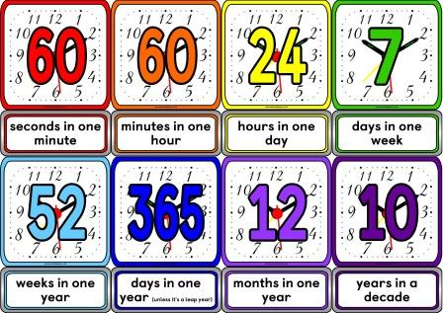
Income and Deductions
Wage:
If you are paid according to the number of hours worked or goods produced,
this is called a wage.
Salary:
If you are paid the same amount regardless of the number of hours worked or goods produced, this is called a salary.
Gross pay:
Gross pay or gross income is money earned before deductions are made.
Net pay:
Net pay or net income or take-home income is money received after all deductions have been made.

Slide 3
Taxable income Tax rates
0=$18,000 nil
$18,201-$37,000 19c for each $ Over $18,200
$37,001-$80,000 $3572 plus 32.5c for each $1 over $37,000
$80,001-$180,000 $17,547 plus 37c for each $1 over $80,000
$180,001+ $54,547 plus 45c for each $1 over $180,000
Income Tax rates

Slide 4
Income

Slide 5
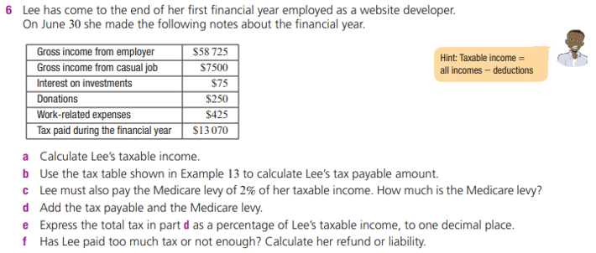
Income

Slide 6
Income
Total Taxable income =
Total(Gross) Income – Deductions
Time and a half rate= 1.5× Hourly rate
Double time rate= 2× Hourly rate

