Slide 1
Mathematics 2E Budgeting: Money, Money, Money
Notes:
PLEASE NOTE:
Information on potential Assessment for Learning (AfL) strategies or Thinking Skills and Personal Capabilities will appear in these notes in italics.
Instructions to the teacher, notes, or questions to discuss in class will appear in these notes as normal text.

Slide 2
^{Learning Intentions}
^{We are learning…}
how to evaluate goods and services (needs and wants)
how to create and evaluate a balanced budget
how to use appropriate mathematical terms when budgeting
Notes:
AfL
Focus on learning
Share these AfL learning intentions with pupils in your introduction to the lesson.
Share and negotiate success criteria with pupils.
Examples of success criteria
Pupils will be able to:
make sure that all needs are met before other items are bought;
create and evaluate a balanced budget; and
discuss their budget planning using mathematical language.

Slide 3
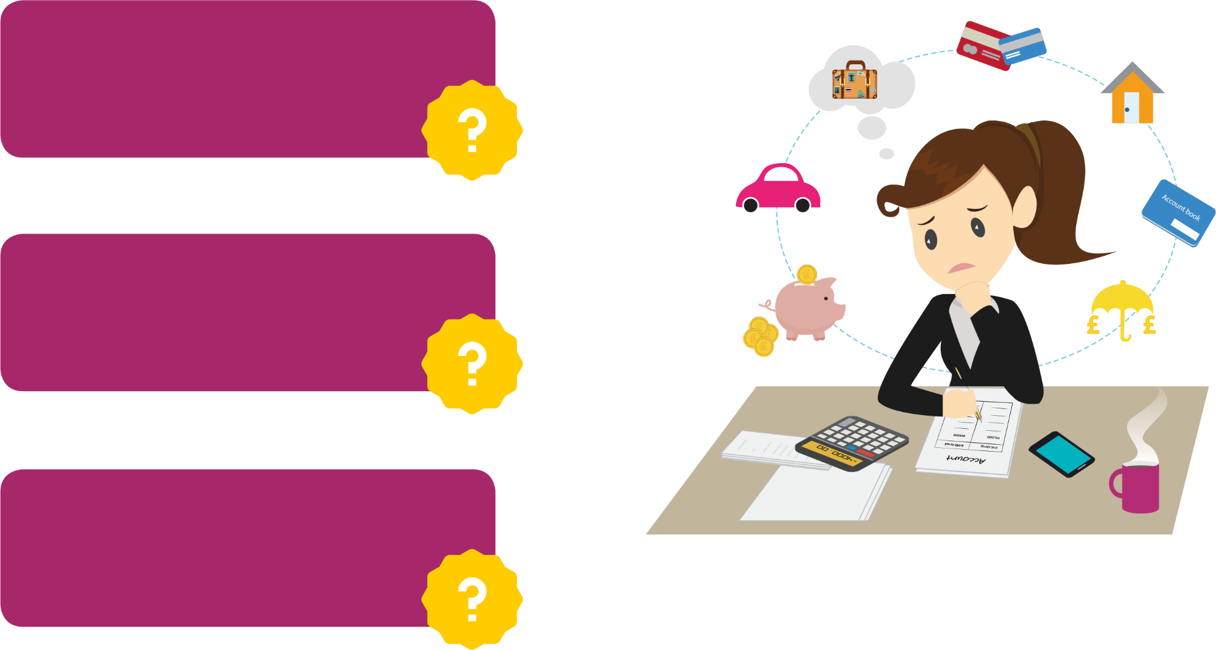
^{How much do you spend?}
Do you know how much you spend?
Do you know where all your money goes?
Are you always asking for more money?
Notes:
AfL
This part of the lesson uses the following strategies:
effective questioning; and
scaffolding reflection by asking for feedback from pupils.
Thinking Skills and Personal Capabilities
In this activity, pupils have the opportunity to develop the following skills:
Thinking, Problem-Solving and Decision-Making;
Being Creative;
Working with Others; and
Self-Management.
You may find useful videos on the Nationwide Education website that you could use to introduce this lesson.

Slide 4
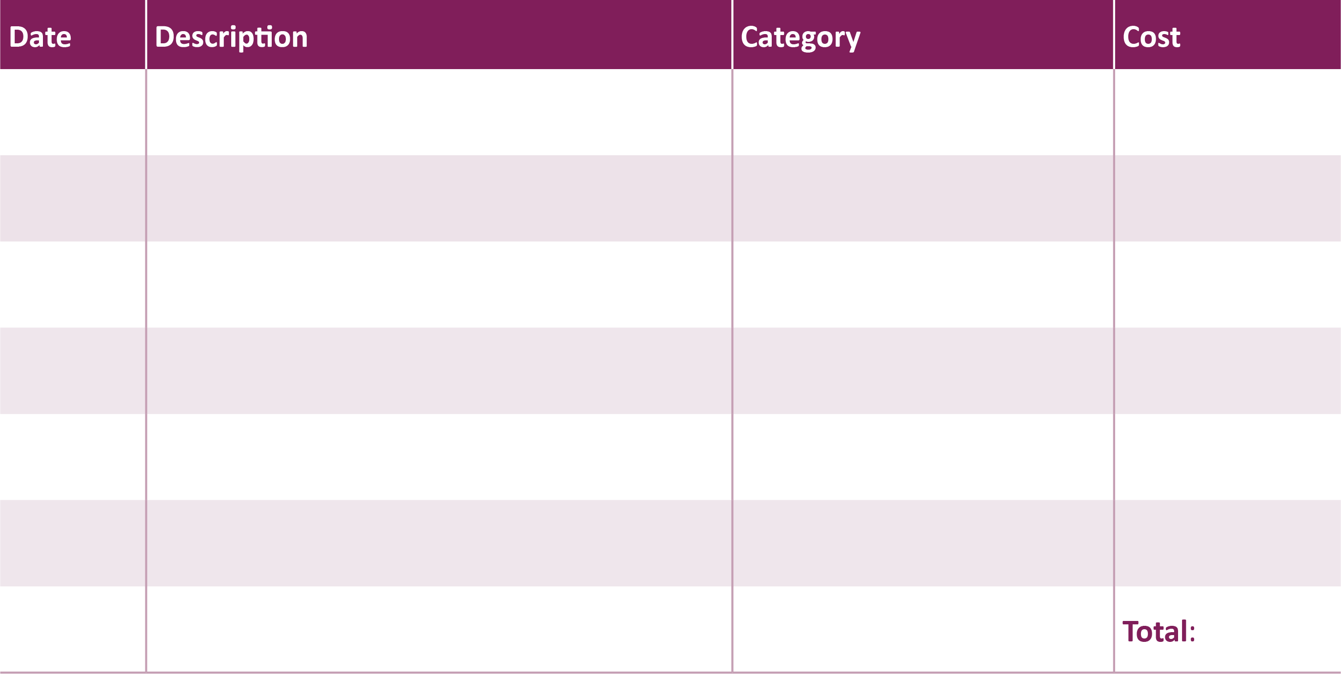
^{Expense Tracking Money Diary}
Notes:
Thinking Skills and Personal Capabilities
In this activity, pupils have the opportunity to develop the following skills:
Managing Information; and
Self-Management.
Explain that the pupils will be tracking their expenses for at least one week.
Show examples by typing into this table or writing in it. Pupils do not need to fill in the category at this stage.
Give out Worksheet 1a: Expense Tracking Money Diary and ask pupils to write down the money they spend over the next week.

Slide 5
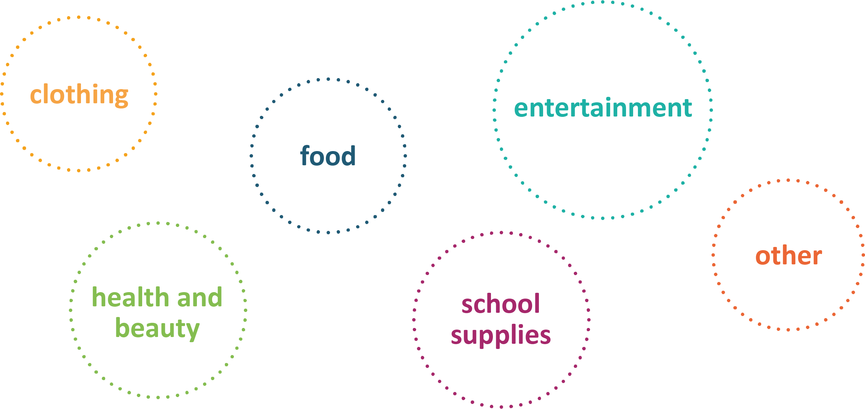
^{Categorise your expenses}
You could put your expenses into the following categories:
Notes:
AfL
This part of the lesson uses the following strategies:
effective questioning; and
scaffolding reflection by asking for feedback from pupils.
Thinking Skills and Personal Capabilities
In this activity, pupils have the opportunity to develop the following skills:
Managing Information; and
Self-Management.
After the specified time of tracking their spending, pupils should bring in the completed Expense Tracking Money Diary.
Discuss some of the items the pupils have bought and categorise them.
Pupils will then complete the category column in their Expense Tracking Money Diary.

Slide 6
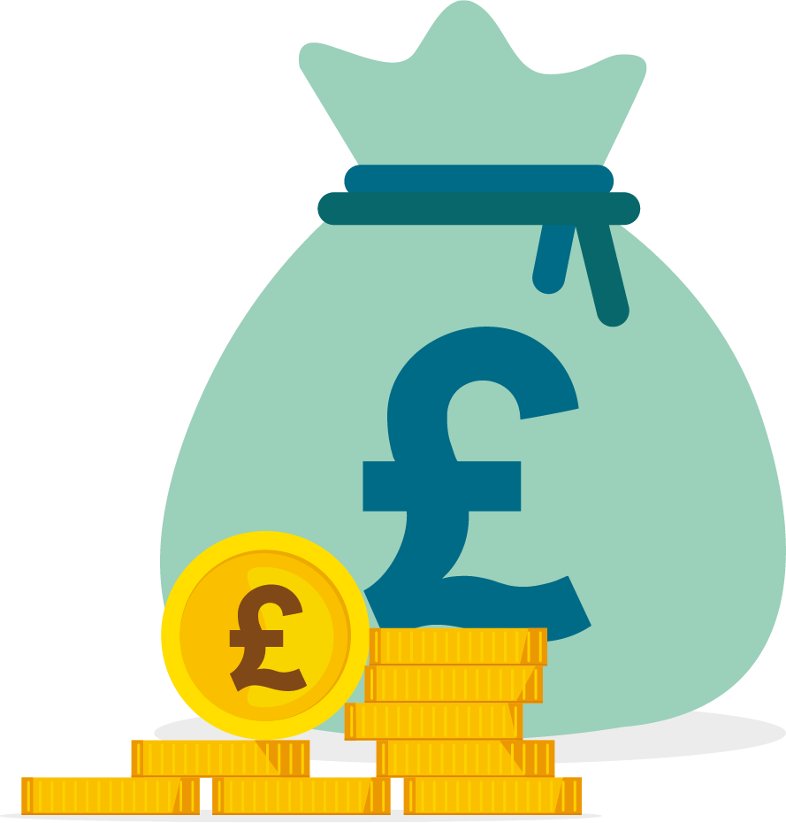
^{Cutbacks!}
How could you save money on the following?
clothing
food
entertainment
health and beauty
school supplies
other
Look at your own expenses.
Decide if you can cut back anywhere to save money.
Notes:
AfL
This part of the lesson uses the following strategies:
effective questioning; and
scaffolding reflection by asking for feedback from pupils.
Thinking Skills and Personal Capabilities
In this activity, pupils have the opportunity to develop the following skills:
Thinking, Problem-Solving and Decision-Making;
Being Creative;
Working with Others; and
Self-Management.
Discuss how pupils could make cutbacks in each category.
For example:
Food – bring lunch to school, eat less sweets or drink water.
Entertainment – rent a movie with friends rather than going to the cinema.
Tell pupils to look at their expenses and decide if they can cut back anywhere to save money.

Slide 7
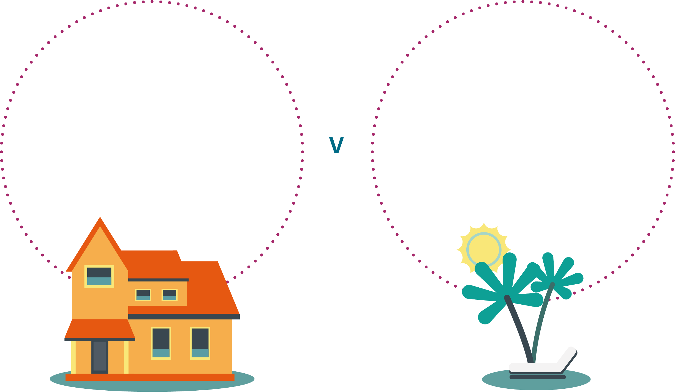
NEEDS
WANTS
Things we must have to stay alive.
Things we don’t need but would like to have.
Notes:
AfL
This part of the lesson uses the following strategies:
effective questioning; and
scaffolding reflection by asking for feedback from pupils.
Thinking Skills and Personal Capabilities
In this activity, pupils have the opportunity to develop the following skills:
Thinking, Problem-Solving and Decision-Making;
Working with Others; and
Self-Management.
Brainstorm with the class to create a list of things they need and a list of things they want.
Highlight things that fall into both categories, for example food is a need but cake is a want.
Give out Worksheet 1b: Needs and Wants.
Working in pairs or groups, the pupils should sort the items into needs and wants.

Slide 8
Notes:
AfL
This part of the lesson uses the following strategies:
effective questioning; and
scaffolding reflection
by asking for feedback from pupils; and
by encouraging peer and self-assessment.
Thinking Skills and Personal Capabilities
In this activity, pupils have the opportunity to develop the following skills:
Thinking, Problem-Solving and Decision-Making;
Being Creative;
Working with Others; and
Self-Management.
You could use this slide and the next two after the Needs and Wants group work activity to discuss with the class how they sorted the items above.
Pupils can explain to the class why they put each item in the different categories.

Slide 9
Notes:
You could use this slide and the next slide after the Needs and Wants group work activity to discuss with the class how they sorted the items above.
Pupils can explain to the class why they put each item in the different categories.
You could show this slide as an example, pointing out that different people have different priorities and may therefore place items in different places.

Slide 10
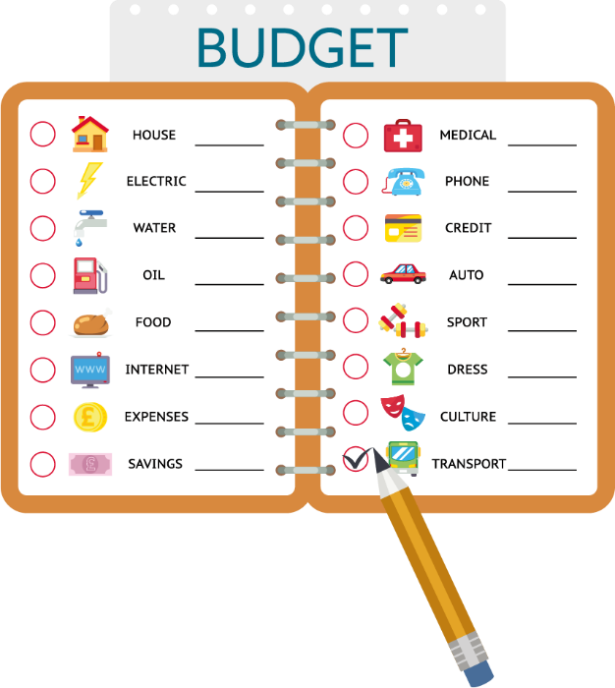
^{Budget}
What is a budget?
A budget is a spending and saving plan.
You can draw it up in advance.
or
You can use it to record your income and expenditure.
It shows:
Income – how much money you have and where it comes from.
Expenditure – how much you expect to spend, or have spent, and on what.
Notes:
Explain to the pupils that there are two types of budget record:
a plan that shows the expected income and expenditure over a week, month or year; and
a continuous record of real income and expenditure.
Explain to the pupils that we can use both types. We can predict what we are likely to earn and spend and then record our actual income and expenditure. Comparing the plan and the record can help us to see where to make changes in the future.

Slide 11
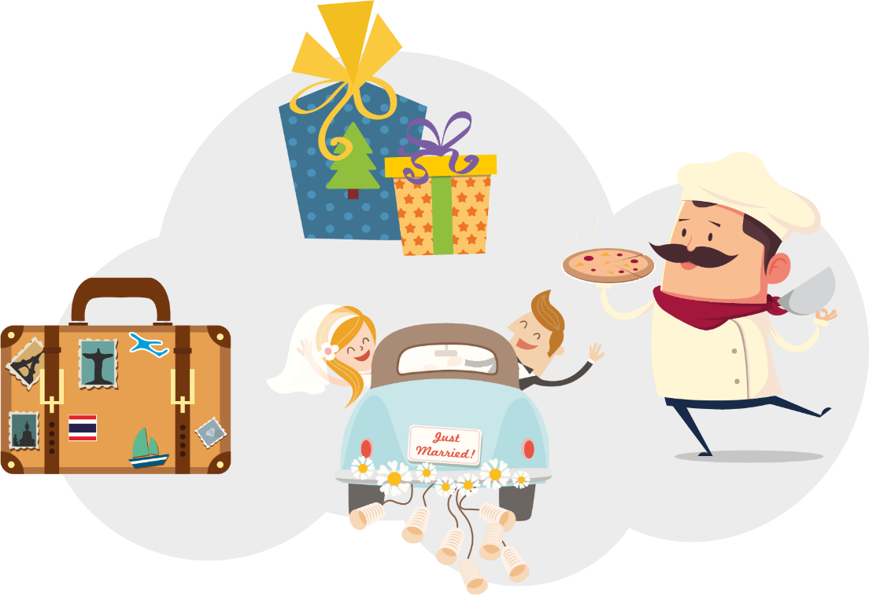
^{What is a budget for?}
A budget can be useful when planning an event like a wedding or a party. It’s also useful when paying for Christmas presents, holidays and meals, and for working out usual weekly or monthly expenses.
Notes:
Explain to the pupils that budgets can be used for many different reasons.
Many different types of people and groups have budgets, including individuals, families, companies and governments.

Slide 12
^{How to make} ^{a budget}
On paper
In a spreadsheet
Use an app
Notes:
AfL
This part of the lesson uses the following strategies:
effective questioning; and
scaffolding reflection by asking for feedback from pupils.
Thinking Skills and Personal Capabilities
In this activity, pupils have the opportunity to develop the following skills:
Managing Information;
Thinking, Problem-Solving and Decision-Making;
Being Creative; and
Self-Management.
Explain to the pupils that they will draw up a budget or spending plan for a given time, for example one month.
They can do this on paper as a simple budget sheet (see Worksheet 1c), in a spreadsheet (pupils can make up their own Excel spreadsheet or download a template) or using an app (there are a lot of free money tracking apps available, for example Wally, Money Lover or Money Manager). Whichever you choose, ensure you guide the pupils through this clearly.

Slide 13
^{Key Words}
Income
Money you receive from pocket money, presents, jobs or interest on savings.
Expenditure
Money you spend on things you need (such as food) and things you want (such as meals in restaurants).
Budget
An estimate of income and expenditure for a specific length of time.
Many different types of people and groups have budgets, including individuals, families, companies and governments.
Notes:
The pupils will need a good knowledge of these key words to fully understand the budget sheet.
If required, give them Resource 1: Key Words.

