Slide 1
Investments and Loans
2H

Slide 2
Today’s Topics: Investments and Loans
Managing Debt and Credit
Saving and Investing
Investment Products
Tips to Avoid Fraud
Notes:
Here’s what we’ll cover today:
We’ll talk a little about managing debt and making smart use of credit.
Then, we’ll talk about strategies for saving and investing.
We’ll discuss some ideas on how to plan for retirement, including a discussion of employer-based and individual retirement investment options.
And finally, we’ll go over tips to protect your money from fraudsters.

Slide 3
Managing Debt and Credit
Notes:
Let’s start at the beginning: Before we can invest, we have to get debt and spending under control.
One of life’s truisms is that debt is easy and fun to rack up, but not so fun to pay off. The best advice is to always be careful and wise about the use of credit.
However, if your debt is a burden, you need a plan. And that plan is simple to say, but tough to do: Stop spending too much and start paying down that debt as aggressively as you can afford.
That likely means you have to pay more than the minimum payment every month.
It doesn’t make sense to invest in a mutual fund that may return 8% if you are paying monthly interest of 18% or more to a credit card company for a revolving balance.
That’s why we should pay down high interest debt first before we can clear the decks for investing.

Slide 4
Knowing the Cost of Credit
50×12×4=$2400
2022: $2000 2026: $2400
Paid in full up front
Paid only $50 each month
Notes:
Paying off debt over a long period of time costs you money.
Take the example of this high-end laptop. If you only pay $50 each month, the laptop will end up costing nearly 50% more and it will take you almost 5 years to pay off, by which time it will probably be obsolete.
No investment strategy pays off as well as, or with less risk than, eliminating high interest debt. Most credit cards charge high interest rates -- as much as 18% or more - if you don’t pay off your balance in full each month.
FOR REFERENCE: This example assumes a 16% APR and a payment of $50 each month with no additional fees/charges incurred.

Slide 5
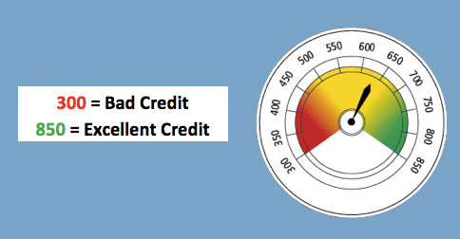
Credit Score = Financial Barometer
Higher Scores = Lower Payments
Notes:
Your credit score—a number between 300 and 850—is the financial barometer that measures the creditworthiness and risk potential of an individual consumer.
It’s one of the tools used by banks and lenders to determine the interest rate you’ll pay on a given loan. The higher your credit score, generally the lower the interest rate charged, and the lower your payments. A higher score also makes it easier to be approved for new lines of credit, such as a mortgage or car loan.
Your credit score may also come into play in other situations, such as when applying for a new job or renting an apartment.

Slide 6
Impact of Credit Score
773×12×30=$278 280
946×12×30=$340 560
$200,000 30-Year Mortgage
Score of 760-850
Rate: 2.337%
Monthly payment: $773
Final cost of payments:
$278,000
Score of 620-639
Rate: 3.926%
Monthly payment: $946
Final cost of payments:
$341,000
Notes:
Look at the impact of two credit scores on a 30-year-fixed mortgage for the same amount of $200,000:
Credit score of 760 – 850; Rate of 2.3%; Monthly payment of $773
Credit score of 620 – 639; Rate of 3.9%; Monthly payment of $946
Bottom line: after 30 years, the person on the right would pay almost $63,000 more for the same house. And it’s all because his credit score was impaired at the time he went to get the mortgage. Source: Rates at MyFico.com; Google Mortgage Calculator

Slide 7
Tips to Improve Your Credit Score
Pay your bills on time, every time
Don’t get close to your credit limit
A long credit history will help your score
Only apply for credit that you need
Source: CFPB www.consumerfinance.gov
Notes:
AUDIENCE QUESTION: What are steps you can take to improve your credit score?
Pay all of your credit cards and other debts on time.
Reduce the balance on your credit cards. Pay off your credit card every month, and avoid paying only the minimum payment required.
Do not get too many lines of credit, especially at the same time, but keep the ones you have for as long as possible. (Applications generate inquiries.)
Review your credit reports to check for errors: www.annualcreditreport.com

Slide 8
Saving and Investing

Slide 9
Smart Money Management Begins with Saving
Saving is important for:
Emergencies
Education
Big Purchases
Family
Notes:
Why do we save?
Audience question: What are some things that you’re saving for or that you plan to save for?
Do you want to own a home some day? Open a business? Start a family? Those are long-term savings goals.
In addition to long-term plans, you also need an emergency fund to cover unexpected shocks, like a major car repair, a house repair or a health crisis.
These things can require money in a hurry, and surveys have shown that many are unprepared to incur an unexpected expense.
As the name implies, “savings” are generally put into safe places that allow for easy access, such as a savings account with a bank or credit union.

Slide 10
Why Not Just Save?
1996 Ford Mustang
Convertible GT
$23,495 MSRP
99% INCREASE
2021 Ford Mustang
Convertible GT
Starting at $46,815
Source: Autotrader.com
Source: Autotrader.com
Notes:
You can’t just put all your money into savings – or stick it under the mattress – because the money you have today won’t have the same purchasing power for what you need later on. Prices for goods and services go up over time – it’s called inflation.
Let’s look at an illustration of inflation – the cost of a Ford Mustang GT 2-door convertible. In 1996, it cost around $23,495.
In 2021, it will run you nearly than $47,000. That’s a 99% increase in price over those 25 years.
That’s the result of inflation.
And inflation also impacts higher education costs, housing costs, food and consumer goods, and everything we need to live. So to keep up with inflation, you have to make your money grow. And that’s what we’re here to talk about – investing.

Slide 11
Saving vs. Investing
Saving:
The money you earn but don’t spend
Investing:
Making that money grow
Notes:
Savings is all the money you earn but don’t spend. Investing is slightly different – it means making that money grow.
The key difference between the two is that investing has risk, but it also has a potential to earn higher returns. What does your bank pay you in interest to keep money in a savings account? 1% maybe? The money you have in a bank account may not grow much, but it will be safe since it’s FDIC insured.
So why might we want to take on more risk? Why might we want to invest?

Slide 12
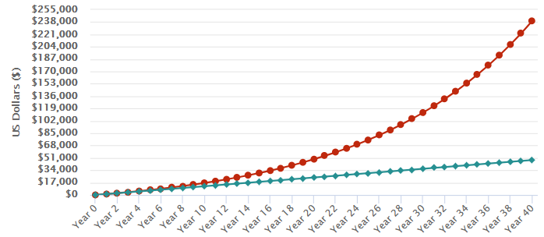
Example of Compound Growth
Value at 40 years:
$239,562
$100/month
$48,000 contributed
7% average annual growth
Notes:
How do investments keep up with inflation? It’s through growing over time thanks to the the power of compounding. Over time, that growth snowballs.
Imagine that at 25 years old, you started investing $100 a month for the next 40 years. After 40 years, you would have invested $48,000, but thanks to the power of compounding, the money you invested would have grown to $239,562, assuming a 7% annual return. That’s about 5 times more than you contributed!
By starting early and using the power of compounding, you’re putting your money to work for you.
Source: Investor.gov compound interest calculator

Slide 13
Dow Jones Over 30 Years
Notes:
That doesn’t mean that the growth is consistent! This graph shows a benchmark of the stock market’s performance known as the Dow Jones Industrial Average over the course of 30 years, from 1990 to 2020. You can see that the index has had many ups and downs. But look at the long term trend – historically the performance of stocks has trended positive.
Keep in mind:
Short-term stock performance tends to be volatile (jagged on the chart), but take a look at the long-term trend.
Stock returns (historically) do well over time (on average approx. 7-9% per year), but as you can see on the slide, the performance isn’t smooth and consistent
Chart source: Macrotrends (https://www.macrotrends.net/1319/dow-jones-100-year-historical-chart)
Chart date: March 15, 2020

Slide 14
The Power of Starting Early
The earlier you start, the less money you need to invest to reach your goals
 | $250,000 by 65 | $500,000 by 65
Age 25 | $104/month | $209/month
Age 35 | $221/month | $441/month
Age 45 | $508/month | $1,016/month
Age 55 | $1,508/month | $3,016/month
Assumes 7% rate of growth Source: Investor.gov Savings Goal Calculator
Notes:
Thanks to the power of compound growth, one of the best ways to build wealth is by saving and investing over a long period of time.
The earlier you start, the easier it is for your money to grow, which means it takes less money to reach your goals.
Here’s how much you’d need to save each month if your retirement goal was $250,000 or $500,000 depending on the age you started investing.

Slide 15
Investment Products

Slide 16
All Investments Have…
Notes:
Rule number one of investing is that all investments have risk.
But if you are a long-term investor in the US markets, you have historically done well.

Slide 17
Investment Risks/Returns
Short-Term Goals Long-Term Goals
Stocks
Bonds
Cash
Lower Risk Higher Risk
Notes:
In investing, the potential for higher return typically comes with higher risk.
Different investments have different risks, and the potential for greater return generally comes with higher risk. Look how we move from safer-but-lower-return cash at the bottom up to riskier-but-higher-return stocks.

Slide 18
Stocks
Stocks, also called “equities,” give stockholders a share of ownership in a company
Benefits:
Share price can increase
Some stocks can pay dividends
Ability to vote shares
Risks:
Share price can decrease
Companies can go bankrupt
Notes:
Stocks are shares of ownership in a company.
Stocks have historically offered the greatest potential for returns. A stock can appreciate in price and some stocks can pay dividends if the company distributes its earnings to stockholders.
Stocks can lose value, however, and companies can even go bankrupt, leaving their stock worthless.

Slide 19
Bonds
Bonds are like loans you make to a government or corporation on which you receive interest payments for a period of time
Benefits:
Predictable income stream
Return of principal after bond matures
Risks:
Inflation risk
The issuer may “call” the bond
Issuers may go bankrupt
Notes:
Bonds are like IOUs: I lend money to a company or government body, and they promise to pay me back in a certain period of time. In the meantime, I can get a predictable income stream from the interest payments.
Some of the benefits of bonds are:
They provide a predictable income stream. Typically, bonds pay interest twice a year.
If the bonds are held to maturity, bondholders get back the entire principal, so bonds are a way to preserve capital while investing.
Bonds can help offset exposure to more volatile stock holdings.
Some of the risks include:
Interest rate changes can affect a bond’s value. If bonds are held to maturity, the investor will receive the face value, plus interest. If sold before maturity, the bond may be worth more or less than the face value. This is called interest rate risk.
The bond issuer may pay you the bond’s face value before the bond’s maturity date. This means that you would stop receiving the interest payments. This is something an issuer might do if interest rates decline. This is called call risk.
The issuer may fail to timely make interest or principal payments and thus default on its bonds. This is called credit risk.

Slide 20
Mutual Funds and Exchange-Traded Funds (ETFs)
Pools of money invested by an investment company in stocks, bonds or other securities – or some combination of those investments
Benefits:
Diversification, professional management, affordability
Risks:
Typically the same as the underlying securities
Notes:
Mutual funds and ETFs are a way to invest in the stock market without purchasing individual securities. Many workplace retirement plans, like 401(k)s, offer a selection of mutual fund investments to employees.
The main benefits of mutual funds and ETFs are:
Professional Management. The fund managers do the research for you. They select the securities and monitor the performance.
Diversification or “Don’t put all your eggs in one basket.” Mutual funds typically invest in a range of companies and industries. This helps to lower your risk if one company fails.
Affordability. Most mutual funds set a relatively low dollar amount for initial investment and subsequent purchases.
Remember that all investments carry some level of risk – typically the same as the underlying securities.

Slide 21
Time: Friend or Foe?
U.S. Large Stock Performance (1926-2019)
Notes:
Audience Question: What stands out the most when you look at this chart?
Lots of volatility (i.e. ups and downs)
There are significant downs (the most prominent represent the 1929 Stock Market Crash, the Great Depression Banking Panic, WWII, the Oil Shock, Dotcom Crash and the recent Financial Crisis/Great Recession)
Its mostly up: Despite inevitable down periods the long-term trend of the market is positive. Historically the long-term average rate of return for the S&P 500 is between 8-10%.
Therefore, if you have a long time horizon for your investments, you can capture the historical averages of the market by investing for the long term and ignoring the volatility and daily fluctuations.
However, it is important to note that this also demonstrates that the shorter your time horizon on your investments, the more volatility becomes relevant. For example, if someone in 2006 planned to retire in the next few years but had all their investments in stocks, they would have been seriously hurt in the downturn in 2008 and likely would have been prevented from retiring at that time. This teaches us that as you get closer to your target date (e.g. retirement), it is important to shift your asset allocations to reflect your changing risk tolerance (e.g. increasingly shift portions of your portfolio away from stocks to less volatile asset classes such as bonds).
It is useful to refer back to this slide later in the presentation when discussing target date funds/TSP Lifecycle funds, and the concept of asset class allocation and how that shifts as risk tolerance changes the closer one gets to their target date.

Slide 22
Managing Risk
Manage risk with asset allocation and diversification
Notes:
In the chart earlier, we saw the risks of various investments.
The best way to manage investment risk is to allocate your assets and diversify your investments.
In other words, put your money in different asset classes -- and within the different asset classes, include different investments (e.g., domestic, international, large cap, small cap) so that if one investment performs poorly, another might do well.
In short, don’t put all of your eggs in one basket.

Slide 23
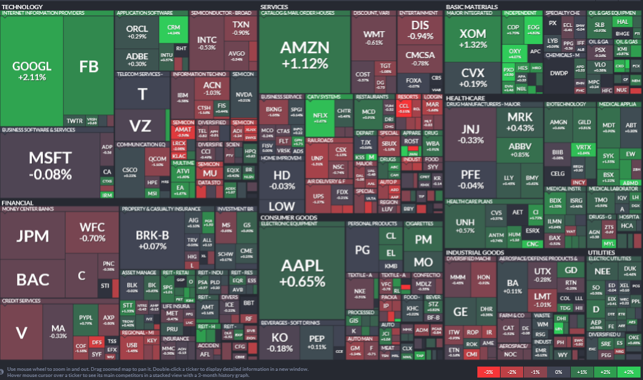
Example of Diversification in Action
While any given company or sector may go down, others may go up
Notes:
The way funds diversify is by holding many different stocks, bonds or other securities.
Diversification helps investors because if one company or sector experiences a decline in value, others may go up.
This graphic shows the S&P 500 stocks over a single day and is merely an example of holdings that a hypothetical fund tracking the S&P 500 index might have.
For example, if industrial stocks in the lower right have a down day, perhaps gains in your tech stocks and financial stocks on the left side will insulate your overall portfolio – that’s the theory of diversification. (Snapshot on January 6, 2020 S&P 500. Source: FinViz https://finviz.com/map.ashx)

Slide 24
Tips to Avoid Fraud
Notes:
When you’re investing, you need to take steps to avoid scam artists who will try to steal your money.

Slide 25
Fraud in the Movies
Wolf of Wall Street Clip
Notes:
Here’s how investment fraud is depicted in the movies.
Let’s look at a clip from the movie Wolf of Wall Street. What are some of the tactics he used?

Slide 26
Red Flags of Fraud
Guaranteed Returns!
Sounds too good to be true, such as promises of high returns with little or no risk
Pressure to buy RIGHT NOW
Lack of documentation, such as:
No public filings
No statements
No prospectus
Unlicensed or unregistered salesperson
Huge Upside, No Risk!
Notes:
Here are some red flags of fraud to keep an eye out for:
Many scams sound too good to be true – trust your instincts. If the offer promises high returns with little risk, it’s probably a scam.
Don’t be pressured to buy right now. No legitimate investment requires a quick decision. Wait until you have the time to do your own due diligence.
Watch out when there’s no prospectus, offering memorandum, or no statements or public filings.
Make sure any investment professional you use is licensed or registered – Check Investor.gov.

Slide 27
Unsolicited Offers
The salesperson or promoter approaches you, not the other way around
Examples:
Cold call
Email
Social media
Radio and newsletters
Direct mail
Free dinner seminar
How to respond: Be cautious! Do your own homework if you’re curious or simply walk away
Notes:
Another red flag of fraud is an unsolicited offer to invest that can come out of the blue. Consider why a stranger would need to pitch the investment to you if it’s really such a good investment, and think about what that stranger’s motives might really be. You should tread carefully when you didn’t seek out the investment or the salesperson. Do your homework if you’re tempted by the offer, or better yet, walk away. The best scenario is when you do your own research and choose where to invest.
Here are a few other things to remember so you don’t get scammed:
Never pay for investments with credit cards, gift cards, or wire transfers.
Don’t ever pay a fee in order to claim a “winning” or other proceeds. That’s not how legitimate lotteries or investment opportunities work.
If someone claims to be from the government, and you did not initiate the contact, call the agency and find out if they work there.
Be cautious when asked to share personal information, such as passwords, credit card numbers and account numbers.

