Slide 1
Comparing Interest using Mathematica

Slide 2
Does anyone have any interest in interest?
Very few banks today pay interest based on the simple interest formula. Instead, they pay interest by using a principle called compounding.
The difference between simple and compound interest is this: Simple interest grows slowly, compounding speeds up the process.

Slide 3
How it works.
Simple interest is interest on the principle amount.
Compound interest is when your principle and any earned interest both earn interest.

Slide 4
Consider this example: You begin with $100 invested at 10% annual interest.
After | Simple Interest | Compound Interest
1 year | 110 | 110
2 years | 120 | 121
3 years | 130 | 133
4 years | 140 | 146
5 years | 150 | 161
10 years | 200 | 259
20 years | 300 | 672
50 years | 600 | 11,739

Slide 5
Compound Interest Wins!!
From this example, it is easy to see that if you are saving money, you would prefer compound interest.

Slide 6
Calculate compound interest using this formula:
A—Total amount
p —principle
r —interest rate
n —number of compounding periods
t —time in years

Slide 7
Example: $100 is invested at 10% interest compounded yearly for 6 years
177.16

Slide 8
$250 invested at 6.5% for 8 years compounded monthly.
419.92

Slide 9
Example……
$500 invested at 12% for 10 years compounded yearly.

Slide 10
Answer……
Problem:
$500 invested at 12% for 10 years compounded yearly.
Answer:

Slide 11
Example……
$1000 at 7.25% for 9 years compounded monthly.

Slide 12
Answer……
Problem:
$1000 at 7.25% for 9 years compounded monthly.
Answer:

Slide 13
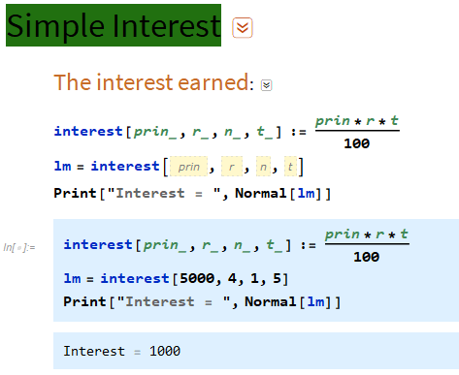
Mathematica: Copy the command, Type data in pink boxes and press Shift +Enter
All in one Master Command

Slide 14
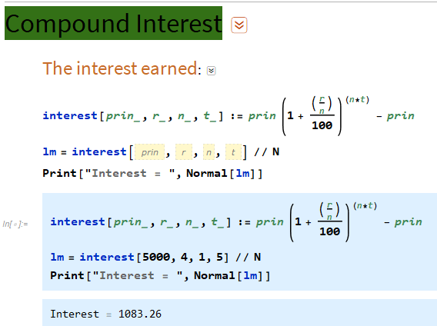
Mathematica: Copy the command, Type data in pink boxes and press Shift +Enter
All in one Master Command

