Slide 1
Consumer Arithmetic
Revision

Slide 2
Fractions, Decimals and Percentages
Fraction
0
1
Decimal
0
0.1
0.2
0.3
0.4
0.5
0.6
0.7
0.8
0.9
1
Percentage
0%
10%
20%
30%
40%
50%
60%
70%
80%
90%
100%
Just different ways of saying the same thing.

Slide 4
Example
Sally deposits £600 into an account with an increase of 5% per annum.
Find how much money she has in the account after one year.
Increase = 5% of £600
100% + 5% = ?
£600 +5% = ?
5% = 5/100 (Multiplier)
5/100 of £600
= £30
New balance = £600 + £30
= £630
Is there a quicker way?

Slide 5
Percent Increase
The increase growth factor is
$1+\frac{r}{100}$
Percentage of increase

Slide 6
Example
Sally deposits £600 into an account with an increase of 5% per annum.
Find how much money she has in the account after one year.
Growth factor=$1+\frac{r}{100}$ = $1+\frac{5}{100}$ =1+0.05=1.05
New balance = £600 $×1.05$
= £630
A quicker way!

Slide 7
Phrase % Multiplier/Growth factor
5 % increase
1.005
10 % increase
1
15 % increase
1.15
½ % increase
1.1
No change
1.05

Slide 8
Example
A car depreciates at rate of 30%. Initially it cost £25,000.
How much will it be worth after a year?
Decrease: 100 - 30 = 70%
70% of £25,000
10%= £2500
70% = £17,500
Is there a quicker way?

Slide 9
Percent Decrease
The decrease decay factor is
$1−\frac{r}{100}$
Percentage of decrease

Slide 10
Example
A car depreciates at rate of 30%. Initially it cost £25,000.
How much will it be worth after a year?
Decay factor= $1−\frac{r}{100}=1−\frac{30}{100}$=0.70
25 000 $×$0.70 = £17,500
A quicker way!

Slide 11
Phrase % Multiplier/Decay factor
0.5
1 % decrease
0.965
0.85
3.5 % decrease
1
15 % decrease
50 % decrease
0.99
No change

Slide 12
Profit= selling price – cost price
Percentage profit = $\frac{profit }{cost price}$ × 100

Slide 13
Income
Net income =
Total(Gross) Income – Deductions
Time and a half rate= 1.5× Hourly rate
Double time rate= 2× Hourly rate

Slide 14
Examples
38 ×12 + 1.5 ×12 ×2 + 5 ×2 ×12 = $ 612
Frazer worked 45 hours last week. 38 hours of normal rate $12, next two hours 1.5 rate and thereafter double time rate. How much is his income last week?

Slide 15
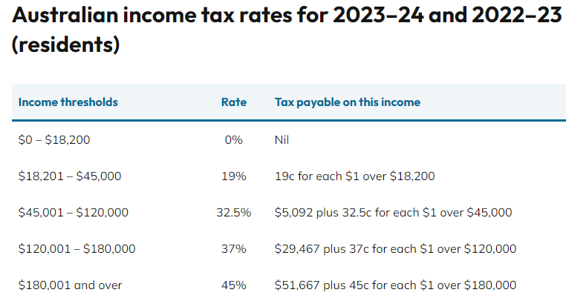
Chapter 2D: Income Taxation
Investigate equivalent representations of rational numbers so that you can:
Flexibly convert between fractions, decimals, and percentages
Use and understand ratio and proportions
Solve money-related problems
https://www.ato.gov.au/Individuals/Your-tax-return/How-to-lodge-your-tax-return/

Slide 16
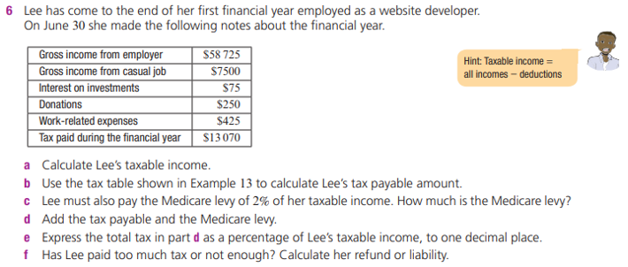
Income

Slide 17
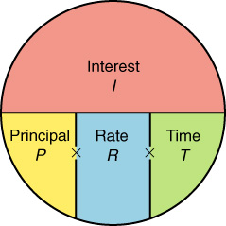
Find the simple interest using the simple interest formula
100

Slide 18
Converting
Change % to decimal
1) 12%
2) 5%
3) 2 ½ %
4) 8.5%
Change from decimal to %
5) .098
6) .455
Answers
1) .12
2) .05
3) .025
4) .085
5) 9.8%
6) 45.5%
Move 2 places
to left & drop % sign
Move 2 places
to right & add % sign

Slide 19
Find the principal, rate or time using the simple interest formula.
100
100
100
100

Slide 20
Consider this example: You begin with $100 invested at 10% annual interest.
After | Simple Interest | Compound Interest
1 year | 110 | 110
2 years | 120 | 121
3 years | 130 | 133
4 years | 140 | 146
5 years | 150 | 161
10 years | 200 | 259
20 years | 300 | 672
50 years | 600 | 11,739

Slide 21
Compound interest formula:

Slide 22
Compound Interest earned I
= value of the investment A
−initial amount invested P
I =A−P

Slide 23
Consider this example: You begin with $100 invested at 10% annual interest.
After | Simple Interest | Compound Interest
1 year | 110 | 110
2 years | 120 | 121
3 years | 130 | 133
4 years | 140 | 146
5 years | 150 | 161
10 years | 200 | 259
20 years | 300 | 672
50 years | 600 | 11,739

Slide 24
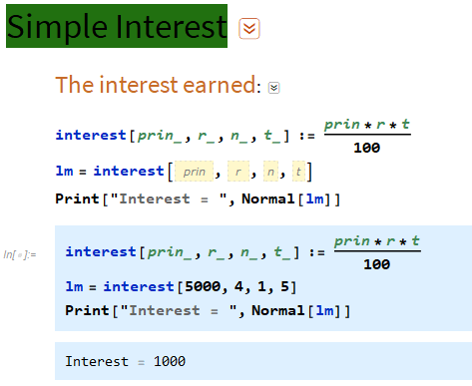
Mathematica: Copy the command, Type data in pink boxes and press Shift +Enter
All in one Master Command

Slide 25
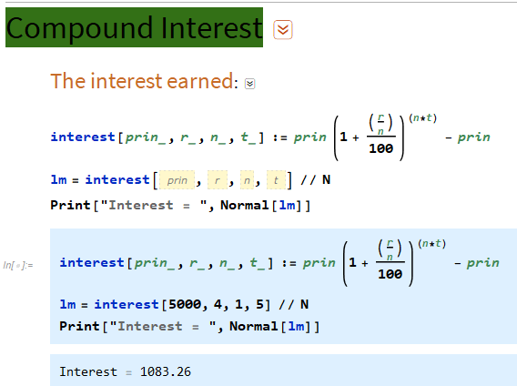
Mathematica: Copy the command, Type data in pink boxes and press Shift +Enter
All in one Master Command

