Slide 1
WALT Compare lengths using mm, cm and m
What does mm mean?
→ millimetres
What does cm mean?
→ centimetres
What does m mean?
→ metres

Slide 2
Which length is bigger? How do you know?
5cm or 2m
Think about what you already know about how big millimetres, centimetres and metres are.
20mm or 3cm

Slide 3
We need to remember that:
mm are smaller than cm and m
cm are smaller than m

Slide 4
How many cm in a m?
There are 100 cm in a m.
To convert m into cm, you need to multiply by 100.
How many cm are in 3m?

Slide 5
Converting m to cm
To convert m to cm multiply by 100
1m = 100cm
1m
1m
1m
100cm
100cm
100cm
3m x 100 = 300cm

Slide 6
Converting cm to m
How many m in 200cm?
To convert cm to m divide by 100
100 cm = 1m
100cm
100cm
1m
1m
200cm ÷ 100 = 2m

Slide 7
Answer these two questions:
To convert m to cm, multiply by 100
To convert cm to m, divide by 100

Slide 8
Can you prove it?
Remember to convert m to cm to work out how long Alex’s skipping rope is. She says her rope is 2 and ½ m long – how many cm are in ½ a metre?
1m = 100cm

Slide 9
How many mm in a cm?
There are 10 mm in a cm.
To convert cm into mm, you need to multiply by 10
To convert mm into cm, you need to divide by 10

Slide 10
Converting cm to mm
To convert cm into mm, you need to multiply by 10
How many mm in 4cm?
1cm = 10mm
1cm
1cm
1cm
1cm
10mm
10mm
10mm
10mm
4cm x 10 = 40mm

Slide 11
Converting mm to cm
To convert mm into cm, you need to divide by 10
How many cm in 30mm?
10mm = 1cm
10mm
10mm
10mm
1cm
1cm
1cm
30mm ÷ 10 = 3cm

Slide 12
Answer these questions:

Slide 13
Now use a ruler or a tape measure at home to measure different items at home. Write down your measurements in a table in cm and mm, and just mm.
Object measured | Measurement in cm and mm | Measurement in mm only
(EXAMPLE) Mobile phone | 15cm 1mm | 151mm

Slide 14
Can you solve this problem?
If you need a little help to solve the problem, you can check the next slide for a few tips…

Slide 15
Can you solve this problem?
Use Ron’s clues to help solve the problem.
What numbers do multiples of 2 end in?
We know that it has to include 8 cm because Ron has told us that already.
If you add up both digits in the number, does it equal 12?
Check your number to see if they match all of Ron’s clues.

Slide 16
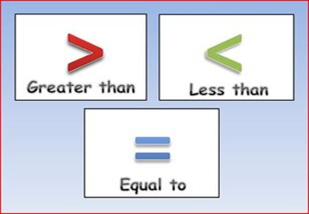
Comparing lengths
Now that you know how to convert mm, cm and m, compare these measurements.
Which measurement is bigger? Use the greater than/less than/ equal to signs to compare them. Remember to convert the measurements to explain the comparison.
Work your way through the question below
EXAMPLE:
4cm > 30mm
(40mm > 30mm)

Slide 19
