Slide 1
10-7 Areas of Circles and Sectors

Slide 2
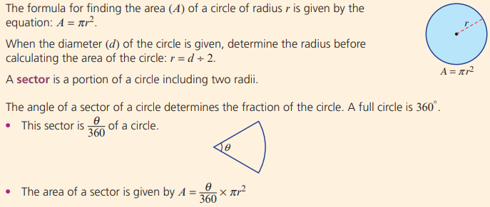

Slide 3
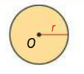
Area of a Circle

Slide 4
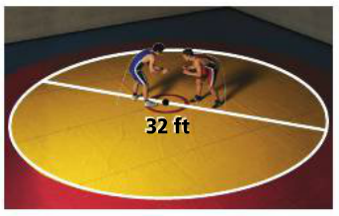
Problem 1: Finding Area of a Circle

Slide 5
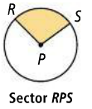
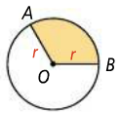
Sector of a Circle: a region bounded by an arc of the circle and the two radii to the arc’s endpoints.
$$θ$$
Area of a Sector of a Circle
$$θ$$

Slide 6
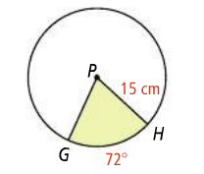
Problem 2: Finding the Area of a Sector of a Circle

Slide 8
Area of a Segment
Segment of a Circle: a part of a circle bounded by an arc and the segment joining its endpoints

Slide 9
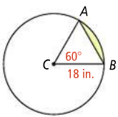
Problem 3: Finding the Area of a Segment of a Circle

Slide 10
