Slide 1
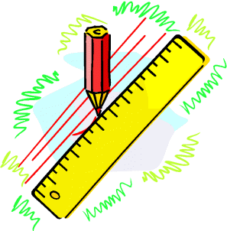
Net and Surface Area
Level 2
Faces Edges and Vertices
The Cube
www.mathsrevision.com
The Cuboid
The Triangular Prism

Slide 2
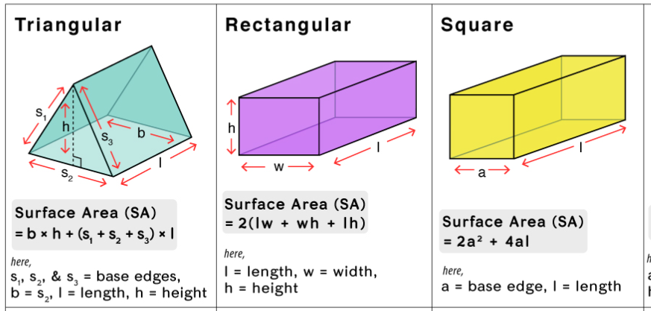

Slide 3
Don’t forget the faces edges and corners we can’t see at the back
Face Edges and Vertices
Level 2
The shape below is called a cuboid.
It is made up of FACES, EDGES and VERTICES.
Edges are where the two faces meet (lines)
www.mathsrevision.com
Faces are the
sides of a shape
(surface area)
Vertices where lines meet (corners)

Slide 4
Calculate the number of faces edges and vertices for a cuboid.
Face Edges and Vertices
Level 2
www.mathsrevision.com
6 faces
12 edges
Front and back are the same
Top and bottom are the same
8 vertices
Right and left are the same

Slide 5
Calculate the number of faces edges and vertices for a cube.
Face Edges and Vertices
Level 2
www.mathsrevision.com
6 faces
12 edges
Faces are squares
8 vertices

Slide 6
Net and Surface Area The Cube
Level 2
The net of a solid shape is the shape you would get
if it was made of cardboard and you “opened it up
and laid it out flat”.
Right
Side
www.mathsrevision.com
left
Side
Top
Back
Front
Bottom
6 faces
All congruent
This is a NET
for the cube
All squares

Slide 7
Net and Surface Area The Cube
Level 2
Question : Find the surface area of the cube below.
What do we know?
Made up of 6 faces
All the same (congruent)
All squares
Total
6 x 25 = 150cm²
www.mathsrevision.com
5cm

Slide 8
Net and Surface Area The Cuboid
Level 2
Bottom
3cm
4cm
LS
Back
RS
4cm
Top
3cm
3cm
www.mathsrevision.com
5cm
Front
4cm
6 faces
Top and bottom congruent
5cm
Front and back congruent
Left and right congruent
This is a NET for the cuboid

Slide 9
Example
Find the surface area of the cuboid
Working
Level 2
Front Area = l x w
DEMO
= 5 x 4 =20cm²
Top Area = l x w
= 5 x 3 =15cm²
4cm
Side Area = l x w
= 3 x 4 =12cm²
3cm
www.mathsrevision.com
5cm
Total Area
= 20+20+15+15+12+12
= 94cm²
Front and back are the same
Top and bottom are the same
Right and left are the same

Slide 10
Net and Surface Area Triangular Prism
Level 2
Bottom
4cm
4cm
BT
Back
FT
10cm
4cm
www.mathsrevision.com
Front
4cm
5 faces
3 congruent rectangles
10cm
2 congruent triangles
This is a NET for the triangular prism.

Slide 11
Example
Find the surface area of the right angle prism
Working
Level 2
Triangle Area =
= 2 x3 =6cm²
Rectangle 1 Area = l x b
= 3 x10 =30cm²
5cm
Rectangle 2 Area = l x b
3cm
10cm
= 4 x 10 =40cm²
4cm
www.mathsrevision.com
Rectangle 3 Area = l x b
2 triangles the same
= 5 x 10 =50cm²
1 rectangle 3cm by 10cm
Total Area
= 6+6+30+40+50 = 132cm²
1 rectangle 4cm by 10cm
1 rectangle 5cm by 10cm

Slide 12
Surface area of a cuboid
To find the surface area of a shape, we calculate the total area of all of the faces.
5 cm
So the total surface area =
8 cm
2 × 40 cm²
Top and bottom
7 cm
+ 2 × 35 cm²
Front and back
+ 2 × 56 cm²
Left and right side
= 80 + 70 + 112 = 262 cm²
Notes:
Stress the importance of working systematically when finding the surface area to ensure that no faces have been left out.
We can also work out the surface area of a cuboid by drawing its net (see slide 51). This may be easier for some pupils because they would be able to see every face rather than visualizing it.

Slide 13
Formula for the surface area of a cuboid
We can find the formula for the surface area of a cuboid as follows.
Surface area of a cuboid =
w
l
2 × lw
Top and bottom
+ 2 × hw
Front and back
h
+ 2 × lh
Left and right side
= 2lw + 2hw + 2lh
Notes:
Pupils should write this formula down.

