Slide 1
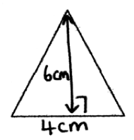
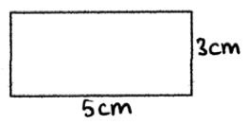
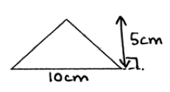
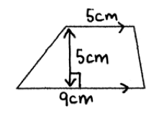
Volume of 3D Shapes
LO: To be able to find the Volume of 3D Shapes
Good: I can find the volume of a cuboid (E)
Great: I can find the volume of a triangular prism (D)
Amazing: I can solve volume problems involving prisms (C)
STARTER: Find the AREA of these shapes
1)
3)
2)
4)

Slide 2
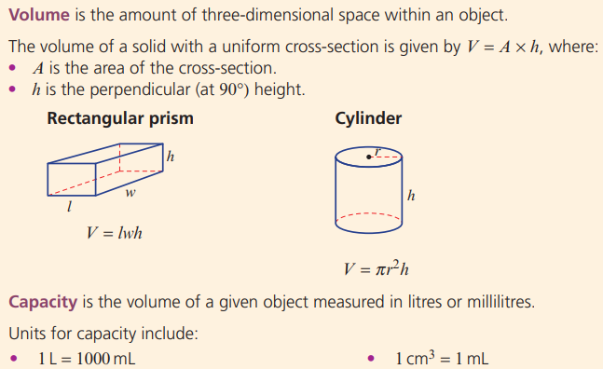

Slide 3
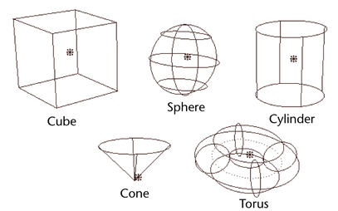
WHAT IS VOLUME?
How could we find the volume of these shapes?

Slide 4
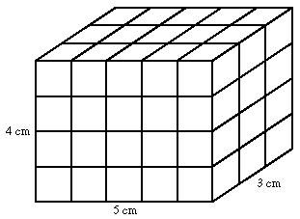
Finding the Volume of a Cuboid
Below is a cuboid. How could we find the Volume?

Slide 5
COPY DOWN THE FORMULA – You need to learn this.
Every 3-Dimensional shape has 3 dimensions.
To find the Volume of a Cuboid, we find the Area of the front face and multiply by the 3rd Dimension.
V = Length x Width x Height
In this example:
V = 4cm x 5cm x 3cm
V = 60cm³

Slide 6
ACTIVITY 1 – Find the Volume
V = Length x Width x Height
V = 48cm³
V = 50cm³
V = 108cm³
Extension
X = 4cm
X = 8cm

Slide 7
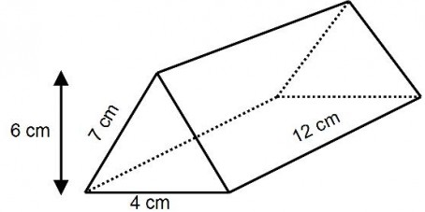
Finding the Volume of a Triangular Prism
Below is a Triangular Prism. How could we find the Volume?
Step 1: Find the Area of the front face (triangle)
Area = (6 x 4) / 2
= 12cm²
Step 2: Multiply your answer by the 3rd Dimension
Volume = 12cm² x 12cm
V = 144cm³
Q - Why do we not use 7cm?
V = $Arⅇa_{triangle}$ x Height
$Arⅇa_{triangle}$ = Base x Height /2

Slide 8
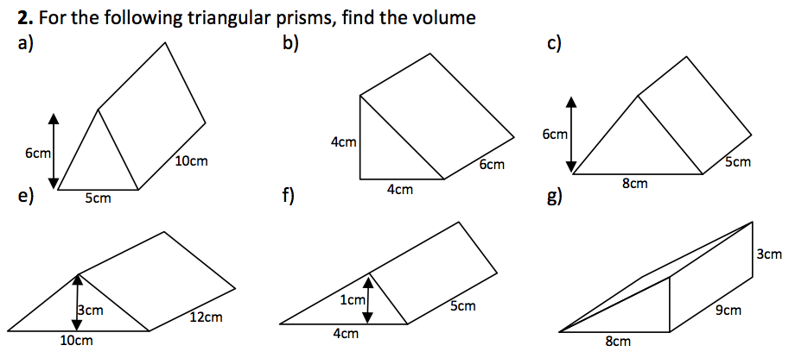
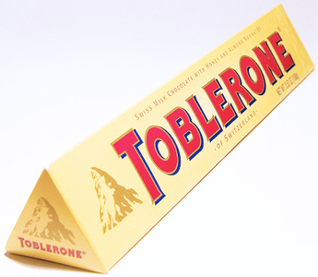
ACTIVITY 2 – Find the Volume
V = $Arⅇa_{triangle}$ x Height
$Arⅇa_{triangle}$ = Base x Height /2
V = 150 cm³
V = 120cm³
V = 48cm³
V = 180cm³
V = 10cm³
V = 108cm³
Extension: The Volume of Toblerone is 100cm^{3.} Find the length.
X
4cm
5cm

Slide 9
How many 3D shapes can you name?
Cone
Hexagonal prism
Cube
Triangular based pyramid
1
2
3
4
5
Sphere
Cube
Cuboid
Cone
Cylinder
Cuboid
Triangular prism
Sphere
Cylinder
Square based pyramid
6
7
Triangular based pyramid
8
Triangular prism
9
Hexagonal prism
Square based pyramid

Slide 10
Activity - Find the Area of the Circles below:
a)
b)
c)
4 cm
5.22 m
7 m
$Arⅇa_{circle}$ = $πr^{2}$
$r$= d/2
3
2
5
1
4

Slide 11
Volume of cylinders
radius
height
V= π × ${radius}^{2}$ × height

Slide 12
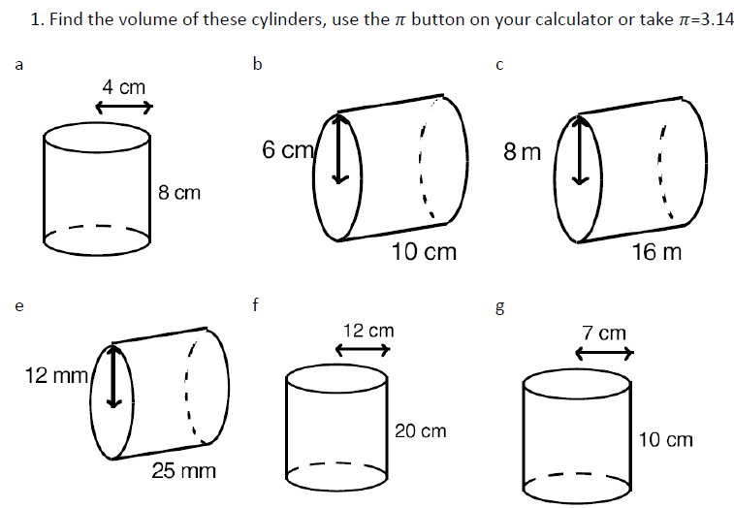
ACTIVITY 1 – Find the Volume
V = 48cm³
V = 50cm³
V = 108cm³
V = 4cm
V = 8cm
V = 8cm

Slide 13
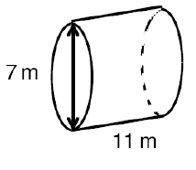
ACTIVITY 1 – Find the Volume
What is different about this question?

Slide 14
ACTIVITY 2 – Find the Volume
Find the volume given the diameter.
V = 48cm³
V = 50cm³
V = 108cm³

Slide 15
Plenary - Find the Volume of Prisms (C)

Slide 16
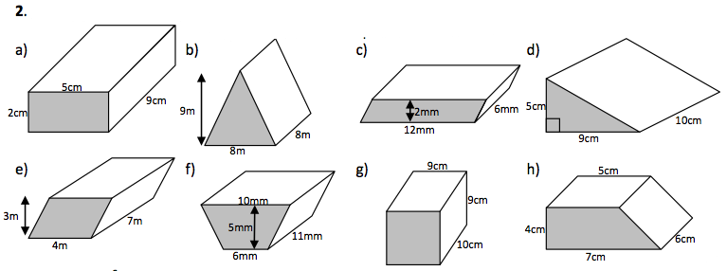
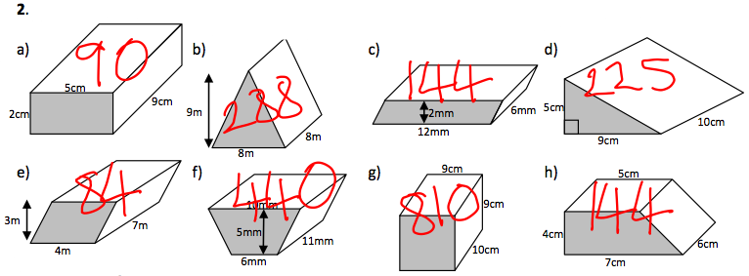
LO: To be able to find the Volume of Prisms (C)

Slide 17
LO: To be able to find the Volume of Prisms (C)

Slide 18
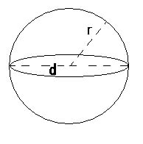
Volume of spheres
V= (4× π × r × r × r) ÷ 3

Slide 19
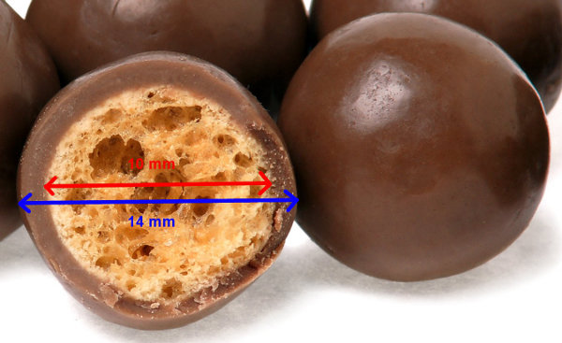
Extension: Find the Volume of a Sphere

Slide 20
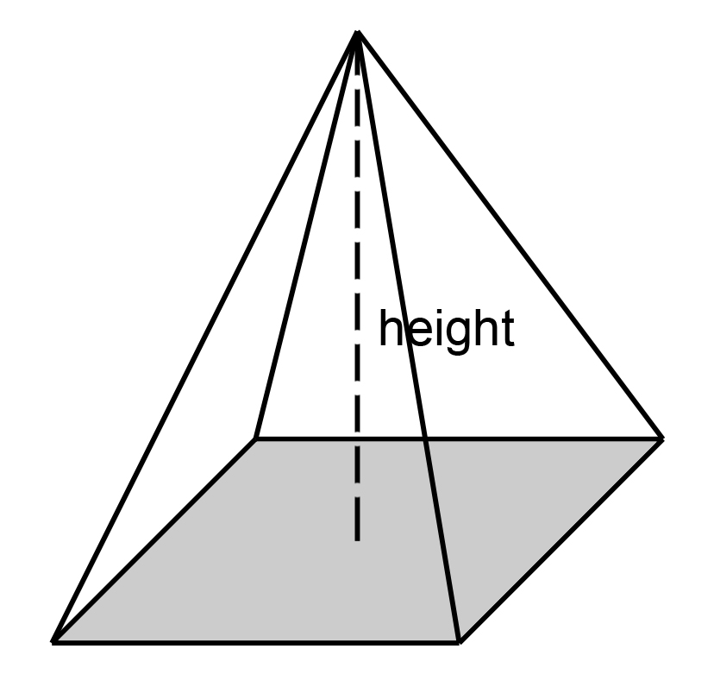
Volume of pyramids
Note
The height must be the perpendicular height from the base.
V= (Base area × height) ÷ 3

Slide 21
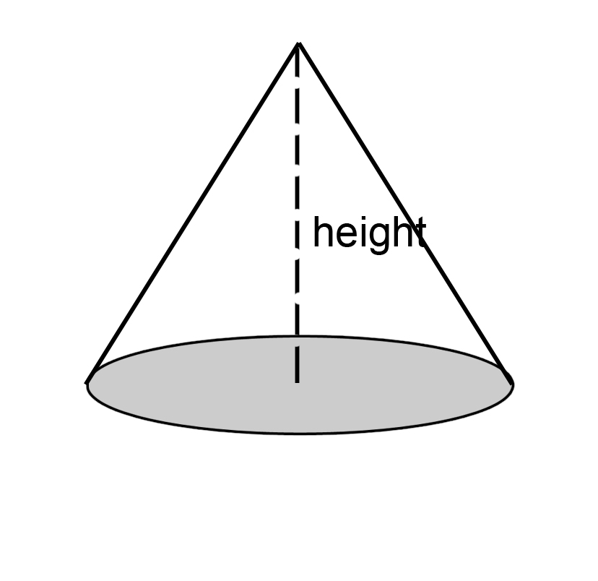
Volume of cones
Note
The height must be the perpendicular height from the base.
V= (π × r × r× height) ÷ 3

Slide 22
Volume of spheres
V= 4× π × radius × radius

