Slide 1
Parallel Lines & Transversals
*students use “parallel Lines cut by a transversal guided notes worksheet” to follow along

Slide 2
Definitions:
Parallel Lines Cut By A Transversal Guided Notes
Parallel Lines: Two lines that never intersect.
Transversal: A line that intersects two or more lines.
When parallel lines are intersected by a transversal, many angles are formed.
They will form special relationships between pairs

Slide 3
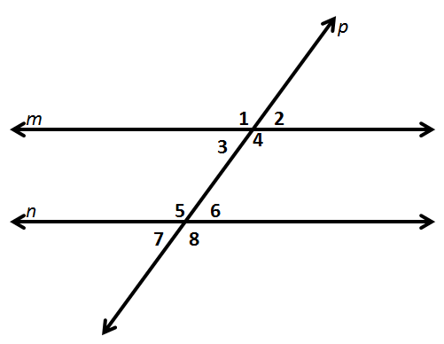
Parallel Lines Cut By A Transversal Guided Notes
Reminder: Supplementary angles are two angles that add up to 180˚. They make a straight line.
Name the parallel lines.
Name the transversal.
The order the angles are numbered isn’t important, that can change from problem to problem…
What stays the same is their relationship!

Slide 4
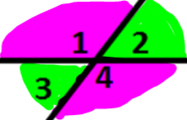
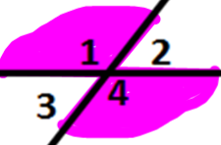
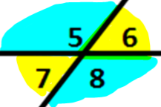
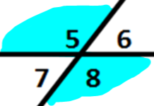
3. Name and highlight the vertical angles.
Vertical angles are congruent
∠1 and ∠4
∠2 and ∠3
∠5 and ∠8
∠6 and ∠7
*TIP* basically means opposite from each other, across the vertex,
not adjacent/next to

Slide 5
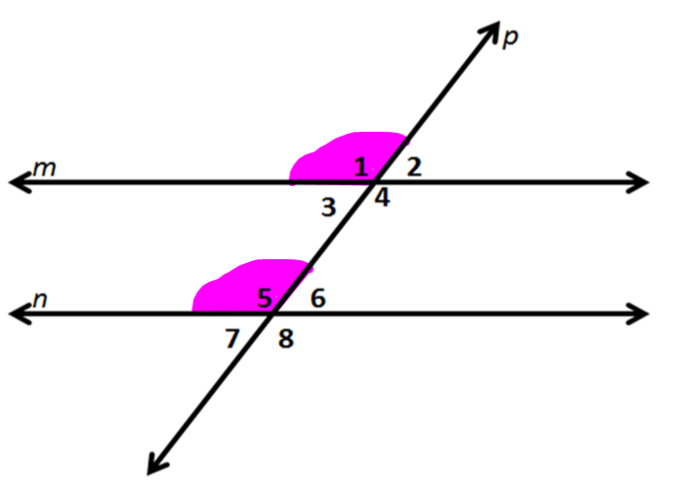
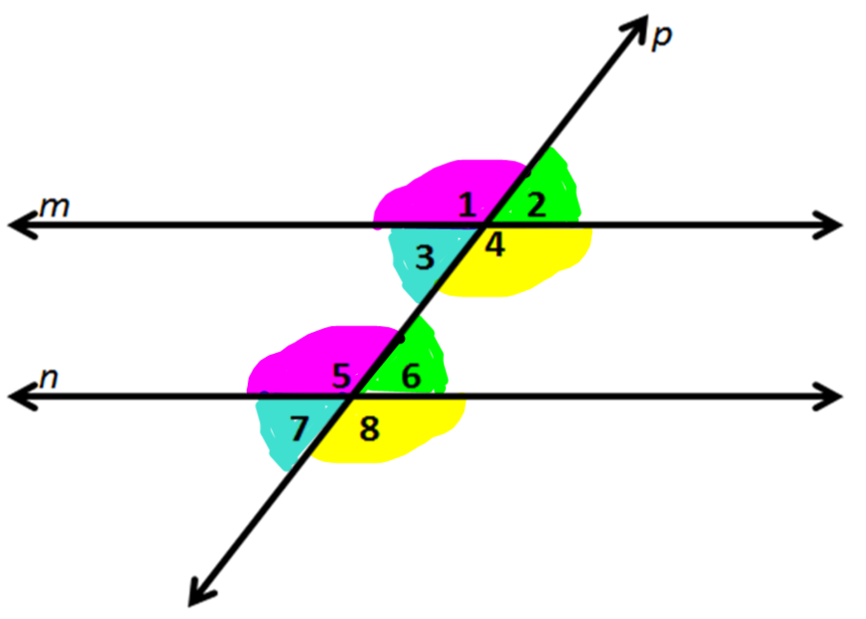
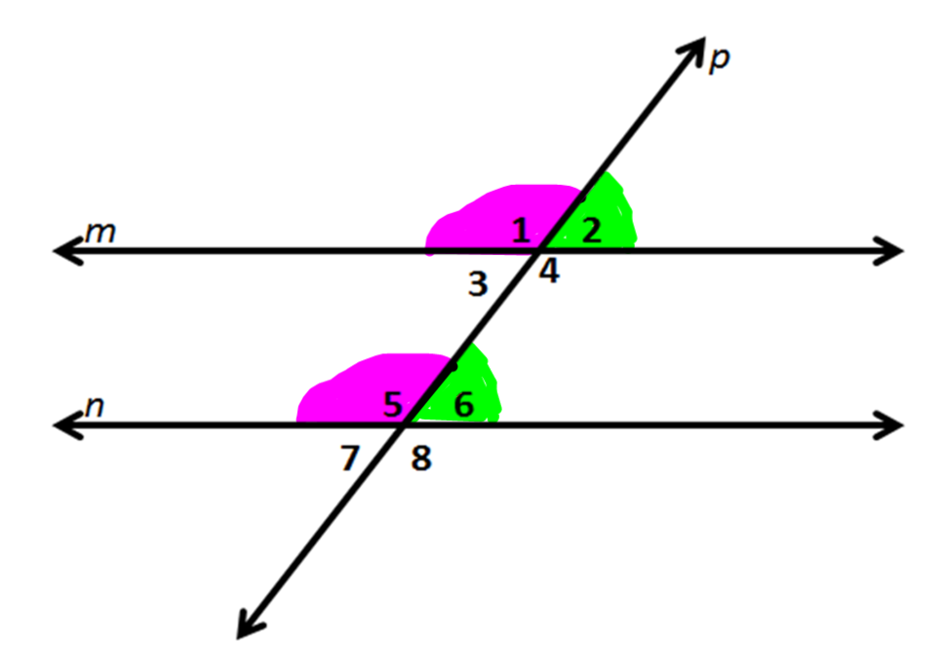
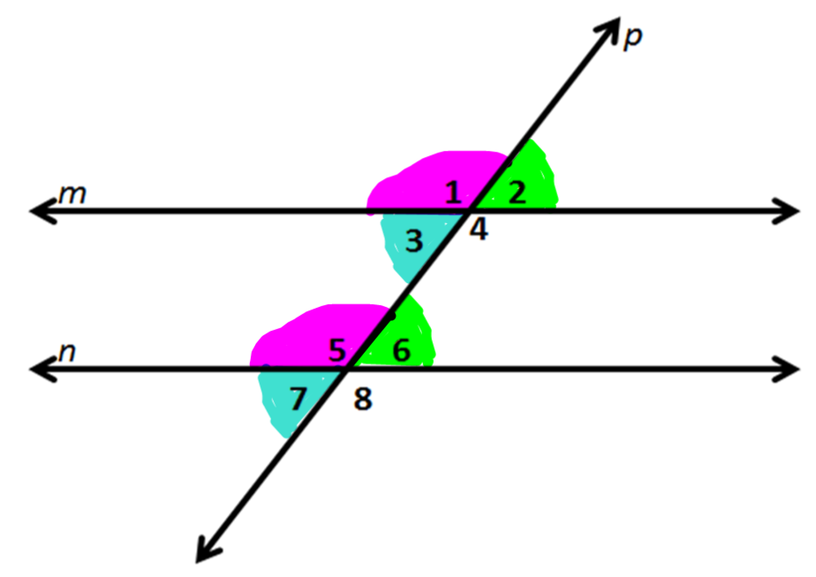
4. Name and highlight the corresponding angles.
Corresponding angles are congruent
∠1 and ∠5
∠2 and ∠6
∠3 and ∠7
∠4 and ∠8
*TIP* think which ones ‘match up’ in the same location? like top left corner with top left corner

Slide 6
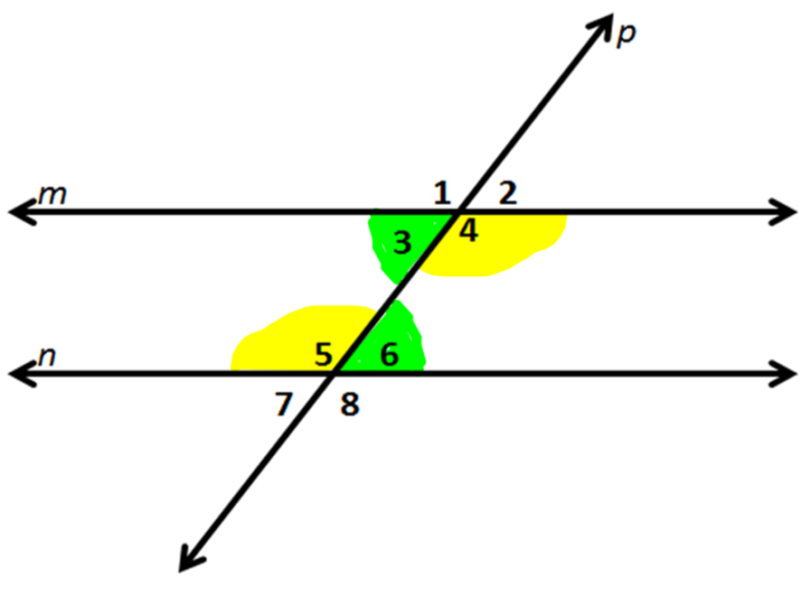
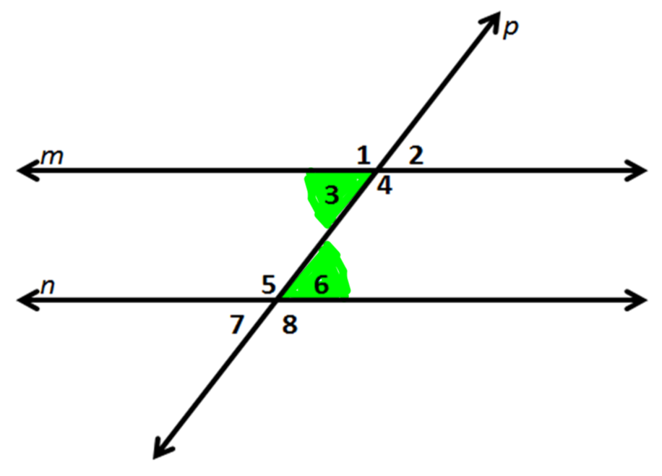
5. Name and highlight the alternate interior angles.
Alternate Interior angles are congruent
∠3 and ∠6
∠4 and ∠5
*TIP* think alternate means on opposite sides of the transversal, and
Interior means inside of the 'track' (parallel lines)

Slide 7
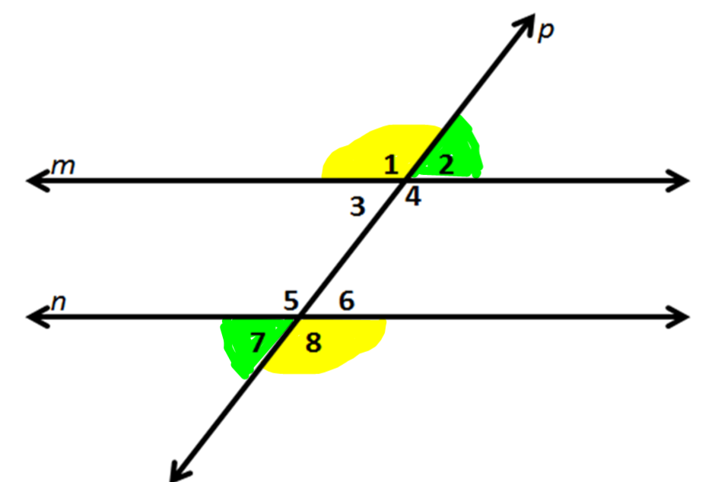
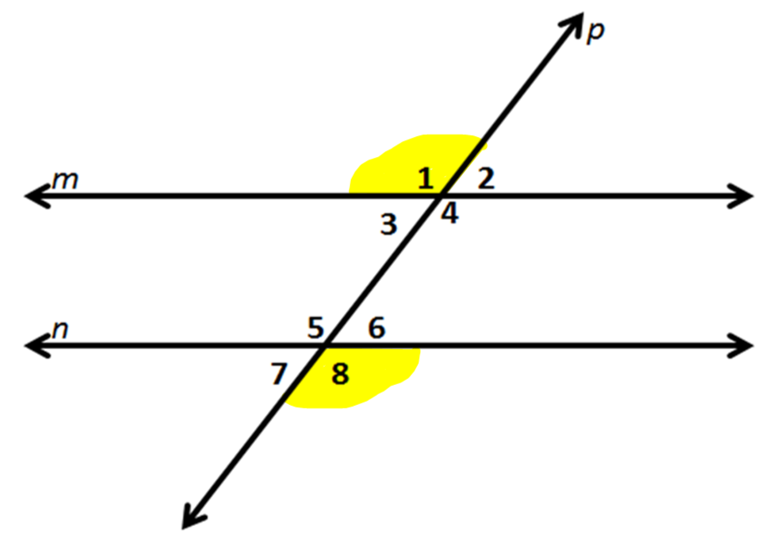
6. Name and highlight the alternate exterior angles.
Alternate exterior angles are congruent
∠1 and ∠8
∠2 and ∠7
*TIP* think alternate means on opposite sides of the transversal, and
exterior means outside of the 'track‘ (parallel lines)

Slide 8
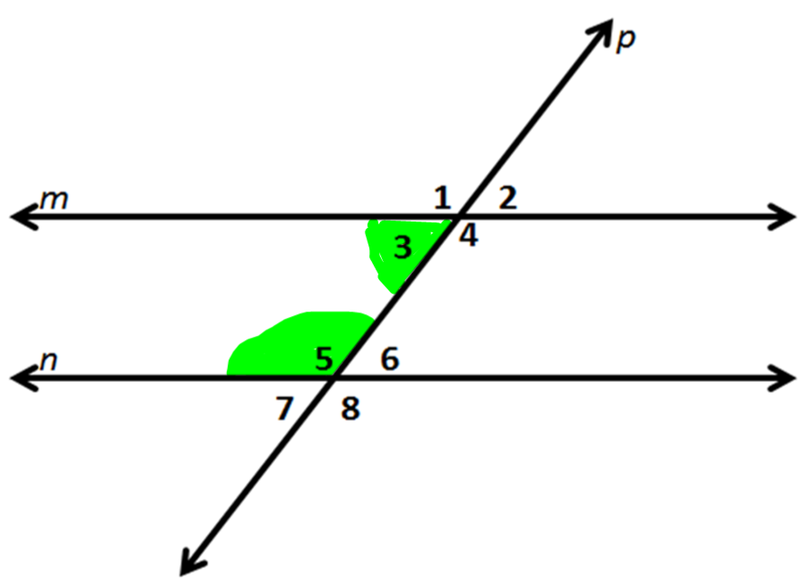
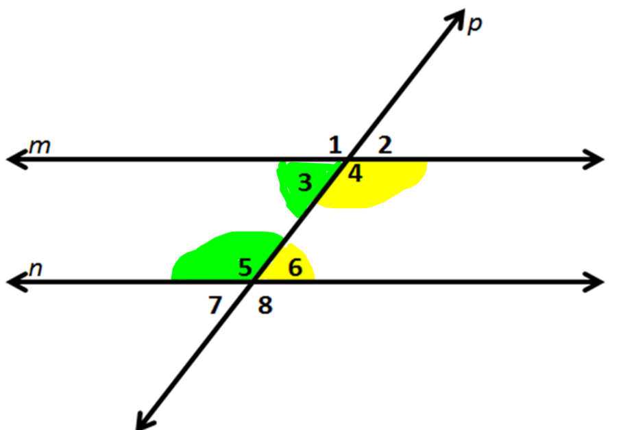
7. Name and highlight the same side interior angles.
Same side interior angles are supplementary
∠3 and ∠5
∠4 and ∠6
*TIP* think same-side means on the same sides of the transversal, and
Interior means inside of the 'track' (parallel lines)

Slide 9
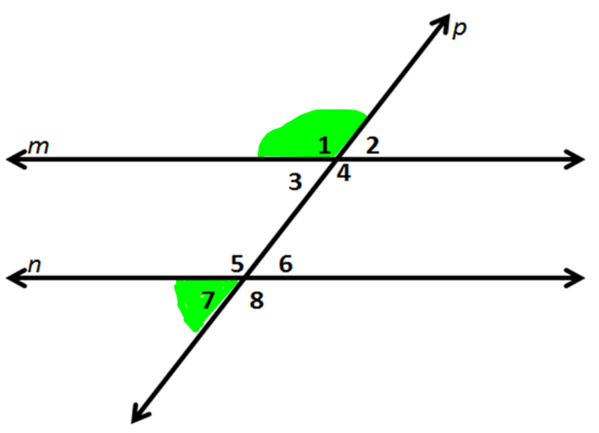
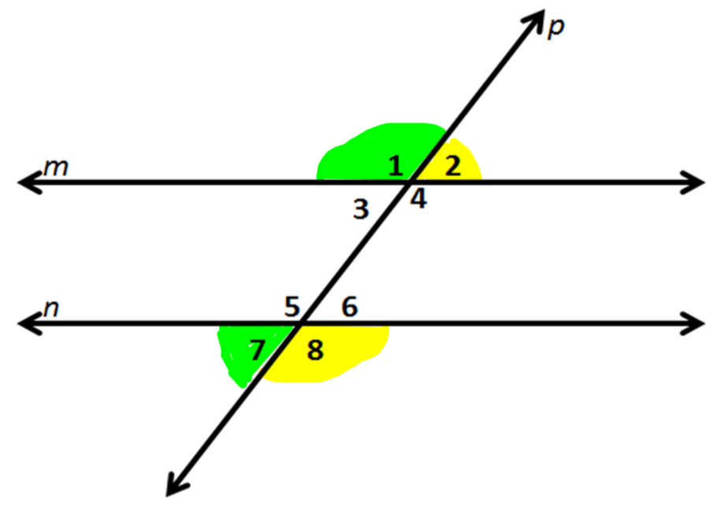
8. Name and highlight the same side exterior angles.
Same side exterior angles are supplementary
∠1 and ∠7
∠2 and ∠8
*TIP* think same-side means on the same sides of the transversal, and
Exterior means outside of the 'track' (parallel lines)

Slide 10
If you know the measure of one of the 8 angles, you can find the measure of all of the others.
Try it. The measure of ∠1 = 120°.
∠1 =
∠2 =
∠3 =
∠4 =
∠5 =
∠6 =
∠7 =
∠8 =
120°
60°
60°
120°
120°
60°
*notice all the acute angles in the problem will be 60° and all the obtuse angles in the problem will be 120°
60°
120°

Slide 11
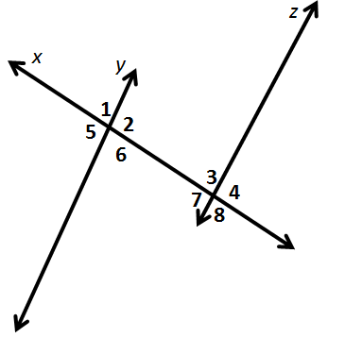
If you know the measure of one of the 8 angles, you can find the measure of all of the others.
Try it again. The measure of ∠1 = 72°.
∠1 =
∠2 =
∠3 =
∠4 =
∠5 =
∠6 =
∠7 =
∠8 =
72°
108°
72°
108°
108°
72°
108°
72°

