Slide 1
Properties of Quadrilaterals

Slide 2
What is a Quadrilateral?
A quadrilateral is a two-dimensional figure with four sides and four angles.
The word part “quad” means 4 and “lateral” means sides.

Slide 3
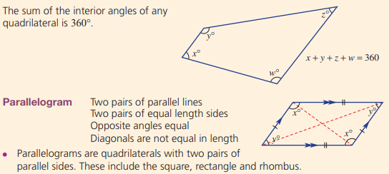

Slide 4
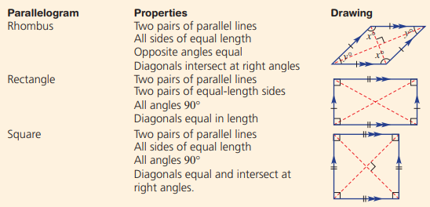

Slide 6
What is a Quadrilateral?
Look around you. Do you see shapes in this room that could be called quadrilaterals?

Slide 7
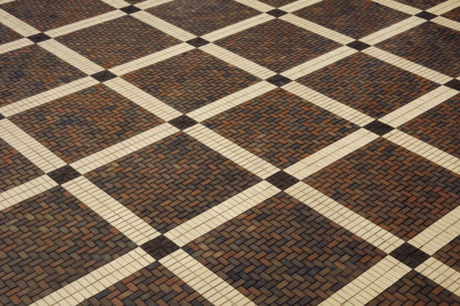
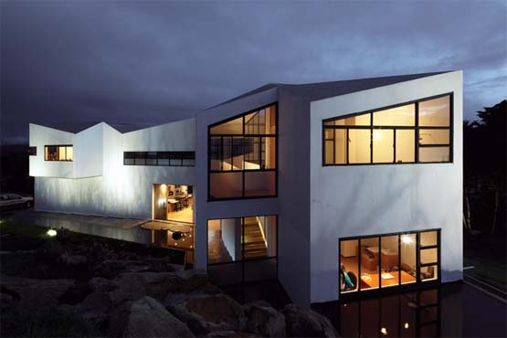
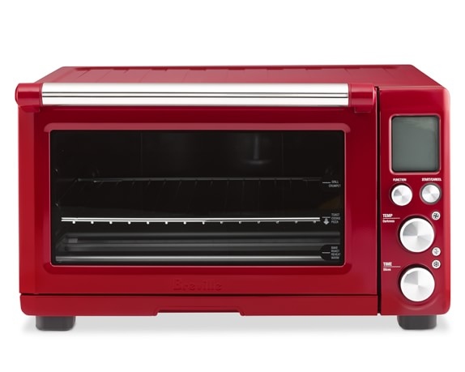
Quadrilaterals in the real world

Slide 8
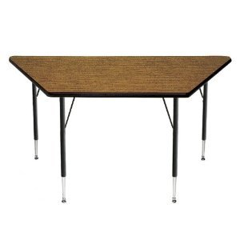
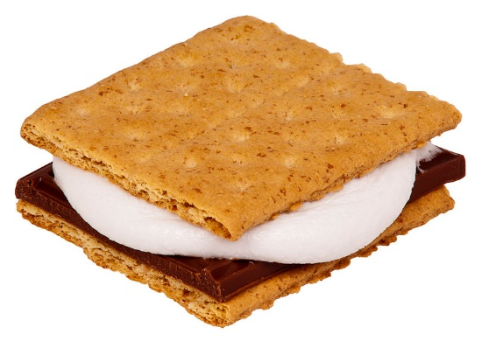
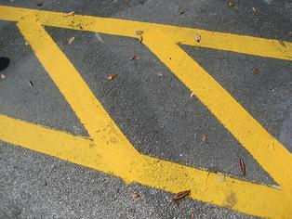
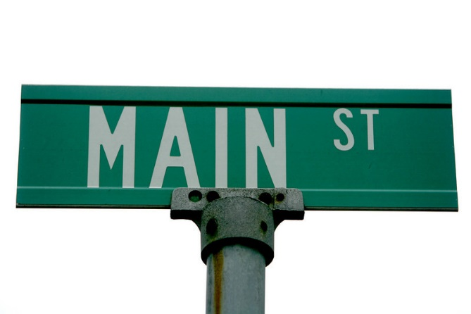
Quadrilaterals in the real world

Slide 9
Types of Quadrilaterals
Square
Rectangle
Trapezoid
Rhombus
Paralellogram

Slide 10
A SQUARE
A square is a quadrilateral with 4 equal sides and 4 right angles.

Slide 11
A RECTANGLE
A rectangle is a quadrilateral with 4 right angles. Its opposite sides are equal and parallel.

Slide 12
Is a square a rectangle?
REMEMBER:
A rectangle is a quadrilateral with 4 right angles. Its opposite sides are equal and parallel.
A square is a quadrilateral with 4 equal sides and 4 right angles.
Rectangle?
Explain your thinking.

Slide 13
Is a rectangle a square?
REMEMBER:
A rectangle is a quadrilateral with 4 right angles. Its opposite sides are equal and parallel.
A square is a quadrilateral with 4 equal sides and 4 right angles.
Square?
Explain your thinking.

Slide 14
Determination…..
A square can also be called a rectangle because it has four right angles and its opposite sides are equal and parallel.
A rectangle is NOT a square because it does not have equal sides.

Slide 15
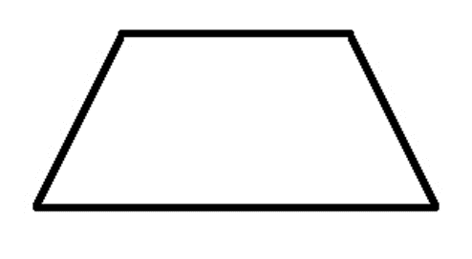
A TRAPEZOID
Remember, parallel lines are lines that will never touch. They are equal distance apart at all points.
A trapezoid is a quadrilateral that has exactly 1 pair of parallel sides.

Slide 16
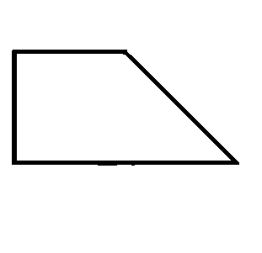
IS THIS A TRAPEZOID?
Yes, it has one set of parallel sides.

Slide 17
A RHOMBUS
A rhombus is a quadrilateral that has 4 equal sides. Its opposite sides are parallel.

Slide 18
A PARALLELOGRAM
A parallelogram is a quadrilateral that has opposite sides that are equal and parallel.
Which of the quadrilaterals we have seen are parallelograms?

Slide 19
Is it a parallelogram?
Remember: A parallelogram is a quadrilateral that has opposite sides that are equal and parallel
A Square
It is a parallelogram
It is NOT a parallelogram
Before you click on the answer, explain your thinking.

Slide 20
Is it a parallelogram?
Remember: A parallelogram is a quadrilateral that has opposite sides that are equal and parallel
A Rectangle
It is a parallelogram
It is NOT a parallelogram
Before you click on the answer, explain your thinking.

Slide 21
Is it a parallelogram?
Remember: A parallelogram is a quadrilateral that has opposite sides that are equal and parallel
A Trapezoid
It is a parallelogram
It is NOT a parallelogram
Before you click on the answer, explain your thinking.

Slide 22
Is it a parallelogram?
Remember: A parallelogram is a quadrilateral that has opposite sides that are equal and parallel
A Rhombus
It is a parallelogram
It is NOT a parallelogram
Before you click on the answer, explain your thinking.

Slide 23
Quadrilaterals
Have 4 sides and 4 angles
Parallelogram
Trapezoid
Has opposite sides that
are equal and parallel.
Has 1 pair of
parallel sides.
Rectangle
Rhombus
Has 4 right angles.
Opposite sides are
equal and parallel.
Has 4 equal sides.
Opposite sides
are parallel.
What conclusions can we draw from the graphic?
Square
Has 4 equal sides and
4 right angles.

Slide 24
What conclusions can we draw from the graphic?
A square can also be called a rhombus, a rectangle, a parallelogram,
and a quadrilateral.
A rectangle can also be called a parallelogram and a quadrilateral.
A rhombus can also be called a parallelogram and a quadrilateral.
A parallelogram can also be called a quadrilateral.
A trapezoid is a quadrilateral.

Slide 25
Name that Quadrilateral!
What is the best name for It?
parallelogram
What are the properties?
Opposite sides are equal in length.
Opposite sides are parallel.

Slide 26
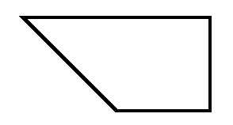
Name that Quadrilateral!
What is the best name for It?
trapezoid
What are the properties?
One pair of opposite sides are parallel

Slide 27
Name that Quadrilateral!
What is the best name for It?
square
What are the properties?
Four equal sides
Four right angles

Slide 28
Name that Quadrilateral!
What is the best name for It?
rectangle
What are the properties?
Four right angles
Opposite sides are equal
Opposite sides are parallel

Slide 29
Name that Quadrilateral!
What is the best name for It?
rhombus
What are the properties?
Four equal sides
Opposite sides are parallel

Slide 30
Click here to play a quadrilateral game.

