Slide 1
Angles in polygons
Today we are learning how to:
Find unknown angles in a triangle
Identify key notation that describes 2D shape properties
Find the unknown angles in a polygon

Slide 2
Notes
Naming & Classifying Polygons
Polygons are classified by the number of sides:
# of sides | Name | # of sides | Name
3 | triangle | 8 | octogon
4 | quadrilateral | 9 | nonogon
5 | pentagon | 10 | decagon
6 | hexagon | 12 | dodecagon
7 | heptagon | n | n-go
equilateral: polygons where all the sides are ≅
equiangular: polygons where all the angles are ≅
regular: concave polygons which are both equilateral and equiangular.

Slide 4
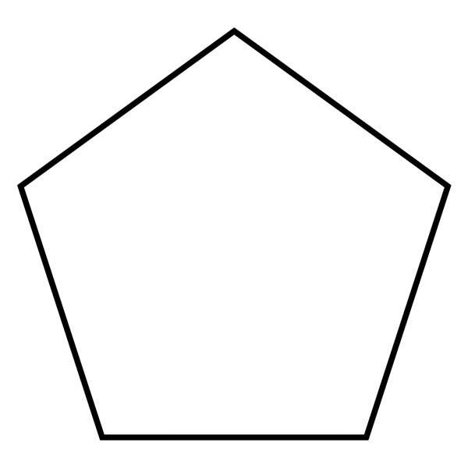
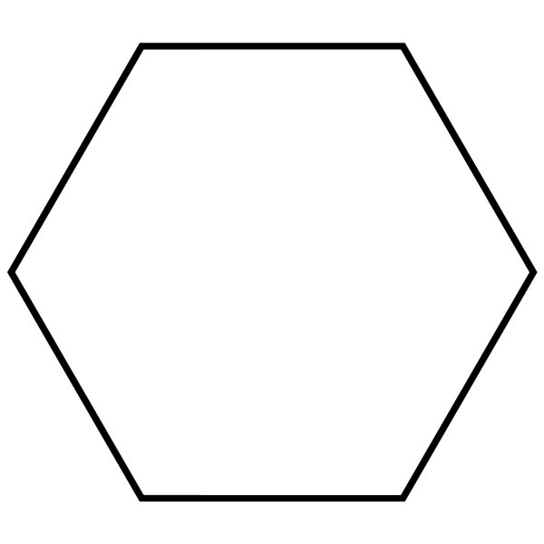
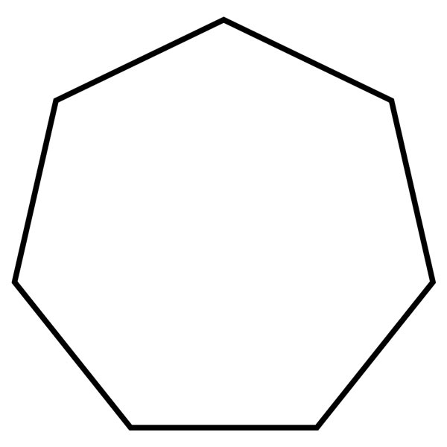
QUICK RECALL
The sum of the interior angles of a regular polygon can be calculated by considering how many triangles the polygon is made up of…
Heptagon is the Greek name, and Septagon comes from Latin
→ Because a lot of geometry originated in Greece, Heptagon is more commonly used…
180˚
?
180˚
180˚
180˚
180˚
180˚
180˚
180˚
180˚
180˚
180˚
180˚
Pentagon
Hexagon
Heptagon
An ‘n’-gon
5 sides
6 sides
7 sides
$n$ sides
3 triangles
4 triangles
5 triangles
$(n – 2)$triangles
3 x 180
4 x 180
5 x 180
$(n – 2)$x 180
= 540˚
= 720˚
= 900˚
= $180(n – 2)$degrees

Slide 5
MODEL IT
Find the missing angle:
My turn:
110º
120º
100º
95º
xº

Slide 6
MODEL IT
Find the missing angle:
Your turn:
110º
120º
150º
100º
165º
xº

Slide 7
DO NOW ACTIVITY
Calculate the unknown angles in the following questions:

Slide 8
DO NOW ACTIVITY
ANSWERS
a = 100º
b = 150º
c = 285º

Slide 9
QUICK RECALL
If the shapes are regular, all the interior angles will be the same.
How do we find only 1 angle?
108˚
120˚
120˚
128.6˚
?
128.6˚
128.6˚
108˚
108˚
120˚
120˚
128.6˚
128.6˚
108˚
108˚
120˚
120˚
128.6˚
128.6˚
Regular Pentagon
Pentagon
Regular Hexagon
Hexagon
Regular Heptagon
Heptagon
Regular ‘n’-gon
Sum of interior angles = 540˚
Sum of interior angles = 720˚
Sum of interior angles
= 900˚
Sum of interior angles
= $180(n – 2)$
5 angles
6 angles
7 angles
n angles
540 ÷ 5
720 ÷ 6
900 ÷ 7
$$180(n – 2)÷n$$
= 108˚
= 120˚
= 128.6˚
$$=\frac{180(n−2)}{n}$$

Slide 10
QUICK RECALL
If the shapes are regular, all the exterior angles will also be the same.
So how do you find 1 exterior angle?
72˚
60˚
51.4˚
51.4˚
108˚
60˚
120˚
120˚
128.6˚
?
72˚
128.6˚
128.6˚
60˚
51.4˚
108˚
108˚
120˚
120˚
51.4˚
72˚
60˚
128.6˚
128.6˚
108˚
108˚
72˚
120˚
120˚
60˚
51.4˚
128.6˚
128.6˚
51.4˚
72˚
60˚
51.4˚
Regular Pentagon
Regular Hexagon
Regular Heptagon
Regular ‘n’-gon
Each interior angle = 108˚
Each interior angle = 120˚
Each interior angle = 128.6˚
Each interior angle
$$=\frac{180(n−2)}{n}$$
Each exterior angle
= 180 - 108
Each exterior angle
= 180 - 120
Each exterior angle
= 180 – 128.6
Each exterior angle
$$=180−\frac{180(n−2)}{n}$$
= 72˚
= 60˚
= 51.4˚

Slide 11
QUICK RECALL
There is also an alternative way to work out the size of the exterior angles (for a regular shape), without needing the interior angle first…
72˚
60˚
51.4˚
51.4˚
60˚
?
72˚
60˚
51.4˚
72˚
51.4˚
60˚
72˚
60˚
51.4˚
51.4˚
72˚
60˚
51.4˚
Regular Pentagon
Regular Hexagon
Regular Heptagon
Regular ‘n’-gon
Each exterior angle = 72˚
Each exterior angle = 60˚
Each exterior angle = 51.4˚
The exterior angles always add up to 360˚ in total
So to find one in a regular (n-sided) polygon:
$$=\frac{360}{n}$$
5 exterior angles
6 exterior angles
7 exterior angles
72 x 5
60 x 6
51.4 x 7
= 360˚
= 360˚
= 360˚
(Remember that the 51.4 has been rounded)

Slide 12
MODEL IT
Find the nth term of the following sequences
My turn:
Your turn:
xº
100º
40º
xº

Slide 13
DO NOW ACTIVITY
Calculate the unknown angles in the following questions:

Slide 14
DO NOW ACTIVITY
ANSWERS:
a = 80º
b = 110º
c = 52º
For bonus points, can you identify any of the interior angles.
How can you identify that these are not regular shapes?

Slide 15
Summary
Calculate the size of the interior angles and exterior angles in a regular dodecagon (12 sides)
Sum of the interior angles
Each interior angle
Number of sides = 12
$${1800}^{°}÷12$$
Calculate
$$180(n−2)$$
$$={150}^{°}$$
n = 12
$$=180(12−2)$$
Each exterior angle
Each exterior angle (alternative)
Calculate
bracket
$$=180(10)$$
$${180}^{°}−{150}^{°}$$
Number of sides = 12
Calculate
Calculate
$$={1800}^{°}$$
$$={30}^{°}$$
$${360}^{°}÷12$$
Calculate
$$={30}^{°}$$

