Slide 1
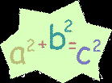
Pythagorean Theorem
https://www.youtube.com/watch?v=BbX44YSsQ2I
Notes:
https://create.kahoot.it/details/e2edbbde-3d4f-45fd-9040-3e60d89bae4b
https://create.kahoot.it/details/b82e8ce9-ce17-4261-aa0d-4a0e0a2ea0d4
https://create.kahoot.it/details/76b015bc-cd21-4c8c-8b25-c29ac95e5d61
https://dashboard.blooket.com/set/61a3a1256e4cf05a33cafaeb
https://dashboard.blooket.com/set/6269bd81881949cd05b1fcfe

Slide 2

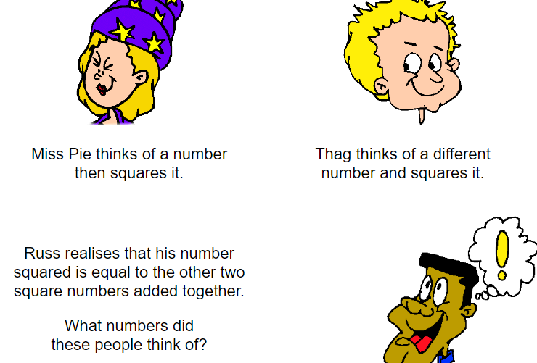
Notes:
https://www.transum.org/Software/SW/Starter_of_the_day/starter_December5.ASP

Slide 3
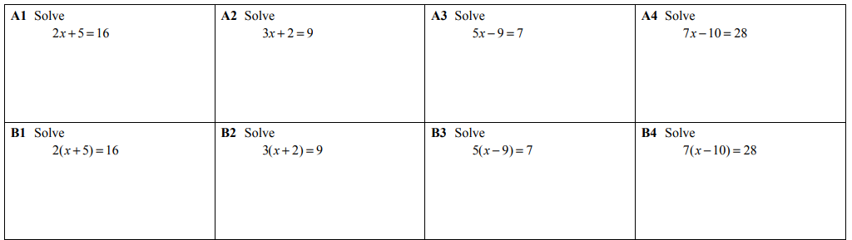
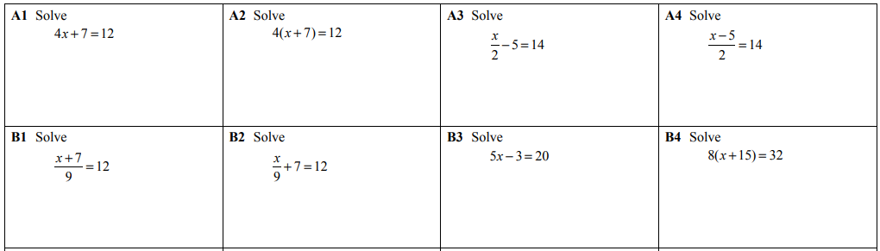
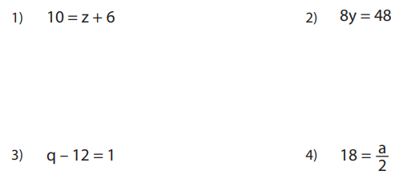
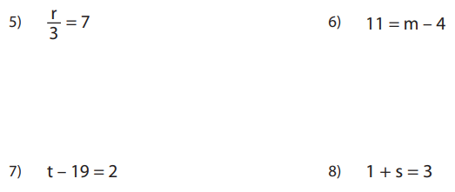

Slide 4
Learning Outcomes
Pythagoras
Pythagorean Theorem equation
Can you label the triangle?
Pythagorean Triples

Slide 5
E
Rounding – to the nearest 10
4 8 3 2
4 8 3 7
1 9 5
5 or more?
5 or more?
5 or more?
No
Yes
Yes
4 8 3 0
4 8 4 0
2 0 0

Slide 6
D
Rounding to 1 Decimal Place (1DP)
4 . 8 3 2 5
4 . 8 4 2 5
4 . 8 5 2
5 or more?
5 or more?
5 or more?
No
No
Yes
4 . 8
4 . 8
4 . 9
4 . 8 7
5 . 2 6 7 1 4
1 . 9 6 7
5 or more?
5 or more?
5 or more?
Yes
Yes
Yes
4 . 9
5 . 3
2 . 0

Slide 7
D
Rounding to Decimal Places: 2DP
4 . 8 3 2 5
4 . 8 4 6
4 . 8 5 9 5 1
5 or more?
5 or more?
5 or more?
No
Yes
Yes
4 . 8 3
4 . 8 5
4 . 8 6
1 . 6 9 4 9
5 . 2 6 7 1
1 . 8 9 7
5 or more?
5 or more?
5 or more?
No
Yes
Yes
1 . 6 9
5 . 2 7
1 . 9 0

Slide 8
This is a right triangle:

Slide 9
We call it a right triangle because it contains a right angle.

Slide 10
The measure of a right angle is 90º
90º

Slide 11
The little square
in the
angle tells you it is a
right angle.
90º

Slide 12
The two sides which come together in a right angle are called

Slide 13
The two sides which come together in a right angle are called

Slide 14
The two sides which come together in a right angle are called
legs.

Slide 15
The lengths of the legs are usually called a and b.
a
b

Slide 16
The side across from the right angle
is called the
hypotenuse.
a
b

Slide 17
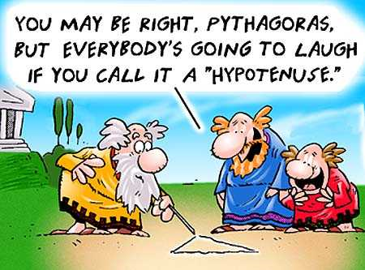
Pythagoras
The Egyptians knew of this concept, as it related to 3, 4, 5 right triangles, long before the time of Pythagoras. It was Pythagoras, however, who generalized the concept and who is attributed with its first geometrical demonstration. Thus, it has become known as the Pythagorean Theorem.

Slide 18
And the length of the hypotenuse is usually labeled c.
c
a
b

Slide 19
The relationship Pythagoras discovered is now called The Pythagorean Theorem:
c
a
b

Slide 20
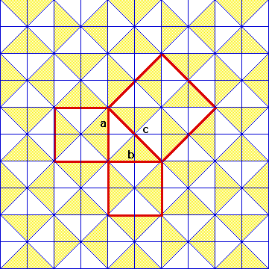
You can verify the Pythagorean Theorem with the following:
Given a piece of graph paper, make a right triangle. Then make squares of the right triangle. Then find the square’s areas.
https://www.youtube.com/watch?v=CAkMUdeB06o

Slide 21
The Pythagorean Theorem
a² + b² = c²
OR
a² = c² – b²
c
a
Which side is the hypotenuse?
b
The right angle points to the hypotenuse.
It’s the side labelled “c”.

Slide 22
Can you label the triangle?
c
leg
b
hypotenuse
a
leg
a, b are legs
c is the hypotenuse
(c is across from the hypotenuse)
Table of contents

Slide 23


Pythagorean triples
A triangle has sides of length 3 cm, 4 cm and 5 cm.
Does this triangle have a right angle?
Using Pythagoras’ Theorem, if the sum of the squares on the two shorter sides is equal to the square on the longest side, the triangle has a right angle.
3² + 4² = 9 + 16
= 25
= 5²
Yes, the triangle has a right-angle.
The numbers 3, 4 and 5 form a Pythagorean triple.
Notes:
Explain that a Pythagorean triple is three whole numbers that obey Pythagoras’ Theorem. Many Pythagorean triples where known to people in ancient times.

Slide 24
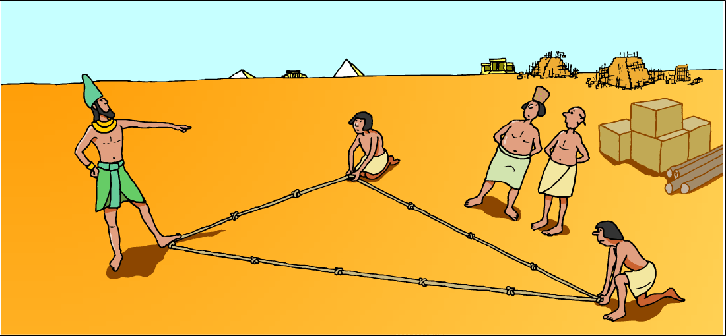
Pythagorean triples
Ancient Egyptians used the fact that a triangle with sides of length 3, 4 and 5 contained a right-angle to mark out field boundaries and for building.

Slide 25
Pythagorean triples
How many of these did you find?
9 + 16 = 25
3² + 4² = 5²
3, 4, 5
36 + 64 = 100
6² + 8² = 10²
6, 8, 10
25 + 144 = 169
5² + 12² = 13²
5, 12, 13
81 + 144 = 225
9² + 12² = 15²
9,12, 15
64 + 225 = 289
8² + 15² = 17²
8, 15, 17
144 + 256 = 400
12² + 16² = 20²
12, 16, 20
The Pythagorean triples 3, 4, 5;
5, 12, 13
and 8, 15 17
are called primitive Pythagorean triples because they are not multiples of another Pythagorean triple.
Notes:
Pupils should notice that the Pythagorean triples that have not been circled are multiples of the the 3, 4, 5 Pythagorean triple.
Tell pupils that a primitive Pythagorean triple is a Pythagorean triple that is not a multiple of another Pythagorean triple.
Ask pupils to explain why any multiple of a Pythagorean triple must be another Pythagorean triple (using similar triangles).

Slide 26


Pythagoras – QUICK METHOD
Decide if the side you are LOOKING FOR is the HYPOTENUSE, or one of the two SHORTER SIDES
Use one of these quick and easy methods to work out what you need
Looking for the LONGEST SIDE?
(the hypotenuse!)
Square it
Square it
Add it
Square root it
Looking for a SHORTER SIDE?
(not the hypotenuse!)
Square it
Square it
Subtract it
Square root it

Slide 27
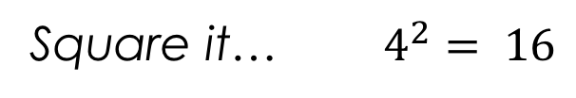
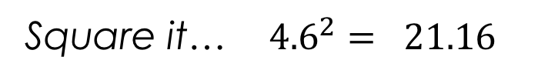
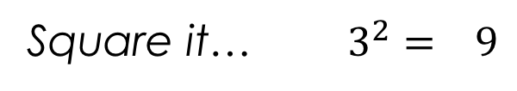
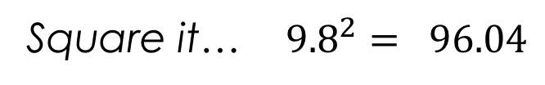
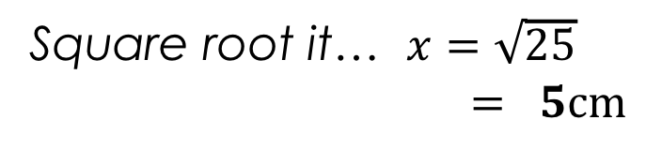
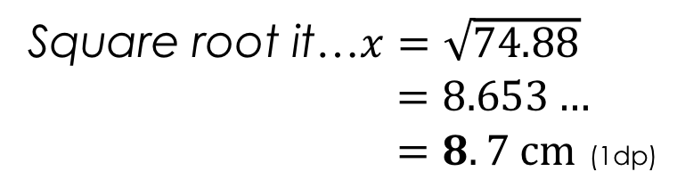




Example – Quick method
1
Square it… $4^{2}= 16$
Square it… $3^{2}= 9$
$$+$$
x
3 cm
Add it… $= 25$
Square root it… $x=\sqrt{25}$
$= 5cm$
4 cm
Square it… ${9.8}^{2}= 96.04$
2
$$−$$
Square it… ${4.6}^{2}= 21.16$
9.8 cm
4.6 cm
Subtract it… $=74.88$
Square root it…$x=\sqrt{74.88}$
$=8.653…$
$=8.7 cm$ (1dp)
y

Slide 28
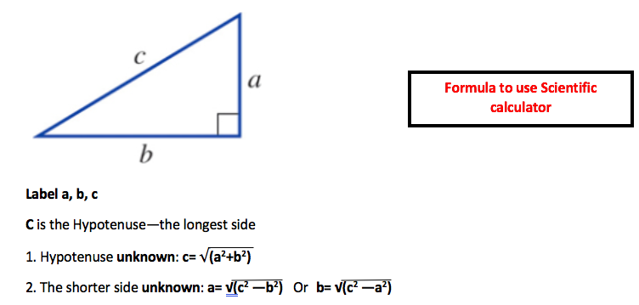




Or simply do it by scientific calculator!
On your calculator:
$$√$$
($a^{2}+b^{2}$)
=
On your calculator:
$$√$$
($c^{2}−b^{2}$)
=

Slide 29
Now it’s time to test your knowledge!
Ex paper
Table of contents

