Slide 1

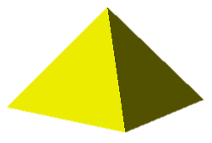
PYTHAGORAS IN 3D
http://www.transum.org/Software/SW/Starter_of_the_day/starter_October30.ASP
L.O. To be able to
Solve problems using Pythagoras’ theorem in 3 dimensions
Key Words
Space Diagonal

Slide 2
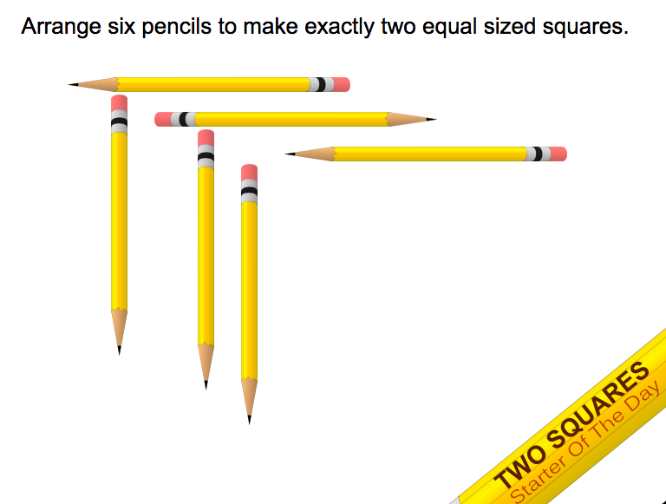

Slide 3
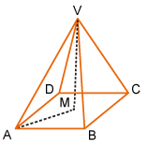
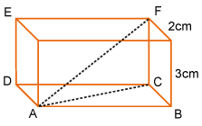
3-Dimensional Figures
12 m
5 m
How would you find the length of segment AV?
Do you see a right triangle inside the shape?
How would you find the length of segment AF?
Do you see the right triangle inside the shape?
Notes:
https://quizizz.com/admin/quiz/627e833da81cb6001d00204f?source=quiz_share
https://quizizz.com/admin/presentation/628e4796c6806b001d343b69?source=lesson_share
https://quizizz.com/admin/quiz/62a76b87473aef001d0eccf6?source=quiz_share

Slide 4



The longest diagonal in a cuboid
Show that the longest diagonal d in a cuboid measuring a by b by c is given by the formula
d = √(a² + b² + c²)
Let’s call the diagonal across the base e.
Using Pythagoras’ Theorem,
e² = a² + b²
d
and
c
d² = e² + c²
So,
e
d² = a² + b² + c²
b
a
d = √(a² + b² + c²)

Slide 5
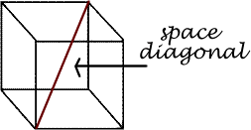
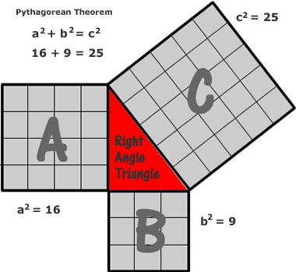

Space Diagonal
The Pythagorean Theorem in 3D

Slide 6
In a rectangular prism, a space diagonal is a line that goes from a vertex of the prism, through the center of the prism to the opposite vertex.
aka, ‘stick in the box’
A rectangular prism has 4 space diagonals.

Slide 7
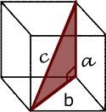
Space Diagonal
The Pythagorean Theorem is useful when we need to find the length of a space diagonal in a rectangular prism.
Side c is the space diagonal.

Slide 8
Look at the rectangular prism below:
It is our task to calculate the length of the space diagonal AG which runs through the space inside the rectangular prism.
H
G
Start by considering the triangle ABC.
E
F
16cm
(2) Calculate the length of AC.
D
C
12cm
C
A
28cm
B
12
A
28
B
AC ≈ 30.5cm
Finding The Length Of A Space Diagonal.

Slide 9
Now look at the box again.
H
G
G
E
16
F
16cm
D
A
C
C
30.5
30.5cm
12cm
A
28cm
B
AG =
AG = 34.4cm
(3) Now consider triangle ACG.
(4) Calculate the length of AG.

Slide 10
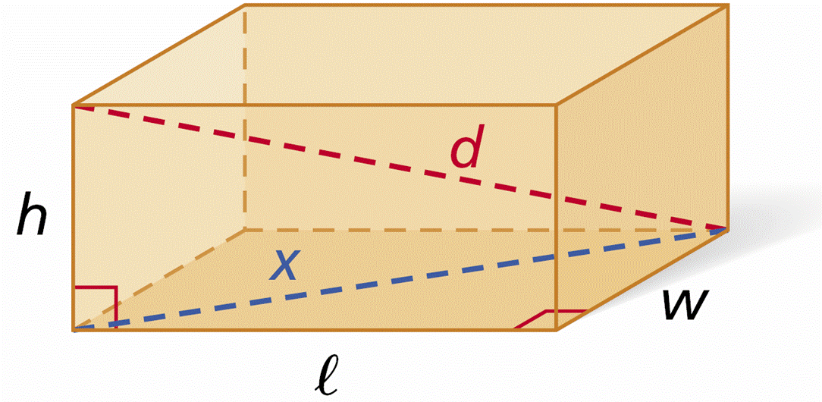
By the Pythagorean Theorem,
l² + w² = x² and x² + h² = d².
Using substitution, d² =l² + w² + h².
A diagonal of a three-dimensional figure connects
two vertices of two different faces.
Diagonal d of a rectangular prism is shown in the diagram.

Slide 11
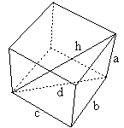
Pythagorean Theorem
2D vs 3D
d
c
b

Slide 12

d² = l² + w² + h².
The Space Diagonal

Slide 13
Space Diagonal
Pythagoras In 3D Shapes.
H
G
E
F
16cm
D
C
12cm
A
28cm
B

Slide 14
What Goes In The Box ?
Calculate the lengths of the space diagonals in
the rectangular prisms below:
(1)
(2)
12m
23cm
3m
17cm
4m
26cm

Slide 15
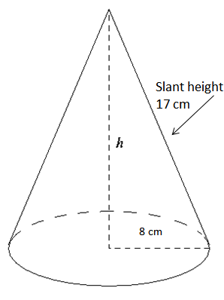
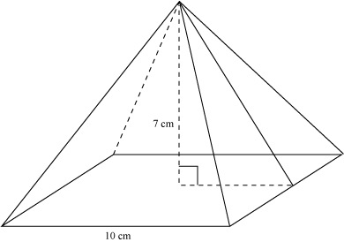
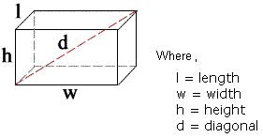
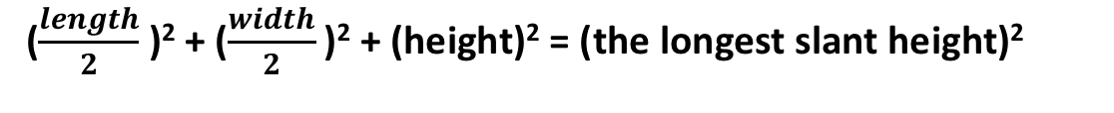
To Find the Space Diagonal of a 3D Prism
3D Figures
To Find the slant height of a cone
(radius)² + (height)² = (slant height)²
To Find the height of a rectangle based pyramid
($\frac{length}{2}$ )² + ($\frac{width}{2}$ )² + (height)² = (the longest slant height)²
(length)² + (width)² + (height)² = (space diagonal of prism)²

Slide 16


Problem solving
My pencil case is in the shape of a cuboid.
It measures 8cm, by 7cm by 5cm.
I want to put my new pencil into the pencil case. The pencil measures 12cm. Does it fit?

Slide 17
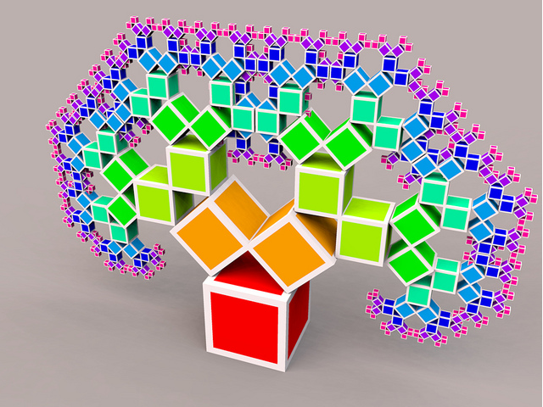
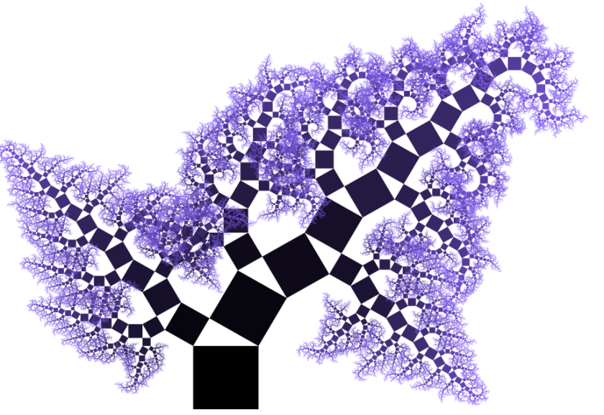
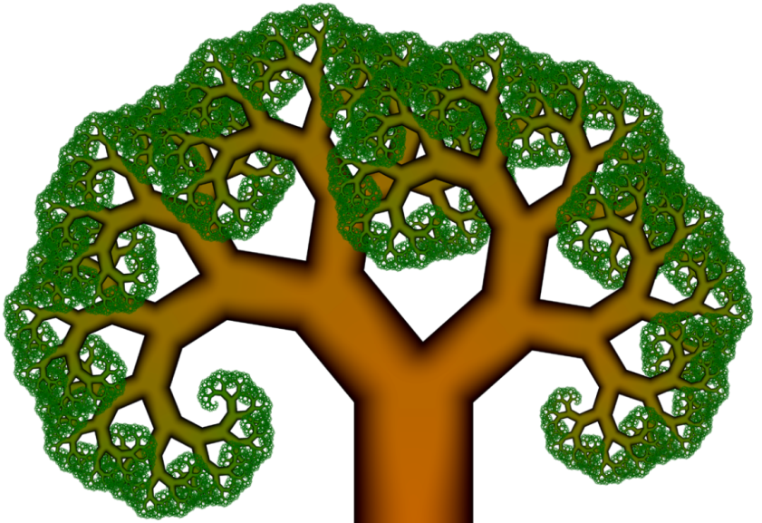

Pythagorean trees! – Do you think you could draw one?!

Slide 18
Ex in book

