Slide 1
Probability
Learning Intention:
What do you know about probability?
Success Criteria:
I can construct a Venn diagram.
I can calculate the probability of an event occurring using a Venn diagram.
Key Words: Probability, Venn diagram, or, and, P(A)
https://www.transum.org/Maths/Activity/Venn/Exercise.asp?Level=1

Slide 2
Notes:
http://www.transum.org/software/SW/Starter_of_the_day/Students/Venn_Diagram.asp

Slide 3
Recap
Event - An event is the situation in which we are interested
Probability- Is the chance of that event happening
Outcome – Is what happens (result of experiment)
Prob (Event ) = Number of ways of event happening
Total possible outcomes
Prob (Not Event) = 1- Prob(Event)

Slide 4
Notation
When working with probability, we can use notation that can help us describe the probability of an event occurring.
P(A) = Probability of Event A
P(A’) = Probability Not A

Slide 5
What is Probability?
1. Numerical measure of the likelihood that event will cccur
P(Event)
P(A)
Prob(A)
2. Lies between 0 & 1
3. Sum of sample points is 1
1
Certain
.5
0
Impossible

Slide 6
Sample Space Examples
Experiment Sample Space
Toss a Coin, Note Face {Head, Tail}
Toss 2 Coins, Note Faces {HH, HT, TH, TT}
Select 1 Card, Note Kind {2♥, 2♠, ..., A♦} (52)
Select 1 Card, Note Color {Red, Black}
Play a Football Game {Win, Lose, Tie}
Inspect a Part, Note Quality {Defective, Good}
Observe Gender {Male, Female}

Slide 7
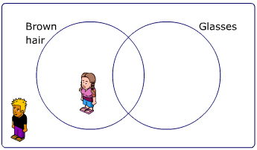
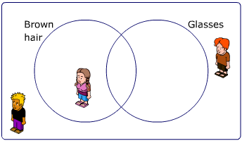
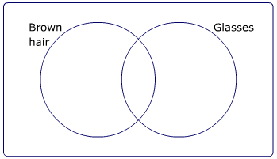
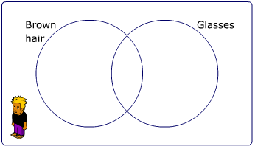
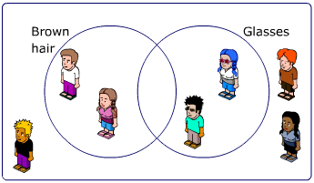
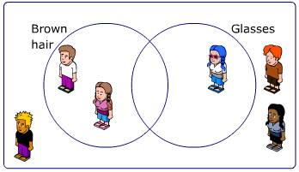
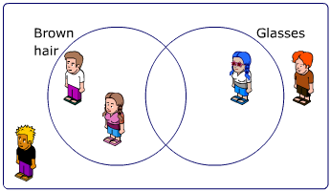
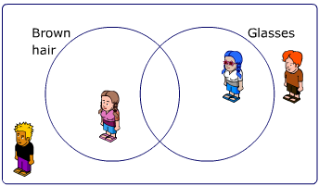
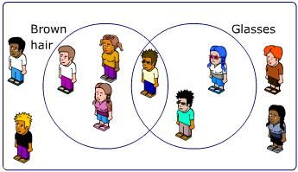
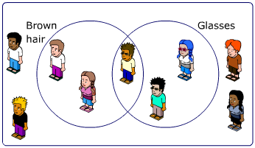
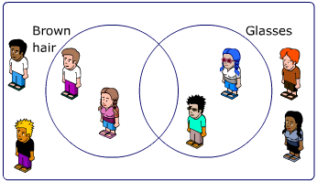
Venn Diagrams
A Venn diagram is used to sort data.
For example, these students below we are going to sort into hair colour and if they wear glasses.

Slide 8
Complementary Events
Complement of Event A
The event that A does not occur
All events not in A
Denote complement of A by A'
A'
A
$$ξ$$

Slide 9
Rule of Complements
The sum of the probabilities of complementary events equals 1:
P(A) + P(A') = 1
A'
A
$$ξ$$

Slide 10
Complement of Event Example
Experiment: Draw 1 Card. Note Color.
Black
Sample Space: 2♥, 2♦, 2♣, ..., A♠
$$ξ$$
Event Black: 2♣, 2♠, ..., A♠
Complement of Event Black, Black': 2♥, 2♦, ..., A♥, A♦

Slide 11
Mutually Exclusive
If A and B are Mutually exclusive then either :
A can happen or
B can happen,
but both can not happen at the same time
If A and B are not Mutually exclusive then they can both happen at the same time

Slide 12
Mutually Exclusive Events
Mutually Exclusive Events
Events do not occur simultaneously
A ∩ Β does not contain any sample points
♠
♠

Slide 13
Mutually Exclusive Events Example
Experiment: Draw 1 Card. Note Kind & Suit.
♥
Outcomes in Event Heart: 2♥, 3♥, 4♥ , ..., A♥
Sample Space: 2♥, 2♦, 2♣, ..., A♠
♠
$$ξ$$
Event Spade: 2♠, 3♠, 4♠, ..., A♠
Events ♠ and♥ are Mutually Exclusive
Notes:
Mutually Exclusive
What is the intersection of mutually exclusive events?
The null set.

Slide 14
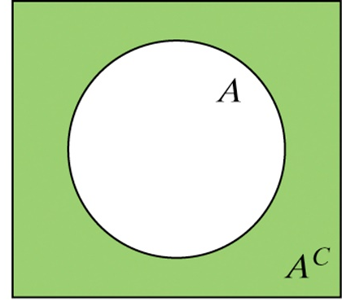
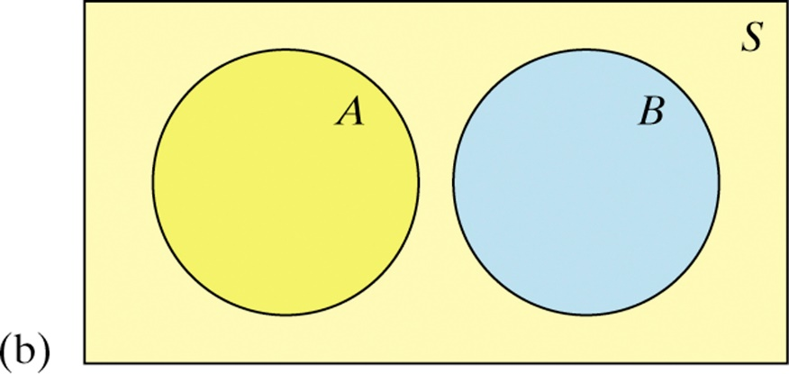
Probability Rules
Venn Diagrams and Probability
Because Venn diagrams have uses in other branches of mathematics, some standard vocabulary and notation have been developed.
The complement A’ contains exactly the outcomes that are not in A.
A’
A
The events A and B are mutually exclusive (disjoint) because they do not overlap. That is, they have no outcomes in common.
$$ξ$$

Slide 15
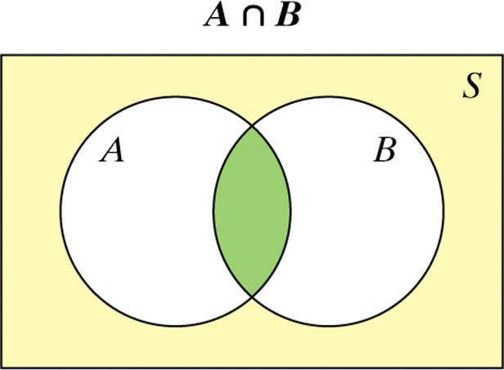
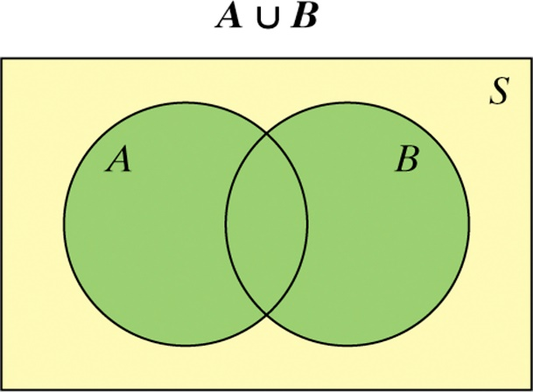
Probability Rules
Venn Diagrams and Probability
The intersection of events A and B (A ∩ B) is the set of all outcomes in both events A and B.
$$ξ$$
The union of events A and B (A ∪ B) is the set of all outcomes in either event A or B.
$$ξ$$
Hint: To keep the symbols straight, remember ∪ for union and ∩ for intersection.

Slide 16
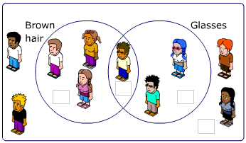
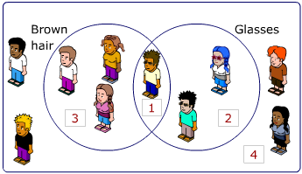
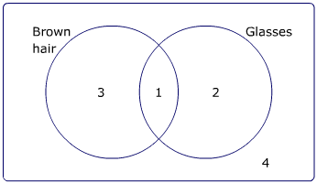
Venn Diagrams
This is the universal set symbol.
It represents all the data.
Rather than drawing pictures, we tend to write numbers to represent each event. So,
$$ξ$$
becomes
becomes
Notice how we have to include how many are NOT in either of the circles.

Slide 17
Using a Venn Diagram
We can use a Venn diagram to calculate a probability.
How many children are there altogether?
$\frac{4}{10}$ = $\frac{2}{5}$
P(brown hair) =
3 + 1 + 2 + 4 = 10
$$\frac{3}{10}$$
How many children have brown hair?
P(wears glasses) =
3 + 1 = 4
= $\frac{1}{10}$
How many children wear glasses?
P(brown hair and wears glasses)
1 + 2 = 3
How many children have brown hair and wear glasses?
P(not brown hair and doesn’t wear glasses) =
$\frac{4}{10}$ = $\frac{2}{5}$
1
How many children don’t have brown hair and don’t wear glasses?
4

Slide 18
Example
A card is selected at random from a pack of 52 playing cards. Let A be the event that the card is and ace and D the event that the card is a diamond. Find:
a) P(A and D)
b) P(A or D)
c) P(A’)
d) P(A’ and D)
There are 13 diamonds of which 1 is an Ace
There are 4 aces of which 1 is a diamond
There are 52 playing cards, 52 – (3 + 1 + 12) = 36 left
$$ξ$$
A
D
3
1
12
36

Slide 19
Example
A card is selected at random from a pack of 52 playing cards. Let A be the event that the card is and ace and D the event that the card is a diamond. Find:
a) P(A and D)
b) P(A or D)
c) P(A’)
d) P(A’ and D)
$$\frac{1}{52}$$
This is the middle of the Venn diagram:
This is the either an ace or a diamond, not forgetting both:
$$\frac{3+1+12}{52}$$
= $\frac{16}{52}$
$$ξ$$
A
D
3
1
12
36

Slide 20
Example
A card is selected at random from a pack of 52 playing cards. Let A be the event that the card is and ace and D the event that the card is a diamond. Find:
a) P(A and D)
b) P(A or D)
c) P(A’)
d) P(A’ and D)
$$\frac{12+36}{52}$$
= $\frac{48}{52}$
This is the everything that does not involve A:
= $\frac{12}{52}$
This is not an ace but is a diamond (can’t include the middle):
$$ξ$$
A
D
3
1
12
36

Slide 21
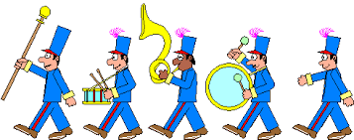
Example
In a class of 30 students, 7 are in the choir, 5 are in the school band and 2 students are in the choir and the band. A student is chosen at random from the class. Find the probability that:
a) The student is not in the band.
b) The student is not in the choir nor in the band.
There are 2 students who are in both
There are 5 in the school band but we already have 2 so 5 – 2 = 3
There are 7 in the choir but we already have 2 so 7 – 2 = 5
$$ξ$$
B
C
There are 30 students overall but we already have 3 + 2 + 5 = 10 so
30 – 10 = 20 that are in neither.
3
2
5
20

Slide 22
Example
In a class of 30 students, 7 are in the choir, 5 are in the school band and 2 students are in the choir and the band. A student is chosen at random from the class. Find the probability that:
a) The student is not in the band.
b) The student is not in the choir nor in the band.
This is everything that doesn’t involve the band:
$$\frac{5+20}{30}$$
= $\frac{25}{30}$
= $\frac{20}{30}$
$$ξ$$
This can’t be in the band or the choir:
B
C
3
2
5
20

Slide 23
Example
A vet surveys 100 of her clients. She finds that:
25 own dogs 15 own cats and dogs 11 own dogs and tropical fish
53 own cats 10 own cats and tropical fish 7 own dogs, cats and tropical fish
40 own tropical fish
A client is chosen at random, find the probability that the client:
a) Owns dogs only.
b) Does not own tropical fish.
c) Does not own dogs, cats or tropical fish.
11 – 7 = 4
25-(8+7+4)=6
15 – 7 = 8
53-(8+7+3)=35
40–(4+7+3)= 26
10 – 7 = 3
$$ξ$$
D
C
Don’t forget to complete the full set:
6+8+35+4+7+3+26 = 89
100 – 89 = 11
8
6
35
7
4
3
NOTE: With questions like this where there are multiple , categories START WITH THE SECTION WHERE ALL SECTIONS OVERLAP (the yellow section) and WORK BACKWARDS
26
F
11

Slide 24
Example
A vet surveys 100 of her clients. She finds that:
25 own dogs 15 own cats and dogs 11 own dogs and tropical fish
53 own cats 10 own cats and tropical fish 7 own dogs, cats and tropical fish
40 own tropical fish
A client is chosen at random, find the probability that the client:
a) Owns dogs only.
b) Does not own tropical fish.
c) Does not own dogs, cats or tropical fish.
$$ξ$$
D
C
= $\frac{6}{100}$
8
Can’t involve fish or cats:
6
35
7
But could still be a cat or a dog or nothing:
4
3
= $\frac{6+8+35+11}{100}$
26
F
11
= $\frac{11}{100}$
= $\frac{60}{100}$

Slide 25
Problem Solving
At Newton School there are 27 students in class 10 1b.
17 students play tennis, 11 play basketball and 2 play neither game. How many students play both tennis and basketball?
$$ξ$$
As 2 is on the outside, there are 25 left for the circles.
T
B
But 17 and 11 can’t go straight in to the circles as there is the intersection.
Tennis + ? + Basket = 25
2
17 + 0 + 11
Does not equal 25
16 + 1 + 10
Does not equal 25
15 + 2 + 9
Does not equal 25
14 + 3 + 8
Equals 25
So students that play both is 3.

Slide 26
Problem Solving
At Newton School there are 27 students in class 10 1b.
17 students play tennis, 11 play basketball and 2 play neither game. How many students play both tennis and basketball?
$$ξ$$
As 2 is on the outside, there are 25 left for the circles.
T
B
Alternatively, lets call the intersection $x$.
17 – $x$
$$x$$
11 – $x$
So tennis is left with 17 – $x$
And basketball is left with 11 – $x$
2
We know that all three parts of the circles add to 25
So 17 – $x$ + $x$ + 11 – $x$ = 25
Simplifying the LHS:
28 – $x$ = 25
So students that play both, $x$, is 3.

Slide 27
Reflection
Write at least once sentence summarising which of the learning intentions you have made progress with in today’s lesson.
Success Criteria:
I can construct a Venn diagram.
I can calculate the probability of an event occurring using a Venn diagram.

Slide 28
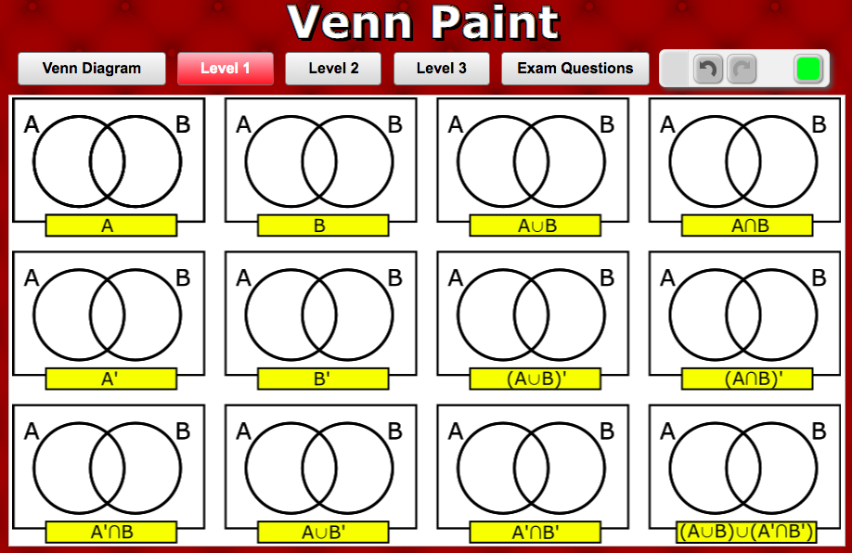
Notes:
http://www.transum.org/Maths/Activity/Venn/?Level=1

Slide 29
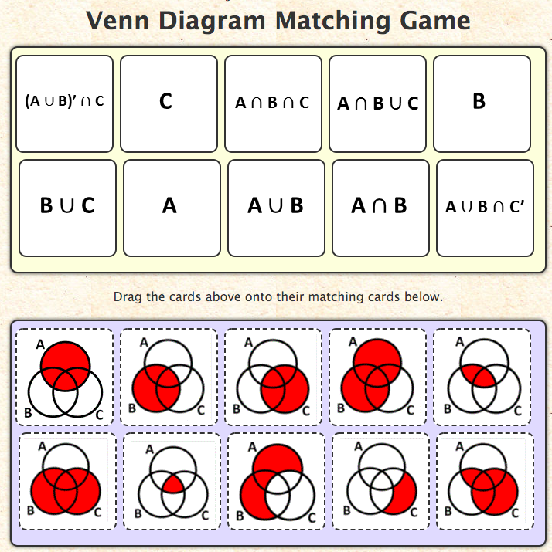
Notes:
http://www.transum.org/software/SW/Starter_of_the_day/Students/Venn_Diagram_Matching.asp

