Slide 1
Starter
The make up of a police station is shown in the two-way table below.
How many female Inspectors are there?
What percentage of the police station are Sergeants?
A police officer is selected at random. What is the probability they are either a male Chief Inspector or a female Sergeant?
 | Male | Female | TOTAL
Constable | 56 | 23 | 79
Sergeant | 8 | 5 | 13
Inspector | 2 | 4 | 6
Chief Inspector | 1 | 1 | 2
TOTAL | 67 | 33 | 100

Slide 2
Two-Way Tables
Two-way tables are a neat way of displaying two sets of data for the same population
They show the frequency of the two categories

Slide 3
Two-Way Tables
In a recent survey of soap viewing habits, a total of 47 people watched Oppenheimer, of which 12 were men. 29 women watched Barbie and 16 women watched John Wick: Chapter 4. Of the 25 men surveyed, 3 watched John Wick: Chapter 4.
Draw and complete a two way table to show the data.
 | EASTENDERS | CORONATION STREET | EMMERDALE | TOTAL
BOYS | 12 | 10 | 3 | 25
GIRLS | 35 | 29 | 16 | 80
TOTAL | 47 | 39 | 19 | 105
 |  | CORONATION STREET |  | TOTAL
BOYS | 12 |  | 3 | 25
GIRLS |  | 29 | 16
TOTAL | 47

Slide 4
Two-Way Tables
Some college students were asked to choose which of the three subjects, English, maths or science they enjoyed most. Complete the two-table below.
 | English | Maths | Sci | Total
Girls | 20 | 13 |  | 50
Boys |  | 15
Total | 38 |  | 40
17
Completing 3
18
23
56
28
106

Slide 5
Two-Way Tables
Complete the questions on the sheet
Stick it into your workbooks

Slide 6
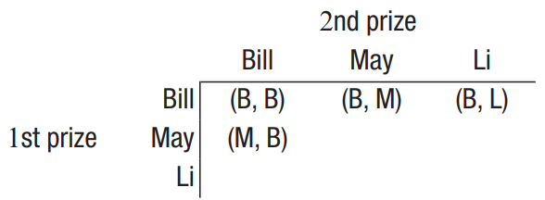
Two prizes, three people
Two special prizes are to be awarded in some way to Bill, May and Li for their efforts in helping at the school fete. This table shows how the prizes might be awarded.
Complete the table to show how the two prizes can be awarded.
Does the table show that the same person can be awarded both prizes?
What is the probability that Bill and Li are both awarded a prize?
How would the table change if the same person could not be awarded both prizes?
How do the words ‘with replacement’ and ‘without replacement’ relate to the situation above? Discuss.

Slide 7
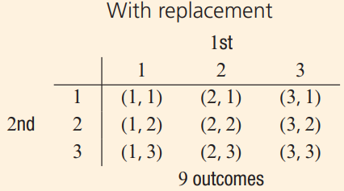
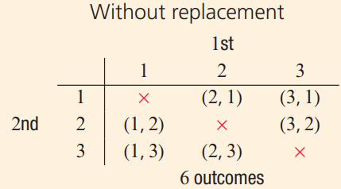
Two-step experiment
A two-step experiment involves two stages of an experiment eg. tossing a coin twice.
Tables are used to list the sample space for two-step experiments.
If replacement is allowed, then outcomes from each selection can be repeated, and such experiments are called with replacement.
If selections are made without replacement, then outcomes from each selection cannot be repeated.
For example, two selections are made from the digits {1, 2, 3}.

