Slide 1
Displaying Frequency

Slide 2
Definition
A frequency table is a table that lists each item in a data set with the number of times the item occurs.

Slide 3
Where Does the Information Come From?
A question is asked.
What kind of ice cream does
everyone like in our class?
A survey is made
The results are recorded

Slide 4
Make a tally mark for every flavor named
The number of tally marks in each row is the frequency
Favorite Ice Cream Flavor
FLAVOR | TALLY | FREQUENCY
Chocolate | | | | | | | 6
Vanilla | | | | | 3
Strawberry | | | | | | 5
Mint & Chip | | | | | | | | 7
Rocky Road | | | | 2

Slide 5
Definition
A line plot is a graph that displays the data by stacking X’s above each data value on a number line.

Slide 6
Making a Line Plot
Suppose thirty people live in an apartment building. These are the following ages:
58, 30, 37, 36, 34, 49, 35, 40, 47, 47, 39, 54, 47, 48, 54, 50, 35, 40, 38, 47, 48, 34, 40, 46, 49, 47, 35, 48, 47, 46
Your first step should be: placing the values in numerical order.
30, 34, 34, 35, 35, 35, 36, 37, 38, 39, 40, 40, 40, 46, 46, 47, 47, 47, 47, 47, 47, 48, 48, 48, 49, 49, 50, 54, 54, 58

Slide 7
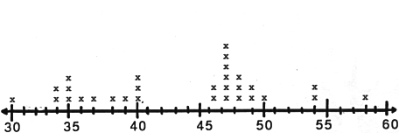
Now create your graph.
This graph shows all the ages of the people who live in the apartment building. It shows the youngest person is 30, and the oldest is 58. Most people in the building are over 46 years of age. The most common age is 47.

Slide 8
Histogram
Histogram is a bar graph that shows the frequency of data within equal intervals.
There is no space in between the bars.

Slide 9
How to make a histogram?

Slide 10
The table below shows the number of hours students watch TV in one week Make a histogram of all the data.
Number of hours of TV
III | 6 | II | 1
IIII - IIII | 7 | IIII | 2
III | 8 | IIII - IIII | 3
IIII | 9 | IIII - I | 4
 |  | IIII - III | 5

Slide 11
Step 1
Make a frequency table of the data. Be sure to use equal intervals
Frequency | Number of hours of TV
15 | 1-3
17 | 4-6
16 | 7-9
Number of hours of TV
III | 6 | II | 1
IIII - IIII | 7 | IIII | 2
III | 8 | IIII - IIII | 3
IIII | 9 | IIII - I | 4
 |  | IIII - III | 5

Slide 12
Step 2
Choose an appropriate scale and interval for the vertical axis. The greatest value on the scale should be at least as great as the greatest frequency.
Frequency | Number of hours of TV
15 | 1-3
17 | 4-6
16 | 7-9

Slide 13
Step 3
Draw a bar for each interval. The height of the bar is the frequency for that interval. Bars must touch but not overlap.
Label the axes and give the graph title
Frequency | Number of hours of TV
15 | 1-3
17 | 4-6
16 | 7-9

Slide 15
Can you now make a histogram?

Slide 16
Use these steps
Decide on an appropriate interval.
Make a frequency table.
Draw a bar for each interval. (bars must touch)
Label the axes.
Add a title for your graph.

Slide 17
The list below shows the results of a typing test in words per minute. Make a histogram of the data.
62, 55, 68, 47, 50, 41, 62, 39, 54, 70, 56, 70, 56, 47, 64, 55, 60, 42

Slide 18
Check your work
Frequency Table
3 | III | 39-46
4 | IIII | 47-54
7 | IIII II | 55-62
4 | IIII | 63-70

Slide 19
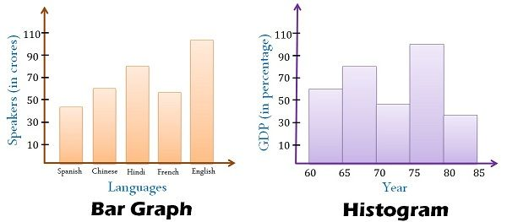
Difference between Column Graph (Bar Chart) & Histogram

