Slide 1

Statistics
Chapter 5
Notes:
https://dashboard.blooket.com/set/6065480b61a6bd0022a75712
https://dashboard.blooket.com/set/6086c926f3bdbf001d254563
https://dashboard.blooket.com/set/60899208adcf58001b136448

Slide 2
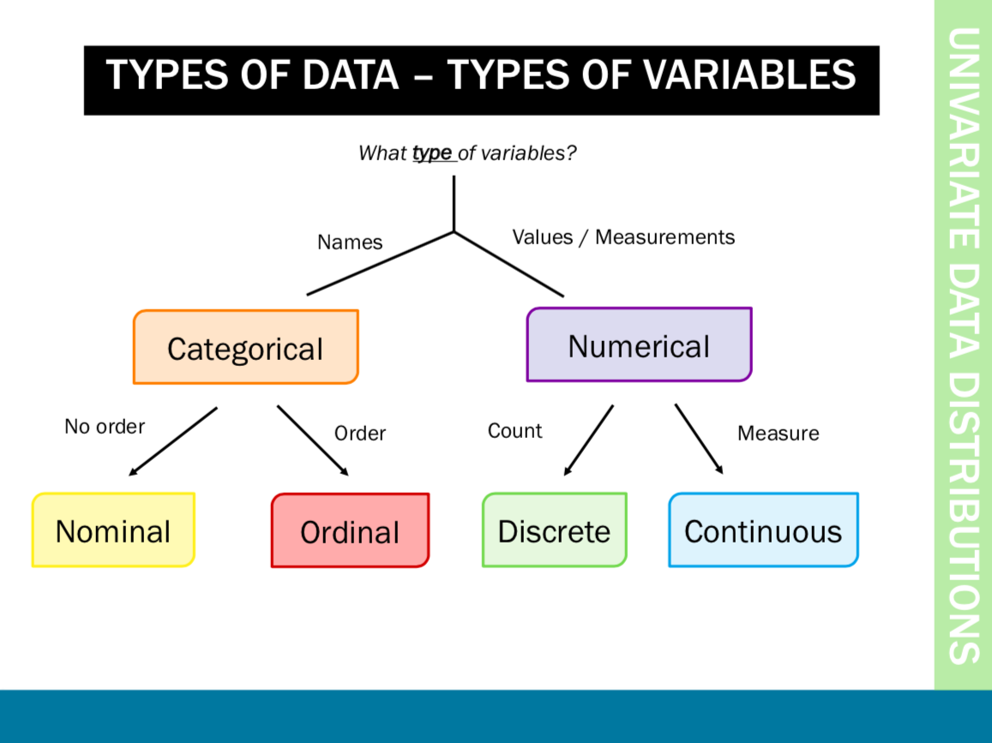

Slide 3
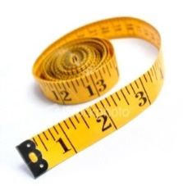

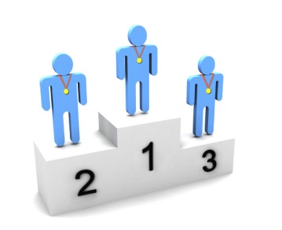



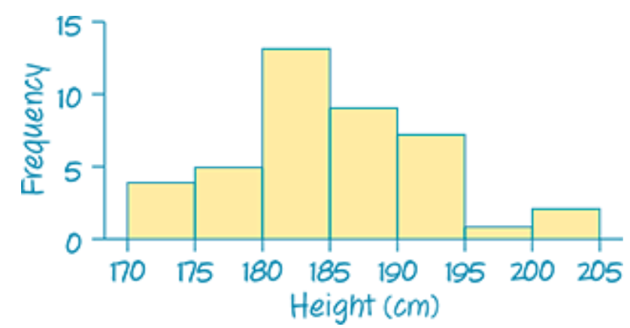
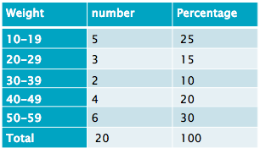
Data types
Variables
Numerical
Categorical
Continuous
Measurements
takes any value
Discrete:
Counts/ integers
Ordinal:
obvious order
Nominal:
no meaningful order
Notes:
Categorical variables can be divided into two: ordinal and nominal. If the categories are meaningfully ordered, the variable is ordinal; if it doesn’t matter in which way the categories are ordered, then the variable is nominal. For example, satisfaction levels (dissatisfied, satisfied and highly satisfied) and education level (secondary, sixth form, undergraduate and postgraduate) are ordinal variables; Student’s religion (Christian, Muslim, Hindu, etc) and favourite animal are nominal variables.
Numerical variables appear as meaningful comparable numbers, such as blood pressure, height, weight, income, age, and probability of illness etc. Numerical variables can be further divided into two subtypes: continuous and discrete. The continuous variables can take any value within a range and are the most common, e.g. body weight, height, income, etc. Discrete variables can only take whole numbers, such as number of students in class, number of new patients every day, etc but are treated as continuous for statistical analysis if there are a large range of numbers.
One point to make is that if ordinal data is scored as ranks such as 1, 2, 3 etc., and then this data is analysed as scale data, then a rather strong assumption is being made that the distances between the value of any pair of neighbouring ranks (e.g. 1 and 2 or 2 and 3 etc.) is the same, which is unlikely in practice to be true. Students often find the difference between ordinal and discrete difficult especially when ordinal is categorised as numbers
The point is that whilst this might not be the most interesting place to start – students need to be aware of the data they have since this affects what analyses are/not suitable.

Slide 4
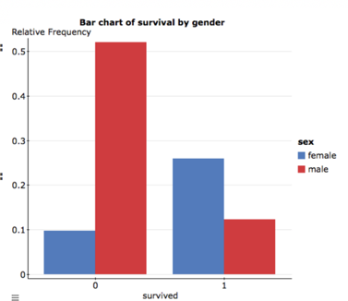
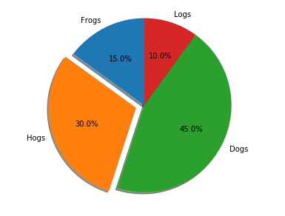
Categorical Data- Use Bar Graph/Pie Chart to represent

Slide 5
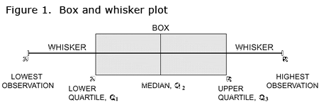
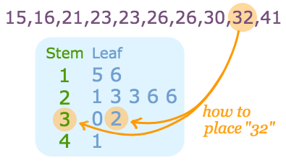
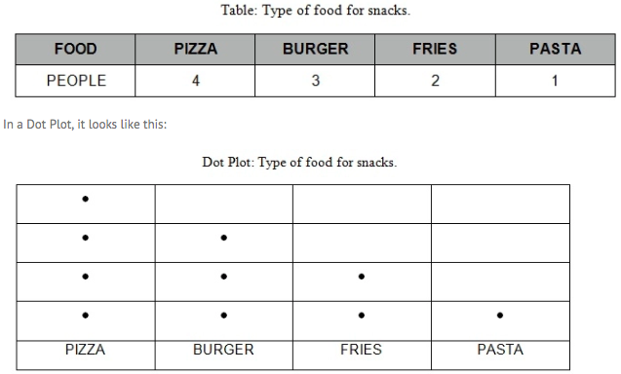
Numerical Data- Includes Discrete Data & Continuous Data
Discrete Data—Use Box-and –Whisker Plot / Stem-and-Leaf plot / Dot Plot

Slide 6
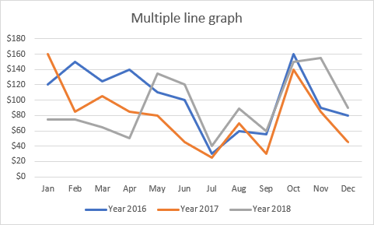
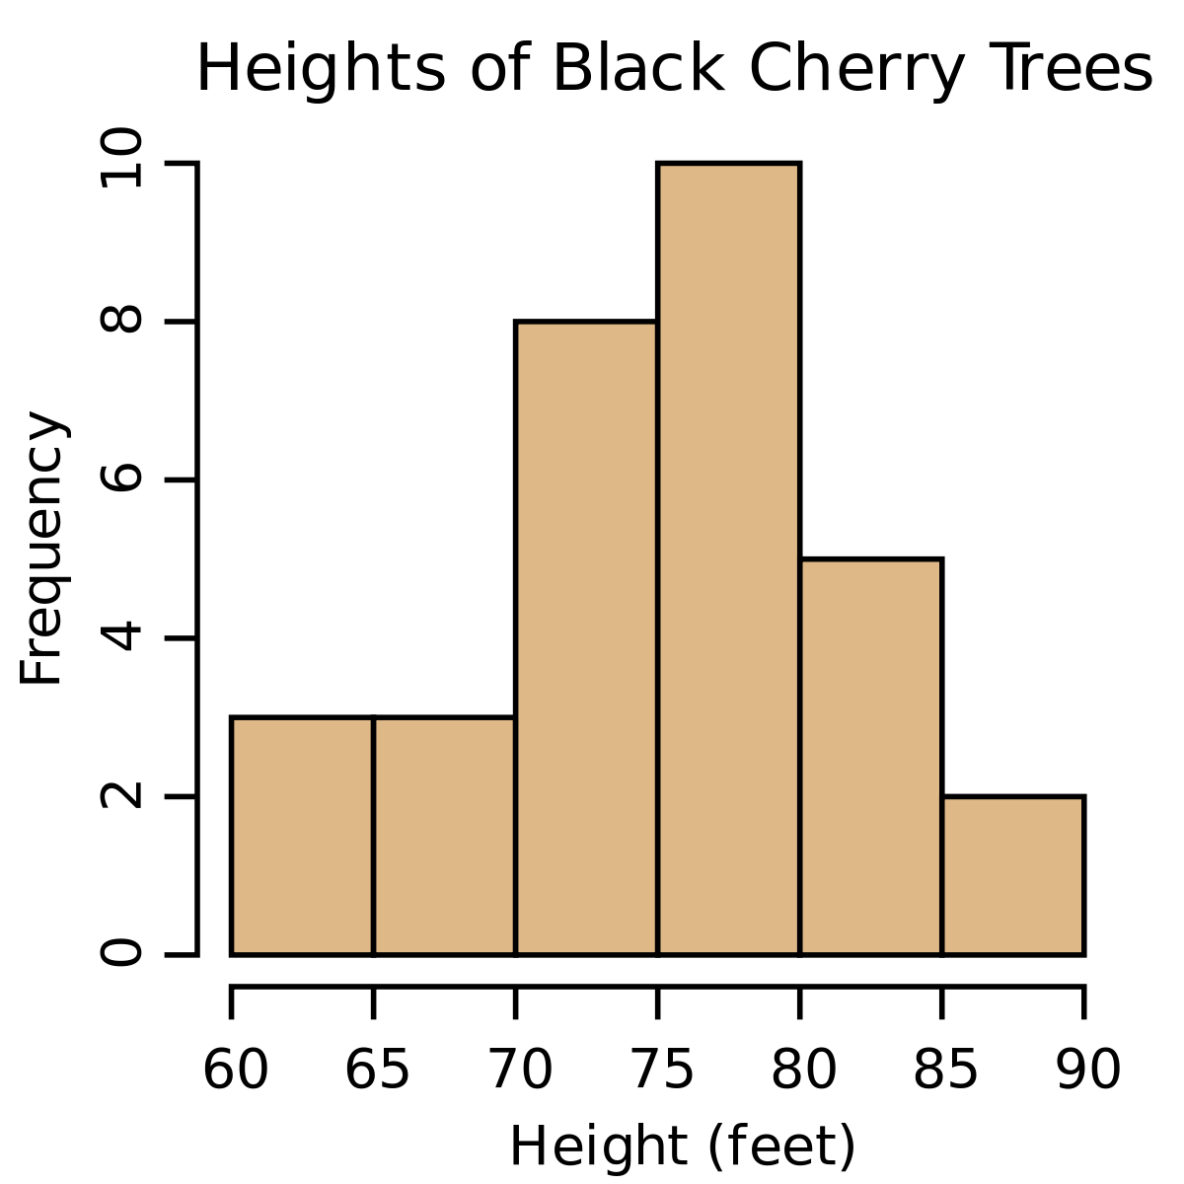
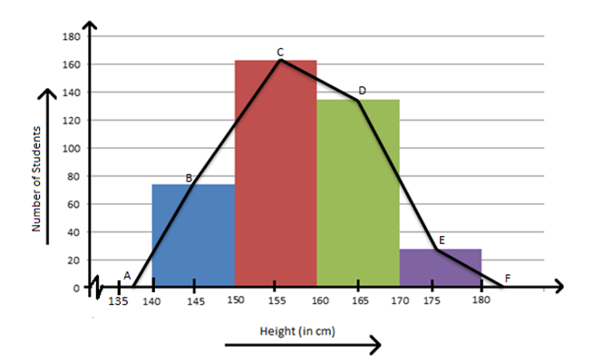
Numerical Data-
Includes Discrete Data & Continuous Data
Continuous Data—Use Histogram/Frequency Polygon/ Line Graph:

Slide 7
Definition
A frequency table is a table that lists each item in a data set with the number of times the item occurs.

Slide 8
Make a tally mark for every flavor named
The number of tally marks in each row is the frequency
Favorite Ice Cream Flavor
FLAVOR | TALLY | FREQUENCY | PERCENTAGE
Chocolate | | | | | | | 6 | 26.09%
Vanilla | | | | | 3 | 13.04%
Strawberry | | | | | | 5 | 21.74%
Mint & Chip | | | | | | | | 7 | 30.43%
Rocky Road | | | | 2 | 8.70%
Total | 23 | 23 | 100%

Slide 9
Definition
A line plot is a graph that displays the data by stacking X’s above each data value on a number line.

Slide 10
Making a Line Plot
Suppose thirty people live in an apartment building. These are the following ages:
58, 30, 37, 36, 34, 49, 35, 40, 47, 47, 39, 54, 47, 48, 54, 50, 35, 40, 38, 47, 48, 34, 40, 46, 49, 47, 35, 48, 47, 46
Your first step should be: placing the values in numerical order.
30, 34, 34, 35, 35, 35, 36, 37, 38, 39, 40, 40, 40, 46, 46, 47, 47, 47, 47, 47, 47, 48, 48, 48, 49, 49, 50, 54, 54, 58

Slide 11
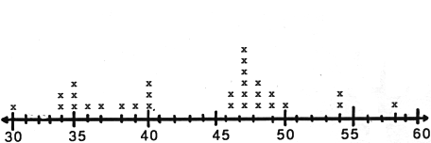
Now create your graph.
This graph shows all the ages of the people who live in the apartment building. It shows the youngest person is 30, and the oldest is 58. Most people in the building are over 46 years of age. The most common age is 47.

Slide 12
How to make a histogram?

Slide 13
The table below shows the number of hours students watch TV in one week Make a histogram of all the data.
Number of hours of TV
III | 6 | II | 1
IIII - IIII | 7 | IIII | 2
III | 8 | IIII - IIII | 3
IIII | 9 | IIII - I | 4
 |  | IIII - III | 5

Slide 14
Step 1
Make a frequency table of the data. Be sure to use equal intervals
Frequency | Number of hours of TV
15 | 1-3
17 | 4-6
16 | 7-9
Number of hours of TV
III | 6 | II | 1
IIII - IIII | 7 | IIII | 2
III | 8 | IIII - IIII | 3
IIII | 9 | IIII - I | 4
 |  | IIII - III | 5

Slide 15
Step 2
Choose an appropriate scale and interval for the vertical axis. The greatest value on the scale should be at least as great as the greatest frequency.
Frequency | Number of hours of TV
15 | 1-3
17 | 4-6
16 | 7-9

Slide 16
Step 3
Draw a bar for each interval. The height of the bar is the frequency for that interval. Bars must touch but not overlap.
Label the axes and give the graph title
Frequency | Number of hours of TV
15 | 1-3
17 | 4-6
16 | 7-9

Slide 17
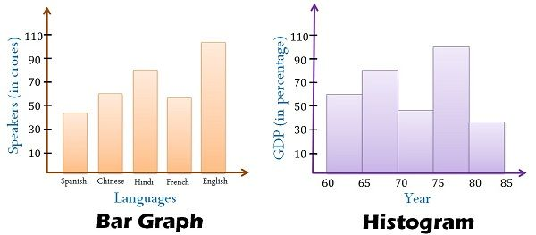
Difference between Column Graph (Bar Chart) & Histogram

Slide 18
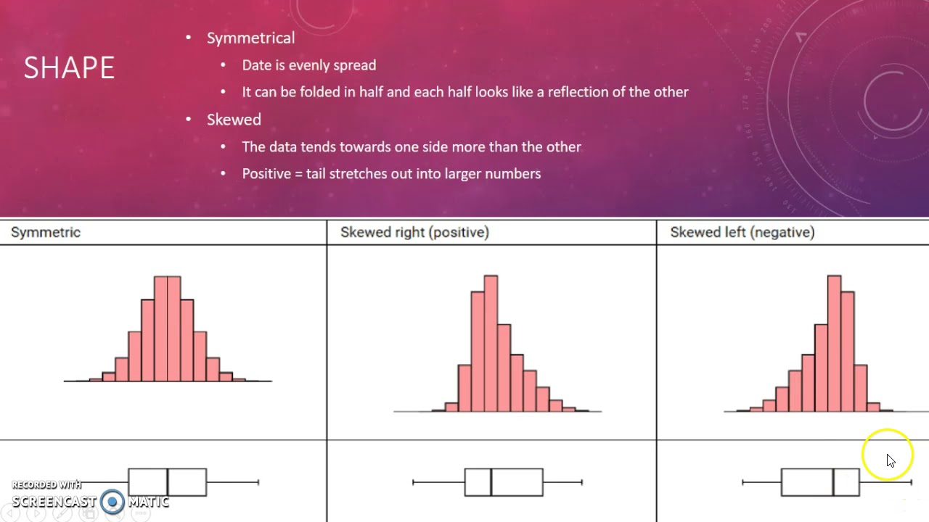

Slide 19
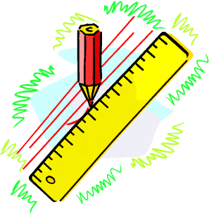
Stem Leaf Graphs
Construction of Stem and Leaf
A Stem – Leaf graph is another way of displaying information :
Ages
This stem and leaf graph shows
the ages of people waiting in a
queue at a post office
2
4
6
8
3
0
1
3
4
4
4
5
6
7
9
How many people in the queue?
20
5
0
3
4
9
6
1
4
5
6
How many people in their forties?
6
stem
leaves
n = 20 Key : 2 4 means 24

Slide 20

Stem Leaf Graphs
We can now answer various questions about the data.
Construction of Stem and Leaf
Example : Construct a stem and leaf graph for the following
weights in (kgs) :
Weight (kgs)
1
2
2
3
5
5
12 | 12 | 13 | 15 | 15
21 | 23 | 29 | 32 | 32
40 | 40 | 41 | 41 | 51
54 | 55 | 55 | 55 | 57
12 | 40 | 57 | 54 | 55
13 | 55 | 15 | 32 | 55
32 | 15 | 41 | 21 | 40
23 | 41 | 29 | 51 | 12
2
1
3
9
3
2
2
4
0
0
1
1
5
1
4
5
5
5
7
stem
leaves
n = 20 Key : 2 3 means 23

Slide 21
Stem Leaf Graphs
Back to Back Stem – Leaf Graphs
Rugby Team 1
Heights
Rugby Team 2
Heights
A back to back stem-leaf
helps us to compare two
sets of data.
4
2
1
14
0
2
6
7
8
7
6
15
3
4
8
5
0
16
0
1
6
Write down a question that can be answered easily from the graph.
6
4
3
3
1
17
1
6
7
0
18
1
4
4
n = 15
n = 15
14 | 1 represents 141cm

Slide 22
Mode
The most frequently occurring value in a data set
Applicable to all levels of data measurement (nominal, ordinal, discrete, and continuous)
The mode or modal category: the most frequently occurring category.
In a bar chart, this is given by the category with the tallest bar.

Slide 23
Mean
Is the average of a group of numbers
Applicable for discrete and continuous data, not applicable for nominal or ordinal data
Computed by summing all values in the data set and dividing the sum by the number of values in the data set

Slide 24
Median
Middle value in an ordered array of numbers.
Applicable for ordinal, discrete, and continuous data
Not applicable for nominal data

Slide 25
Median
Median (middle value)
Example Find the median for the data.
2, 4, 5, 5, 6, 7, 7, 7, 8, 9, 10
7
Median=
2
4
5
5
6
7
7
7
8
9
10

Slide 26
Median
Median (middle value)
Example Find the five figure summary for the data.
2, 4, 5, 5, 6, 7, 7, 8, 9, 10
Median =
6.5
2
4
5
5
6
7
7
8
9
10

Slide 27
Range
The difference between the largest and the smallest values in a set of data
Ignores all data points
except the
two extremes
Example: Range = Largest - Smallest = 48 - 35 = 13
35
41
44
45
37
41
44
46
37
43
44
46
39
43
44
46
40
43
44
46
40
43
45
48

Slide 28
Quartiles
Measures of central tendency that divide a group of data into four subgroups
Q₁: 25% of the data set is below the first quartile
Q₂: 50% of the data set is below the second quartile
Q₃: 75% of the data set is below the third quartile

Slide 29
Quartiles
Q₁
Q₂
Q₃
25%
25%
25%
25%

Slide 30
Interquartile Range
Range of values between the first and third quartiles
Range of the “middle half”
Less influenced by extremes

Slide 31
Five Figure Summary
When a set of numbers are put in ORDER,
it can be summarised by quoting five figures.
1. The highest number (H)
2. The lowest number (L)
3. The median, the number that halves the list (Q₂)
4. The upper quartile, the median of the upper half (Q₃)
5. The lower quartile, the median of the lower half (Q₁)

Slide 32
Five Figure Summary
Q₂ = Median (middle value)
Q₃ = upper middle value
Q₁ = lower middle value
Example Find the five figure summary for the data.
2, 4, 5, 5, 6, 7, 7, 7, 8, 9, 10
The 11 numbers are already in order !
Q₁ =
5
Q₂ =
7
Q₃ =
8
2
4
5
5
6
7
7
7
8
9
10
L =
2
H =
10

Slide 33
Five Figure Summary
Q₂ = Median (middle value)
Q₁ = lower middle value
Q₃ = upper middle value
Example Find the five figure summary for the data.
2, 4, 5, 5, 6, 7, 7, 8, 9, 10
The 10 numbers are already in order !
Q₁ =
5
Q₂ =
6.5
Q₃ =
8
2
4
5
5
6
7
7
8
9
10
L =
2
H =
10

Slide 34
Five Figure Summary
Q₂ = Median (middle value)
Q₃ = upper middle value
Q₁ = lower middle value
Example Find the five figure summary for the data.
2, 4, 5, 5, 6, 7, 8, 9, 10
The 9 numbers are already in order !
Q₁ =
4.5
Q₂ =
6
Q₃ =
8.5
2
4
5
5
6
7
8
9
10
L =
2
H =
10

Slide 35
Outlier
An outlier is a piece of data that is an abnormal distance from other points. In other words, it’s data that lies outside the other values in the set.

Slide 36
Outlier
An outlier is defined as being any point of data that lies over 1.5 IQRs below the first quartile (Q1) or above the third quartile (Q3)in a data set.
High = (Q3) + 1.5 IQR
Low = (Q1) – 1.5 IQR

Slide 37
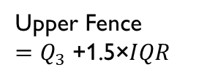

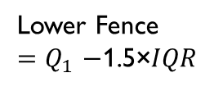


Box and Whisker Plots
Box plots are graphical representations of 5 number summary.
Anatomy of a Box and Whisker Plot
Max
Lowest Value Other than Outliers
Highest Value Other than Outliers
Min
Lowest Value
Highest Value
Lower Quartile
$$Q_{1}$$
$$Q_{2}$$
Upper Quartile
$$Q_{3}$$
.
.
Median
.
Whisker
Whisker
Box
Outliers
Outlier
4
5
6
7
8
9
10
11
12
25% data
25% data
25% data
25% data
Lower Fence
${=Q}_{1}−$1.5×𝐼𝑄𝑅
50% of data is contained in the box.
25% of data is found in each whisker.
Upper Fence
${=Q}_{3}$+1.5×𝐼𝑄𝑅

Slide 38
Box Plot – How to draw by hand
Use the given data
to make a box plot.
31, 23, 33, 35, 26, 24, 31, 29
Order the data from least to greatest.
Find the median (Q2)
  The median divides the data in half.
Find the median of the lower half. This is the 1st Quartile (Q1).
Find the median of the upper half. This is the 3rd Quartile (Q3).
Draw a number line that coordinates with five figures: Xmin, Q1, Q2, Q3, Xmax.
23 24 26 29 31 31 33 35
Median = (29 + 31) ÷ 2 = 30
Q1 = (24 + 26) ÷ 2 = 25
Q3 = (31 + 33) ÷ 2 = 32
_____________________________
22 24 26 28 30 32 36 38

Slide 39
Box Plot – How to draw…
23
30
Place a dot above the line for the lowest number _____, Q1 _____, the median _____, Q3 _____ and the highest number _____.
Draw the box from Q1 to Q3. Add a line in the box for Q2 (the median).
Draw a line from the lowest number to Q1. Draw a line from Q3 to the highest number. Fencing on each side.
Draw any outliers as dots.
Give your Box Plot a title.
25
32
35
22 24 26 28 30 32 34 36 38

Slide 40
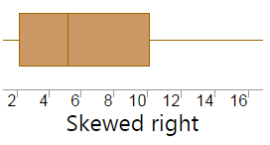
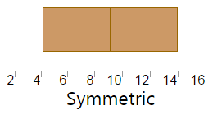
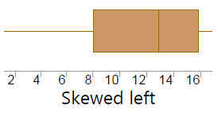
Interpret a Box Plot
Range: This represents the spread of the data. The difference between the highest and lowest value.
Interquartile Range (IQR): The middle half of the data. The data that is in the box. The difference between Q3 and Q1.
Shape:
Positively Skewed
Symmetrical
Negatively Skewed

Slide 41
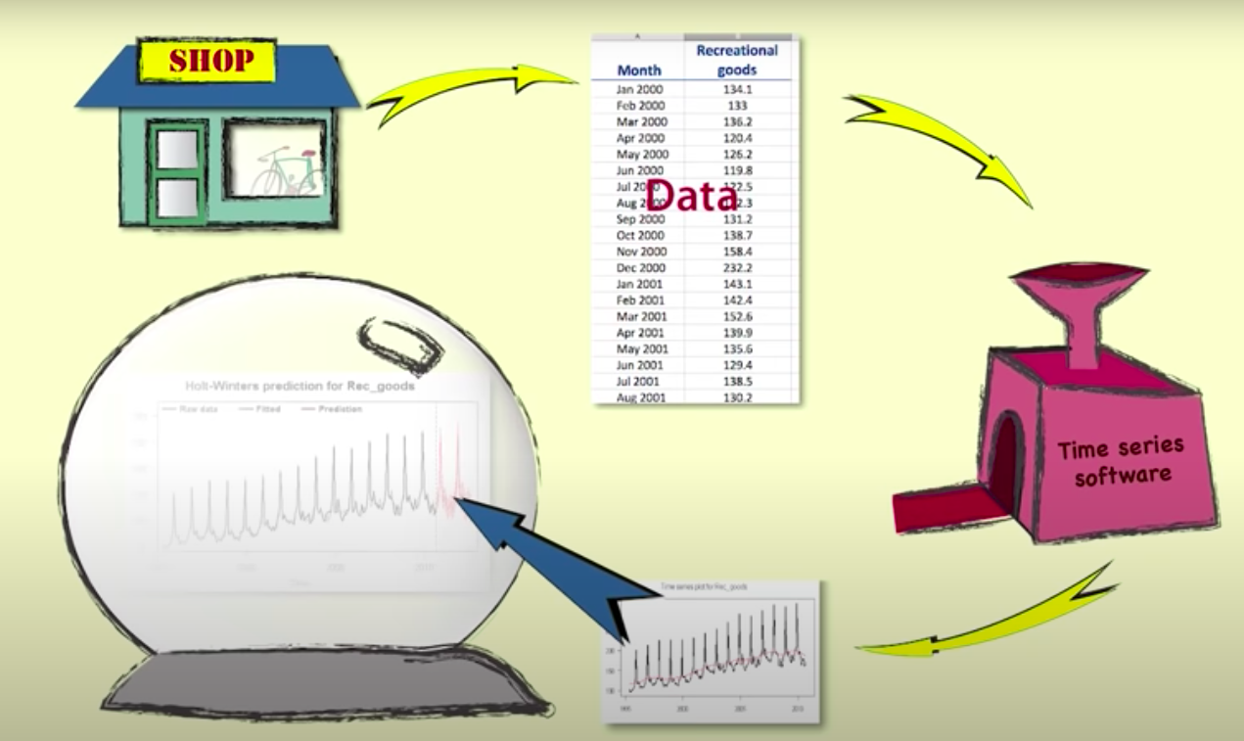
Time Series
Time series data is a sequence of data values that are recorded at regular time intervals.
Time series data can be collected Yearly, Quarterly, Monthly, Weekly, Daily, Hourly.

Slide 42
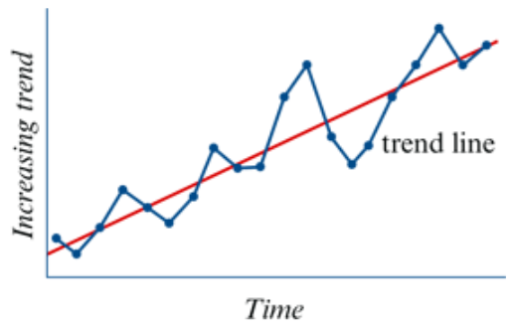
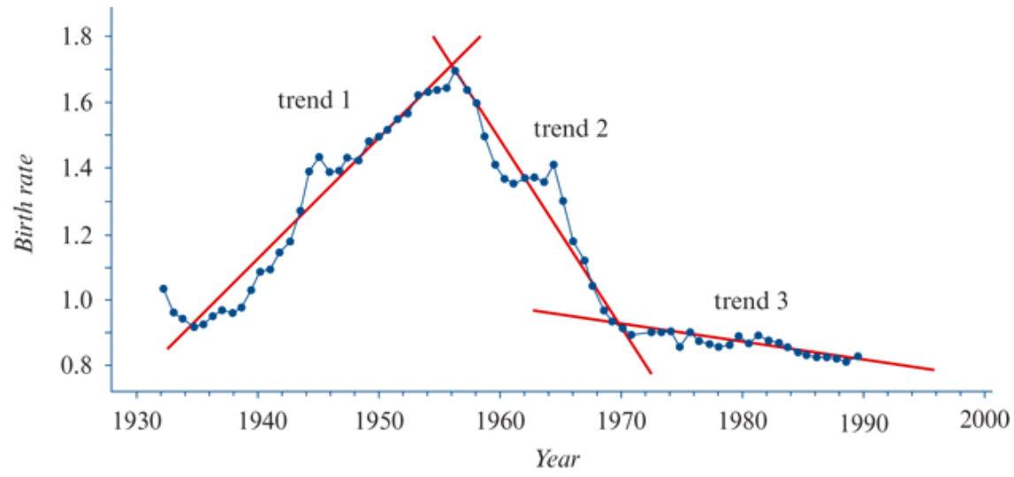
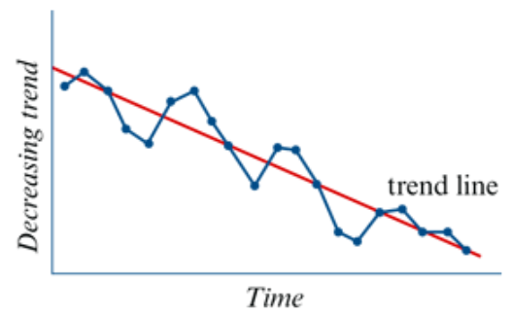

Slide 43
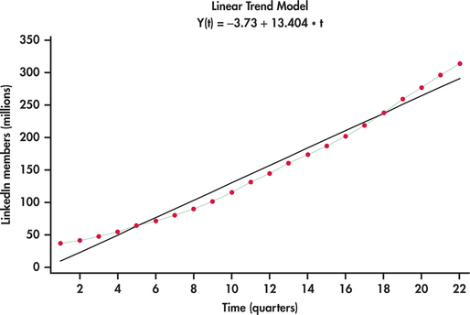

If the time-series plot results in points being on or near a straight line, then we say that the trend is linear.

Slide 44
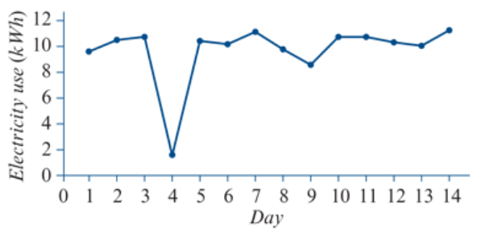
The time series plot below shows the daily power bill for a house (in kWh) for a fortnight.
On this day, the house was without power for 18 hours due to a storm

Slide 45
Scatterplots and Correlation
CONSTRUCT: Scatterplots Manually
  The most useful graph for displaying the relationship between two quantitative variables is a scatterplot.
How to Make a Scatterplot
Decide which variable should go on each axis.
  Remember, the eXplanatory variable goes on the X-axis!
Label and scale your axes.
  Remember, labels need to cover all minimum and maximum numbers!
Plot individual data values (x, y).
  Remember, Mark each data point on your scatter plot.!

Slide 46
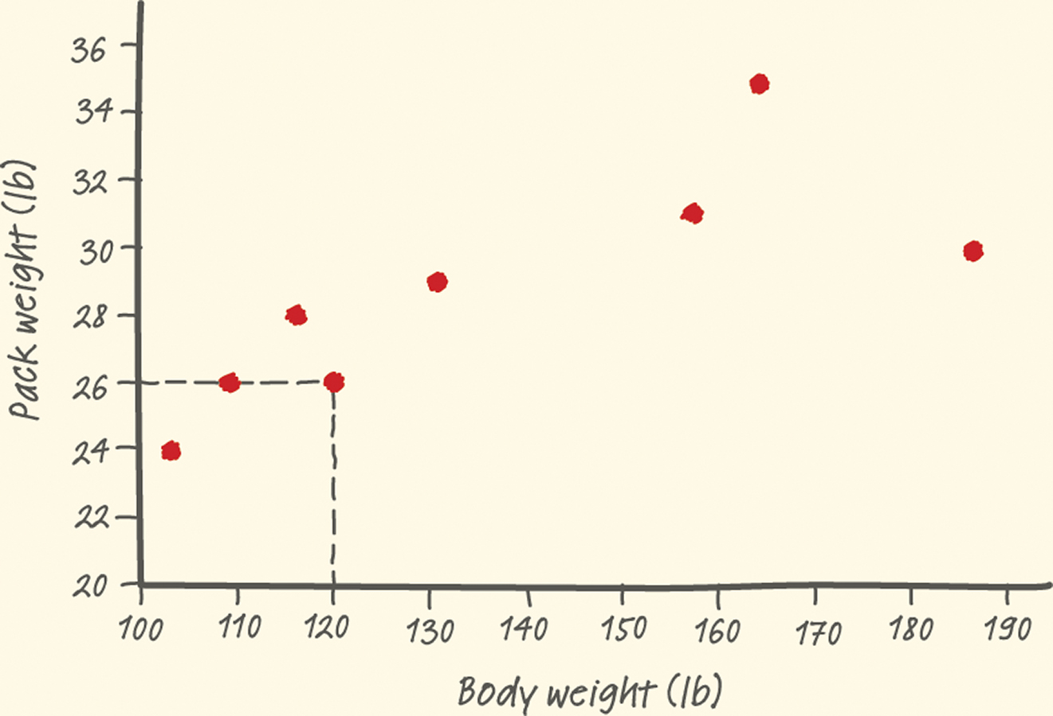
Scatterplots and Correlation
Displaying Relationships: Scatterplots
  Make a scatterplot of the relationship between body weight and pack weight.
  Since Body weight is our eXplanatory variable, be sure to place it on the X-axis!
Body weight (lb) | 120 | 187 | 109 | 103 | 131 | 165 | 158 | 116
Backpack weight (lb) | 26 | 30 | 26 | 24 | 29 | 35 | 31 | 28

Slide 47
Correlation
correlation for linear relationships
Measures the strength and direction of a linear relationship between two quantitative variables

Slide 48
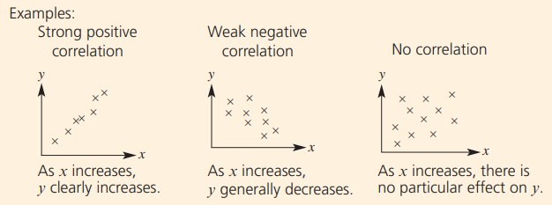
Types of Correlation
The correlation is positive if the y variable generally increases as the x variable increases.
The correlation is negative if the y variable generally decreases as the x variable increases.

Slide 49
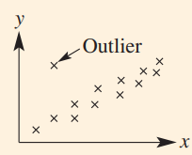
Outlier
An outlier can be clearly identified as a data point that is isolated from the rest of the data.

Slide 50


Scatter Graphs
Scatter graphs are used to show whether there is a relationship between two sets of data. The relationship between the data can be described as either:
1. A positive correlation. As one quantity increases so does the other.
2. A negative correlation. As one quantity increases the other decreases.
3. No correlation. Both quantities vary with no clear relationship.
Height
Soup Sales
Shoe Size
Shoe Size
Temperature
Annual Income
Positive Correlation
Negative correlation
No correlation

Slide 51
Scatter Graphs
Scatter graphs are used to show whether there is a relationship between two sets of data. The relationship between the data can be described as either:
1. A positive correlation. As one quantity increases so does the other.
2. A negative correlation. As one quantity increases the other decreases.
3. No correlation. Both quantities vary with no clear relationship.
A negative correlation is characterised by a straight line with a negative gradient.
A positive correlation is characterised by a straight line with a positive gradient.
Height
Soup Sales
Shoe Size
Shoe Size
Temperature
Annual Income

Slide 52
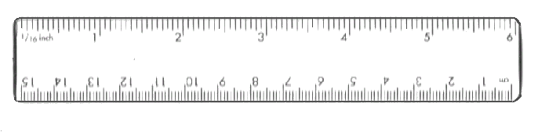
Lobf
Drawing a Line of Best Fit
A line of best fit can be drawn to data that shows a correlation. The stronger the correlation between the data, the easier it is to draw the line. The line can be drawn by eye and should have roughly the same number of data points on either side.
The sum of the vertical distances above the line should be roughly the same as those below.

Slide 53
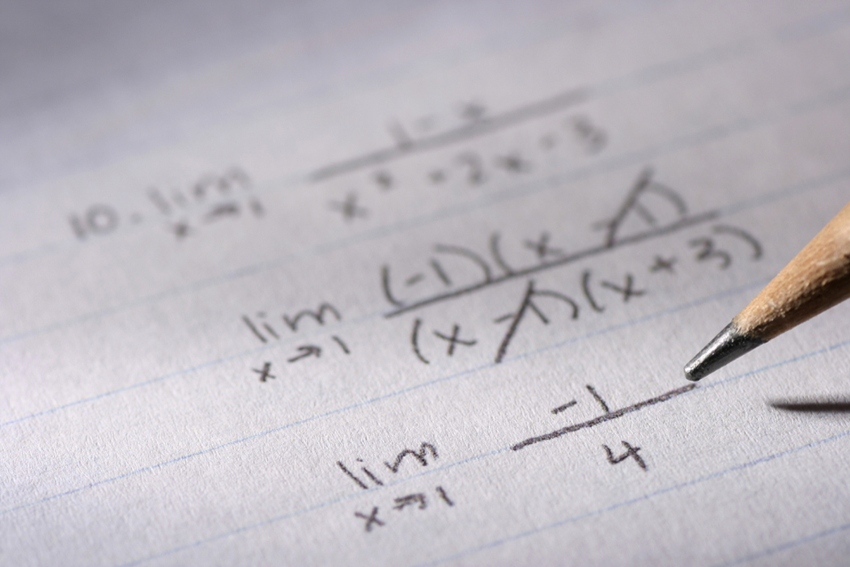
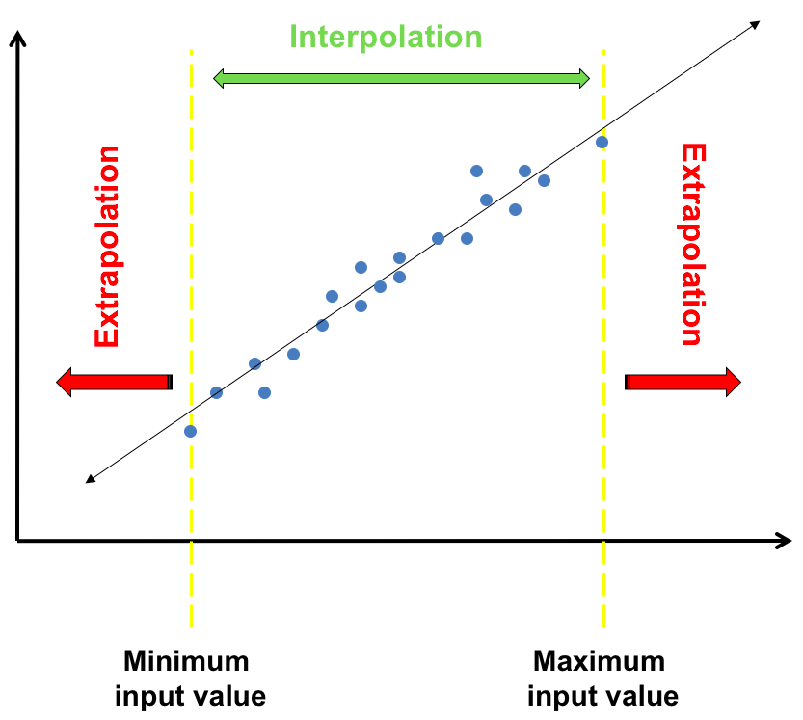
Vocabulary
Interpolation – Using a model to make a prediction within the range of data used to construct the model.
Extrapolation – Using a model to make a prediction beyond the range of data used to construct the model.

