Slide 1
Simplify by collecting like terms
Notes:
https://www.transum.org/software/SW/Starter_of_the_day/Students/Algebraic_Fractions.asp

Slide 2
Algebraic Expressions
OBJECTIVE TODAY
Simplifying algebraic expressions
OUTCOMES
I can identify Like Terms
I can combine Like Terms
I can simplify expressions by Collecting Like Terms
I can form algebraic expressions from worded problems
1
2
3
4
Key words
Simplify, Expression, Term, Like terms, Equation, Coefficient, Variable, Constant

Slide 3
Like terms contain the same letter.
Definition
Notes:
Constant = fixed amount

Slide 4
Like Terms
Like Terms have the EXACT same variables with the same exponents.
Like Terms Unlike Terms
2x, -5x 4x, 4y
-8, 10 9, 6x
3y², 8y² -5x, 5x²
7xy, -xy 3x²y, 8xy²

Slide 5
Combining Like Terms
Terms must be like in order to add and subtract them.
To combine like terms:
Add the coefficients
Keep the variable

Slide 6
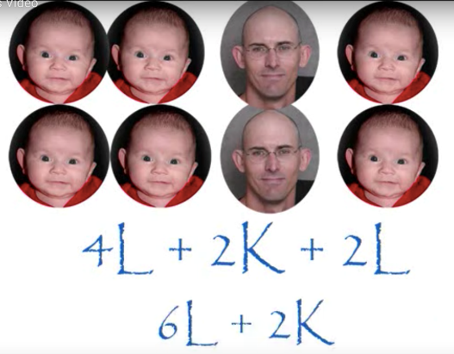
Simplifying Expressions
“4 lots of a”
a + a + a + a
= 4a
c + c + c
= 3c
3b + 4b
= 7b
3x + 4x – 2x
= 5x
3y + 4y – y
= 6y

Slide 7
Simplifying Expressions
4a + 2b + a + 3b
= 5a
+ 5b
3x + 2y - x + 3y
= 2x
+ 5y
2d + 2e - d – 3e
= d
$−$ e

Slide 8
Two pipes of lengths 5a and 3a are joined together
5a 3a
The total length = 5a + 3a = 8a
5a and 3a are like terms
They can be combined, or collected together

Slide 9
Write the total lengths of these pipes when the two parts are joined together
1a) 6x + 4x =
1b) 5y + 2y =
1c) 4z +2z + z

Slide 10
This necklace is made from two kinds of beads of length a cm and b cm
4a 4a
3b
The total length = 4a + 3b + 4a
= 8a + 3b
Since 4a + 4a = 8a
8a and 3b are unlike terms. They cannot be combined

Slide 11
Necklaces are made from two beads of lengths xcm and ycm
Write the total length
as simply as you can
Q3a) 3x + 2y + 3x =
Q3b) 2x + 3y + 2x + 3y =

Slide 12
Can the expression be simplified?
3.7r + 8.2r
r
r
YES

Slide 13
Can the expression be simplified?
6.4h – 7w
NO

Slide 14
Can the expression be simplified?
4a + 3 + 6
3
6
YES

Slide 15
Can the expression be simplified?
4f² + 2f
f²
f
NO

Slide 16
Can the expression be simplified?
5f + 3f + 2j + j
f
f
j
j
YES

Slide 17
Can the expression be simplified?
4x + 3y + 7
NO

Slide 18
Simplifying Fractions

Slide 19
Today’s Learning Intention:
To reduce fractions to their simplest terms.

Slide 20
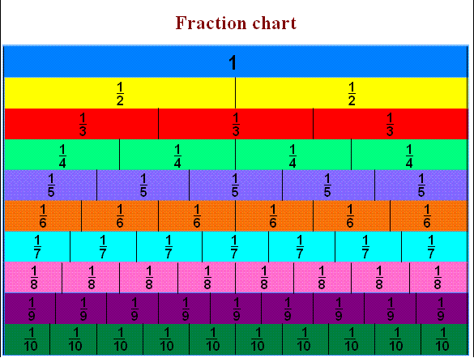
Equivalent Fractions

Slide 21
We can see that ½ is the same as 2/4, 3/6, 4/8 and 5/10.
These are EQUIVALENT FRACTIONS.
Find me an equivalent of:
2/8
3/9
8/10
9/9
4/6

Slide 22
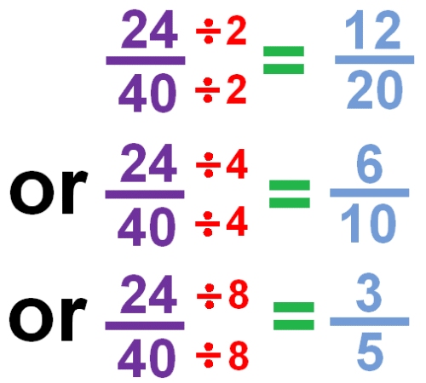
Simplified Fractions
To simplify a fraction, we find an equivalent fraction which uses the smallest numbers possible.
We do this by dividing.
We need to know our tables for this!
Ask yourself, what can I divide both 24 and 40 by?
8 is the biggest number we can divide both by and 3/5 uses the smallest possible numbers as we cannot divide them by anything else.

Slide 23
Look at this one
28
28
÷
7=
4
The first thing I notice is that 28 and 56 are both in the 7 times table. So I’m going to divide both numbers by 7.
56
56
÷
7=
8
NO!
I can still divide both numbers by 4.
Is this simplified?
4
÷
4=
1
8
÷
4=
2

Slide 24
Let’s work through this together.
$\frac{48}{60}$ = $\frac{48÷12}{60÷12}$ = $\frac{4}{5}$

Slide 25
Let’s work through this together.
$$\frac{4{8m}^{2}n}{60mn}$$
= $\frac{48∗m∗m∗n}{60∗m∗n}$
= $\frac{48∗m}{60}$ = $\frac{4m}{5}$

Slide 26
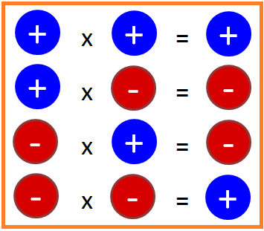
How about multiplication?
2x*3y = 2*3*x*y =6xy
(-3c)*(-4$r^{2}\text{)}$ = (-3)*(-4)*c* $r^{2}$
= 12 $r^{2}$c

Slide 27
Questions & Summary Book
2. What are like terms and how to combine like terms?
1. Ex Lesson 3B
3. Summary notes for Homework.

