Slide 1
Starter
Fill in the times table grid.
x | 3 | 5 | 7 | 9
2 | 6 | 10 | 14 | 18
4 | 12 | 20 | 28 | 36
7 | 21 | 35 | 49 | 63
8 | 24 | 40 | 56 | 72
?
?
?
?
?
?
?
?
?
?
?
?
?
?
?
?

Slide 2
A quick reminder that …
$$Sum \text{=} +$$
Difference = -
Product = x
Quotient = ÷

Slide 3
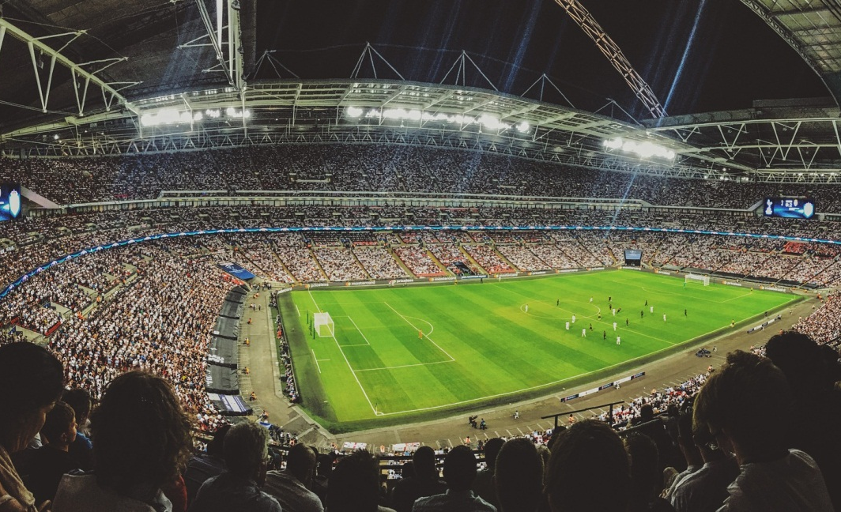
Wednesday, 14 September 2022
Substitution
Objective:
To be able to substitute positive and negative numbers into expressions
image © PIXAbay/Eelffica

Slide 4
Substitution
An expression
$$4x+17$$
What is the value of the expression when…
$$x=1$$
$$x=7$$
$$x=\frac{1}{2}$$
$$x=−1$$
$$x=4$$
$$x=10$$

Slide 5
Substitution
When substituting into our expressions, we simply replace our unknown with whatever we’re asked to substitute in.
Remember!
When we have an expression like $4y$ this is algebraic code for 4 lots of y.
If we substituted 5 into this expression we would get
4 x 5 = 20

Slide 6
Substitution
Ex1. If $x=1, y=3, a=6 and b=2$. Find the values of the following expressions. Find the odd one out in each row.
$$x−1$$ | $$y−3$$ | $$a−6$$ | $$b−2$$ | $$a+1$$
$$4x$$ | $$3y$$ | $$6a$$ | $$12a$$ | $$2b$$
$$5x+1$$ | $$3x +8$$ | $$6a −3$$ | $$10b+2$$ | $$10y+3$$
$$5x+3y$$ | $$6x+6a$$ | $$5b+y+x$$ | $$2a+b$$ | $$5b+4x$$
$$5x^{2}$$ | $$y^{2}+3$$ | $$b^{2}+11$$ | $$a^{2}−16$$ | $$a^{2}−y^{2}−2$$
$${9x}/3$$ | $${8y}/4$$ | $$\frac{4a+4b}{2}$$ | $$\frac{4a+6}{2}$$ | $$\frac{11a+13y}{5}$$
Notes:
5, 12,15,20,25

Slide 7
Substitution
Ex1. If $x=1, y=3, a=6 and b=2$. Find the values of the following expressions. Find the odd one out in each row.
$$0$$ | $$0$$ | $$0$$ | $$0$$ | $7$ (Not 0)
$$4$$ | $$9$$ | $$36$$ | $72$ (Not square) | $$4$$
$6$ (Not 11n) | $$11$$ | $$33$$ | $$22$$ | $$33$$
$$14$$ | $42$(Not 14) | $$14$$ | $$14$$ | $$14$$
$$5$$ | $12$(Not 5n) | $$15$$ | $$20$$ | $$25$$
$$3$$ | $$6$$ | $16$(Not triangle) | $$15$$ | $$21$$
Notes:
5, 12,15,20,25

Slide 8
Substitution
What’s the point of substitution?
Substitution allows us to generalise and then accept an input. For example here’s a picture of the cooking instructions for a turkey.
These instructions allow us to substitute in the weight of our turkey to find out how long to cook it for.

Slide 9
Substitution
How long to cook:
An unstuffed 3lb Turkey? 36 minutes
A stuffed 5 lb Turkey? 75 minutes (1 hour 15 minutes)
?
?

Slide 10
Substitution
Solve these problems…
Mark rents a car. It costs him £25 a day, plus a £50 hiring fee. How much does it cost him to rent the car for (a) 1 day? £75 (b) 2 days? £100 (c) 10 days? £300
Liam buys some flour. He gets a discount. The first bag is £3. He gets every other bag after that at half price. How much for… (a) 5 bags? £8 (b) 10 bags? £15.50 (c) 100 bags? £150.50
Damon buys $x$ polo shirts at £35 and $y$ pairs of jeans at £45. (a) Write an expression for his expenditure $35x+45y$ (b) What is the total cost of 10 pairs of each? £800.
Jarvis is mowing a lawn. He charges using a formula. He multiplies the area, $A$(in meters squared), by 10, adds 30 and divides by 3 (a) Write an expression to show this algebraically $\frac{10A+30}{3}$. (b) How much does he charge for an area of lawn 18m² ? £70
?
?
?
?
?
?
?
?
?
?

Slide 11
Substitution
Sometimes exams will ask you to substitute into formulas you may have encountered in science…
To convert from Celsius to Fahrenheit we use the formula $F=\frac{9}{5}C+32.$ (a) Convert 32 Celsius to Fahrenheit (b) Convert 100 Fahrenheit to Celsius.
To find the surface area of a cylinder, we can use the formula $S=2πrh+2πr^{2}$ (a) Find the S.A of a cylinder of radius 3cm and height 4cm
The area of a hexagon can be found with the formula $A=\frac{3\sqrt{3}}{2}l$ (a) Find the area of a hexagon length 5cm (b) Find the side length of a regular hexagon of area 54cm².
The formula for resistance in a circuit is described with the formula $\frac{1}{R}=\frac{1}{R_{1}}+\frac{1}{R_{2}}$ (a) Calculate R when $R_{1}=0.8$ and $R_{1}=1.6$
Notes:
https://www.youtube.com/watch?v=nROK4cjQVXM < - this is a funny sketch on the Celsius and Fahrenheit scales (from the radio)

Slide 12
Substitution
Sometimes exams will ask you to substitute into formulas you may have encountered in science…
To convert from Celsius to Fahrenheit we use the formula $F=\frac{9}{5}C+32.$ (a) 89.6 (b) 37.8.
To find the surface area of a cylinder, we can use the formula $S=2πrh+2πr^{2}$ (a) 42$π {cm}^{2}$
The area of a hexagon can be found with the formula $A=\frac{3\sqrt{3}}{2}l$ (a) 13cm (b) 20.8cm².
The formula for resistance in a circuit is described with the formula $\frac{1}{R}=\frac{1}{R_{1}}+\frac{1}{R_{2}}$ (a) $\frac{8}{15}$
Notes:
https://www.youtube.com/watch?v=nROK4cjQVXM < - this is a funny sketch on the Celsius and Fahrenheit scales (from the radio)

Slide 13
Substitution
Copy and complete the substitution spider for (a) n = 3 (b) n = 9 (c) n = 12. Notice anything?
$$3(n−1)$$
$${3n}^{2}−n$$
$${3n}^{2}$$
$$n−1−2$$
$$n−1$$
$$n^{2}$$
$${2n}^{2}$$
$$6n−2$$
$$6n$$
$$3n$$
$$n$$
$$n−3$$
$$\frac{n−3}{\frac{1}{2}}$$
$$3n−1$$
$$n(3n−1)$$
$$\frac{n}{3}$$
$$\frac{n−3}{3}$$
$$2(3n−1)$$
$$\frac{n}{3}+4$$
$$3\left(\frac{n}{3}+4\right)$$

Slide 14
Substitution
Answers
$$6, 24, 33$$
$$24, 234,420$$
$$27, 243, 432$$
$$0, 6, 9$$
$$2, 8, 11$$
$$9, 81, 144$$
$$18, 162, 288$$
$$16, 52, 70$$
$$18, 54, 72$$
$$9,27,36$$
$$3,9,12$$
$$0,6,9$$
$$0, 12, 18$$
$$8, 26, 35$$
$$24, 234,420$$
$$1,3,4$$
$$0, 2, 3$$
$$16, 52, 70$$
$$5,7,8$$
$$15, 21, 24$$

Slide 15
Substitution
Substitute in values of n to complete the tables. Notice anything?
n | 1 | 2 | 3 | 4 | 5 | 6 | 7
2n -1 | 1 | 3 | 5 | 7 | 9 | 11 | 13
?
?
?
?
?
?
?
n | 1 | 2 | 3 | 4 | 5 | 6 | 7
3n +2 | 5 | 8 | 11 | 14 | 17 | 20 | 23
?
?
?
?
?
?
?
n | 1 | 2 | 3 | 4 | 5 | 6 | 7
5n - 6 | -1 | 4 | 9 | 14 | 19 | 24 | 29
?
?
?
?
?
?
?
n | 1 | 2 | 3 | 4 | 5 | 6 | 7
4n + 1 | 5 | 9 | 13 | 17 | 21 | 25 | 29
?
?
?
?
?
?
?

Slide 16
Substitution
A hacker has hacked the schools wi-fi and changed the password! Luckily he’s left some clues. Crack the code to find the password
13 -7 -1 4 12 7 10 47 21 -15
a
e
$$2a+3 (a=2)$$
$$5b−3 (b=3)$$
u
i
$$2d−3 (d=−2)$$
$$2c+3 (c=−2)$$
p
i
$$2f^{2}+f (f=2)$$
$$5e^{2}+2 (e=3)$$
n
g
$$2g^{2}+g+3 (g=2)$$
$$2h^{2}+h+3 (h=−1)$$
s
g
$$2j^{3}+j+3 (j=−2)$$
$$2i^{3}+i+3 (i=2)$$

Slide 17
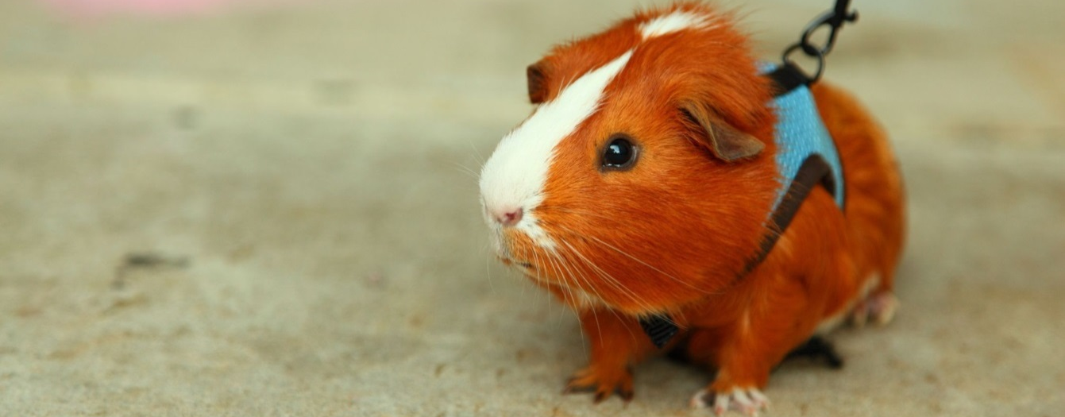
Substitution
Password:
g
u
i
n
e
a
p
i
g
s

Slide 18
Problem Solving Question
What is the perimeter of the triangle when $x=5$?
$$3(x+1)$$
$$2x+3$$
$$\frac{3x}{5}$$

Slide 19
Problem Solving Question
What is the perimeter of the triangle when $x=5$?
$$18$$
$$13$$
$$3$$
$$Total=34$$

Slide 20
Substitution
5 QUICK QUESTIONS CHECK
Now it’s time to check your learning.
You’ll see five questions.
The questions have a 30 second timer
How many can you get right?

Slide 21
Substitution
Question 1
$$5c+5 \\ c=5$$
Timer

Slide 22
Substitution
Question 2
$$5c+2d \\ c=5, d=3$$
Timer

Slide 23
Substitution
Question 3
$$2q−8 \\ q=−3$$
Timer

Slide 24
Substitution
Question 4
$$3(a+b) \\ a=2 \\ b=3$$
Timer

Slide 25
Substitution
Question 5
$$3m^{2}−n+5 \\ m=−1 \\ n=3$$
Timer

Slide 26
Substitution
Your answers:
30
31
-14
15
5

