Slide 1
Expanding Brackets
Lesson 6

Slide 2
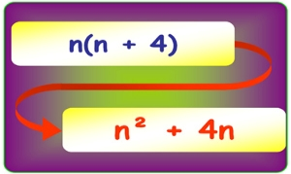
Expanding Brackets
Understand what expanding brackets / distributive law means
Be able to expand brackets involving an expression with addition and subtraction
Be able to expand and simplify brackets
Keywords: brackets, expanding, expressions, simplify

Slide 5
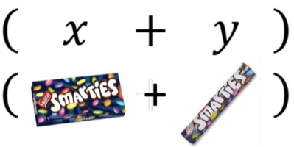
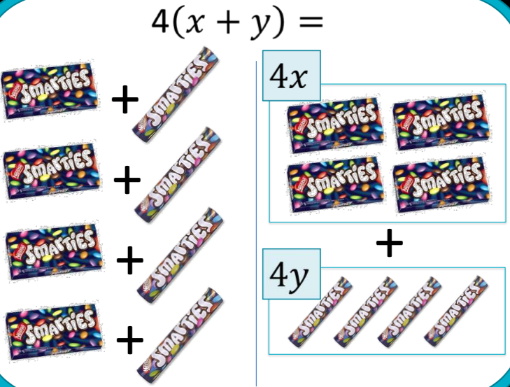
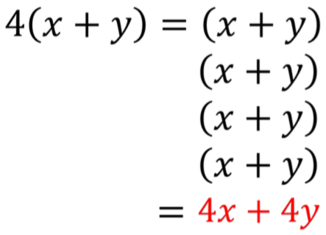
Expanding Brackets

Slide 6
DEMO
Expanding Single Brackets: Grid Method
YOUR TURN
Expand & Simplify:
Expand & Simplify:
$$3(x+2)$$
$$4(x+5)$$
×
$$x$$
$$+ 2$$
×
$$x$$
$$+ 5$$
$$3$$
$$3x$$
$$+ 6$$
$$4$$
$$4x$$
$$+ 20$$
$$3x+6$$
$$4x+20$$

Slide 7
DEMO
Expanding Single Brackets: Grid Method
YOUR TURN
Expand & Simplify:
Expand & Simplify:
$$2x(2x−3)$$
$$3x(4x+2)$$
×
$$2x$$
$$− 3$$
×
$$4x$$
$$+ 2$$
$$2x$$
$$4x2$$
$$− 6x$$
$$3x$$
$$12x2$$
$$+ 6x$$
$$4x2−6x$$
$$12x2+6x$$

Slide 8
Expanding double brackets FOIL method
$$(x+6)(x+4)$$
First terms: $x × x= x^{2}$
Outside terms: $x × 4=4x$
Inside terms: 6$× x=6x$
Last terms: $6 ×4=24$
Now collect them :$x^{2}+4x+6x+24$
$$x^{2}+10x+24$$

Slide 9
Expanding double brackets FOIL method
$${(2x−3)}^{2}$$
This means ‘the bracket’ multiplied by itself….
$${(2x−3)}^{2}=\left(2x−3\right)\left(2x−3\right)$$
Now expand the brackets as normal using FOIL:
First terms: $2x ×2x= {4x}^{2}$
Outside terms: $2x ×−3=−6x$
Inside terms: -3$×2x=−6x$
Last terms: $−3×−3=9$
${(2x−3)}^{2}={4x}^{2}−6x−6x$ +$9$ = ${4x}^{2}−12x$ +$9$

Slide 10
Questions & Summary Book
3. What is the rule of expanding brackets by grid method?
1. Exercise Questions
4. Rule for expanding brackets by FOIL method.
5. Summary notes for Homework.
2. What is the definition of expanding brackets?

