Slide 1


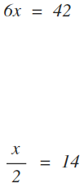
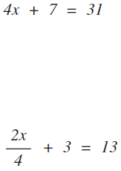
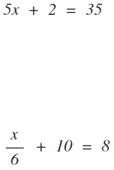


Solving 2 Step Equations
Level 1
Level 2
Level 3

Slide 2



Solving Equations
Level 1
Level 2
Level 3
Level 4
Identify how to solve equations with an unknown on either side

Slide 3
Solving Two Step Equations
Solve 2x + 1 = 9
Describe what has happened to the x.
Do ‘opposites backwards’.
Substitute your answer into the original equation to check.
2x + 1 | = | 9
-1 |  | -1
2x | = | 8
÷ 2 |  | ÷ 2
x | = | 4

Slide 4

Solving Two Step Equations
Solve 3x – 5 = 12
Describe what has happened to the x.
Do ‘opposites backwards’.
Substitute your answer into the original equation to check.
3x - 5 | = | 12
+5 |  | +5
3x | = | 17
÷ 3 |  | ÷ 3
x | =
Leave answer as an improper fraction if it doesn’t divide.
ACHIEVE @ Sedgefield

Slide 5






Equations: With Fractions
Describe what has happened to the x.
Do ‘opposites backwards’.
Substitute your answer into the original equation to check.
 | = | 13
-4 |  | -4
 | = | 9
x2 |  | x2
3x | = | 18
÷ 3 |  | ÷ 3
x | = | 6

Slide 6


Individual Response – Learning Check
A
B
50
14
C
D
11
6
Notes:
Introduction – see what the students can do

Slide 7

Solving Fractional Equations
Solve
Describe what has happened to the x.
Do ‘opposites backwards’.
Substitute your answer into the original equation to check.
X 5 |  | X 5
3x | = | 30
÷ 3 |  | ÷ 3
x | = | 3

Slide 8
Solving with a negative x
Solve:
Describe what has happened to the x.
Work backwards to leave x by itself
Change the signs to make the answer correct
12 – 2x | = | 4
-12 |  | -12
-2x | = | -8
÷ 2 |  | ÷ 2
-x | = | -4
x (-1) |  | x (-1)
x | = | 4

Slide 9
Solving Equations
Number side
X side
4x + 22 = 7x + 10
Take 4x from both sides
-4x
22
=
3x
+10
-4x
Take 10 from both sides
-10
-10
12
=
3x
Divide both sides by 3
÷ 3
÷ 3
4
=
x
Identify how to solve equations with an unknown on either side

Slide 10

Solving Equations
Number side
X side
16 – 5x = 6x + 11
Add 5x to both sides
+5x
+5x
16
=
11x
+11
Take 11 from both sides
-11
-11
5
=
11x
Divide both sides by 11
÷ 11
÷ 11
Identify how to solve equations with an unknown on either side

Slide 11





Solve equations with non-integer answers
× 15
× 15
Multiply 15 to both sides
3
5
$$\frac{15\left(2x+1\right)}{5}=\frac{15\left(x−1\right)}{3}$$
1
1
Get rid of brackets
$$3\left(2x+1\right)=5\left(x−1\right)$$
Take 5x from both sides
-5x
$$6x+3=5x−5$$
-5x
-3
$$x+3=−5$$
-3
Take 3 from both sides
$$x=−8$$

Slide 12


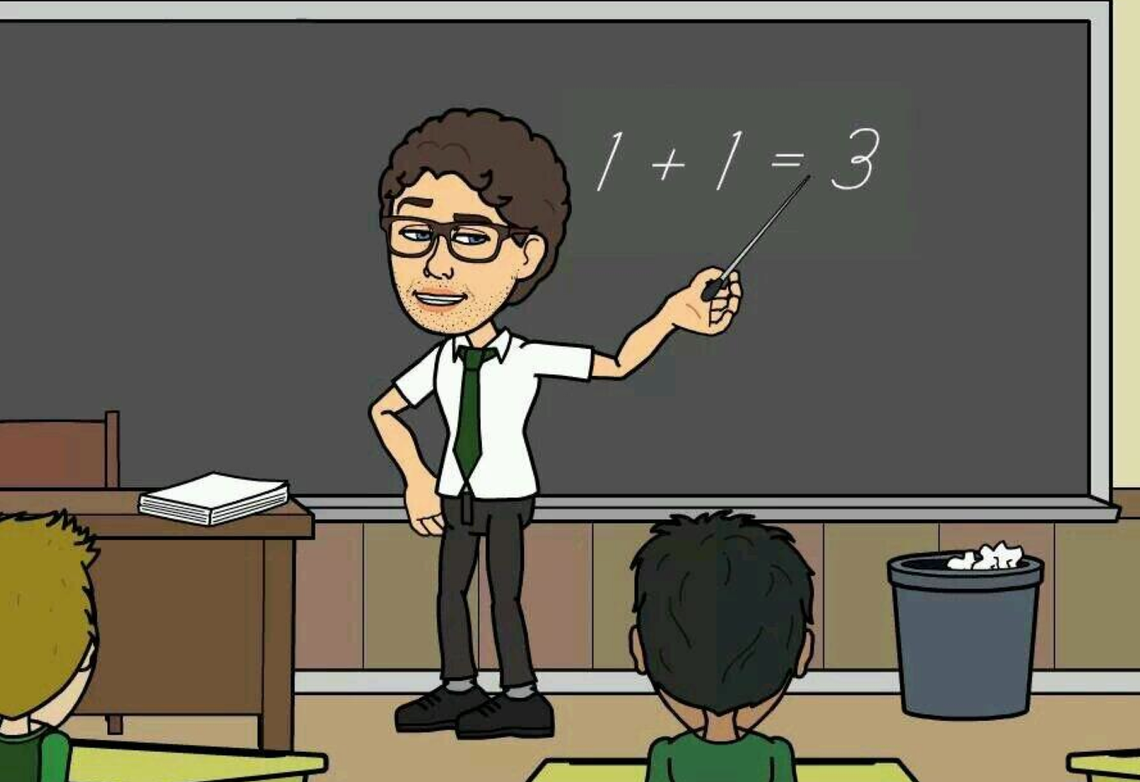
Spot the mistakes

