Slide 1
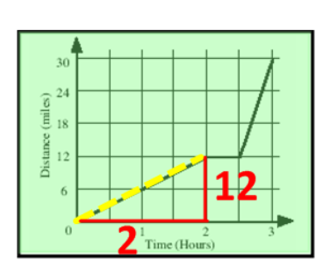
Chapter 6AB
Distance-Time graphs
LO To interpret distance-time graphs
Notes:
Highlight the gradients illustrated on the following few cards on the accompanying matching cards

Slide 2
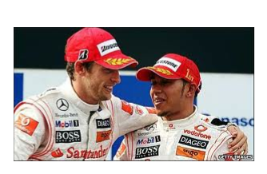
Memory Task
Working in Pairs:
1) You will have 30 seconds to look at a graph on the following slide.
2) You will then have 2 minutes to reproduce the diagram in as much detail as you can.
Notes:
http://www.youtube.com/watch?v=i9MytO0O_q0&safe=active for countdown clock

Slide 3
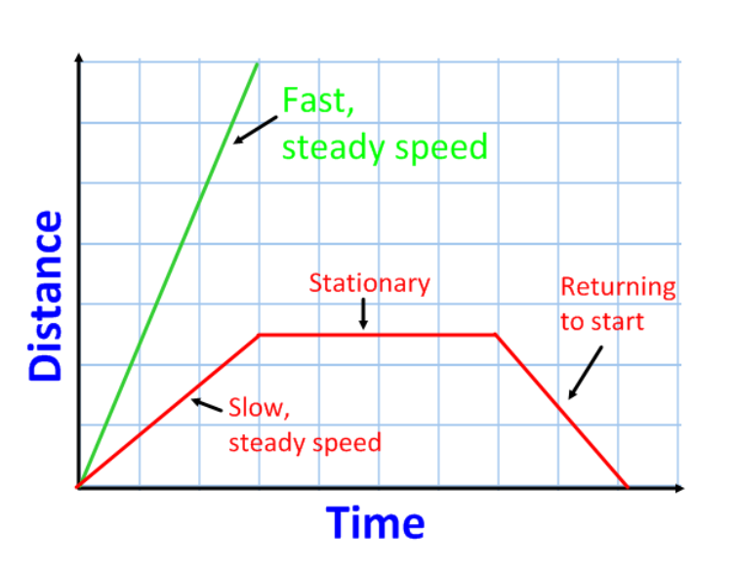
Memory Task
Notes:
30 seconds to observe (no notes) accompanied by countdown clock http://www.youtube.com/watch?v=i9MytO0O_q0&safe=active

Slide 4
Memory Task
Notes:
2 minutes to finish – use countdown clock for last 30 secondshttp://www.youtube.com/watch?v=i9MytO0O_q0&safe=active for countdown clock

Slide 5
Memory Task
Notes:
Compare answers for accuracy and ensure correct version copied down

Slide 6
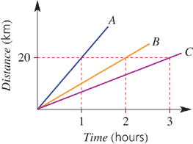

Slide 7
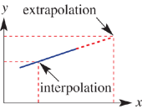

Slide 8
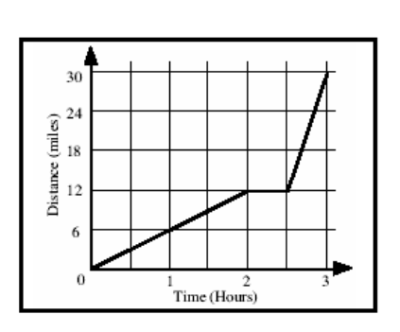
Speed = distance
time
How can you use a distance-time graph to find the speed?
The gradient of a distance-time graph represents the speed

Slide 9
Speed = distance
time
Speed = 12 miles
2 hours
Speed = 6 mph
The steeper the gradient the faster the speed

Slide 10
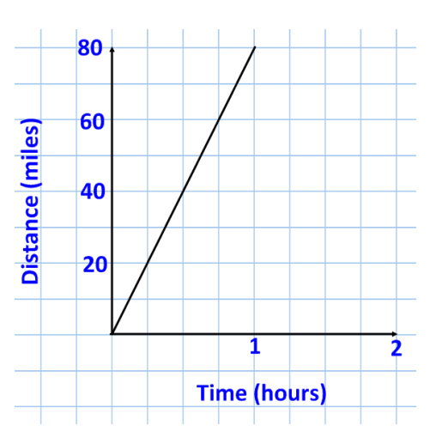
Find the speed in the following distance-time graph
Speed = distance
time
Speed = 20miles
4hrs
Speed = 5 mph

Slide 11
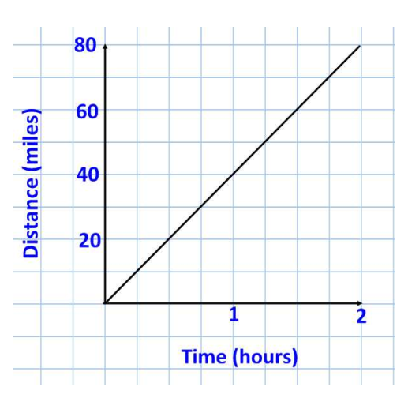
Find the speed in the following distance-time graph
Speed = distance
time
Speed = 80miles
2hrs
Speed = 40 mph

Slide 12
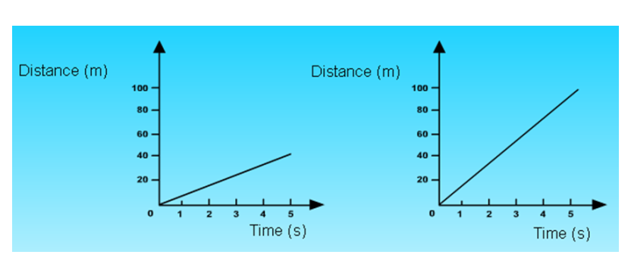
5 Quick questions
1)
Which graph shows the object moving at a faster speed?
The steeper the gradient the faster the speed
Notes:
Answer with MWB’s

Slide 13
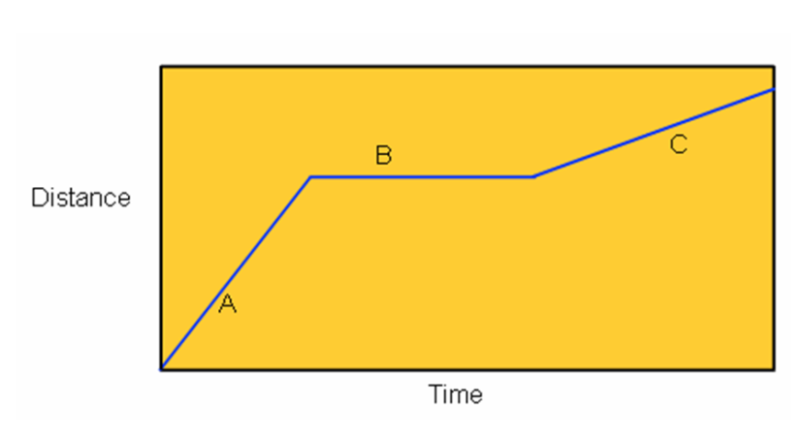
5 Quick questions
2)
Use one word to describe what is happening at B
Stationary
Notes:
Answer with MWB’s

Slide 14
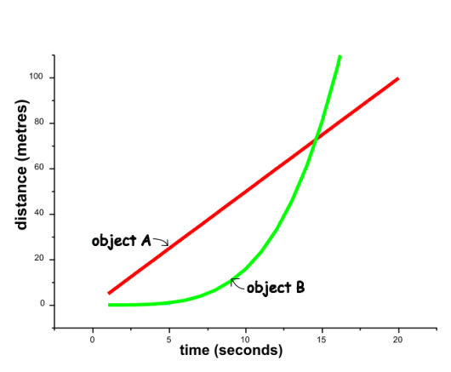
5 Quick questions
3)
Which object is moving at a steady speed?
Steady (constant) speed
Notes:
Answer with MWB’s

Slide 15
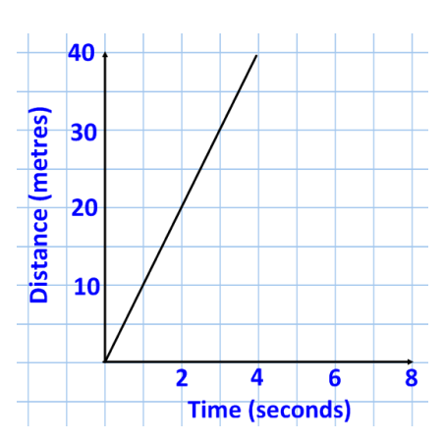
5 Quick questions
4)
How far does this object travel in 4 seconds?
40m
Notes:
Answer with MWB’s

Slide 16
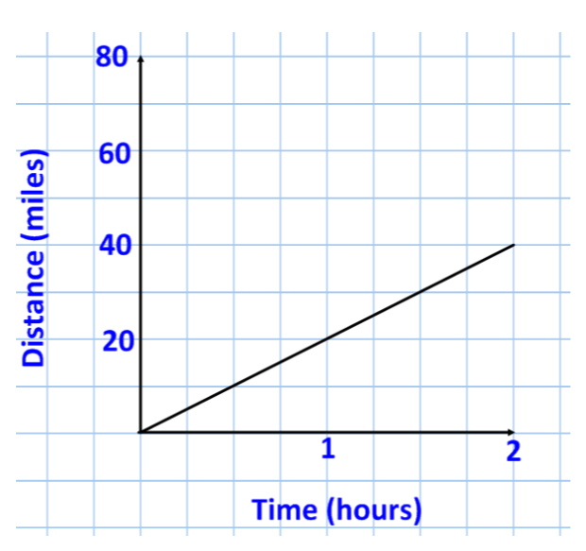
5 Quick questions
Use the graph to find the speed of the following object:
5)
40miles
2hrs
=20mph
Notes:
Answer with MWB’s

Slide 17
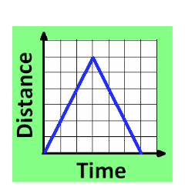
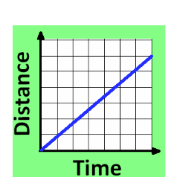
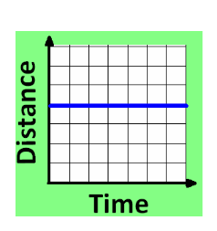
Matching activity
Notes:
Paired discussion for 1 minute then choose a pair to complete on board

Slide 18
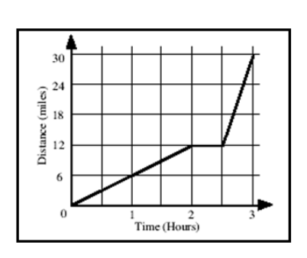
Matching activity
Match the distance-time graphs with the correct descriptions
>>> EXT
Choose a graph and create an alternative description
Notes:
Allow 15-20 minutes in pairs/ groups

Slide 19
Matching activity

Slide 20
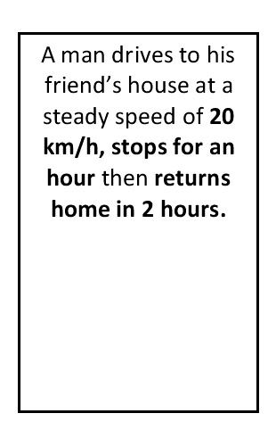
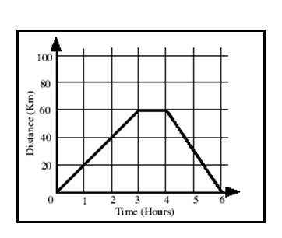
Matching activity

Slide 21
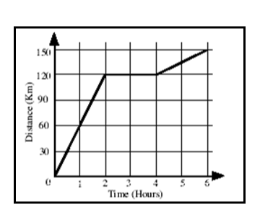
Matching activity

Slide 22
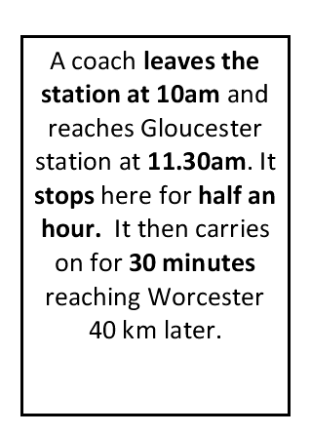
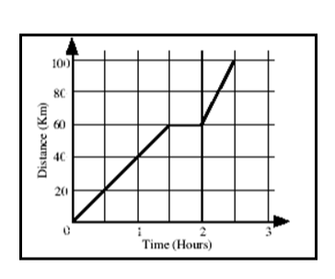
Matching activity

Slide 23
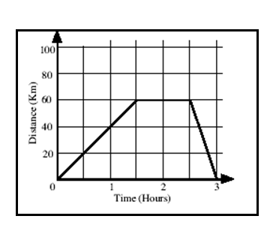
Matching activity

Slide 24
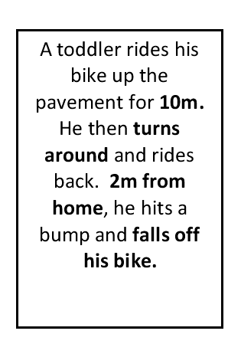
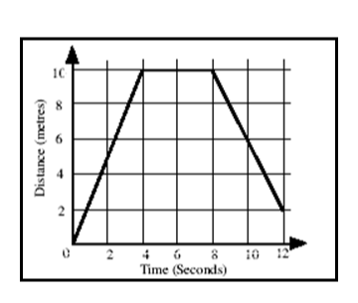
Matching activity

Slide 25
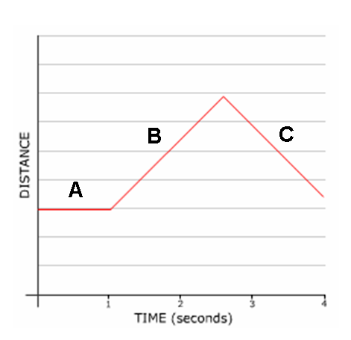
1)
Which part of the graph shows the object returning to the start?
C

Slide 26
2)
Which parts of the graph shows the object moving at constant speed?
B &C

Slide 27
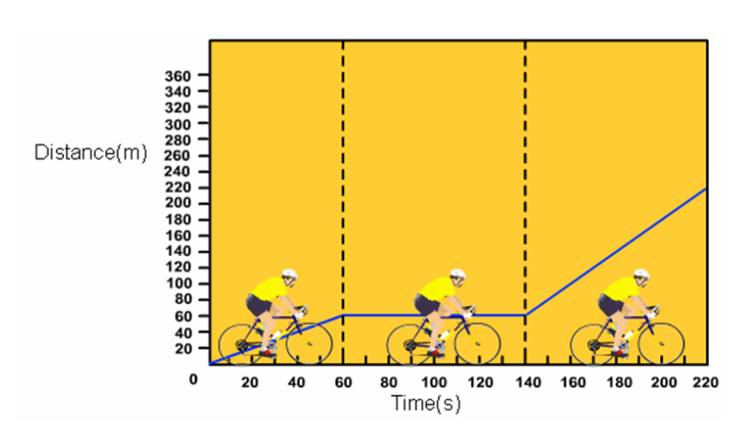
3)
How long was the cyclist stationary for?
80 seconds

Slide 28
4)
What was the cyclists initial speed?
60m
60s
= 1 m/s

Slide 29
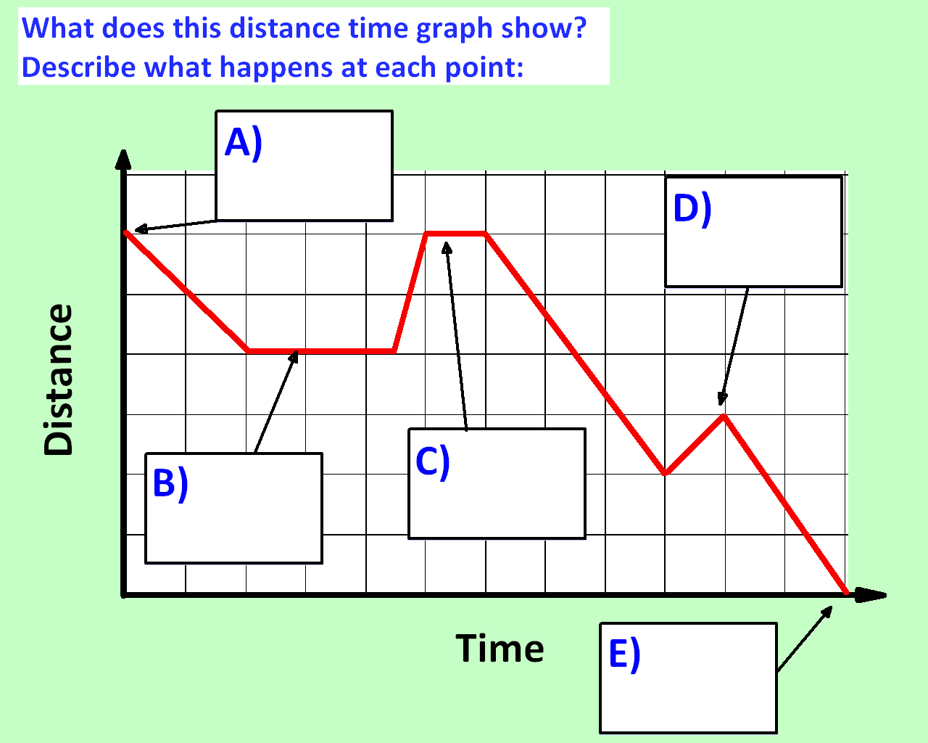
Heads
home
Turns around
Stationary
Stationary
Arrives home

