Slide 1
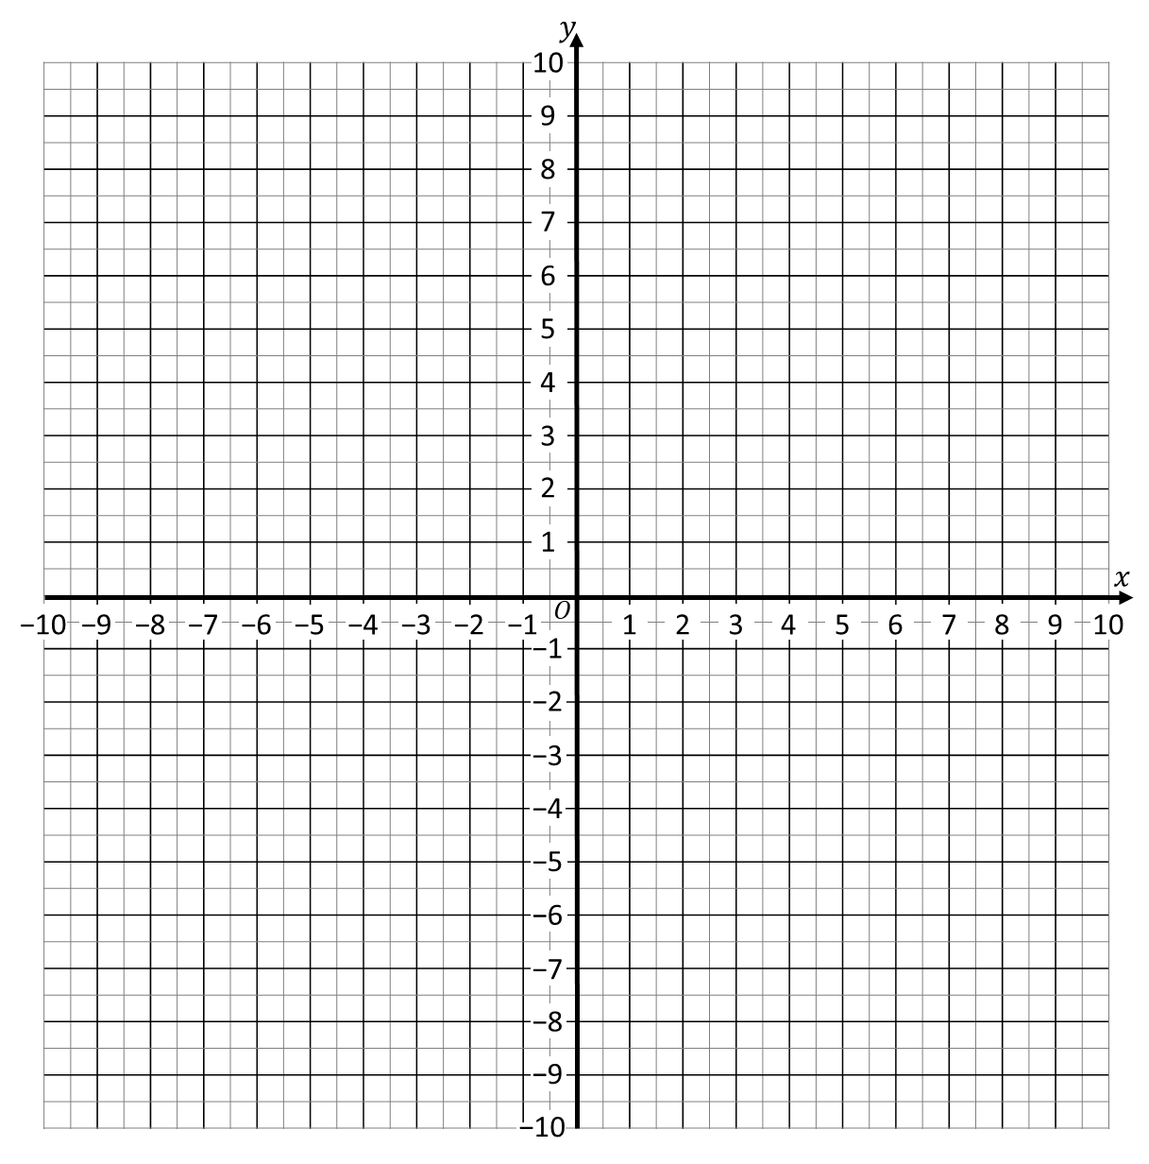
STARTER
Coordinates
What are the coordinates of the….
… circle? (____ , _____)
… star? (____ , _____)
… rectangle?
… square?
… hexagon?
… equilateral triangle?
… pentagon?
… isosceles triangle?
… trapezium?
… octagon?
Plot (mark) coordinates (2 , 5) & (−5 , −2)
Join the two points with a line.
Plot (mark) coordinates (6 , −5) & (−7 , 8)
Join the two points with a line.
What can we say about where
these lines cross?
Notes:
https://quizizz.com/admin/quiz/5eac6a6e4b3268001bace7bc?source=quiz_share
https://quizizz.com/admin/quiz/62c3ef2383e3ba001d3fbc31?source=quiz_share
https://quizizz.com/admin/quiz/630b463303393b001e9ae814?source=quiz_share

Slide 2
STARTER
Coordinates
What are the coordinates of the….
(7 , 8)
… circle? (____ , _____)
… star? (____ , _____)
… rectangle?
… square?
… hexagon?
… equilateral triangle?
… pentagon?
… isosceles triangle?
… trapezium?
… octagon?
(4 , 5)
(0 , 7)
(8 , 0)
(− 4 , 3)
(− 9 , 0)
(5 , − 8)
(2 , − 4)
(0 , − 7)
(− 6 , −3)
Plot (mark) coordinates (2 , 5) & (−5 , −2)
Join the two points with a line.
Plot (mark) coordinates (6 , −5) & (−7 , 8)
Join the two points with a line.
They are at 90°
(perpendicular).
What can we say about where
these lines cross?

Slide 3
STARTER
× 3
− 4
Two-Step Function Machines
INPUT
2
4
0
−1
−2
OUTPUT
2
8
−4
−7
−10
Calculate the output for each input.
INPUT
Double
Add 3
OUTPUT
INPUT
1
2
4
0
−2
OUTPUT
5
÷ 2
+ 2
INPUT
6
OUTPUT
2
1
0

Slide 4
STARTER
× 3
− 4
Two-Step Function Machines
INPUT
2
4
0
−1
−2
OUTPUT
2
8
−4
−7
−10
Calculate the output for each input.
INPUT
Double
Add 3
OUTPUT
INPUT
1
2
4
0
−2
OUTPUT
5
7
11
3
−1
÷ 2
+ 2
INPUT
6
0
−2
−4
OUTPUT
5
2
1
0
Answers

Slide 5
LOPT
PLOT
INEL
LINE
RGHAP
GRAPH
ATRDENCOOI
COORDINATE
UQIENAOT
EQUATION
EILANR
LINEAR

Slide 6
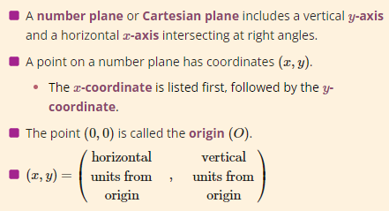
02 November 2022
Plotting Linear Graphs:
Table of Values

Slide 7
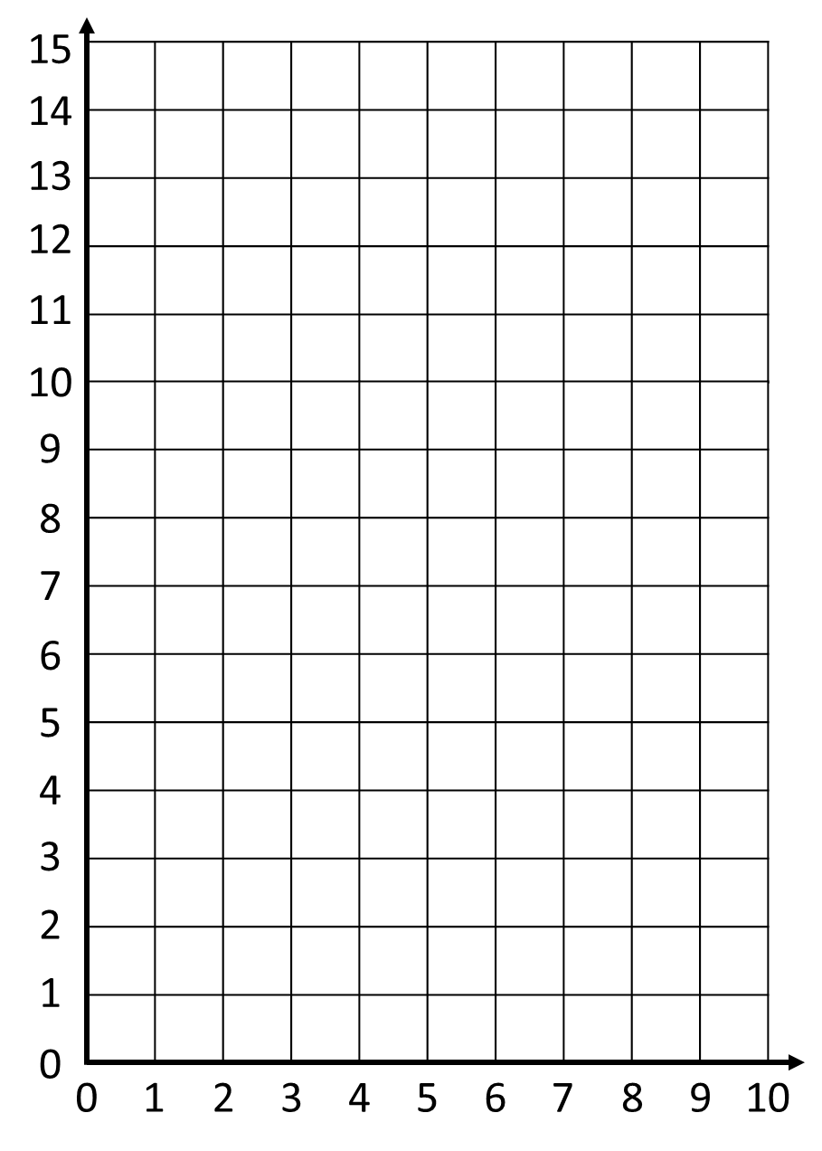
A taxi charges $2 per mile.
There is also a $3 callout charge.
How much does it cost to go…
2 miles?
3 miles?
10 miles?
$7
$9
$23
$$y$$
How is distance related to cost?
Can you draw a function machine?
Can you write an equation?
$
$$x$$
× 2
+ 3
$$y$$
$$x=Miles$$
$$y=Cost$$
$$y=2x+3$$
$$x$$
Miles

Slide 8
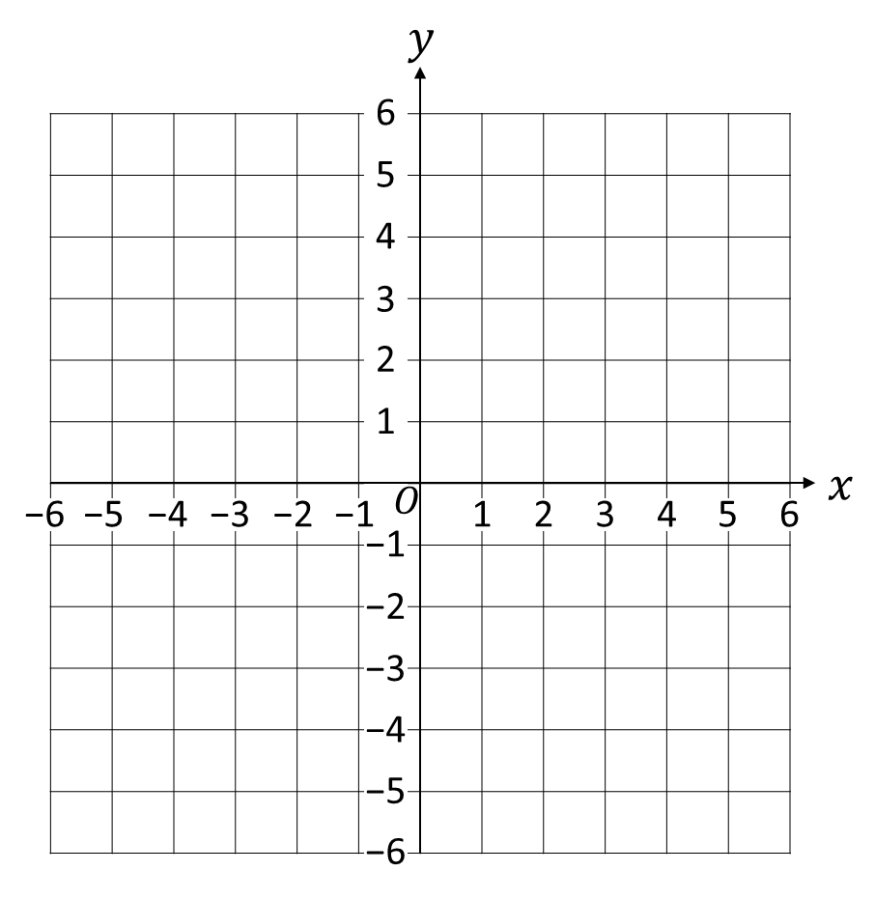
Vocabulary
$y$-axis
Equation
$x, y$values
Point
$$y=2x+3$$
$x$-axis
Variables
We plot, or draw,
a graph on a grid.
The line represents all
the values where the
equation is true, is satisfied.
Origin
(0 , 0)
Line Segment
(it goes forever)

Slide 9
$$y=2x+3$$
One method to draw a straight line is
to substitute values
for $x$ and $y$ into the equation.
To make it easy,
we use a table of values.

Slide 10
Draw the graph of:
Always label your line!
$$y=x+2$$
$$y=x+2$$
1) Express the equation as
a function machine.
×
×
$$x$$
+ 2
$$y$$
×
×
×
2) Complete a Table of Values.
×
×
$$x$$ | −3 | −2 | −1 | 0 | 1 | 2 | 3
$$y$$ | −1 | 0 | 1 | 2 | 3 | 4 | 5
3) Plot each pair of values as coordinates.
4) Join the points to make a line.

Slide 11
Draw the graph of:
$$y=x−3$$
1) Express the equation as
a function machine.
$$x$$
− 3
$$y$$
2) Complete a Table of Values.
×
×
$$x$$ | −3 | −2 | −1 | 0 | 1 | 2 | 3
$$y$$ | −6 | −5 | −4 | −3 | −2 | −1 | 0
×
×
×
×
×
3) Plot each pair of values as coordinates.
$$y=x−3$$
4) Join the points to make a line.

Slide 12
Draw the graph of:
$$y=2x$$
$$y=2x$$
1) Express the equation as
a function machine.
×
×
$$x$$
× 2
$$y$$
×
2) Complete a Table of Values.
×
$$x$$ | −3 | −2 | −1 | 0 | 1 | 2 | 3
$$y$$ | −6 | −4 | −2 | 0 | 2 | 4 | 6
×
×
×
3) Plot each pair of values as coordinates.
4) Join the points to make a line.

Slide 13
Draw the graph of:
$$y=2x+1$$
$$y=2x+1$$
1) Express the equation as
a function machine.
×
$$x$$
× 2
+ 1
$$y$$
×
×
2) Complete a Table of Values.
×
$$x$$ | −3 | −2 | −1 | 0 | 1 | 2 | 3
$$y$$ | −5 | −3 | −1 | 1 | 3 | 5 | 7
×
??
×
3) Plot each pair of values as coordinates.
4) Join the points to make a line.

Slide 14
Draw the graph of:
$$y=3x−4$$
$$y=3x−4$$
1) Express the equation as
a function machine.
×
$$x$$
× 3
− 4
$$y$$
×
2) Complete a Table of Values.
×
$$x$$ | −3 | −2 | −1 | 0 | 1 | 2 | 3
$$y$$ | −13 | −12 | −7 | −4 | −1 | 2 | 5
×
3) Plot each pair of values as coordinates.
4) Join the points to make a line.

Slide 15
Draw the graph of:
$$y=x+4$$
$$y=x+4$$
1) Complete a Table of Values.
$$x$$ | −3 | −2 | −1 | 0 | 1 | 2 | 3
$$y$$ | 1 | 2 | 3 | 4 | 5 | 6 | 7
2) Plot each pair of values as coordinates.
3) Join the points to make a line.

Slide 16
Draw the graph of:
$$y=2x+1$$
$$y=2x+1$$
1) Complete a Table of Values.
$$x$$ | −3 | −2 | −1 | 0 | 1 | 2 | 3
$$y$$ | −5 | −3 | −1 | 1 | 3 | 5 | 7
2) Plot each pair of values as coordinates.
3) Join the points to make a line.

Slide 17
Draw the graph of:
$$y=\frac{1}{2}x+2$$
$$y=\frac{1}{2}x+2$$
1) Complete a Table of Values.
$$x$$ | −3 | −2 | −1 | 0 | 1 | 2 | 3
$$y$$ | 0.5 | 1 | 1.5 | 2 | 2.5 | 3 | 3.5
2) Plot each pair of values as coordinates.
3) Join the points to make a line.

Slide 18
Draw the graph of:
$$y=2−2x$$
$$y=2−2x$$
1) Complete a Table of Values.
$$x$$ | −3 | −2 | −1 | 0 | 1 | 2 | 3
$$y$$ | 8 | 6 | 4 | 2 | 0 | −2 | −4
2) Plot each pair of values as coordinates.
3) Join the points to make a line.

Slide 19
You only need 2 points to plot a straight line.
Why bother with the rest?
Do you agree?
$$y=2x+3$$
$$y=2x+3$$
$$x$$ | 0 | −2
$$y$$ | 3 | −1

Slide 20
Plot one of these lines
using a table of values.
KNOWLEDGE CHECK
$$y=x+3$$
$$y=2x−1$$
$$y=\frac{1}{2}x−1$$
$$y=1−3x$$
Notes:
Previous knowledge check to see whether students can already complete the learning objective. If they can’t, this provides an excellent opportunity to show progress at the end of the lesson.

Slide 21
Plot one of these lines
using a table of values.
KNOWLEDGE CHECK
$$y=x+3$$
$$y=2x−1$$
$$y=\frac{1}{2}x−1$$
$$y=1−3x$$
Notes:
Previous knowledge check to see whether students can already complete the learning objective. If they can’t, this provides an excellent opportunity to show progress at the end of the lesson.

