Slide 1
Learning objective:
To be able to:
Calculate the gradient of a straight line
Work out the equation of a straight line
Write the learning objective into your books and discuss in pairs the following question:
What is gradient?
Notes:
https://www.transum.org/Software/Graphmatch/Gradient.asp
https://quizizz.com/admin/quiz/631fb23315fcf5001df0bee4?source=quiz_share
https://quizizz.com/admin/quiz/5f4be721e1b31b001b2074ae?source=quiz_share
https://quizizz.com/admin/quiz/5f61914a82fdb0001b9aee9e?source=quiz_share

Slide 2
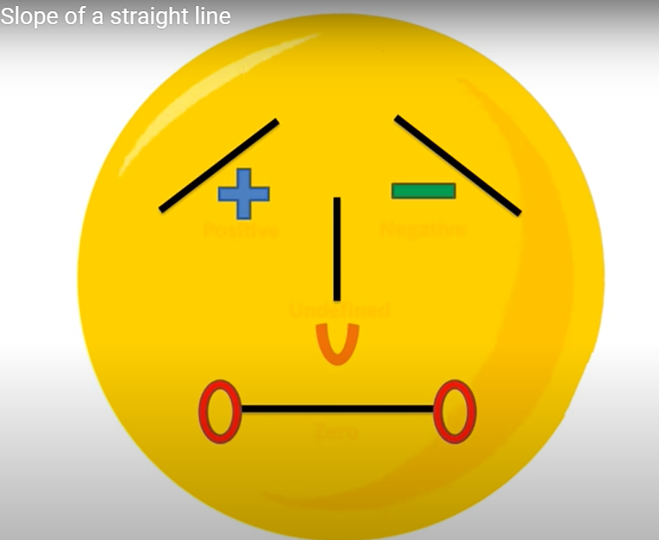
What is gradient?
Gradient is the measure of how steep a line is. The bigger the gradient, the steeper the line.

Slide 3
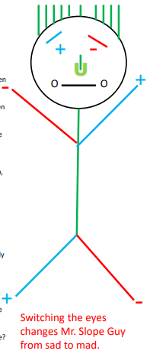

Slide 4
The way we work out the gradient of any line is by the formula:
change in y
Gradient =
change in x
Rise
Gradient = Slope =
Run

Slide 5
change in y
Gradient =
change in x
2 ÷ 1 = 2
Increase of 2 up the y-axis
Rise
Gradient of 2
For 1 along the x-axis
Run

Slide 6
change in y
Gradient =
change in x
3 ÷ 1 = 3
Gradient of 3
Increase of 3 up the y-axis
Rise
For 1 along the x-axis
Run

Slide 7
change in y
Gradient =
change in x
1 ÷ 1 = 1
Increase of 1 up the y-axis
Gradient of 1
For 1 along the x-axis

Slide 8
change in y
Gradient =
change in x
5 ÷ 1 = 5
Gradient of 5
Increase of 5 up the y-axis
For 1 along the x-axis

Slide 9
change in y
Gradient =
change in x
4 ÷ 1 = 4
Gradient of 4
Increase of 4 up the y-axis
For 1 along the x-axis

Slide 10
change in y
Gradient =
change in x
-2 ÷ 1 = -2
Gradient of -2
Decrease of 2 down the y-axis
For 1 along the x-axis

Slide 11
change in y
Gradient =
change in x
-4 ÷ 1 = -4
Gradient of -4
Decrease of 4 down the y-axis
For 1 along the x-axis

Slide 12
change in y
Gradient =
change in x
-1 ÷ 1 = -1
Gradient of -1
Decrease of 1 down the y-axis
For 1 along the x-axis

Slide 13
change in y
Gradient =
change in x
1
1 ÷ 2 =
2
Increase of 1 up the y-axis
For 2 along the x-axis
1
Gradient of
2

Slide 14
change in y
Gradient =
change in x
1
1 ÷ 2 =
4
1
Gradient of
4
Increase of 1 up the y-axis
For 4 along the x-axis

Slide 15
change in y
Gradient =
change in x
2
2 ÷ 3 =
3
Increase of 2 up the y-axis
2
Gradient of
For 3 along the x-axis
3

Slide 16
Mr. Slope

Slide 17
Mr. Slope

