Slide 1
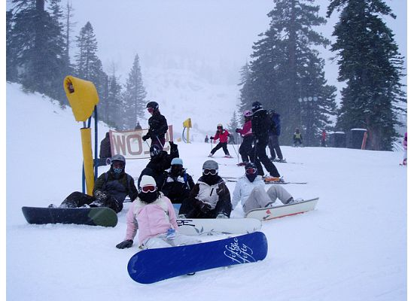
Rate of Change and Slope
Objective: Determine the slope of a line given a graph or two ordered pairs.

Slide 2
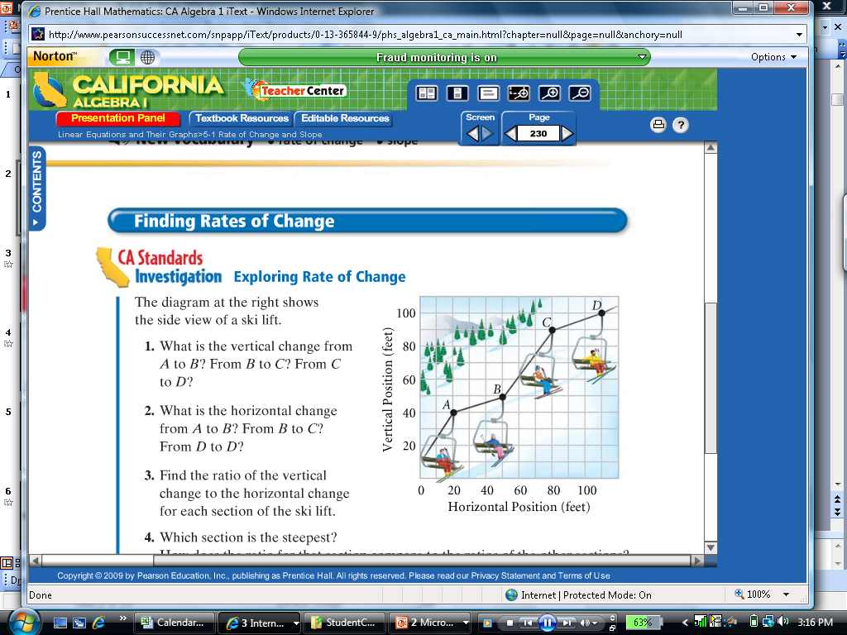
Quick Preview
The diagram at the right shows the side view of a ski lift.
What is the vertical change from:
  A to B?
  B to C?
  C to D?
What is the horizontal change from:
  A to B?
  B to C?
  C to D
10 feet
40 feet
10 feet
30 feet
30 feet
30 feet
Find the ratio of the vertical change to the horizontal change for each section of the ski lift.
Which section is the steepest?
A 1 B 4 C 1
B 3 C 3 D 3
= ; = ; =
B to C

Slide 3
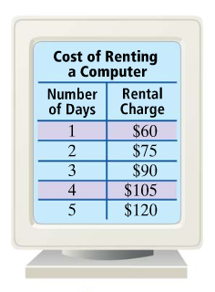


Rate of Change
$$Rise$$
$$\text{Run}$$
What is the rate of change for the data to the left?
change of quantity = $15
change of time = 1 day
$15 = $15/day
1 day
What does the rate of change mean?
It cost $15 more to rent a computer each day.

Slide 4
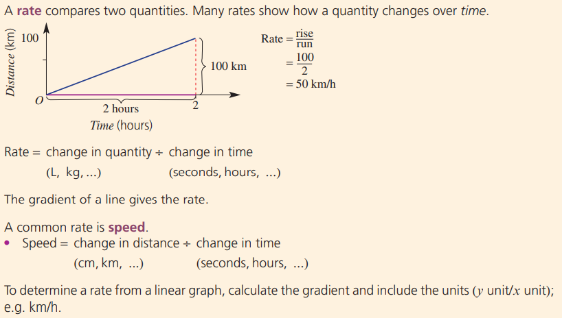

Slide 5
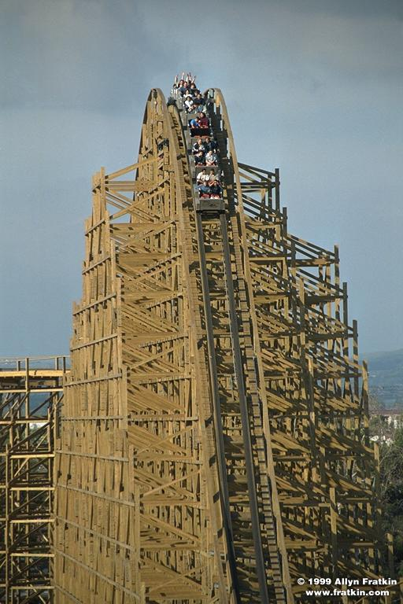
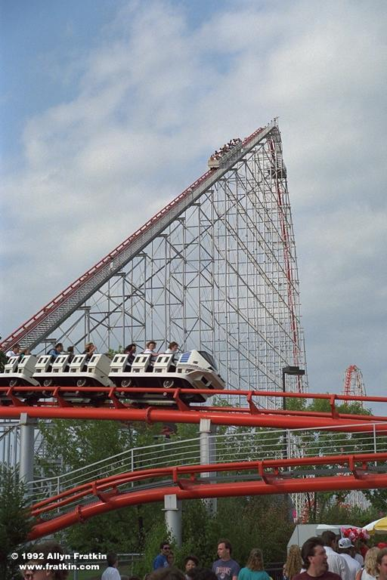
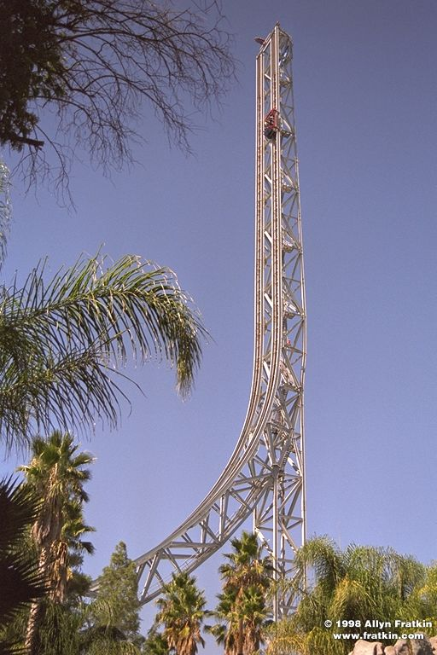
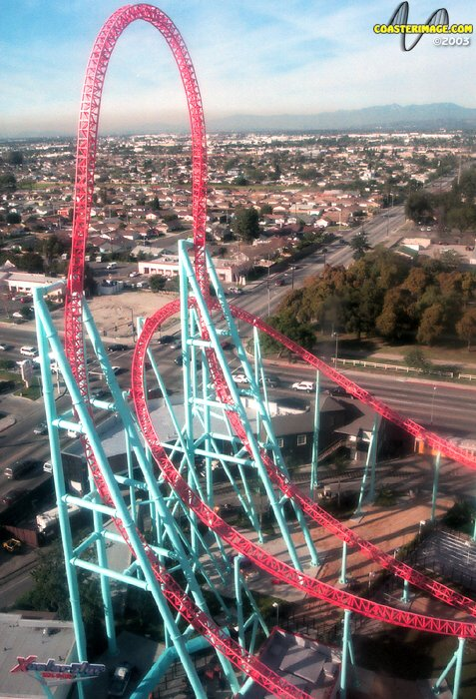
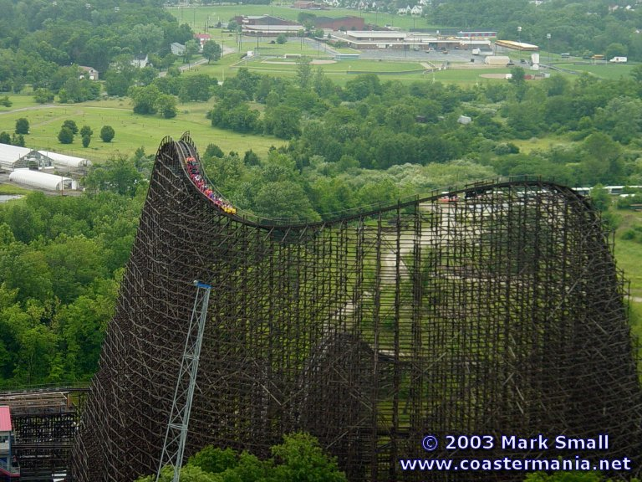
How steep is the steepest roller coaster?
The Magnum
Cedar Point, OH
Ghost Rider
Knott’s Berry Farm
Superman
6 Flags Magic Mountain
Xcelerator
Knott’s Berry Farm
These are
completely
vertical!
Son of Beast
King’s Island, OH

Slide 6
Imagine a roller coaster moving from LEFT to RIGHT

Slide 7
There are four different kinds of slope the coaster could encounter...

Slide 8

Uphill
Positive
Slope

Slide 9
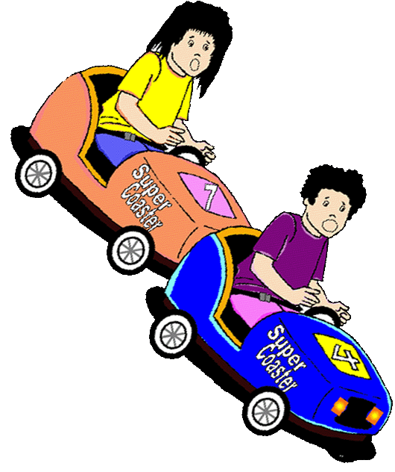
Negative
Slope
Downhill

Slide 10


And 2 Special Cases…
The impossibly scary coaster
The zero-fun coaster
What kind of slope are they?

Slide 11

Horizontal
Aw!
That’s zero fun!
Zero
Slope

Slide 12
That’s a really scary coaster, so the slope is…
Vertical
Undefined
Slope

Slide 13
For the following slides, call out whether the slope is positive, negative, zero, or undefined.
Wait for the count of 3 before you say your answer!

Slide 14
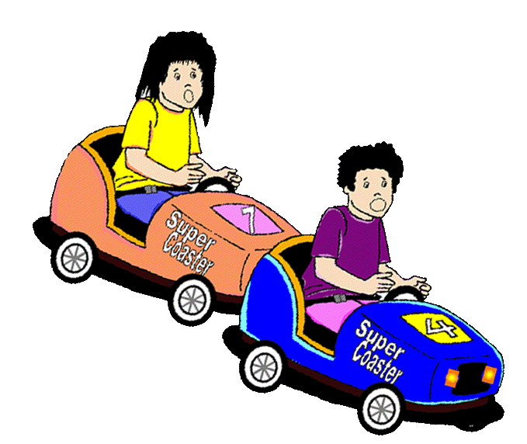
1
2
3
negative

Slide 15
1
2
3
positive

Slide 16
1
2
3
zero

Slide 17
1
2
3
undefined

Slide 18
How do you calculate the slope of a line?
There are 3 steps:
Pick two points on the line
Calculate “rise over run”
Determine the sign

Slide 19
Start with 2 points on gridline intersections
Step 1
OK
(2, 3)
OK
Not OK
OK
(1, 1)
OK
Not OK
OK
(0, -1)
OK
Not OK
OK
(-1, -3)
OK

Slide 20
How do you calculate the slope of a line?
Step 2
Vertical change
m
Slope =
divided by
Horizontal change
m
Rise
OR...
Slope =
Run
divided by
Run
Rise

Slide 21
What sign is it?
Step 3
Show me!
Look to see if the slope is increasing
Positive
Or decreasing
Negative

Slide 22

Step 1: Choose 2 points
Model # 1: Watch me do the three steps
Step 2:
Rise
Run = 1
Slope =
divided by
Run
positive
Rise = 2
Step 3:
Determine
the sign
m = 2
2
Rise
+
divided by
1
Run

Slide 23

Step 1: Choose 2 points
Model # 2: Watch me do the three steps
Step 2:
Rise
Run = 3
Slope =
divided by
Run
Rise = 1
negative
Step 3:
Determine
the sign
m = 1/3
1
Rise
-
divided by
3
Run

Slide 24
Practice # 3: Find the slope of this line
Think Pair Share
Run = 2
Rise = 3
Rise
divided by
Run
+
Step 1: Choose Two points
Step 2: Rise Over Run
Step 3: Determine Sign

Slide 25
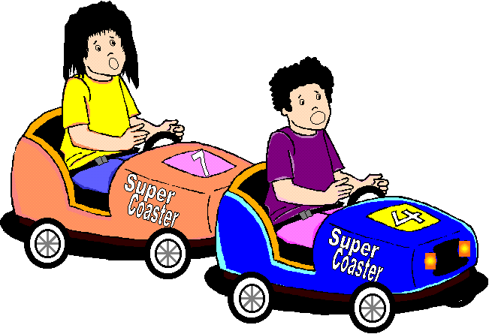
Practice # 4: Find the slope of this line
Think Pair Share
negative
Run = 3
Rise = 1
Rise
divided by
Run
Step 1: Choose Two points
Step 2: Rise Over Run
Step 3: Determine Sign

Slide 26
Slope Formula
x₁
y₁
x₂
y₂
5. Given (5, -3) and (-4, 2), find the slope of the line.
m =

Slide 27
Slope Formula
x₁
y₁
x₂
y₂
6. Given (0, -2) and (4, -2), find the slope of the line.
m =

Slide 28
Tell your partner...
What are the steps to find the slope of a line from a graph?
Calculate
rise over run.
Look at the
line to see if
the slope is
positive or
negative.

Slide 29
Wrap Up
Rate of Change (includes units)
Slope
  Positive
  Negative
  Zero
  Undefined
HW: P. 234 #1-29 odd, 75-85 odd
DLUQ: What’s the difference between slope and rate of change?

Slide 30
Before you leave:
1. What type of slope is shown? (Positive, negative, zero or undefined?)
2. What would a slope of -1/2 look like? (Uphill, downhill, steep, shallow)
3. What is the slope of the line above?

