Slide 1
Learning objective:
To be able to:
Calculate the gradient of a straight line
Work out the equation of a straight line
Write the learning objective into your books and discuss in pairs the following question:
What is gradient?
Notes:
https://quizizz.com/admin/quiz/62faff64072c6f001d2165e5?source=quiz_share
https://quizizz.com/admin/quiz/634f1c352574da001d7f4e10?source=quiz_share
https://quizizz.com/admin/quiz/62f2fd406bf071001defc623?source=quiz_share
https://create.kahoot.it/share/052e2d1f-e01a-4265-8ea8-580bb7c47065
https://create.kahoot.it/share/b65a58b4-aaac-4635-a05f-cbcf3f1154c3
https://dashboard.blooket.com/set/62fc174f624294b64fc0fdc9
https://dashboard.blooket.com/set/60c7d7e13fce2f001bfc6e90
https://dashboard.blooket.com/set/61f9a4f90f3147aec55b805e
https://dashboard.blooket.com/set/61a6654e1ce3b064598f25aa
https://dashboard.blooket.com/set/62267faa2ab8f1122daae152

Slide 2
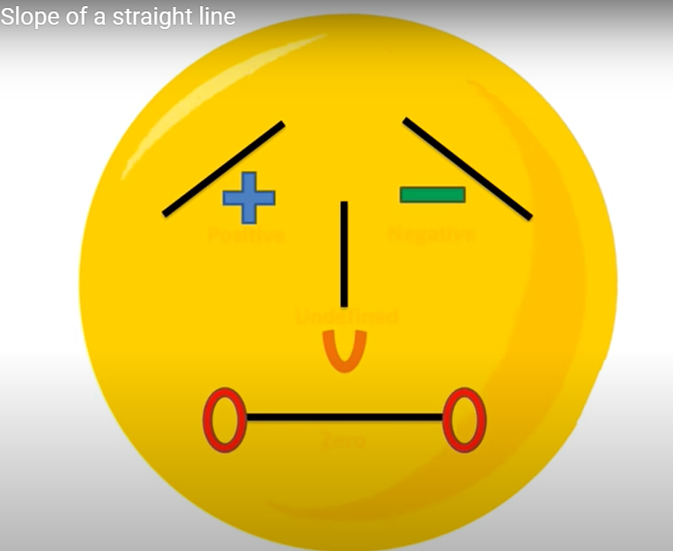
What is gradient?
Gradient is the measure of how steep a line is. The bigger the gradient, the steeper the line.

Slide 3
The way we work out the gradient of any line is by the formula:
change in y
Gradient =
change in x
Rise
Gradient = Slope =
Run

Slide 4
slope
$\frac{Rise}{Run}$
Unit rate
Hourly rate
Gradient
Rate of change
$\frac{the change in Y}{the change in X}$
m in y=mx+c
Next to the x in the equation y=mx+c

Slide 5
The equation of any straight line is of the form:
y = mx + c
Gradient
(steepness)
y-intercept
(where is crosses the y-axis)

Slide 6
Y-intercept
Initial value
Starting point
One time fee
Where the line crosses the y-axis
Down payment
The letter b in y=mx+c
Fixed
By itself in the equation y=mx+c
Where x=0
point

Slide 7
y = mx + c
Gradient of 2
crosses y-axis
Gradient
Increase of 2 up the y-axis
For 1 along the x-axis
Crosses y-axis at 3
y = 2x + 3

Slide 8
y = mx + c
Gradient of 3
crosses y-axis
Gradient
Increase of 3 up the y-axis
Crosses y-axis at 2
For 1 along the x-axis
y = 3x + 2

Slide 9
y = mx + c
Gradient of 1
crosses y-axis
Gradient
Increase of 1 up the y-axis
Crosses y-axis at 4
For 1 along the x-axis
y = x + 4

Slide 10
See if you can find the equation of the following graphs...

Slide 11
change in y
Gradient of 5
y = mx + c
Gradient =
change in x
crosses y-axis
Gradient
Crosses y-axis at 1
y = 5x + 1
Increase of 5 up the y-axis
For 1 along the x-axis

Slide 12
change in y
y = mx + c
Gradient of 4
Gradient =
change in x
crosses y-axis
Gradient
Increase of 4 up the y-axis
Crosses y-axis at 4
For 1 along the x-axis
y = 4x + 4

Slide 13
change in y
Gradient of 2
y = mx + c
Gradient =
change in x
crosses y-axis
Gradient
Crosses y-axis at -1
Increase of 2 up the y-axis
y = 2x - 1
For 1 along the x-axis

Slide 14
Equations of harder lines plenary

Slide 15
-1
Gradient of
change in y
y = mx + c
3
Gradient =
change in x
crosses y-axis
Gradient
-1
-1 ÷ 3 =
3
-1
Gradient of
Crosses y-axis at 5
3
Decrease of 1 down the y-axis
-1
y = x + 5
For 3 along the x-axis
3

Slide 16
-2
Gradient of
change in y
y = mx + c
3
Gradient =
change in x
crosses y-axis
Gradient
-2
-2 ÷ 3 =
3
-2
Crosses y-axis at 5
Gradient of
3
-2
y = x + 5
3
Decrease of 2 down the y-axis
For 3 along the x-axis

Slide 17
y
8
7
6
5
4
3
2
1
x
–7 –6 –5 –4 –3 –2 –1
1 2 3 4 5 6 7
⁻1
⁻2
⁻3
⁻4
⁻5
⁻6

Slide 18
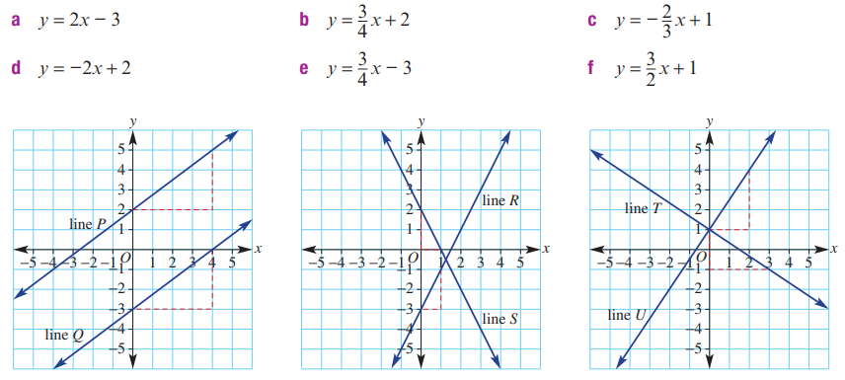
Matching up?

