Slide 1

Graphing Using x and y Intercepts
TODAY I AM GOING TO SHOW YOU
AN EASIER WAY TO GRAPH LINES
BUT REMEMBER WHEN ALL ELSE
FAILS, YOU CAN ALWAYS SOLVE
FOR Y AND MAKE A T-CHART!!!

Slide 2


What does it mean to INTERCEPT a pass in football?
The path of the defender crosses the path of the thrown football.
In algebra, what are x- and y-intercepts?

Slide 3

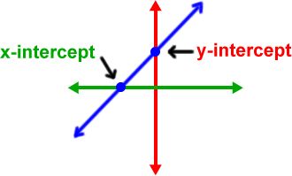
The x-intercept of a graph is the point where the graph crosses the x-axis.
The y-intercept of a graph is the point where the graph crosses the y-axis.

Slide 4
y
x - intercept
X
(2,0)
(0,-1)
y - intercept
Notes:
Definitions. Instruct student to add to notebook.

Slide 5
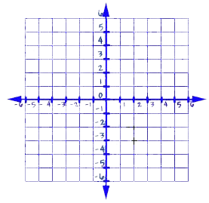
Vocabulary – BIG CONCEPT
x-intercept - the coordinate of a point where the graph crosses the x-axis. (Important – this is when y = 0)
y-intercept - the coordinate of a point where the graph crosses the y-axis (when x = 0).
y - intercept
x - intercept

Slide 6
EXAMPLES OF X-INTERCEPTS
(-2,0)
(-1,0)
(4,0)
(0,0)
(1.8,0)
(-256,0)
REMEMBER Y = 0
EXAMPLES OF Y-INTERCEPTS
(0,-44)
(0,19)
(0,5)
(0,0)
REMEMBER X = 0

Slide 7
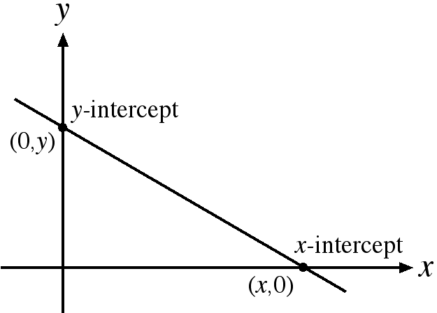
Example 1: Find the x-intercept and the
y-intercept of the graph of 3x - 4y = 12.
To find the x-intercept, plug zero in for y and solve for x.
To find the y-intercept, plug zero in for x and solve for y.

Slide 8
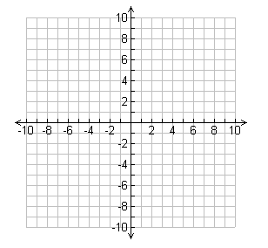
3x - 4y = 12
x-intercept
3x – 4(0) = 12
3x = 12
x = 4
  y-intercept
  3(0) – 4y= 12
-4y = 12
y = -3
(4,0)
(0,-3)
Make a small t-chart
x y
4
0
0
-3

Slide 9
So when is it a good idea to use x and y intercepts to graph???
When the two coefficients go into the constant!!
2x + 3y = 6
-3x – 4y = 24
12x + 5y = 60
5x – 4y = 40

Slide 10
Example 2: Graph the equation
4x + 8y =24 using the x and y-intercepts.
Find the x and y-intercepts.
Plot the x and y-intercepts and draw a line through them connecting them with a straight edge.
4x + 8y =24
x-intercept y-intercept
4x + 8(0) = 24 4(0) + 8y = 24
4x = 24 8y = 24
(6,0) (0,3)

Slide 11
(0,3)
4x + 8y =24
(6,0)

Slide 12
Example 3: Identify the x-intercept and y-intercept
of the graph.
x-int: (2,0)
y-int: (0,-4)

Slide 13
Graph 4x + 3y = 12 using intercepts
Find x-intercept
4x + 3(0) = 12
Find y-intercept
4(0) + 3y = 12
4x = 12
3y = 12
x = 3
y = 4
Notes:
Teach and demonstrate the concept.

Slide 14
Horizontal and Vertical Lines
The graph of y= # is HORIZONTAL
The graph x =# is VERTICAL

Slide 15
The equation
is written _______________ form.
slope intercept
If we move “
” to the other side of the equation,
we have _______________________.

Slide 16
If we move “
” to the other side of the equation,
we have _______________________.
This is still a ________ equation, but it is written
in a different form.
linear
A linear equation in the form _______________ is in ______________, where A, B, and C are integers.
standard form

Slide 17
Quick Review
An x-intercept is the ______ coordinate of a point where a graph crosses the ____ axis.
At the x-intercept, the value of y is _____.
A y-intercept is the ______ coordinate of a point where a graph crosses the ____ axis.
At the y-intercept, the value of x is ______ .
To graph a line using the intercepts you need to…….
How many ways do you know how to graph NOW?

