Slide 1
Constant of Proportionality, Unit Rate, and Slope
One bag of pretzels costs three dollars. Five bags of pretzels costs $10. Which is the better deal?
https://www.youtube.com/watch?v=Cbge4teixr0

Slide 2
Vocabulary
Relationships that have a positive proportional relationship are said to have Direct Variation or Vary Directly
Direct Variation – the ratio of output and input ($\frac{y}{x}$)
is constant (proportional).
The constant ratio is called the Constant of Proportionality
Constant of Proportionality - a constant ratio (unit rate) in any proportional relationship.

Slide 3
Formula for Proportional Relationships:
All proportional relationships fit the same formula:
y = kx
Total
Focus
(dependent variable)
(independent variable)
Constant of Proportionality!!!!

Slide 4
What if I told you to find the Constant of Proportionality?
y = kx
Does this look like anything you've seen before?
y
new
__
_____
k =
k =
x
original

Slide 5
RATES OF CHANGE
Scale
Slope
Unit Rate
Constant of Proportionality

Slide 6
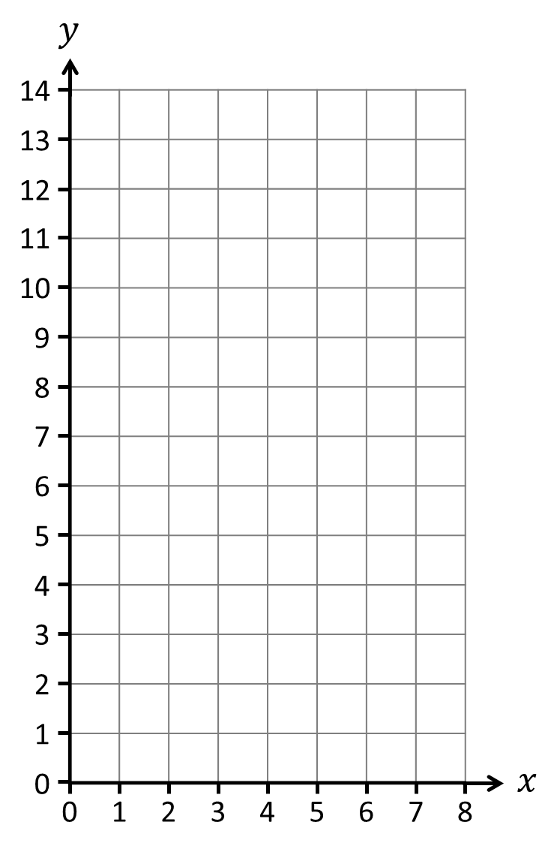
A theatre group sells tickets to
its next performance.
Each ticket costs £3.
$$y=4x$$
$$y=3x$$
What does the income graph look like?
What is the gradient?
Where is the $y$-intercept?
$$y = kx$$
Income
£
$$y=3x$$
gradient,
constant of proportionality
If they charge £4 how
does the graph change?
$y$-intercept
(0, 0)
$x$ & $y$ are directly proportional.
When one variable doubles, so
does the other.
Tickets Sold

Slide 7
A taxi company charges
£2 per mile plus a £3 pickup charge.
What does the cost graph look like?
Are $x$ & $y$ proportional?
$$y=2x+3$$
Cost
£
When $x$ = 2, $y$ = 7
When $x$ = 4, $y$ = 11
$x$ & $y$ are in a linear relationship but
not directly proportional.
Because of the pickup charge, the variables do not increase at the same rate.
Miles Travelled

Slide 8
The relationship between two variables can be graphed.
If they have a linear, directly proportional relationship, the line will be straight & pass through the origin.
$$y$$
Which of these relationships can be
represented with a linear direct proportion graph?
Revision Time – Test Result
Cookies eaten – Calories consumed
0
$$x$$
0
Employees – Products produced
Linear Direct Proportion
Earnings – Hours worked
$$y = kx$$
Home heating – Energy Bill

Slide 9
If you didn’t revise would you get zero?
Which of these relationships can be
represented with a linear direct proportion graph?
Employees also need equipment. So more workers don’t necessarily create more products.
Revision Time – Test Result
Cookies eaten – Calories consumed
Employees – Products produced
Earnings – Hours worked
Heat is harder & harder to create: a tropical-temperature living room would cost a lot more than one slightly above ambient temperature.
Home heating – Energy Bill

Slide 10
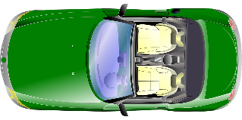
These questions all show two variables in direct proportion.
When one quantity increases or decreases so does the other.
$$y \text{∝} x$$
Proportionality constant
(the multiplying factor)
Equation of Proportionality
$$y = kx$$
A car can travel 30 miles per litre of petrol.
How far can the car travel with 5 litres of fuel?
$$total distance = k ×litres$$
$$total distance = 30 ×litres$$
$$= 30 ×5$$
$= 150$ miles
A shoe factory produces 120 shoes a day.
How many shoes are produced in half a day?
$$total shoes = k ×days$$
$$total shoes = 120 ×days$$
$$= 120 ×0.5$$
$= 60$ shoes

Slide 11
To answer proportion questions we must know $k$,
the multiplying factor between variables.
Proportionality constant
(the multiplying factor)
$$y = kx$$
$$20 = k × 4$$
A sports car can travel 20 miles using 4 litres of petrol.
How far can the car travel with 11 litres of fuel?
$$5 = k$$
$$y = kx$$
$$y = 5 ×11$$
$y = 55$ miles
$$90 = k ×3$$
A shoe factory produces 90 shoes in 3 days.
How many shoes are produced in 7 days?
$$30 = k$$
$$y = kx$$
$$y = 30 ×7$$
How can you find k?
Show with an equation.
$y = 210$ shoes

Slide 12
①
Write an equation of proportionality.
Substitute $x$ & $y$ to find $k$.
Rewrite the equation using $k$ and substitute $x$ to find $y$.
②
③
①
$$y = kx$$
total feed
days
Over 2 days a herd of cows eat 16 kg of feed.
How much feed does the herd eat over 3 days?
②
$$16 = k ×2$$
$$8 = k$$
8 kg per day
③
$$y = 8x$$
$$y = 8×3$$
$$y = 24$$
kg

Slide 13
Write an equation of proportionality.
Substitute $x$ & $y$ to find $k$.
Rewrite the equation using $k$ and substitute $x$ to find $y$.
$y$ is directly proportional to $x$.
$y$ = 27 when $x$ = 9
Find the value of $y$ when $x$ = 5
$$y = kx$$
$$27 = k ×9$$
$$3= k$$
REWRITE & SUBSTITUTE
$$y = 3x$$
$$y = 3×5$$
$$y = 15$$

Slide 14
Write an equation of proportionality.
Substitute $x$ & $y$ to find $k$.
Rewrite the equation using $k$ and substitute $x$ to find $y$.
$y$ is directly proportional to $x$.
$y$ = 32 when $x$ = 4
Find the value of $y$ when $x$ = 10
$$y = kx$$
$$32 = k ×4$$
$$8= k$$
REWRITE & SUBSTITUTE
$$y = 8x$$
$$y = 8×10$$
$$y = 80$$

Slide 15
Write an equation of proportionality.
Substitute $x$ & $y$ to find $k$.
Rewrite the equation using $k$ and substitute $x$ to find $y$.
$y$ is directly proportional to $x$.
$y$ = 32 when $x$ = 4
Find the value of $y$ when $x$ = 10
$y$ is directly proportional to $x$.
$y$ = 18 when $x$ = 2
Find the value of $y$ when $x$ = 7
$$y = kx$$
$$y = kx$$
$$32 = k ×4$$
$$18 = k ×2$$
$$8= k$$
$$9= k$$
REWRITE & SUBSTITUTE
REWRITE & SUBSTITUTE
$$y = 8x$$
$$y = 9x$$
$$y = 8×10$$
$$y = 9×7$$
$$y = 80$$
$$y = 63$$

Slide 16
Write an equation of proportionality.
Substitute $x$ & $y$ to find $k$.
Rewrite the equation using $k$ and substitute $x$ to find $y$.
$y$ is directly proportional to $x$.
$y$ = 32 when $x$ = 4
Find the value of $y$ when $x$ = 10
$y$ is directly proportional to $x$.
$y$ = 30 when $x$ = 6
Find the value of $y$ when $x$ = 20
$$y = kx$$
$$y = kx$$
$$32 = k ×4$$
$$30 = k ×6$$
$$8= k$$
$$5= k$$
REWRITE & SUBSTITUTE
REWRITE & SUBSTITUTE
$$y = 8x$$
$$y = 5x$$
$$y = 8×10$$
$$y = 5×20$$
$$y = 80$$
$$y = 100$$

Slide 17
Write an equation of proportionality.
Substitute $x$ & $y$ to find $k$.
Rewrite the equation using $k$ and substitute $x$ to find $y$.
$y$ is directly proportional to $x$.
$y$ = 32 when $x$ = 4
Find the value of $y$ when $x$ = 10
$y$ is directly proportional to $x$.
$y$ = 15 when $x$ = 6
Find the value of $y$ when $x$ = 4
$$y = kx$$
$$y = kx$$
$$32 = k ×4$$
$$15 = k ×6$$
$$8= k$$
$$2.5= k$$
REWRITE & SUBSTITUTE
REWRITE & SUBSTITUTE
$$y = 8x$$
$$y = 2.5x$$
$$y = 8×10$$
$$y = 2.5×4$$
$$y = 80$$
$$y = 10$$

Slide 18
$y$ is directly proportional to $x$.
When$x$ = 6, $y$ = 24
a) When $x$ = 7 what does $y$ equal?
$$y = 4x$$
$$y = 4 ×7$$
$$y = kx$$
$$y = 28$$
$$24 = k ×6$$
$$4 = k$$
b) When $y$ = 36 what does $x$ equal?
$$y = 4x$$
$$y = 4x$$
$$36 = 4 ×x$$
(÷ 4)
(÷ 4)
Using our equation of proportionality we need to be able to find $x$ or $y$.
$$9 = x$$
c) When $y$ = 8 what does $x$ equal?
$$y = 4x$$
$$8 = 4 ×x$$
(÷ 4)
(÷ 4)
$$2 = x$$

Slide 19
Summarize
What does a relationship that is proportional look like on a graph?
How is the Constant of Proportionality (Unit Rate) involved?

