Slide 1
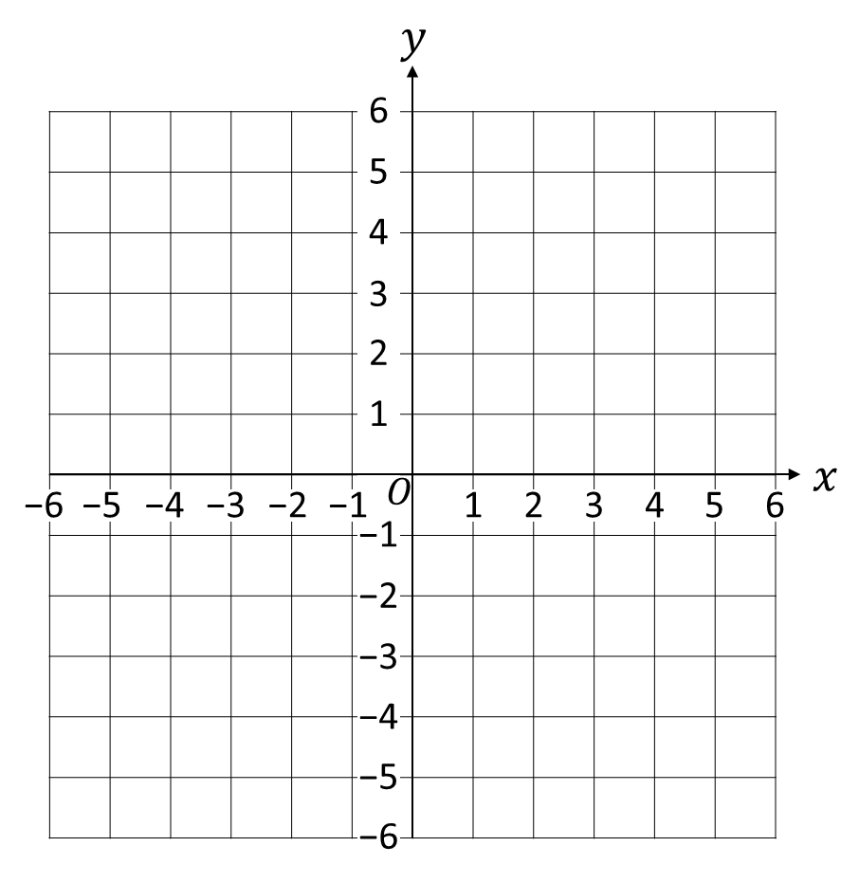
Vocabulary
$y$-axis
Equation
$x, y$values
Point
$$y=2x+3$$
$x$-axis
Variables
We plot, or draw,
a graph on a grid.
The line represents all
the values where the
equation is true, is satisfied.
Origin
(0 , 0)
Line Segment
(it goes forever)

Slide 2
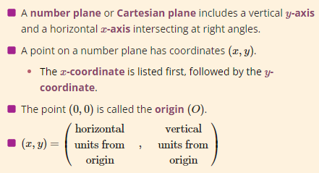
22 November 2022
Plotting Linear Graphs:
Table of Values

Slide 3
You only need 2 points to plot a straight line.
Why bother with the rest?
Do you agree?
$$y=2x+3$$
$$y=2x+3$$
$$x$$ | 0 | −2
$$y$$ | 3 | −1

Slide 4
Introduction
A line segment is a part of a line that is noted by two endpoints, ($x_{1}, y_{1})$ and ($x_{2}, y_{2}$).
You can divide a line segment in lots of different ways.
A popular partition is dividing a line segment into two equal parts. The point on the segment where this division occurs is called the midpoint.

Slide 5
Steps to Finding the Midpoint of a Line Segment
Determine the endpoints of the line segment, (x₁, y₁) and (x₂, y₂). Write the Midpoint Formula. Substitute the values of (x₁, y₁) and (x₂, y₂) into the midpoint formula: Simplify.

Slide 6
Guided Practice - Example 1
Calculate the midpoint of the line segment with endpoints (–2, 1) and (4, 10).
Write and label the endpoints of the line segment. (x₁, y₁) and (x₂, y₂). (–2, 1) and (4, 10). | Substitute your endpoints into the Midpoint Formula. ( $\frac{−2+4}{2}$ , $\frac{1+10}{2}$ )
2. Write the Midpoint Formula. | Simplify. ( $\frac{2}{2}$ , $\frac{11}{2}$ ) ( $1$, $5.5$)
Notes:
https://quizizz.com/admin/quiz/6290fa61de08ed001d527843?source=quiz_share
https://quizizz.com/admin/quiz/62fb5b5720dd9e001e27462b?source=quiz_share

Slide 7
Length of a Line Segment
What could I use to measure the length of the line AB?
y
(6, 3)
c² = a² + b²
c² = 4² + 2²
c² = 16 + 4
c² = 20
c = √20
c = 4.47 (2dp)
3
B
2
2
A
1
4
(2, 1)
$$x$$
-7
-6
-5
-4
-3
-2
-1
0
1
2
3
4
5
6
7
-1
-2
-3

Slide 8
Length of a line segment
What is the length of the line between the points (1, 6) and (5, 9)?
c² = a² + b²
c² = 4² + 3²
c² = 16 + 9
c² = 25
c = √25
c = 5
(5, 9)
3
(1, 6)
4

Slide 9
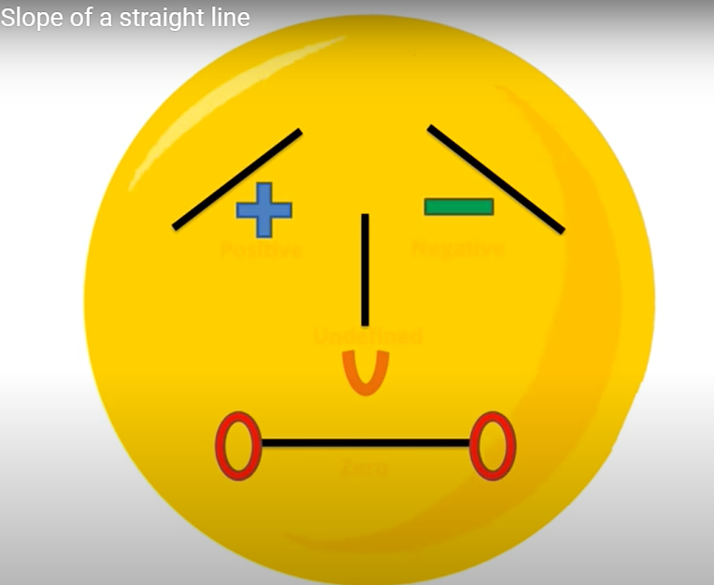
What is gradient?
Gradient is the measure of how steep a line is. The bigger the gradient, the steeper the line.

Slide 10
The way we work out the gradient of any line is by the formula:
change in y
Gradient =
change in x
Rise
Gradient = Slope =
Run

Slide 11
change in y
Gradient =
change in x
2 ÷ 1 = 2
Increase of 2 up the y-axis
Rise
Gradient of 2
For 1 along the x-axis
Run

Slide 12
change in y
Gradient =
change in x
-2 ÷ 1 = -2
Gradient of -2
Decrease of 2 down the y-axis
For 1 along the x-axis

Slide 13
The equation of any straight line is of the form:
y = mx + c
Gradient
(steepness)
y-intercept
(where is crosses the y-axis)

Slide 14
y = mx + c
Gradient of 2
crosses y-axis
Gradient
Increase of 2 up the y-axis
For 1 along the x-axis
Crosses y-axis at 3
y = 2x + 3

Slide 15
See if you can find the equation of the following graphs...

Slide 16
change in y
Gradient of 5
y = mx + c
Gradient =
change in x
crosses y-axis
Gradient
Crosses y-axis at 1
y = 5x + 1
Increase of 5 up the y-axis
For 1 along the x-axis

Slide 17
-1
Gradient of
change in y
y = mx + c
3
Gradient =
change in x
crosses y-axis
Gradient
-1
-1 ÷ 3 =
3
-1
Gradient of
Crosses y-axis at 5
3
Decrease of 1 down the y-axis
-1
y = x + 5
For 3 along the x-axis
3

Slide 18
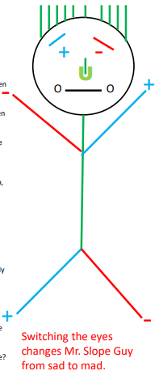

Slide 19
Mr. Slope

Slide 20
Mr. Slope

