Slide 1

Data Types
1A

Slide 2
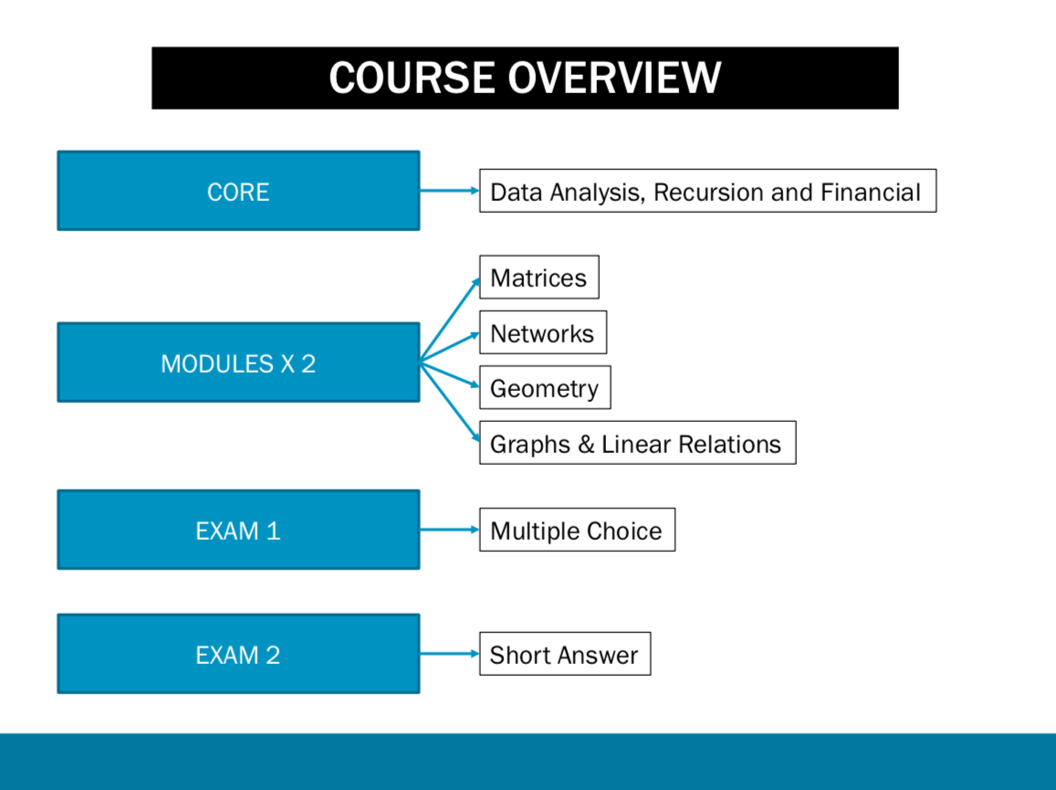
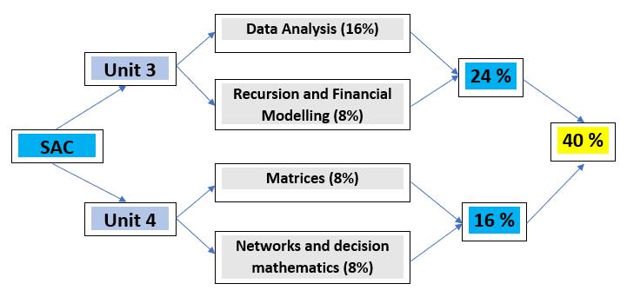
School Assessment Coursework SAC

Slide 3

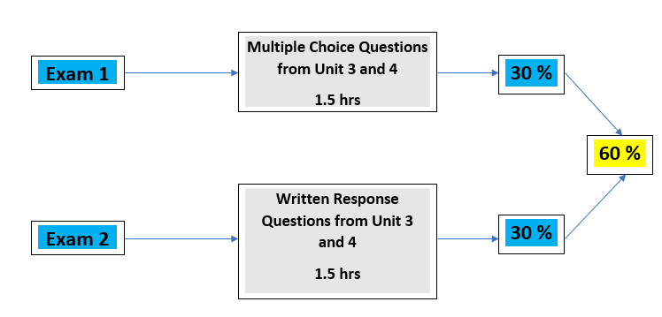
External Exams
34

Slide 4
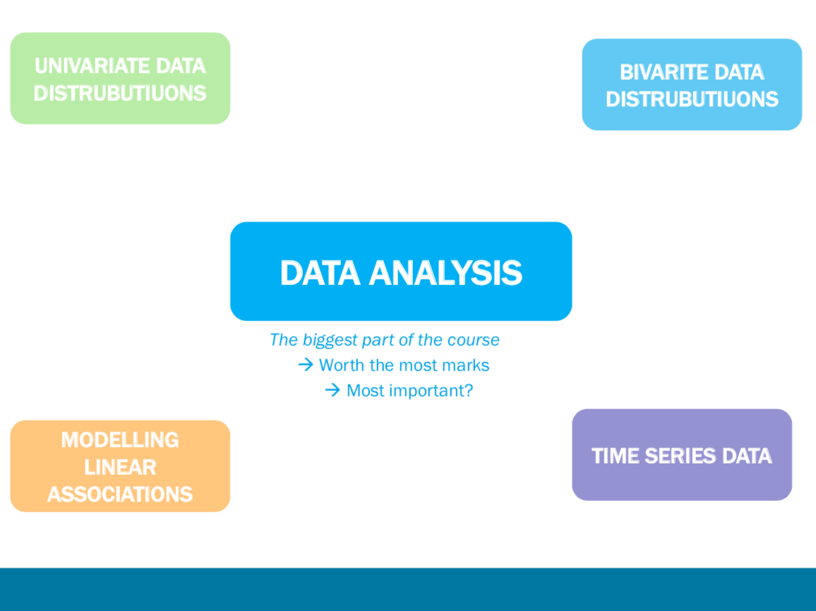

Slide 5
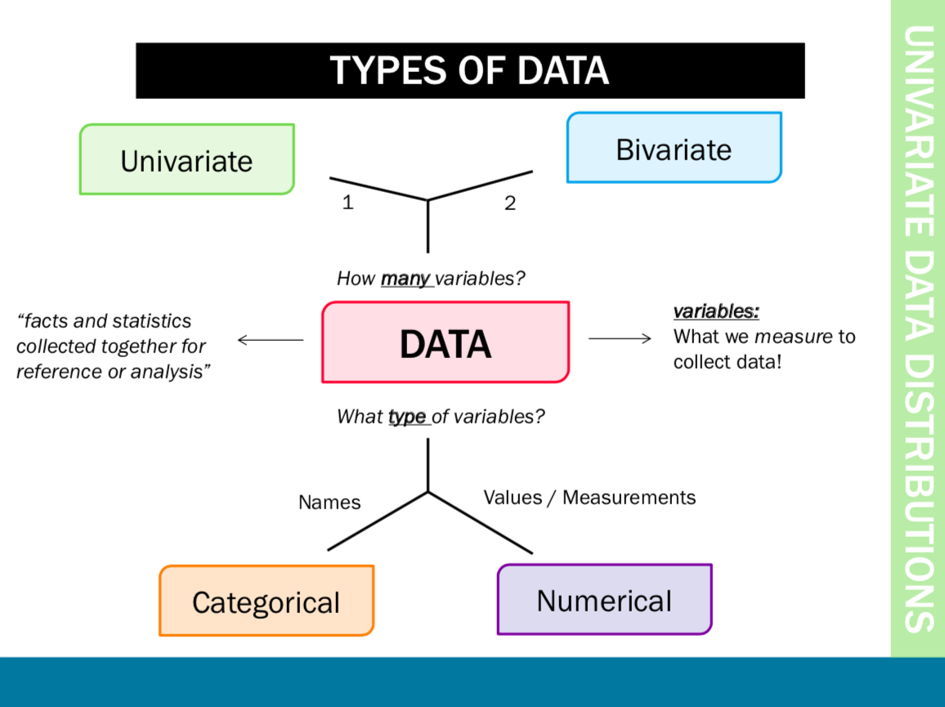

Slide 6
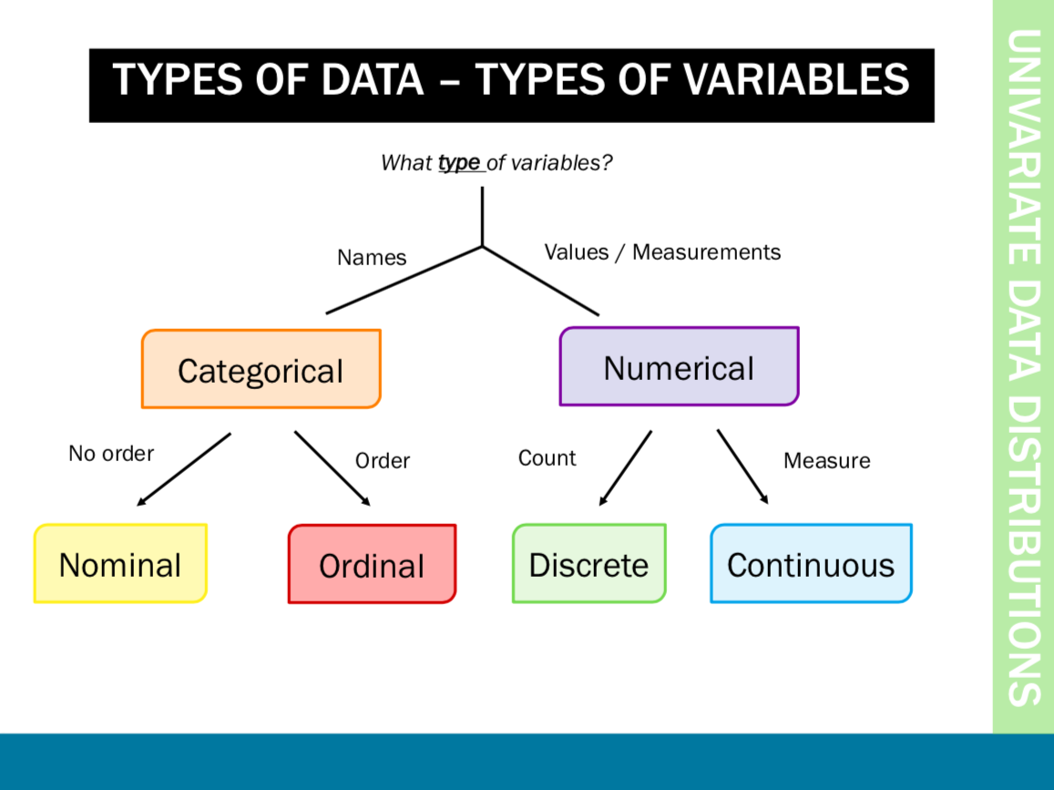

Slide 7

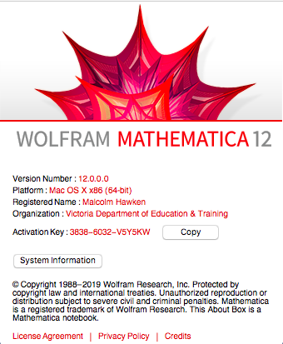

Slide 8
Data types
Data Variables
Numerical:
Measured/ counted data
Categorical:
appear as categories
Tick boxes on questionnaires
Notes:
What types of data are there? Within the data structure there are observations or individuals, and for each observation there are data variables. These variables can be classified into two main groups, Numerical and categorical.
Categorical variables indicate categories and questions with categorical answers usually appear as tick boxes on questionaires. Numerical variables are either measurements or counts.

Slide 9





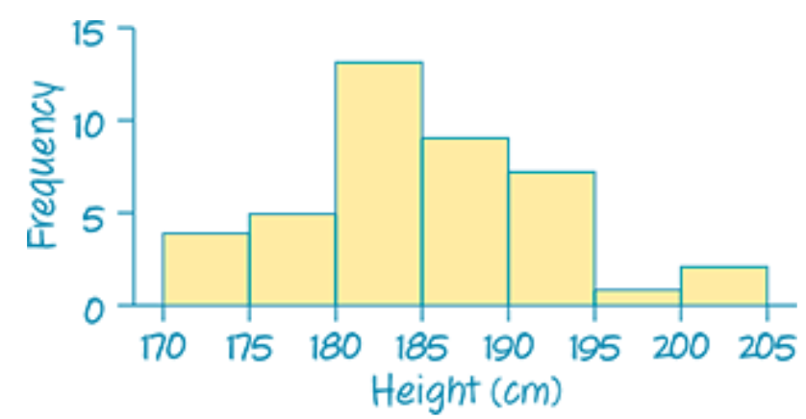
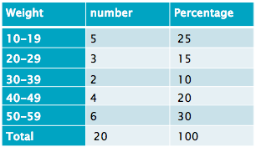
Data types
Variables
Numerical
Categorical
Continuous
Measurements
takes any value
Discrete:
Counts/ integers
Ordinal:
obvious order
Nominal:
no meaningful order
Notes:
Categorical variables can be divided into two: ordinal and nominal. If the categories are meaningfully ordered, the variable is ordinal; if it doesn’t matter in which way the categories are ordered, then the variable is nominal. For example, satisfaction levels (dissatisfied, satisfied and highly satisfied) and education level (secondary, sixth form, undergraduate and postgraduate) are ordinal variables; Student’s religion (Christian, Muslim, Hindu, etc) and favourite animal are nominal variables.
Numerical variables appear as meaningful comparable numbers, such as blood pressure, height, weight, income, age, and probability of illness etc. Numerical variables can be further divided into two subtypes: continuous and discrete. The continuous variables can take any value within a range and are the most common, e.g. body weight, height, income, etc. Discrete variables can only take whole numbers, such as number of students in class, number of new patients every day, etc but are treated as continuous for statistical analysis if there are a large range of numbers.
One point to make is that if ordinal data is scored as ranks such as 1, 2, 3 etc., and then this data is analysed as scale data, then a rather strong assumption is being made that the distances between the value of any pair of neighbouring ranks (e.g. 1 and 2 or 2 and 3 etc.) is the same, which is unlikely in practice to be true. Students often find the difference between ordinal and discrete difficult especially when ordinal is categorised as numbers
The point is that whilst this might not be the most interesting place to start – students need to be aware of the data they have since this affects what analyses are/not suitable.

Slide 10
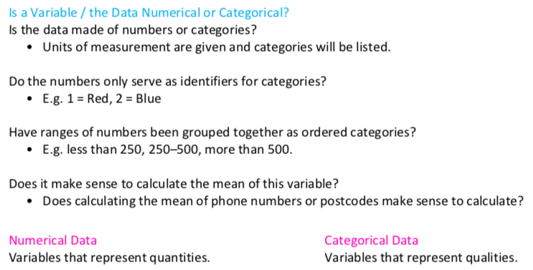

Slide 11
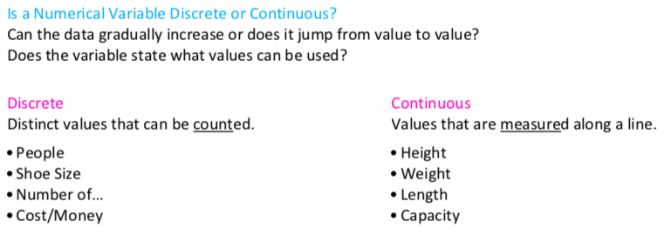

Slide 12
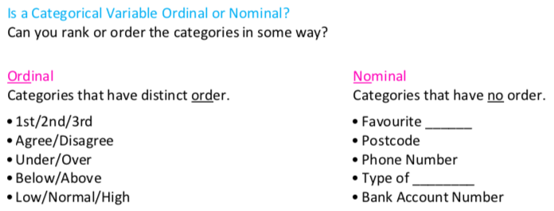

Slide 13
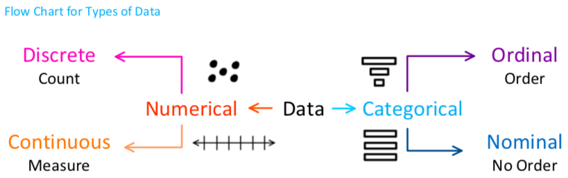

Slide 14
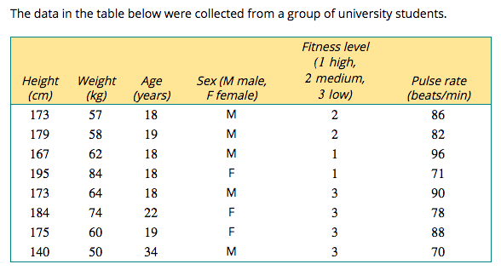

Slide 15
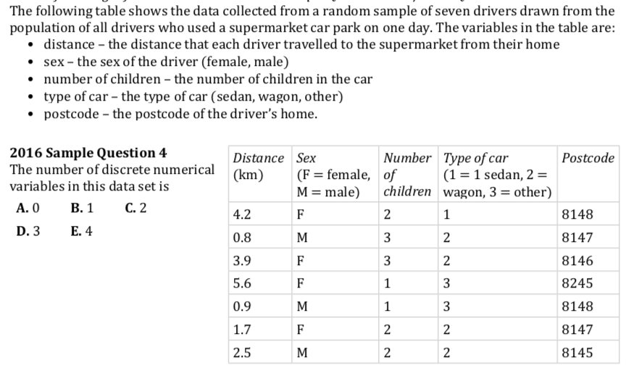

Slide 16
    exercises & Summary Book
1. Ex page 1-3
2. Summary notes

