Slide 1
Investigating associations between categorical variables
2B

Slide 2
Explanatory Variable
Response Variable

Slide 4
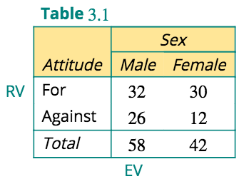
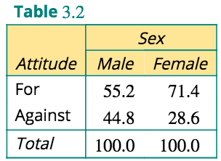

Slide 9
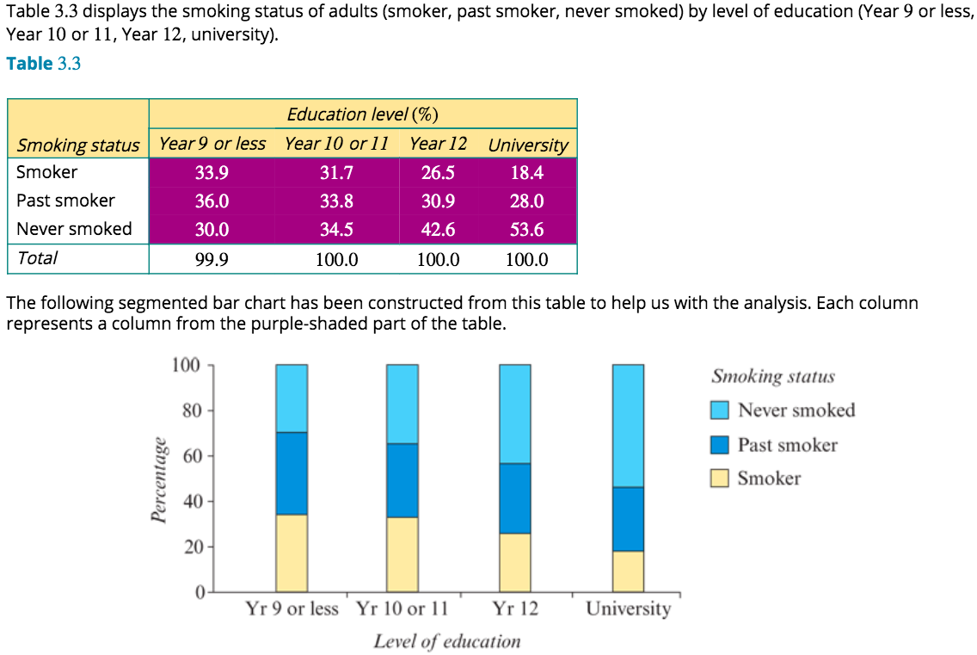
Analysing a situation where two categorical variables have multiple categories

Slide 12
exercises & Summary Book
1. Ex page 2B
2. Summary notes

