Slide 1
1D Ratios & Proportion
Notes:
https://www.mathgames.com/skill/7.31-solving-proportions
https://quizizz.com/admin/quiz/5817addeefa277402cee5a37/solving-proportions
https://create.kahoot.it/details/439b683f-c311-42c7-a7bd-7e7f00de082a
https://quizizz.com/admin/quiz/58e3bbb1578787c01e4c9aa2?source=quiz_share
https://quizizz.com/admin/presentation/602f140eb92419001e655fde?source=lesson_share

Slide 2
A RATIO is a quotient
that compare 2 quantities.
3
4
3 : 4
3 to 4
These are all the same.

Slide 3
How to simplify ratios?
Now I tell you I have 12 cats and 6 dogs. Can you simplify the ratio of cats and dogs to 2 to 1?
=
=
Divide both numerator and denominator by their Greatest Common Factor 6.

Slide 4
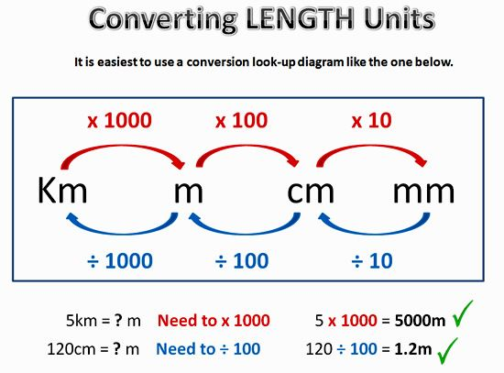
How to simplify ratios?
A person’s arm is 80cm, he is 2m tall.
Find the ratio of the length of his arm to his total height
To compare them, we need to convert both numbers into the same unit …either cm or m.
Let’s try cm first!
Once we have the same units, we can simplify them.

Slide 5
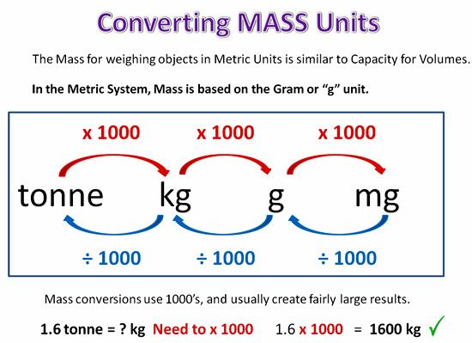
How to simplify ratios?
If the numerator and denominator do not have the same units it may be easier to convert to the smaller unit so we don’t have to work with decimals…
3cm/12m = 3cm/1200cm = 1/400
2kg/15g = 2000g/15g = 400/3
2g/8g = 1/4
Of course, if they are already in the same units, we don’t have to worry about converting. Good deal☺

Slide 6
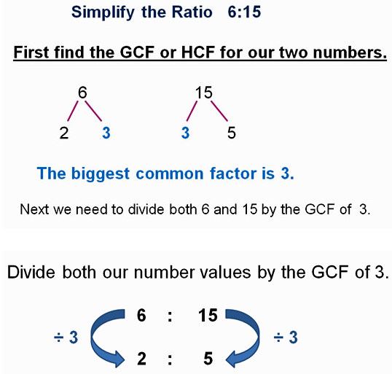

Slide 7
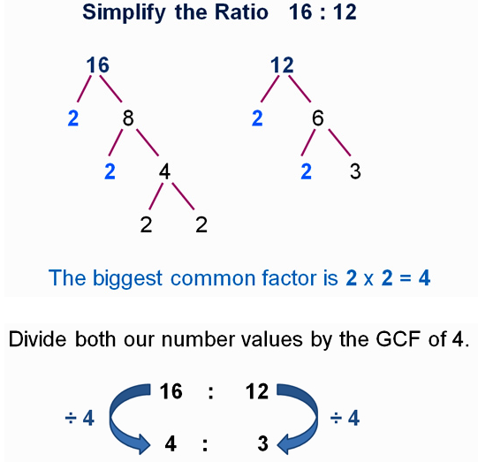

Slide 8
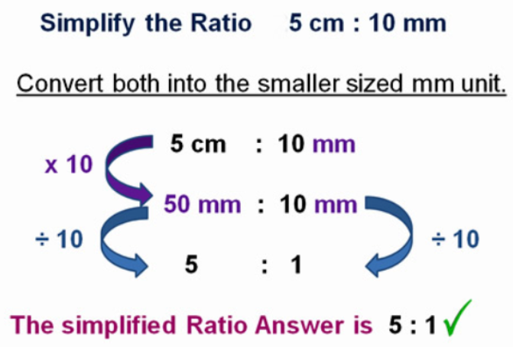

Slide 9
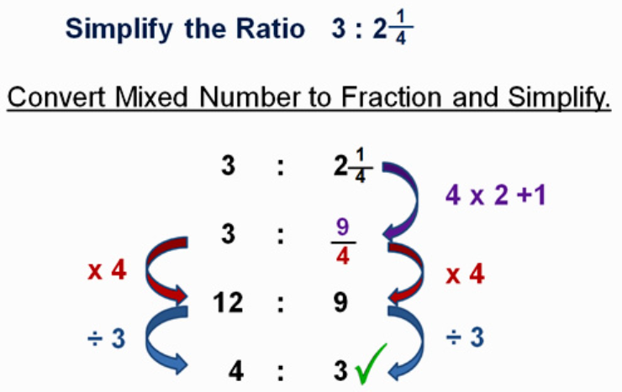

Slide 10
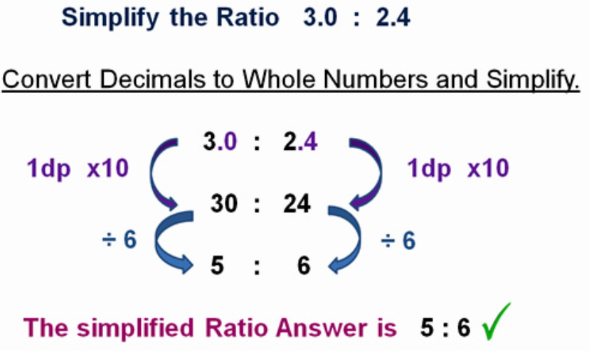

Slide 11
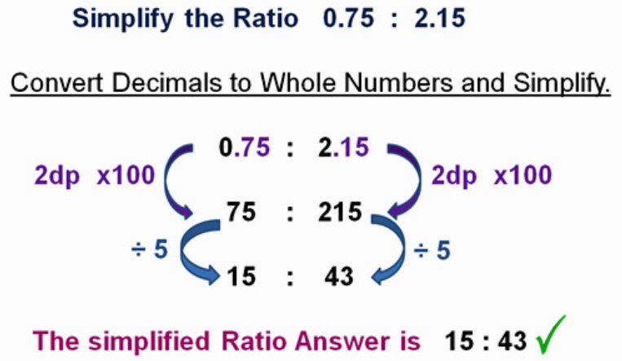

Slide 12

Some simplifying questions:
Simplify these ratios, giving your answers in its lowest terms.
25:35
21:14
36:48
27:15
5cm:1m
1½ hours: 1 day
Answers:
5:7
3:2
3:4
9:5
1:20
1:16

Slide 13
A Proportion is an equation of two equal ratios.

Slide 14
all
reduce
to 1/2
3 4 5
6 8 10
=
=
Proportion is true if fractions are equal when in lowest terms.

Slide 15
the Extremes.
the Means.

Slide 16
The product of the means equals the product of the extremes.
Cross products are equal.
2 × 12 = 3 × 8
24 = 24

Slide 17
To Solve Proportions
Find n
9 n =
(3) (6)
9 n = 18
n = 2

Slide 18

3: 8 = n : 6
3 = n
8 6
18 = 8*n
18/8 = n
2.25 = n

