Slide 1
1E Dividing quantities in given ratios
Express the division of a quantity into two parts as a ratio
Notes:
https://www.mathplayground.com/ASB_DirtBikeProportions.html 1 marks
https://www.mathplayground.com/ASB_RatioBlaster.html 1 marks
https://mathsnacks.com/ratio-rumble.html 1 marks
https://www.softschools.com/math/ratios/ratio_coloring_game/
https://www.mathgames.com/skill/6.122-describe-pictures-as-ratios

Slide 2
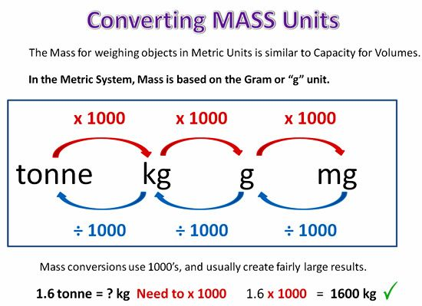
Key Vocabulary
Ratio
Parts
Common units

Slide 3
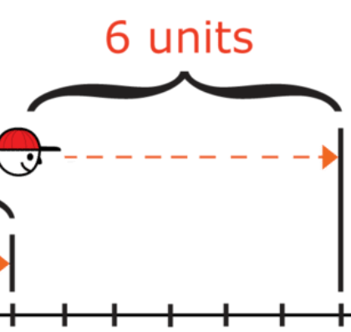
How to divide quantity as a ratio
1) Share £24 into the ratio 1 : 5
We add the parts of the ratio
1 + 5 = 6
1:5
To find each part, we divide £24 by 6
24 ÷ 6 = £4
£24
This means one part is equivalent to £4
Since one gets 1 part = 1 x £4 = £4
Since the other gets 5 parts = 5 x £4 = £20

Slide 4
How to divide quantity as a ratio
6m
600cm
2) Share 6m into the ratio 3 : 7
We add the parts of the ratio
3 + 7 = 10
3 units
7 units
To find each part, we divide 6m by 10
6m = 600cm , 600 ÷ 10 = 60
This means one part is equivalent to 60cm
Since one gets 3 parts = 3 x 60 = 180cm = 1.8m
Since the other gets 7 parts = 7 x 60 = 420cm = 4.2m
Why did we change 6m to 600cm?

Slide 5
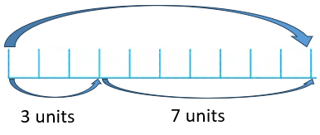
How to divide quantity as a ratio
4) Isabella and Louisa share their money in the ratio 3 : 7. If Louisa gets £84 more than Isabella, how much money have they in total?
Isabella Louisa
3 : 7
If Louisa has £84 more, this refers to the difference in parts of the ratio. 7 – 3 = 4.
If 4 parts is £84, then 1 part is £84 ÷ 4 = £21
If Isabella has 3 shares, then she has £21 x 3 = £63
If Louisa has 7 shares, then she has £21 x 7 = £147
In total, they have £63 + £147 = £210

