Slide 1
Bivariate Data

Slide 9
(RV)
(EV)

Slide 10
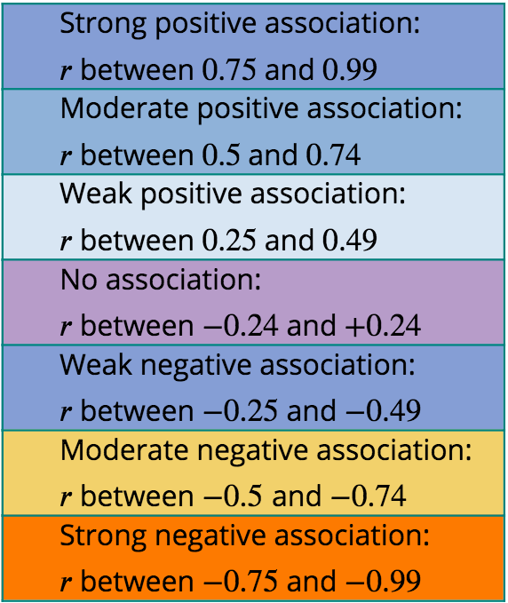
Strength
-1 ≤ r ≤ 1

Slide 11
Strength

Slide 12
Strength of the Association: r²
Coefficient of Determination = r²
General Interpretation: The coefficient of determination tells the percent of the variation in the response variable that is explained (determined) by the model and the explanatory variable.
The degree to which one variable can be predicted from another linearly related variable is given by a statistic called the coefficient of determination.

Slide 13
Interpretation of r²
Example: r² =0.927=92.7%.
Interpretation:
Almost 93% of the variability in the amount of water consumed is explained by outside temperature using this model.
Note: Therefore 7% of the variation in the amount of water consumed is not explained by this model using temperature.
Reporting on Coefficient of Determination
Almost[Coefficient of Determination in Percentage] of [response variable RV 𝑦] can be explained/predicted by [explanatory variable EV 𝑥].
Notes:
Note: This means that approximately 7% of the variation in the water consumption is not explained by the temperature. So perhaps there is another variable that accounts for the remaining portion of the variation. Can you think of a reasonable variable? Multiple Regression is the name of the method that would include more than one independent variable to predict amount of water people would drink.

