Slide 1
Organise personal work priorities and development
BSBWOR301
Learning Check Point 1
Learning Check Point 2
Learning Check Point 3
For this unit, you will be assessed on the following:
Assessment 1 Question and Answers
Assessment 2 Project
Workbook Activities Hint

Slide 2
Two Types of People

Slide 4
There are 168 hours in a Week
 | Urgent | Not Urgent
Important | Do Now | Plan to Do
Not Important | Reject Trivial requests from others Apparent emergencies Interruptions and distractions Scrutinize and probe demands. Help originators to re-assess. Wherever possible reject and avoid these tasks. | Resist ‘Comfort’ activities, computer games, net surfing Chat, gossip, text, social communications Daydreaming, doodling over long breaks Unnecessary adjusting equipment Habitual ‘comforters’ not true tasks. Non-productive, de-motivational. Minimize or cease altogether. Plan to avoid them.

Slide 5
Organise personal work priorities and development
Organise and complete own work schedule
Monitor own work performance
Co-ordinate personal skill development and learning

Slide 6
Performance evidence
Evidence of the ability to:
prepare a work plan
use business technology
assess and prioritise own work load
monitor and assess personal performance
identify personal development needs

Slide 7
Knowledge evidence
To complete the unit requirements safely and effectively, the individual must:
outline key provisions of legislation
describe goals, objectives or key performance indicators of own work role
explain ways to elicit, analyse and interpret feedback when communicating with other people in the workplace
explain the principles and techniques of goal setting, measuring performance, time management and personal assessment of learning and development needs
explain signs and sources of stress and strategies
identify methods to identify and prioritise personal learning needs.

Slide 8
Work goals and objectives
What are Performance Goals? - Definition & Examples here
Notes:
Discuss some examples from industry: Based on the sample PD, discuss what workloads could become heavy and could be stressful. For eg; workloads during weekends could be heavy in a Hospital during weekends due to more people presenting to ED.
Discuss KPIs in general and explain what it aims to achieve. You can use this link to explain better
Ask students to develop their own KPIs as students or a sample KPI for the role they will hold once qualified. Discuss how it helps achieve goals and productivity of organisation. Discuss KPIs as a team/project. Download a sample for a Patient Services Assistant (PSA) or Allied Health Assistant job description and discuss KPIs and goals as explained in the PD.
Recording goals-where could this occur. Discuss technology or software available for this purpose. For eg; Goals on Track software

Slide 9
Setting SMART goals

Slide 10
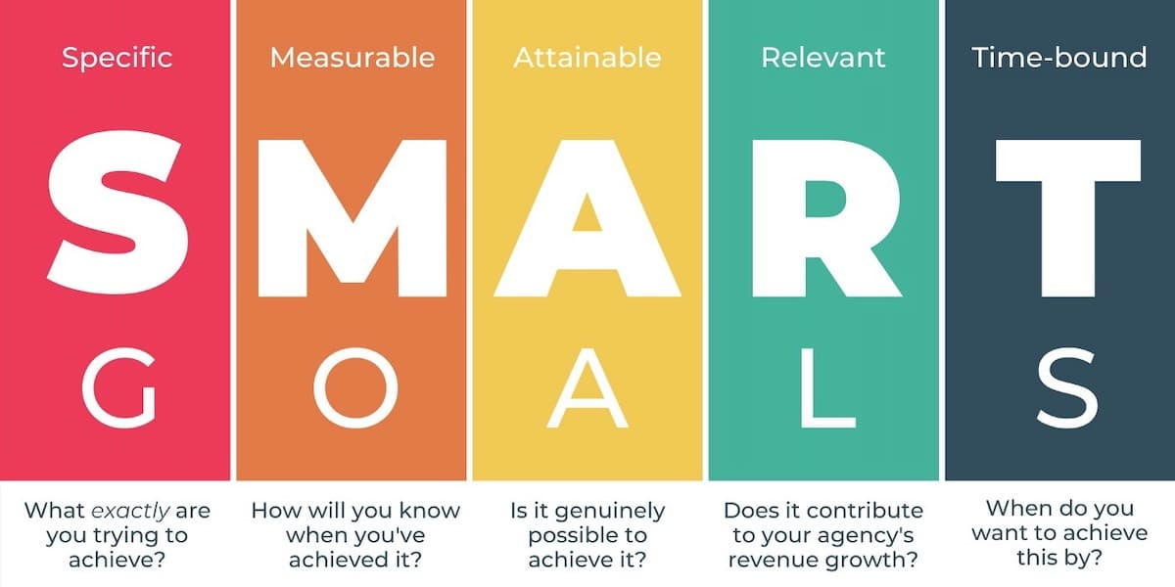
https://www.youtube.com/watch?v=rz-OhYcpOIQ

Slide 11
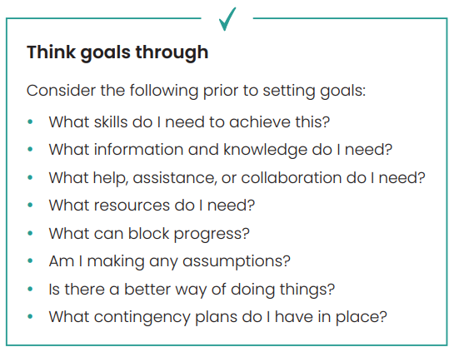
Achieving your goals
Set priorities
Keep operational goals small
Get agreement from others
Regularly review goals
Celebrate
Examples of workload/Task management software. For eg; CARPS. View info here.
https://clickup.com/teams/health
Notes:
Discuss how software can be useful in managing workload.
Based on the sample PD, discuss what workloads could become heavy and could be stressful. For eg; workloads during weekends could be heavy in a Hospital during weekends due to more people presenting to ED.

Slide 12
Learning Checkpoint 1
1. Why is it important for every employee to set their own work goals?
Because their work needs to contribute to the achievement of the organisation’s goals.
2. What can happen if your goals are too specific?
They can be very limiting and hard to achieve.
3. Why should employees be involved in developing KPIs?
So everyone understand them
Gives them ownership so more likely to want to meet them.
4. When making a goal specific what questions should you ask?
• Who?
• What?
• When?
• Where?
• Why?

Slide 13
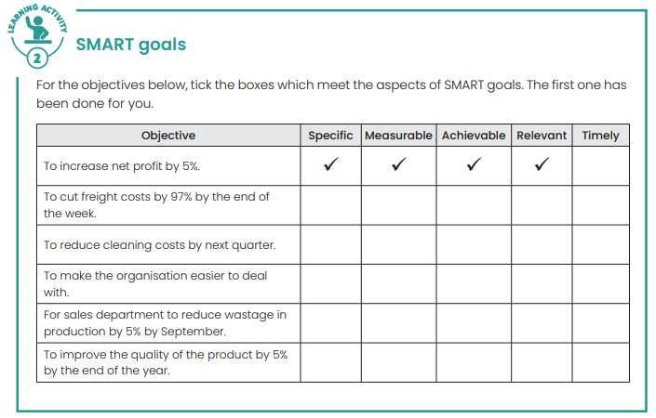
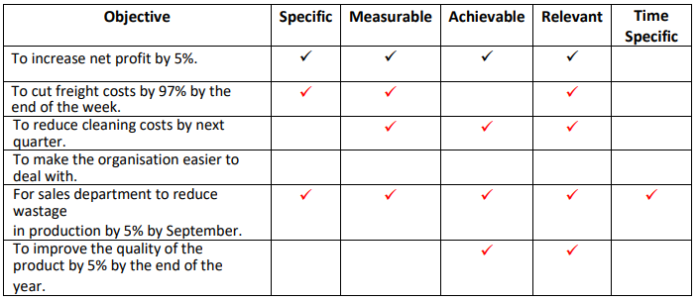

Slide 14
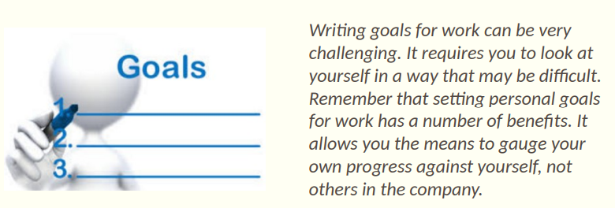
Recording your goals
Notes:
Simulated ward exercise
Ask students to make a list of what is expected of them in the workplace (This can be based off the Position Description) and then what could happen in reality. For example; PD states you can take approximately 30 mins per patient intake/assessment, but sometimes people like to talk and it might end being an hour. How could they monitor this and ensure they are meeting their deadlines.
For work standards choose a relevant standard for example; participation and inclusion. In pairs or groups, ask students to list everything they need to do to ensure their clients/patients/consumers have the equal opportunity to participate regardless of their situation and how services offered can be inclusive. Access the Emoji Cards activity here. Students can use these emoji cards to express how they felt after the activity. This activity promotes self-awareness and empathy while giving and receiving feedback.

Slide 15
Assessing your workload
The key to effective time management is to be aware of everything that needs to be done. Though many people keep track of day-to-day activities in their heads, effective time management is achieved by documenting goals and allocating estimated completion times for each task.
https://www.khanacademy.org/college-careers-more/career-content/support-health-and-wellness/registered-nurse/v/julia-registered-nurse-what-i-do-and-how-much-i-make

Slide 16
Daily, weekly and monthly goals
Analyse your use of time
Plan for achievement
Monitor your plan

Slide 17
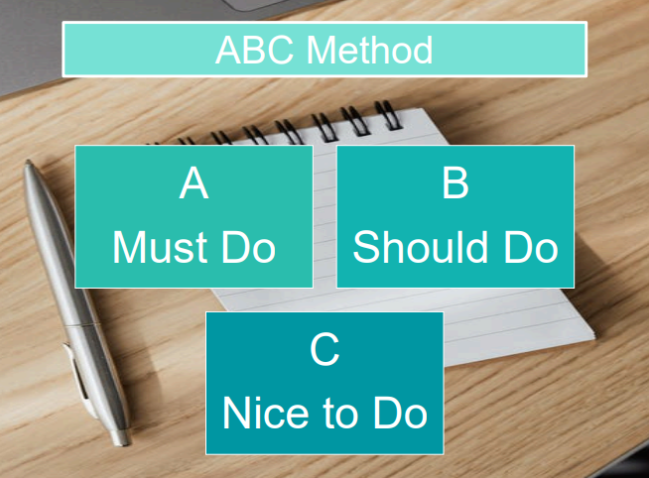
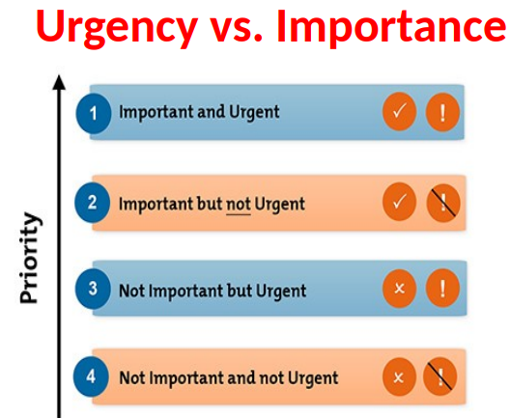
Flexibility
Urgent tasks – A
What needs to be done within a specific timeframe so must have time allocated for completion – B
What will contribute to your results but need not be done now or could be delegated to someone else – C
What can be set aside altogether – D
Notes:
Access Mindtools and discuss flexibility in the workplace.
Discuss issues arising when not flexible. Provide an example in a healthcare workplace. For eg; when supporting a person with dementia, everyday is a new day due to the nature of dementia. Changes in behaviour can be sudden and routines can be upset. Discuss what strategies each student has developed in the past to deal with changes and how they will apply this in the workplace. Make a whiteboard list or mind map these strategies.

Slide 18
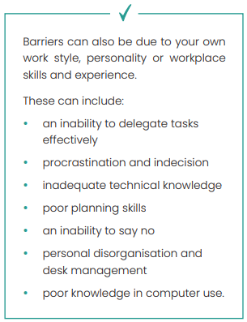
Efficiency and effectiveness
Barriers
Not receiving information or resources when required
Stress and fatigue
Unclear communication between work personnel
Unrealistic deadlines
Unclear goals and priorities
Bullying and harassment
Notes:
Focussing on work can be hard when distracted. Discuss what strategies can be applied to focus on one task at a time. Discuss what can be a distraction, for example phones or social media.
Make a list of internal and organisational barriers. For each barrier list a solution or strategy and discuss what skills will be required to develop those solutions. For eg; more training? Discuss procrastination and how it affects achieving tasks and goals. Click here for ideas.

Slide 19
Efficiency and effectiveness
Work factors
Interruptions to your work can come from many sources, including:
* telephone calls
* visitors
* staff members asking for assistance or advice
* staff members dropping in for a chat
* meetings
* too many emails.
Notes:
Access Jump In Jump Out activity here. This activity promotes self-awareness, self-management, social awareness, responsible decision-making, and relationship skills.
Ask the class to review service standards from health or community sector. For eg; Access NSQHS standards here and map own work to meet these standards if working in a Hospital. You can access Aged care quality standards here or Disability Service Standards here.
Discuss a typical performance appraisal within the workplace, the process and what it achieves. Mind map with goals, KPIs and explain how they are interconnected. Access more information here.

Slide 20
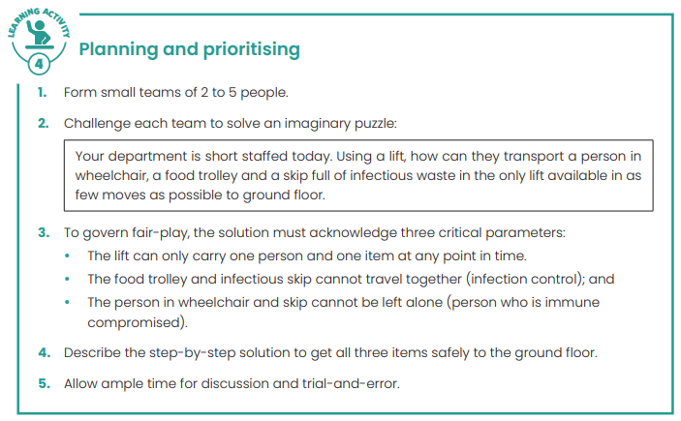

Slide 21
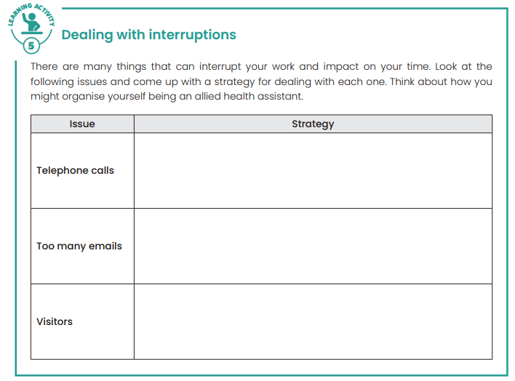
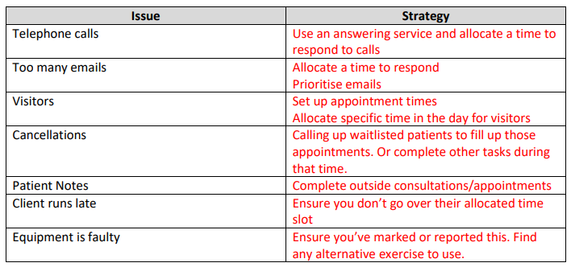

Slide 22
Learning Checkpoint 2
1. What is the key to effective time management?
To be aware of everything that needs to be done.
2. Why should you monitor your work plan regularly?
So you can identify problems early and seek out solutions.
3. How can you prioritise tasks in your work plan?
Allocate codes to the tasks
4. If you look at your own work style or personality what things might be a barrier to you
working effectively?
Answer will vary.

Slide 23
Learning Checkpoint 2
5. It is said that effective time management is achieved by documenting goals and allocating estimated completion times for each task. Name two (2) ways this will benefit you.
Answer will vary but may include:
• You will be less likely to forget even minor tasks.
• You will have a realistic idea of work that needs to be completed and the time available to
complete it.
• You will have more flexibility when deciding what to do and when to do it because you know which tasks have high priority.
• You will have both a short and long-range view of the work coming up.

Slide 24
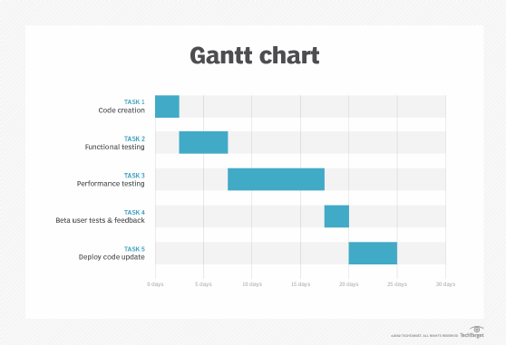
Monitor own work performance
Performance monitoring and evaluation
Setting work standards
Self-assessment
Tools for self-assessment
Notes:
Self-assessment tools:
Access PERT chart information here.
Build a Gantt chart by signing up here. Or Here.
In groups or pairs, set out a sample project or task and map it out on the PERT or Gantt charts and discuss the timelines and whether they achieve the targets.

Slide 25
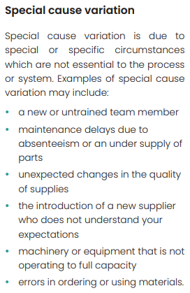
Feedback on work performance
https://www.youtube.com/watch?v=gi5UfSIf0BM
Individual performance measures
Receiving feedback
Seeking feedback
Variations in quality of services and products
Notes:
Receiving feedback on own work performance. Watch this video from Harvard Business Review and read this PDF from ACTPS Performance framework: The art of giving and receiving feedback. Make a list of how we can overcome our natural protective instincts and evaluate our performance based on feedback received.

Slide 26
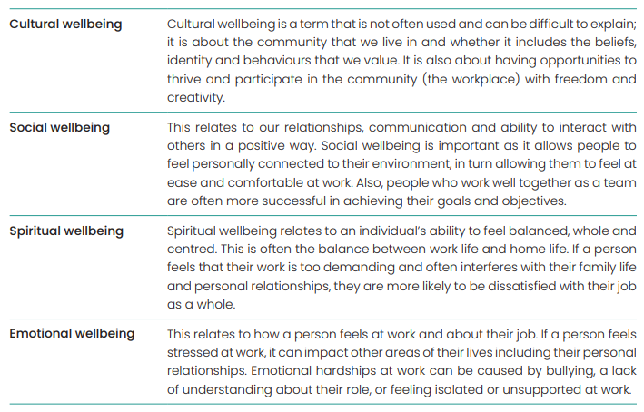
Personal wellbeing
Cultural wellbeing
Social wellbeing
Spiritual wellbeing
Emotional wellbeing

Slide 27
Activity

Slide 29
Sources of stress
Complex tasks
Cultural issues
Work and family conflict
Workloads
a video on work related stress
Notes:
Access more information on workplace related stress here. Watch a video on work related stress. Following both activities, make a list of stressors and discuss the causes and strategies of each. Discuss the consequences of long-term stressors and how we can reduce these.

Slide 30
Signs of stress
Absence from work
Alcohol and substance abuse
Conflict
Poor work performance
learning modules from People at work and access the following sections:
Mentally Healthy workplaces,
Understanding psychosocial risk assessments
Taking action and implementing control
Notes:
Access learning modules from People at work and access the following sections: 1. Mentally Healthy workplaces, 2. Understanding psychosocial risk assessments and 3. Taking action and implementing control as an extended activity. You can also access additional resources for workplaces and workers and discuss in depth.

Slide 31
Effects of Stress
Stress affects us in many ways, including:
Emotionally – anxiety, depression, tension, anger
The way we think – poor concentration, forgetfulness, indecisiveness, apathy, hopelessness
Behaviourally – increased drinking and smoking, insomnia, accident proneness, weight problems, obsessive-compulsive behaviour, nervousness, gambling.

Slide 32
Stress management
Exercise regularly – regular exercise is a great way to manage stress. You should do some form of exercise that causes you to feel puffed afterwards – a leisurely stroll to the bus stop is not enough! Have at least 20 minutes of exercise 3 times a week.
Avoid conflict – avoid situations that make you feel stressed such as unnecessary arguments and conflict (although ignoring a problem is not always the best way to reduce stress). Assertiveness is fine but becoming distressed is not.
Relax – give yourself some time to relax each day and try to spend time with people who make you feel good about yourself.
Eat well – a nutritious diet is important. Eat plenty of fresh fruit and vegetables and avoid sweet and fatty foods.
Sleep – a good sleep routine is essential. If you have difficulty falling asleep, do something calm and relaxing before you go to bed like listening to music or reading.
Enjoy your life – it’s important to make time to have some fun and to get a balance in your life.

Slide 33
Activity

Slide 35
Support and resolution strategies
Options for support
Training
Sharing the workload
Group activities
Job design
Time off
Employee Assistance Programs (EAP)
Mediation
Counselling
Choose 3 of these previous strategies and discuss how they can support employees to improve their performance

Slide 36
Professional development opportunities
Career planning and development
Coaching, mentoring and/or supervision
Formal/informal learning programs
Internal/external training
Performance appraisals
Personal study
Quality assurance assessments and recommendations
Recognition of current competence/skills recognition
Work experience/ exchange opportunities
Work skills assessment
Notes:
Discuss the importance of ongoing professional development. You can find more information here.
Discuss career portfolios and how they benefit in recording career goals and plans.
Students can complete career portfolios. Access them here.

Slide 37
Professional development
Maintaining records and documents
Notes:
Discuss career portfolios and how they benefit in recording career goals and plans.

Slide 38
Workplace legislation
Equal Employment Opportunity (EEO) and anti-discrimination
Workplace health and safety
Industrial relations
Consumer protection
Notes:
List and discuss all workplace legislation applicable. Explain the importance and how they safeguard rights. Access Fairwork information for further discussion.

Slide 39
Business technology
Computers
Software
Accounting systems
Inventory control systems - Inventory control systems are used in many businesses including retail stores and businesses, warehouses and manufacturers. The system keeps track of stock or products held onsite and when they are sold and need to be replaced.
Mobile technology
Notes:
List different business technologies available and discuss uses of each.

Slide 40
Business technology
changes to business by Lumen here
Notes:
Access Technological changes to business by Lumen here and complete the modules as further learning. Amazongo video in the link.

Slide 41
Technology
Internet, extranet, intranet
What’s the different?
Write the 3 types and what makes them different from others

Slide 42
Learning Checkpoint 3
1. What are two (2) reasons why complex tasks can be a cause of stress?
Because people are under pressure from superiors or managers to meet deadlines and achieve results.
It can cause the employee to become overwhelmed and unable to manage the task properly, or with clear thinking.
2. What are two (2) strategies for solving this?
Task could be broken down into smaller, more manageable tasks and shared between colleagues
More time could be allocated to completing the task, to relieve the pressure on the employee.
3. What are three (3) ways an employee could benefit from being mentored?
• Learn new skills
• Develop confidence
• Enhance opportunities for career progression

Slide 43
Learning Checkpoint 3
4. Give five (5) reasons why is it important to record your professional development activities.
Answer may include:
• Offers the organisation an opportunity to recognise and reward your learning
• Acts as an example to other employees
• Adds to the organisation’s knowledge base
• Can be used to support performance assessments and evaluations
• Can be used to determine pay schedules and promotion opportunities
• Can be used to determine your suitability for special projects or assignments
• Supports your value to the organisation.

Slide 44
Assessment Questions
1. Potential barriers to achieving goals can be due to your own work style, personality or workplace skills and experience. Look at the barriers in the table below can give a potential solution for each one.

Slide 45
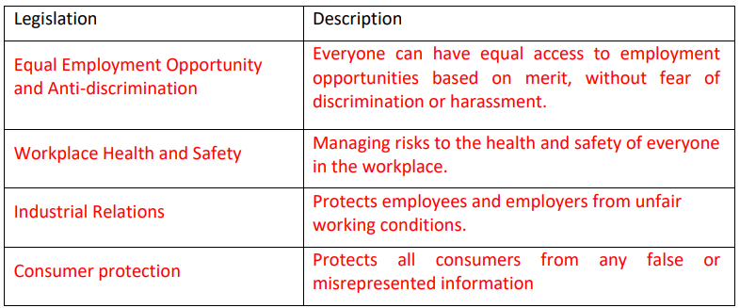
Assessment Questions
2. List three (3) pieces of legislation which apply to most workplaces and give a brief description of each.

Slide 46
Assessment Questions
3. List two (2) things that KPIs are used for.
• to determine the success and productivity of specific areas within an organisation
• to motivate staff and give them targets to achieve
• to award commissions, extra pay and/or incentives
4. What are two (2) advantages for a workplace to provide feedback in formal performance reviews?
• allows individual employees to monitor their own performance
• provides opportunities for employees to assess their work with managers or supervisors
• can indicate skills gaps or training requirements
• can work out whether your work meets the necessary standards
5. List two (2) ways you can get feedback outside of a formal process.
• Ask to speak to manager/supervisor
• Ask clients/suppliers
• Ask colleagues

Slide 47
Assessment Questions
6. If you receive negative feedback you should: (Choose all that apply)
a) See it as a learning opportunity
b) Ask for specific examples
DEFAULT QUESTION: What are two (2) advantages to receiving negative feedback?
• It can be a learning opportunity
• It can help you improve your work performance
• Could identify where you need training
7. If you see a variation in quality standards you should: (Choose all that apply)
a) Follow the correct reporting process
b) Tell your superior
DEFAULT QUESTION: What are two (2) things you can do if you see a variation in quality standards?
• Follow the correct reporting process
• Tell your superior

Slide 48
Assessment Questions
8. What is the first step in achieving your work goals?
Identifying the goal and what needs to be achieved
9. What are two (2) reasons for monitoring your work performance?
• to ensure your work meets the required standards
• to contribute toward continuous improvement
• to make sure you are meeting your organisation’s quality standards
10. What is time management?
A self-management process which involves deciding how, and in what order, tasks should be
completed so that you meet your deadlines and make the best use of time and resources.

Slide 49
Assessment Questions
11. List three (3) signs of stress and give two (2) strategies for dealing with each one.
Alcoholics Anonymous (AA) is a global program created to help those struggling with alcohol misuse achieve and maintain sobriety with the support of their peers through meetings surrounding addiction.

Slide 50
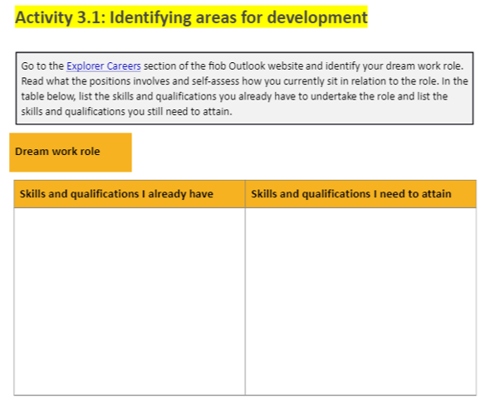
Workbook Activities
Financial Planner
Master of Financial Planning
Many universities not accept irrelevant undergraduate degree
Irrelevant undergraduate degree, Not financial related

Slide 51
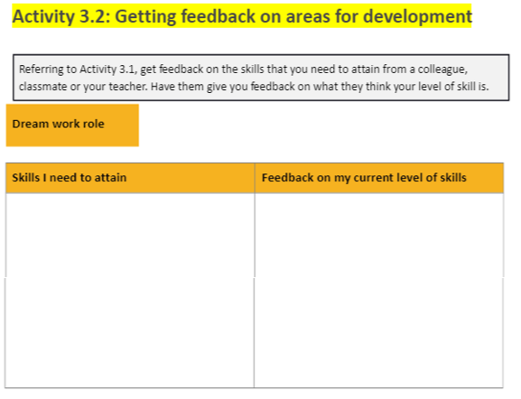
Workbook Activities
Financial Planner
Investment
Fundamental financial planning
Retirement planning
Applied Taxation
Financial Planning case studies
Nil experience

Slide 52
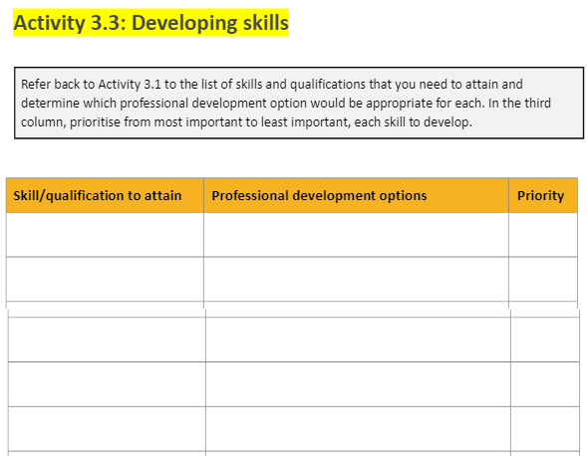
Workbook Activities
Fundamental financial planning
Financial Planning case studies
Applied Taxation
Investment
Retirement planning
Graduate diploma or above to get certified financial planner
Volunteer work to get experience

Slide 53
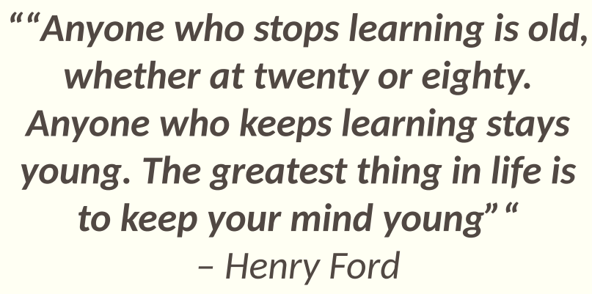
COMPLETE ONLINE ASSESSMENT

