Slide 1
Data Transformation
4A The squared transformation
Notes:
https://quizizz.com/admin/quiz/5eb3ecd0272827001be13023?source=quiz_share
https://quizizz.com/admin/quiz/5f439516596f6b001b7eb347?source=quiz_share

Slide 2
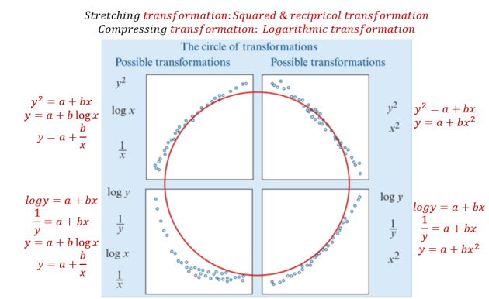
Data Transformation
Use a mathematical rule to change the scale on either x- or y-axis in order to linearise a non-linear scatterplot.
The types of scatterplots that can be transformed by the squared, log or reciprocal transformations can be fitted together into what we call the circle of transformations.

Slide 3
Data Transformation
The purpose of the circle of transformations is to guide us in our choice of transformation to linearise a given scatterplot.
There are two things to note when using the circle of transformations:
1. In each case, there is more than one type of transformation that might work.
2. These transformations only apply to scatterplots with a consistently increasing or decreasing trend.

Slide 4
Using data transformation to linearise a scatterplot The squared transformation
The squared transformation is a stretching transformation. It works by stretching out the upper end of the scale on either the x- or y-axis. The effect of applying an $x^{2}$transformation to a scatterplot is illustrated graphically below.

Slide 5
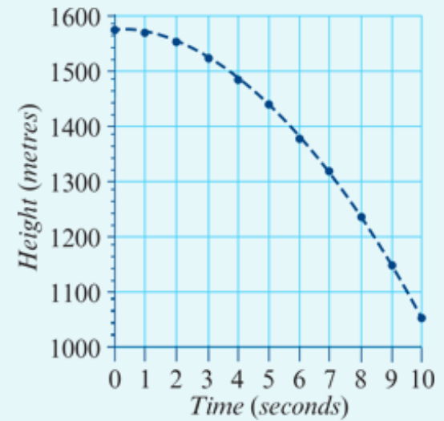
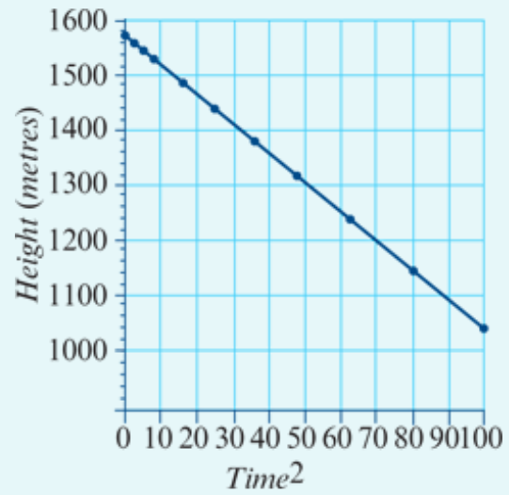
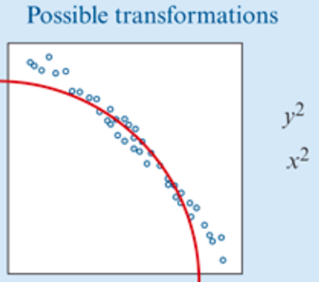
Applying the squared transformation
A base jumper leaps from the top of a cliff, 1560 metres above the valley floor. The scatterplot below shows the height (in metres) of the base jumper above the valley floor every second, for the first 10 seconds of the jump. After this time she opened her parachute to bring her safely to the ground.
A scatterplot shows that there is a strong negative association between the height of the base jumper above the ground and time.

Slide 6
Using Mathematica to perform a squared transformation
y-int= 1560, Slope = $\frac{rise}{run}=\frac{change in y}{change in x^{2}}=\frac{1555−1560}{1−0}$ = $\frac{−5}{1}$ = $−$5
$$EV^{2}$$
Ti$mⅇ^{2}$ | 0 | 1 | 4 | 9 | 16 | 25 | 36 | 49 | 64 | 81 | 100
$$x^{2}$$
E$V$
x
$$RV$$
$$y$$
$$RV=y−ⅈnt+Slope∗EV$$
$$y=1560−\text{5}∗x^{2}$$
$Height=1560−\text{5}∗{3.4}^{2}$ = 1502.2
$$RV=y−ⅈnt+Slope∗EV^{2}$$
$$Height=1560−\text{5}∗{Time}^{2}$$

Slide 7
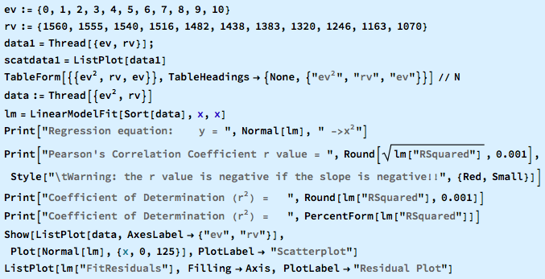
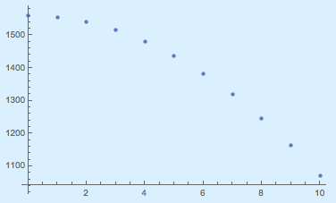
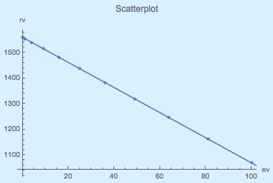
All in one Command
Change x to $x^{2}$…..
To 3 Sig. Fig.
To 2 Decimal Places

