Slide 1
Recognise healthy body systems
Learning Check Point 1
Learning Check Point 2
Learning Check Point 3
Learning Check Point 4
Learning Check Point 5
Learning Check Point 6
Learning Check Point 7
Learning Check Point 8
Learning Check Point 9
Learning Check Point 10
Learning Check Point 11
Learning Check Point 12
Learning Check Point 13
Learning Check Point 14
Learning Check Point 15
For this unit, you will be assessed on the following:
Assessment 1 Questions and Answers
Assessment 2 Project
Assessment 3 Case Studies

Slide 2
Recognise healthy body systems
Introduction
Anatomical terminology
Health terminology
Cells
Organs
The cardiovascular system
The respiratory system
The musculoskeletal system
The skeletal system
The endocrine system
The digestive system
The urinary system
The reproductive system
The integumentary system
The nervous system
The lymphatic and immune system
The special senses
Processes of body regulation
Recognise and promote ways to support healthy functioning of the body
Using and sharing information about healthy functioning of the body

Slide 3
Recognise healthy body systems workbook activities
Anatomical terminology - crossword
Label the cell
Labelling activity - the human heart
Comparsion task - compare the blood vessels
Pathway of O2 - breathe in
Labelling activity - the respiratory system structures
Label it - skeletal system
8. Name that bone
9. GI activities - what and where
10. Labelling activity - the urinary system
11. The brain - lobe control
12. Quiz - the lymphatic and immune system
13. Case study-use your knowledge

Slide 4
Work with information about the human body
Watch video: The Human Body: the ultimate frontier of complexity (duration: 1 hr 10 mins)
Body systems we will cover include the:
Cardiovascular system – heart, blood, blood vessels
Respiratory system – nose, pharynx, trachea, bronchus, bronchioles, lungs, alveoli
Musculoskeletal system – muscles, bones and joints
Nervous system – brain, spinal chord, nerves including sensory systems (eye and ear)
Digestive system – tongue, oesophagus, stomach, liver, pancreas, gall bladder, small intestine, large intestine, rectum, anus
Urinary system – kidneys, ureters, bladder, urethra
Reproductive system (male and female)
Endocrine system – glands: pituitary, hypothalamus, pineal, parathyroid, thyroid, adrenals, pancreas, gonads, ovaries, testes and their hormones
Lymphatic and immune systems: lymph glands, vessels, lymph, lymphocytes, T and B cells
Special senses – smell, taste, vision, equilibrium and hearing
Integumentary (skin) system – the layers of the skin

Slide 5
Introduction
The study of anatomy and physiology is the basis of all health professions and is fundamental to any role within the health services industry.
Anatomy
Anatomy is the study of the interrelationships of all of the structures in the human body. Anatomy helps us to understand the interconnections of body structures, such as how muscles, nerves and blood vessels work together to support a particular area of the body.
Physiology
Physiology is the scientific study of the chemistry and physics of the structures of the body and the ways in which they work together to support the functions of a healthy body. It is important to understand the distinction between the two.
Anatomy is about structure, whereas physiology is about function.
Watch video: Introduction to Anatomy & Physiology

Slide 6
Anatomical terminology Anatomical position
Anatomical position refers to the human body standing upright with feet shoulder width apart, toes pointed forward with the upper limbs held out to each side. We can also view the human body in the anatomical position from either the front (anterior view) or the back (posterior view).

Slide 7
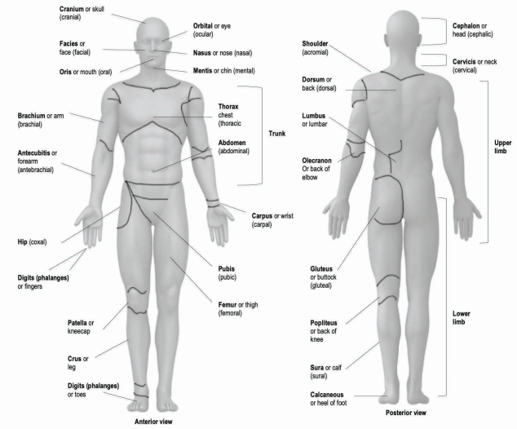

Slide 8
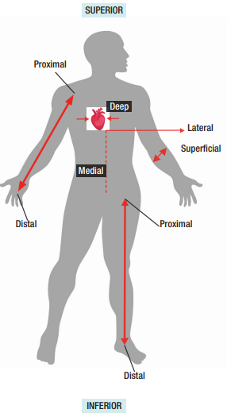
Anatomical terminology Directional Terms
Directional terms | Definitions
Anterior | Towards the front
Posterior | Towards the back
Superior | Above or higher
Inferior | Below or lower than another part of the body. The patella is inferior to the femur.
Lateral | Heading away from the midline of the body. The arm is lateral to the abdomen.
Medial | Towards the middle of the body. The nose is medial to the ears.
Proximal | A position of a limb that is nearer to the point of attachment or the trunk of the body.
Distal | A position of a limb that is further from the point of attachment or the trunk of the body.
Superficial | Closer to the surface of the body. The skin is superficial to the bones.
Deep | Further from the surface of the body. The heart is deep to the chest.

Slide 9
Anatomical terminology The planes of the body
For anatomical and medical imaging purposes the body is often sectioned into flat surfaces called planes.
A plane is an imaginary line that horizontally and vertically divides the body into
different sections.
Anatomical planes are used in many medical imaging procedures such as x-rays, CT and MRI scans.
There are three anatomical planes that are referred to in the health services and medical industry.

Slide 10
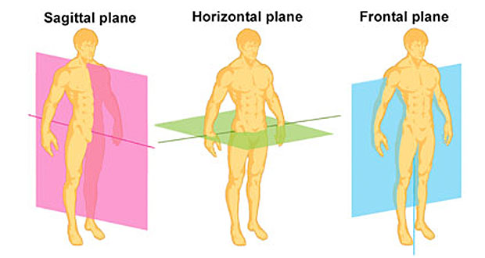

Slide 11
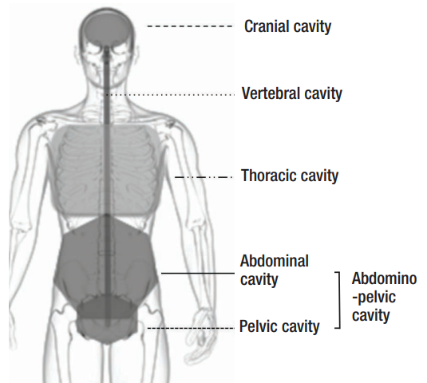
Anatomical terminology Body cavities
The internal structures of the human body are efficiently organised by membranes, sheaths and other vital structures.
These structures separate compartments of the body creating spaces called cavities.
Body cavities have the very crucial function of housing and protecting vital organs.
They also allow organs such as the heart, lungs and stomach to expand and contract without interfering with other tissues or organs.
The body has four main Cavities. The body’s four main cavities can be divided into posterior and anterior cavities.

Slide 12
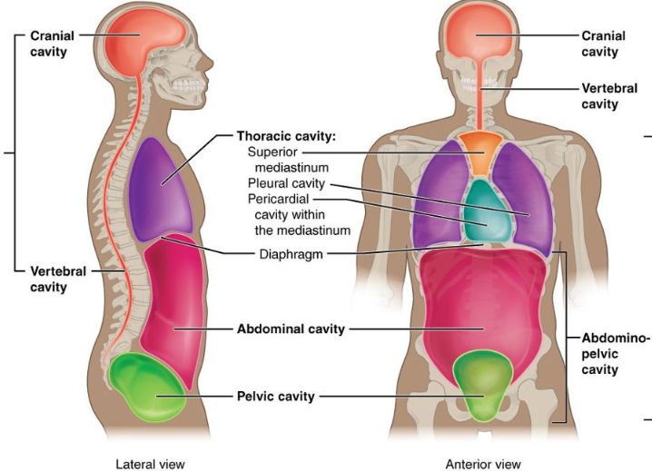
Anatomical terminology Body cavities
Posterior
cavity
Anterior
cavity

Slide 13
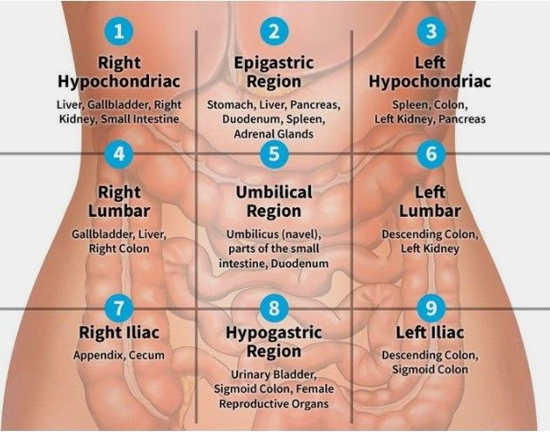
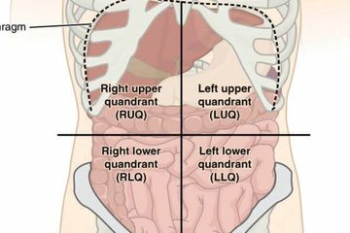
Anatomical terminology Abdominal regions and quadrants

Slide 14
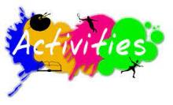
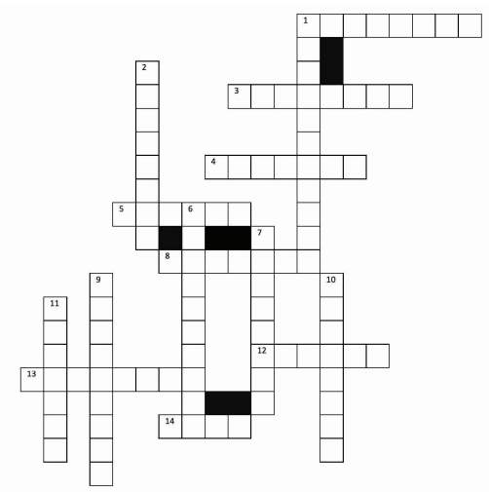
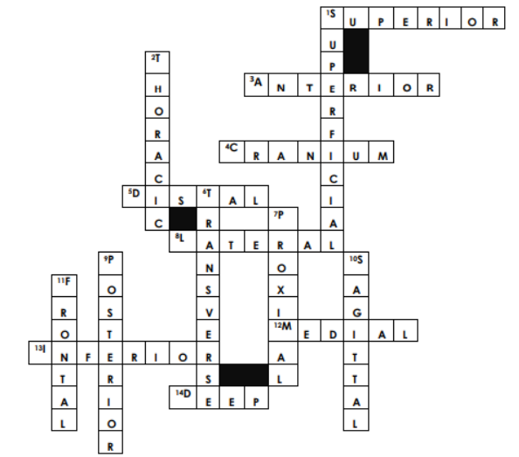
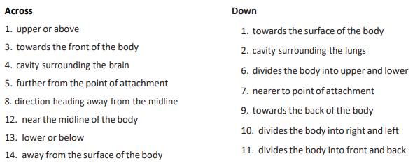
1. Anatomical terminology - crossword

Slide 15
Health terminology
Ask a supervisor
Listen to colleagues
Refer to anatomical models, charts and diagrams
Refer to a medical dictionary or encyclopedia

Slide 16
Health terminology Prefixes and suffixes
A-D | I-P
a- or an- (prefix) without ab- (prefix) away ad- (prefix) towards -algia (suffix) pain anti- (prefix) against asthen- (prefix) weakens bi- (prefix) two -cele (suffix) swelling -dema (suffix) swelling | inter- (prefix) between intra- (prefix) inside -ism (suffix) condition -it is (suffix) inflammation -osis (suffix) disease or condition pan- (suffix) all -pathy (suffix) disease poly- (prefix) many post- (prefix) behind or after pre- (prefix) before
E-H | S-Z
-ectomy (suffix) surgical removal edem- (prefix) swelling endo- (prefix) within epi- (prefix) upper hyper- (prefix) excessive hypo- (prefix) deficiency | sclerosis- (suffix) hardening sub- (prefix) below super/supra- (prefix) above trans- (prefix) across

Slide 17
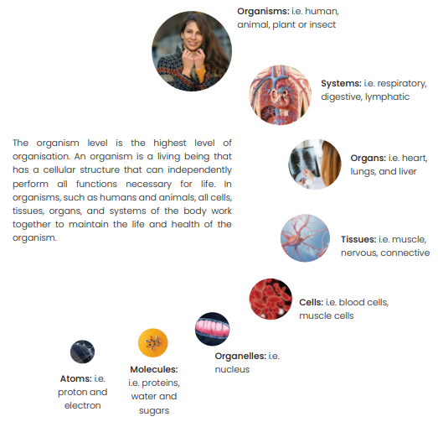
Health terminology The organisation of the body
Watch video: Cells, Tissue, and Organs
Four major
structures

Slide 18
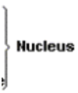
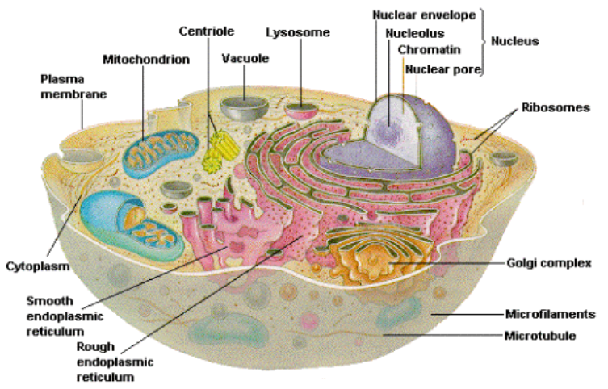
Health terminology Cells
Song: https://youtu.be/NkC9AiJf7gI
Cell membrane
Cytoplasm
Nucleus
Endoplasmic reticulum
Golgi apparatus
Lysosomes
Mitochondria
Cell
apparatus
Smooth ER
Rough ER
Notes:
Cell membrane: encloses the inner contents of cell, protecting it from the outside environment.
Cytoplasm: or protoplasm is the fluid medium inside the cell that is made up of two key organs, cytosol (fluid) and organelles. Jelly-like substance to freely float.
Nucleus: the largest organelle within the cell and is responsible for controlling the process of eating, reproduction and movement.
Endoplasmic reticulum: a system of channels made of a network of membranes. The ER acts as a manufacturing and packaging unit of the cell and is designed to keep organs isolated from other parts of the cell, until the process of manufacturing is complete.
Golgi apparatus: a type of packing organ and is responsible for sorting, altering and sending proteins that have come from the rough ER.
Lysosomes: contain a high concentration of digestive enzymes that breakdown and digest damaged or foreign organelles.
Mitochondria: the power station of the cell and their sole function is to create energy.

Slide 19
Health terminology Cells
Cell membrane: encloses the inner contents of cell, protecting it from the outside environment.
Cytoplasm: or protoplasm is the fluid medium inside the cell that is made up of two key organs, cytosol (fluid) and organelles. Jelly-like substance to freely float.
Nucleus: the largest organelle within the cell and is responsible for controlling the process of eating, reproduction and movement.
Endoplasmic reticulum: a system of channels made of a network of membranes. The ER acts as a manufacturing and packaging unit of the cell and is designed to keep organs isolated from other parts of the cell, until the process of manufacturing is complete.
Golgi apparatus: a type of packing organ and is responsible for sorting, altering and sending proteins that have come from the rough ER.
Lysosomes: contain a high concentration of digestive enzymes that breakdown and digest damaged or foreign organelles.
Mitochondria: the power station of the cell and their sole function is to create energy.

Slide 20
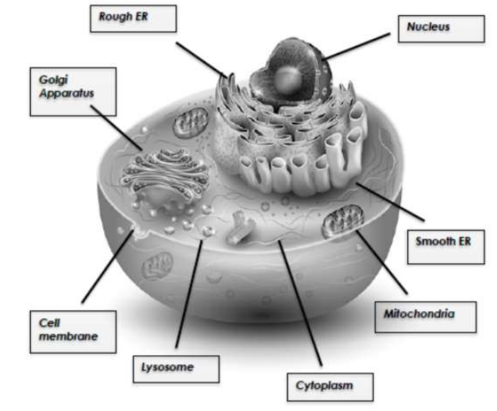
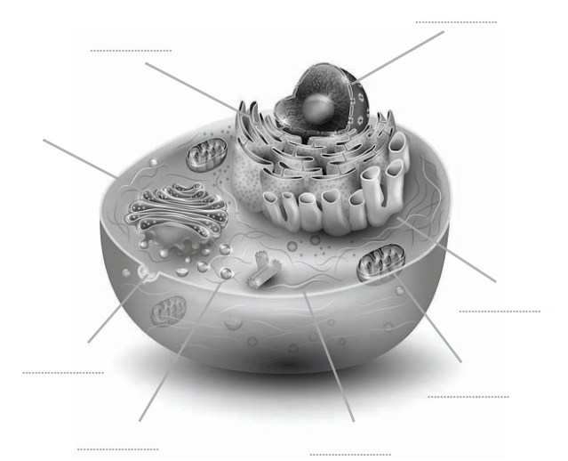
2. Label the cell
Your task is to correctly label the cell below and then describe the function of each structure.

Slide 21
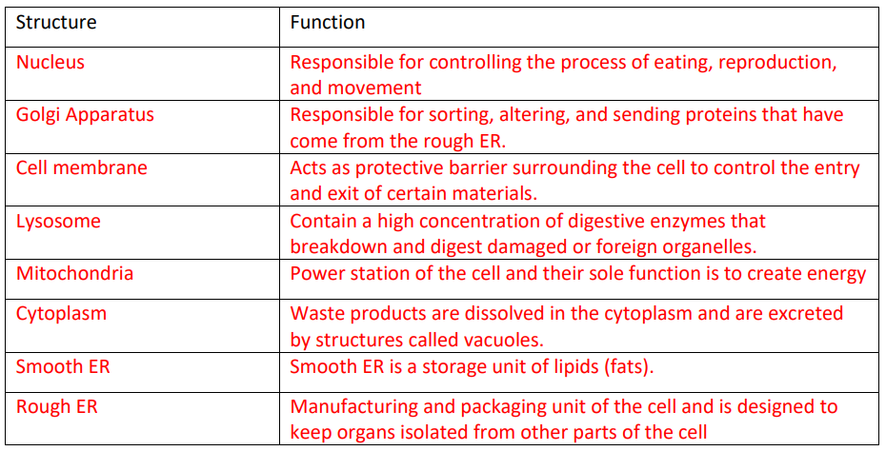
2. Label the cell
Your task is to correctly label the cell below and then describe the function of each structure.

Slide 22
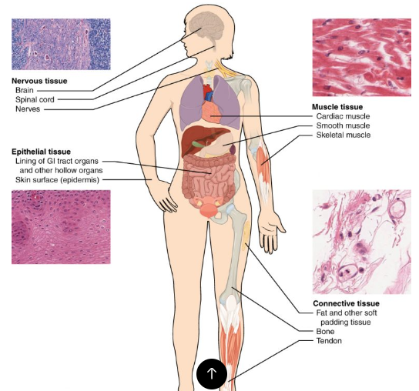
Health terminology tissues
Epithelial tissue: groups of cells that cover the exterior surfaces of the body, line internal cavities and passageways, and form certain glands.
Connective tissue: binds the cells and organs of the body together.
Muscle tissue: contracts forcefully when excited, providing movement.
Nervous tissue is also excitable, allowing for the generation and propagation of electrochemical signals in the form of nerve impulses that communicate between different regions of the body

Slide 23
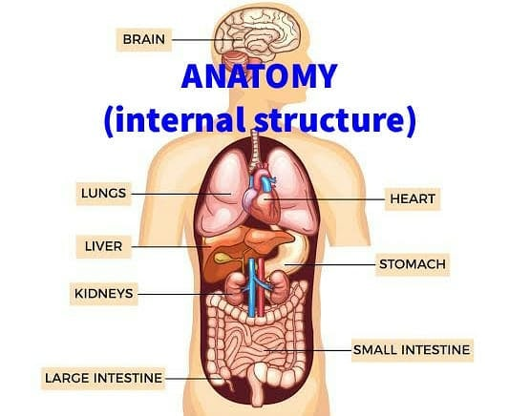
Health terminology organs
Brain: the control centre of the body.
Heart: the primary organ of the cardiovascular system and responsible for circulating blood around the body.
Lungs: connected to the trachea via
bronchi and are a major organ of the respiratory system.
Liver: the 2nd largest organ. An accessory organ to the digestive system but has important functions within other including the endocrine system.
Stomach and intestines: components of the gastrointestinal (GI) tract and
work as part of the digestive system.
Kidneys: the primary organs of the urinary system.

Slide 24
Learning Checkpoint 1
1. Explain the difference between anatomy and physiology.
Anatomy is the study of the interrelationships of all of the structures in the human body.
Physiology is the scientific study of the chemistry and physics of the structures of the body and the ways in which they work together to support the functions of a healthy body.
2. Explain how the body is arranged when in the anatomical position.
Refers to the human body standing upright with feet shoulder-width apart, toes pointed forward with the upper limbs held out to each side.
3. When viewing the body from the anterior view, outline from which position we are viewing.
Describes the direction towards the front of the body, the nose is anterior to the face.
4. When viewing the body from the posterior view, outline from which position we are viewing.
Describes the direction towards the back of the body, the gluteus is posterior to the hip.

Slide 25
Learning Checkpoint 1
5. For the following regions outline which part of the body each region refers to:
6. Give a brief explanation for the following direction terms:
• Inferior: describes the position below or lower than another part of the body
• Superior: describes the position above or higher than another part of the body
• Medial: describes the direction towards the middle of the body
• Lateral: describes the direction heading away from the midline of the body
• Distal: describes the position of a limb that is further from the point of attachment
• Proximal: describes the position of a limb that is nearer to the point of attachment
• Cranial: skull
• Brachial: arm
• Dorsal: back
• Femoral: thigh
• Ocular: eyes
• Cephalic: head
• Gluteal: buttock
• Abdomen: abdominal
• Thorax: chest

Slide 26
Learning Checkpoint 1
7. Outline and define the three planes of the body.
The Frontal plane divides the body or an organ into a front anterior section and a rear posterior section. The transverse plane divides the body or an organ horizontally into upper and lower sections. The sagittal plane divides the body or an organ vertically into right and left sides, this vertical plane runs directly down the middle of the body.
8. Outline the four major structures of the organisation of the body.
• Cells • Tissues • Organs • Systems
9. Briefly explain the structure and function of the four main tissue types of the human body:
a) Epithelial: Epithelial tissue is packed very close together. It lines cavities within the body; covers external surfaces and is involved in secretion, excretion and absorption of material.
b) Connective: Connective tissue is a fibrous tissue that connects tissues and organs together to protect and support.
c) Muscular: Muscular tissue contains structures called microfilaments and produces movement and responds to stimulation via nerve impulses.
d) Nervous: Nervous tissue contains neurons that receive stimuli and conducts nerve impulses that communicate between different body regions

Slide 27
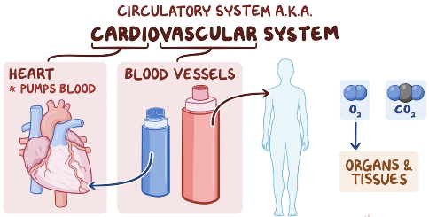
The cardiovascular system
Body systems Watch video: Human Body 101 | National Geographic
Responsible for transporting oxygen, nutrients, hormones, and cellular waste throughout the body via the blood. Even at rest, the heart easily pumps on average over 5 litres of blood throughout the body every minute. The cardiovascular system consists of the heart, blood and, the blood vessels leading to and from the heart. It also works in conjunction with the respiratory system to help transport oxygen throughout the body.
https://youtu.be/CWFyxn0qDEU
You Tube: The Heart and Circulatory System - How They Work

Slide 28
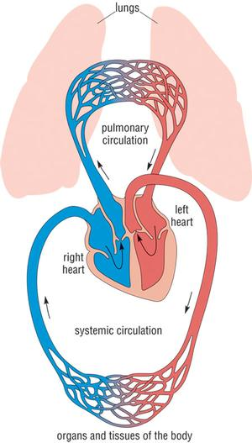
The cardiovascular system
Watch video: Cardiovascular System Overview, Animation
The cardiovascular system has three major functions:
1. Transportation: Transports blood to almost all of the body’s tissues. The blood delivers essential nutrients and oxygen and removes wastes and carbon dioxide to be processed or removed from the body.
2. Protection: Protects the body through white blood cells. White blood cells clean up cellular debris and fight pathogens that have entered the body. Platelets and red blood cells form scabs to seal wounds and prevent pathogens from entering the body and liquids from leaking.
3. Regulation: Maintain homeostatic control of several internal conditions. Blood vessels help maintain a stable body temperature by controlling the blood flow to the surface of the skin. Blood vessels near the skin’s surface open during times of overheating to allow hot blood to off- load its heat into the body’s surroundings. In the case of hypothermia (extreme cold), these blood vessels constrict to keep blood flowing only to vital organs at the body’s core.

Slide 29
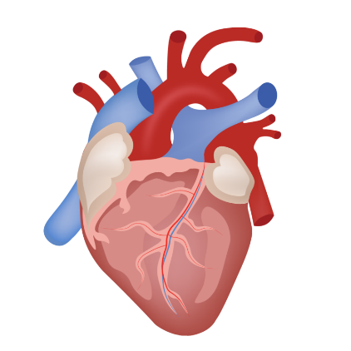
The cardiovascular system The heart
It is a muscular pumping organ located medial to the lungs deep in the thoracic cavity of the body. Within this space the heart sits in it’s own pericardial cavity. The shape of the heart is similar to a pinecone and is approximately the size of your fist. This size and weight of your heart will vary depending on your age, gender and athleticism. For example, highly trained athletes particularly those specialising in aerobic sports, such as long-distance cycling and marathon running can have hearts that are considerably larger than average.

Slide 30
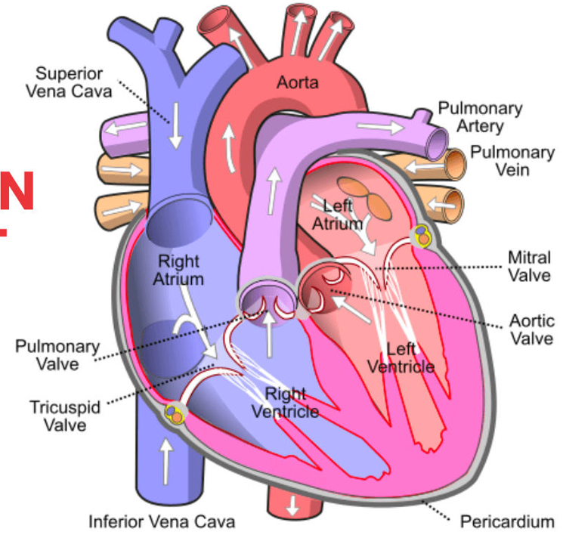
The cardiovascular system The heart Structure and function
Left
Pump blood around our body.
A thick muscular wall called the septum.
Four chambers: the left and right atrium and ventricle
Aorta
Superior vena cava
Inferior vena cava
Pulmonary artery
Pulmonary veins
The valves prevent the backward flow of blood. Four valves: the tricuspid valve (right AV valve), the pulmonary valve, mitral valve (left AV valve) and the aortic valve.
Right Pulmonary Artery
Left
Right Pulmonary Vein
Left AV valve
Right AV valve

Slide 31
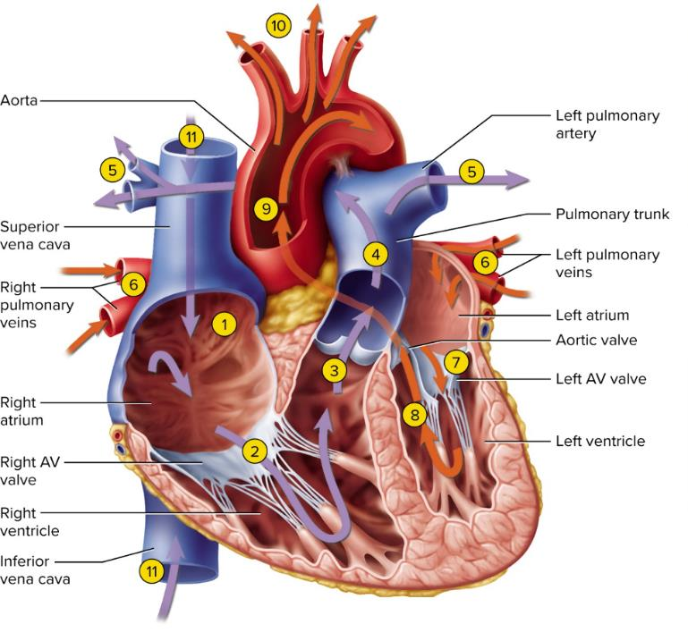
The cardiovascular system The pathway of blood through the heart
To body
From Upper body
The right atrium and ventricle are to collect deoxygenated blood (low in oxygen) that has been used by the body’s working muscles and pass it to the lungs to be re-oxygenated.
Once blood cells have been re-oxygenated by the lungs, the blood is passed through the left atrium, to the left ventricle and out through the aorta, to be distributed to working muscles by the many arteries in the body.
To Right Lung
To Left Lung
From Left Lung
From Right Lung
From Lower body
https://www.youtube.com/watch?v=jBt5jZSWhMI

Slide 32
The cardiovascular system The pathway of blood through the heart
To body
From Upper body
The pathway of the blood:
1. Deoxygenated blood from the body via the superior and inferior vena cava.
2. The blood then enters the right atrium where it is pumped through the right AV valve (tricuspid valve) to the right ventricle.
3. The right ventricle then pumps the deoxygenated blood through the pulmonary valve.
4. The blood is then pumped through to the pulmonary arteries.
5. The left and right pulmonary arteries transport the deoxygenated blood to the left and right lung where the exchange of carbon dioxide and oxygen can take place. Carbon dioxide exits the blood and oxygen enters.
To Right Lung
To Left Lung
From Left Lung
From Right Lung
From Lower body
https://www.youtube.com/watch?v=jBt5jZSWhMI

Slide 33
The cardiovascular system The pathway of blood through the heart
To body
From Upper body
The pathway of the blood:
6. Highly oxygenated blood returns from the lungs via the left and right pulmonary veins.
7. The pulmonary veins transport blood into the
left atrium and passes through the left AV valve
(mitral valve)
8. Oxygenated blood then enters the left ventricle.
9. The left ventricle pumps the blood into the aorta where it passes through the aortic valve.
10. Under enormous relative pressure the oxygenated blood is then pumped from the aorta to the organs, tissues and cells of the body.
To Right Lung
To Left Lung
From Left Lung
From Right Lung
From Lower body
https://www.youtube.com/watch?v=jBt5jZSWhMI

Slide 34
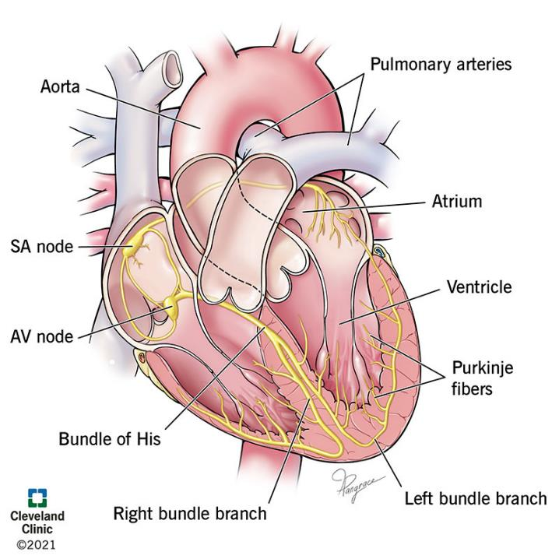
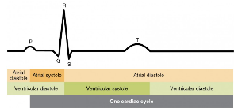
The cardiovascular system Cardiac cycle and heartbeat
The cardiac peacemaking and conduction system comprises the sinoatrial node (SAN), where electrical activation of the healthy atria begins, the atrioventricular node (AVN), responsible for channeling electrical conduction to the ventricles and serving as a backup pacemaker when the SAN fails.
Each heartbeat has two basic parts, diastole (relaxation phase) and systole (contraction phase).
The cardiac cycle begins with atrial systole and progresses to ventricular systole, atrial diastole, and ventricular diastole, when the cycle begins again.
Sinoatrial node (pacemaker)
Atrioventricular node

Slide 35
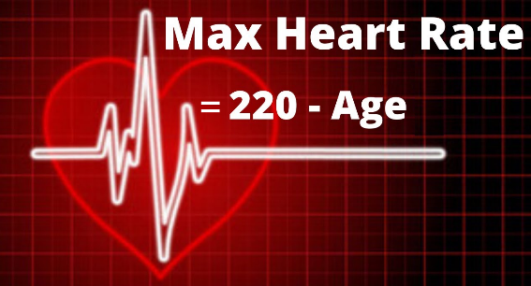
The cardiovascular system Heart rate (HR)
Pulse, or heart rate, is the number of signals the SA node produces per minute. Peripheral factors such as emotions, ion concentrations, and body temperature can affect your heart rate.
An average healthy resting heart rate for adults can be between 60 and 100 beats (signals) per minute (BPM). However, during exercise your body requires more oxygen. To obtain this oxygen, the heart needs to pump harder to cope with the demand.
Your maximum heart rate can be calculated using the following equation:

Slide 36
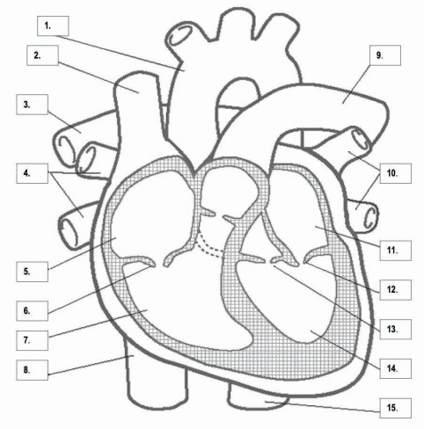
3. Labelling activity - the human heart
Your task is to correctly identify each numbered structure in the corresponding space below.
You will then need to draw arrows in the direction in which the blood flows.

Slide 37
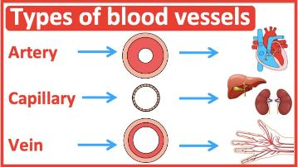
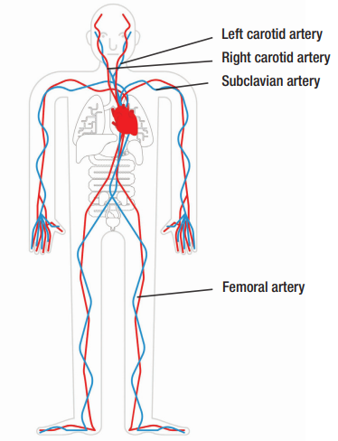
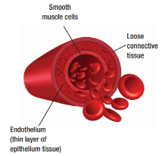
The cardiovascular system The blood vessels
Arteries
Arteries are blood vessels that carry oxygenated blood from the heart, with the exception of the pulmonary artery, which carries deoxygenated blood. The walls of arteries are thicker, elastic and transport blood under enormous pressure. No valves to prevent the backflow of blood. Provide oxygen rich blood to the body. There are over 20 major arteries throughout the human body. They include:
1. The aorta: the largest artery in the body and provides oxygen rich blood to the organs, cells and tissues of the body.
2. The femoral artery: provides oxygen rich blood to the lower limbs of the body.
3. The subclavian artery: supplies blood to the upper limbs of the body.
4. The carotid artery: large artery located in the left and right side of the neck.

Slide 38
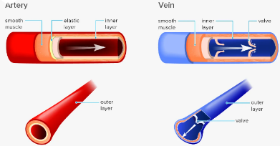
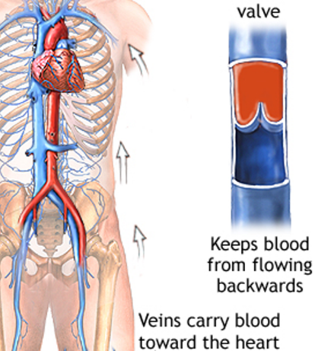
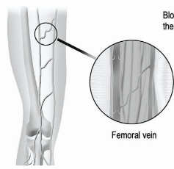
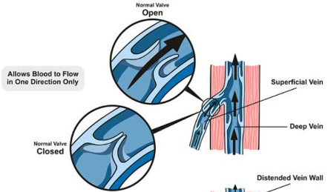
The cardiovascular system The blood vessels
Veins
Veins are blood vessels that carry deoxygenated blood to the heart, with the exception of the pulmonary vein, which carries oxygenated blood. Veins in comparison to arteries are located further from the heart in the circulatory pathway, and the pressure in them tends to be low all the time. Thus veins have significantly thinner walls and lack the thin elastic layer that allows them to expand. Veins are also structurally similar to arteries but with an important difference. Veins have valves that prevent the back flow of blood, whereas arteries do not.

Slide 39
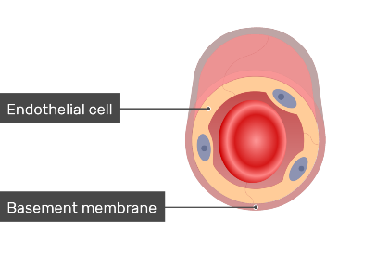
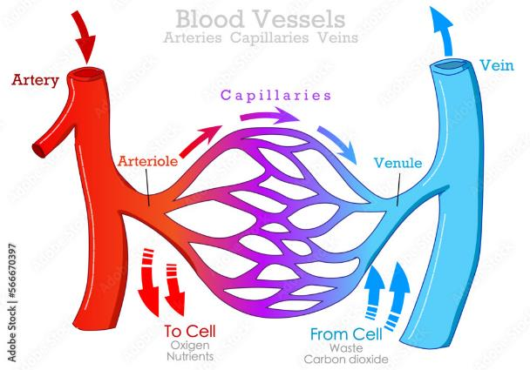
The cardiovascular system The blood vessels
Endothelium
Capillaries
Capillaries are the smallest blood vessels and the human body contains billions. Their main function is to allow for the movement of oxygen and carbon dioxide through a process called gaseous exchange. A single capillary is only one cell thick and is surrounded by only a layer of endothelium enclosed in a basement membrane. Capillaries are the site of nutrient and oxygen transfer from the bloodstream to other tissues in the body. Capillaries also collect carbon dioxide waste materials and fluids for return to the veins. They connect the tiny muscular branches of arteries, called arterioles, with tiny veins called venules.
Basement membrane
Oxygen rich blood from the heart
Oxygen poor blood to the heart
Arterial
Capillary
Venous
Capillary

Slide 40
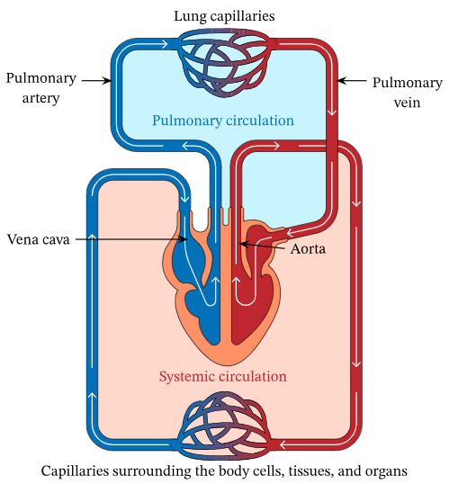
The cardiovascular system Cardiovascular circulation
Capillary beds of the lungs where gaseous exchange occurs
Arteries and veins transport blood in two distinct circuits: the systemic circuit and the pulmonary circuit.
Systemic arteries provide oxygen rich blood to the body. The blood returns to the heart through systemic veins with less oxygen.
In contrast, in the pulmonary circuit, arteries carry blood low in oxygen exclusively to the lungs for gas exchange. Pulmonary veins then return freshly oxygenated blood from the lungs to the heart to be pumped back out into systemic circulation.
Although arteries and veins differ structurally and functionally, they share certain features:
Capillary beds of all body tissues where oxygen rich blood is delivered and controls blood distribution according to the body’s needs.

Slide 41
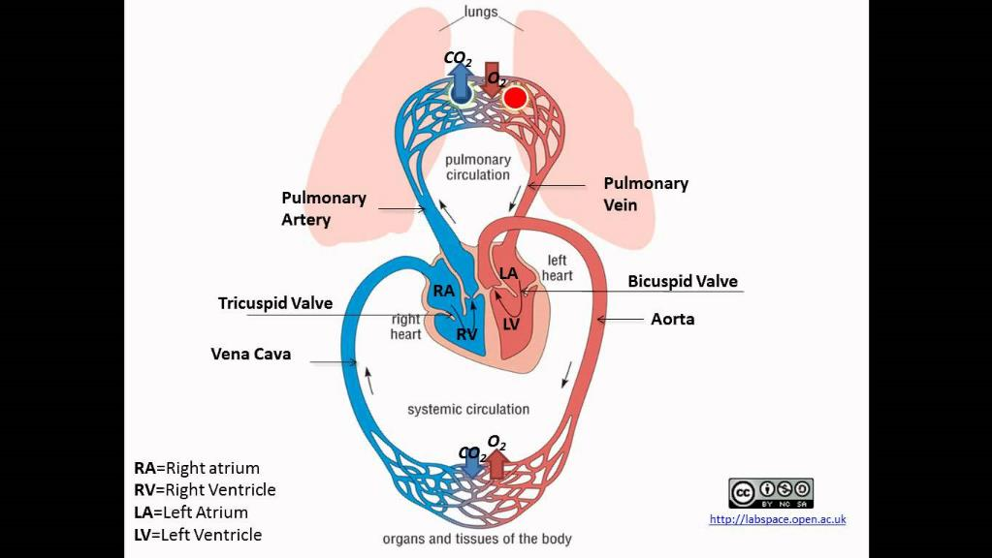
The cardiovascular system Cardiovascular circulation

Slide 42
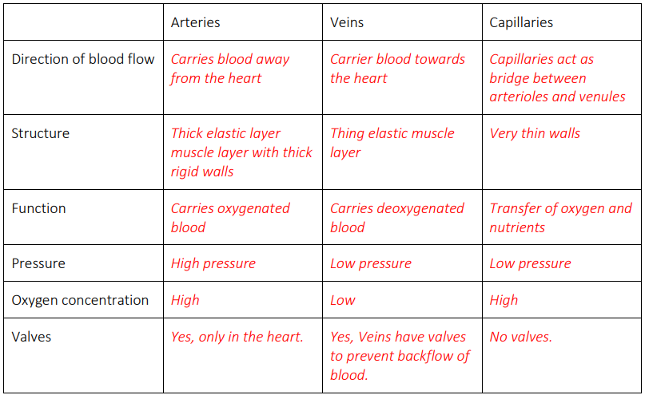
4. Comparison task - compare the blood vessels
For this task compare each type of blood vessel in the table below and correctly identify the similarities and/or differences for each.

Slide 43
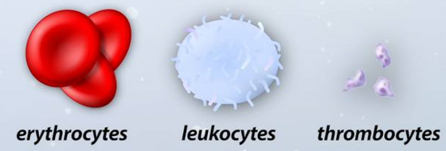
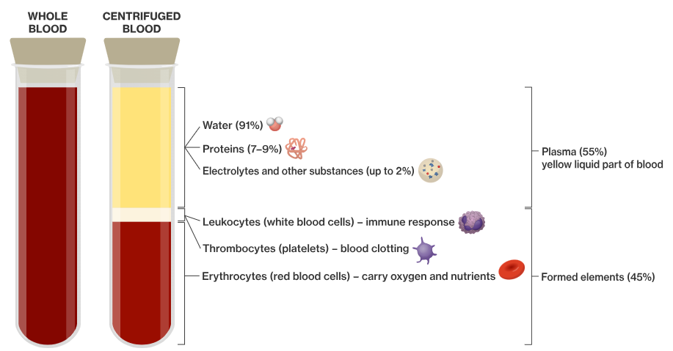
The cardiovascular system The Blood
Blood is the only fluid tissue in the body. Blood contains both solid and liquid components. Blood makes up about 8% of a human’s total body weight; males have around 5 to 6 litres of blood, while females have 4 to 5 litres. The main function of blood is to transport oxygen, nutrients, wastes and hormones around the body.
Blood also has an important role in maintaining and regulating body temperature.
Blood is made up of four main components: red blood cells, white blood cells, plasma and platelets.
(red blood cells) (white blood cells) (platelets)

Slide 44
The cardiovascular system The Blood
Red blood cells (erythrocytes) contain haemoglobin, which allows oxygen to bind with the cells
and be transported around the body. Red blood cells (RBC’s)
are small, flexible and are shaped like flat concave discs: ideal for gaseous exchange. RBC’s make up approximately 40 to 45% of our blood. They also carry carbon dioxide from the cells to the lungs so that they may be re-oxygenated. When we exercise, the working muscles require more oxygen to work, so the heart pumps faster to ensure that more red blood cells containing haemoglobin and oxygen can be delivered.
(red blood cells) (white blood cells) (platelets)

Slide 45
The cardiovascular system The Blood
White blood cells (leukocytes) are far less in number than RBC’s and are crucial to the body’s defense against disease. White blood cells form protective movable colonies that help defend the body against damage by bacteria, viruses, parasites and foreign cells. They have some very special characteristics: they are not confined to the blood stream like RBC’s; rather they can pass in and out of blood vessels and circulate in blood to attend to the sites of damage. There are six different types of white blood cells in the body, the most common neutrophils (58%) is produced in bone marrow.
(red blood cells) (white blood cells) (platelets)

Slide 46
The cardiovascular system The Blood
Platelets (thrombocytes) are not actually cells. They are cell fragments that quickly seal
themselves off from surrounding fluids. Platelets perform the vital function of blood clotting when
blood vessels are ruptured or broken. When you cut yourself hundreds of thousands of platelets
bind at the site of the damaged area creating a blood clot.
Plasma is the liquid component of blood. Over 100 different
substances are dissolved in this pale-yellow fluid such as nutrients, salts respiratory gases and hormones. Blood plasma assists in maintaining normal blood
pressure, clotting, immunity and the exchange of minerals.
(red blood cells) (white blood cells) (platelets)

Slide 47
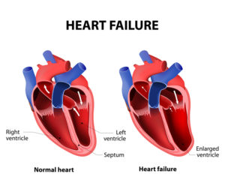
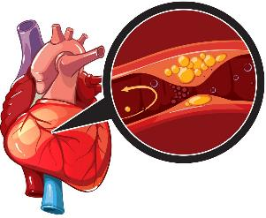
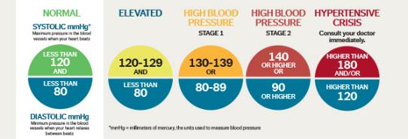
The cardiovascular system Disorders of the CV system
There are many different types of cardiovascular disease conditions, so symptoms and signs will vary depending on the specific type of disease. However, typical symptoms of an underlying cardiovascular disorder include:
Pains or pressure in the chest
Pain or discomfort in the arms, the left shoulder, elbows, jaw, or back
Shortness of breath
Nausea and fatigue.
Light-headed or dizziness
Cold sweats
cholesterol

Slide 48
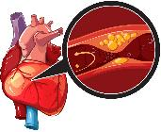
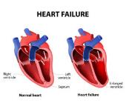
The cardiovascular system Disorders of the CV system
cholesterol
Interruptions, blockages, or diseases that affect how the heart or blood vessels pump blood can cause disorders such as heart disease or stroke. These disorders can develop due to a variety of factors, from genetics to lifestyle. The most common disorder is cardiovascular disease, which includes conditions such as:
Coronary heart disease: the arteries that supply blood to the heart become hardened and narrowed. This is due to the build-up of cholesterol and other material, called plaque, on their inner walls. This build-up is called atherosclerosis. As more plaque builds up, less blood can flow through the arteries. The heart cannot get sufficient blood or oxygen. This can lead to chest pain (angina) and a heart attack which can cause permanent heart damage.
High blood pressure (hypertension): hypertension defines a blood pressure higher than 140 / 90 millimetres of mercury (mmhg). The systolic reading of 140 mmhg refers to the pressure as the heart pumps blood around the body. The diastolic reading of 90 mmhg refers to the pressure as the heart relaxes and refills with blood. High blood pressure affects the blood flow to your organs. Over the years, this increases your chances of heart disease, stroke, kidney failure and diabetes.
Congestive heart failure: the heart’s pumping power is weaker and less effectively than normal. Pressure in the heart increases, harder for your heart to deliver oxygen and nutrients. To compensate for reduced pumping power, the heart’s chambers respond by stretching to hold more blood. This keeps the blood moving, but over time, the heart muscle walls may weaken and become unable to pump as strongly. As a result, the kidneys often respond by causing the body to retain fluid. The resulting fluid builds up in the arms, legs, ankles, feet, lungs, or other organs.

Slide 49
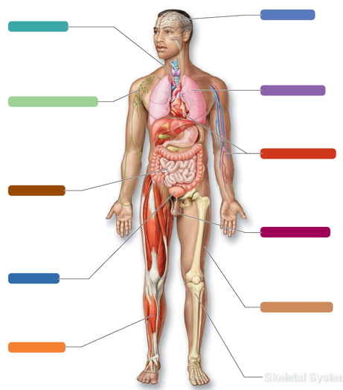
The cardiovascular system Systems in sync - the cardiovascular system
NERVOUS SYSTEM:
The CV system delivers oxygen, nutrients and removes waste.
Nervous system regulates cardiac cycle and helps maintain blood pressure and controls blood distribution according to the body’s needs.
DIGESTIVE SYSTEM:
The digestive system extracts nutrients from food to be absorbed into the blood
RESPIRATORY SYSTEM:
The CV system delivers oxygen and carries away waste.
The respiratory system carries out gaseous exchange: loads oxygen and unload carbon dioxide.
LYMPHATIC SYSTEM:
The CV system delivers oxygen and nutrients to the lymphatic organs, which contains immune cells.
The immune cells of the lymphatic system protect cardiovascular organs from illness.
CARDIOVASCULAR
SYSTEM
All eleven of the body’s systems interact to maintain our internal stability, balance and heath. The way in which each individual body system works in conjunction with the other body system describes the interrelationship between the systems.
DIGESTIVE SYSTEM:
The CV system delivers oxygen and sends blood to aid in digestion.
Regular aerobic exercise enhances CV efficiency.
REPRODUCTIVE SYSTEM:
The CV system supplies blood to the reproductive organs and removes waste.
The hormone Oestrogen assists with vascular health.
URINARY SYSTEM:
The CV system delivers oxygen to the system’s
tissues and carries away waste. The CV system helps maintain blood pressure for healthy kidney function.
The urinary system helps to regulate blood volume and pressure through urine.
INTEGUMENTARY (SKIN) SYSTEM:
The CV system delivers oxygen and nutrients to skin cells.
The skin’s blood vessels provide an important site for heat loss to help maintain body temperature.
MUSCULAR SYSTEM:
The CV system delivers oxygen and nutrients to all muscles.
Regular aerobic exercise enhances CV efficiency.
SKELETAL SYSTEM:
Bones protect and support organs of the CV system.

Slide 50
Learning Checkpoint 2
1. Outline and briefly explain the three major functions of the cardiovascular system.
Transportation: The cardiovascular system transports blood to almost all of the body’s tissues. Protection: The cardiovascular system protects the body through white blood cells.
Regulation: The cardiovascular system is instrumental in the body’s ability to maintain homeostatic control of several internal conditions.
2. Identify all the main structures of the heart.
Aorta, Superior Vena Cava, Inferior Vena Cava, Pulmonary artery and the Pulmonary Veins.
3. Explain the function of the atrium and ventricles in the heart.
The right atrium and the left atrium, acts as a receiving chamber and contracts to push blood into the lower chambers, the right ventricle and the left ventricle. The ventricles then pump blood out to the lungs or to the rest of the body.

Slide 51
Learning Checkpoint 2
4. Describe the key function of the valves within the heart.
The valves within the heart prevent the backward flow of blood. These valves are flaps that
are located between each atrium and ventricle and only allow blood to flow in one direction.
5. Outline the structure that first receives oxygen blood from the heart.
The lungs and other organs
6. Outline the equation to calculate a person’s maximum heart rate.
Maximum heart rate = 220 – (minus) your age
7. Describe the main function of the blood.
The main function of blood is to transport oxygen, nutrients, wastes and hormones around
the body. Blood also has an important role in maintaining and regulating body temperature.
8. Outline the four major components of the blood.
Red blood cells, white blood cells, plasma, and platelets.

Slide 52
The respiratory system
Watch video: The Respiratory System
Takes up oxygen from the air we breathe and expels the unwanted carbon dioxide. Around every 2 to 5 seconds, the nervous system stimulates the breathing process. After this, there is an exchange of gases between the lungs and the blood. The organs of the respiratory system facilitate the gas exchange that occurs between the blood and our external environment. There are three major parts of the respiratory system: the airway, the lungs and the muscles of ventilation.
The major organs of the respiratory system and airway include:
Nose, trachea, bronchioles, mouth, trachea, lungs, pharynx and larynx, bronchi, alveoli
The muscles of respiration include the diaphragm and intercostal muscles. These work together during inspiration and expiration (breathing in and out).

Slide 53
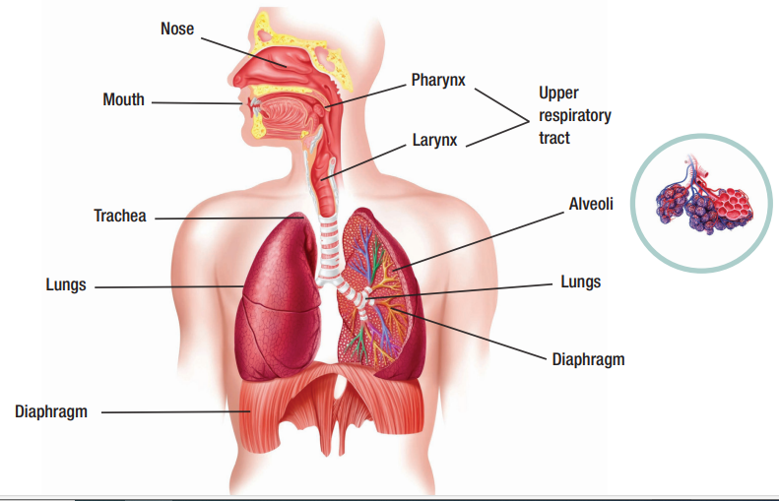
The respiratory system

Slide 54
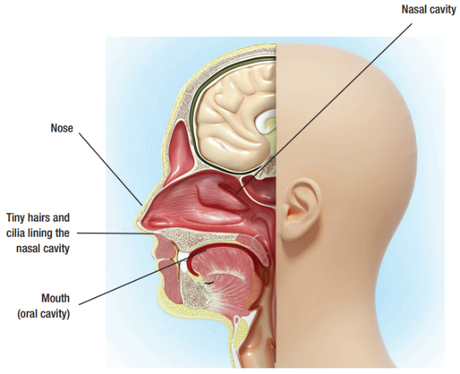
The respiratory system The nose and mouth
Visible external structure is primarily composed of the nose and nasal cavity, which consist of cartilage, bone, and skin. The nasal cavity is lined with tiny hairs (cilia) and epithelial tissue that produce mucus. Its main functions include warming, humidifying, and filtering air before it reaches the lungs, with the cilia and hairs trapping particles like dust and microbes. Mucus secreted helps trap substances, and the cilia then move the mucus particles towards the throat for swallowing or coughing.
The mouth serves as a secondary external opening, particularly useful when the nose is blocked. Breathing through the mouth lacks capabilities of nose, potentially allowing foreign particles to enter. Nonetheless, breathing through the mouth allows for a larger volume of air to enter due to its shorter distance and larger opening.

Slide 55
The respiratory system The pharynx (throat)
The pharynx is a muscular passageway located in the posterior part of the nasal cavity and superior to the end of the esophagus. The pharynx works with both the respiratory and digestive systems. The pharynx receives air from the nasal cavity and receives food and water from mouth. When air is inhaled through the oral cavity it is diverted to the larynx by epiglottis. The epiglottis is a piece of elastic cartilage that works as a switch between the trachea and the esophagus. As the pharynx is used to help swallow food and water, the epiglottis ensures that air passes into the trachea by covering the opening to the esophagus. During the process of swallowing, the epiglottis covers the trachea to ensure that food enters the esophagus and not the trachea. So we don’t choke on food.

Slide 56
The respiratory system The larynx (voice box) and trachea (windpipe)
The larynx helps to direct air and food into the proper channels and is located inferior to the pharynx. It is comprised of eight pieces of cartilage that are connected to muscles and ligaments. When we swallow
food, the larynx is pulled upwards causing the epiglottis to tip forward and close the opening of the larynx. Food is then directed into the esophagus. During sound production, the vocal cords close together and vibrate as air is exhaled. The air then passes between
these cords to produce sound.
The trachea is the first structure of the lower respiratory tract. The trachea is the only path way to the lungs and functions only to provide a passageway for air to be
inhaled and exhaled. The wall of the trachea is made up of flexible soft cartilage connected by dense connective tissue to prevent it from collapsing. Like the nasal cavity, the trachea is also lined with mucus membrane and cilia designed to trap airborne particles.
Left Bronchi
Right Bronchi

Slide 57
The respiratory system The bronchi and bronchioles
The trachea is then divided into the right and left bronchi. The bronchi branches into smaller and smaller
passageways (tubes) called bronchioles, which then lead to tiny air sacs of the alveoli.

Slide 58
The respiratory system The lungs
Perform the exchange of oxygen and carbon dioxide. The lungs are the major organ of the respiratory system and contain important structures such as the bronchi, bronchioles, and alveoli. They are soft, spongy structures and are made up of elastic connective tissue. The right lung is shorter, has a greater volume, and is divided into three lobes. The left lung is narrower and has an indentation called the cardiac notch which allows the heart to sit. The left lung has two lobes and is the smaller. The lungs are located within the thoracic cavity and are surrounded by a unique structure called the pleura. The pleura is a membrane that encloses and connects the lungs to the thoracic wall and the diaphragm. It produces pleural fluid and helps to create cavities that separate the lungs from other organs. The pleural fluid plays a very important role when the lungs expand during inspiration (breathing in). This causes the lungs to enlarge when the thoracic wall expands during inspiration, allowing the lungs to fill with air.
Diaphragm

Slide 59
The respiratory system Gaseous exchange
The alveoli are microscopic elastic air sacs in the lungs that are surrounded by a dense network of
capillaries. The oxygen you breathe in diffuses through the alveoli and the capillaries into the blood. The carbon dioxide you breathe out is diffused from the capillaries to the alveoli, up the bronchial tree and out your mouth. This is external respiration. When the oxygenated blood is transported to rest of the body, there is an exchange of oxygen and carbon dioxide between blood and tissues in the body, this is called internal respiration.
Differences between external and internal respiration:
External | Internal
Oxygen diffuses from alveolar air into blood | Oxygen diffuses out from blood to tissues
Carbon dioxide diffuses out from the blood into the alveolar air | Carbon dioxide diffuses into the blood from the tissue.

Slide 60
5. Pathway of O2 - breathe in
Using the knowledge you have just learnt about the structures of the respiratory system your task is to correctly identify the pathway of oxygen (O2) from when it first enters the body to when it reaches the blood.
Describe the process of gaseous exchange.
Gaseous exchange or internal respiration in the lungs occurs when oxygen and carbon dioxide is exchanged in the tiny air sacs of the alveoli. Capillaries surround the alveoli. When
a person inhales, oxygen moves from the alveoli to the surrounding capillaries and into the bloodstream. At the same time, carbon dioxide moves from the bloodstream to the
capillaries and into the alveoli. The carbon dioxide is removed from the lungs when a person exhales.

Slide 61
The respiratory system Muscles of ventilation
Pulmonary ventilation or breathing is the movement of air through the passages between the external environment and the lungs. Air is able to move through these passages due to the pressure gradients produced by the contraction of the diaphragm and thoracic muscles including, the internal and external intercostal muscles. When we breathe in the intercostal muscles move the ribs upwards and outwards and the diaphragm pushes downwards, this draws air into the expanded lungs. When we breathe out the ribs draw back to return the diaphragm to a higher position, which pushes the air out.
Inspiration: is the process of taking air into the lungs. It is the active phase of pulmonary ventilation because it is the result of muscle contraction. During inspiration, the diaphragm contracts and the thoracic cavity increases in volume.
Expiration: is the process of letting air out of the lungs during the breathing cycle. During expiration, the relaxation of the diaphragm and elastic recoil of tissue decreases the thoracic volume and increases the intra-alveolar pressure.

Slide 62
The respiratory system Muscles of ventilation

Slide 63
6. Labelling activity - the respiratory system structures
Using the list of terms below, correctly label the diagram of the respiratory system.

Slide 64
The respiratory system Disorders of the respiratory system
The respiratory tract is constantly exposed to particles and microorganisms in the air. Mechanisms such as mucous membranes and cilia help filter the air to prevent pathogens from entering. Failure or weakness of these mechanisms can lead to respiratory problems. Common respiratory conditions and disorders include:
Asthma: Chronic inflammation and narrowing of bronchial tubes in the lungs. Symptoms include wheezing and shortness of breath. Triggers include allergies, infections, and pollution. Can begin in childhood and worsen if untreated. Managed with medication; no cure.
Bronchitis: Chronic or acute; chronic develops over time with excessive mucous secretion. Acute bronchitis caused by viral or bacterial infection. Symptoms include coughing and excretion of sticky mucous. Acute bronchitis often treated with antibiotics.
Emphysema: Lung disorder causing shortness of breath. Alveoli (lung air sacs) become damaged, reducing oxygen intake. Difficulty breathing out, leading to trapped old air and reduced oxygen supply. Often coexists with chronic bronchitis.
Pneumonia: Infection in lung alveoli caused by bacteria, viruses, or fungi. Symptoms include cough, fever, chills, and shortness of breath. Can be treated with antibiotics but can be life-threatening, especially in the elderly.
Allergies: Immune system reacts excessively to substances, causing allergic reactions. Common triggers include pollen, dust, food, insect bites, animal fur, mold, and certain medications. Affects sinuses, throat, and lungs.

Slide 65
The respiratory system Disorders of the respiratory system

Slide 66
The respiratory system Systems in sync - the respiratory system
NERVOUS SYSTEM:
The respiratory system provides oxygen for healthy nerve function.
The nervous system regulates breathing and helps signal certain muscles to engage during breathing.
ENDOCRINE SYSTEM:
The respiratory system provides oxygen and removes carbon dioxide.
The endocrine system releases hormones that work to dilate bronchioles during inspiration
RESPIRATORY SYSTEM
LYMPHATIC SYSTEM:
The respiratory system provides oxygen and removes carbon dioxide. The tonsils in the pharynx house immune cells.
Lymphatic system helps to maintain blood volume and protects respiratory organs from foreign pathogens.
CARDIOVASCULAR SYSTEM
The respiratory system provides oxygen and removes carbon dioxide.
The blood transports respiratory gases
All eleven of the body’s systems interact to maintain our internal stability, balance and heath. The way in which each individual body system works in conjunction with the other body system describes the interrelationship between the systems.
DIGESTIVE SYSTEM:
The respiratory system provides oxygen to the digestive organs.
Digestive system provides nutrients needed by the respiratory system.
REPRODUCTIVE SYSTEM:
The respiratory system provides oxygen and removes waste for healthy functioning of reproductive organs.
URINARY SYSTEM:
The respiratory system provides oxygen and helps removes waste.
Kidneys dispose of metabolic wastes.
INTEGUMENTARY (SKIN) SYSTEM:
The respiratory system provides oxygen and removes carbon dioxide.
The skin protects the respiratory organs by forming barriers and cavities.
MUSCULAR SYSTEM:
The respiratory system provides oxygen needed for muscular contractions.
The diaphragm and intercostal muscles produce contractions necessary for breathing.
SKELETAL SYSTEM:
The respiratory system provides oxygen to bones and removes waste.
The rib bones enclose and protect the lungs.

Slide 67
Learning Checkpoint 3
1. Describe ‘respiration’.
Respiration is the sequence of events that results in the exchange of oxygen and carbon dioxide
between the atmosphere and the cells of our body.
2. Briefly explain the main functions of the respiratory system.
The main function of the respiratory system is the exchange of gases between the lungs and the
blood. The organs of the respiratory system facilitate the gas exchange that occurs between the
blood and our external environment.
3. Identify the muscles involved in respiration.
Diaphragm and intercostal muscles.
4. Explain the difference between ‘inspiration’ and ‘expiration’.
Inspiration is the process of taking air into lungs. It is the active phase of pulmonary ventilation
because it is the result of muscle contraction. Expiration is the process of letting air out of the
lungs during the breathing cycle. During expiration, the relaxation of the diaphragm and elastic
recoil of tissue decreases the thoracic volume and increases the intra-alveolar pressure.

Slide 68
Learning Checkpoint 3
5. Describe the movement of the diaphragm during each phase of breathing.
While breathing in the diaphragm contracts and moves downwards, and when you breathe out
the diaphragm relaxes, and the ribs return to normal position.
6. Briefly describe how the nervous system interacts with the respiratory system.
The respiratory system provides oxygen for healthy nerve function and the nervous system
regulates breathing and helps signal certain muscles to engage during inspiration and expiration.

