Slide 1
Recognise healthy body systems
Learning Check Point 1
Learning Check Point 2
Learning Check Point 3
Learning Check Point 4
Learning Check Point 5
Learning Check Point 6
Learning Check Point 7
Learning Check Point 8
Learning Check Point 9
Learning Check Point 10
Learning Check Point 11
Learning Check Point 12
Learning Check Point 13
Learning Check Point 14
Learning Check Point 15
For this unit, you will be assessed on the following:
Assessment 1 Questions and Answers
Assessment 2 Project
Assessment 3 Case Studies

Slide 2
Recognise healthy body systems
Introduction
Anatomical terminology
Health terminology
Cells
Organs
The cardiovascular system
The respiratory system
The musculoskeletal system
The skeletal system
The endocrine system
The digestive system
The urinary system
The reproductive system
The integumentary system
The nervous system
The lymphatic and immune system
The special senses
Processes of body regulation
Recognise and promote ways to support healthy functioning of the body
Using and sharing information about healthy functioning of the body

Slide 3
Recognise healthy body systems workbook activities
Anatomical terminology - crossword
Label the cell
Labelling activity - the human heart
Comparsion task - compare the blood vessels
Pathway of O2 - breathe in
Labelling activity - the respiratory system structures
Label it - skeletal system
8. Name that bone
9. GI activities - what and where
10. Labelling activity - the urinary system
11. The brain - lobe control
12. Quiz - the lymphatic and immune system
13. Case study-use your knowledge

Slide 4
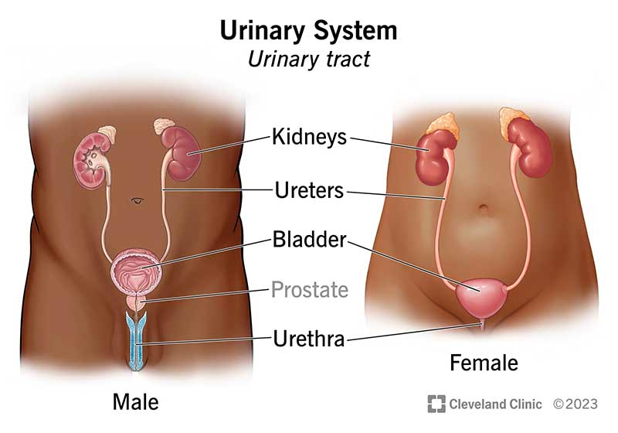
The urinary system
The urinary system purifies internal fluids by filtering 150-180 litres of fluid daily from the bloodstream.
It processes the fluid, allowing waste and ions to exit the body in urine while returning necessary substances to the blood, maintaining fluid homeostasis.
While the lungs and skin also excrete waste, the urinary system is primarily responsible for excretion; if it fails, other organs cannot compensate.
Besides fluid homeostasis, the urinary system regulates red blood cell production by secreting erythropoietin, vital for RBC formation, and maintains normal blood pressure by secreting renin.
Organs of the urinary system include kidneys, ureters, urinary bladder, and urethra.
Watch video The Urinary System In 7 Minutes

Slide 5
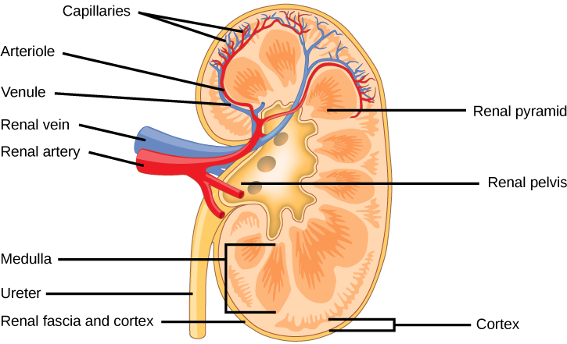
The urinary system The kidneys
The kidneys are primary organs of the urinary system, bean-shaped and responsible for eliminating wastes by producing urine.
Positioned between the twelfth thoracic vertebrae and protected by lower ribs, each kidney is dark red.
Held in place by renal fascia and surrounded by a thick renal capsule, an adult kidney is about 12cm long, 6cm wide, and 3cm thick.
Kidneys continuously filter blood, with about a quarter of the body's total blood supply passing through them every minute.
While the kidneys perform urinary functions, accessory structures like the urinary bladder eliminate urine from the body.
Segmental Artery
Renal Capsule

Slide 6
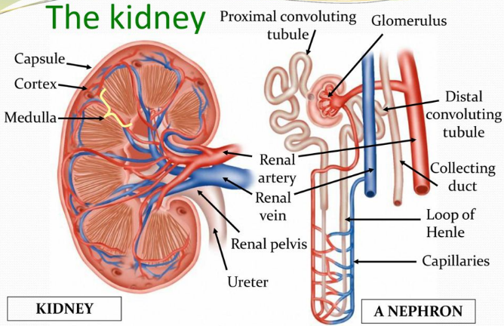
The urinary system Nephrons and urine formation
Nephrons consist of two main structures: the glomerulus and the renal tubule, with the closed end of the tubule surrounding the glomerulus in a section known as Bowman's capsule.
Urine formation involves three processes:
Glomerular filtration: Forces water and solutes through the capillary walls of the glomerular capsule, resulting in filtrate, akin to blood plasma without proteins.
Tubular reabsorption: Important substances like water, glucose, and ions are transported out of tubule cells and removed from the filtrate, while some wastes and excess ions remain.
Tubular secretion: Waste products such as hydrogen, potassium, and creatinine are removed from the blood and secreted by tubule cells into the urine, aiding in the elimination of substances not initially in the filtrate, like certain drugs and excess potassium.
Bowman’s capsule

Slide 7
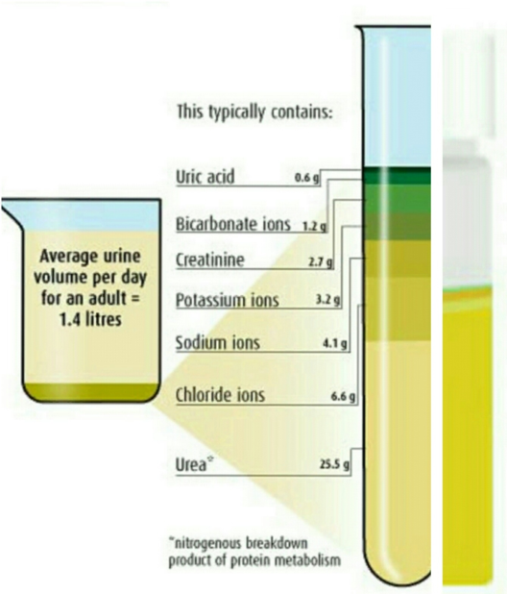
The urinary system Characteristics of urine
Kidneys filter 150 to 180 litres of blood plasma through their glomeruli into the tubules in 24 hours.
Despite this, only about 1 to 1.8 litres of urine is produced within the same period.
Filtrate and urine are distinct substances; filtrate initially contains all necessary nutrients and ions.
However, as filtrate progresses through collecting ducts, it loses most of its water, nutrients, and ions.
What remains is urine, which contains nitrogenous waste like uric acid and other unnecessary substances.
95% of water

Slide 8
The urinary system Ureters
Ureters are slender tubes, each about 25 to 30 cm long.
They extend from the kidneys to the back surface of the bladder.
Ureters function as conduits for transporting urine from the kidneys to the bladder.
The smooth muscle layers in their walls contract to push urine into the bladder.
Valve-like folds in the ureter walls prevent urine reflux back towards the kidneys once it enters the bladder.

Slide 9
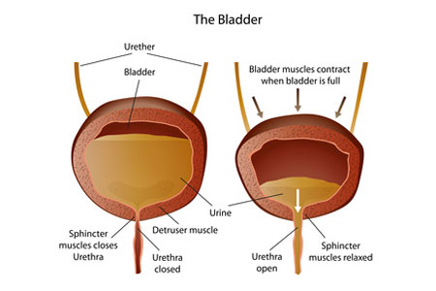
The urinary system Urinary bladder
The urinary bladder is a collapsible muscular sac serving as a temporary reservoir for urine.
Positioned behind the pelvis, it consists of three layers of smooth muscle and a specialized mucosal lining.
As urine collects, the bladder expands within the abdominal cavity.
Its muscular wall stretches to accommodate increasing urine volume without raising internal pressure.
When full, the bladder becomes firm, pear-shaped, and palpable in the lower abdomen.

Slide 10
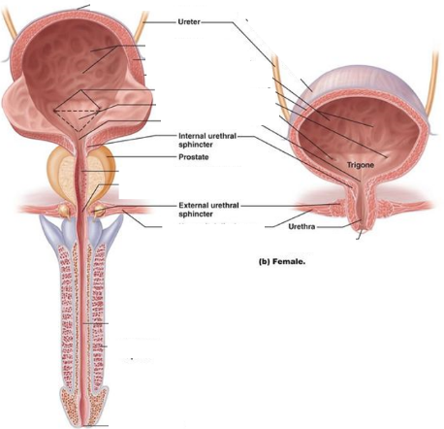
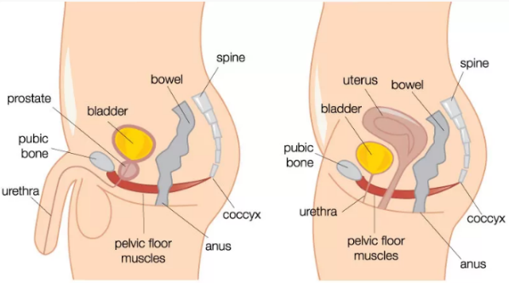
The urinary system Urethra
The urethra is a thin-walled tube responsible for conveying urine from the bladder to outside the body.
It features two sphincters: the internal urethral sphincter at the bladder-urethra junction, and the external urethral sphincter made of skeletal muscle, located in the pelvic floor.
Both sphincters regulate urine flow and can be controlled voluntarily.
In females, the urethra is short (3 to 4 cm) and opens externally near the vaginal opening.
In males, the urethra is longer (about 20 cm) and transports both urine and semen.
It comprises three parts: the prostatic urethra passing through the prostate gland, the membranous urethra entering the penis, and the spongy urethra extending the length of the penis and opening at its tip.

Slide 11
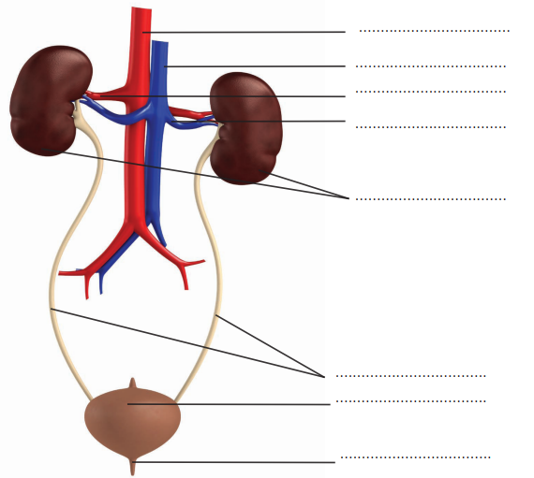
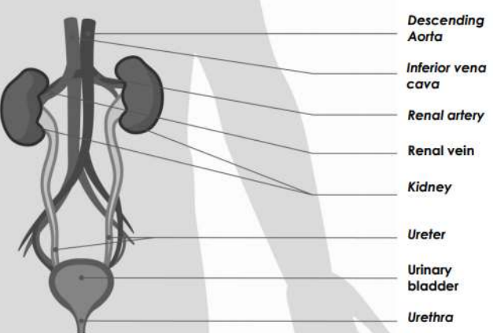
10. Labelling activity - the urinary system
Using your knowledge of the urinary system correctly label the diagram.

Slide 12
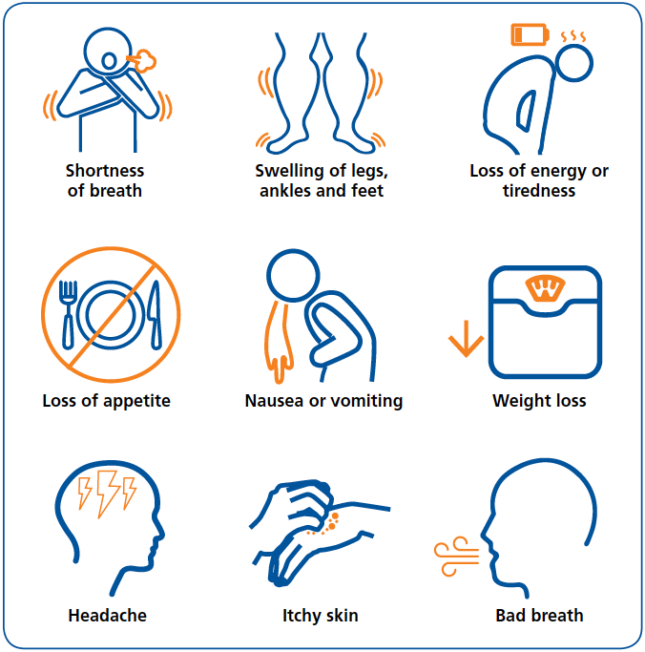
The urinary system Disorders of the urinary system
The urinary system, also known as the renal system, produces, stores, and eliminates urine, which is the fluid waste excreted by the kidneys.
Common disorders of the urinary system include:
Urinary tract infection (UTI), caused by bacteria entering the urinary tract, leading to symptoms like pain, burning sensation during urination, and blood in the urine. Usually treated with antibiotics.
Incontinence, often due to weakened pelvic floor muscles, resulting in loss of bladder control, particularly common after childbirth, with urine leakage occurring during physical activity or sneezing.
Kidney stones, calcium clumps forming in the urinary tract due to concentrated urine chemicals, causing pain in the back and sides and sometimes requiring antibiotics or surgical removal.
Kidney failure, also known as renal failure or chronic kidney disease, can be temporary or chronic, resulting from the kidneys' inability to filter waste from the blood, often associated with conditions like diabetes and hypertension.
Symptoms of kidney failure

Slide 13
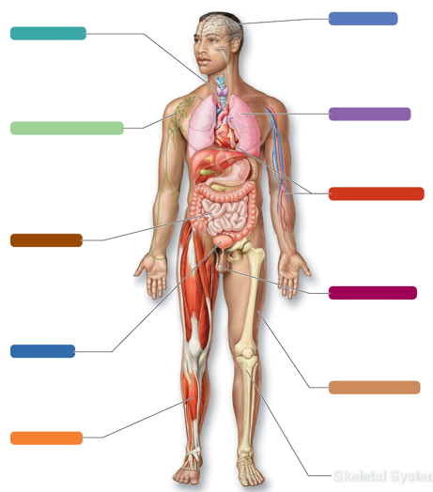
The urinary system Systems in sync - the urinary system
NERVOUS SYSTEM:
The kidneys remove nitrogenous waste. They also reabsorb nutrients such as potassium and sodium that are essential for healthy nerve function.
ENDOCRINE SYSTEM:
The kidneys dispose of wastes and produce the hormone erythropoietin.
The endocrine system produces hormones that help regulate renal reabsorption.
RESPIRATORY SYSTEM
The urinary system disposes of nitrogenous waste and maintains fluid balance of the blood.
The respiratory system provides oxygen required by the kidney cells.
LYMPHATIC SYSTEM:
The urinary system disposes of nitrogenous wastes and toxins filtered by the lymph nodes.
The lymphatic system produces immune cells that protect urinary organs from infection and cancer.
CARDIOVASCULAR SYSTEM
The urinary system disposes of wastes and regulates fluid balance of the blood. It also reabsorbs calcium, potassium and sodium that are needed for blood pressure regulation and normal heart function.
The CV provides the necessary blood pressure required for glomerular filtration.
The diagram below illustrates the interrelationship between the urinary system and the other body
systems.
DIGESTIVE SYSTEM:
The urinary system disposes of nitrogenous waste and maintains fluid balance of the blood. It also activates vitamin D, which can then be used for calcium absorption.
The digestive system provides nutrients for healthy kidney function.
REPRODUCTIVE SYSTEM:
The urinary system disposes of wastes and maintains the fluid balance of the blood to help maintain reproductive organ health.
INTEGUMENTARY (SKIN) SYSTEM:
The urinary system disposes of waste and toxin absorbed through the skin.
The skin synthesises vitamin D needed for calcium absorption in the kidneys.
URINARY SYSTEM
SKELETAL SYSTEM:
The kidneys produce erythropoietin that helps the formation of RBC’s produced in bone marrow.
Bones of the rib cage protect the kidneys.
MUSCULAR SYSTEM
The urinary system disposes of wastes generated by muscular activity.
Skeletal muscle of the pelvic floor supports the bladder.

Slide 14
Learning Checkpoint 8
1. Describe the function of the urinary system.
The urinary or renal system works to filter toxins and other substances from our internal fluids.
2. Outline the process of ‘fluid homeostasis’.
Every day the urinary system filters litres of fluid from the bloodstream. It then processes the fluid
allowing waste and ions to leave the body in urine, while returning needed substances to the blood.
3. Identify the other body systems that perform a similar function to the urinary system.
Lymphatic system and the digestive system.
4. Identify the structure responsible for urine formation.
The kidneys are responsible for eliminating and excreting wastes, toxins and drugs from the body.
They do this by producing urine.
5. Describe the difference between the male and female urethra.
In females, the urethra is short, only 3 to 4 cm long. The external urethra opens to the outside to
the opening of the vagina. In males the urethra is much longer, about 20cm in length and transports both urine and semen.

Slide 15
Learning Checkpoint 8
6. Identify the structures of the urethra that allows us to have conscious control over when we
urinate.
A second structure called the external urethral sphincter is made of skeletal muscle and is located
as the urethra passes through the pelvic floor. This sphincter is under voluntary control, which means that we can consciously control when we release urine.

Slide 16
Learning Checkpoint 8
7. Describe how the urinary system interacts with the following body systems:
• Cardiovascular system
o The urinary system disposes of wastes and regulates fluid balance of the blood. It also reabsorbs calcium, potassium and sodium that are needed for blood pressure regulation and normal heart function. The CV provides the necessary blood pressure required for glomerular filtration
• Lymphatic system
o The urinary system disposes of nitrogenous wastes and toxins filtered by the lymph nodes. The lymphatic system produces immune cells that protect urinary organs from infection and cancer
• Nervous system
o The urinary system disposes of nitrogenous wastes and toxins filtered by the lymph nodes. The lymphatic system produces immune cells that protect urinary organs from infection and cancer
• Endocrine system
o The kidneys dispose of wastes and produce the hormone erythropoietin. The endocrine system produces hormones that help regulate renal reabsorption.

Slide 17
The reproductive system
The main function of the reproductive system is to reproduce or produce babies.
Unlike most other body systems that function continuously, the reproductive system starts functioning at puberty.
The reproductive system has four functions:
Producing egg and sperm cells.
Transporting and caring for these cells.
Supporting the development of offspring (children).
Producing hormones.
These functions are divided between primary and accessory reproductive organs.
Primary reproductive organs, known as gonads, include the ovaries in females and the testes in males, responsible for producing egg, sperm cells, and hormones.
Hormones produced by gonads play a crucial role in reproductive organ development, function, and sexual behavior, influencing other organs and tissues in the body.
All other organs, ducts, and glands in the reproductive system are considered accessory reproductive organs.
Watch video Male reproductive system, Female Reproductive System:

Slide 18
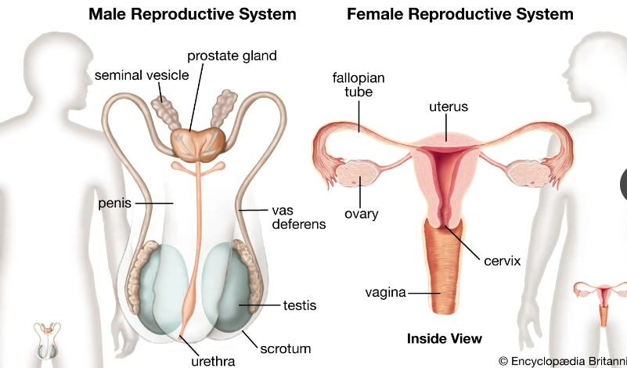
The reproductive system

Slide 19
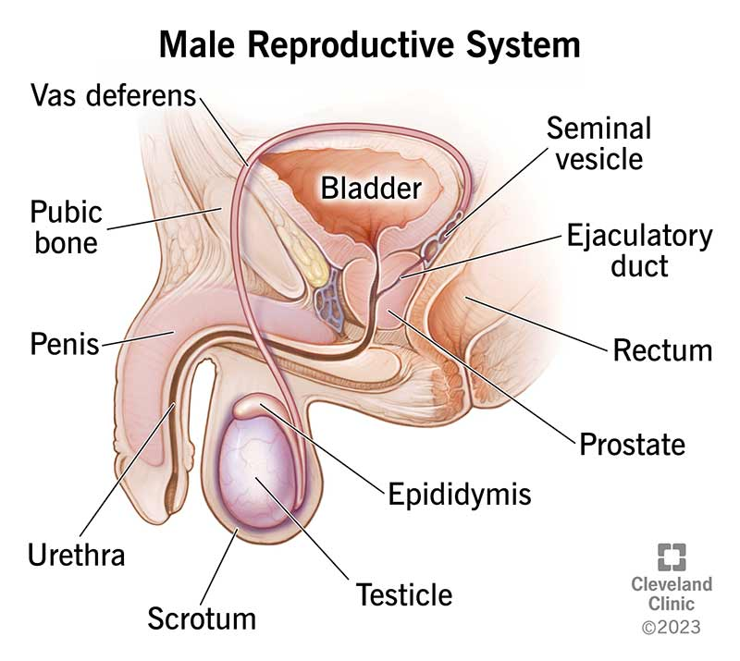
The reproductive system Anatomy of the male reproductive organs
(Ductus deferens)
The reproductive role of the man is to develop male sex cells called sperm and deliver them to a woman’s reproductive tract.
A male’s primary reproductive organ are the testes, which have a dual function, producing sperm and the hormone testosterone.
Gland
Spongy

Slide 20
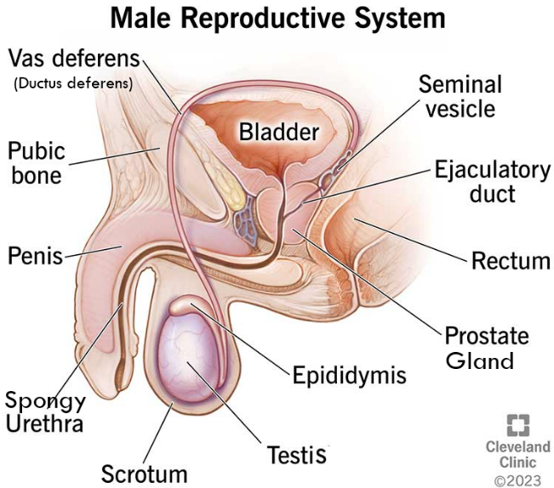
The reproductive system The testes and the duct system
The testes are paired, plum-shaped organs, about 4cm long and 2.5cm wide. Seminiferous tubules within the testes produce sperm.
Sperm travel through the epididymis, located on the external surface of the testes, which serves as a temporary storage site for maturing sperm.
Accessory organs forming the male duct system include the epididymis, ductus (vas) deferens, and urethra.
The epididymis contracts during sexual stimulation to expel sperm into the ductus deferens.
The ductus deferens runs from the epididymis through the pelvic cavity, over the bladder, and empties into the ejaculatory duct to join the urethra.
During ejaculation, smooth muscle contractions in the walls of the ductus deferens propel sperm forward.

Slide 21
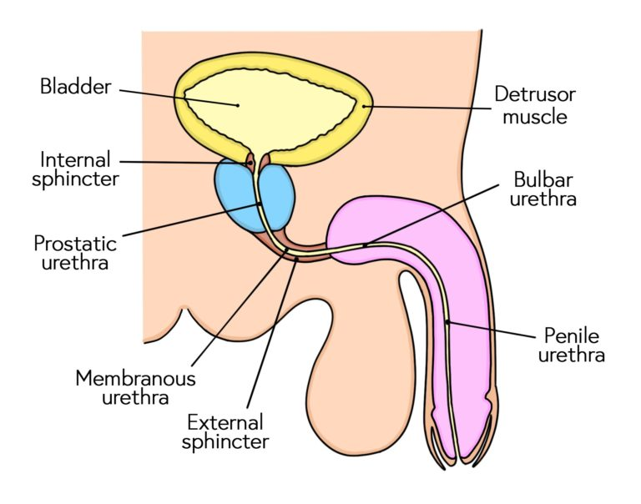
The reproductive system The urethra
The male urethra extends from the urinary bladder to the tip of the penis.
It carries both urine and semen to the outside of the body.
When ejaculation occurs and sperm enter the urethra, the internal bladder sphincter constricts.
This important process prevents the urine from entering the urethra while sperm is being ejaculated.

Slide 22
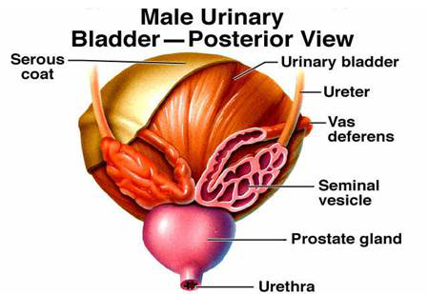
The reproductive system Accessory organs and semen
Seminal vesicles: Located at the base of the bladder, they produce seminal fluid, comprising 60% of semen volume. Their ducts join with the ductus deferens, and during ejaculation, sperm and seminal fluid enter the urethra together.
Prostate gland: Positioned on the upper part of the urethra below the urinary bladder, roughly the size of a peach pit. It secretes a milky fluid that aids in sperm activation.

Slide 23
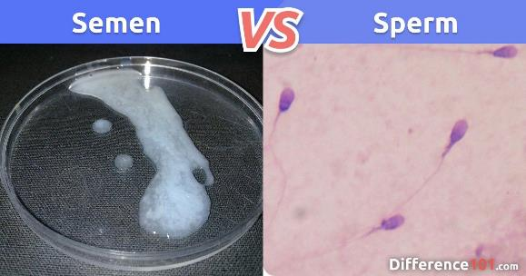
The reproductive system Semen and sperm
Semen, or seminal fluid, consists of sperm cells capable of fertilizing female eggs.
Seminal plasma, also present in semen, supports the viability of sperm cells.
Mature sperm cells feature smooth oval-shaped heads and long tails to aid in propulsion through the female reproductive tract.
Sperm is produced in the testes through spermatogenesis.
Spermatogenesis initiates during puberty and persists throughout adult life.

Slide 24
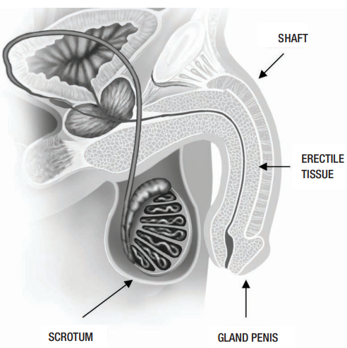
The reproductive system External male genitalia
Male external genitalia comprise the scrotum and the penis.
The scrotum is a skin sac situated outside the abdominal cavity, between the legs, and at the penis base, protecting and holding the testes.
Sensory nerves in the scrotum respond to temperature changes, crucial for maintaining the testes' optimal temperature for sperm production.
The scrotum typically hangs loosely but contracts and wrinkles in cold conditions to draw the testes closer to the body for warmth.
The penis functions to deliver sperm into the female reproductive tract.
It consists of a shaft and an enlarged tip called the glans penis.
The penis primarily comprises erectile tissue, which fills with blood during sexual arousal, causing it to enlarge and become erect.

Slide 25
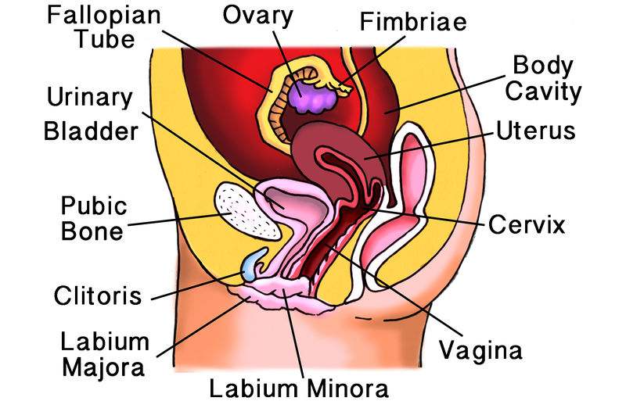
The reproductive system Anatomy of the female reproductive organs
Female reproductive system is more complex, involving producing ova and supporting pregnancy.
Ovaries are primary female reproductive organs, responsible for egg production and hormone secretion.
They produce oestrogen and progesterone, vital for reproductive processes.
Other organs are accessory, aiding in supporting and safeguarding reproductive cells.
Rectum
Anus
Urethra

Slide 26
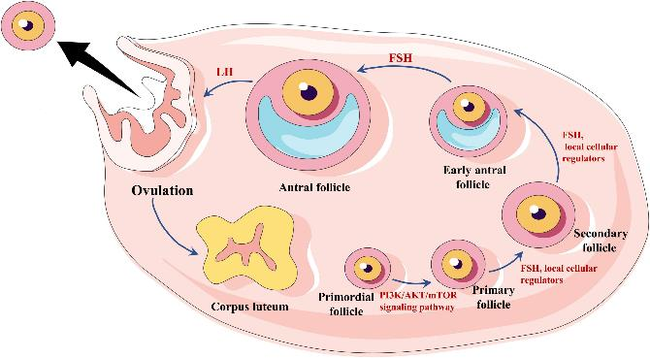
The reproductive system The ovaries
Ovaries: almond-shaped organs, about 3.5 cm in length, located in the pelvic region.
Functions: produce eggs (ova) and hormones oestrogen and progesterone.
Located within ovarian fossae, secured by ligaments to the pelvis walls.
Internally composed of ovarian follicles containing oocytes (young eggs).
Follicle cells surrounding eggs enlarge as eggs mature.
Ovulation: process where mature egg is released from ovary when follicle breaks open.
Ovarian follicles
Young eggs

Slide 27
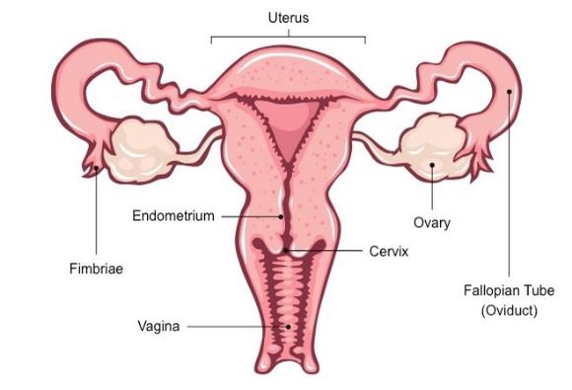
The reproductive system The female duct system and accessory organs
Fallopian tubes: First part of the female reproductive tract duct system.
Functions: provide passageway for mature egg for fertilization.
Each tube about 10cm long, extending from ovaries to uterus.
Distal end expands into funnel-shaped structure with fimbriae to capture egg.
Uterus: Muscular hollow organ between urinary bladder and rectum. Normal size and shape of a pear in women who have never been pregnant. Expands during pregnancy to accommodate fetus.
Task: supports and grows fertilized egg during pregnancy.
Main section referred to as the body, with a narrow outlet called the cervix.
Cervix dilates during childbirth to allow baby's head to pass through.
Vagina: Thin-walled tube, 8 to 10cm long, located between bladder and rectum. Also known as the birth canal.
Functions: provides passageway for baby delivery and menstrual blood exit.

Slide 28
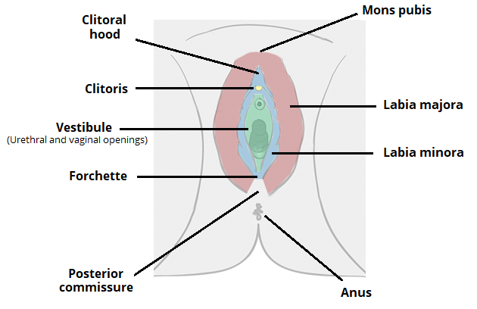
The reproductive system External female genitalia
Female external genitalia collectively called the vulva.
Includes:
Labia majora: Outer "lips" of the vulva, larger folds of skin.
Mons pubis: Mound of fatty tissue over the pubic bone.
Labia minora: Inner "lips" of the vulva, smaller folds of skin.
Clitoris: Erectile organ, analogous to the male penis, responsive to sexual stimulation.

Slide 29
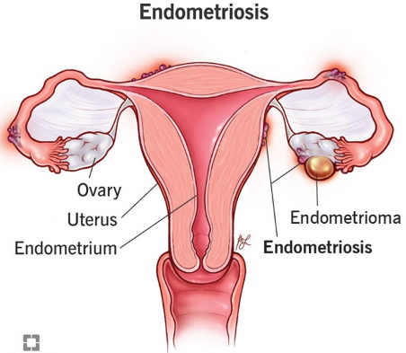
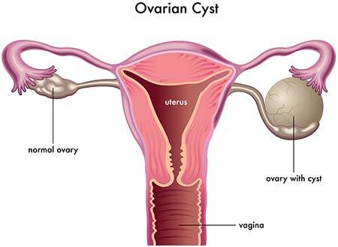
The reproductive system Disorders of the female reproductive system
Endometriosis:
Endometrium lining sheds off during menstruation.
Discharge enters uterine tube, spills into abdomen, forms tissue clots.
Symptoms include:
Abdominal and lower back pain
Irregular periods
Painful bowel movements or urination
Pain during sexual intercourse
Ovarian cysts:
Fluid-filled swellings on or in one or both ovaries.
Common in women aged 30-45.
Most are non-cancerous but may become cancerous.
Symptoms:
Abdominal pain
Pain during sexual intercourse
Changes in menstruation

Slide 30
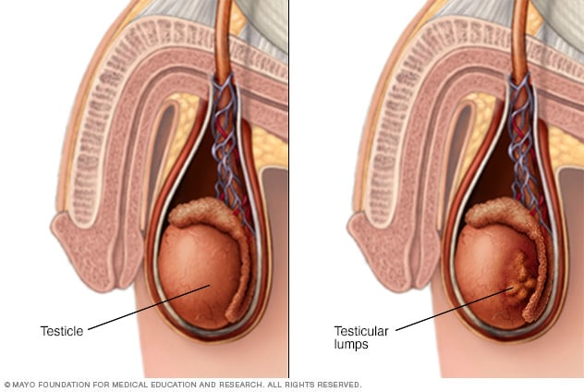
The reproductive system Disorders of the male reproductive system
Testicular cancer:
Cancerous tumor developing within a testis.
Most common in males aged 20-40.
Can be linked to family history and lifestyle.
Easily cured if discovered early.
May spread to lymph nodes and other parts of the body if untreated.
Usually affects only one testis.
Most tumors develop in sperm-producing cells of the testes.

Slide 31
The reproductive system Systems in sync - the reproductive system
NERVOUS SYSTEM:
Sex hormones interact with the nervous system to influence sex drive.
The hypothalamus regulates the timing of puberty.
ENDOCRINE SYSTEM:
Gonadal hormones that interact with the hypothalamus and pituitary gland.
Hormones produced by the endocrine system help regulate the function of he ovaries and testes.
RESPIRATORY SYSTEM
During pregnancy the enlarged uterus impairs the function of the diaphragm.
The respiratory system provides oxygen required by the reproductive organs.
LYMPHATIC SYSTEM:
The lymphatic system transports sex hormones and produce immune cells that protect reproductive organs from disease.
CARDIOVASCULAR SYSTEM
Oestrogen helps to lower blood cholesterol and promote CV health in women.
The CV transports needed substances to reproductive organs and transports sex hormones
The diagram below illustrates the interrelationship between the reproductive system and the other body systems.
DIGESTIVE SYSTEM:
During pregnancy the enlarged uterus squashes the digestive organs.
The digestive system provides nutrients to the unborn baby and to the reproductive organs.
REPRODUCTIVE SYSTEM
INTEGUMENTARY (SKIN) SYSTEM:
Male and female sex hormones help keep skin and hair hydrated. They also stimulate the growth of pubic hair.
The skin surrounding the testes (scrotum) protects and supports them.
URINARY SYSTEM:
The male reproductive system shares structures with the reproductive system, such as the urethra.
Kidneys dispose of wastes and toxins.
SKELETAL SYSTEM:
Testosterone influences the growth and increases bone density.
Oestrogen helps to maintain bone mass in women.
The pelvis surrounds and protects most of the male and female reproductive organs.
MUSCULAR SYSTEM
Testosterone promotes muscle growth.
Abdominal muscles play an important role in childbirth. Also, muscles of the pelvic floor support reproductive organs.

Slide 32
Learning Checkpoint 9
1. Outline the four major functions of the reproductive system.
To produce egg and sperm cells, to transport and care for these cells, to support developing offspring, to produce hormones.
2. Describe the structure, function and location of the following primary sex organs:
• Testes
o The testes are a pair plum shaped organs that are approximately 4cm long and 2.5cm wide; the testes produce sperm and the hormone testosterone.
• Ovaries
o The ovaries are the primary female reproductive organs and like the testes they have a dual function. They produce the eggs (ova) and also produce the hormones oestrogen and, progesterone. The ovaries are a pair of almond-shaped organs that are about 3.5 cm in length, 2 cm wide, and 1 cm thick.
3. What is ‘ovulation’ and its role in reproduction.
Ovulation is when the follicle breaks open causing the release of a mature egg from the ovary.
The fertile period of a woman’s menstrual cycle is when the egg is released.

Slide 33
The integumentary system
Largest organ of the body.
Main function is protection and covering of internal organs from the external environment.
Includes skin and accessory structures like oil and sweat glands, hair, and nails.
Acts as a barrier against foreign organisms such as bacteria.
Keeps water and important molecules in the body.
Protects, insulates, and cushions deeper organs.
Defends against physical, chemical, and thermal damage, as well as UV radiation and bacteria.
Physical damage (bumps and cuts):
Upper skin layer contains keratin for toughness.
Fat cells cushion impacts.
Pressure receptors alert system of possible damage.
Chemical damage (acids):
Specialized keratin cells block chemicals.
Minimizes damage from contact with substances.
Thermal damage (heat and cold):
Skin's sensory receptors send quick messages to the brain.
Allows rapid body reaction to temperature changes.
UV radiation (sunlight's damaging effects):
Melanin production in skin offers protection.
Bacteria:
Skin secretions, like sweat, are acidic, destroying bacteria.
Immune cells surround and destroy bacteria entering through wounds.
Watch video The Integumentary System. Watch video The Integumentary System “Disorders, Conditions, and Diseases

Slide 34
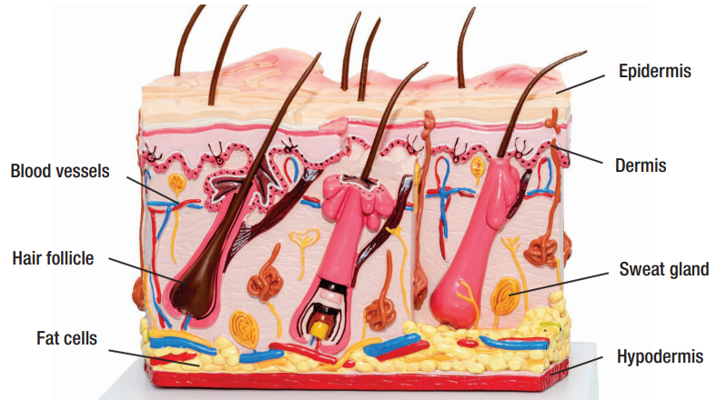
The integumentary system Structure of skin
Epidermis: Outer layer made of stratified squamous epithelium.
Capable of becoming hard and tough.
Dermis: Second layer mostly composed of dense connective tissue.
Firmly connected to the epidermis but can separate under certain conditions.
Friction, like from tight footwear, can cause separation, resulting in blister formation.
Hypodermis: Located below the dermis.
Not considered part of the skin but has important functions.
Connects skin to organs and serves as a shock absorber.
Insulates deeper tissues from external temperature changes.

Slide 35
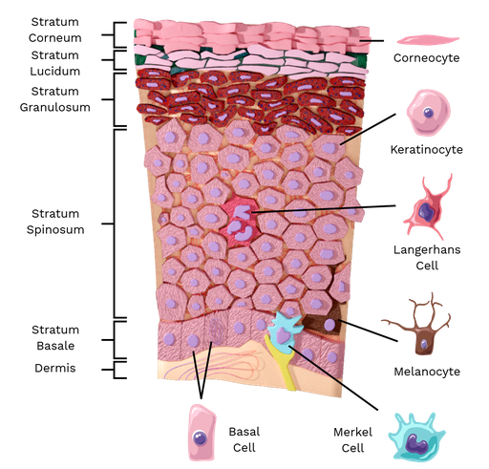
The integumentary system Epidermis
Epidermis Composition and Function:
Comprises five layers of skin, lacking its own blood supply.
Mainly consists of keratin cells producing tough protein keratin.
Keratin protects against water loss and various damages.
Outer layer, the stratum corneum, sheds daily, with an average person losing about 18kg of flakes in a lifetime.
Constant replacement from the deep layer, the stratum basal, occurs every 25 to 45 days.
Melanocytes and Melanin Production:
Special cells called melanocytes produce melanin, determining skin color.
Exposure to sunlight prompts melanocytes to produce more melanin, resulting in a tan.
Epidermis
Basal layer

Slide 36
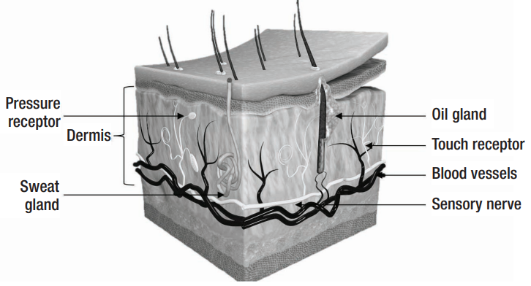
The integumentary system Dermis
Strong and elastic layer of skin that supports the body.
Comprises two layers: papillary layer (upper) and reticular layer (deep).
Thickness varies across the body, thicker on palms and soles, thinner on eyelids and nose.
Papillary Layer:
Located beneath the epidermis and connected to it via papillae.
Papillae serve various functions including blood supply and sensory reception.
Contains immune cells (phagocytes) to combat bacteria.
Reticular Layer:
Contains collagen and elastic fibers, contributing to skin toughness and elasticity.
Reduction in collagen and elastin with age leads to sagging and wrinkles.
Vascular Supply and Temperature Regulation:
Rich blood vessel network aids in maintaining body temperature.

Slide 37
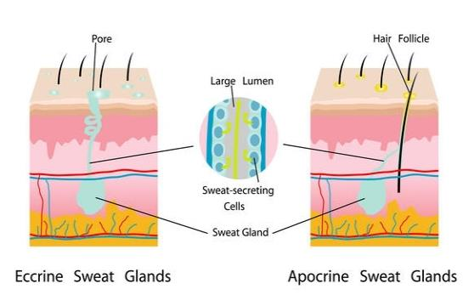
The integumentary system Accessory structures of the skin
Sweat and Oil Glands:
Sweat glands (eccrine and apocrine) distributed throughout the skin.
Eccrine glands secrete clear fluid containing water, salts, vitamins, and waste products.
Eccrine glands regulate body temperature, responding to internal and external temperature changes.
Apocrine glands, larger and found in genital areas, produce fatty acids, proteins, and substances from eccrine glands.
Apocrine glands become active during puberty but play a minimal role in temperature regulation.
Oil glands present everywhere except palms and soles, secreting sebum to keep skin moist, prevent hair dryness, and kill bacteria.
Hair: Millions of hairs across the body provide minimal protection.
Hair produced by hair follicles, consisting of keratin core and outer layer.
Arrector pili muscles contract, causing hair to stand upright (goosebumps).
Hair varies in shape, size, and thickness depending on body location.
Nails: Scale-like extensions of the epidermis, made mostly of keratin.
No significant function within the integumentary system.

Slide 38
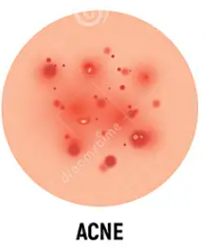
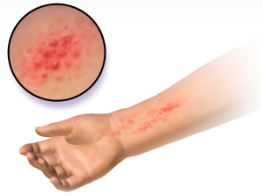
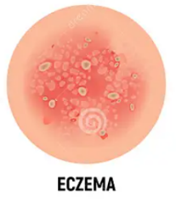
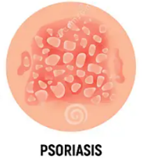
The integumentary system Disorders of the integumentary (skin) system
Acne:
Affects skin's oil glands, leading to clogged pores and pimples.
Causes include poor skin hygiene, diet, and hormonal changes.
Dermatitis:
Inflammation of the skin due to irritants or allergic reactions.
Results in red, itchy, and inflamed skin.
Eczema:
Long-term skin disease characterized by dry, itchy skin and rashes.
Commonly treated with medicated creams, ointments, and antibiotics.
Psoriasis:
Causes scaling and swelling of the skin, often with red patches and silvery scales.
Usually found on elbows, knees, scalp, face, palms, and soles of feet.
Hives:
Red, itchy bumps on the skin caused by allergic reactions, infections, or stress.
Common and typically resolve on their own.
Skin Cancer:
Most common cancer type, usually treatable if detected early.
Three main types: basal cell carcinoma, squamous cell carcinoma, and melanoma.
Caused primarily by exposure to ultraviolet light (sunlight).
HIVES

Slide 39
The integumentary system Systems in sync - the integumentary system
NERVOUS SYSTEM:
The skin protects nervous system organs and contains sensory receptors.
The nervous system regulates blood vessel activity in the skin and activates sweat glands. It also activates the arrector pili muscles.
ENDOCRINE SYSTEM:
The skin provides protection for organs of the endocrine system.
Hormones produced by the endocrine system helps to activate glands and regulate hair growth.
RESPIRATORY SYSTEM
The skin protects respiratory organs
The respiratory system delivers oxygen to the skins cells and removes carbon dioxide via gas exchange with the blood.
LYMPHATIC SYSTEM:
The skin protects lymph organs and prevents pathogens from entering the body.
Phagocytes found in the skin help protect skin cells from infection and disease
CARDIOVASCULAR SYSTEM
Skin protects CV organs and prevents fluid loss from the body surface, which maintains blood volume.
The CV transports oxygen and blood flow to the skin.
The diagram below illustrates the interrelationship between the integumentary system and the other
body systems
DIGESTIVE SYSTEM:
Skin protects digestive organs and provides vitamin D needed for calcium absorption by the small intestines.
The digestive system provides nutrients such as fats to the skin.
REPRODUCTIVE SYSTEM:
The skin protects the organs of the reproductive system and highly specialised sweat glands in the breasts produce milk during pregnancy.
The reproductive organs produce hormones that influence the secretions of oil glands during puberty
URINARY SYSTEM:
The skin protects the organs of the urinary system and excretes salts and wastes in sweat.
The urinary system disposes of toxins and wastes absorbed by the skin.
INTEGUMENTARY (SKIN) SYSTEM
SKELETAL SYSTEM:
The skin protects the bones and synthesizes vitamin D.
The skeletal system provides support for the skin
MUSCULAR SYSTEM
The skin protects the muscles
Muscle activity generates heat, which increases blood flow to the skin and activates sweat glands.

Slide 40
Learning Checkpoint 10
1. Describe the major functions of the integumentary system.
The skin in the largest organ of the body and has a number of different functions. The main
function of our skin is to protect and cover the internal organs of the body from the external
environment.
2. Describe the structure of skin.
The skin in made up of two types of tissue. The outer layer is called the epidermis, which is made
of stratified squamous epithelium that is capable of becoming hard and tough. The second layer
of skin is called the dermis and is mostly made of dense connective tissue.
3. Identify the layer of skin that is constantly shedding cells
The epidermis.
4. Identify the time taken for a new layer of skin to be produced.
24 to 25 days
5. Identify the accessory structures of the integumentary system.
Sweat and oil glands, hair and nails

Slide 41
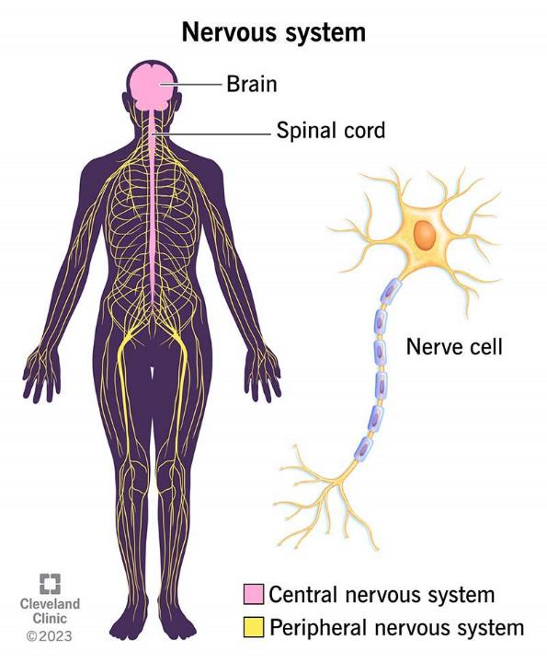
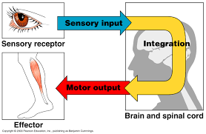
The nervous system
Function of the Nervous System:
1. Sensory Input:
Monitors internal and external changes through sensory receptors.
Information gathered from stimuli.
2. Integration:
Processes and interprets sensory input.
Decides on appropriate action.
3. Motor Output:
Activates muscles or glands (effectors) based on integration.
Collaboration with Endocrine System:
Works alongside the endocrine system to regulate and maintain homeostasis.
Watch video The Nervous System In 9 Minutes.

Slide 42
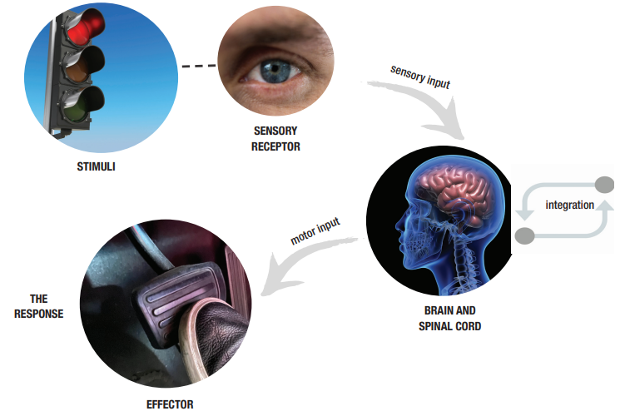
The nervous system
Example:
Driving scenario: Seeing a red light (sensory input) leads to processing by the nervous system.
Integration results in motor output to muscles of the right leg and foot.
Response: Applying the brake to stop the car.

Slide 43
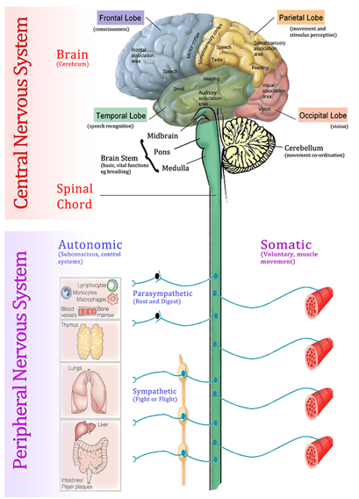
The nervous system Structural classification
Central Nervous System (CNS):
Comprises the brain and spinal cord.
Functions as command centres for the nervous system.
Interprets incoming sensory information.
Determines instructions for specific body parts.
Peripheral Nervous System (PNS):
Consists of nerves extending from the brain and spinal cord.
Connects the CNS to the rest of the body.
Facilitates communication between the CNS and peripheral organs.

Slide 44
The nervous system The peripheral nervous system (PNS)
Operates outside of the CNS. Comprises nerves extending from the brain and spinal cord.
Special spinal nerves carry impulses from the spinal cord, while cranial nerves carry impulses to and from the brain. Links all body parts and serves as communication lines.
Carries impulses from sensory receptors to the CNS, and then to glands or muscles.
Afferent (Sensory) Division:
Transmits impulses to the CNS from sensory receptors.
Includes somatic sensory fibres in the skin, skeletal muscles, and joints.
Keeps the body informed about internal and external conditions.
Efferent (Motor) Division:
Carries impulses from the CNS to effector organs, muscles, and glands. Induces motor responses, such as pressing a brake pedal.
Further subdivided into:
Somatic or Voluntary Nervous System: Allows conscious control over muscles. Reflexes are under involuntary control.
Autonomic Nervous System (ANS): Regulates automatic or involuntary actions. Includes:
1. Sympathetic Division: Activates during excitement or threat ("fight-or-flight").
2. Parasympathetic Division: Active during rest or normal conditions.

Slide 45
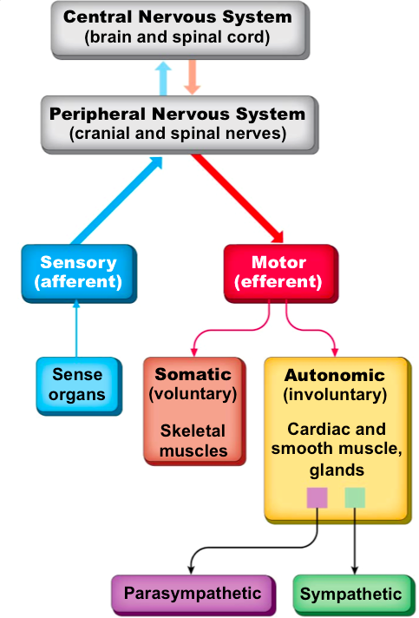
The nervous system The peripheral nervous system (PNS)
How the CNS and PNS interact and function.

Slide 46
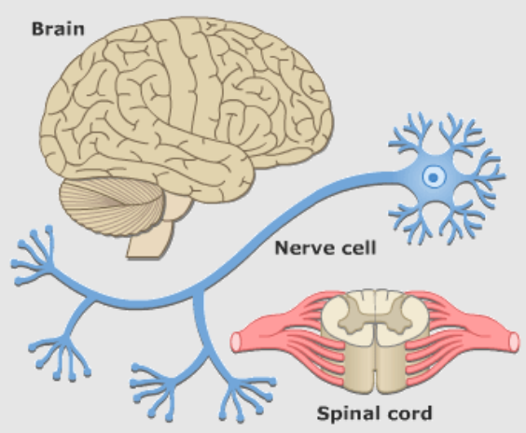
The nervous system Nerves and nervous tissue structure and function
Nervous Tissue Composition:
Consists of supporting cells and neurons.
Supporting Cells:
Grouped together to form neuroglia in the CNS.
Neuroglia encompasses various types of cells that: Support, insulate, and protect neurons.

Slide 47
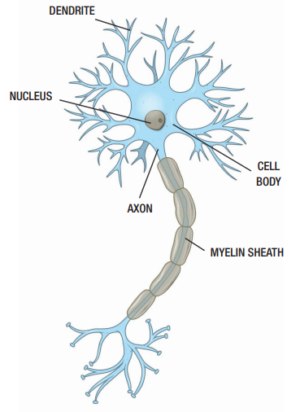
The nervous system Neurons
Neuron Structure:
Often called nerve cells. Specialized to transmit nerve impulses.
Have a cell body containing a nucleus and processes.
Dendrites: Receive incoming messages.
Axons: Transmit messages away from the neuron.
Covered and protected by myelin, increasing impulse transmission rate.
Neuron Functions:
Respond to stimuli and convert them into nerve impulses.
Transmit impulses to other neurons, muscles, or glands.
Neuron Classification:
Sensory or Afferent Neurons:
Carry impulses from sensory receptors to the CNS.
Register and transmit pain.
Detect stretch or tension in muscles.
Motor or Efferent Neurons:
Transmit impulses from the CNS to muscles and glands.
Interneurons:
Connect motor and sensory neurons to neural pathways in the brain.

Slide 48
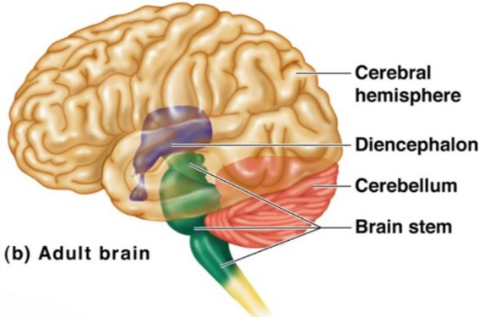
The nervous system The central nervous system (CNS)
The CNS comprises the brain and the spinal cord.
The brain is a sizable, convoluted mass of pink tissue weighing over 1.3kg.
Located within the cranial cavity, it serves as the largest and most intricate organ of the nervous system.
The brain is segmented into four primary regions: cerebrum, diencephalon, brainstem, and cerebellum.

Slide 49
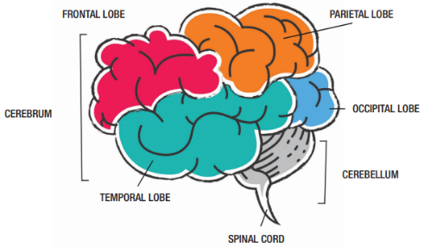
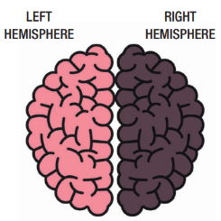
The nervous system CNS: The cerebral hemispheres
The cerebrum consists of two cerebral hemispheres, left and right, which form the superior part of the brain.
The cerebrum is larger than the other three regions of the brain combined.
These cerebral hemispheres are divided into lobes, encased within the cerebral cortex, a thin layer of grey matter covering the cerebrum.
The cerebral cortex is responsible for various functions such as speech, memory, logical and emotional responses, and voluntary movement.
The lobes of the brain include the parietal, occipital, temporal, and frontal lobes, each with distinct functions.
The corpus callosum, a thick band of nerve fibers, divides the cerebral cortex lobes into left and right hemispheres, facilitating communication between them.

Slide 50
The nervous system CNS: The cerebral hemispheres

Slide 51
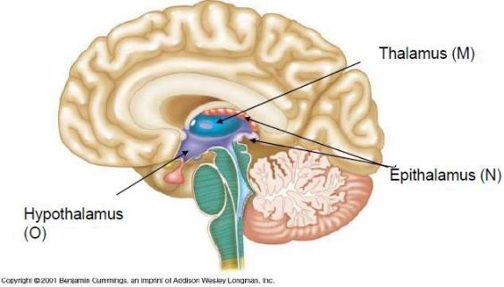
The nervous system CNS: The diencephalon
The diencephalon is located at the base of the brain stem and is surrounded by the cerebral hemispheres.
Major structures of the diencephalon include the thalamus, hypothalamus, and epithalamus.
The thalamus serves as a relay station for sensory impulses traveling to the sensory cortex, distinguishing between pleasant and unpleasant sensations.
The hypothalamus regulates temperature, water balance, and is involved in emotions and urges such as thirst, appetite, pain, sex, and pleasure.
It closely interacts with the pituitary gland to regulate hormones in the endocrine system.
The epithalamus contains the pineal gland, which secretes melatonin, and the choroid plexus, responsible for producing cerebrospinal fluid.

Slide 52
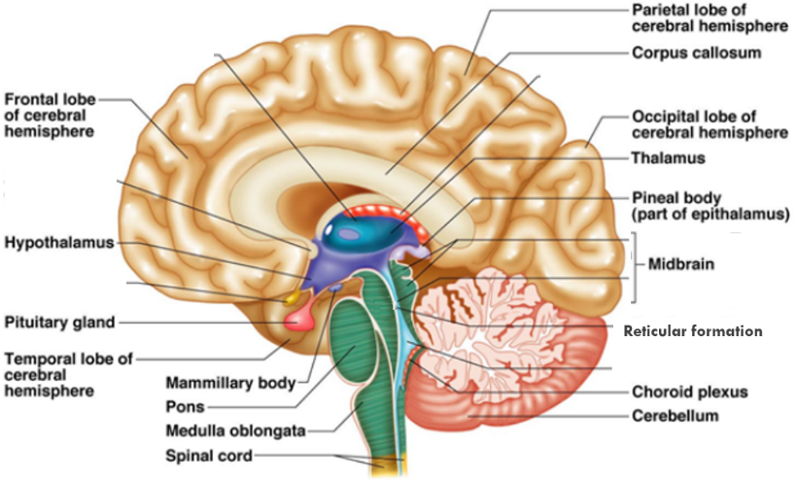
The nervous system CNS: The brain stem
The brain stem comprises four structures: the midbrain, pons, medulla oblongata, and reticular formation.
Midbrain: It initiates the superior part of the brain stem, transmitting ascending and descending impulses and serving as a reflex center for vision and hearing.
Pons: Located inferiorly to the midbrain, it consists mostly of fibers and is involved in breathing control.
Medulla oblongata: The most inferior part of the brain stem, merging with the spinal column; it controls vital functions like heart rate, blood pressure, breathing, swallowing, and vomiting.
Reticular formation

Slide 53
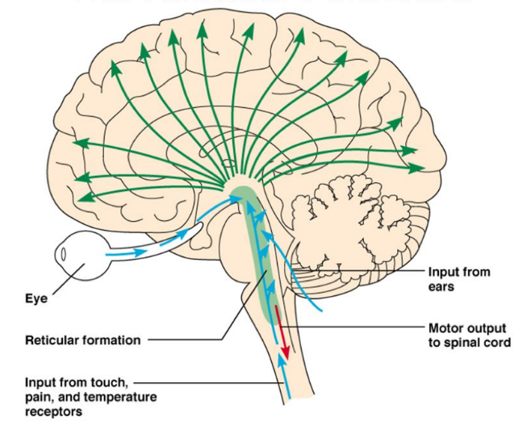
The nervous system CNS: The brain stem
Reticular formation: Extending from the medulla to the midbrain, it aids in processing sensory impulses from the eyes and ears, integrating visual, auditory, and vestibular stimuli for motor coordination. It also regulates arousal, consciousness, movement, and sensation, and damage can lead to coma.
Sensory Radiations
Auditory impulses
Visual impulses
Ascending sensory tracts
Descending motor signals

Slide 54
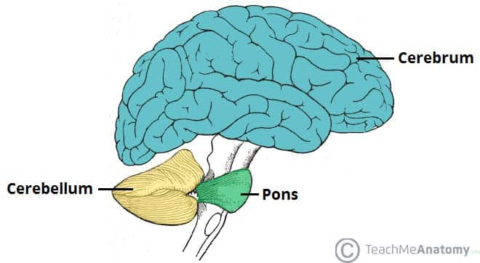
The nervous system CNS: The cerebellum
The cerebellum is a large cauliflower-shaped region of the brain situated beneath the occipital lobe of the cerebrum.
It is responsible for providing precise timing of skeletal muscle activity and regulating balance and equilibrium.
Nerve fibers from the inner ear, eyes, and proprioceptors from skeletal muscles transmit signals to the cerebellum.
Equilibrium is a function closely associated with the cerebellum.

Slide 55
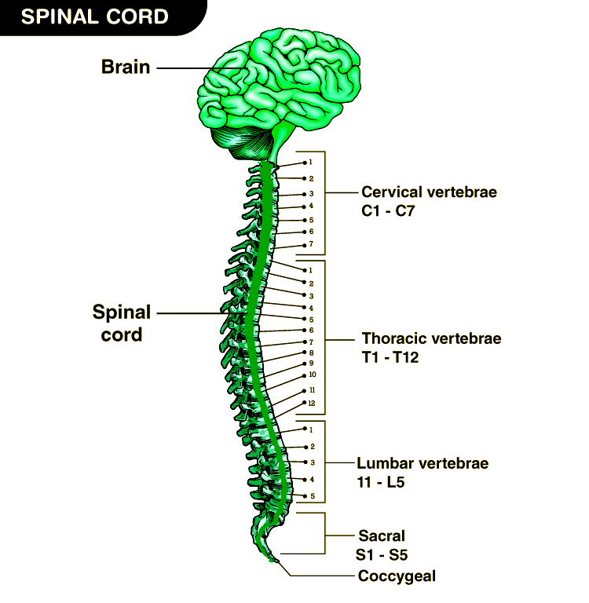
The nervous system CNS: The spinal cord
The spinal cord resembles a cylinder and extends approximately 42 cm in length, serving as a white extension of the brainstem.
It functions as a two-way pathway to and from the brain and acts as a major reflex center.
Surrounding and protecting the spinal cord is the vertebral column, which spans from the base of the skull to the second lumbar vertebra.
The spinal cord is safeguarded by both the bones of the vertebral column and three layers of connective tissue known as meninges, which also provide cushioning for the brain.
Exiting the spinal cord are 31 pairs of nerves that innervate the body regions closest to them.
While generally the width of a thumb, the spinal column enlarges in the cervical and lumbar regions to accommodate the upper and lower limbs of the body.

Slide 56
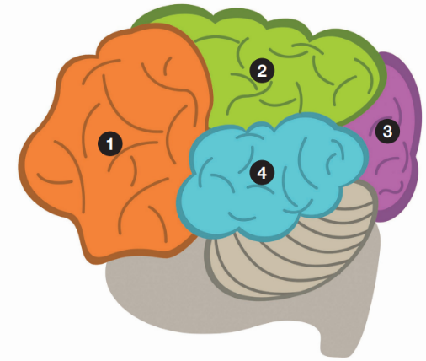
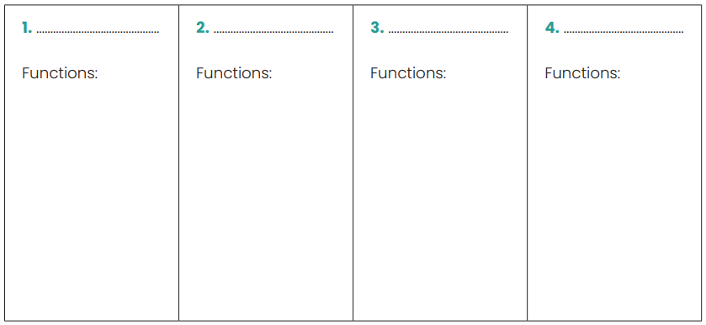
11. The brain - lobe control
Your task is to label the lobes of the brain and further investigate their functions.

Slide 57
The nervous system CNS: Grey and white matter of the spinal cord
Grey matter tissue of the spinal cord resembles a butterfly, with two posterior projections called the dorsal or grey horns and anterior projections known as the anterior horns.
Surrounding the grey matter is the central canal, housing cerebrospinal fluid.
White matter comprises myelinated fibers transmitting impulses between the brain and spinal cord, as well as across spinal cord segments.
The white matter can be categorized into dorsal, lateral, and ventral columns, each containing various fiber tracts composed of axons.
Sensory tracts transmit impulses from sensory receptors to the brain, while motor tracts carry impulses from the brain to skeletal muscles.

Slide 58
The nervous system Protection of the central nervous system (CNS)
Nervous tissue is fragile and irreplaceable, emphasizing the need for protection mechanisms.
The skeletal system provides bony enclosures around the brain and spinal cord for physical protection.
Additional protective measures include:
Blood-brain barrier: Capillaries restrict the passage of substances, maintaining a stable internal environment for neurons. Allows minimal substances like glucose and water while preventing toxins and most drugs.
Meninges: Comprising three layers (dura mater, arachnoid, and pia mater), these tissues shield CNS structures. The pia mater adheres tightly to the brain's surface and absorbs cerebrospinal fluid (CSF).
Cerebrospinal fluid (CSF): Produced by the choroid plexus in the diencephalon, CSF resembles blood plasma but with fewer proteins and more vitamins. It cushions and safeguards nervous tissue from physical impact or damage, circulating within the brain and spinal cord.

Slide 59
The nervous system Protection of the central nervous system (CNS)
Reflexes are rapid, predictable, and involuntary responses to stimuli.
They follow a one-way street pattern and involve neural pathways known as reflex arcs, which encompass both the CNS and PNS.
Two main types of reflexes exist: somatic and autonomic reflexes.
Somatic reflexes stimulate skeletal muscles, such as withdrawing your hand from a hot surface.
Autonomic reflexes regulate smooth muscle and gland activity, like the involuntary beating of the heart and stomach digestion.
Autonomic reflexes also aid in regulating body functions like digestion, blood pressure, and sweating.

Slide 60
The nervous system Disorders of the nervous system
The nervous system facilitates communication between body parts, comprising the CNS (brain and spinal cord) and the PNS (nerves extending to extremities). Common nervous system disorders include:
Epilepsy: Neurons in the brain fire simultaneously, causing seizures; causes include genetics, brain injury, stroke, or abnormalities.
Meningitis: Infection of membranes around the brain and spinal cord, caused by bacteria or viruses; symptoms include fever, rash, difficulty waking, and loss of appetite.
Multiple Sclerosis (MS): Affects the CNS, including the brain, spinal cord, and optic nerves; immune system attacks myelin, disrupting nerve signal transmission; symptoms vary but may include fatigue, bladder and bowel issues, mood alterations, sensory changes, and visual disturbances.
Multiple Sclerosis
Watch video for neurological disorders.

Slide 61
The nervous system Systems in sync – the nervous system
NERVOUS SYSTEM:
ENDOCRINE SYSTEM:
Sympathetic division of the ANS activates the adrenal medulla and the hypothalamus.
Hormones can influence the activity of neurons.
RESPIRATORY SYSTEM
The nervous system regulates breathing.
The respiratory system delivers oxygen to the neurons and the brain.
LYMPHATIC SYSTEM:
Nerves stimulate organs of the lymphatic system and the brain plays a role in regulating the immune system.
Immune cells protect the organs of the nervous system from infection and disease.
CARDIOVASCULAR SYSTEM
The ANS helps regulate heart rate and blood pressure.
The CV transports oxygen and blood flow to nervous tissue.
The diagram below illustrates the interrelationship between the nervous system and the other
body systems.
DIGESTIVE SYSTEM:
Automatic nervous system (ANS) and the parasympathetic nervous system regulates digestive activity.
The digestive system provides nutrients needed for healthy neurons
REPRODUCTIVE SYSTEM:
The ANS regulates sexual arousal in both males and females.
The reproductive organs produce hormones that influence mood and behaviour.
URINARY SYSTEM:
The ANS regulates the emptying of the urinary bladder.
The kidneys dispose of metabolic wastes and help to maintain blood volume for normal neural function.
INTEGUMENTARY (SKIN) SYSTEM:
Sympathetic division of the nervous system regulates sweat glands and blood vessels of the skin for temperature regulation.
The skin contains sensory receptors
SKELETAL SYSTEM:
The nervous system supplies bones with nerves.
Bones are a storage tank for calcium, which is needed for neural function.
MUSCULAR SYSTEM
Somatic division of the nervous system activates skeletal muscles
Skeletal muscles are effectors of the somatic division of the nervous system.

Slide 62
Learning Checkpoint 11
1. Describe the interrelated functions of the nervous system.
The nervous system continually monitors changes inside and outside the body using millions of
sensory receptors. These changes are called stimuli and the information that’s gathered from these
stimuli is called sensory input. It processes and interprets the sensory input and decides what action
needs to be carried out. This process is called integration. It then initiates a response by activating
muscles or glands via motor output.
2. Identify the two structural classifications of the nervous system and identify the organs within each.
Peripheral nervous system (nerves) and the central nervous system (brain and spinal cord)
3. Briefly outline the function of the PNS.
The PNS works outside of the CNS and consists of nerves that extend from the brain and the spinal
cord. Special spinal nerves carry impulses from the spinal cord and cranial nerves carrying impulses to and from the brain. These nerves link all parts of the body and serve as communication lines that carry impulses from the sensory receptors to the CNS, and then to the appropriate glands or muscles.

Slide 63
Learning Checkpoint 11
4. Describe the difference between the afferent division and the efferent division of the PNS.
The afferent division consists of nerves that transmit impulses to the CNS from sensory receptors
located in different parts of the body. The efferent or motor division carries impulses from the CNS
to effector organs, muscles and glands.
5. Explain the function of the somatic or voluntary nervous system.
This system allows us to consciously control our muscles.
6. Explain the function of the automatic nervous system (ANS).
This system regulates actions that are automatic or involuntary, such as the pumping of our heart.
7. Explain the function of the sympathetic nervous system.
The sympathetic division referred to as the ‘fight-or-flight’ system that activates when we are
excited or in a threatening situation, such as being scared or frightened.
8. Explain the function of the parasympathetic system.
Conserves energy as it slows down the heart rate, increases the intestinal and gland activity and
relaxes sphincter muscles in the gastrointestinal tract.

Slide 64
Learning Checkpoint 11
9. Briefly outline the function of the CNS.
The CNS consists of the brain and spinal cord that act as the command centres for the nervous
system. The CNS interprets incoming sensory information and determines the instructions to be
sent to particular parts of the body
10. Outline the structure and function of the spinal cord.
The spinal cord is shaped like a cylinder and is approximately 42cms long and is a white extension of the brainstem. The spinal cord provides a two-way pathway to and from the brain, and is a major reflex centre
11. Explain reflexes.
Reflexes are rapid, predictable and involuntary responses to stimuli. They are very much like a one way street and once a reflex begins it always goes in the same direction.

