Slide 1
Recognise healthy body systems
Learning Check Point 1
Learning Check Point 2
Learning Check Point 3
Learning Check Point 4
Learning Check Point 5
Learning Check Point 6
Learning Check Point 7
Learning Check Point 8
Learning Check Point 9
Learning Check Point 10
Learning Check Point 11
Learning Check Point 12
Learning Check Point 13
Learning Check Point 14
Learning Check Point 15
For this unit, you will be assessed on the following:
Assessment 1 Questions and Answers
Assessment 2 Project
Assessment 3 Case Studies

Slide 2
Recognise healthy body systems
Introduction
Anatomical terminology
Health terminology
Cells
Organs
The cardiovascular system
The respiratory system
The musculoskeletal system
The skeletal system
The endocrine system
The digestive system
The urinary system
The reproductive system
The integumentary system
The nervous system
The lymphatic and immune system
The special senses
Processes of body regulation
Recognise and promote ways to support healthy functioning of the body
Using and sharing information about healthy functioning of the body

Slide 3
Recognise healthy body systems workbook activities
Anatomical terminology - crossword
Label the cell
Labelling activity - the human heart
Comparsion task - compare the blood vessels
Pathway of O2 - breathe in
Labelling activity - the respiratory system structures
Label it - skeletal system
8. Name that bone
9. GI activities - what and where
10. Labelling activity - the urinary system
11. The brain - lobe control
12. Quiz - the lymphatic and immune system
13. Case study-use your knowledge

Slide 4
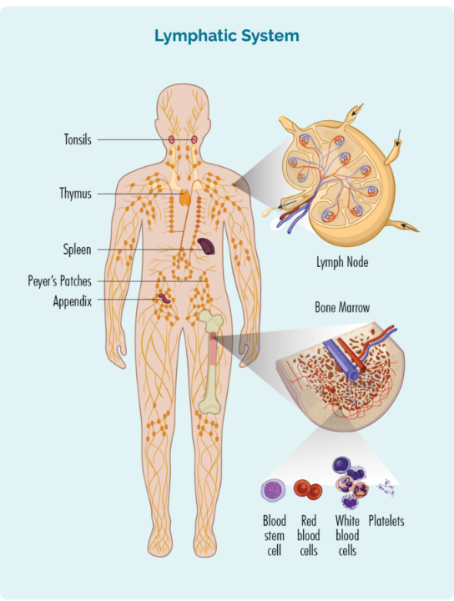
The lymphatic and immune system
Without the lymphatic system our other body systems would stop working and our immune system would be compromised.
The structures of the lymphatic system include, lymphatic vessels and lymph nodes.
The system also contains lymphoid organs such as the spleen, thymus, and tonsils.
Watch video Lymphatic System

Slide 5
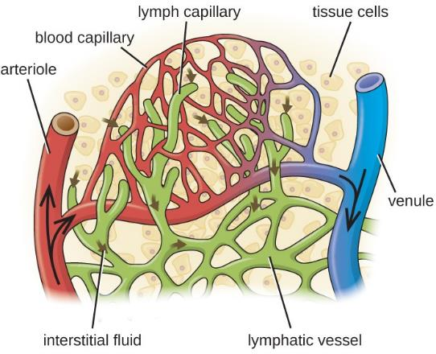
The lymphatic and immune system Structure of the lymphatic system
The lymphatic system comprises two main components:
Lymphatic vessels: Form a network that transports lymph, a fluid containing blood components that have leaked from the vascular system.
Lymphoid tissues and organs: Include structures containing phagocyte cells and lymphocytes crucial for immune system function.
Lymphatic vessels carry escaped blood fluids, while lymphoid tissues and organs house immune cells essential for immune responses.

Slide 6
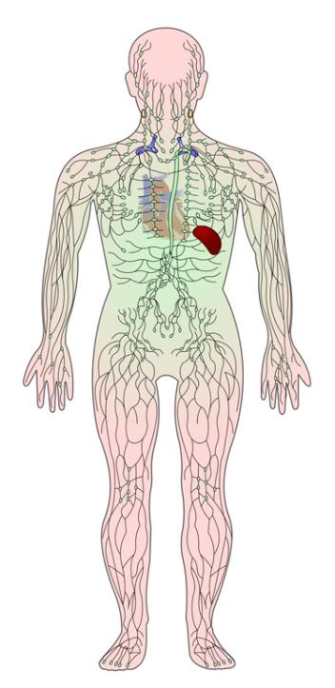
The lymphatic and immune system Structure of the lymphatic system: Lymphatic vessels
Blood circulation involves exchanges of nutrients, wastes, and gases with interstitial fluid outside cells.
Interstitial fluid contains various substances: amino acids, sugars, and fatty acids. Capillaries push fluid out of tissues into the bloodstream, leaving behind interstitial fluid. Failure to return leaked fluid and proteins to the cardiovascular system can lead to edema (swelling).
The lymphatic system acts as a drainage system, collecting excess tissue fluid (lymph) and returning it to the blood. Lymphatic vessels form a one-way system transporting lymph towards the heart.
Lymph capillaries, found in connective tissue, allow fluid flow but can also permit bacteria, proteins, and cancer cells to enter.
Lymph nodes filter potentially harmful cells from lymph.
Lymph is transported through lymphatic vessels to the cardiovascular system via two ducts:
The right lymphatic duct drains lymph from the right arm and head into the subclavian vein.
The thoracic duct receives lymph from the rest of the body and drains into the subclavian vein.

Slide 7
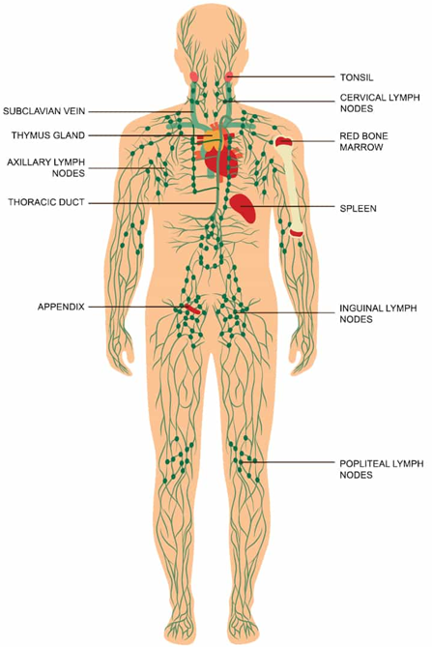
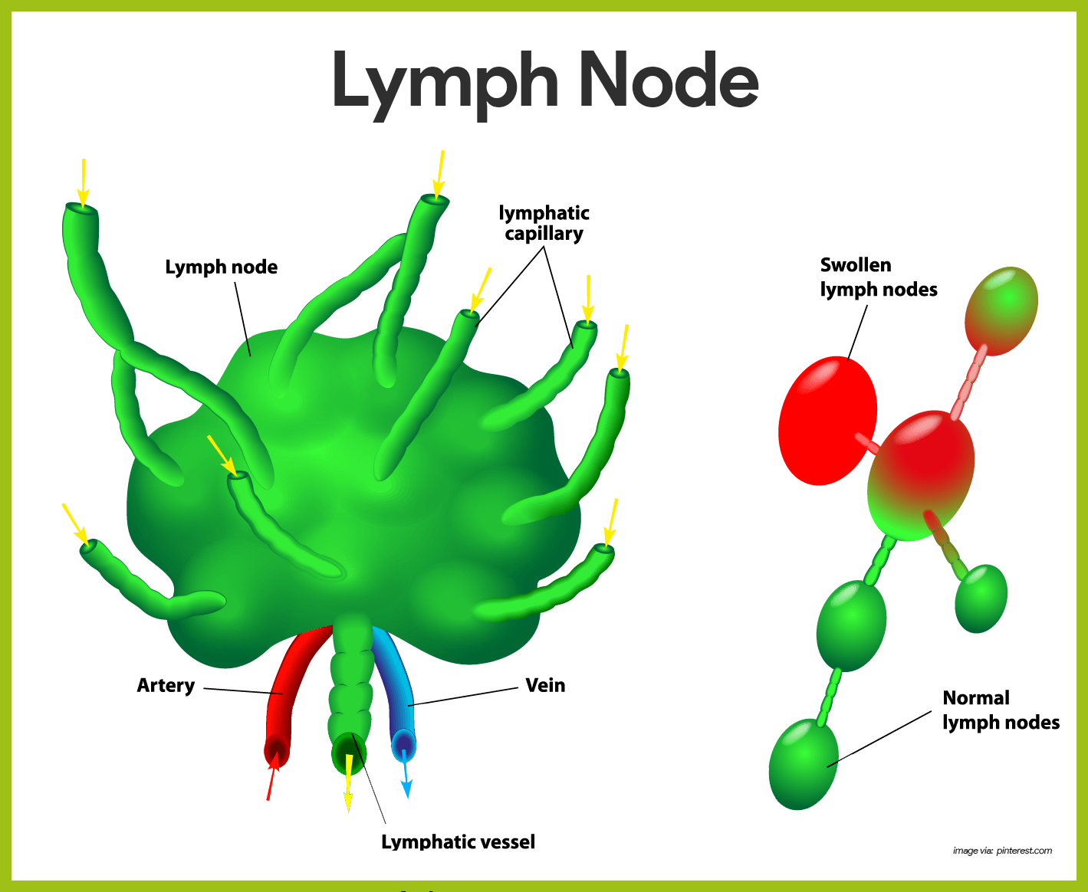
The lymphatic and immune system Structure of the lymphatic system: Lymph nodes
Lymphoid tissues & organs support the immune system to maintain health.
Lymph nodes: filters removes foreign organisms from the lymphatic system.
Lymph nodes: produce lymphocytes, contributing the body's defense mechanisms.
Lymph fluid is filtered as it passes through lymph nodes along lymphatic vessels.
Lymph nodes: a kidney-shaped appearance and are about 2.5cm long.
Larger lymph nodes are commonly found in the inguinal (groin), axillary (under the arm) and cervical (neck) regions.
Macrophages in lymph nodes eliminate bacteria, viruses, and other foreign invaders.
Lymphocytes in lymph nodes recognise and respond to foreign microorganisms.
Swollen lymph nodes: signal infections like colds or flu, fighting pathogens.
Lymph nodes: sites for cancer metastasis, particularly in cancers that spread through the lymphatic system.

Slide 8
The lymphatic and immune system Structure of the lymphatic system: Other lymphoid organs
The spleen: Filters blood, cleanses it of pathogens, and removes old red blood cells. Also stores platelets and acts as a blood reservoir.
The thymus: Processes and matures T-cells, which help defend against pathogens. Produces thymosin, stimulating lymphocyte growth in other organs.
The tonsils: Small lymphatic tissue masses located in the nose, mouth, and throat. Include adenoids, palatine tonsils, and lingual tonsils. Protect against pathogens entering through the nose or mouth.
Peyer's patches: Clusters of lymphatic tissue in the small intestine walls. Monitor bacteria levels, capture and destroy bacteria, preventing absorption by the intestine.

Slide 9
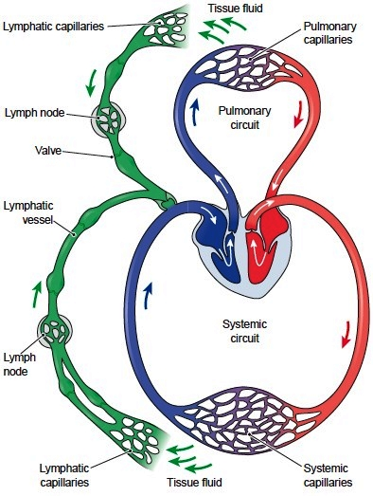
The lymphatic and immune system Summary of the functions of the lymphatic system
Returning excess interstitial fluid to the blood: Lymph capillaries collect excess fluid and proteins from tissue, returning them to the bloodstream as lymph.
Absorption of fats and fat-soluble vitamins: From the digestive system, these nutrients are transported to the bloodstream via the lymphatic system.
Defense against foreign organisms: Lymph nodes and other lymphatic organs filter lymph to remove bacteria and toxins. Lymphocytes within these organs destroy invading pathogens.

Slide 10
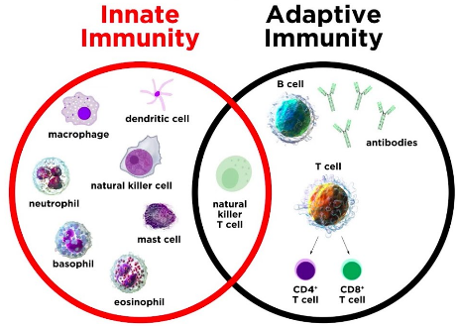
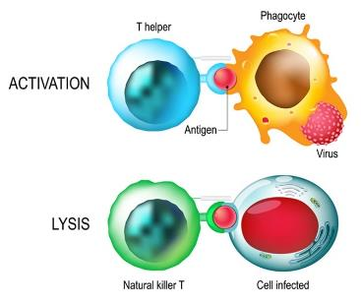
The lymphatic and immune system The immune system
The immune system defends against harmful pathogens through two main systems: innate and adaptive defense systems.
The innate defense system responds immediately to protect the body from foreign microorganisms.
Innate defenses include the skin, mucous membranes, and protective proteins like phagocytes and natural killer cells.
The body uses the inflammatory response and fever to combat invaders.
The adaptive defense system targets specific foreign microorganisms.
It doesn't have its own organs but relies on immune cells like lymphocytes and macrophages.
While innate defenses are always ready, the adaptive system needs to encounter the pathogen first to mount a defense.
Watch Immune System: Innate and Adaptive Immunity Explained.

Slide 11
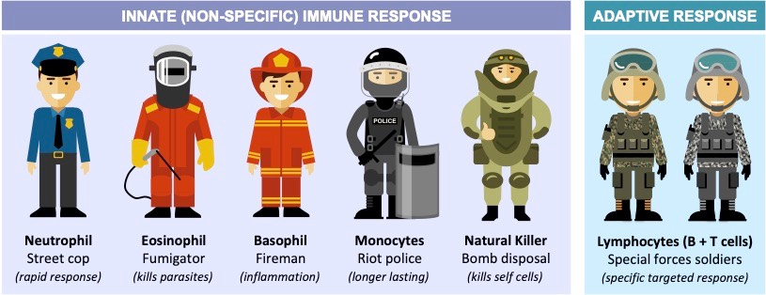
The lymphatic and immune system The immune system

Slide 12
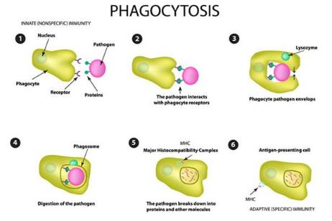
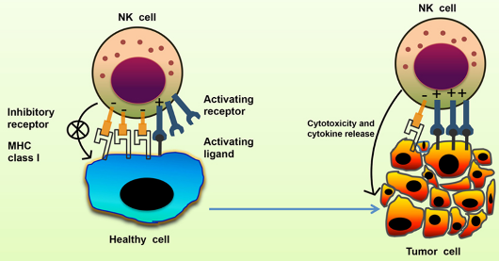
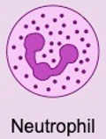
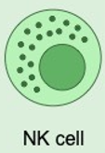
The lymphatic and immune system The immune system: Innate defense system
The skin and mucous membranes form the first line of defense against harmful microorganisms.
Skin's keratin layer acts as a physical barrier, while mucous membranes produce protective secretions.
Secretions include:
Phagocytes, which are cells that engulf and digest foreign pathogens. Present in every organ and include white blood cells and neutrophils.
Natural killer cells (NK) are specialised lymphocytes that patrol the body and target cancerous or virus-infected cells. NK cells identify foreign cells and release chemicals to disintegrate their membrane nucleus, effectively destroying them.

Slide 13
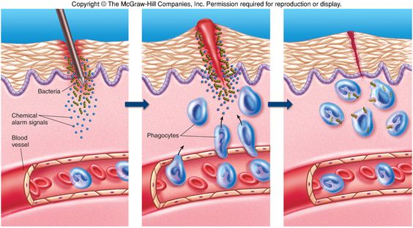
The lymphatic and immune system The immune system: The inflammatory response
The inflammatory response is activated when body tissues are injured, such as by physical trauma or infection.
Symptoms include swelling, redness, heat, and pain in the affected area.
Injured cells release inflammatory chemicals, triggering blood vessel dilation and attracting phagocytes.
Dilation increases blood flow, causing redness and heat, while swelling activates pain receptors.
Inflammation prevents further damage and initiates the repair process.
Fever is the body's response to foreign microorganisms, involving an abnormally high body temperature.
Fever is regulated by the hypothalamus and can be beneficial as it stimulates immune responses and speeds up the repair process.

Slide 14
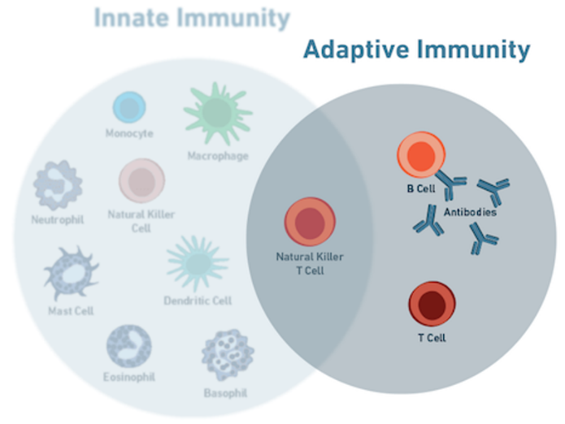
The lymphatic and immune system Adaptive defence system
The adaptive defense system is the body's third line of defense, involving lymphocyte and macrophage cells.
Specialised lymphocytes, B cells, and T cells play a crucial role in this system.
It recognises foreign molecules (antigens) and works to inactivate or destroy them.
The adaptive defense system protects against a wide variety of pathogens and abnormal body cells.
Malfunctioning of this system can lead to serious diseases like cancer.
It requires encountering the antigen before mounting a response, and subsequent encounters lead to stronger responses.
Specialised proteins called antibodies protect against future attacks by the same antigen.

Slide 15
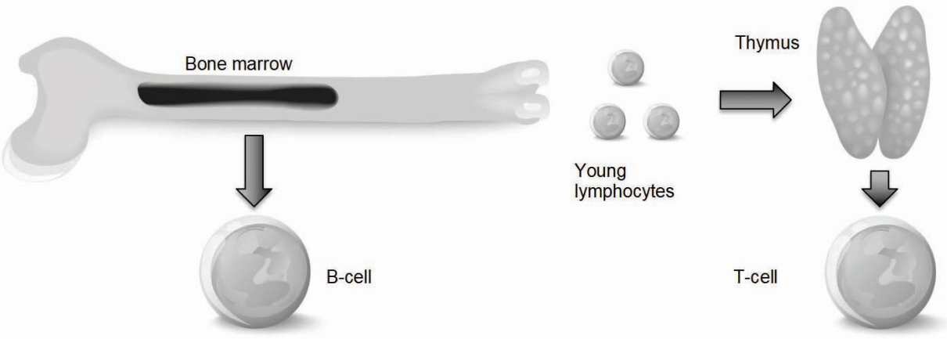
The lymphatic and immune system Adaptive defence system: Lymphocyte
Lymphocytes are produced in the bone marrow and can develop into T-cells or B-cells.
T-cells mature in the thymus and recognise specific foreign antigens, while B-cells mature in the bone marrow and secrete antibodies to destroy antigens.
Both types of cells circulate in the blood, ready to respond to immune challenges.

Slide 16
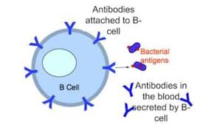
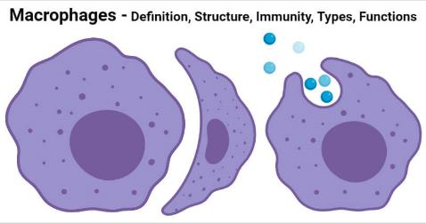
The lymphatic and immune system Adaptive defence system: Macrophages Antigens Antibodies
2. Macrophages are abundant in lymphoid organs and connective tissue, responsible for engulfing foreign particles and presenting antigen fragments to T-cells.
They secrete proteins that activate T-cells to carry out their functions.
3. Antigens are substances capable of activating the immune system, recognized as foreign molecules by the body.
Antigens can be proteins, large carbohydrate molecules, or foreign particles like bacteria, pollen, fungi, viruses, chemicals, and animal fur.
Self-antigens are proteins found in our own cells, while non-self antigens are foreign substances.
Allergic reactions occur when the body mistakes harmless substances for antigens and mounts an attack.
4. Antibodies, secreted by B cells, are produced in response to various antigens and come in different classes with diverse functions.

Slide 17
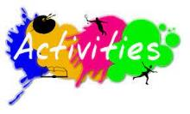
12. Quiz - the lymphatic and immune system
Using the information you have just learnt about the lymphatic and immune systems complete the following task by filling in the blanks with the words from the word bank below.
Lymphatic vessels
Edema
Neck
Adaptive defence
Spleen
Fever
Phagocytes
B
Antigen
Allergic
Underarm
Natural killer (NK)
Groin
Inflammatory response
Lymph nodes
Antibodies
Innate defence
T
Macrophage
Self-antigens
Secrete
Interstitial fluid
Lymphocytes
1. Structures of the lymphatic system include Lymphatic vessels (2 words) and Lymph nodes . (2 words).
2. Interstitial fluid (2 words) is found outside the exterior of our cells and contains thousands of ingredients.
3. The build-up of fluid in our cells is called Edema .
4. Lymphoid tissues and organs contain Macrophages .
5. Lymph nodes are glands that work like filters to remove foreign organisms. Large nodes are found in your Neck , Groin , and Underarm .
6. The Spleen provides a site for lymphocyte activity and gets rid of old red blood cells.
7. The Adaptive defence (2 words) system must first encounter a foreign organism before it can protect the body.
8. White blood cells and neutrophils are types of Phagocytes .
9. Natural killer (NK) (2 words) cells immediately act to destroy harmful pathogens by identifying the surface of a foreign cell and releasing chemicals.

Slide 18
12. Quiz - the lymphatic and immune system
Using the information you have just learnt about the lymphatic and immune systems complete the following task by filling in the blanks with the words from the word bank below.
Lymphatic vessels
Edema
Neck
Adaptive defence
Spleen
Fever
Phagocytes
B
Antigen
Allergic
Underarm
Natural killer (NK)
Groin
Inflammatory response
Lymph nodes
Antibodies
Innate defence
T
Macrophage
Self-antigens
Secrete
Interstitial fluid
Lymphocytes
10. The Inflammatory response (2 words) dilates blood vessels and activates pain receptors.
11. Fever increases the metabolic rate of cells and speeds up the repair process.
12. B cells are produced and mature in bone marrow.
13. A foreign substance that invades your body is called an Antigen .
14. When your body detects an antigen, Antibodies are made and bind to it.
15. Humans are born with an Innate defence (2 words) system.
16. The thymus is the site for Lymphocytes cell maturation.
17. T cells display fragments of destroyed antigens on their surface.
18. An Allergic reaction occurs when the immune system overreacts to exposure to antigenic particles
19. The proteins that belong to the body: Self-antigens (2 words).
20. The function of a B cell is to Secrete antibodies.

Slide 19
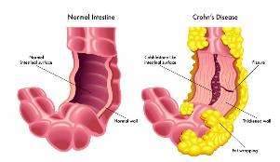
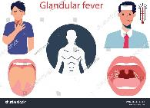
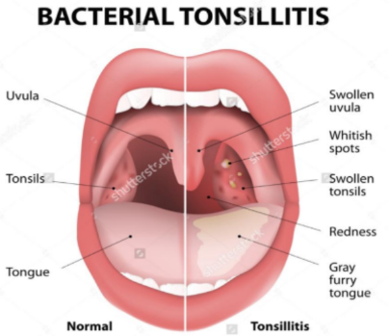
The lymphatic and immune system Disorders of the lymphatic and immune system
The lymphatic system's main function is to transport lymph, a clear fluid containing white blood cells, which eliminates toxins, waste, and unwanted foreign materials from the body.
Unwanted substances are collected and destroyed by white blood cells in lymph nodes.
The lymphatic system also regulates fluid levels in the body.
Glandular fever:
Caused by a virus transmitted through saliva.
Treatment involves rest.
Symptoms include enlarged lymph nodes and/or spleen, jaundice, sore throat, tiredness, swollen tonsils, and headache.
Crohn’s Disease:
Inflammation of the bowel affecting any part of the digestive tract.
Symptoms include abdominal pain, diarrhea, fever, and weight loss.
Caused by abnormalities in the immune system.
Tonsillitis:
Infection of the tonsils in the throat.
Tonsils become inflamed, swollen, red, and sore due to infection.

Slide 20
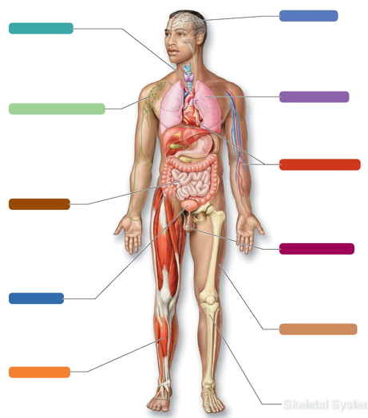
The lymphatic and immune system Systems in sync – the lymphatic and immune system
NERVOUS SYSTEM:
The lymphatic vessels pick up leaked fluid and proteins in the nervous system. And the immune system protects organs of the nervous system from pathogens.
The brain helps to regulate the immune response, helps to dilate lymphatic vessels.
ENDOCRINE SYSTEM:
Sympathetic division of the ANS activates the adrenal medulla and the hypothalamus.
Hormones can influence the activity of neurons.
RESPIRATORY SYSTEM
Lymphatic vessels pick up leaked fluid from respiratory organs.
The lungs provide oxygen required by the lymphoid and immune cells.
Organs of the respiratory tract contain lymphoid organs.
LYMPHATIC SYSTEM
CARDIOVASCULAR SYSTEM
The lymphatic system pick up leaked fluid from tissues of the CV system.
The spleen acts to destroy old red blood cells.
Lymph travels in the blood stream and provides a route for the circulation of immune cells such as lymphocytes and antibodies.
The diagram below illustrates the interrelationship between the lymphatic and immune system and the
other body systems.
DIGESTIVE SYSTEM:
Lymph transports some products of fat digestion to the blood. Peyer’s patches in the intestines helps protect against pathogens.
The digestive system digests and absorbs nutrients needed for lymphatic organ function.
REPRODUCTIVE SYSTEM:
Lymphatic vessels pick up leaked fluid and proteins from the reproductive organs.
Acidic secretions of the vagina act to destroy bacteria.
URINARY SYSTEM:
Immune cells protect the organs of the urinary system.
The urinary system eliminates waste and flushes some pathogens out of the body.
INTEGUMENTARY (SKIN) SYSTEM:
The lymphatic vessels pick up leaked fluid from the dermis layer of the skin.
Sebum produced by the skin acts to kill bacteria.
SKELETAL SYSTEM:
Lymphatic vessels pick up leaked fluid and immune cells protect bones from pathogens
Bone marrow produces lymphocytes and B-cells, which protect against pathogens.
MUSCULAR SYSTEM
Lymphatic vessels pick up leaked fluid and proteins from skeletal muscles.
Muscle activity helps the flow of lymph around the body.

Slide 21
Learning Checkpoint 12
1. Identify the key structures of the lymphatic system.
The lymphatic system contains lymph vessels and lymph nodes.
2. The lymphatic system consists of two parts. Identify these two parts.
Lymphatic vessels and various lymphoid tissues and organs.
3. Explain the term ‘edema’.
Edema is the medical term for swelling. Large amounts of edema stop the tissues from
exchanging interstitial fluid, which is dangerous and can lead to serious health conditions.
4. Describe the three main functions of the lymphatic system.
The lymphatic system is responsible for draining excess fluid in our cells and to filter and remove
potentially harmful organisms such as bacteria out of the body.
5. Describe the role of the skin in our immune system.
The skin has a strong layer of keratin cells that act as a physical barrier to block pathogens from
entering the body.

Slide 22
Learning Checkpoint 12
6. Briefly explain how mucous membranes and saliva act to protect the body from pathogens.
The mucous lining of the stomach secretes acid and protein digesting enzymes that kill pathogens. Saliva contains an enzyme called lysozyme that destroys bacteria.
7. Explain the process and function of the inflammatory response.
The inflammatory response is triggered whenever tissues are injured or infected. Its primary function is to protect the body from harmful stimuli, such as pathogens, toxins, or physical trauma, and to initiate the healing process.
8. Explain the process and the function of fever.
It is a protective mechanism of the body in response to foreign microorganisms. Our body temperature is regulated by the hypothalamus and continually works to keep the body at around
37 degrees Celsius. We will discuss the regulation of body temperature in further detail in the
next section. High fevers are dangerous as they start to essentially ‘cook’ the enzymes and
proteins in the body. However, mild to moderate fever can be beneficial to the body as it
stimulates the liver and spleen to gather nutrients, making them less available for bacteria to feed
on. Fever also increases the metabolic rate of tissues cells, which speeds up the repair process.

Slide 23
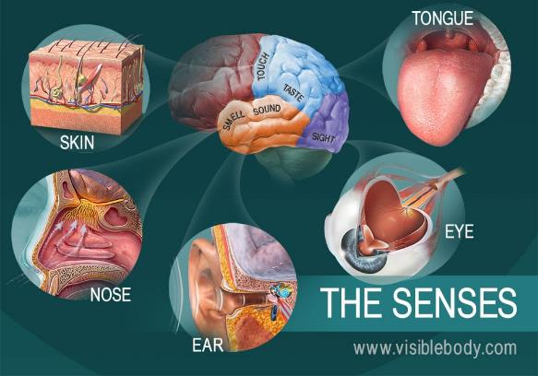
The special senses
Humans possess thousands of sensory receptors to perceive stimuli from the external world.
Stimuli are interpreted by the nervous system.
There are five main senses: touch, taste, smell, sight, and hearing.
Touch is a combination of general senses for temperature, pressure, and pain.
The other four senses are considered special senses.
Equilibrium, a fifth special sense, is governed by the organs of the ear and helps maintain balance.
Sensory systems overlap, producing integrated feelings from various stimuli.
Sense of the smell Watch video Olfaction - structure and function

Slide 24
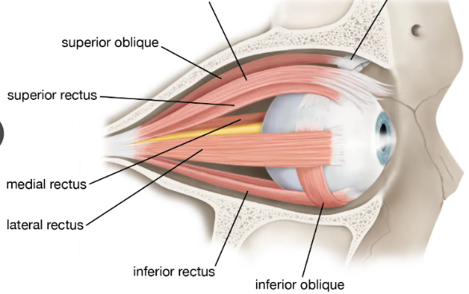
The special senses Sight: External and accessory structures of the eye
The eye is approximately 2.5 cm in diameter and mostly protected by bone.
Accessory structures of the eye include eye muscles, eyelids, conjunctiva, and lacrimal system.
Eyelids serve various functions including protection, light control, and moistening during blinking.
The conjunctiva is a thin membrane inside the eyelid that secretes mucus to keep the eye moist.
The lacrimal system consists of glands and ducts that drain tears into the nasal cavity. The lacrimal glands are located above the lateral end of each eye and produce tears.
External eye muscles are highly precise and contract rapidly, aiding in eye movement.
These muscles include superior and inferior rectus, lateral and medial rectus, and superior and inferior oblique muscles.
Rectus muscles move the eyeballs up, down, left, and right.
Oblique muscles adjust to counteract head movements, allowing for focused vision while the head moves.

Slide 25
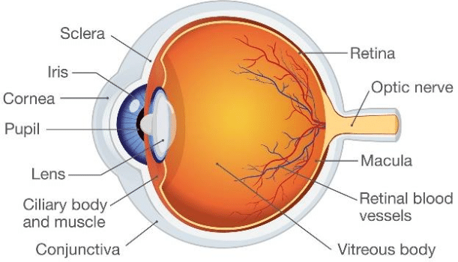
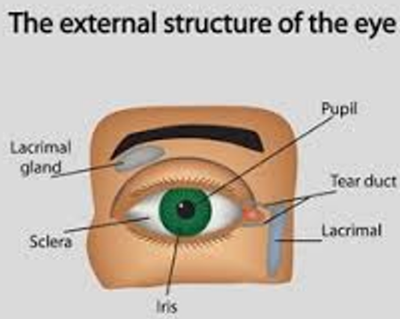
The special senses Sight: Internal structure of the eye
Watch video The Human Eye
The eye is a hollow structure composed of three layers.
The outer layer consists of the sclera (white connective tissue) and the cornea (transparent).
The cornea, rich in nerve endings, initiates blinking when touched and serves as the entry point for light.
The cornea is unique as it can be transplanted without rejection.
The middle layer contains the choroid, a blood-rich tissue with pigment, housing the ciliary body, iris, and pupil.
The ciliary body connects to the lens, while the iris, with smooth muscle fibers, regulates light entering the eye.
The pupil, controlled by the iris, contracts in bright light and dilates in dim light.
The innermost layer, the retina, contains photoreceptor cells and a pigment layer.
Photoreceptors capture light and transmit electrical signals, which travel via the optic nerve to the brain's occipital lobe, enabling vision.
Choroid
Optic disc

Slide 26
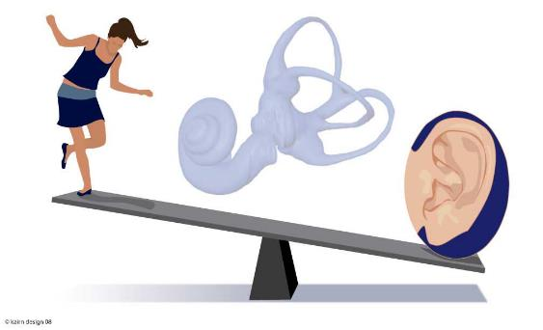
The special senses Hearing and balance
Hearing and balance mechanisms involve various structures in the ear.
Sound vibrations are generated by fluid movement in the ear, stimulating hearing receptors.
Sudden head movements disrupt fluid around balance organs.
Mechanoreceptors detect these movements and aid in balance maintenance.
Hearing organs enable perception of diverse sounds.
Equilibrium receptors provide continuous updates on head position and movement.
Without this sensory information, balance maintenance would be compromised.

Slide 27
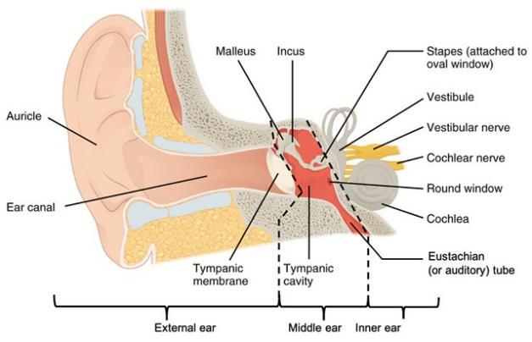
The special senses Hearing and balance: External structures of the ear
1. The external ear consists of the auricle (pinna) and the external acoustic meatus (ear canal).
The auricle surrounds the opening of the auditory canal and is commonly referred to as the "ear."
The ear canal is a narrow chamber within the skull bone, containing glands that secrete earwax to trap foreign particles.
2. The middle ear, or tympanic cavity, is an air-filled space within the temporal bone.
Components of the middle ear include the auditory tube, eardrum, malleus, incus, and stapes.
The auditory tube connects the middle ear to the throat, helping to equalize pressure.
Tiny bones in the middle ear transmit vibrations from the eardrum to the inner ear fluids.
3. The inner ear, located deep behind the eye socket, contains the cochlea, responsible for hearing, and tiny hair cells act as hearing receptors.
Cochlear hairs transfer impulses to cranial nerves in the temporal lobe for sound interpretation.
The inner ear also houses the semicircular canals and vestibule, crucial for balance and equilibrium.
Temporal bone
Semicircular canals
(external acoustic meatus)
cartilage
Watch video How the ear works
(eardrum)

Slide 28
The special senses Mechanisms of equilibrium
Equilibrium responds to head movements without conscious awareness.
Equilibrium receptors are located in the vestibule (vestibular apparatus) and semicircular canals of the inner ear. Two types of equilibrium mechanisms exist: static and dynamic.
1. Static equilibrium(not moving) detects head position changes when the body is still.
Otoliths in the vestibule roll in response to gravity changes, signaling head orientation to the brain.
Static equilibrium aids divers in maintaining orientation in dark depths.
2. Dynamic equilibrium(moving) receptors in the semicircular canals detect angular and rotatory head movements.
Movement of fluid in the semicircular canals stimulates impulses to inform the brain of body position.
Taste and smell receptors, classified as chemoreceptors, respond to chemicals.
Taste receptors distinguish five types of chemicals, while olfactory receptors are sensitive to a wider range.
Taste and smell receptors respond to similar stimuli; for instance, smelling food triggers salivation.
Olfactory receptors, located on the roof of the nasal cavity, contain cilia covered in mucous.
Stimulated olfactory receptors transmit nerve impulses via the olfactory nerve to the brain.
The brain associates smells with memories and emotions, explaining why smells can evoke strong responses.
Intensity of smell increases with the amount of air breathed or sniffed into the nasal passageway.

Slide 29
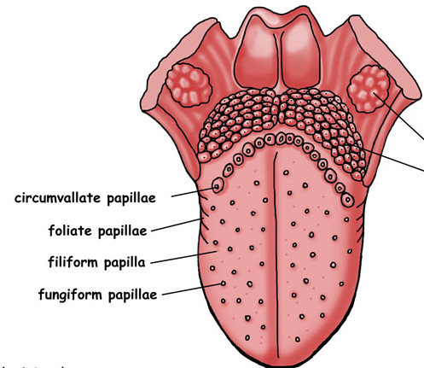
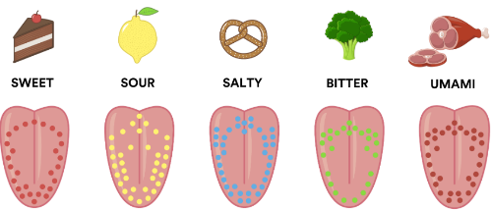
The special senses Taste buds and the sense of taste
Watch video Taste: Anatomy and Physiology, Animation
Taste receptors, known as taste buds, are located in the mouth, primarily on the tongue.
The tongue is covered in papillae, which respond to various chemicals dissolved in saliva.
There are five basic taste sensations, each corresponding to stimulation in different areas of the tongue:
Sweet receptors: respond to sugars and amino acids.
Sour receptors: respond to hydrogen ions and acidity.
Salty receptors: respond to metal ions like sodium and chlorine.
Bitter receptors: respond to amino acids, commonly found in vegetables.
Umami receptors: responsible for the taste of "beef" and other red meats.
Taste perception is influenced by various factors, including olfactory stimulation.
A cold or blocked nose can diminish taste perception.
Texture and temperature can enhance or impair taste perception.
Spicy foods can stimulate pain receptors in the mouth, affecting taste perception.

Slide 30
Learning Checkpoint 13
1. Identify the four special senses of the body.
Taste, small, sight and hearing
2. Explain why ‘touch’ is not classified as a special sense.
The sense of touch is actually a mixture of our general senses that act to sense temperature, pressure and pain
3. Explain the role photoreceptors play in our vision.
The sense of touch is actually a mixture of our general senses that act to sense temperature,
pressure and pain
4. Briefly explain why it is when we travel on airplanes that we sometimes have to open our mouths
or yawn to unblock our ears. Identify the structure that we are trying to open.
The auditory tube links the middle ear with the throat. Normally this tube is flattened and closed
but when we yawn or swallow it opens briefly to help equalise the pressure in the middle ear with
the external pressure

Slide 31
Learning Checkpoint 13
5. Explain the roles of the vestibule and semicircular canals in equilibrium.
The inner ear also contains the semicircular canals and the vestibule that work together to
achieve equilibrium. What it does is respond to various head movements without our awareness.
The equilibrium receptors in the inner ear are located in the vestibule, which are called the
vestibular apparatus and the semicircular canals.
6. Outline the difference between static and dynamic equilibrium.
Static equilibrium helps to report changes of the position of the head in space when the body is
not moving, while dynamic equilibrium responds to angular and rotatory movements of the head.
7. Briefly explain why it is that certain smells can cause emotional reactions or thoughts.
The brain takes a ‘snapshot’ of the odour to remember it for next time. The olfactory part of the
brain is closely linked to the emotional part of the brain. This explains why certain smells can
remind us of or make us think of people or places

Slide 32
Learning Checkpoint 13
8. Identify all five taste receptors and outline their function.
The receptors that are responsible for taste and smell (olfactory) are classified as chemoreceptors
and act to respond to chemicals. The taste receptors can identify five types of chemicals, while
the olfactory receptors for smell are sensitive to a much wider range. The receptors for taste and
smell work with each other and respond to many of the same stimuli. So, when a blocked nose
impairs our sense of smell it is difficult for us to taste certain foods.

Slide 33
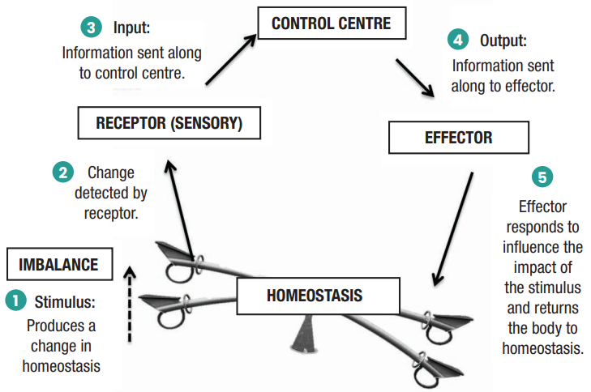
Processes of body regulation
Homeostasis originates from Greek words meaning "same" and "steady," referring to maintaining stable conditions for survival.
It involves continuous adjustments by the body to maintain a constant internal environment.
Homeostatic regulation consists of three parts: receptor, control centre, and effector.
Receptors detect changes in the environment, the control centre processes this information, and effectors execute commands to make changes in response.
When body systems work harmoniously, homeostasis is achieved.
Processes contributing to homeostasis include body temperature regulation, fluid and electrolyte balance (pH), and maintenance of blood pressure.
Watch video: Homeostasis

Slide 34
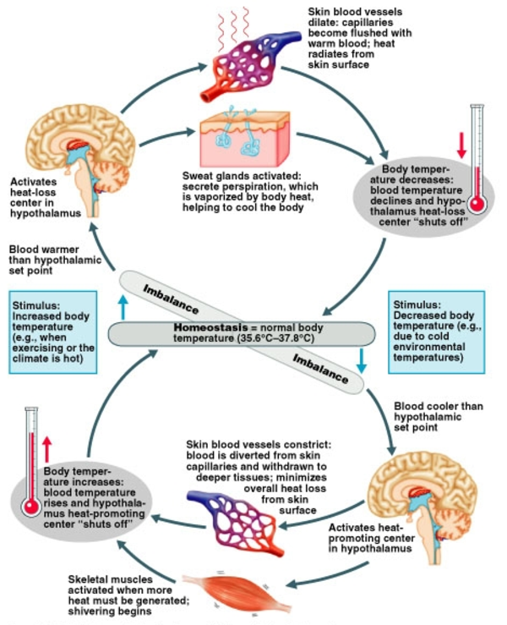
Processes of body regulation Body temperature regulation
3
4
Body temperature is regulated by a balance between heat production and heat loss.
The hypothalamus in the brain acts as the body's thermostat, maintaining a set point of around 36.5 to 37 degrees Celsius.
Heat-producing mechanisms include vasoconstriction of skin blood vessels to conserve heat and shivering to generate heat through muscle activity.
Heat loss mechanisms involve dilation of skin blood vessels for heat radiation and sweating for evaporative cooling.
Evaporation through sweating is efficient for heat loss but is less effective in humid conditions.
5
2
6
1
7
8

Slide 35
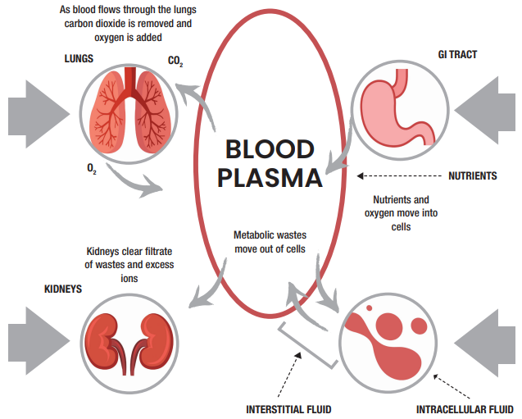
Processes of body regulation Water and electrolyte balance
Water makes up more than half of our body weight, with around 50% in women and 60% in men.
Water is distributed into two main fluid compartments: intracellular fluid ICF(inside cells) and extracellular fluid ECF(outside cells).
Extracellular fluid includes blood plasma, interstitial fluid, cerebrospinal fluid, lymph, and other bodily fluids.
Continuous exchanges of fluid occur in the lungs, gastrointestinal tract, and kidneys to maintain fluid balance and homeostasis.
Adjustments in fluid volume occur in both intracellular and extracellular compartments to maintain overall balance.

Slide 36
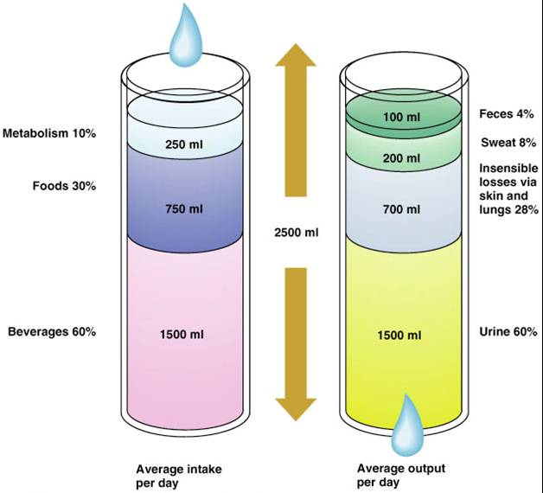
Processes of body regulation Regulation of water intake and output
Proper hydration requires a balance between water intake and loss.
Most water intake comes from drinking and eating, with a small amount produced by cells.
The thirst mechanism, controlled by the hypothalamus, prompts us to drink water when needed.
Dry mouth indicates a need for water; reduced saliva production stimulates thirst.
Water can leave the body through perspiration, respiration, and in feces.
The kidneys play a crucial role in maintaining fluid balance, adjusting urine production based on water intake and loss.
Excessive water loss triggers reduced urine production, while excess water intake leads to increased urine output.

Slide 37
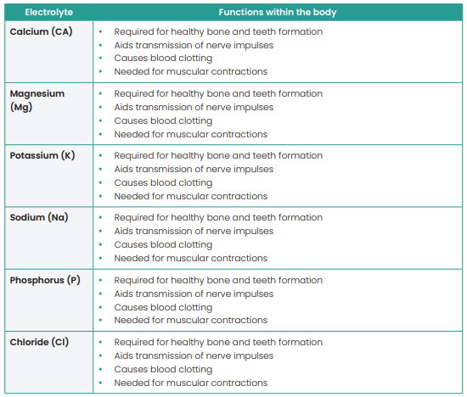
Processes of body regulation Electrolyte balance
Electrolytes are vital nutrients that regulate heartbeat and muscle contractions.
Major electrolytes in the body include calcium, magnesium, potassium, sodium, phosphorus, and chloride.
Each electrolyte serves essential functions in bone health, nerve transmission, blood clotting, and muscle function.
Electrolyte concentrations in intra and extracellular fluid must be balanced.
Electrolytes are obtained from food and drink and are regulated by the kidneys.
Hormones like antidiuretic hormone ADH and aldosterone help maintain electrolyte balance by regulating water reabsorption and sodium levels in response to changes in blood volume.
Sodium plays a crucial role in water balance, and imbalances can lead to conditions like edema.

Slide 38
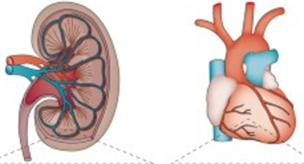
Processes of body regulation Maintenance of blood pressure (BP)
Blood pressure is the force exerted by blood against the walls of blood vessels, vital for circulation.
The body has mechanisms to regulate blood pressure via sensory receptors in artery walls.
Heart rate increase leads to more blood ejection, elevating blood pressure.
Veins dilate, allowing more blood circulation, reducing blood return to the heart and lowering pressure.
Veins constrict, pooling blood to be pumped out by the heart, elevating blood pressure.
Arterioles dilate, reducing resistance and lowering pressure, while constriction raises resistance and increases pressure.
Kidneys adjust blood pressure by altering urine production; more urine lowers blood volume and pressure, while less urine increases volume and pressure.
Changes in urine production affect blood pressure slowly over hours and days, contrasting with quick adjustments by other mechanisms like heart rate, vein constriction, and arteriole narrowing.
In cases like severe bleeding, quick adjustments include increased heart rate and forcefulness, vein constriction, reduced kidney blood flow, and arteriole narrowing to elevate blood pressure.

Slide 39
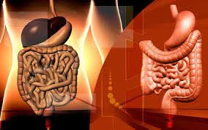
Processes of body regulation Elimination of wastes
Food provides essential nutrients for the body's functioning, converted into energy through internal processes.
These processes generate waste and unusable compounds that need elimination to prevent toxicity and illness.
Excretion involves locating and expelling body waste, managed by organs like lungs, kidneys, skin, and large intestine.
Lungs eliminate waste gases like carbon dioxide and nitrogen through exhalation.
Skin removes waste by shedding dead cells through flaking and sweating.
Kidneys excrete liquid waste like urea, ions, and toxins through urine production and excretion.
Solid waste in the form of feces is eliminated by the large intestine.

Slide 40
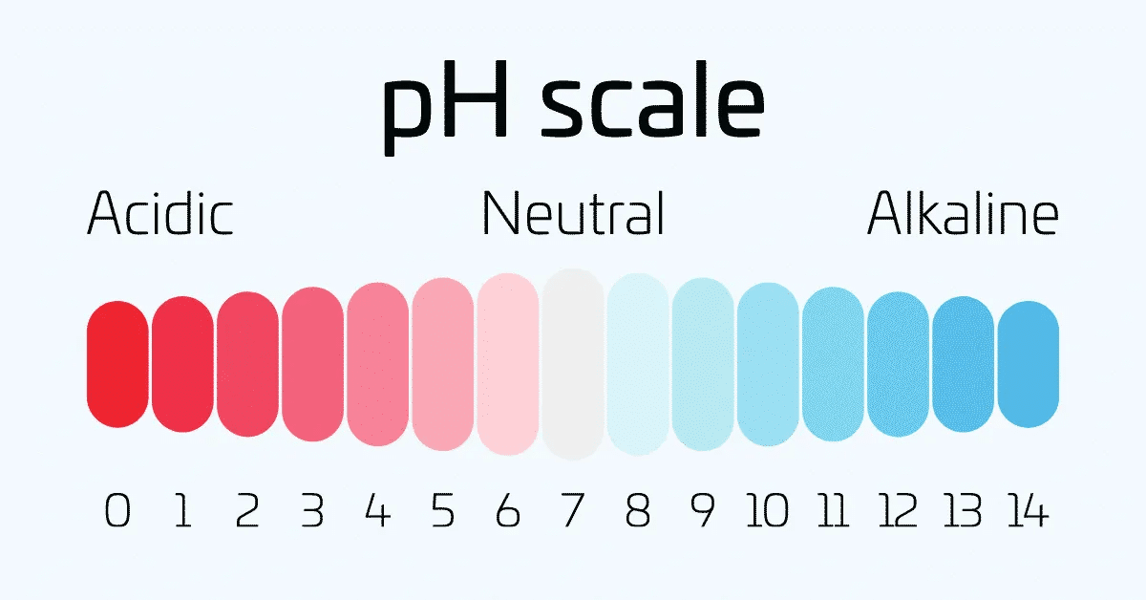
Processes of body regulation Maintaining acid-base (pH) balance of the blood
Efficient cellular function relies on maintaining blood pH.
Blood pH indicates acidity level, with lower pH indicating higher acidity and higher pH indicating higher alkalinity.
Ideal blood pH is around 7.4.
Alkalosis occurs when blood pH rises above 7.4, indicating low levels of CO2.
Acidosis occurs when blood pH drops below 7.4.
Acidosis can lead to severe health issues and is potentially life-threatening.
Acidosis results from high hydrogen concentration in the blood, hindering cellular function.
Most hydrogen ions in the body are by-products of cellular activity.
Blood buffers help regulate hydrogen concentration by binding to hydrogen ions when pH drops and releasing them when pH rises.

Slide 41
Learning Checkpoint 14
1. Identify the processes of homeostasis.
Homeostasis refers to any process that living things use to actively maintain stable conditions
necessary for survival. Maintaining a constant internal environment requires the body to make
continuous adjustments to many structures and processes. These adjustments are referred to as
regulation of homeostasis
2. Identify the normal body temperature range and the organ responsible for regulating body
temperature.
The body’s thermostat is in the hypothalamus of the brain. Through the pathways of our nervous
system, the hypothalamus is continually regulating our body temperature around a set point of 36.5 to 37 degrees Celsius (0 °C).
3. Explain the term ‘acidosis’.
A drop in pH in the blood below 7.4 results in acidosis, which means the blood is more acidic.
4. Explain the term ‘alkalosis’.
Whenever the pH of blood rises above 7.4, a person is said to have alkalosis.

Slide 42
Learning Checkpoint 14
5. Outline why it is important to keep the blood pH level at 7.4.
For the cells in our body to function efficiently our blood PH must be maintained. The pH of the
blood refers to how acidic the blood is and is measured by determining its pH. A lower pH means
that the blood is more acidic, while a higher pH means that your blood is more basic (less acidic).
The pH of your blood should be around 7.4Briefly explain how carbon dioxide affects blood pH
levels.
6. Outline three ways that waste can be eliminated from the body.
The main organs in the human body responsible for excretion are the lungs, kidneys, and the skin.
The lungs are responsible for removing waste gases such as carbon dioxide and nitrogen. The skin is used to remove dead cells by the flaking and sweating. Liquid waste such as urea, ions and toxins are removed from the body through the kidneys

Slide 43
Learning Checkpoint 14
7. Explain how the following adaptive responses helps to regulate blood pressure:
o Increase in heart rate - When heart rate increases it can eject more blood with each contraction. Both of these responses increase the flow of blood into the arteries and increase blood pressure.
o Veins dilate and constrict - When our veins dilate, more blood can circulate in them and less blood returns to the heart for pumping into the arteries. As a result, the heart pumps less blood, and blood pressure is lowered. On the other hand, when our veins constrict blood is pooled back to the heart for pumping into the arteries, and blood pressure increases.
o Arterioles dilate and constrict - Expanded arterioles create less resistance to the flow of blood and decrease blood pressure, while narrowed arterioles create more resistance and raise blood pressure.
o Kidneys producing more or less urine - Urine is primarily water that is removed from the blood. When the kidneys produce more urine our blood volume decreases, and this lowers blood pressure. If the kidneys produce less urine our blood volume increases, which also increases blood pressure.

Slide 44
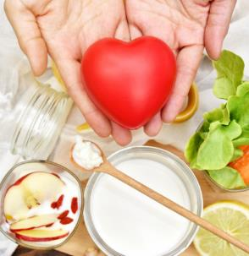
Recognise and promote ways to support healthy functioning of the body
Understanding of how the body's systems function is crucial for health services workers.
Recognition and reporting of signs indicating malfunctioning systems is essential.
Awareness of factors supporting healthy body function, including environment, lifestyle, genetics, diet, and physical activity.
Maintenance of health requires continuous awareness and conscious effort.
Lifestyle and environmental factors play a vital role in overall health.
Proactive maintenance of health is more effective and cost-efficient than treating illness.
Health encompasses physical, mental, and social well-being, as per the World Health Organization.
Health is not merely the absence of illness but a state of complete well-being.
Physical, mental, and social health dimensions are interrelated and can influence each other.
Health service professionals should consider various elements to maintain, promote, and support a healthy body.

Slide 45
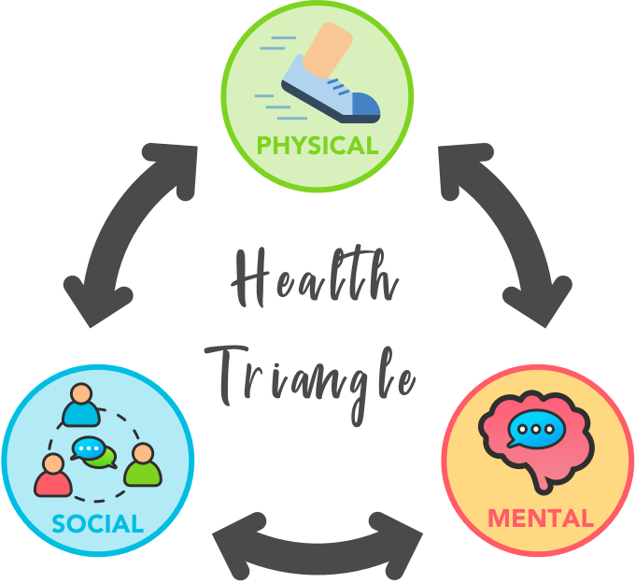
Recognise and promote ways to support healthy functioning of the body
Physical health:
Refers to the functionality of our body and its absence of disease or injury.
Includes aspects like exercise, nutrition, sleep, alcohol consumption, and weight management.
Decline in physical health can impact other dimensions, leading to feelings of depression or social isolation.
Social health:
Relates to our ability to establish and maintain meaningful relationships.
Involves appropriate behavior in various environments and situations.
Good social health is associated with happiness, self-esteem, and stress reduction through supportive friendships and relationships.
Mental health:
Concerns our thoughts, emotions, and coping mechanisms in daily life.
Linked to stress management and the ability to deal with challenges.
Mental health conditions like Alzheimer's, depression, anxiety, and bipolar disorder can arise from difficulties in coping.
Good mental health can boost self-esteem and confidence in social interactions.

Slide 46
Recognise and promote ways to support healthy functioning of the body Factors that help maintain a healthy functioning body
Lifetime Health Maintenance:
Throughout life, individuals undergo physical, mental, and social changes, making health a continuous process.
Active measures like physical activity, nutrition, hygiene, sleep, and regular check-ups support lifelong health.
Family history and genetics play a role in health outcomes.
Physical Activity:
Benefits physical, mental, and social health.
Two types: active (e.g., walking, running, sports) and passive (e.g., stretching, yoga).
Active physical activity increases heart rate, while passive activities focus on mobility and joint function.
Regular exercise (30 mins, 3-4 times/week) reduces risks of obesity, heart disease, diabetes, hypertension, cancer, and sleep issues.
Maintains muscle mass, bone strength, mobility, balance, and concentration, reducing the risk of osteoporosis and falls.
Prevention of injuries and diseases reduces healthcare costs, benefiting society by reallocating resources to other areas.

Slide 47
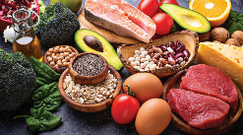
Recognise and promote ways to support healthy functioning of the body Good nutrition
Healthy Diet Importance:
Crucial for maintaining overall health and preventing diseases like cardiovascular issues, hypertension, and stroke.
Enhances wellbeing, energy levels, stress management, healing, and infection resistance.
Supports social and emotional wellbeing, particularly in socialization and family settings.
Essential for the elderly and young children's care, understanding nutrition basics is vital for health service workers.
Australian Dietary Guidelines 2013:
Recommends balanced consumption from five food groups daily for a healthy weight.
Emphasizes variety, drinking water, and limiting intake of fats, salt, sugars, and alcohol.
Gender-Specific Nutritional Needs:
Women have unique nutritional requirements, particularly for iron and calcium.
Iron is crucial for immune function and oxygen transport, while calcium maintains bone density.
Deficiencies in iron lead to anemia, and inadequate calcium intake increases osteoporosis risk.
Food sources include lean meats, chicken, fish, eggs, spinach, dairy, and nuts for iron and calcium intake.

Slide 48
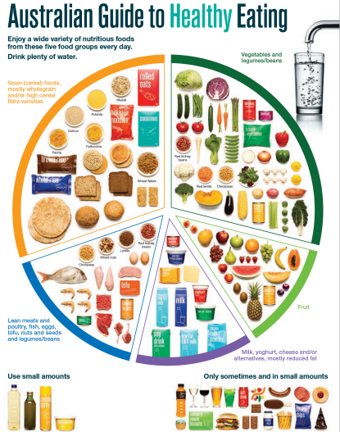
Recognise and promote ways to support healthy functioning of the body Good nutrition

Slide 49
Recognise and promote ways to support healthy functioning of the body Chronic disease related to a poor diet
Cardiovascular Disease (CVD):
Encompasses heart and blood vessel diseases like coronary heart disease, peripheral vascular disease, heart attacks, stroke, heart failure, and angina.
Coronary heart disease results from artery narrowing (atherosclerosis) due to fatty deposits, leading to plaque formation and artery blockage.
Increased consumption of saturated and trans fats contributes to fatty deposit buildup, causing artery narrowing and clot formation.
Stroke:
Occurs due to brain oxygen deficiency caused by inadequate blood flow, often from artery blockage.
Leads to loss of body functions, such as speech, vision, or limb movement, and can result in death or neurological damage.
Risk factors include high cholesterol diet, hypertension, diabetes, smoking, and aging.
Hypertension (High Blood Pressure):
Describes elevated blood pressure exerting excess force on artery walls.
Can accelerate artery clogging (atherosclerosis), leading to heart attacks and strokes.
Diet high in saturated/trans fats and salt contributes to hypertension, as does smoking, lack of exercise, excessive alcohol, and genetic factors.

Slide 50
Recognise and promote ways to support healthy functioning of the body Chronic disease related to a poor diet
Diabetes:
Main types include Type I, Type II, and gestational diabetes.
High glucose levels in blood characterize diabetes, with insulin regulating glucose levels in non-diabetics.
Type II diabetes is prevalent, primarily caused by poor diet and lack of exercise, although genetics also play a role.
Managed through healthy eating and physical activity, with some cases requiring insulin.
Gallstones:
Common in individuals over 50 years old, gallstones are small formations comprising cholesterol, bile pigment, and calcium salts.
Two main types: cholesterol stones (80% of cases) and pigment stones.
Excess cholesterol in bile can lead to stone formation when bile fails to dissolve it effectively.
Celiac Disease:
Autoimmune condition affecting the small intestine due to gluten intolerance.
Gluten damages the small intestine lining, impairing nutrient absorption (fat, calcium, iron, folate).
Continuous gluten consumption leads to malnutrition; gluten-free diet essential for management.

Slide 51
Recognise and promote ways to support healthy functioning of the body Chronic disease related to a poor diet
Lactose Intolerance:
Inability to digest lactose in dairy products leads to symptoms like abdominal pain, gas, bloating, and diarrhea.
Important to maintain calcium intake despite intolerance; some lactose-containing dairy products tolerated better (e.g., mozzarella, Swiss cheese).
Obesity:
Characterized by abnormal fat accumulation due to energy imbalance (excess food intake versus insufficient physical activity).
Obesity increases the risk of various diseases like hypertension, cardiovascular disease, type II diabetes, and stroke.
Arthritis:
Inflammation in joints, commonly wrists and knees, causing pain, stiffness, and deformity.
Types include rheumatoid arthritis and osteoarthritis, the latter often associated with aging and joint injuries.
Obesity is a significant risk factor, as excess weight places strain on joints, accelerating cartilage breakdown and inflammation.

Slide 52
Recognise and promote ways to support healthy functioning of the body Lifestyle choices
Impact of Lifestyle Choices:
Lifestyle choices significantly influence overall health and bodily function.
Certain choices increase the risk of various illnesses and diseases.
Factors like smoking, alcohol consumption, stress levels, poor diet, and lack of physical activity contribute to lifestyle-related health issues.
Importance of Lifestyle Changes:
Lifestyle adjustments are crucial for managing and preventing major diseases such as cardiovascular disease, diabetes, stroke, and cancer.
Changes are often adopted after disease symptoms appear, but proactive adjustments are more effective.
Types of Lifestyle Changes:
Consuming a healthy diet and staying hydrated.
Limiting caffeine and alcohol intake.
Managing stress, finding relaxation techniques, and achieving a work-life balance.
Engaging in social activities and keeping the brain active.
Quitting smoking and avoiding illicit drug use.
Regular participation in physical activity.

Slide 53
Recognise and promote ways to support healthy functioning of the body Hygiene and protection from infection
Understanding Infections:
Infections arise when microorganisms enter the body, multiplying after attaching to healthy cells.
Illness occurs when these microorganisms overwhelm the body's natural defences.
Body’s Defence Mechanisms:
Skin: Forms a physical barrier against microorganisms, with cuts or wounds increasing infection risk.
Inflammation: Immune response involving white blood cells to combat microorganisms, causing swelling, redness, and fever.
Respiratory System: Acts as a barrier, with nasal hairs filtering air to trap particles and microorganisms.
Antibodies: Produced by the immune system to recognize and eliminate harmful microorganisms.
Hand Hygiene Importance: Essential for health service workers and patients to prevent illnesses. Inadequate hand hygiene leads to many preventable diseases.
Comprehensive Hygiene Practices:
Includes thorough body washing, avoiding coughing or sneezing on others, washing hands before food handling, and proper disposal of potentially infectious items.
Incorporating Hygiene into Daily Life: Should be a regular aspect of everyday healthcare and daily activities. Effective Handwashing Guide: Offers instructions on proper handwashing techniques for infection prevention.

Slide 54
Recognise and promote ways to support healthy functioning of the body
Adequate Sleep:
Sleep is crucial for bodily repair and brain function.
Inadequate sleep leads to confusion, reduced productivity, and accidents.
Children require 11 hours of sleep up to age 5 and 9-11 hours from 6 to 13 years.
Adults need 7-8 hours of sleep for health and wellbeing.
Both quantity and quality of sleep are important for overall health, with inadequate sleep causing fatigue.
Regular Healthcare Check-ups:
Vital for detecting health issues early and ensuring a long and healthy life.
Includes pap smears, prostate checks, blood tests, mammograms, and hearing tests.
Early detection improves treatment and cure chances.
Family History and Genetics:
Understanding family history helps in risk reduction through healthy lifestyle choices and regular check-ups.
Family members share genes, environment, and habits, influencing disease risk.
Key features indicating increased risk include diseases occurring at an earlier age, affecting multiple close relatives, and certain combinations of diseases within the family.
Healthy lifestyle choices can mitigate disease risk, even with a family history.

Slide 55
Learning Checkpoint 15
1. Identify and describe the three key dimensions of health.
The physical dimension of health refers to our body and how well it is functioning. It refers to the
more traditional definition of health as the absence of disease and injury. The social dimension of
health refers to our ability to make and maintain meaningful relationships with others. Mental
health refers to how we think, feel and cope with daily life.
2. List the major factors that can help maintain a healthy functioning body.
With physical activity, good nutrition, healthy lifestyle choices, adequate sleep, good hygiene
practices and regular health care check-ups, it is possible to preserve and maintain a healthy
functioning body.
3. Describe how physical activity can be beneficial for your health.
The physical dimension of health refers to our body and how well it is functioning. It refers to the
more traditional definition of health as the absence of disease and injury. Physical health can include
elements that impact our body such as, exercise, nutrition, sleep, alcohol, and weight management.

Slide 56
Learning Checkpoint 15
4. Explain the difference between active and passive physical activity.
Active physical activity involves the movement of many groups of muscles and is designed to
increase our heart rate. Activities such as walking, running, jumping and playing sports. Passive
exercises require minimal or very little effort on the part of the person exercising. Physical activities
such as stretching, and some varieties of yoga are examples of passive physical activity
5. Briefly explain why you think passive physical activity is used in rehabilitation programs.
When the goal is to increase the patient’s range of motion, joint function and prevent a loss of
mobility
6. Identify the main lifestyle changes a person can make to help maintain a healthy functioning body.
Maintain the full collaboration of three key dimensions: physical, mental and social health. These
three dimensions provide a holistic view of our health as the dimensions are interrelated and have
the ability to affect one another. It’s important to consume a healthy diet, reduce intake of caffeine
and alcohol, have a work-life balance and reduce stress, make sure to socialise often, quit smoking,
don’t use illicit drugs and make sure to exercise frequently

Slide 57
Learning Checkpoint 15
7. What is an infection?
An infection is the process in which bacteria, viruses, fungi and other microorganisms enter the body
8. Describe how regular check-ups can help you maintain a healthy body.
Regular health check-ups can help detect health problems before they start or become serious.
9. List three types of tests or screenings that can help detect health problems early.
Tests such as pap smears, prostate checks, blood tests, mammograms and hearing tests.
10. Explain why it is important to have an understanding of your family history.
Your family history and genetics can influence your risk of developing illnesses such as heart disease, stroke, diabetes and cancer. Knowing your family history can help you reduce your risk of
developing health problems by making healthy lifestyle choices and regular check ups.

Slide 58
Using and sharing information about healthy functioning of the body
Importance of Health Knowledge:
Vital for health service professionals to ensure quality patient care.
Factors contributing to a healthy body include diet, physical activity, lifestyle choices, and regular medical check-ups.
Strategies for Maintaining Mental and Physical Health: Maintaining Social Interaction:
Crucial for psychological well-being as people age, become ill, or face disabilities.
Loss of social networks may lead to isolation and decreased confidence.
Encouragement to engage in social activities is essential.
Difficulties in socializing not limited to the elderly; young people may also face challenges.
Health Professional Support:
Assisting Patients in Social Interaction:
Seek opportunities for patients to meet new people.
Encourage patients to engage in social activities.
Ensure accessibility to activities for patients.
Develop care plans tailored to patients' social interaction needs.

Slide 59
Using and sharing information about healthy functioning of the body
Development of Care Plans:
Essential for providing ongoing care to patients, ensuring they maintain overall health.
Can be short or long term, comprising information, checklists, or instructions.
Components of a Care Plan:
Medical Check-ups: Schedule regular check-ups for monitoring health status.
Exercise Routine or Recommendations: Include tailored exercise plans or general recommendations.
Mental Stimulation Activities: Offer activities to keep the mind engaged and stimulated.
Support for Healthy Lifestyle Choices: Provide guidance on quitting smoking and making healthy lifestyle decisions.
Healthy Diet Strategies: Offer strategies for maintaining a nutritious diet.
Medication Management: Assist patients in organizing and tracking their medication intake.
Social Engagement Strategies: Encourage participation in social activities and meeting new people.
Alcohol Consumption Guidance: Provide information and recommendations regarding alcohol intake.
Health Education Materials: Distribute pamphlets and brochures on relevant health topics for patient education.

Slide 60
13. Case study - use your knowledge
Using your knowledge of the body systems and ways to maintain a healthy functioning body
read the following case study and answer the questions below
Case Study:
Clara is a home and community care worker. Clara visits Mrs Ashton twice a week to monitor her health and to assist with basic household tasks. The next time Clara visits Mrs Ashton she tells her that she doesn’t really go outside anymore and mostly stays indoors and watches television. She then tells her that she always seems to be suffering from a cold, sore throat and her muscles feel very weak. She has recently been for a bone density test and the doctor indicated that she is continuing to lose bone mass. She doesn’t understand why this is the case as she is taking calcium supplements and is drinking plenty of milk. Mrs Ashton then begins to tell Clara that she is having trouble sleeping and feels very lonely but she still keeps in contact with a few friends on the phone. She is able to still drive a car and is able to get to the shopping centre to do her grocery shopping once a week. Clara asks Mrs Ashton about her diet and what she eats on a regular basis. She says she eats lots of fruit, loves sweet biscuits, drinks 4 cups of coffee a day and has one cigarette a week.
Questions:
1. Identify the body systems that would be affected and may be contributing to Mrs Ashton’s illnesses.
The skeletal system, Lymphatic system and the muscular system.
2. Describe why you think Mrs Ashton would be experiencing a decrease in bone density despite the fact that she seems to have an adequate intake of calcium.
She is lacking vitamin D, which is essential for normal mineralisation of bone and the absorption and use of calcium. She is also not moving and exercising enough. Exercise especially weight training can strengthen bones
3. Explain why you think it is important for Mrs Ashton to spend more time outside in the sun.
By spending more time in the sun, she will help her body or more specifically her skin to produce more vitamin D

Slide 61
13. Case study - use your knowledge
4. Explain why Mrs Ashton’s muscles may be feeling weak.
A lack of exercise means that Mrs Ashton’s muscles are slowly decreasing in size and strength as she ages. To prevent this from happening she must include a moderate amount of exercise into her daily routine. The exercise must be appropriate to her age and fitness level.
5. Describe how Mrs Ashton’s diet would be helping/hindering her to maintain a healthy body.
Her diet lacks some nutrients like for example vitamin D and protein. She consumes too much caffeine and too much sugar. The sugary snacks mean her glucose levels drop significantly at times during the day making her feel lethargic. The lack of protein is contributing to her weak muscles and the excess caffeine may be dehydrating her body and again this can have a negative effect on her muscular system.
6. What recommendations would you give to Mrs Ashton in regard to her lifestyle choices?
She needs to make an effort to go outside every day and have short exposure to the sun. A good idea would be to go for a short walk, the walk will help strengthen her leg muscles and can improve her cardiovascular system. She can then progress to also including pool aerobic sessions, so her body works against resistance to help further strengthen her muscles and improve her energy levels.
7. Explain why she may feel lonely even though she keeps in regular contact with her friends on the phone.
She feels lonely because she does not have enough face-to-face contact with people, she needs to get outside and join certain social groups or even just participating in the pool aerobic sessions will allow her to make friends and come into contact with people on a more regular basis.
8. Explain a strategy you could suggest to Mrs Ashton to help her improve her mental health.
To improve her mental health, I would suggest Mrs Ashton finds a book she would enjoy to read and to seek out a puzzle or crossword book she can work through, both these suggestions will help improve her mental health.

Slide 62
13. Case study - use your knowledge
9. Explain a strategy you could suggest to Mrs Ashton to help her improve her social health.
To improve her social health, she should participate in some sort of social group and make the effort to once a week at the very least meet up with a friend face to face.
10. Explain a strategy you could suggest to Mrs Ashton to help her improve her physical health.
She will need to build up to going for a short walk every day of the week and also include at least two water aerobic sessions a week. Down the track it would be beneficial for her to start weight training with an instructor.
11. Explain why a care plan would be important for Mrs Ashton’s health and if you were to write one for her what should you include.
A care plan would be very important to help ensure that Mrs Ashton is doing everything possible to maximise her mental, social and physical health. I would include a manageable workout routine that she can maintain. This would include regular visits by an instructor/therapist to ensure she in on track with her physical health progress. Medical and dietary check ups to ensure her diet and Lymphatic, Cardiovascular and Skeletal system are healthy. Also, the care plan would include
strategies to help improve her mental and social health.

Slide 63
1. short answer questions
1. The human body is a single structure that is made up of billions of smaller structures. Select the four (4) major structures included in the organisation of the body?
a) Cells
b) Tissues
c) Organs
d) Systems
e) Muscles
f) Joints
g) Bones
h) Nerves
DEFAULT QUESTION: What is one (1) major structure of the body?
Cells, tissues, organs, systems
2. Describe one major function of the cardiovascular system.
• Transportation: The cardiovascular system transports blood to almost all the body’s tissues.
• Protection: The cardiovascular system protects the body though white blood cells.
• Regulation: The cardiovascular systems is instrumental in the body’s ability to maintain homeostatic control of several internal conditions.
3. The heart consists of a left and right side, which comprises of three chambers.
a) True b) False
DEFAULT QUESTION: List the four (4) chambers of the heart.
• Left ventricle. Right ventricle. Left atrium. Right atrium.

Slide 64
1. short answer questions
4. What is the interrelationship between the cardiovascular system and the respiratory system?
The cardiovascular system delivers oxygen and carries away wastes from the respiratory system. The respiratory system carries our gaseous exchange, where it loads the blood oxygen and unloads carbon dioxide.
5. What are the three (3) types of muscles found in the body?
• Cardiac
• Skeletal
• Smooth
6. Name one (1) organ of the body and its function.
• The Brain – Control centre of our body.
• The Heart – Circulates blood around the body.
• The lungs - Exchange oxygen and carbon dioxide between the air we breathe.
• The liver – multi-functional organ, assists with digestion and works in conjunction with the endocrine system.
• The stomach and intestines – Assist with digestion and absorption of nutrients.
• The kidneys – Filters metabolic waste from the body.
7. What does the endocrine system do?
The endocrine system keeps the body in balance or in homeostasis. Students might also list the main functions such as:
• Growth and development
• Reproduction
• Regulation of metabolism
• Defence against stress
• Maintenance of electrolyte balance

Slide 65
1. short answer questions
8. What system eliminates waste from our bodies?
Urinary system
9. Our body absorbs nutrients through what system?
Digestive system
10. What is the relationship between the endocrine system and the reproductive system?
Hormones produced by the endocrine system help the development and function of our sex organs. The gonads produce hormones that influence the function of the endocrine system.
11. What two layers make up the skin?
Epidermis and the dermis
12. What does the lymphatic system do?
It transports blood fluids that have escaped the vascular system.
13. What is the central nervous system made up of?
Brain and spinal cord.
14. Name two (2) sensory receptors.
Eyes and ears.
15. What are the special senses?
Vision, Smell, Taste, Hearing, and equilibrium
16. What sense helps us maintain balance?
Equilibrium

Slide 66
1. short answer questions
17. How do you protect yourself from infection? Provide one (1) way.
• Good hygiene such as hand washing
• Adequate sleep
• Regular health check ups
18. Our immune system helps fight off infection in our bodies. What is our first line of defence?
The skin.
19. What part of the brain regulates our body temperature?
Hypothalamus
20. What is one way to stay hydrated?
Drink water
21. Name one (1) electrolyte in the body.
• Calcium
• Magnesium
• Potassium
• Sodium
• Phosphorus
• Chloride
22. Why do we need to maintain blood pressure in our bodies?
To keep blood circulating around our bodies.

Slide 67
1. short answer questions
23. What is one way to eliminate waste from the body?
• Sweating
• Breathing out (Carbon dioxide and nitrogen)
• Urine or faeces
24. What is the difference between active and passive physical activity?
Active physical activity is any active that requires the individual to get moving, such as increasing their heard rate. These activities can include running, jumping, and playing sport. Whereas passive physical activity requires less energy. Stretching and yoga are forms of passive activity.
25. Anna is a 15-year-old female who suffers from asthma. She is a very active individual who is usually found playing basketball in her spare time. Recently she has just broken her arm while playing basketball on the weekend. Currently she is unable to undertake basketball for the next 5 weeks.
What could Anna do to ensure she maintains a healthy lifestyle despite not being able to play basketball? Provide one (1) recommendation.
Student just need to be able to identify that although Anna in injured she can still live a healthy lifestyle despite this. Answers may include:
• Eat healthy
• Hydrate (drink water)
• Passive physical activity such as stretching
• Exercise such as walking

Slide 68
2. Presentation file
You need to create a presentation about the body and present it as though you are sharing this information to another individual.
You will need to select two (2) body systems. Be mindful when selecting your two systems that you will need to outline how they interrelate.
You will need to include the following in your presentation.
Structure and function and location of two (2) body systems
Major components of that system and its interrelationships with other systems.
Factors that contribute to the maintenance of a healthy body
Evaluate the relationship between different body systems and affect and support healthy functioning.
You do NOT need to present this just provide your slides/flyers/posters as evidence by uploading them via the 'Add Files' button In IVET Assessment 2(Body Systems).

Slide 69
3. Case Studies
Case Study 1
Henry is working as a home and community care worker. He has been visiting Mr Jones once a week to monitor his health and wellbeing but also assist with tasks around the house. Mr Jones has type 2 diabetes and has been told by his doctor he needs to ensure he is maintaining a healthy lifestyle.
Mr Jones usually spends most of his time at home or indoors. He rarely leaves the house unless it’s to go the shops. Mr Jones has been getting poor blood glucose readings. Currently he is not on any medication, He’s been instructed that with a good lifestyle, he can manage his diabetes without any medication. Mr Jones currently eats the same thing almost every day. He is a man of routine.
1. Identify the body systems that is affected by Mr Jones’s illness.
Endocrine system
2. What affect does type 2 diabetes have on Mr Jones body?
Student needs to explain what diabetes is and how it affects the body. They should identify that
diabetes type 2 is when the pancreas does not produce enough insulin for the body’s needs.
3. Explain why you think it is important for Mr Jones to maintain a healthy lifestyle.
Student should identify that Mr Jones should be trying to avoid going on medication with his diabetes.
4. What is one (1) recommendation would you give Mr Jones regarding his lifestyle choices?
• Encourage Mr Jones to be more active and participate in some physical activity.
• Encourage him to maintain a healthy diet
5. Outline what might happen if Mr Jones is unable to keep his blood glucose levels under control?
Mr Jones might suffer from either high or low blood sugar levels. Students might also write he will need to use medication to keep his blood sugar under control.

Slide 70
3. Case Studies
Case Study 2
You are working as Allied Health assistant at the local hospital. You have been assigned to the rehabilitation centre to work alongside the physiotherapy team. Your next client is David a 60-year-old male who is recovering from a stroke. The program consists mainly of strength and range of movement exercises.
The physiotherapist believes that David could make a full recover. David has also been struggling mentally since the stroke. He was a very active individual playing golf most days, he likes to read and hang out with his friends.
1. Identify the body system that is affected by David’s illness.
Cardiovascular system
2. What is one (1) affect can a stroke have one the body?
• Loss of body function
• Lose the ability to speak
• Unable to move part of the body
3. How might the stroke affect his physical condition?
David might have difficulty walking from paralysis or muscle weakness. Student might identify that the stroke might just effect on side of David’s body and be causing in stability.
4. Identify one (1) benefit if the rehabilitation program for David?
• Help increase ROM
• Increase strength
• Prevent loss of mobility
• Increase joint function
5. What is a strategy you could suggest to David to improve his mental health?
• Get in contact with his friends; Get back into reading; Encourage him to continue his exercise program

