Slide 1
Recognise healthy body systems
Learning Check Point 1
Learning Check Point 2
Learning Check Point 3
Learning Check Point 4
Learning Check Point 5
Learning Check Point 6
Learning Check Point 7
Learning Check Point 8
Learning Check Point 9
Learning Check Point 10
Learning Check Point 11
Learning Check Point 12
Learning Check Point 13
Learning Check Point 14
Learning Check Point 15
For this unit, you will be assessed on the following:
Assessment 1 Questions and Answers
Assessment 2 Project
Assessment 3 Case Studies

Slide 2
Recognise healthy body systems
Introduction
Anatomical terminology
Health terminology
Cells
Organs
The cardiovascular system
The respiratory system
The musculoskeletal system
The skeletal system
The endocrine system
The digestive system
The urinary system
The reproductive system
The integumentary system
The nervous system
The lymphatic and immune system
The special senses
Processes of body regulation
Recognise and promote ways to support healthy functioning of the body
Using and sharing information about healthy functioning of the body

Slide 3
Recognise healthy body systems workbook activities
Anatomical terminology - crossword
Label the cell
Labelling activity - the human heart
Comparsion task - compare the blood vessels
Pathway of O2 - breathe in
Labelling activity - the respiratory system structures
Label it - skeletal system
8. Name that bone
9. GI activities - what and where
10. Labelling activity - the urinary system
11. The brain - lobe control
12. Quiz - the lymphatic and immune system
13. Case study-use your knowledge

Slide 4
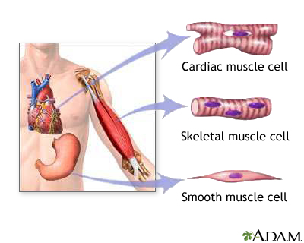
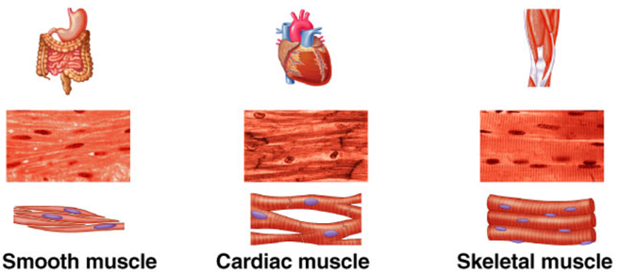
The musculoskeletal system
Watch video: The Muscular System Explained In 6 Minutes
The movements that we complete every day such as walking, sitting, standing and running are all
activities that require the support of our bones and the movement of skeletal muscles. Even during sleep
our muscles and bones are in use. The major function of the musculoskeletal system is to protect and
support the body.
The musculoskeletal system is made up of two major body systems, the muscular and skeletal.

Slide 5
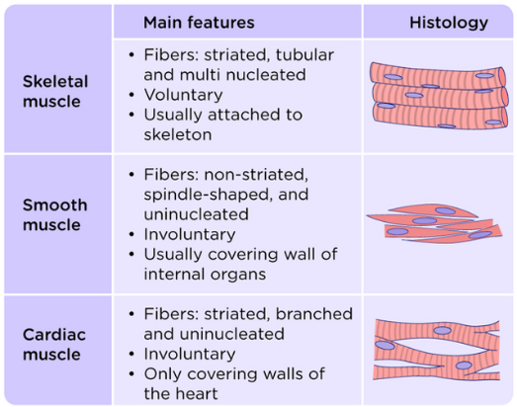
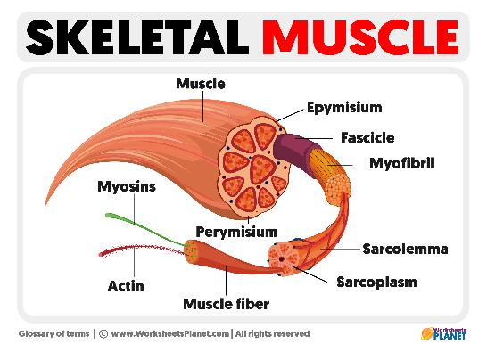
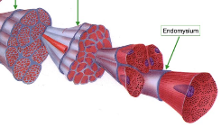
The musculoskeletal system The muscular system
There are over 600 skeletal muscles in the human body. Each is composed of specialised cells called muscle fibres. The muscular system has a number of important functions including movement, strength, heat production, shock absorption, shape, posture and respiration. Our muscles are attached to bones, internal organs and blood vessels and are responsible for movement. The majority of movement produced by the body is the result of muscle contraction that occurs around the joints in the body. The muscular system is made up of three types of muscles cardiac, smooth and skeletal.
endomysium
Protein fibres responsible for
muscle contractions

Slide 6
The musculoskeletal system Major functions of muscles
Producing movement:
Skeletal muscles are multifunctional and crucial for movement.
Nearly all body movements result from muscular contractions.
Skeletal muscles enable actions like walking, running, jumping, and facial expressions.
Maintaining posture and supporting joints:
Skeletal muscles maintain body posture despite gravity's pull.
Correct posture is essential for avoiding pain, illness, and indicating health.
Muscles stabilize and support joints of the skeleton.
Generating heat:
Skeletal muscles generate body heat as a by-product of muscle activity.
Heat is crucial for maintaining normal body temperature.

Slide 7
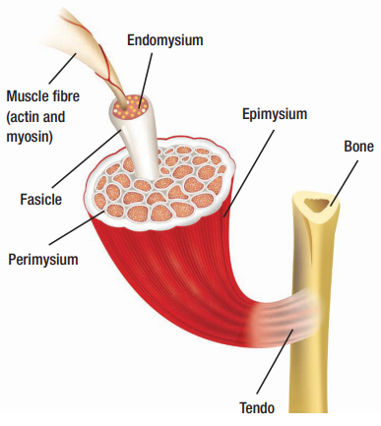
The musculoskeletal system Anatomy of skeletal muscle
Skeletal muscles attach to bones via tendons, which are strong and flexible connective tissue bands.
Each skeletal muscle protein fiber, consisting of actin and myosin, is surrounded by endomysium.
Fibers are organized into bundles covered by perimysium.
Multiple bundles or the belly of the muscle are wrapped together by epimysium to form the entire muscle.

Slide 8
The musculoskeletal system Muscle groups
Account for about 40 percent of a person’s weight. Most skeletal muscles have names that describe their features. Below are some terms relating to muscle features:
Size: vastus (huge); maximus (large); longus (long); minimus (small); brevis (short).
Shape: deltoid (triangular); rhomboid (like a rhombus with equal and parallel sides); latissimus (wide); teres (round); trapezius (like a trapezoid, a four-sided figure with two sides parallel)
Direction of fibres: rectus (straight); transverse (across); oblique (diagonally); orbicularis (circular).
Location: pectoralis (chest); gluteus (buttock or rump); brachii (arm); supra- (above); infra- (below); sub- (under or beneath); lateralis (lateral).
Number of origins (fixed attachments): biceps (two heads); triceps (three heads); quadriceps (four heads).
Action: abductor (to abduct a structure); adductor (to adduct a structure); flexor (to flex a structure); extensor (to extend a structure); levator (to lift or elevate a structure); masseter (chewing).

Slide 9
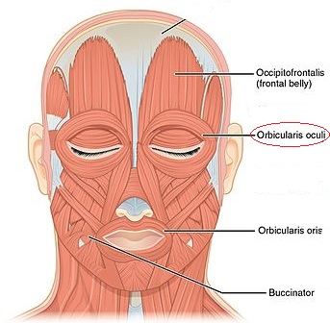
The musculoskeletal system Muscles of the head and neck
Most skeletal muscles are attached to bone. As muscles contract, they apply force on the bones, which they are attached, this helps to support and move our body.
One end of the muscle is fixed in position, while the other end moves during a contraction.
The origin is the attachment site that doesn’t move during contraction, while the insertion is the attachment site that moves when the muscle contracts.

Slide 10
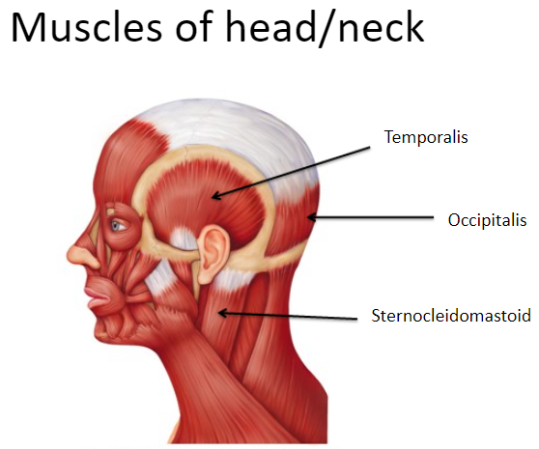
The musculoskeletal system Muscle of the head and neck
Muscles in the face and neck serve various functions:
Highly tuned facial muscles enable a range of expressions.
Jaw muscles aid in chewing movements for eating.
Neck muscles assist in swallowing and support the weight of the skull.
Neck muscles are among the hardest working in the body.
Disorders in these muscles can lead to health issues and may indicate illness:
Loss of facial muscle tension, especially on one side, could indicate a stroke.

Slide 11
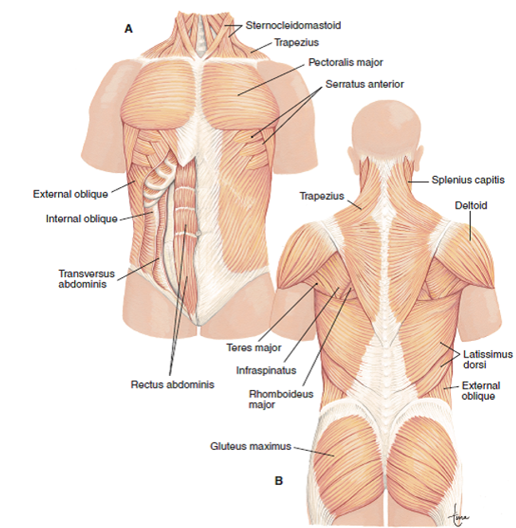
The musculoskeletal system Muscle of the trunk
Muscles of the trunk are crucial for supporting and stabilizing hips and spinal column.
Large muscles on each side of the vertebral column extend from lower spine to base of skull, primarily straightening the vertebral column for posture.
Muscles in thoracic region mainly involved in breathing (inspiration and expiration).
Pectoralis major, the main chest muscle, is responsible for shoulder movement.

Slide 12
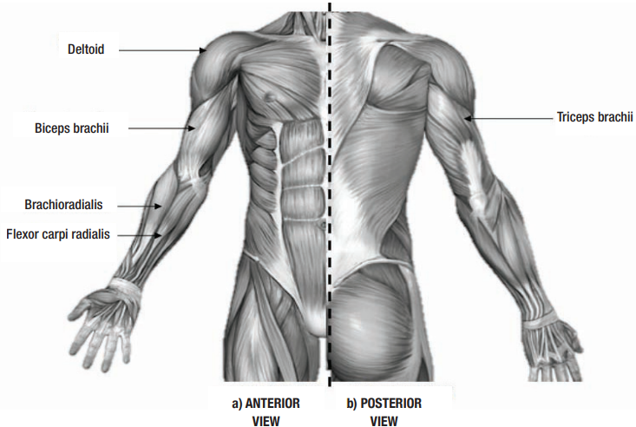
The musculoskeletal system Muscle of the upper body
The muscles of the upper extremity are responsible for movements of the arm, shoulder, elbow and wrist.
For example, the biceps brachii controls the movement of the arm at the elbow, while the brachioradialis is one of the muscles responsible for movement at the wrist.

Slide 13
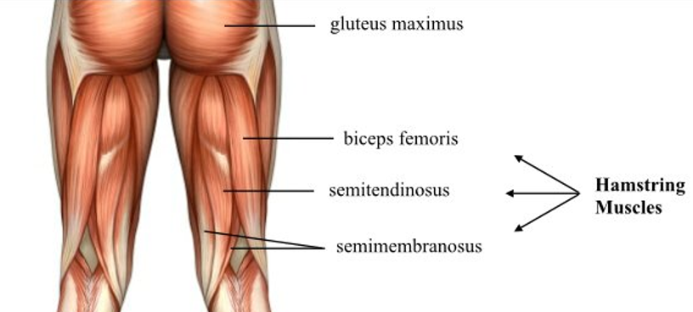
The musculoskeletal system Muscle of the hip and thigh
Act on the lower limbs and cause movement of the hip knee and foot.
The largest, strongest muscles in the body and specialised for walking and balancing.
Muscles that act on the thigh are large muscles and help hold the body upright against the pull of gravity. These muscles cross the knee joint and also have attachments at the hip to allow movement at the hip joint.
Posterior view

Slide 14
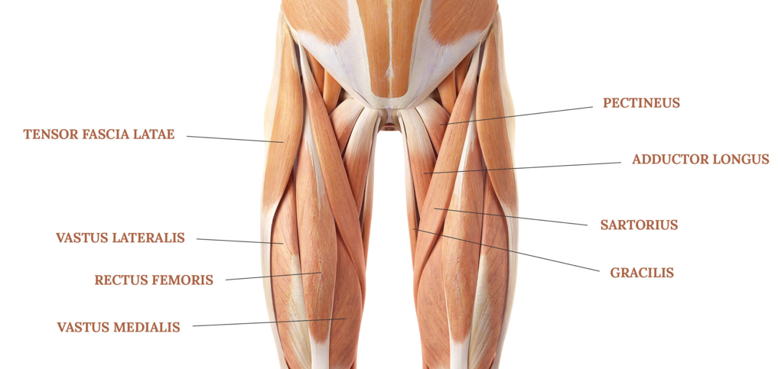
The musculoskeletal system Muscle of the hip and thigh
Act on the lower limbs and cause movement of the hip knee and foot.
The largest, strongest muscles in the body and specialised for walking and balancing.
Muscles that act on the thigh are large muscles and help hold the body upright against the pull of gravity. These muscles cross the knee joint and also have attachments at the hip to allow movement at the hip joint.
Anterior view
Adductor group
Quadriceps

Slide 15
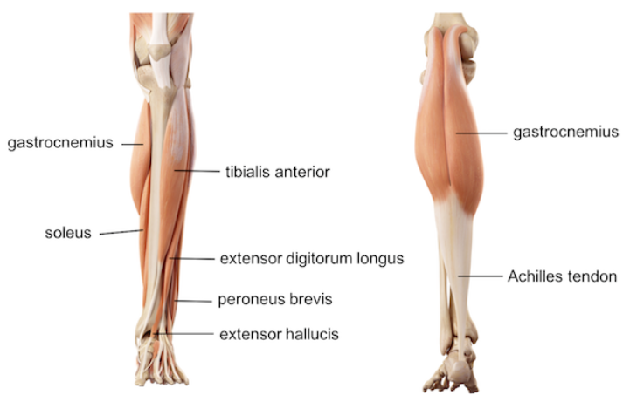
The musculoskeletal system Muscle of the lower leg
Responsible for the movement of the ankle and the foot.
These muscles assist the thigh and hip muscles during movements such as walking, running and balancing.
The lower leg also contains the largest tendon in the human body, the achilles tendon. This tendon plays a vital role in the transfer and absorption of force when walking, running and jumping.
Anterior view
Posterior view
fibularis tertius

Slide 16
The musculoskeletal system Disorders of the muscular system
The most common disorders and conditions of the muscular system can include injuries such as sprains and strains, cramps, tendinitis, overuse, and inflammation.
Sprains are an over extension of a joint often causing ligament damage (tears and ruptures). This will affect the ability of the joint to be stable as ligaments help to stabilise and connect bone to bone.
Symptoms of a sprain may include: Swelling, Bruising, Inability to weight-bear or pain.
Strains are caused when a muscle is over-stretched, causing damage to tendons and muscle tears.
Symptoms of a strain may include: A loud snapping or cracking noise when injured, Pain, Swelling, Tenderness and an inability to weight-bear.
Inflammation is a localised physical condition, where a specific part of the body becomes reddened, swollen, hot, and often painful as a result of an injury or infection.
Symptoms of inflammation may include: Pain, Swelling, Redness, Heat, Loss of function
Tendonitis is when the tendon (connective tissue that attaches bone to muscle) of a muscle becomes sore and inflamed. It is often caused by overuse. Common areas for tendonitis include the shoulder, wrist, knee, shin and heel.
Symptoms of tendonitis may include: Pain, Swelling

Slide 17
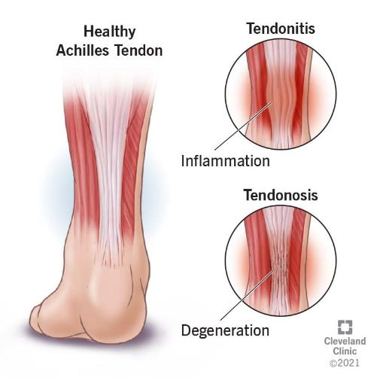
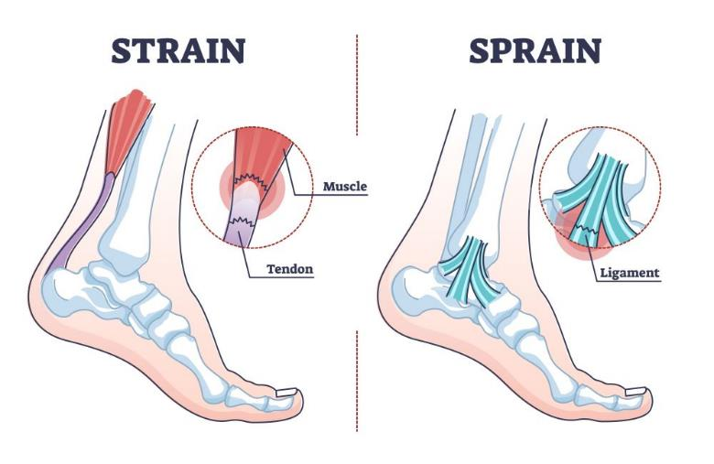
The musculoskeletal system Disorders of the muscular system

Slide 18
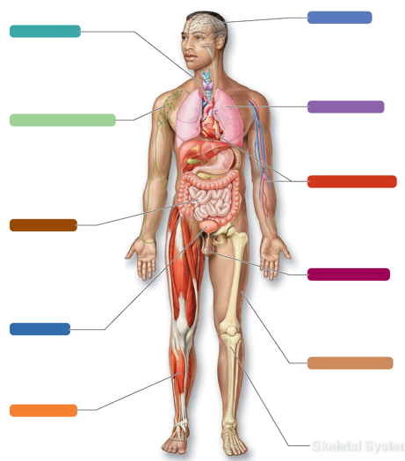
The muscular system Systems in sync - the muscular system
NERVOUS SYSTEM:
The muscular system produces all movements of the body.
The nervous system stimulates and regulates muscle activity.
ENDOCRINE SYSTEM:
Hormones of the endocrine system influence the growth of skeletal muscles.
RESPIRATORY SYSTEM
The muscular system produces movements necessary for breathing. Muscular exercise assists with respiratory health.
The respiratory system provides oxygen to the muscles and removes carbon dioxide.
LYMPHATIC SYSTEM:
Muscle activity assist with immunity
The lymphatic system helps to protect the muscles from illness
CARDIOVASCULAR SYSTEM
Skeletal muscle activity increases CV efficiency and helps to prevent CV illness and disease.
All eleven of the body’s systems interact to maintain our internal stability, balance and heath. The way in which each individual body system works in conjunction with the other body system describes the interrelationship between the systems.
DIGESTIVE SYSTEM:
Both skeletal and smooth muscles assist with digestion. Skeletal muscles of the face help with chewing, while smooth muscles in the stomach help to digest food.
Digestive system provides nutrients for healthy muscular activity.
REPRODUCTIVE SYSTEM:
Skeletal muscles in the pelvis help to support reproductive organs in both males and females.
Hormones produced in the esticles promote muscle growth.
URINARY SYSTEM:
Muscle activity helps to keep the urinary system healthy.
Urinary system disposes of waste products generated by the muscular system.
INTEGUMENTARY (SKIN) SYSTEM:
The CV system delivers oxygen and nutrients to skin cells.
The skin’s blood vessels provide an important site for heat loss to help maintain body temperature.
MUSCULAR SYSTEM
SKELETAL SYSTEM:
Skeletal muscle activity helps to maintain healthy bones.
Bones provide points of attachments for muscles.

Slide 19
Learning Checkpoint 4
1. Identify the three types of muscles in the human body.
Cardiac, smooth and skeletal
2. In terms of muscular contractions describe the term ‘involuntary’.
Automatically contracts and is not under conscious control.
3. In terms of muscular contractions describe the term ‘voluntary’.
Under conscious control.
4. Outline and briefly describe the three key functions of skeletal muscle.
To produce movement, generate heat and protect organs.
5. Briefly explain the key functions of the muscles of the trunk.
Muscles of the trunk support and stabilize the hips and spinal column.

Slide 20
Learning Checkpoint 4
6. Briefly explain the key functions of the muscles of the hip and thigh.
These muscles cause movement of hip, knee and foot.
7. Briefly explain the key functions of the muscles of the lower leg.
These muscles of the lower leg are responsible for the movement of the ankle and the foot.
8. Describe the term ‘origin’.
The origin is the attachment site of a muscle that does not move during contraction.
9. Describe the term ‘insertion’.
The insertion is the attachment site that moves when the muscle contacts.

Slide 21
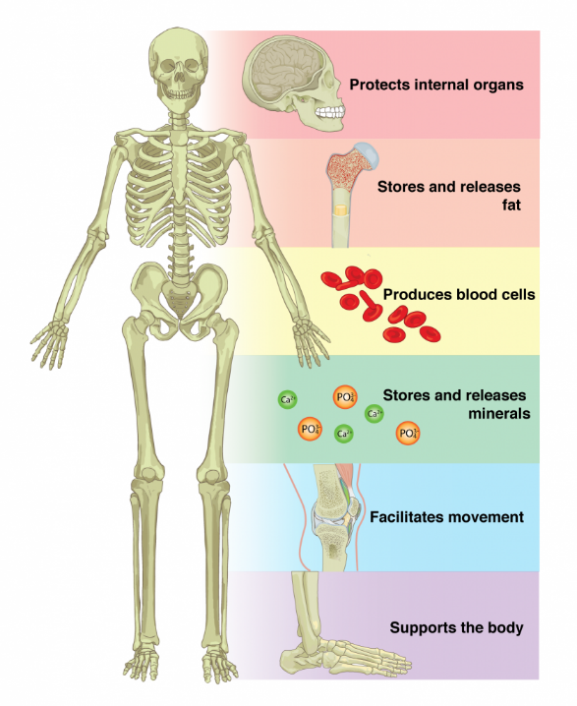
The musculoskeletal system The skeletal system
Watch video: Introduction to the Skeletal System In 7 Minutes
The skeletal system is made up of bones, cartilage, ligaments, tendons and other tissues. The skeletal system has five major functions:
Support and stability – Allows our body to stand upright. Provides structural support for the entire body.
Protection – Protection for major organs. For example, the ribs provide protection for the heart and lungs, the vertebrae and vertebral column provide protection for the spinal cord and the skull provides protection for the brain.
Mineral storage – Store nutrients that provide vital functions, including calcium and phosphorus.
Movement – The skeleton provides attachment sites for major muscles allowing for movement.
Blood cell production – Both red and white blood cells are produced in the marrow of bones. Immune cells such as lymphocytes are also produced in bone marrow.

Slide 22
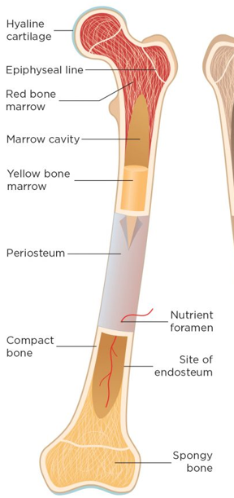
The musculoskeletal system Anatomy of bones
Bones in the human body vary in size and shape but share basic anatomy.
The outer surface is called periosteum, a thin, dense membrane containing nerves and blood vessels.
Compact bone, beneath periosteum, is smooth and extremely hard.
Cancellous bone, inside compact bone, resembles a sponge and is less strong but protective.
Cancellous bone typically safeguards bone marrow.
Bone marrow, a soft tissue inside bones, comes in two types: red and yellow.
Red bone marrow produces blood cells, while yellow bone marrow stores fat.
Yellow bone marrow can transform into red marrow when blood supply is low to boost blood cell production.
Medullary
Nutrition vessel

Slide 23
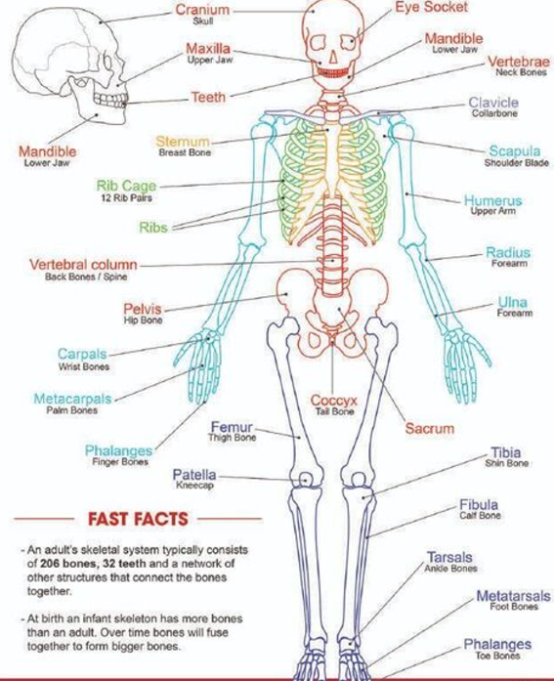
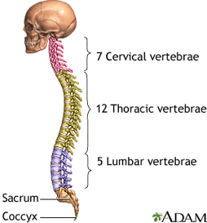
The musculoskeletal system The human skeleton
The adult human skeleton usually consists of 206 named bones.
These bones can be grouped in two divisions: axial skeleton and appendicular skeleton.
The 80 bones of the axial skeleton include the bones of the head, vertebral column and thoracic cage.
The appendicular skeleton consists of 126 bones and includes the upper and lower extremities (limbs) and their attachments that are called girdles

Slide 24
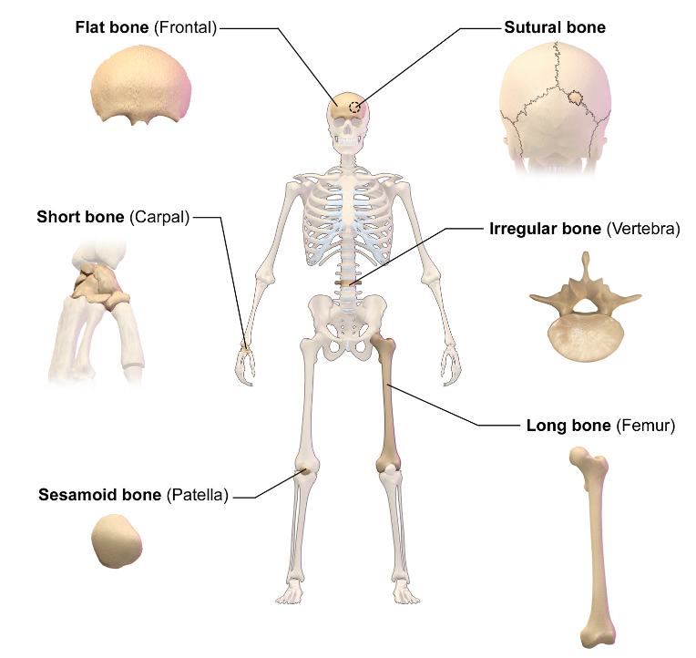
The musculoskeletal system FIVE Classification of bones
Long bones are longer than they are wide, with cartilage covering both ends for shock absorption and protection. Examples: femur, tibia, humerus, metacarpals.
Short bones are generally as wide as they are long, providing stability and support. Examples: carpals, tarsals.
Flat bones are flat in shape and protect vital organs. Examples: cranium, ribs, sternum, pelvis.
Irregular bones have asymmetrical shapes and do not fit into other categories. Examples: vertebrae, mandible.
Sesamoid bones are irregular or flat bones embedded within tendons, often small and rounded. Examples: patella (knee cap), two in hand and foot, one in wrist (pisiform).

Slide 25
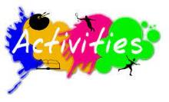
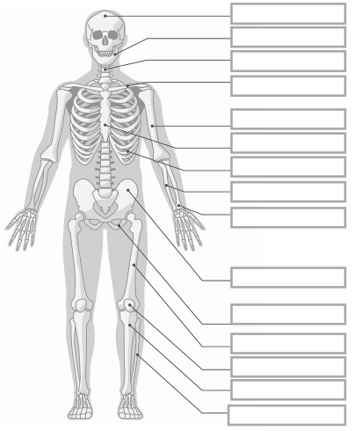
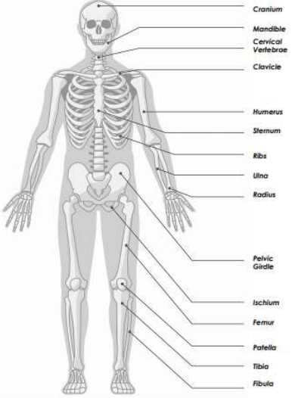
7. Label it - skeletal system
Using your knowledge of the skeletal system correctly label the diagram.

Slide 26
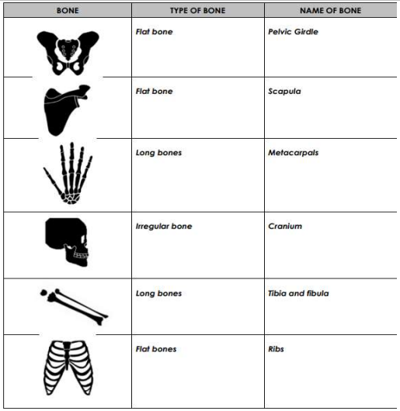
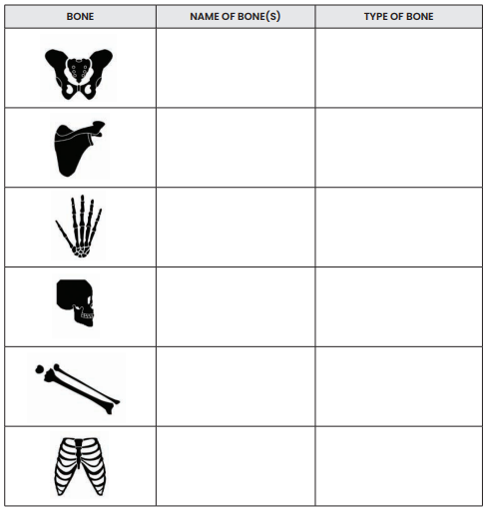
8. Name that bone
For each of these bones write the following:
The name of the bones (e.g. clavicle and scapula)
The type of bone (e.g. long and sesamoid)

Slide 27
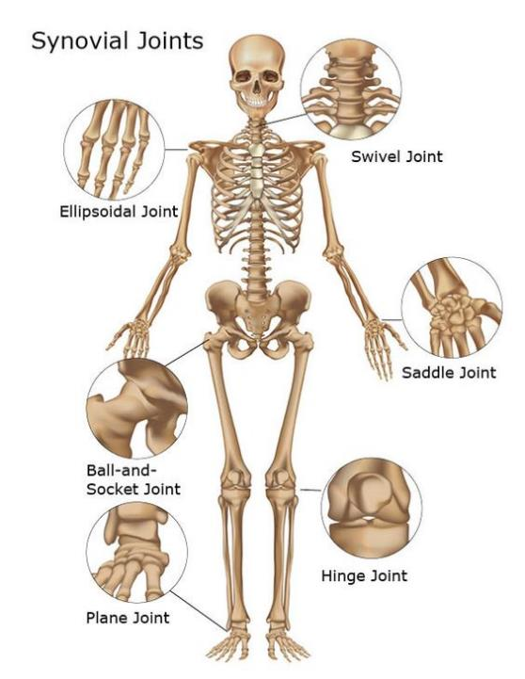
The musculoskeletal system Joints
Joints are where two or more bones make contact, designed for movement, support, and weight bearing.
Synovial joints are the most movable type in the body, with various types allowing different movements.
Joint anatomy includes bones, ligaments, articular cartilage, synovial membrane, synovial fluid, and joint capsule.
Four types of synovial joints:
Ball and socket joints: Multi-axial, with one bone's rounded head fitting into another's cup-like cavity (e.g., shoulder, hip).
Hinge joints: Uniaxial, moving back and forth along a single plane with some rotation (e.g., elbow, knee).
Gliding joints: Allow sliding movements, such as sideways movement (e.g., ankle, wrist).
Vertebral joints: Slightly movable, with intervertebral discs limiting movement, providing stability to the skeletal system.
Vertebral
Gliding
Gliding

Slide 28
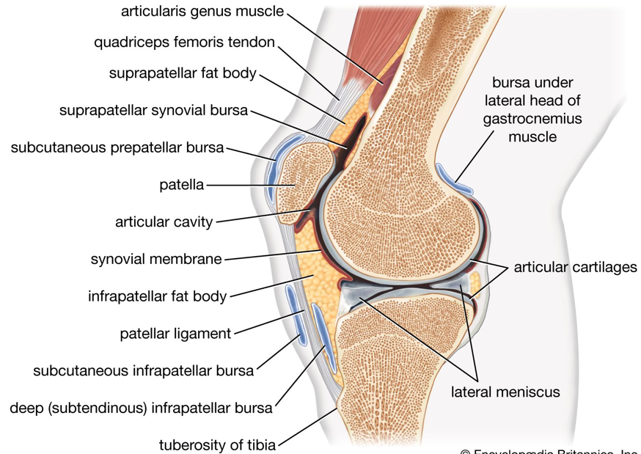
The musculoskeletal system Joints
Joint
Anatomy of knee joint
Joint capsule
pad
Superficial

Slide 29
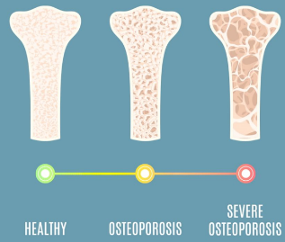
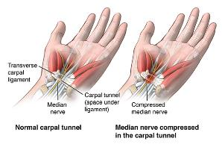
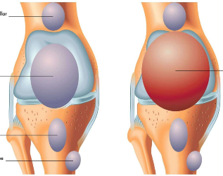
The musculoskeletal system Disorders of the Skeletal System
Risk factors for musculoskeletal disorders include age, occupation, activity level, lifestyle, and family history.
Certain activities like repetitive motions, heavy lifting, or prolonged sitting can contribute to musculoskeletal issues.
Common musculoskeletal disorders:
Arthritis: Joints deteriorate over time, leading to swelling, pain, and reduced mobility. Rheumatoid arthritis involves chronic inflammation due to the immune system attacking joint tissues.
Osteoporosis: Calcium loss from bones leads to decreased density and increased fracture risk, particularly in postmenopausal women.
Carpal tunnel syndrome: Repetitive wrist flexion causes tingling, pain, and weakness due to nerve compression in the wrist.
Bursitis: Inflammation of fluid-filled pockets (bursae) in joints results in pain and immobility.
Fractures (broken bones): Bone structure is disrupted due to excessive force, causing pain, loss of function, and potential bleeding and injury.

Slide 30
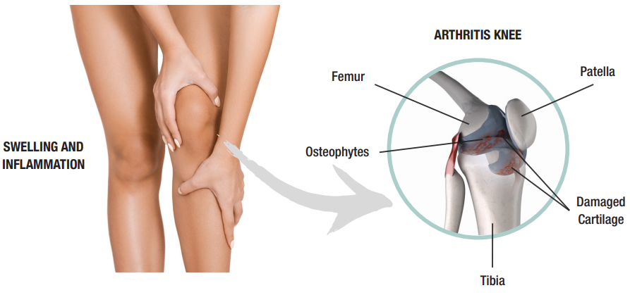
The musculoskeletal system Disorders of the Skeletal System

Slide 31
The skeletal system Systems in sync - the skeletal system
NERVOUS SYSTEM:
The skeletal system protects the brain and spinal column.
The nervous system supplies bones and joints with nerves that detect sensory information.
ENDOCRINE SYSTEM:
The skeletal system provides protection for organs of the endocrine system.
Hormones of the endocrine system help to regulate the uptake and release of calcium.
RESPIRATORY SYSTEM
The skeletal system protects the lungs by enclosing them in the rib cage.
The respiratory system provides oxygen to the muscles and removes waste.
LYMPHATIC SYSTEM:
The skeletal system provides protection for lymphatic organs. Immune cells such as lymphocytes are produced in bone marrow.
The lymphatic system helps to protect the bones from illness and disease.
CARDIOVASCULAR SYSTEM
Bone marrow cavities provide the site for blood cell production, which is needed for cardiac muscle activity.
The CV system delivers oxygen and nutrients to bones
The diagram below illustrates the interrelationship between the skeletal system and the other body
systems.
DIGESTIVE SYSTEM:
The skeletal system provides protection for the organs of the digestive system.
Digestive system provides nutrients for bone health and growth
REPRODUCTIVE SYSTEM:
The skeletal system provides some protection for the reproductive organs in both males and females.
Hormones produced in the testicles influence bone growth.
URINARY SYSTEM:
The skeletal system protects the bladder and kidneys via the pelvis and rib cage.
Urinary system helps to activate vitamin D, which is needed for calcium.
INTEGUMENTARY (SKIN) SYSTEM:
The skeletal system provides support for the skin and other organs of the body.
The skin absorbs vitamin D from the sun that is needed for calcium absorption.
MUSCULAR SYSTEM
The skeletal system provides levers and points of attachments for muscles. Bones also provide calcium needed for healthy muscle activity.
Muscles pull on bones that increase bone strength and growth.
SKELETAL SYSTEM:

Slide 32
Learning Checkpoint 5
1. Describe the five major functions of the skeletal system
Support and stability, protection, mineral storage, movement, and blood cell production.
2. Outline the components of the axial skeleton.
The axial skeleton includes the bones of the head, vertebral column and thoracic cage.
3. Identify the three divisions of the spinal column.
Cervical, thoracic and lumbar
4. The joints of the human body have unique functions. Briefly describe the main functions of joints.
Joints are constructed to allow movement and provide mechanical support and weight bearing.
5. Describe the structure and function of a ‘synovial’ joint.
Synovial joints are made up of bones and ligaments and contain synovial fluid, which acts to
cushion the joint against damage. The ligaments hold the joint stable and allow the joint to move
in the right direction.

Slide 33
Learning Checkpoint 5
6. Briefly explain how the skeletal system interacts with the following body systems:
• Muscular system
o The skeletal system provides levers and points of attachment for muscles.
• Lymphatic system
o The skeletal system provides protection for lymphatic organs. Particular immune cells
such as B and T cells are produced in bone marrow within our bones.
• Respiratory system
o The skeletal system protects the lungs by enclosing them in the rib cage.
• Digestive system.
o The skeletal system provides protection for the organs of the digestive system.
• Cardiovascular system
o Bone marrow cavities provide the site for blood cell protection, which is needed for
cardiac muscle activity.

Slide 34
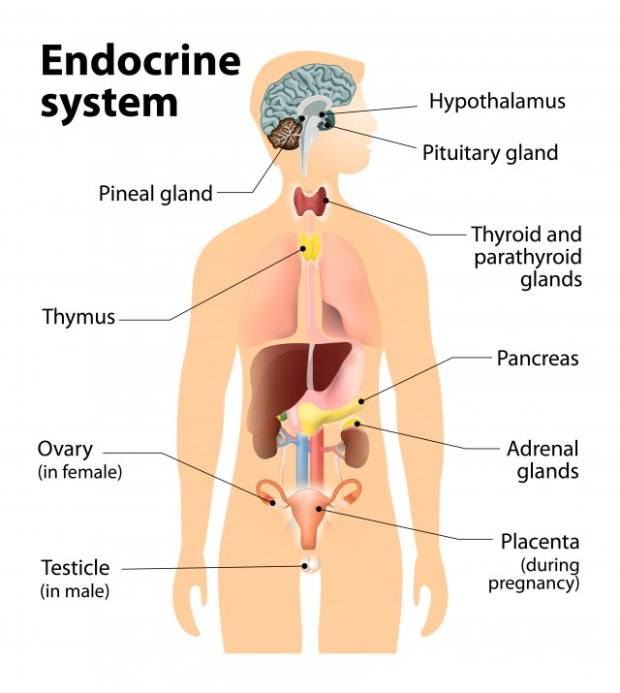
The endocrine system
Major function of body systems is maintaining balance, known as homeostasis.
Alongside the nervous system, the endocrine system plays a significant role in homeostasis, coordinating cell activity.
Nervous system operates quickly using nerve impulses to control muscles and glands for rapid responses.
Endocrine system acts slowly, releasing hormones into the blood for widespread effect.
Main functions of the endocrine system:
Growth and development
Defense against stress
Reproduction
Maintenance of electrolyte balance
Regulation of metabolism
Watch video: The Endocrine System, Overview, Animation

Slide 35
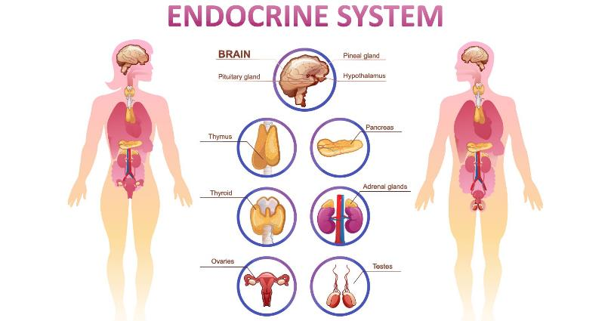
The endocrine system Hormones
Hormones produced by the endocrine system are crucial for body functions.
Hormones are chemical substances secreted by endocrine cells to regulate metabolic activity of other cells.
Hormones are classified as amino acid-based molecules (proteins) or steroids.
Steroid hormones include sex hormones produced by ovaries and testes.

Slide 36
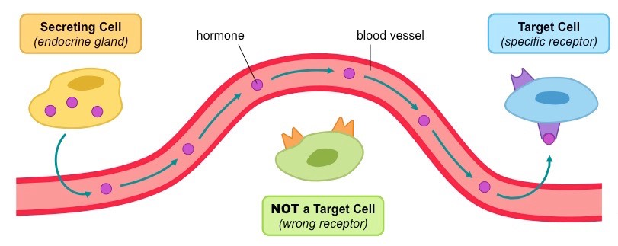
The endocrine system Mechanisms of hormones
Hormones travel via blood throughout the body but only affect specific cells.
Cells respond to hormones through receptor sites, akin to a lock-and-key mechanism.
If hormone fits the receptor site, there's an effect; otherwise, no reaction occurs.
Cells with receptor sites for a hormone are target cells.
Target cells may be localized in specific organs, called target organs.

Slide 37
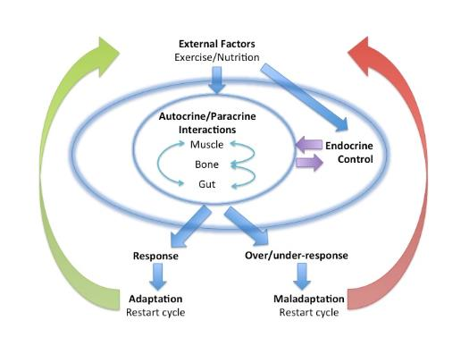
The endocrine system Hormone control
Hormones are potent substances, meaning small amounts can significantly affect metabolic processes.
Negative feedback mechanisms regulate blood levels of most hormones. In negative feedback, glands are sensitive to substance concentrations they regulate.
Negative feedback reverses specific body conditions to maintain homeostasis. Example: Body temperature higher than normal triggers processes to lower it.
Some glands secrete hormones in response to other hormones.

Slide 38
The endocrine system Major organs of the endocrine system
The major organs of the endocrine system include the pituitary gland, thyroid gland, adrenal glands, thymus, pineal gland, pancreas and the gonads (ovaries and testes). The hypothalamus, which is part of the nervous system, is also a major part of the endocrine system.

Slide 39
The endocrine system Pituitary gland
The pituitary gland, about the size of a pea, hangs from the hypothalamus' inferior surface.
It has anterior and posterior lobes, responsible for secreting different hormones.
Glandular tissues receive hormones from the anterior pituitary, while nervous tissue receives from the posterior pituitary.
Hormone release by the pituitary gland is controlled by hypothalamic hormones.
Anterior pituitary gland secretes several hormones:
Follicle stimulating hormone (FSH): Stimulates follicle growth in ovaries and sperm development in testes.
Luteinizing hormone (LH): Triggers ovulation in females and testosterone production in males.
Growth hormone (GH): Major hormone for skeletal muscle and bone growth, influencing body size.
Melanocyte stimulating hormone (MSH): Regulates skin pigment cells in response to UV radiation.
Prolactin (PRL): Stimulates milk production in breast cells after childbirth.
Adrenocorticotropic hormone (ACTH): Regulates cortisol levels released from the adrenal gland.
Thyroid stimulating hormone (TSH): Influences thyroid gland growth and activity, regulating metabolism.

Slide 40
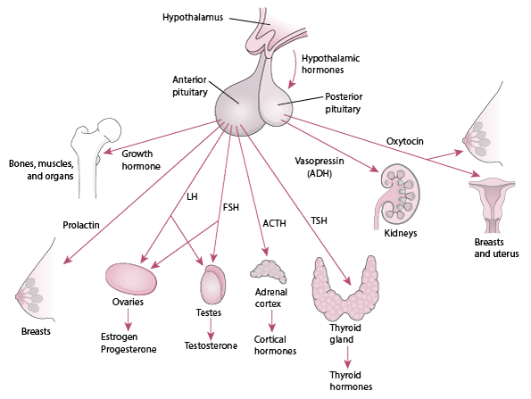
The endocrine system Pituitary gland
Follicle stimulating hormone (FSH):
Luteinizing hormone (LH)
Growth hormone (GH)
Melanocyte stimulating hormone (MSH)
Prolactin (PRL)
Adrenocorticotropic hormone (ACTH)
Thyroid stimulating hormone (TSH)

Slide 41
The endocrine system Hormones of the posterior pituitary gland
Acts as a storage area for hormones produced by the hypothalamus. The hormones produced by the posterior pituitary include:
Oxytocin – this hormone is released in significant amounts only during childbirth. Oxytocin stimulates powerful contractions of the uterus during labour.
Antidiuretic hormone (ADH)- which causes the kidneys to reabsorb water to form urine.

Slide 42
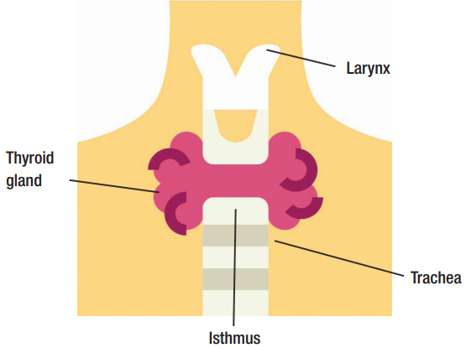
The endocrine system The thyroid gland
Thyroid gland: Located at base of throat, consists of two lobes joined by isthmus.
Produces two hormones:
Thyroid hormone: Contains iodine, regulates glucose usage, body heat, chemical energy. Important for tissue growth and development, especially reproductive and nervous systems.
Calcitonin: Regulates blood calcium levels by decreasing it, opposes actions of parathyroid hormone.
Parathyroid glands: Produce parathyroid hormone, controlling blood calcium levels.
Calcium vital for nerves, muscles, bones, heart, kidneys.
Excess parathyroid hormone can lead to calcium depletion from bones, increasing osteoporosis risk.

Slide 43
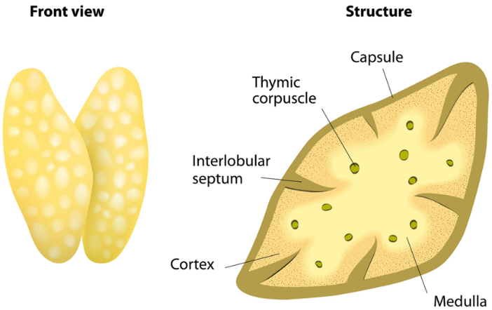
The endocrine system The thymus gland
Thymus gland: Located on upper thorax, behind sternum.
Larger in infants and children, decreases in size with adulthood.
Produces hormone called thymosin.
Thymosin crucial for normal development of a special group of white blood cells called T-cells.
T-cells important for immune system function.

Slide 44
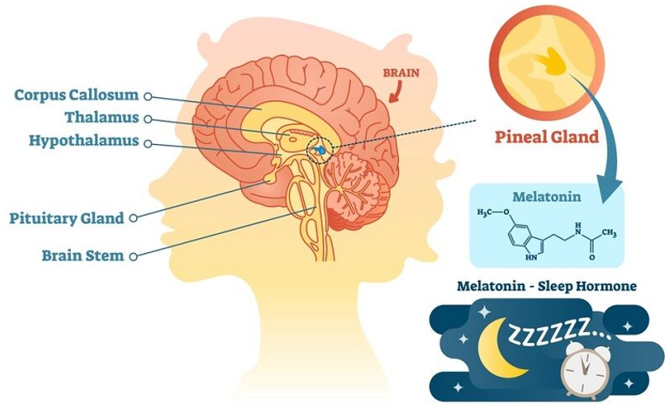
The endocrine system The pineal gland
Pineal gland: Small cone-shaped gland hanging from brain's roof.
Endocrine function: secretes hormone called melatonin.
Melatonin secreted directly into cerebrospinal fluid.
Melatonin controls sleeping and waking cycles.
Varies melatonin secretion throughout day and night.
Peak levels at night induce drowsiness, lowest during midday.
Melatonin crucial for establishing body's sleeping patterns and regulating mood.

Slide 45
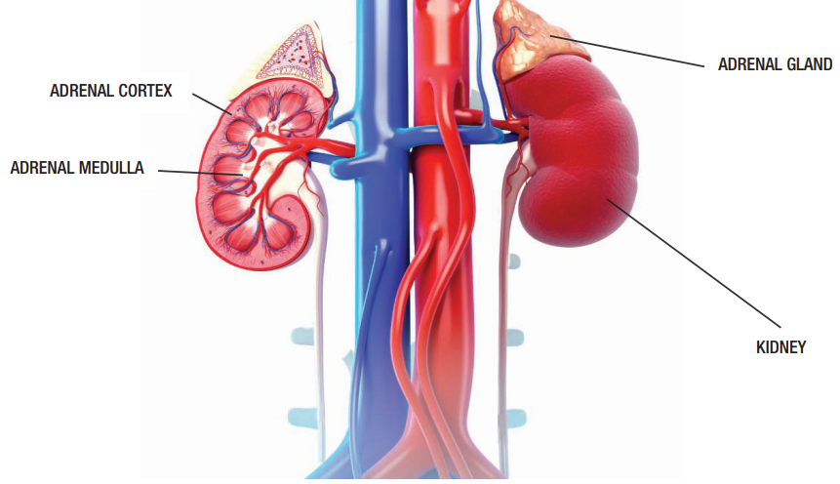
The endocrine system The adrenal glands
Adrenal glands: Paired glands curved over top of kidneys. Each gland has outer cortex (adrenal cortex) and inner medulla. Cortex and medulla secrete different hormones, developed from different tissues.
Hypothalamus influences both adrenal glands via different mechanisms. Adrenal cortex regulated by negative feedback involving hypothalamus. Adrenal medulla regulated by nerve impulses from hypothalamus.
Adrenal cortex produces corticosteroids, including:
Mineral corticoids: regulate blood mineral content (e.g., sodium, potassium).
Glucocorticoids: promote normal cell metabolism, aid in blood glucose regulation.
Sex hormones (oestrogen, androgens): essential for reproductive system function.

Slide 46
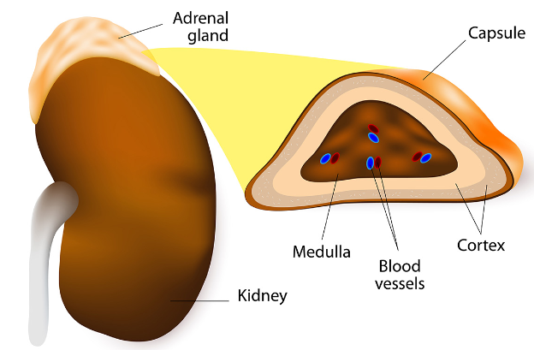
The endocrine system The adrenal medulla
Adrenal medulla stimulated by nerve impulses from hypothalamus.
Releases two hormones into bloodstream: epinephrine (adrenaline) and norepinephrine (noradrenaline).
Initiates 'flight or fight' response when threatened, scared, or frightened.
Response helps body cope with stressful situations.
Hormones increase heart rate, blood pressure, and dilate capillaries in lungs.

Slide 47
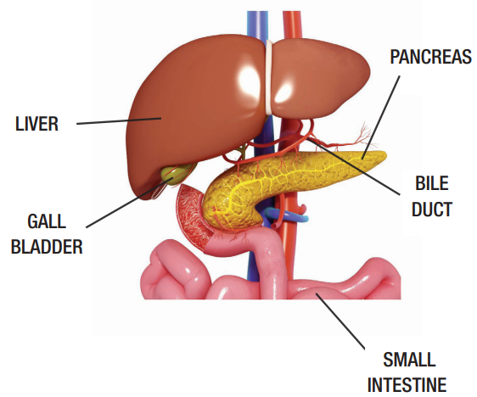
The endocrine system The pancreas
Pancreas: Long, soft organ located inferior to liver in abdominal cavity.
Assists in digestion and regulates blood sugar levels.
Exocrine portion secretes digestive enzymes into ducts leading to duodenum.
Endocrine portion secretes directly into the Blood and consists of pancreatic islets (small tissues) producing hormones.
Pancreatic islets secrete two important hormones:
Glucagon: Secreted by alpha cells in response to low blood glucose levels.
Insulin: Secreted by beta cells in response to high blood glucose levels.

Slide 48
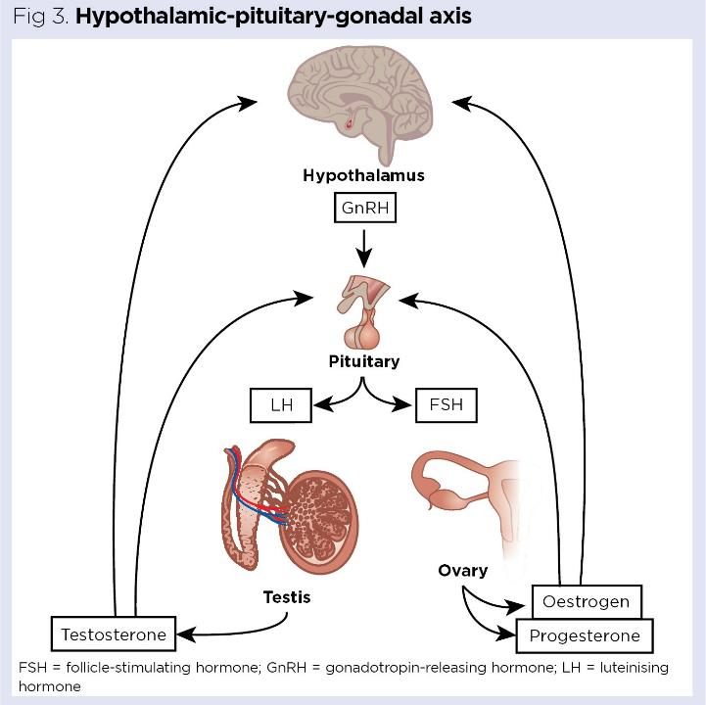
The endocrine system The gonads (ovaries and testes)
Ovaries:
Almond-shaped organs located in pelvic cavity.
Produce female sex cells (ova/eggs) and steroid hormones: oestrogen and progesterone.
Oestrogen: Contributes to development of female reproductive organs and sex characteristics.
During puberty, promotes breast development and fat distribution in hips and legs.
Progesterone: Builds uterine lining in preparation for pregnancy.
Testes:
Pair of oval glands suspended in scrotum outside pelvic cavity.
Produce male sex hormone testosterone.
During puberty, promotes growth of male reproductive organs and sex characteristics.
Includes facial hair growth, muscle development, and voice deepening.

Slide 49
The endocrine system Disorders of the endocrine system
Endocrine structures and glands produce hormones that travel through bloodstream to tissues and organs.
Hormones regulate body processes like growth, repair, and temperature regulation.
Hormone imbalance can lead to endocrine disorders:
Result from gland producing too much or too little hormones.
Result from development of tumors or cancers in endocrine system, affecting hormone levels.
Common endocrine disorders include:
Diabetes: High blood sugar levels due to insulin deficiency or resistance.
Type 1: Pancreas can't produce insulin.
Type 2: Cells don't respond to insulin properly, pancreas produces inadequate insulin.
Hypoglycemia: Low blood sugar levels, often associated with diabetes. Symptoms include fatigue, anxiety, pale skin, heart palpitations, tingling around mouth.
Hyperthyroidism (overactive thyroid): Excessive thyroid hormone production. Symptoms include weight loss, increased heart rate, sweating, anxiety, bulging eyes, thyroid enlargement.
Goitre: Enlargement of thyroid gland due to iodine deficiency, thyroid cancer, or thyroid dysfunction. Can cause throat enlargement, leading to breathing and swallowing difficulties.

Slide 50
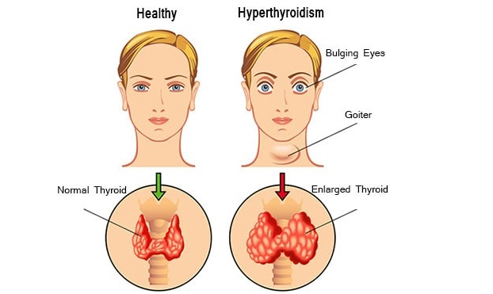
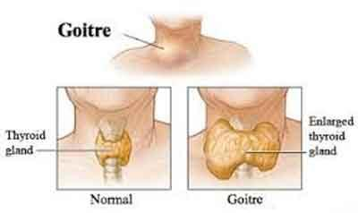
The endocrine system Disorders of the endocrine system

Slide 51
The endocrine system Systems in sync - the endocrine system
NERVOUS SYSTEM:
Hormones such as growth hormone influence the maturation and function of the nervous system.
The hypothalamus controls the function of the anterior pituitary gland.
ENDOCRINE SYSTEM
RESPIRATORY SYSTEM
The endocrine system produces epinephrine, which influences ventilation.
The respiratory system provides oxygen to organs of the endocrine system and assists to convert enzymes in the lungs.
LYMPHATIC SYSTEM:
The endocrine system works directly with the lymphatic system to keep our immune system functioning efficiently.
Lymph nodes assist in the transportation of hormones.
CARDIOVASCULAR SYSTEM
Several hormones influence blood volume, blood pressure and heart rate
Blood transports hormones around the body.
The diagram below illustrates the interrelationship between the endocrine system and the other body
systems.
DIGESTIVE SYSTEM:
Hormones of the gastrointestinal tract influence digestion. Vitamin D that is activated by hormones of the endocrine system is necessary for calcium absorption.
The digestive system provides nutrients to the organs of the endocrine system.
REPRODUCTIVE SYSTEM:
Hormones produced in the hypothalamus, pituitary glands and gonads direct the reproductive system’s development and function.
Hormones in the gonads influence endocrine system function.
INTEGUMENTARY (SKIN) SYSTEM:
The endocrine system produces hormones that increase skin hydration.
The skin produces a precursor of vitamin D, which converts it into an active form that can be absorbed by the body.
URINARY SYSTEM:
The hormone ADH influences kidney function and assists with urine formation.
Urinary system uses a type of hormones to activate vitamin D.
SKELETAL SYSTEM:
The endocrine system produces hormones that are important for bone growth and development.
The skeleton protects some organs of the endocrine system, especially those in the brain, chest and pelvis.
MUSCULAR SYSTEM
The endocrine system provides growth hormone (GH) that is essential for muscular growth and development.
Muscular system helps to protect organs of the endocrine system.

Slide 52
Learning Checkpoint 6
1. In comparison to the nervous system describe the speed and mode of transport the endocrine
system uses to transmit messages around the body.
The endocrine system acts slowly using chemical messages called hormones that are released
into the blood and are transported throughout the bod
2. Identify the five major functions of the endocrine system.
Growth and development, defense against stress, reproduction, maintenance of electrolyte
balance and regulation of metabolism.
3. Define ‘hormone’.
Hormones can be defined as chemical substances that are secreted by endocrine cells to regulate
the metabolic activity of other cells in the body

Slide 53
Learning Checkpoint 6
4. Briefly explain the mechanism in which hormones work their way around the body and find their
way to different organs.
Our blood carries hormones throughout the entire body; hormones only affect certain cells that
have receptor sites for that hormone just like a lock and key mechanism. If the hormone fits,
there will be a reaction.
5. Briefly explain the process of ‘negative feedback’ and comment on how it works within the
endocrine system.
A negative feedback system causes a reversal of increases and decreases in body conditions in
order to maintain a state of homeostasis. For example, if your body temperature becomes higher
than normal your body will initiate a process to lower it. The negative feedback mechanism is
important to maintain a state of homeostasis. Some endocrine glands secrete hormones in
response to other hormones.

Slide 54
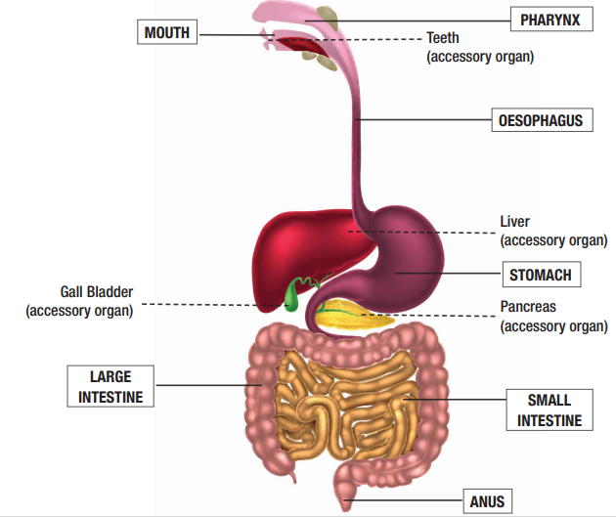
The digestive system
Digestive system consists of digestive tract and accessory organs.
Processes food into molecules for absorption and use by body.
Food is broken down until small enough for absorption, then excreted as waste.
Digestive tract, or gastrointestinal (GI) tract, is long continuous tube from mouth to anus.
GI tract includes mouth, pharynx, esophagus, stomach, small intestine, large intestine, and anus.
Tongue and teeth are accessory structures aiding food ingestion.
Salivary glands, liver, gallbladder, and pancreas are major accessory organs secreting fluids for digestion.
Accessory organs assist in normal functioning of digestive system.
Digestive system functions include digestion, absorption, and elimination.
Watch video The digestive system. Watch video Common Disorders of the Digestive System.
Additional video: 3D Medical Animation - Peristalsis in Large Intestine/Bowel

Slide 55
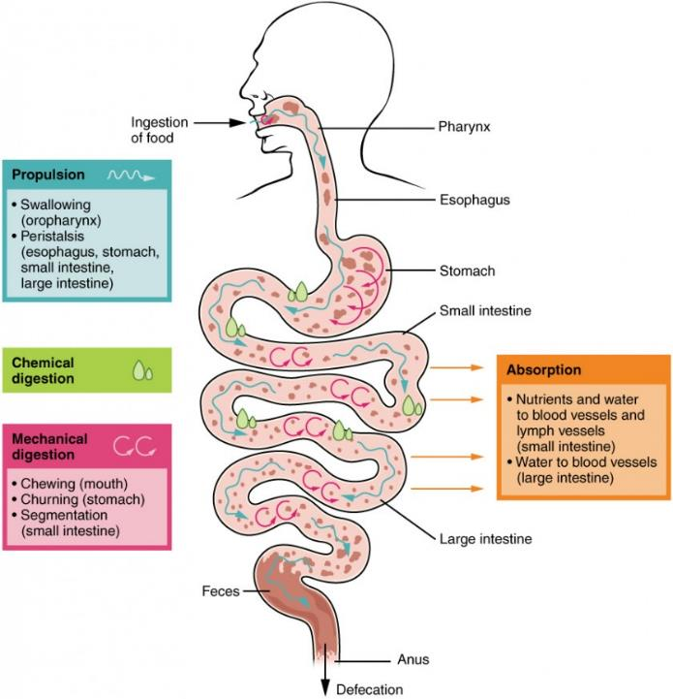
The digestive system
Digestion and absorption occur in digestive tract, providing nutrients for body's metabolism.
Six major processes of digestive system:
Ingestion: Food intake into mouth.
Mechanical digestion: Breaking down large food pieces into smaller ones, starting in mouth and continuing in stomach.
Chemical digestion: Transformation of food molecules into smaller ones by digestive enzymes and water.
Propulsion and digestive movements: Movement of food particles from mouth to pharynx, then to esophagus (swallowing), and mixing movements in stomach through peristalsis.
Absorption: Passage of smaller molecules resulting from digestion through small intestine lining into blood or lymph capillaries.
Elimination: Removal of undigested waste from body through anus as feces (defecation).

Slide 56
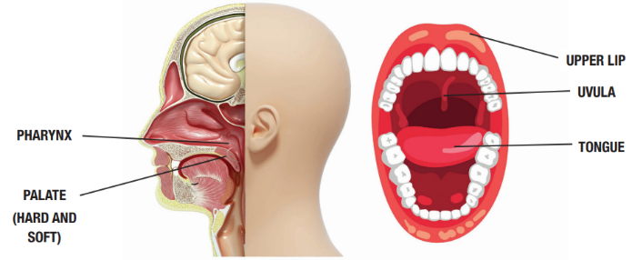
The digestive system Major organs of the GI tract: The mouth
Food enters the digestive tract via the mouth or oral cavity.
Lips and cheeks assist in guiding food into the mouth, keeping it in place for chewing, and aiding in speech formation.
Lips and cheeks possess sensory receptors for assessing food texture and temperature.
Palate, dividing the oral and nasal cavities, consists of the hard palate anteriorly, supported by bone, and the soft palate posteriorly, made of skeletal muscle and connective tissue.
Soft palate terminates in the uvula, which moves upward during swallowing to guide food away from the nasal cavity into the pharynx.
Tongue, a muscular organ, manipulates food and is involved in speech, covered with papillae containing taste buds for detecting flavors.

Slide 57
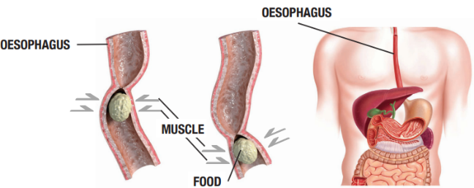
The digestive system Major organs of the GI tract: The pharynx and oesophagus
The pharynx, located behind the nasal cavity and above the oesophagus, functions to propel food into the oesophagus as part of the digestive system.
Peristalsis, a series of smooth muscle contractions, facilitates the movement of food through various digestive organs.
Sensory receptors in the pharynx initiate an automatic swallowing reflex when food is received from the tongue.
The oesophagus extends from the lower part of the pharynx through the diaphragm into the stomach, serving as a passage for food.
About 25cm long, the esophagus is lined with mucosa tissue secreting mucus to moisten and lubricate its lining for easy food passage.
An oesophageal sphincter regulates the movement of food into and out of the oesophagus.

Slide 58
The digestive system Major organs of the GI tract: The stomach
The stomach, situated on the left side of the abdominal cavity, is a c-shaped structure located posterior to the liver.
Comprising four regions: the cardiac region, the fundus, the body, and the pyloric region.
Functions as a temporary storage tank for food and performs mechanical and chemical digestion.
Smooth muscles within the stomach contract to churn and mix food, aiding in physical breakdown.
Secretes gastric juice to further break down food into chyme, a thick liquid.
Chyme passes into the small intestines through the pyloric sphincter.
The pyloric region of the stomach is where the majority of digestive activity occurs.

Slide 59
The digestive system Major organs of the GI tract: Gastric juice
The stomach's mucosal lining contains gastric glands opening to the surface through gastric pits.
Gastric glands consist of four types of cells:
Chief cells: Produce protein-digesting enzymes.
Parietal cells: Produce corrosive acids activating gastric enzymes.
Mucous cells: Generate an alkaline mucous layer protecting stomach walls from acid and enzymes.
Endocrine cells: Secrete the hormone gastrin.
Secretions from these cells form gastric juice, excluding endocrine cell products.
Gastrin, a hormone produced by endocrine cells, regulates gastric activity.
Regulation of gastric juice secretion involves the nervous and endocrine systems.
Sensory stimuli like sight, smell, and taste of food increase gastric juice secretion via the nervous system.
Presence of food and rising stomach acidity stimulate cells to release gastrin.
On average, the human body produces 2 to 3 liters of gastric juice daily.

Slide 60
The digestive system Major organs of the GI tract: The small and large intestine
The small intestine is the primary digestive organ, approximately six meters long, extending from the pyloric sphincter to the large intestine.
It's suspended in the abdominal cavity and divided into three sections: duodenum, jejunum, and ileum.
Jejunum: Coiled tube in the umbilical region, thicker and more vascular than the ileum.
Villi and microvilli on its surface enhance nutrient absorption.
Nutrients like sugars, vitamins, and amino acids enter the bloodstream, while fats pass into lymph capillaries.
Duodenum: First section, located at the end of the stomach.
Receives chyme from the stomach, mixed with bile and digestive juices from accessory organs.
Nutrient absorption begins here.
Ileum: Last section, mostly in the pelvic region, thinner than the jejunum with fewer blood vessels.
Final absorption of nutrients, including vitamin B12 crucial for nerve function.
Unabsorbed food proceeds to the large intestine.

Slide 61
The digestive system Major organs of the GI tract: Large intestine and anus
The large intestine is wider than the small intestine but shorter. Lacks villi or microvilli since most nutrient absorption occurs in the small intestine. Divided into three sections: cecum, colon, and rectum.
Cecum: First section, receives chyme from the small intestine. Acts as a temporary storage for liquid waste.
Responsible for salt and electrolyte absorption.
Colon: Long, coiled organ that removes water from digested food. Remaining material, faeces, moves to the rectum for elimination.
Divided into transverse, ascending, and descending colon.
Rectum: Final stop before faeces is expelled through the anus. Absorbs electrolytes like sodium, potassium, chloride.
Specialized bacteria break down indigestible food.
Faeces thickened through water absorption and mixed with mucus.

Slide 62
The digestive system Major organs of the GI tract: How the three work together
Indigestible waste moves into the cecum.
Cecum passes waste to the colon for absorption of fluids and salts.
Undigested waste travels up the ascending colon, across the transverse colon, down the descending colon, and into the rectum.
Colon absorbs water from undigested food.
Remaining matter forms faeces, consisting of fibre, undigested food, cells, and bacteria.
About 30% of faeces weight comprises bacteria, which are beneficial and reside in the colon.
Faeces stored in the rectum until expelled through the anus as a bowel movement.

Slide 63
The digestive system Accessory organs
Accessory organs play a significant role in aiding digestion.
Accessory organs include teeth, salivary glands, pancreas, liver, and gallbladder.
Teeth masticate food through jaw movements, tearing and grinding it into smaller pieces. Adults have 32 permanent teeth.
Salivary glands secrete saliva, primarily water but also containing mucous, electrolytes, and enzymes to moisten and lubricate food.
The pancreas, a triangular gland in the abdomen, secretes enzymes into the small intestine, breaking down fats, proteins, and carbohydrates.
The liver, the largest gland in the body, produces bile, a solution aiding in fat digestion. Bile consists of salts, bile pigments, cholesterol, and electrolytes.
The gallbladder, situated beneath the liver, stores bile.

Slide 64
The digestive system Gut transit time (GTT)
GTT (Gut Transit Time) is the duration between food ingestion and elimination.
Food typically takes 4 to 11 hours to pass into the large intestine, with an average of 6 to 8 hours.
Food can spend up to 70 hours in the large intestine before excretion, with an average of 40 hours.
Timing varies based on metabolism and food type.
Healthy GTT ranges from 12 to 48 hours.
Faster transit may result in inadequate nutrient absorption.
Slower transit may lead to water absorption, causing constipation.

Slide 65
9. GI activities - what and where
As previously discussed in the Chapter the functions and activities of the GI tract include mechanical digestion, chewing and absorption. On the diagram below label all of the organs of the digestive tract and identify what type of activity this organ carries out. An example has
been given for you as a guide.

Slide 66
The digestive system Disorders of the digestive system
The digestive system breaks down food for cellular nourishment and energy, spanning from mouth to anus.
Common digestive disorders include:
Diarrhoea: Frequent passing of loose, watery stools with or without abdominal discomfort.
Constipation: Difficulty emptying bowels, with hard, dry stools and discomfort during bowel movements.
Irritable bowel syndrome (IBS): Affects the large intestine, causing abdominal pain, diarrhoea, constipation, and bloating, with various causes like stress and inflammation.
Gastroesophageal reflux (acid reflux): Liquid from the stomach regurgitates into the oesophagus, causing heartburn; GERD is a more severe and persistent form due to a weak lower oesophageal sphincter.

Slide 67
The digestive system Systems in sync - the digestive system
NERVOUS SYSTEM:
The digestive system provides nutrients for healthy neural function.
The nervous system controls the secretion of enzymes and hormones into the digestive system.
ENDOCRINE SYSTEM:
The digestive system provides nutrients to keep endocrine organs healthy.
The endocrine system produces hormones that help regulate digestion.
RESPIRATORY SYSTEM
The digestive system provides nutrients for energy metabolism, growth and repair of respiratory organs.
The respiratory system provides oxygen and carries away carbon dioxide produced by digestive organs.
LYMPHATIC SYSTEM:
The digestive system provides nutrients to keep the lymph nodes functioning efficiently.
The lymphatic system produces specialised immune cells that protect the organs of the GI tract against infection.
CARDIOVASCULAR SYSTEM
The digestive system provides nutrients to the heart and blood vessels. It also absorbs iron and water that is necessary for normal blood volume.
The CV system transports nutrients absorbed by the GI tract to all the tissues of the body. It also distributes hormones of the digestive system.
The diagram below illustrates the interrelationship between the digestive system and the other body
systems.
DIGESTIVE SYSTEM
REPRODUCTIVE SYSTEM:
The digestive system provides vital nutrients needed for growth and repair. Extra nutrition is also needed to support fetal (unborn baby) growth.
INTEGUMENTARY (SKIN) SYSTEM:
The digestive system provides nutrients for healthy skin growth and repair. Fats also provide insulation in the layers of the skin.
The skin synthesises vitamin D needed for calcium absorption from the small intestines.
URINARY SYSTEM:
The digestive system provides nutrients to the urinary system to help keep it healthy. It also eliminates enzymes produced by the liver.
Urinary system uses a type of hormones to activate vitamin D that is needed for calcium absorption.
SKELETAL SYSTEM:
The digestive system provides nutrients from food such as calcium for healthy bone growth and repair.
Bones of the skeletal system protect organs of the digestive system and provide sites for nutrient storage.
MUSCULAR SYSTEM
The digestive system provides essential nutrients needed for muscular activity, growth and repair.
Skeletal muscle activity helps to keep the GI tract functioning efficiently.

Slide 68
Learning Checkpoint 7
1. Describe the major functions of the digestive system.
To process food into molecules to be absorbed and used by the body.
2. Identify all accessory organs of the digestive system and briefly explain their function.
• The teeth: The teeth help to tear and break down smaller pieces of food.
• The salivary glands: The salivary glands secrete saliva, which contains mucous,
electrolytes and enzymes that moisten and lubricate food during ingestion.
• The Pancreas: The pancreas releases insulin, which is important for the transportation of
glucose. The liver produces bile, which helps break down fats we eat
3. Describe the function of the oesophagus in digestion.
The oesophagus runs from the inferior section of the pharynx through the diaphragm and into the
stomach. It is about 25cm long and is an essential passageway that directs food into the stomach.
The oesophagus is lined with mucosa tissue that secretes mucus to keep the lining moist and well
lubricated to ease the passage of food.

Slide 69
Learning Checkpoint 7
4. Identify the four regions of the stomach.
The cardiac region, the fundus, the body and the Plyloric region.
5. Outline the type(s) of digestion that occurs in the stomach
Mechanical and chemical digestion.
6. Explain the function of the large intestine.
Solid waste products and liquids are passed into the large intestine; the large intestine is also the
site where absorption of salts and electrolytes into the body occurs
7. Identify the three sections of the large intestine.
The cecum, the colon and the rectum.

