Slide 1
Communicate and work in health or community service
Learning Check Point 1
Learning Check Point 2
Learning Check Point 3
Learning Check Point 4
Learning Check Point 5
Learning Check Point 6
For this unit, you will be assessed on the following:
Assessment 1: Knowledge Theory Assessment
Assessment 2: Practical Observations

Slide 2
CONTENTS
Communicate Effectively
Collaborate With Colleagues
Address Constraints to Communication
Report Problems to Supervisor
Complete Workplace Correspondence and Documentation
Contributing to Continuous Improvement
Activity 1
Activity 2
Activity 3
Activity 4
Activity 5
Activity 6
Activity 7
Activity 8
Activity 9
Activity 10
Activity 11

Slide 3
Communicate Effectively
(2) Transmission Model of Communication: Shannon and Weaver - YouTube
Effective communication: consciously plan and structure the most effective way to share our message.
It can lead to better productivity and improved relationships in all aspects of our lives.
Effective Communication in Healthcare Organizations (youtube.com)
Notes:
2nd video better

Slide 4
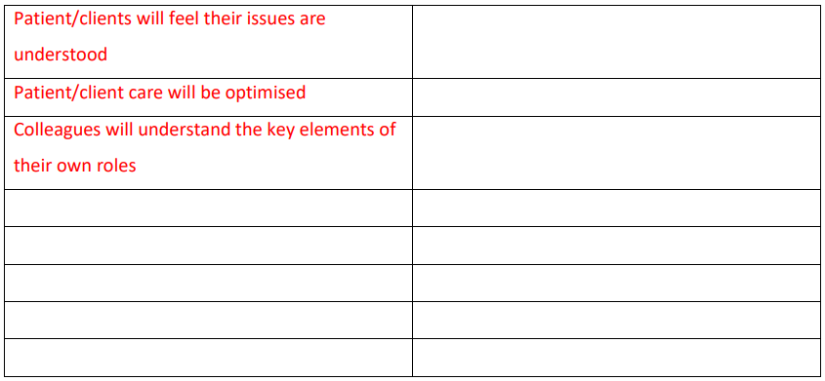
1. Small Group Brainstorming Activity - Effective Communication
For this activity, you should break into groups of 4-5. You are to do a brainstorming session that looks at the benefits of effective communication, and the risks when communication is not effective.
Write a list of as many benefits as you can.

Slide 5
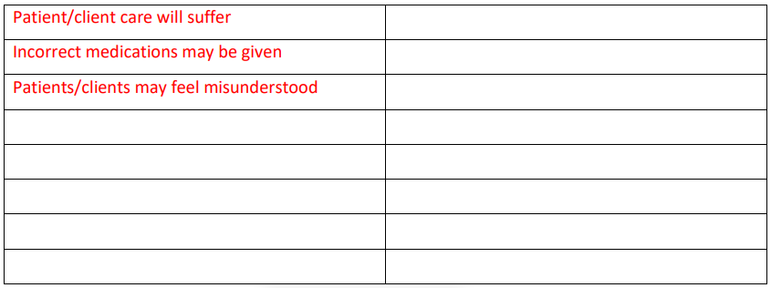
1. Small Group Brainstorming Activity - Effective Communication
For this activity, you should break into groups of 4-5. You are to do a brainstorming session that looks at the benefits of effective communication, and the risks when communication is not effective.
What are the risks of not communicating effectively?

Slide 6
Communicate Effectively
Benefits of Effective Communication
Building trust
Preventing or resolving problems
Providing clarity and direction
Creating better relationships
Increasing engagement
Improving productivity
Promoting team building

Slide 7
Communicate Effectively
Verbal Communication
Listening
» Pay attention: Look directly at the speaker; concentrate on what they are saying, don’t silently prepare for what you will say next; avoid being distracted by side conversations or environmental factors.
» Show that you are listening: Smile and nod occasionally; use positive body language and posture.
» Provide feedback and respond appropriately: Ask questions to clarify information; use open
questions to gain additional information; be honest in your answers/feedback
Speaking
When speaking with co-workers and clients, you should consider your speech, including your tone, the speed at which you speak, and the words you use. When working in a community service setting, it is important to make your voice and tone engaging, positive and upbeat.
How To Communicate Better With Coworkers | Indeed.com
(2) Communication Skills at Work: 4 Key Tips | Indeed Career Tips - YouTube

Slide 8
Communicate Effectively
Communication Techniques
» The use of open-ended questions
» Affirmations
» Reflections
» Summaries
» Motivational interviewing
» Coercive approach
» Collaboration
» Confrontation
» Non-verbal communication
» Body language
» Active listening
Skillbuilder: Body Language in the Workplace (youtube.com)
Questioning
Questioning Techniques (youtube.com)

Slide 9
Communicate Effectively
Listen Better: 5 Essential Phrases for Active/Reflective Listening (youtube.com)
Communication Techniques
Affirmations: statements or gestures that recognise a co-worker or client’s strengths and acknowledge behaviours that they exhibit that are positive.
Reflective Listening: » Repeating or rephrasing » Paraphrasing » Reflection of feeling
Summaries: Provide an opportunity in a conversation as a transition point – to conclude one component or a topic and change to another component or topic.
Motivational Interviewing: Purposefully create a conversation around change without attempting to make the person change or instructing them about how to make any change.
Coercive Approach: A more calculated and forceful approach that demands that the person do something. It can be less effective because the motivation to complete the request is external.
Collaboration versus Confrontation: Collaboration implies a ‘win-win’ scenario as an effective means of restoring peace, with both parties feeling that they have ‘won’; Confrontation involves a more forceful approach where one party declares that the other must do something or face the consequences. This may cause distrust, resentment, and anger amongst the other party, especially if they feel that a confrontational approach is unfair.

Slide 10
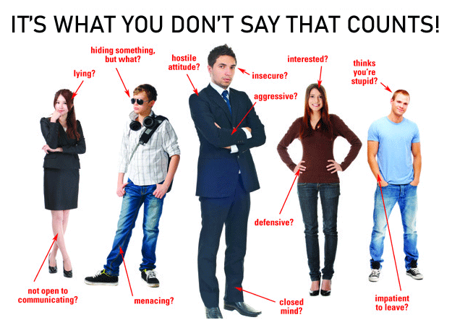
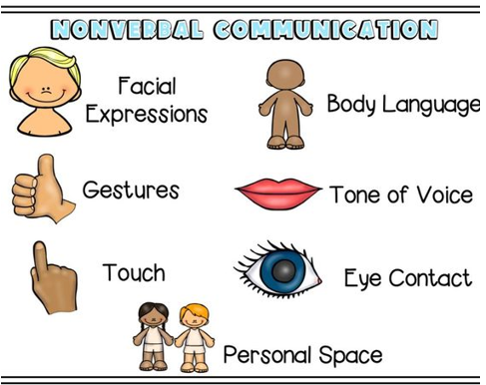
Communicate Effectively
Non-Verbal Communication

Slide 11
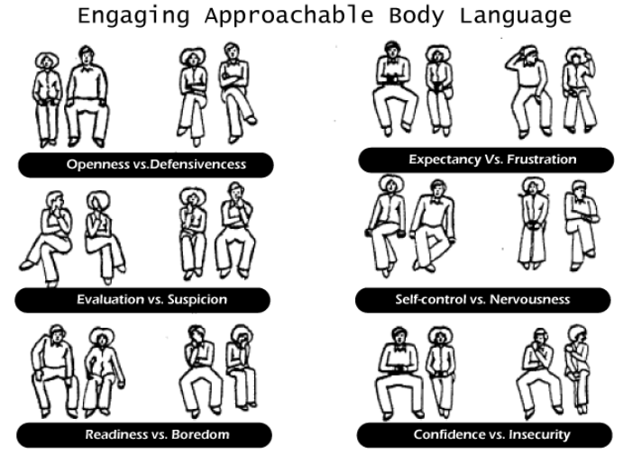
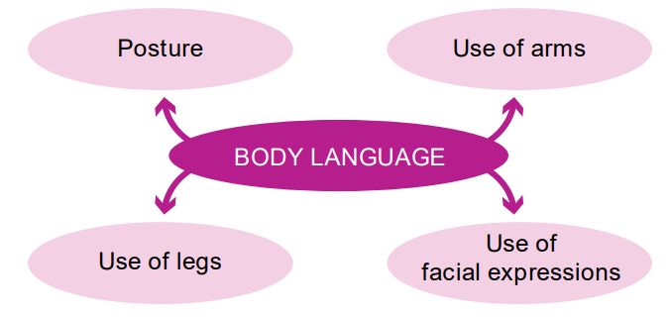
Communicate Effectively
Non-Verbal Communication
How to read body language

Slide 12
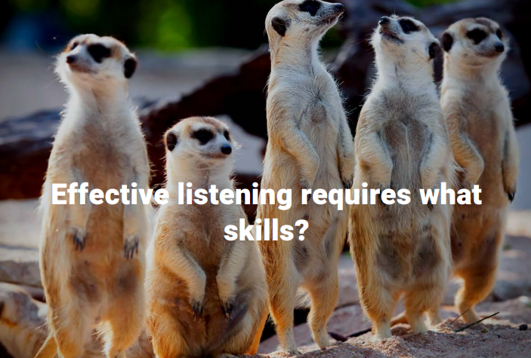
Communicate Effectively
Effective listening
Verbal
Non-Verbal
Positive reinforcement
Overuse of words and phrases
Remembering
Questioning
Reflection
Clarification
Summarisation
Smile
Eye contact
Posture
Mirroring
Distraction

Slide 13
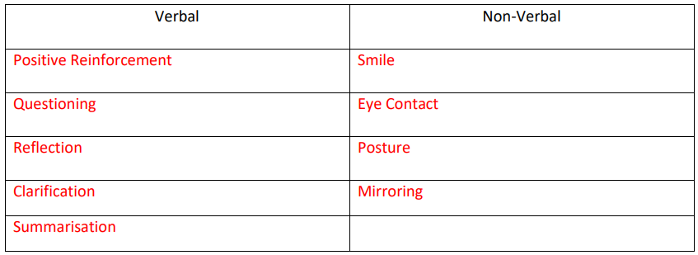
2. Knowledge Application - Active Listening
As a class, watch the YouTube clip at the link below: https://www.youtube.com/watch?v=3_dAkDsBQyk
In this clip, Amy goes from showing a distinct disinterest in what Sheldon is saying to showing signs of being a very active listener.
In the table below, list three (3) verbal signs and three (3) non-verbal signs she displays whilst Sheldon is talking.
Notes:
Team Building Activity: Mine Field | GUIDE, Inc. (guideinc.org)

Slide 14
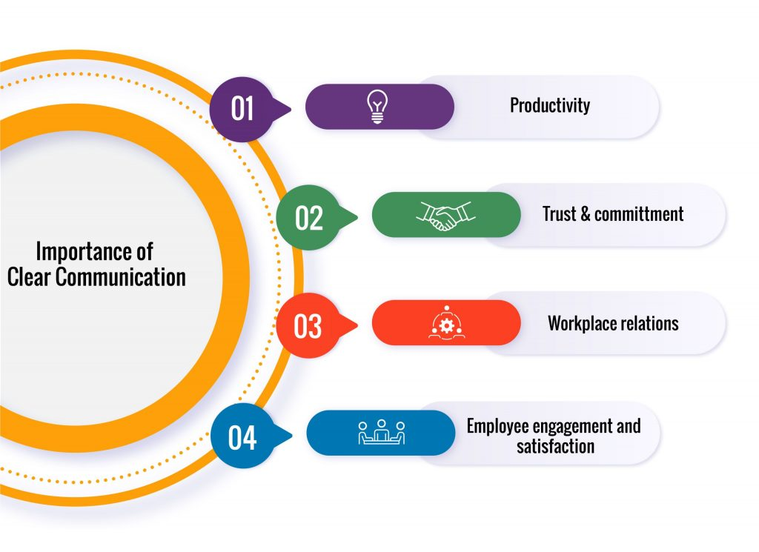
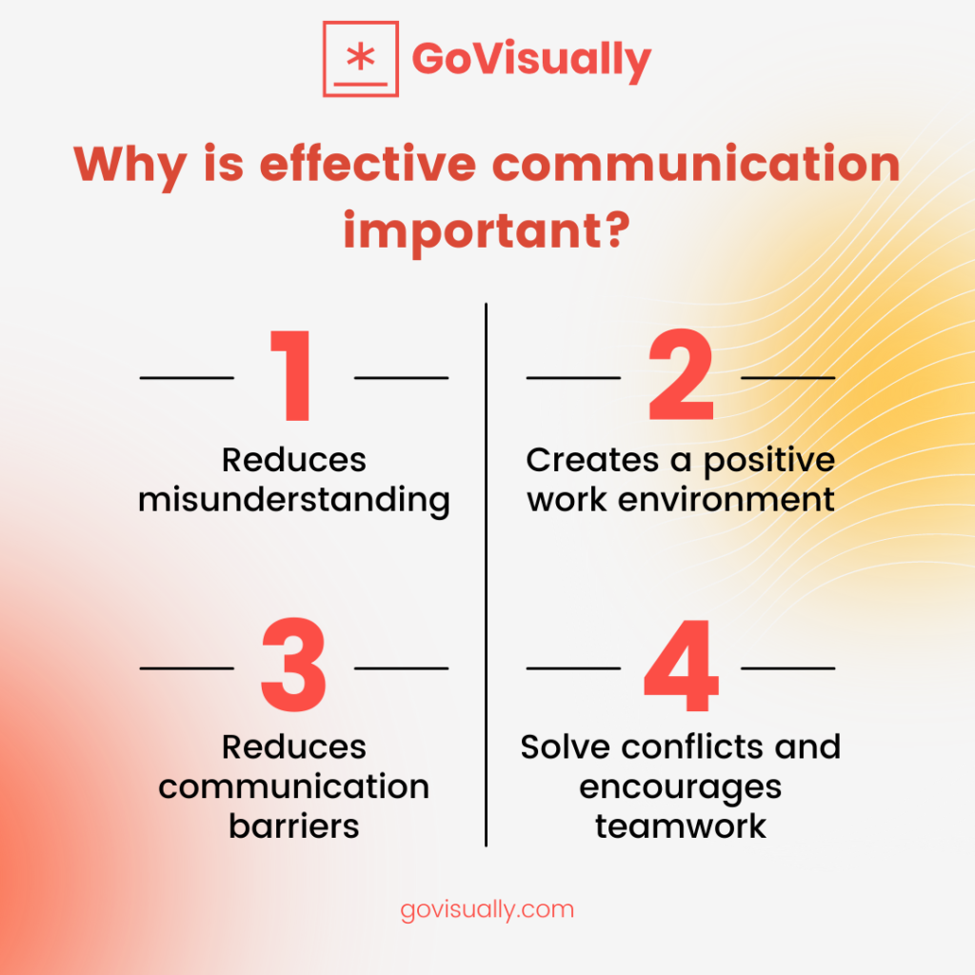
Communicate Effectively
Clear Communication

Slide 15
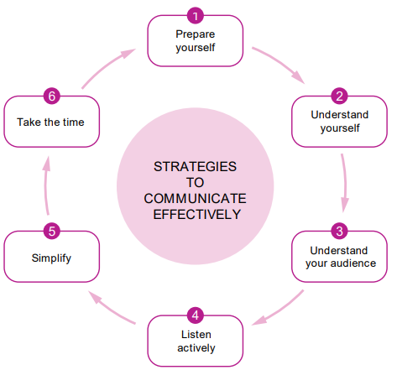
Communicate Effectively
Principles of Effective Communication

Slide 16
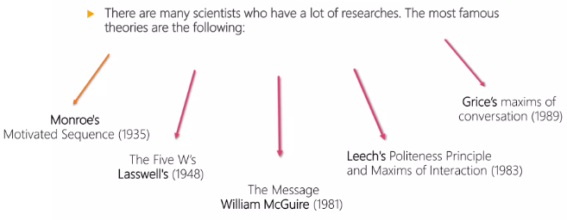
Communicate Effectively
Communication Models
There has been a wide array of research into effective communication, and these include several formal models that include:
» Lasswell’s – The Five W’s
» William McGuire - Model of Persuasion
» Monroe’s – Motivation sequence

Slide 17
Communicate Effectively
Communication Models
» Lasswell’s – The Five W’s
Who should be told?
When should they be told?
What should they be told?
Where should the message be conveyed?
Who should control the communications process?

Slide 18
Communicate Effectively
Communication Models
Exposure/Presentation: This is where you introduce your topic.
Attention/Awareness: This is where you gain their attention – hook them into your narrative.
Comprehension/Understanding: This is where you clarify their comprehension and understanding.
Acceptance: This is where you get them to accept this transition.
Retention: They register and retain the message and can repeat it.
Action: They act upon the change in the message.

Slide 19
Communicate Effectively
Communication Models
» Monroe’s – Motivation sequence
ATTENTION
Hook audience into your story
NEED
Offer a clear concise statement of need
ILLUSTRATION
Discuss or give the scope and nature
RAMIFICATION
SATISFACTION
VISUALISATION
ACTION
Monroe's Motivated Sequence - YouTube
Use supporting materials and state, to address
the issue
Offer a solution to the problem: Initial, detailed, final summary
visualise a future where the problem solved
what
steps are involved?

Slide 20
Communicate Effectively
Advantages
Disadvantages
Models of Communication
One to one
Cascade
One to one endorsement
within a group
Round table management-led consensus
Round table consensus
for a group decision
More time & voice their own opinions
Dominate, manipulate,
time consuming
Reach more staff, middle management more involved
Message diluted, incorrect, or forgotten
Rationale remains intact, easier to achieve commitment
Respond within a private capacity but isolated from other opinions
Everyone hears the same message, opinions, open communication channel
Less likely to defend their own corner, difficulty in getting together
Everyone hears the same message, opinions, open communication channel
No leader to keep the conversation focused. Lead to no outcomes.

Slide 21
3. Class Game - Listen and Draw
Poor listening leads to assumptions and misunderstandings. These lead to errors, ineffective decisions, and/or mistakes that can be costly in a health and community services environment.
This game is easy to play but not so easy to win. It requires your full attention and the engagement of active listening.
Your trainer will hand out a piece of paper and a pen to each student. They will then give you verbal instructions on drawing an object, one step at a time.
Make sure you listen closely to the instructions and follow these precisely.
At the end, your trainer will show you what the object should look like. If they have communicated effectively, and you have listened effectively, you should both have drawings that look the same.
Notes:
Gather your group of students together and hand out a piece of paper and a pen or pencil to each one. Tell them you will give them verbal instructions on drawing an object, one step at a time. For example, you might give them instructions like: • Draw a square, measuring 5 inches on each side. • Draw a circle within the square, such that it fits exactly in the middle of the square. • Intersect 2 lines through the circle, dividing the circle into 4 equal parts. As the exercise continues, it will get progressively harder; one misstep could mean that every following instruction is misinterpreted or misapplied. Students will need to listen carefully to ensure their drawing comes out accurately. Once the instructions have all been read, compare drawings and decide who won. Then use the following reflection: Imagine you have had a very busy day answering phone calls, and you forget to document a client's symptom of experiencing pain in their left hip. What might the consequences of this be for the client? https://www.youtube.com/watch?v=HcjOVJTSmdI

Slide 22
Communicate Effectively
Privacy Versus Confidentiality (youtube.com)
Legal and Ethical Considerations in Relation to Communication
Privacy, Confidentiality and Disclosure
Information that might be considered confidential might include:
» Assessments or reports
» Bank details
» Criminal record
» Current contact details of next of kin, family,
guardian etc.
» Ethnic or racial origin
» Guardianship order
» Health or lifestyle
» Incoming or outgoing personal correspondence
» Individual personal plans
» Medical history or records
» Name, date of birth, age, sex, and current
address
» Personal care issues
» Philosophical beliefs
» Political opinions
» Religious beliefs
» Service records and file progress notes
» Sexual preference

Slide 23
Communicate Effectively
Legal and Ethical Considerations in Relation to Communication
Duty of Care
The following checklist can help determine duty of care:
» Assess the likelihood and extent of the foreseeable harm.
» Assess the likelihood and extent of the foreseeable benefit.
» Look for ways to minimise the risk of harm without sacrificing the benefits of the activity.
» Balance foreseeable harm against the benefit.
Work Role Boundaries
The parameters of your job role will be defined by your job description, your qualifications, and your level of experience.
Not Friends, Not Family - By Dave Hingsburger (youtube.com)
Professional Boundaries – Ideas That Work

Slide 24
Communicate Effectively
Legal and Ethical Considerations in Relation to Communication
Child Protection
Mandatory reporting is required when:
» You need to protect children and others identified to be at risk
» Issues are defined by jurisdictional legislation and / or regulatory requirements
» Issues are specifically identified by organisational policies
Discrimination
Anti-discrimination is enforced through four main types of legislation:
» Age Discrimination Act
» Disability Discrimination Act
» Racial Discrimination Act
» Sex Discrimination Act

Slide 25
Communicate Effectively
Ethical Decision Making and Conflicts of Interest
Australian Community Workers Association has eight guidelines:
As a community worker, you have responsibilities to your:
» Ethical practice
» Provision of service and supports
» Confidentiality in the workplace
» The regulatory framework
» Diversity
» The workplace
» Professional development
» Professional standing
» Clients
» Employer
» Colleagues
» Profession

Slide 26
Learning checkpoint 1
1. Name one (1) verbal and one (1) non-verbal way you can demonstrate that you're listing to a
client.
• Verbal: You can use verbal nods or phrases like "I see" or "I understand".
• Non-verbal: You can maintain eye contact, or you can nod your head.
2. What are two (2) things you can do to ensure that information provided to a client is clear
and easily understood?
• Speak clearly and at a pace that is appropriate for them
• Use language they will understand
3. What are two (2) ways to make sure a client has understood the information you have given
them?
• You can confirm their understanding by asking them a couple of quick questions at the end of your explanation, such as "have I made everything clear?" or "do you have any questions?"
• You can ask them specific questions like "so, what date is your next appointment"?

Slide 27
Learning checkpoint 1
4. When might you paraphrase information?
You might paraphrase information when you want to check that you have understood something a client has said.
5. Name two (2) examples of how you can maintain a client's trust.
• A clients' medical details are not discussed without their consent.
• Adult clients have the right to keep information about themselves confidential.
• Individual files are safely secured or locked away
• Information regarding a client is not shared with people who don't need to know
• Support workers don't reveal details of a client's file unless they have authorisation
from the client

Slide 28
Collaborate With Colleagues
Organisation Structure and Different Models to Support Optimum Client Service
⮑ Person-Centred Delivery: Focusing on the client as a person and what they can do, not on their condition or disability.
⮑ Human Rights-Based Approach
Participation
Accountability
Non-discrimination
and equality
Empowerment
Legality

Slide 29
Collaborate With Colleagues
Health and Community Service Structure
General Practitioners (GPs) and emergency departments (EDs) often act as the main gateway through to other supporting health services, including diagnostic tests, hospital admission, specialist consultations, hospital admission, or inpatient care.
There will be many links and interrelationships between different parts of the health and community service system.
Multidisciplinary Team Care
A multidisciplinary team involves a range of health professionals, either from one or more organisations, to deliver comprehensive patient care. This might include:
» General practitioners
» Practice nurses
» Community health nurses
» Allied health professionals
» Health educators

Slide 30
Collaborate With Colleagues
Health and Community Service Structure
General Practice and Primary Healthcare
Primary health care is usually the first point of call for most people. It is delivered in various settings, including general practices, community health centres or at home, and provided by doctors, community nurses, dentists, pharmacists and other allied health professionals.
Allied Health: They can help manage a client’s physical or mental health through services that may include diagnosis, treatment or rehabilitation. They include:
» Aboriginal and Torres Strait Islander health practitioner
» Accredited exercise physiologists
» Chinese medicine practitioners
» Chiropractors
» Medical radiation practitioners
» Occupational therapists
» Optometrists
» Osteopaths
» Pharmacists
» Physiotherapists
» Podiatrists
» Psychologists
» Social workers
» Speech pathology

Slide 31
Collaborate With Colleagues
Health and Community Service Structure
Community Health Services
These provide community health services funded by the state. They work alongside general practice, privately funded services as well as other health and support services. They primarily deliver:
» Allied health services
» Child health services
» Chronic disease management (including support for self-management)
» Dental health services
» Disability services
» Drug and alcohol services
» Family planning
» Health promotion
» Home and community care services
» Medical services
» Mental health services
» Post-acute care services
» Refugee health

Slide 32
Collaborate With Colleagues
Health and Community Service Structure
Emergency Departments (EDs): They are primarily managed and operated within public hospitals throughout Australia. ED’s are designed to deal with acute or life-threatening medical emergencies.
Specialist Services: There are a variety of different specialisations within the area of medicine. These can include:
» Anaesthesia
» Dermatology
» Obstetrics and gynaecology
» Occupational and environmental medicine
» Ophthalmology
» Paediatrics and child health
» Palliative medicine
» Pathology
» Physician
» Psychiatry
» Radiology
» Rehabilitation
» Sport and exercise medicine
» Surgery

Slide 33
4. Brainstorm - Allied Health Professionals
In this activity, we are going to explore the range of different health and allied health professionals.
1. You should form small groups; ideally between 3 and 4.
2. Each group will need a notebook and a pen.
3. At the start of each round, your assessor will choose a letter.
4. They will then set a timer. As they are about to start this, they will give the class the letter they have chosen, then say go as they start the 1-minute timer.
5. During the 1-minute period, a scribe for each team should write down the name of as many health and allied health professionals that the group can name, beginning with the letter that the assessor has announced at the start of the round.
6. At the end of the 1-minute, scribes are to stop writing immediately.
7. Each group is to take turns reading out their answers, and the assessor will write these down in a place that is visible for all the class to see.
8. Groups receive one point for each answer that is unique.
9. At the end of each round, the assessor should write all groups scores on the board, creating a healthy level of competition.
10. They may choose to run as many rounds as there is time for. At the end of the nominated rounds, the group with the highest points will be declared the winners.
By the end of the game, you should have a much better understanding of the scope of health professionals.

Slide 34
4. Brainstorm - Allied Health Professionals
A
Acupuncturist
Addiction psychiatrist
Allergist
Ambulance officer
Anaesthesiologist
Anatomical Pathologist
Andrologist
Audiologist
C
Cardiac Electrophysiologist
Cardiothoracic surgeon
Cardiologists
Chemical Pathologist
Chemist
Chinese Herbalist
Chiropractor
Clinical Pharmacologist
Complementary Health Therapist
Counsellors
D
Dental Hygienist
Dentist
Dermatologist
Developmental Paediatrician
Diagnostic Radiologist
Diagnostician
Dietitians
Division Therapist
Doctor
E/F
Emergency Doctor
Emergency Medicine Specialist
Emergency services worker
Endocrinologist
ENT Specialist
(Ear, nose and throat)
Epidemiologist
Exercise physiologist
Forensic pathologist
G/H/I
Gastroenterologist
General Practitioner
Genetic Counsellors
Gynaecologist
Haematologist
Hepatologist
Herbal Medicine
Hyperbaric Physician
Immunologist
Infectious Disease Specialist
Intensivist
Internist
Interventional Cardiologist
M
Massage Therapist
Maxillofacial Surgeon
Medical examiner
Medical imaging technicians
Medical laboratory professionals
Medical technician
Microbiologist
Midwife
Music Therapist
Myotherapist

Slide 35
4. Brainstorm - Allied Health Professionals
N
Naturopath
Neonatologist
Nephrologist
Neurologist
Neurosurgeon
Nuclear Medicine Specialist
Nurse
Nutritionist
O
Obstetrician
Occupational Therapist
Oncologist
Optometrist
Oral Surgeon
Orthodontist
Orthopaedic Surgeon
Ophthalmologist
Osteopath
Otolaryngologist
P
Paediatrician
Pain Management Specialist
Palliative Care Specialist
Paramedic
Parasitologist
Pathologist
Perinatologist
Periodontist
Pharmacists
Phlebotomists
Physical Therapist
Physician
Physiotherapist
Plastic Surgeon
Podiatrist
Prosthetist
Psychiatrist
Psychologist
Pulmonologist
R
Radiation Oncologist
Radiographer
Radiologist
Registered nurse
Reproductive Endocrinologist
Respiratory Therapist
Rheumatologist
S
Social worker
Sonographers
Speech Pathologist
Spinal Cord Injury Specialist
Sports Medicine Specialist
Sleep Disorder Specialist
Surgeon
T/U/V
Therapist
Thoracic Surgeon
Urologist
Vascular Surgeon

Slide 36
Collaborate With Colleagues
Working in Collaboration With Other Professionals
In the health and community services industries, you may work collaboratively with other professionals to provide quality care for clients and patients. For example, a theatre technician would need to work collaboratively with surgeons, nurses, anaesthesiologists, orderlies, and other specialised staff.
Funding
Funding for health and community services is provided by a variety of sources. These include:
» All levels of government
» Non-government organisations
» Private health insurers
Health Funding Facts | Australian Government Department of Health and Aged Care

Slide 37
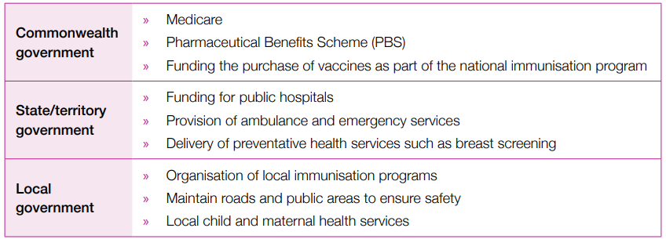
Collaborate With Colleagues
Funding
Australian Public System
Australia adopts a universal health care system through Medicare and the Pharmaceutical Benefits Scheme (PBS). The public health sector is funded by all levels of the Australian government (Commonwealth); they provide almost 70% of all health care funding, with the additional 30% being contributed by both state/territory and local governments.

Slide 38
Collaborate With Colleagues
Funding
Australian Public System
Medicare ensures that all Australians have access to health professionals, services and hospitals free of charge, or in some cases, at a heavily subsidised rate.
Medicare is funded by the government and through contributions from taxpayers via the 2% Medicare Levy.
The Pharmaceutical Benefits Scheme (PBS) ensures that all Australians have access to ‘life-saving and disease-preventing medicines free of charge or at a subsidised cost.
Approximately 139 medications are covered under the PBS. They are accessible to anyone who has been prescribed them and holds a Medicare card.

Slide 39
Collaborate With Colleagues
Funding
Private Health System
Access benefits such as their choice of doctor, their choice of hospital, and the timing for procedures. It can also assist with subsidising the cost of healthcare services that are not covered by Medicare, such as dental, optical, physiotherapy and podiatry services.
The government has three main incentives including:
1. A rebate (i.e., discount): Private health insurance policy holders may be eligible for a rebate depending on an individual or family’s income and age. This eligibility is means-tested.
2. Medicare Levy Surcharge (MLS): Higher-income earners (over $90,000 for singles and $180,000 for families) who do not have an appropriate level of private health insurance may be required to pay an additional surcharge.
3. Lifetime Health Cover: A person to purchase private health insurance (by the 1st of July following their 31st birthday and maintain it for life. This benefits them by paying the lowest premium for life. Those who take out private health insurance after is required to pay an additional 2% on their premium for every year after this time. For example, someone who takes out private health insurance at 40 years of age may pay 20% more on their premium.

Slide 40
Collaborate With Colleagues
Funding
NDIS
The National Disability Insurance Scheme (NDIS) is an Australian Government scheme that funds costs associated with disability.
The NDIS scheme entitles people under the age of sixty-five who have a “permanent and significant” disability to full funding for what is considered to be “reasonable and necessary” support needs related to their disability.
The NDIS scheme is fully funded by the public, meaning that recipients do not purchase or contribute to any form of insurance policy. It is important to understand that the scheme is not means-tested.
Australian National Aged Care Classification (AN-ACC) The Aged Care Funding Instrument (ACFI)
An instrument that assists aged care facilities to ascertain how much subsidy they will receive to cover the cost of care of an individual resident.

Slide 41
Collaborate With Colleagues
Lines of Communication Between the Organisation and Other Services
Referrals
Referrals ensure that people only use certain health and community services or seek the advice of professionals when it is required.
Terminology and Language in Health and Community Services
Most medical terminology can be easily found online; however, knowing it by heart has a number of benefits, including:
» Saving time; medical terminology, especially abbreviations and acronyms, can be written down quickly.
» Ensuring all those involved in patient care are communicating using a common language.
» Efficient in your work role. For example, making notes and records quickly and easily.
» Avoid errors that may occur when writing long sentences. The use of acronyms and abbreviations are less likely to create errors.

Slide 42
Collaborate With Colleagues
Lines of Communication Between the Organisation and Other Services
Terminology and Language in Health and Community Services
» Clinical: Body parts, diseases, operations, symptoms, treatments and medicines.
» Laboratory: Diagnostic tools, tests and results. For example: CXR (chest X-ray), ECG (electrocardiograph) and MRI (magnetic resonance imaging)
» Pharmaceutical: Medicines, route of administration, concentration, dosage form, frequency and timing. For example: inj (injection), tds (three times a day), PO (oral) and cap (capsule).
» Billing and Medicare: Item numbers and levels for corresponding procedures as well as terminology associated with the use of Medicare such as MBS (Medicare Benefits Schedule), bulk billing, co-payment, and safety net. For example: A routine appointment in a doctor’s consulting room would use the following item numbers and levels to bill Medicare.

Slide 43
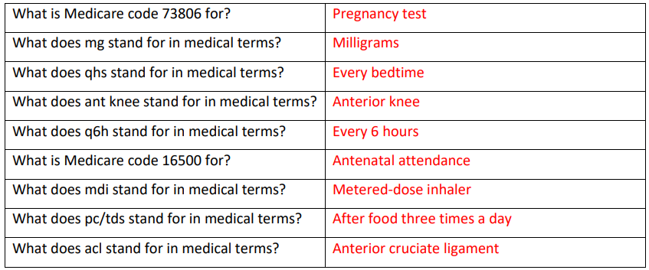
5. Research - Terminology and Abbreviations
It is important that you understand a range of different codes and abbreviations that are used in the healthcare industry. Use the internet to fill in the table below.

Slide 44
Collaborate With Colleagues
Communicating Through Digital Media
Extremely cautious about what information you communicate on social media platforms, ensuring that information doesn’t breach any moral or privacy. This includes any time you are producing or distributing content on any of the following mediums:
» Web
» Email
» Social media
» Podcast and videos
» Tablets and applications
» Newsletters and broadcasts
» Intranet
Factors That Influence Interpersonal Communication - Video & Lesson Transcript | Study.com

Slide 45
Learning checkpoint 2
1. What may suffer if you do not carry out tasks within agreed timeframes?
The level of client care you can provide may suffer.
2. What sort of document might you need to fill out if you have to send a patient or client to another professional within the health or community services sector?
You may need to fill out a referral form.
3. Why is it important to use industry terminology correctly in all verbal, written and digital communications?
To ensure that there is no confusion about what you are communicating, and each person will have the same understanding.
4. Name two (2) ways you could confirm communication protocols that apply within your organisation.
You could refer to your organisation's Policy and Procedure manual, or you could speak to your manager/supervisor.

Slide 46
Address Constraints to Communication
Language
Culture
Disability
Religion
Emotional state
Health
Age
Influences on Communication
Language
» Taking care to speak slowly and clearly
» Use interpreters
» Use translated information
» Avoid the use of slang, sayings or abbreviations
» Ask questions to clarify understanding

Slide 47
Address Constraints to Communication
Language
Culture
Disability
Religion
Emotional state
Health
Age
Influences on Communication
Cultural Differences
Cultural differences such as language can cause communication barriers and misunderstandings. Some cultures have various beliefs and values when it comes to illness and medical treatment.
» The Chinese believe that a person’s behaviour is a reflection of their family. Because of this, clients are unlikely to discuss symptoms or seek assistance for depression, anxiety or other mental health conditions.
» Pacific Islanders such as people from Fiji, Samoa and Tonga place a great significance of their extended family. The oldest male in the family with often be the spokesperson for all members of the family. They will decide the medical treatment and care of others in their family. Their decisions are respected and not questioned.

Slide 48
Address Constraints to Communication
Language
Culture
Disability
Religion
Emotional state
Health
Age
Influences on Communication
Religion
Those with strong religious or spiritual beliefs may have vastly different ideas and opinions about what constitutes appropriate life practices or behaviours. These beliefs, or the discrepancy between the beliefs, can potentially impact how people communicate with each other.

Slide 49
Address Constraints to Communication
Language
Culture
Disability
Religion
Emotional state
Health
Age
Influences on Communication
Emotional State
Respond to distressed people in a relaxed and calming manner, continuing with the active listening and open communication. Identify that someone is distressed by their language or simply through observation. These signs may include:
» Paleness
» Excessive sweating
» Tearful or crying
» Anxiety
» Aggressive and displaying anger
» Talking very quickly and seem confused

Slide 50
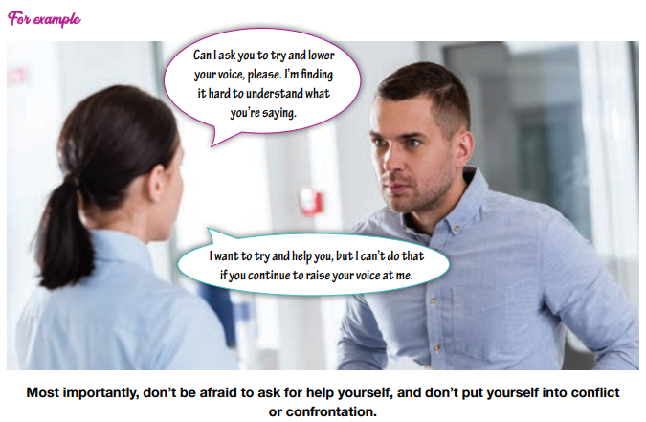
Address Constraints to Communication
Influences on Communication
Emotional State

Slide 51
Address Constraints to Communication
Language
Culture
Disability
Religion
Emotional state
Health
Age
Influences on Communication
Disability
Physical disabilities; hearing problems, or speech difficulties that may affect verbal communication. A lack of sight or total blindness creates a barrier for non-verbal communication.
Health
Unwell clients in either a physical or mental state, be aware that their responses and understanding of questions may be delayed or confused.
How Generations Influence Communication Styles, Habits, and Behaviors - Week 1: What Influences the Way People Communicate? | Coursera

Slide 52
Address Constraints to Communication
Language
Culture
Disability
Religion
Emotional state
Health
Age
Influences on Communication
Age
Conditions that may impair their ability to communicate. These could include a stroke, COPD, dementia as well as hearing impairments. Less apparent symptoms or conditions include:
» Acquired brain injuries
» Anxiety
» Dehydration
» Delirium
» Depression
» Frailty
» Hearing impairments
» Low mood
» Medication effects or side effects
» Mobility impairments
» Pain
» Polypharmacy
» Self-care impairments
» Sleep deprivation
» Under-nutrition
» Vision impairments
The Generational Cheat Sheet - Best Ways To Communicate With Each One - Form Simplicity

Slide 53
6. Role Play - Influences on Communication
You are to form groups of 3-4.
Each group will be given one of the seven Influences on Communication below:
You should then create two (2) roleplays.
In the first roleplay, you should show the correct way to communicate with someone from your sub-group.
In the second, you should show what ineffective communication would look like. Each group member must contribute to the writing of the roleplays whilst acting in at least one (1) of them.
You will perform these in front of the class.
» Language
» Culture
» Religion
» Emotional state
» Disability
» Health
» Age

Slide 54
Address Constraints to Communication
Environment
Inability to listen
Attitude and ego
Poor communication
Lack of planning or organisation
Listening skills for conflict resolution (youtube.com)
(2) Communication Breakdown in Healthcare - YouTube
Potential Constraints to Effective Communication in Health and Community Service Contexts
Environment: Free from distraction, noise and other people not involved in the conversation.
An Inability to Listen: Listen without interrupting until the person speaking to you has finished, and then ask any clarifying questions that you may have. Pay attention, and don’t get distracted.
Attitude and Ego: Employees need to work as a team; there is no room for negative attitudes or egos. An employee’s attitude and actions should always be in the best interest of their client.
Poor Communication: Carefully read over email, written letters, brochures before sending it and check the language, tone, and grammar. When communicating with people verbally, ensure that you are open and clear.
A Lack of Planning and Organisation: Organisations and employees should take the time to plan for what’s ahead. Ensure the effective use of time, that all work tasks are completed and that all clients have their needs met.

Slide 55
Address Constraints to Communication
Identifying Early Signs of Potentially Complex Situations and Report Accordingly
Reading a person’s body language and other non-verbal cues and picking up on verbal cues such as changes in tone and language.
You can take control of the situation by:
» Addressing the issue with the client/patient involved
» Listening to concerns of the client/patient
» Finding common ground with them where possible
» Confronting negative feelings
» Asking them to define what changes would need to occur for them to be happy
» Negotiating a resolution where possible that meets the needs of all parties
Poor Communication (youtube.com)
How Effective Communication Can Save Lives in the Healthcare Settings (youtube.com)

Slide 56
Address Constraints to Communication
Staying Calm in Conflict - Video Tips from Jessica Vangrud at Revela (youtube.com)
Identifying Early Signs of Potentially Complex Situations and Report Accordingly
Conflict Management Strategies
Selecting the right strategy is vital to resolve conflict successfully.
What to do if You Can’t Find a Resolution?
Stay calm. Be mindful of your own gestures and facial expressions and maintain an even tone of voice. Try not to over-react as this can make matters worse.
Conflicts Arising From Misunderstandings
Taking into account diversity to resolve the differences sensitively where appropriate. Some ways you can resolve differences include:
Withdrawal
Smoothing
Forcing
Confrontation
Compromise
How to Present Challenges to Your Boss (youtube.com)
» Not judging people
» Not issuing blame
» Offering support
» Showing empathy

Slide 57
7. Role Play - Conflict Resolution
You are to form groups of 3.
Each group is to identify situations within the health and community services sectors where conflicts or misunderstandings may occur. This could be with peers or work colleagues or with clients and patients.
You should work through the five (5) conflict resolution strategies that we covered, using a suitable scenario for each.
You may create your own situations, or you may use any or all of the below.
Some examples may be:
» A patient/client is not happy. They had an 11.00am appointment; it is now 11.45am, and they have not been seen.
» Two staff members want to take the same annual leave day; however, only one staff member can be rostered off at once.
» A patient/client is angry as they believe they were misinformed about the cost of a service.
» A patient/client turns up for an appointment, but in fact, they are a week early as it is scheduled for the same day next week. They demand to be seen today.
Each role-play should have two (2) students acting in it. The third student should be providing feedback on the effectiveness of the conflict resolution strategy used.

Slide 58
Learning checkpoint 3
1. What are two (2) early signs that may indicate a situation may be about to become complicated?
• Change in tone of voice
• Change in verbal language
• Change in body language
• Reading other non-verbal cues
2. When might you need to report a difficult situation, and how would you do this?
If you are unable to resolve a difficult situation or conflict. You would report this according to the Policies and Procedures in place within your organisation.

Slide 59
Learning checkpoint 3
3. Name three (3) issues that may cause constraints in communicating.
• Environment
• Inability to listen
• Attitude and ego
• Poor communication
• Lack of planning or organisation
4. Name three (3) elements that can influence communication.
• Language
• Culture
• Religion
• Emotional state
• Disability
• Health
• Age
5. How can active listening help to defuse a situation?
Sometimes a patient or client just needs to be heard without being interrupted. This can be the first step to resolving or controlling a situation.

Slide 60
Report Problems to Supervisor
There may be times when you find yourself in a situation where you have been compromised. This may be due to multiple reasons such as:
» the quality of your work or your own safety has been put at risk through the action or inaction of others
» your organisation or department is under-resourced.
Undertake the following ‘assessments’ first to validate your concern has merit.
Discuss with your co-workers: If they are finding similar problems with the workload, then you may be able to discuss it as a group, if they find that there isn’t an issue and it’s more about you not getting through your tasks on time, then it might be worth reassessing your perspective.
Describe the problem in writing prior to raising it: What are the specifics of the complaint or concern? What do you propose might be a way to resolve this?
Accept responsibility: It’s okay to make mistakes, especially if you’re just starting out in a role.

Slide 61
Report Problems to Supervisor
Legal and Ethical Aspects of Health and Community Services Work
Correct information relating to the legal and ethical aspects of working within the health and community services sector:
» From the internet
» Direct from governing bodies
» From industry journals
» From your organisation intra-web
» From your manager/supervisor
Reporting Breach or Non-Adherence to Standard Procedures
You are responsible for reporting any breach or non-adherence to your supervisor. Examples may be stealing property or medication or not providing an adequate level of care or service to clients or patients.

Slide 62
Report Problems to Supervisor
Refer Issues Impacting on Achievement of Rights and Responsibilities
You have a duty of care to your client’s and patient’s which includes supporting them through all facets of the use of the facilities and services your organisation provides.
If a situation has been in breach of duty of care or a client has suffered or been mistreated or under-represented, then you should follow your organisational policies and procedures to initiate a resolution.
Refer Unresolved Conflict Situations to Supervisor
If conflict situations cannot be resolved, they should be escalated or reported to a manager or supervisor.

Slide 63
8. Brainstorm - Reporting Breaches
In groups of 3-4, think about as many things as possible that would be considered breaches or non-adherence to standard procedures within the health and community services sector.
Come back together as a class and compare your lists.
Discuss what you think the repercussions of each of these should be. Did people have opinions that differed significantly?

Slide 64
Learning checkpoint 4
1. Name three (3) places you can gather information relating to legal and ethical responsibilities.
• From the internet
• Direct from governing bodies
• From industry journals
• From your organisation intra-web
• From your manager/supervisor
2. If your supervisor does not take the reporting of a breach seriously, what should you do?
If they don't listen or take the report seriously, you are obliged to report it to a relevant external mediator or supervisory organisation.
3. Whose rights does Duty of Care relate to?
Duty of Care relates to patients’ rights.
4. What is the benefit of referring unresolved conflict situations to your supervisor?
They may have suggestions on how the situation can be resolved or advice on how you could approach a similar situation in future.

Slide 65
Complete Workplace Correspondence and Documentation
Endeavour to take your time to make sure that you have written everything down correctly.
Read and re-read what you’ve written, make sure that all details are correct, check your spelling, and if handwritten, your handwriting is legible.
» Accident reports
» Client notes
» Emails
» Equipment and machine logs
» Hazard reporting
» Newsletters
» Operating procedures
» Report – routine and summary
» Shift reporting
» Written instructions

Slide 66
Complete Workplace Correspondence and Documentation
Documenting Skills
Documentation Skills in Aged Care: care plan, progress notes
The Writing Process: by exception; objective; concise; appropriate in language; include only necessary information
Documenting By Exception: Record only events and instances that may affect the care plan. This includes:
Will it affect the direction of care or the Care Plan?
Does it relate to the status of the client’s health?
Did client refuse care?
Was any care omitted?
Did the client make a complaint?
Did the client do/not do something which will impact on the status of their health and overall well being?

Slide 67
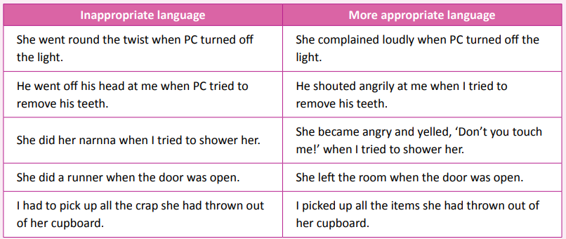
Complete Workplace Correspondence and Documentation
Who
Who is it about?
Where
Where did it happen?
When
When did it happen?
Why did it happen?
What
What happened?
Why
Include this only if there is direct evidence
How
Documenting Skills
Structuring Information
Using Appropriate Language: Notes should not be written using slang, unless recording a client’s exact words. Language should be simple but appropriate.
×

Slide 68
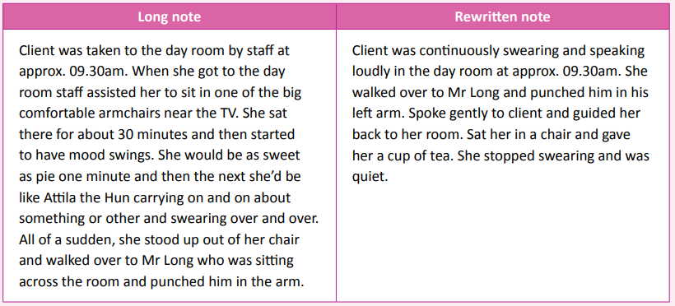
Complete Workplace Correspondence and Documentation
Documenting Skills
Include Only Necessary Information
×

Slide 69
Complete Workplace Correspondence and Documentation
Documenting Skills
Objective Documenting: Only information that is seen, heard, tasted, witnessed or initiated should be included in Progress Notes, in other words, facts.
×

Slide 70
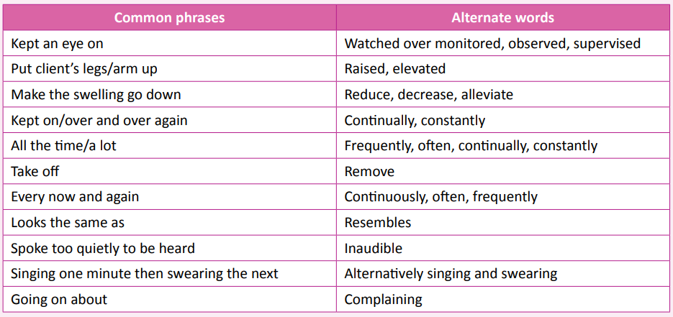
Complete Workplace Correspondence and Documentation
Documenting Skills
Documenting Concisely: the information included; the words used; the structure of both the sentences and information.
×

Slide 71
Complete Workplace Correspondence and Documentation
Documenting Skills
Documenting Concisely: the information included; the words used; the structure of both the sentences and information.
×

Slide 72
Complete Workplace Correspondence and Documentation
Documenting Skills
Structuring Progress Notes: Using the active voice rather than the passive voice will get the message across more directly.
×

Slide 73
9. Knowledge Application - Documenting
The below sentence has been written using common phrases and language.
I was on my shift and had been asked to keep an eye on Mr. Jones as he was acting strangely. He kept on telling me over and over that he was going to see his daughter tomorrow, but she is on holiday overseas, something he is aware of. He was then going on about how bad he thought tonight’s dinner was, but it was almost too quiet to be heard.
Rewrite the same content using alternate phrases as covered in the previous section.

Slide 74
Complete Workplace Correspondence and Documentation
Legal and Organisation Requirements for Documentation
The Health Records Act 2001 (the Act) created a framework to protect the privacy of individuals’ health information. It regulates the collection and handling of health information. The Act:
» gives individuals a legally enforceable right of access to health information about them that is contained in records held in Victoria by the private sector; and
» establishes Health Privacy Principles (HPPs) that will apply to health information collected and handled in Victoria by the Victorian public sector and the private sector.

Slide 75
10. Watch - Health Records Act 2001
As a class, watch the YouTube video at the link below:
https://www.youtube.com/watch?v=VJUoqPdp4zQ

Slide 76
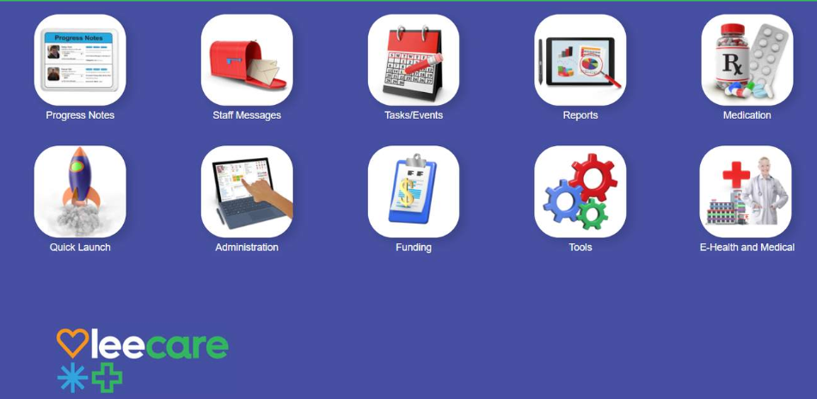
Complete Workplace Correspondence and Documentation
Understanding Documents Relating to Your Role
A wide range of workplace documents that you’ll deal with daily

Slide 77
Complete Workplace Correspondence and Documentation
Complete Workplace Documents to Organisation Standards
Stages of Completing a Form: The same fundamental principles can be applied to any information that’s added to a template, used in an email, or written in a referral.
Select the correct form
Complete the form
Check that all the information on the form is correct
Sign the form if required
Give, or submit the form, to the correct person or address
PDCA Cycle: Plan Do Check Act (What is PDCA and how is it used?) - YouTube

Slide 78
Complete Workplace Correspondence and Documentation
Follow Organisation Communication Policies and Procedures for Using Digital Media
A digital media policy outlines how an organisation and its employees should conduct themselves online and in all digital transactions. It provides guidelines that safeguard an organisations reputation online and serves to educate employees on professionalism and online etiquette.
Use Clear, Accurate and Objective Language When Documenting Events
The convention of ‘objective’ writing is that arguments use impartial language, which is not personal, judgmental, or emotive. Objective language, therefore, is considered fair and accurate. It avoids exaggeration and bias and shows respect for the views of others.

Slide 79
Learning checkpoint 5
1. What can information collected from clients or patients be used for?
It can be used or disclosed for the primary purpose it was collected or for what can be seen as a directly related and reasonable secondary purpose.
2. What should you do if you don't understand a document that relates to your role?
You should seek clarity from a manager or supervisor.
3. When is it most appropriate for an employee to be introduced to the organisation's digital media policy?
During induction.
4. Does objective writing use partial or impartial language?
Impartial

Slide 80
Contributing to Continuous Improvement
Improvement opportunities might include:
» Formal and informal training
» Educational programmes
» Internal coaching
» Personal and professional support
» Online courses
» Online research and reading
Contribute to Identifying and Voicing Improvements in Work Practices
It could involve the development of soft skills or hard skills.
A soft skill might include personality traits such as work ethic, effective communication, or time management.
Hard skills are specific abilities or capabilities that an individual can possess and demonstrate in a measured way. These would relate to your individual role in the health and community services sector.

Slide 81
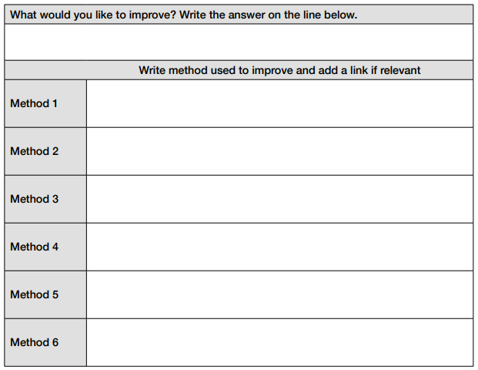
11. Research - Enhance Your Skills
Think about something in your life that you’d like to improve. It might be your photography skills, a
specific dance skill, your ability to juggle – anything you like!
Now, you are to research all the different ways that you might be able to do this. It might be through online tutorials, through face-to-face classes, through reading a textbook. Find as many ways as you can in the time allocated, then fill in the table below.

Slide 82
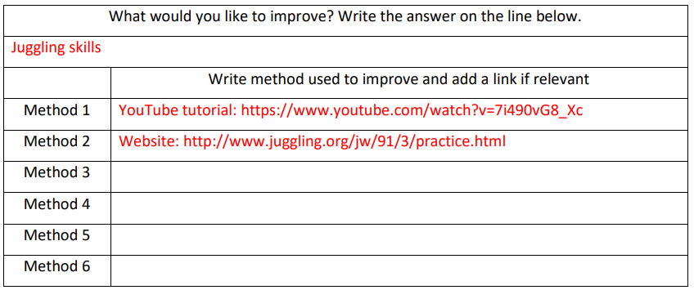
11. Research - Enhance Your Skills

Slide 83
Contributing to Continuous Improvement
Seeking Feedback
One of the simplest ways to identify areas for improvement. The feedback may be for you
personally or for the organisation as a whole.
Consult With Manager Regarding Options For Accessing Skill Development
A good thing to do before embarking on your journey is to consult your manager.
Keep Records: Always maintain a portfolio of professional and personal work you have undertaken to upskill yourself, even if it is unaccredited.

Slide 84
Contributing to Continuous Improvement
Promote and Model Changes to Improved Work Practices and Procedures
You approach your manager and tell them about the number of people who have been asking about the Instagram page. You then tell them about the course that you found that you believe could help build your skill set and help the organisation.
Your manager is impressed that you have done this research and come to them with a solution to a problem, rather than just raising the problem. They ask if you would be happy to take on the Instagram posting as part of your role if you were upskilled, and you say yes.
Your manager agrees to you doing the course and offers to pay for it out of the professional development budget.
Everyone is happy with the outcome!
So, you go off and do the course and come back feeling energised. You start working on some copy that you can use on your posts, including a rebranding and introduction for your current followers.
You relaunch the page, and in line with this, you send an email to all employees – with your manager’s permission - advising them of the refreshed page and asking them to promote this to their clients. You also design some posters that can be used around the centre to highlight the relaunch of the page.

Slide 85
Learning checkpoint 6
1. If a client comes to you with a suggestion for improvement, why is it important that you voice it with the right people?
If you don't raise it, it can't be addressed, and then the client may think you have not passed on their feedback.
2. Name three (3) ways you could gain additional skills.
• Formal and informal training
• Educational programmes
• Internal coaching
• Personal and professional support
• Online courses
• Online research and reading

Slide 86
Learning checkpoint 6
3. Name three (3) people you could seek feedback and/or advice from on skill and knowledge development areas.
You could seek feedback from managers, colleagues or clients/patients.
4. Why is it good to consult with your manager before initiating any skill development work?
Because they may have access to resources you don't or experiences they can share with you.

Slide 87
knowledge questions
1. For each of the scenario's in the following table, choose one of the legal and ethical considerations listed below that you would need to factor.
• Privacy, confidentiality and disclosure
• Discrimination
• Duty of care
• Mandatory reporting
• Translation
• Informed consent
• Work role boundaries – responsibilities and limitations
• Child protection across all health and community services contexts, including duty of care when child is not the client, indicators of risk and adult disclosure.

Slide 88
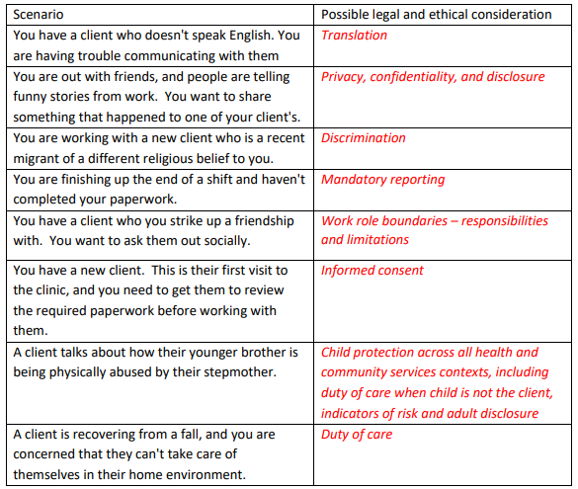
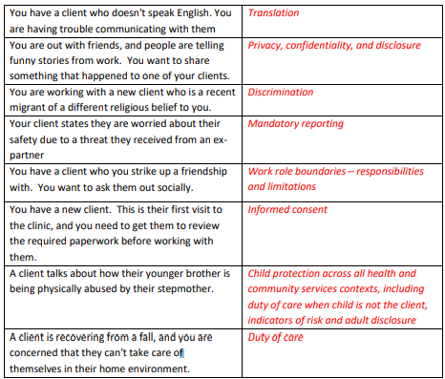
knowledge questions

Slide 89
knowledge questions
2. The Australian Community Workers Association has eight (8) guidelines that cover all of its members. What are they?
• Ethical practice
• Provision of service and supports
• Confidentiality in the workplace
• The regulatory framework
• Diversity
• The workplace
• Professional development
• Professional standing
3. Briefly define the concepts of ethical decision-making and conflict of interest.
• Ethical decision-making is about upholding standards and make oneself accountable for
their decisions in accordance with your personal and professional beliefs.
• A conflict of interest is when you may have a vested or personal interest in the outcome of an action

Slide 90
knowledge questions
4. Lasswell's model of the five W's is used in effective communication. What are the five (5) W's?
• Who should be told?
• When should they be told?
• What should they be told?
• Where should the message be conveyed?
• Who should control the communications process?

Slide 91
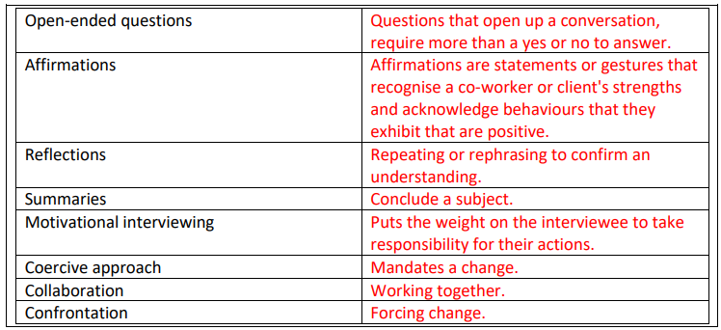
knowledge questions
5. In relation to communication techniques, provide a brief definition of the following:

Slide 92
knowledge questions
6. Give an example of how each of the following elements can influence communication.

Slide 93
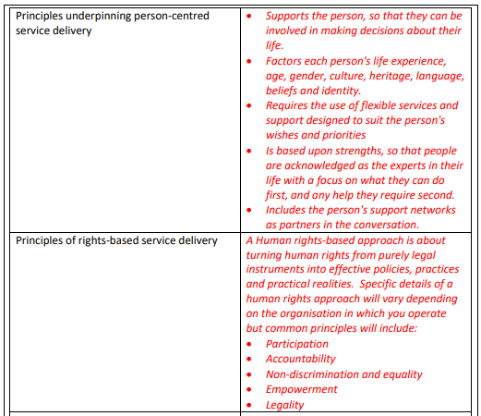
knowledge questions
7. Complete the table below, providing a brief summary of your understanding of the organisational structure and different models in place to support optimum client service.

Slide 94
knowledge questions
8. Complete the table below, providing a brief summary of your understanding of the organisational structure and different models in place to support optimum client service
Structure of the health and community services system in Australia | Including population health, prevention, community health, general practice, emergency services, hospital care, rehabilitation, and palliative care. These services address aged care, disability support, housing assistance, and services for vulnerable populations.
Different roles and responsibilities of team. | Example: An emergency department in a hospital relies on team-based care. Physicians, nurses, and paramedics work together
Characteristics of multi-disciplinary teams and how they are used. | Prioritise respect and trust among members, utilize the team's skill mix effectively, recognize and apply agreed clinical governance structures, and enforce systems and protocols for communication and interaction.
Relationships between different members of the health and community services workforces. | Primary health care, typically the initial point of contact for most individuals, is delivered across various settings such as general practices, community health centers, or at home, by a range of professionals including doctors, community nurses, dentists, pharmacists, and allied health practitioners, collaborating to provide comprehensive medical care and referrals when necessary.

Slide 95
knowledge questions
8. Complete the table below, providing a brief summary of your understanding of the organisational structure and different models in place to support optimum client service
Role of support services | To offer services including allied health, child health, chronic disease management, dental care, disability support, drug and alcohol assistance, family planning, health promotion, home and community care, medical treatment, mental health support, post-acute care, and refugee health.
Links and interrelationships with other services | Involve a combination of general practice, primary healthcare, allied health, and community health services, with numerous links and interrelationships between different sectors of the healthcare and community service system.
Funding environment | • All levels of government • Non-government organisations • Private health insurers Individuals when they pay out-of-pocket costs for products and services that aren’t fully subsidised or reimbursed.

Slide 96
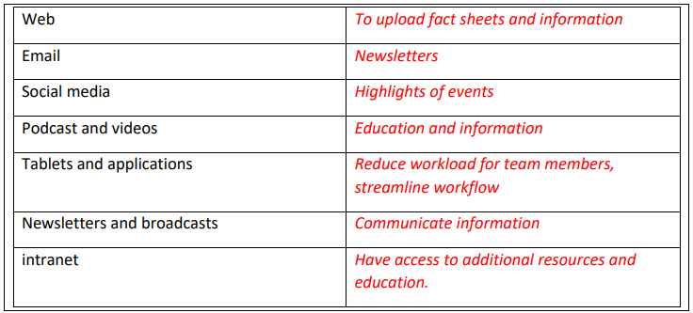
knowledge questions
9. In regards to the community services and health sector, give an example of how you could use digital media in each of the following mediums:

Slide 97
knowledge questions
10. List three (3) valuable sources of information that you can use to ensure your work practices are in line with relevant legal and ethical work requirements, in the health and community environment.
• Manager
• Co-workers
• Relevant industry bodies
• Training
• Professional development opportunities such as seminars or training events.
11. List five (5) principles of effective communication.
• Be clear
• Be concise
• Be concrete
• Be correct
• Be coherent
• Listen

Slide 98
knowledge questions
12. Identify three (3) potential constraints on effective communication in the health/community service contexts.
• Patients ability to communicate.
• Competing demands
• Time constraints
• Lack of privacy
13. Identify the lines of communication between a health organisation and two (2) other health services.
• Mental health organisations – counsellors
• Community health services – addiction services
14. List four (4) benefits of using health and community services terminology.
• Saving time; medical terminology, especially abbreviations and acronyms, can be
written down quickly.
• Ensuring all those involved in patient care are communicating using a common
language.
• Allowing you to be more efficient in your work role. For example, making notes and
records quickly and easily.
• Avoid errors that may occur when writing long sentences. The use of acronyms and
abbreviations are less likely to create errors..

Slide 99
knowledge questions
15. Explain or expand each of the health and community services terminology below.
COPD Chronic obstructive pulmonary disease
DM Diabetes Mellitus
tds three times a day
MBS Medicare Benefits Schedule
Case Management Coordinating & overseeing a patient / client’s care to ensure necessary services and support.
16. Why are factors such as grammar, speed and pronunciation important when communicating verbally?
• To ensure the message is clear; To avoid mixed messages; To be professional; To help the listener understand; To give time to the listener to take the information in.
17. For each of the situations below provide guidelines for using and recognising non-verbal communication
In everyday conversations:
Use: Non-verbal cues like facial expressions, gestures, and body language can enhance the understanding and impact of your spoken words. For example, smiling while saying thank you conveys sincerity.
Recognise: Pay attention to others' non-verbal cues to better understand their emotions and reactions. A furrowed brow may indicate confusion or concern.
.

Slide 100
knowledge questions
In Conflict Resolution:
Use: Non-verbal cues can be helpful in de-escalating conflicts. Maintain a calm tone and open body language to convey your willingness to listen and cooperate.
Recognise: In conflict situations, heightened non-verbal cues, such as clenched fists or raised voices, can indicate escalating tension.
In Cross-Cultural Communication:
Use: Non-verbal cues can help bridge language barriers when communicating with people from different cultures. Use universal gestures for concepts like agreement or disagreement.
Recognise: Be aware that non-verbal cues may vary across cultures. What is respectful in one culture may be perceived differently in another. For example, disinterest or facial expressions conveying anger or frustrations.

Slide 101
Practical Observation
• You will need to complete three (3) checklists for each student, one checklist for each of the three (3) role plays.
• You will need to participate in each of the three (3) role-plays, with each student, to allow every student the opportunity to demonstrate the required skills.
For Role-play #1
• Use your verbal and non-verbal communication to be respectful and to improve understanding for both of you.
• Communicate in a way that is clear and allows you to be easily understood.
• Confirm that the potential client understands what you are saying. Consideration: how can you check for clarity and understanding?
• Deliver your information in a timely manner.
• Adhere to standard confidentiality procedures that would be relevant to the healthcare industry. Considerations: confidentiality, privacy, respect.
• Use industry terminology correctly when speaking to the potential client.
• Follow communication protocols that apply to speaking with a potential client (be respectful, don't share personal information without their consent etc.).
• Promote and model your teams improved work practices (communicating with and building relationships with those in the community).
• Use appropriate communication strategies and techniques to respond appropriately to the communication constraint here.
• Show effective communication skills at all times.
Notes:
You are to act as though you are interested in the counselling services that the student is discussing.
Ask questions regarding what services they have available, what the costs would be, and who is eligible for the service. Seek clarification on questions and feel free to make mistakes to get them to correct or reclarify information.

Slide 102
Practical Observation
Role-play #1
You are working as a team member in the community service sector. This year your team leader wants to connect with the community. Today you are helping at a pop-up stall in a shopping mall to advise local people about some of the services your workplace provides.
One of these services is a counselling service.
The counsellor helps in areas of family violence, chronic disease, issues for adults over 65, issues young people face and homelessness. Gambler's Help also offers services at the centre.
These services are available for families or for groups. They use flexible and creative approaches to work with the client to address social or emotional issues of concern. This service is free for people with a Healthcare Card and there may be a waiting list.
Your Assessor will play the role of a potential client. They will introduce themselves and then ask you about what services you provide. You are then to:
• Communicate information about the counselling services to them in a clear and easy manner for them to understand.
• Clarify any questions they may have and then confirm their understanding.
Communication Constraint: The potential client has some difficulties with their hearing so you will need to ensure your communication strategies and skills are appropriate for the client.
Notes:
You are to act as though you are interested in the counselling services that the student is discussing.
Ask questions regarding what services they have available, what the costs would be, and who is eligible for the service. Seek clarification on questions and feel free to make mistakes to get them to correct or reclarify information.

Slide 103
Practical Observation
For Role-play #2
• Use your verbal and non-verbal communication to be respectful and to improve understanding for both of you.
• Listen to your managers requests, clarify what they mean and respond appropriately in the discussions.
• Listen to your Manager. Clarify and agree on the timeframes for the instructions.
• Use industry terminology correctly when speaking, writing and completing the confidentiality form (provided to you by your Assessor).
• Follow the correct communication protocols when working with your Manager.
• Read the confidentiality form and clarify your understanding of this, what you need to sign and when you must have it signed by, with your supervisor.
• Correctly complete the confidentiality form.
• Use language that is clear, accurate and objective when documenting your meeting notes.
• Seek feedback and advice from your supervisor on areas that you can further develop your skill and knowledge.
• Ask your Manager about options for accessing skill development opportunities in the workplace.
• Ask your Manager to include you in the next training session.
• Show effective communication skills at all times.
• Use communication strategies and techniques to respond appropriately to the communication constraint here.
• Complete two (2) workplace documents (confidentiality form/meeting notes) appropriately.
Notes:
Documents to be provided to the students for this role-play:
ü Job description
ü Confidentiality Form
You will provide the student with the job description for their role in the rehabilitation centre, ask them to read it and then clarify their understanding of the role. You are then to outline the following tasks for them to complete on their shift. Their shift runs from 8am – 3pm.
• 8 am: they need to collect breakfast orders from the residents.
• 8:30 am: they need to deliver orders to the kitchen.
• 9:00 – 10:00 am: they need to deliver breakfast meals to residents and then collect plates and return to kitchen.
• 10:30 - 12:00: they need to assist clients in getting to rehab sessions.
• 12:00: they need to take lunch orders.
• 12:30: they need to deliver orders to the kitchen.
• 1.00 pm - 2.00 pm: they need to deliver lunch meals to residents and then collect plates and return to the kitchen.
• 2.00 pm-3.00 pm: they need to complete any relevant documentation and hand over their shift.
Clarify that they understand these tasks and have them repeat back to you. They should take notes for memory. Important: You will also need to provide the student with a blank confidentiality (industry relevant) form for them to sign, scan and email to you. You will need to give the student an email address or online storage place where there are to send or upload the scanned completed version to. Blank confidentiality agreements can be located online or from your training and assessment supervisor.

Slide 104
Practical Observation
Role-play #2
You have just started a new role as a Health Care Assistant at a rehabilitation centre. You are meeting with your Manager for the first time. They will provide you with a job description of your role which you are to read, and then clarify what you understand to be the key elements of your role to be.
They will then give you a list of the tasks you need to complete during the following shift. You are to take notes of the instructions that are given to you, clarify and confirm that you have recorded them correctly and then agree to their requests while negotiating timeframes.
Note: for the purposes of this activity, your Assessor will play the role of your Manager.
Communication Constraint: Your Manager is in a rush and has spoken quickly. Demonstrate how you will overcome this.

Slide 105
Practical Observation
For Role-play #3
• Report this situation to your supervisor.
• Use your communication skills to avoid, defuse and resolve this conflicting situation with your co-worker.
• Follow the correct protocols when communicating with your Manager.
• Discuss your concerns with your supervisor.
• Refer to the potential breach or non-adherence to standard procedures with your Manager.
• Refer and discuss the conflict issue regarding breach of client rights and responsibilities.
• Clarify instructions from your Manager and negotiate when to do what you have been directed to.
• Use appropriate communication strategies and techniques to respond to the communication constraint here.
• Contribute to the workplace by identifying issues and articulating ways that the work environment can be improved.
• Show effective communication skills at all times.
Notes:
You will act in the role of the Manager of a disability facility. The student will bring an issue to your attention. You are to role-play the situation with them and confirm that the suggested action was wrong and that you appreciate that they have brought it to your attention. Instructions to be given to the Student “You are required to perform the tasks as outlined in the Student Assessment Guide to demonstrate your skills for the unit(s). I will observe you performing these tasks to ensure you can demonstrate the necessary skills, and I will record my observations using this checklist. I may also ask you some questions to confirm your understanding of the tasks”. During this task, you will be required to demonstrate your ability to: • Communicate effectively with people • Collaborate with colleagues • Address constraints to communication • Report problems to supervisor • Complete workplace correspondence and documentation • Contribute to continuous improvement

Slide 106
Practical Observation
Role-play #3
One of your co-workers has told you they recently posted details about how a client passed away on social media and they have since gained a massive following online. Now their followers are demanding more stories from the workplace. The co-worker wants to know which story they should post next. You tell them that this would be in breach of social media policies, and they call you a spoilsport.
As a result, this co-worker doesn't want to work with you and is spreading rumours that you aren't completing your required tasks. You now need to discuss the matter with your manager and ask for advice on what to do.
Note: for the purposes of this activity, your Assessor will play the role of your Manager.
Communication Constraint: Your Manager is working from home this week; demonstrate how you will overcome this to communicate effectively with your Manager. When communicating with your Manager, you must clarify the workplace instructions you are to follow and negotiate timeframes as to when to have this done by.

