Slide 1
Interpret and Apply Medical Terminology Appropriately
Health terminology dictionary- Access: Medical Dictionary of Health
Learning Check Point 1
Learning Check Point 2
Learning Check Point 3
Learning Check Point 4
For this unit, you will be assessed on the following:
Assessment 1 Questions and Answers
Assessment 2 Project
Assessment 3 Observation

Slide 2
Contents Index
Interpret and apply medical terminology appropriately
Medical terminology
What is medical terminology?
Medical terminology in the real world
The word root
Word roots of the body
The prefix
The suffix
The combining vowel
The combining form
Putting it all Together
Interpreting acronyms and abbreviations
Acronyms
Abbreviations
Working with medical terminology
Interpreting and adhering to policies and procedures
Carry out routine tasks
Seeking assistance
Use appropriate medical terminology in written and oral communication
Oral communication
Teamwork
Initiative
Written communication
Accuracy and checking information and terminology
Spelling and pronunciation
American versus English spelling
Dropping a vowel when joining word parts
Plurals
Exceptions to these principles
Reading backwards
Pronouncing medical words and phonetic spelling.

Slide 3
Workbook Activities Index
Prefix practice makes perfect
Quiz – Suffix
Breaking it down
Multiple health problems
Abbreviations
Multiple health problems
Written communications
8. Do you know what I am saying?
9. Policies and procedures
10. Oral communication
11. Written communication
12. Medical terminology
13. All in the pronunciation

Slide 4

Elements and performance criteria
Respond appropriately to instructions which contain medical terminology.
Carry out routine tasks.
Use appropriate medical terminology in oral and written communication.

Slide 5


Interpret and apply medical terminology appropriately
Medical terminology
The word root
The prefix
The suffix
The combining vowel
The combining form
Putting it all together

Slide 6

Medical terminology
Medical terminology is a special vocabulary of scientific and technical terms used in the health services industry.
Basic word elements including word roots, prefixes, suffixes, and the combining vowels and combining forms.
Medical terms can include:
all three main elements (word roots, prefixes and suffixes)
just a word root and a pre-fix
a word root and a suffix
multiple word roots
https://medicalterminologyblog.com/breaking-down-medical-terms/
A badly broken wrist ≠ a type II fracture of the right distal radius with moderate lateral displacement.
Download the following app to test your medical terminology: https://apps.apple.com/us/app/medterm-scramble/id590745869?ign-mpt=uo%3D4
Notes:
ASK- why is it important to interpret and apply medical terminology appropriately?
Interpret and apply medical terminology appropriately
Medical terminology
ASK- what are the benefits of knowing medical terminology by heart?
ASK- who can explain what medical terminology is?
What is medical terminology?
ASK- what can be included in a medical term?
Student can download this app to test their medical terminology skills.

Slide 7
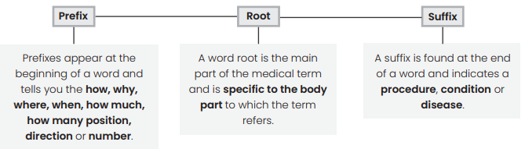
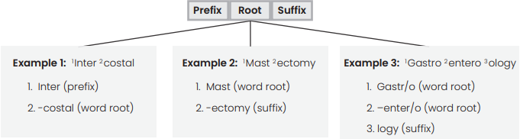
Medical terminology
https://www.youtube.com/watch?v=iLiNhqk80tU
https://www.youtube.com/watch?v=78Rp1mcEsco

Slide 8
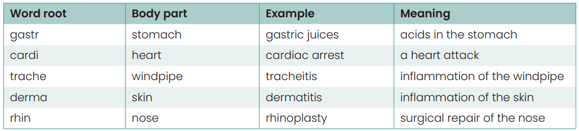
The word root
https://www.youtube.com/watch?v=H0QRsBxKZM4
A word root is the subject of the medical term and is specific to the body part to which the term refers. A word root usually describes the location, system or the specific element that has been affected by the disease, disorder or condition. It requires a prefix or suffix to complete its meaning, as they are usually only half words. For example, adip means fat (i.e. adipose tissue). Common ones:
Notes:
ASK- who can explain three examples of medical root words , their body part and meaning?

Slide 9
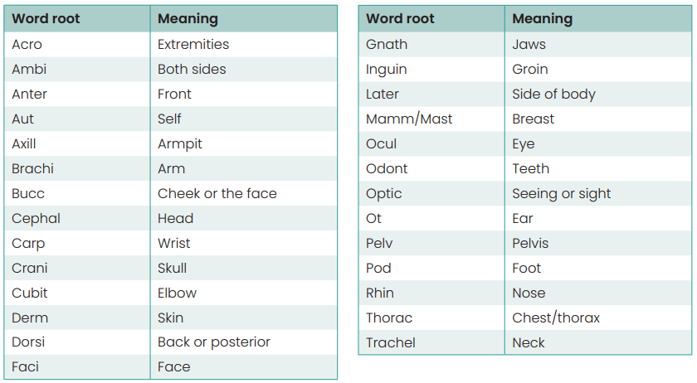
Word roots of the body
They divide into two categories: exterior root words, which describe the exterior (outside) of the body, and interior root words, which relates to the inside.
Exterior word roots

Slide 10
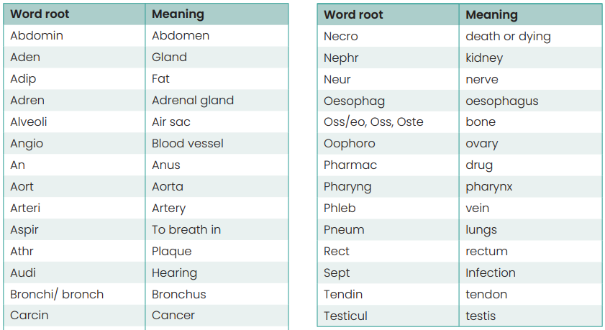
Word roots of the body
Interior word roots

Slide 11
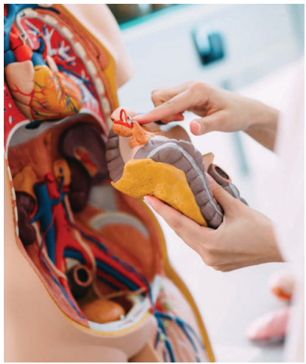
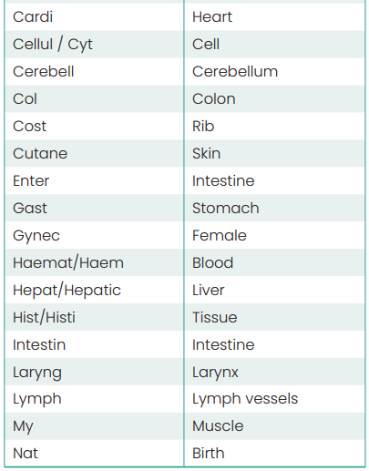
Word roots of the body
Interior word roots

Slide 12
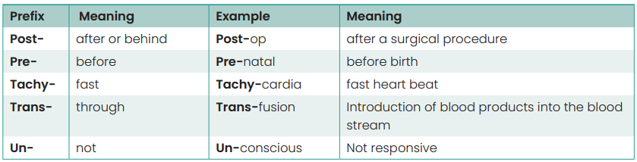
The prefix
Prefixes appear at the beginning of a word and tell you the how, why, where, when, how much, how many, position, direction or number.
https://www.youtube.com/watch?v=uVm91-NH5Ek

Slide 13
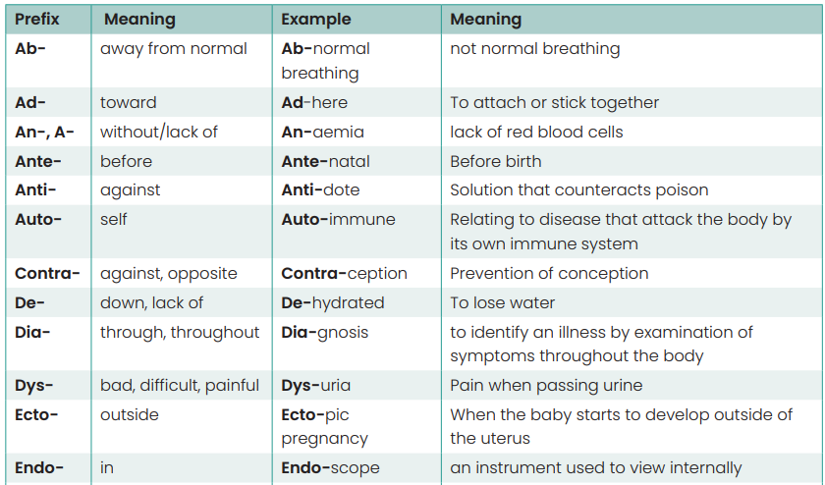
The prefix

Slide 14
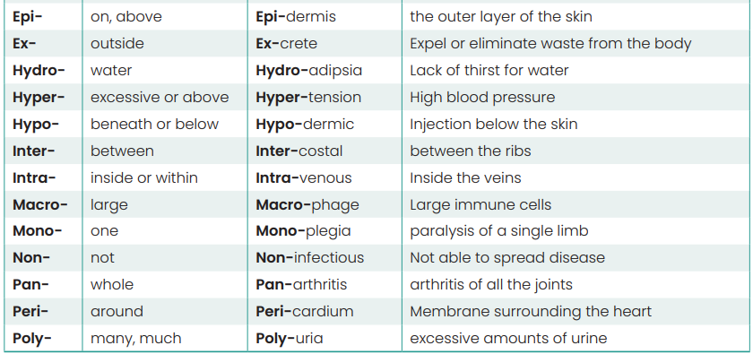
The prefix

Slide 15
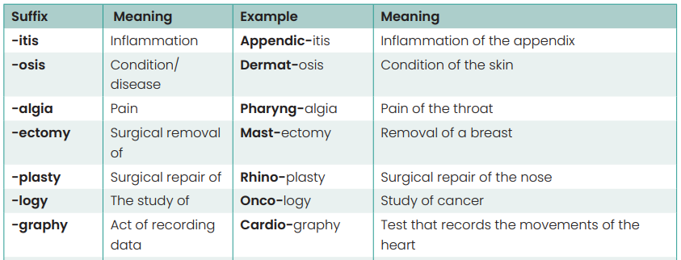
The suffix
A suffix is found at the end of a word and indicates the procedure, condition or disease.
Watch the following video: “How to approach medical terms by breaking them up into pieces (prefix, root, suffix).” https://www.youtube.com/watch?v=3fiEszFPRE8
https://www.youtube.com/watch?v=PDVq6KwtHCE

Slide 16
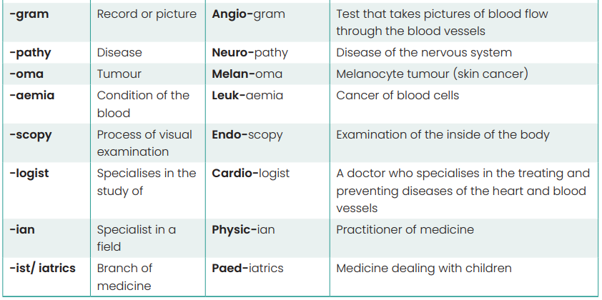
The suffix

Slide 17
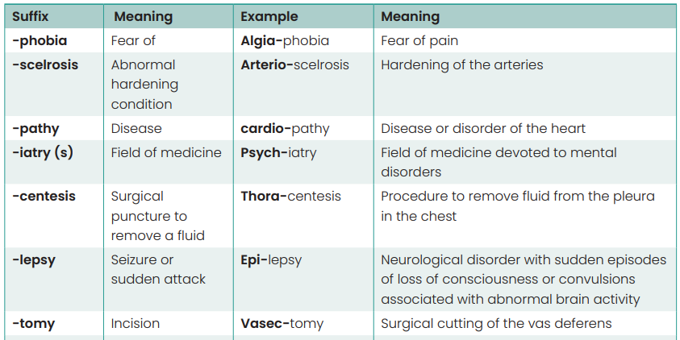
The suffix

Slide 18
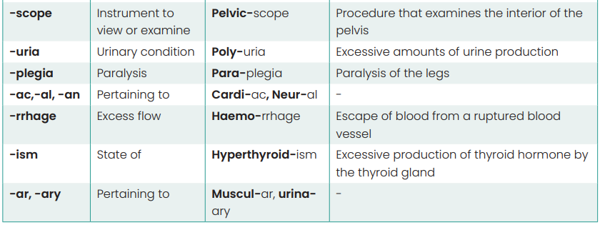
The suffix

Slide 19
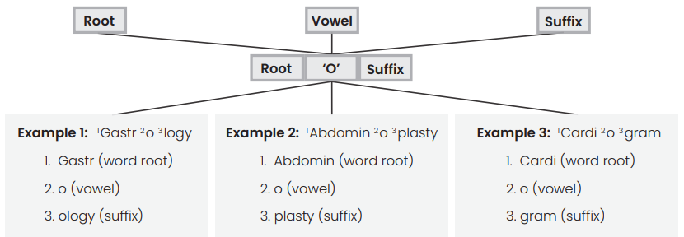
The combining vowel
The combining vowels (a, e, i, o and u) are used to join various elements of medical terms together.

Slide 20
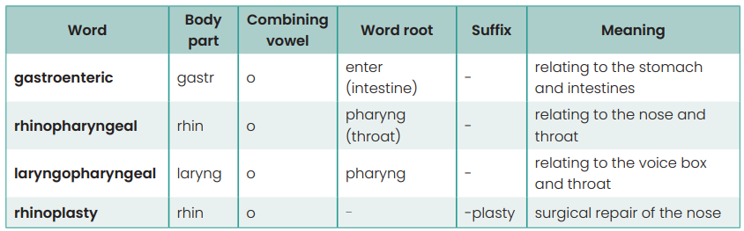
The combining vowel

Slide 21
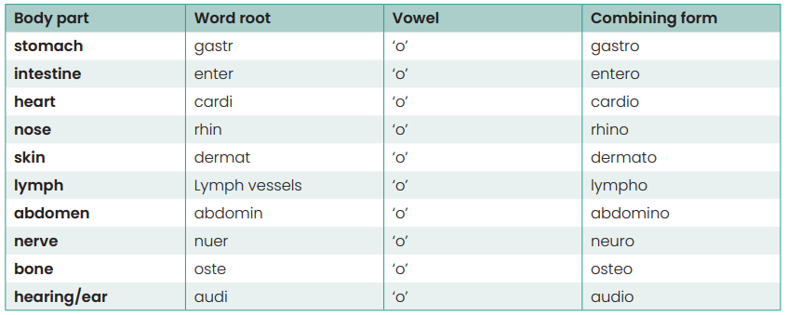
The combining form
The combining form is a word root together with a combining vowel. For example, ‘gastr’ is the root for stomach but ‘gastro’ is the combining form of stomach. The combining form ‘gastro’ is ready to join another root or a suffix. Turning the word root into the combining form also makes it much easier to pronounce.

Slide 22
Putting it all together
Knowing the different word parts means you can put them together to create a word. Not all words have a prefix but most have at least one root word, a combining vowel and a suffix.
Example 1:
Angiogram: test taken to record a picture of the blood vessels.
1. Angio – describes the location, i.e. blood vessels (artery)
2. gram – record or picture
Example 2:
Rhinoplasty: surgical repair or reconstruction of a person’s nose.
1. Rhino – describes the location, i.e. nose
2. plasty – describes the procedure, i.e. surgical repair/reconstruction
Example 3:
Neurology: study of the nervous system
1. Neuro – describes the location (i.e. nerves)
2. logy – the study of

Slide 23
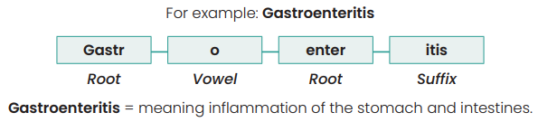
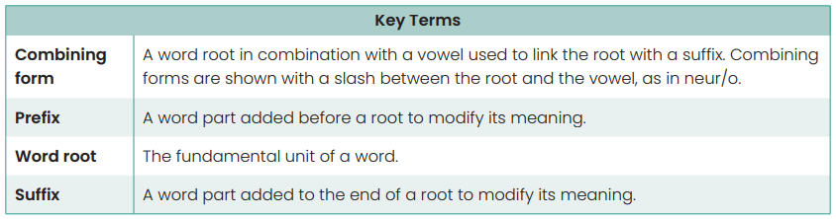
Putting it all together

Slide 24

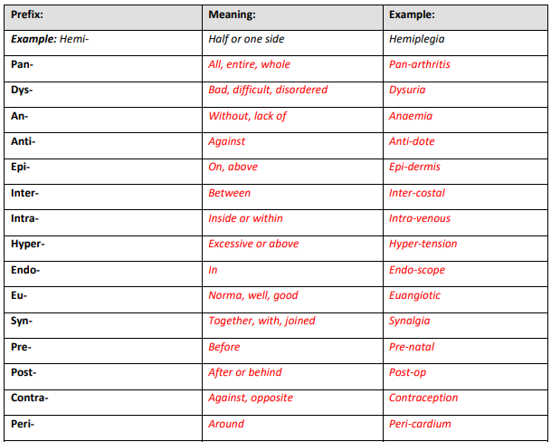

1. Prefix practice makes perfect

Slide 25
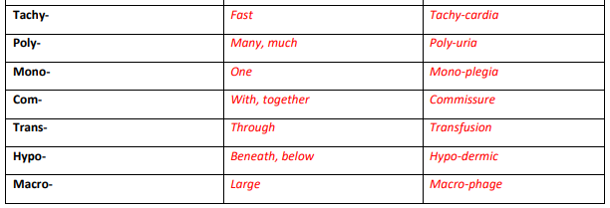
1. Prefix practice makes perfect
Jump online to https://medicalterminologyblog.com/medical-terminology-quizzes/
to continue learning your medical terminology.

Slide 26
2. Quiz - Suffix
1. The word root for stomach is “gastr-.” Inflammation of the stomach is:
a) gastroscopy.
b) gastropathy.
c) gastritis.
d) gastrectomy.
2. The word root for bone is “oste-.” An instrument that cuts bone is an:
a) osteoscope.
b) osteotome.
c) osteoma.
d) osteograph.
3. “Dermat-.” is one word root for skin.Inflammation of the skin is:
a) dermatemesis
b) dermatitis.
c) dermatocele.
d) dermatogram.
4. The word root “ocul” means:
a) oesophagus
b) ear.
c) eye.
d) Intestine
5. The word root that means blood vessel is “arteri.” Hardening of the arteries is:
a) arteriosclerosis
b) arterioalgia.
c) arterioitis.
d) arteriopathy.
6. The word root that means chest is “thora-.” A surgical puncture into the chest is:
a)t horamalacia.
b) thorascopy.
c) thoracentesis.
c, b, b, c, a, c

Slide 27
2. Quiz - Suffix
7. The word root “haemat” means blood. The term haematology means:
a)process of measuring blood.
b) blood count
c) study of blood.
d) blood transfusion.
8. The word root “mast-” means breast. The term mastectomy means:
a) surgical removal of a breast.
b) surgical puncture of a breath.
c) incision into a breast.
d) suturing of a breast.
9. “Derm-” is the word root that means skin. The term that means “forming or producing
skin” is:
a) dermocele.
b) dermopathy.
c) dermogenesis
10. The word root that means heart is “cardi-.” A test taken to record activity of the heart is a:
a) cardiomegaly
b) cardiogram.
c) carditis.
d) cardiopathy.
11. The word root for lung is “pneum-” or “pneumon-“ Inflammation of the lung is:
a) pneumoitis.
b) pneumonitis.
c) pneumitus.
d) pneumonoitis.
12. The word root for bronchus is “bronch-.” A tumor that begins in a bronchus is called:
a) bronchoma.
b) brochomata.
c) bronchocystic.
d) bronchogenic.
c, a, c, b, b, d

Slide 28
2. Quiz - Suffix
13. “Spiro-” is a word root for breathing. An instrument that measures breathing is a:
a) spiroscope.
b) spirometer.
c) spirogram.
d) spirograph.
14. The word root for sternum is “stern-.” The word sternotomy means:
a) incision into the sternum.
b) surgical repair of the sternum.
c) rupture of the sternum.
d) herniation of the sternum.
15. The word root “gynec” means female. A doctor specialising in women’s health particularly reproductive health is a:
a) gynecomastia.
b) gynecologist.
c) gynecology
d) gynecoid.
16. The word root that means liver is “hepat-.” Inflammation of the liver is:
a) hepatoma.
b) hepatitis.
c) hepatomegaly.
d) hepatocele.
17. Two suffixes, “-algia” and “-dynia,” identify pain. Pain in the chest (“thorac-”) is:
a) thoracoalgia.
b) thoralgia.
c) thoracodynia
d) thorocodynia.
18. The word root for stomach is “gastr-.” An examination of the stomach is a:
a) gastrocele.
b) gastrorrhaphy.
c) gastroscopy.
d) gastrogram.
c, a, b, b, c, c

Slide 29
2. Quiz - Suffix
19. The word root “pharyng-” means throat. Pain of the throat is known as:
a) pharyngosis.
b) pharyntosis.
c) pharyngalgia.
d) pharyngoma.
20. The word root “hepat-” means liver. The term hepatocentesis means:
a) surgical incision into the liver.
b) visual examination of the liver.
c) sclerosis of the liver.
d) surgical puncture into the liver.
c, a

Slide 30
Interpreting acronyms and abbreviations
Medical terminology also uses acronyms, abbreviations and anatomical planes and positions. These are used to save time, space, and paperwork.
Acronyms
Abbreviations
Students can jump online to https://medicalterminologyblog.com/medical-terminology-quizzes/
Notes:
ASK- who can example five common medical acronyms?

Slide 31
Acronyms
An acronym is a word that is formed by the first letters or syllables of other words. Most acronyms are expressed in uppercase letters. Common medical acronyms:
HRT – Hormone Replacement Therapy
TKR – Total Knee Replacement
BMD – Bone Mineral Density
DVT – Deep Vein Thrombosis
AMA – Australian Medical Association
MRI – Medical Resonance Imaging
CAT – Computerised Axial Tomography (scan)
COPD – Chronic Obstructive Pulmonary Disease

Slide 32
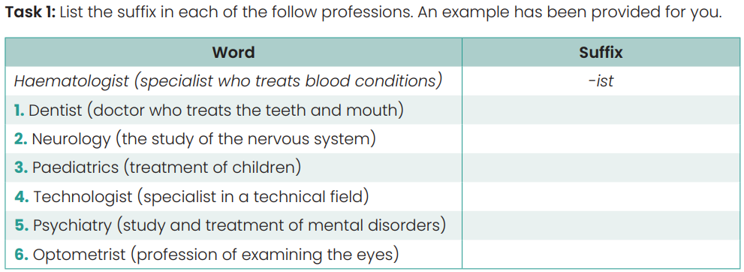
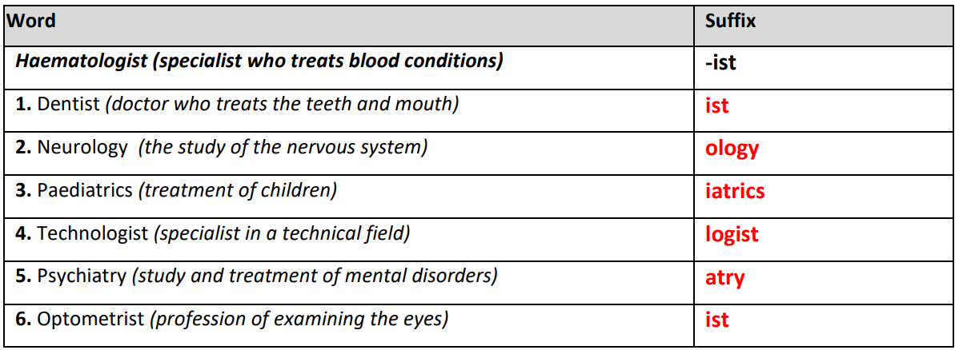
3. Breaking it down

Slide 33
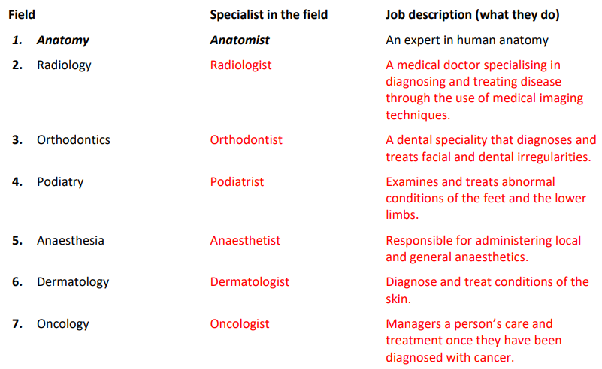
3. Breaking it down

Slide 34
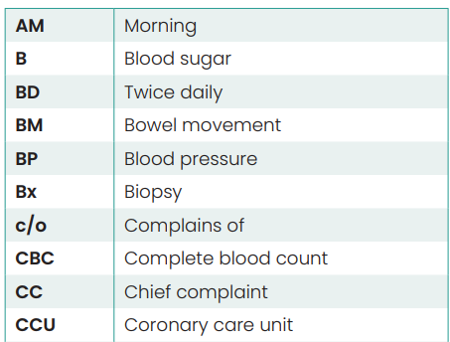
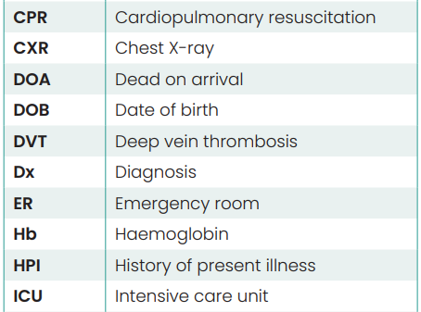
Abbreviations
Abbreviations are commonly used in medical terminology to shorten words and phrases. For example, a.c. in medical terminology means before meals, and p.c. means after meals. Most common abbreviations:

Slide 35
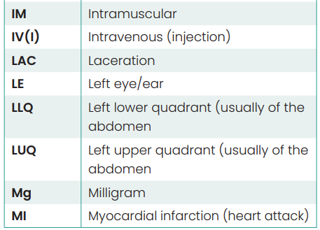
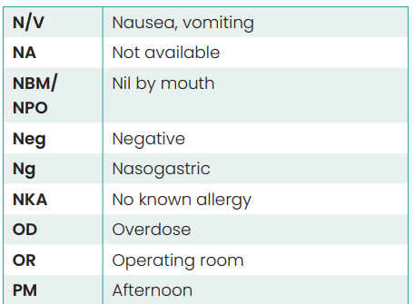
Abbreviations

Slide 36
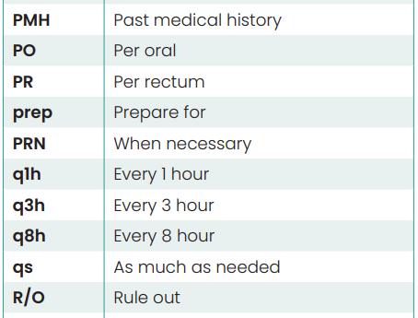
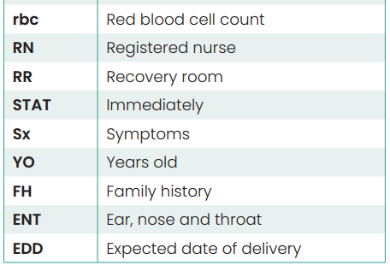
Abbreviations

Slide 37
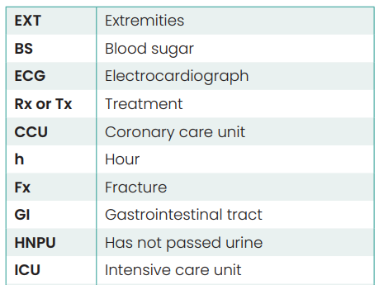
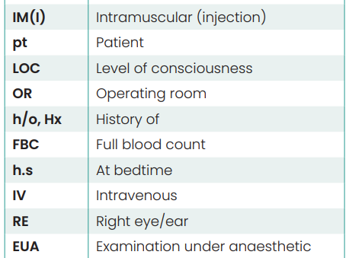
Abbreviations

Slide 38
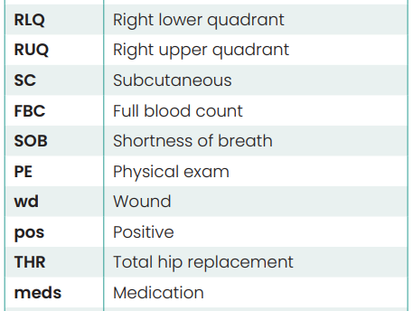
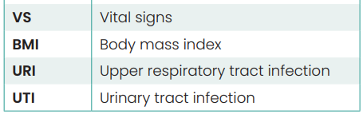
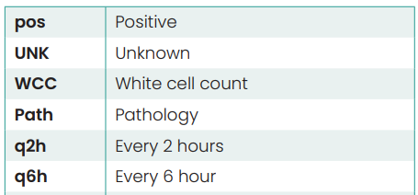
Abbreviations

Slide 39
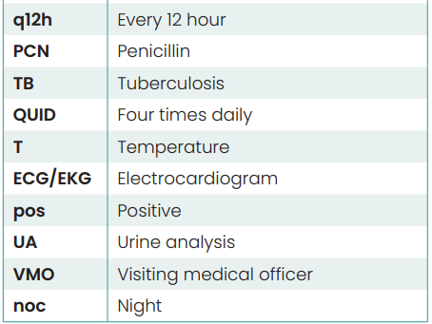
Abbreviations

Slide 40
4. Multiple health problems
Read the following case study and answer the questions below.
“Oliver, a 39-year-old archaeologist, has just returned from a 6-month expedition in the rainforest of South America. Upon his return, he has been suffering from a combination of physical symptoms and conditions. He has been fatigued, yet unable to sleep through the night. He also had a mild fever, night sweats, occasional dizziness, double vision, and mild abdominal pain accompanied by occasional diarrhoea. In addition, he had a non-healing wound on his ankle from an insect bite.
He made an appointment with his family doctor when the symptoms did not appear to be getting better. On examination, Oliver was febrile with a temperature of 39.5°C. His heart and lung function were normal, with a slightly elevated heart rate. He had areas of oedema and tenderness over both patellae. The laceration on his left lateral ankle had a ring of necrosis surrounding an area of tissue.
Oliver’s doctor ordered a series of haematology tests. The doctor suspected a viral disease, possibly carried by mosquitoes that inhabit tropical rai forests. He also suspected a form of dysentery typically caused by bacteria. Oliver was also possibly anaemic and dehydrated. The doctor was confident that after his diagnosis and treatment, Oliver would gain relief from his insomnia, diplopia and dizziness.”

Slide 41
4. Multiple health problems
1. Diplopia, the condition of having double vision has the suffix:
a) lopia
b) opia
c) ia
d) pia
e) plopia
2. Febrile, means:
a) Feeling cold
b) Feeling scared
c) Fever
d) Hypertension
3. Oedema refers to:
a) pain
b) fever
c) cuts
d) wound
e) swelling
4. Write the suffix that means ‘condition
of’ for each of the following words:
Necrosis: .........................................
Insomnia: .........................................
5. The ‘patellae’ refers to which part of the body:
a) ankles
b) mouth
c) knees
d) elbow
e) wrist
6. The term ‘anaemic’ means having a deficiency of red blood cells and has the prefix:
a) a
b) ana
c) an
d) mic
7. The abbreviation for the term ‘laceration’ is:
a) LACER
b) LRATION
c) LC
d) LAC
e) ACL
8. Write down the abbreviation for diagnosis:
...........................................
b, c, e, sis, nia, c, c, d, dx

Slide 42
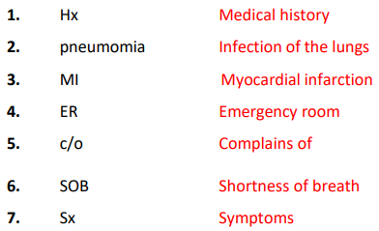
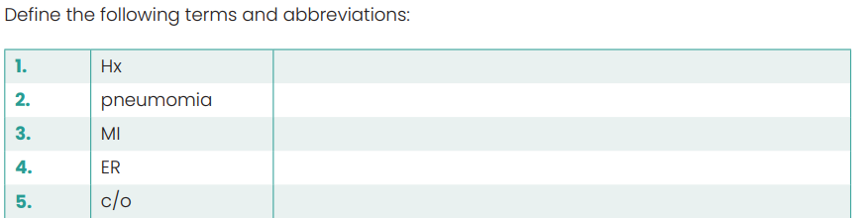
5. Abbreviations
The case study below contains several medical terms and abbreviations that you will need to interpret. Following the case study you will be asked to provide the meanings of these terms and abbreviations.
“Mr Campbell, a 42 year-old patient with a Hx of pneumonia and a mild MI presents to the ER and c/o of SOB which has increased over the past three days. He also c/o the following Sx: chest pain in the RQU, headache and dizziness. The RN orders a full CXR and FBC. CXR reveals fluid in the lungs in the posterior lobe and the FBC also reveals that his rbc count was normal, which would R/O anaemia.
The pt was admitted to the CCU and was monitored q1h with VS taken every 30 minutes. A resident Cardiologist in the CCU ordered an ECG to be carried out”.

Slide 43
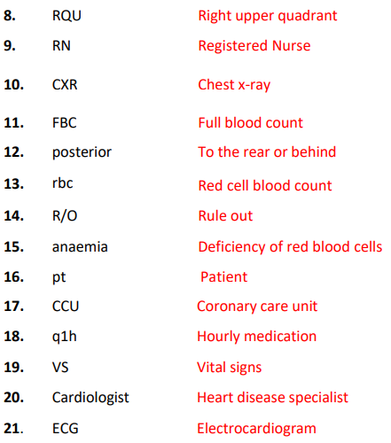
5. Abbreviations

Slide 44
6. Multiple health problems
Read the following case study and answer the questions below.
“Diana, a 28-year-old woman, was treated for injuries sustained in a motorcycle accident. During the course of her treatment, she was seen by several specialists. For pain in her knee and hip joints, she was referred to an Osteopath. For her headaches and blurry vision, she consulted a neurologist.
Later, for a persistant and dry cough resulting from a fractured nose she was referred to an otorhinolaryngologist. During her initial course of treatment, she had a CT scan of her abdomen and brain and an MRI of her hip and knee.
Several months after the accident, Diana was still experiencing some discomfort and decided to investigate some alternative therapies. She made an appointment with a naturopath who specialised in homeopathy and herbal medicine. Before her appointment she browsed her local health shop, which carried nutritional supplements, vitamins, homeopathic remedies and herbal formulas. She planned to ask the Naturopath about some of the products she saw including remedies with the names Pneumogen, Arthogesia-plus and Hematone”.

Slide 45
6. Multiple health problems
1. The -ist in the word neurologist is a:
a) prefix
b) root
c) suffix
d) combining form
2. Endo- in endoscopic is a:
a) root
b) suffix
c) combining form
d) prefix
e) derivation
3. MRI stands for Magnetic Resonance
Imaging. This term represents a:
a) combining form
b) acronym
c) prefix
d) suffix
4. Diana needed plastic surgery on her nose to repair the fracture. This procedure is called a:
a) septoscope
b) rhinoplasty
c) neurectomy
d) Cardioplasty
5. The product ‘Hematone’ effects which body part:
a) lung
b) nerves
c) liver
d) blood
6. The term ‘otorhinolaryngologist’ contain how many word roots?
a) one
b) two
c) three
d) none
7. The word root ‘Pneum’ relates to which part of the body:
a) stomach
b) liver
c) lungs
d) kidney
8. The root word ‘Osteo’ relates to which part of the body:
a) nerves
b) liver
c) tendons
d) bones
c, d, b, b, d, c, c, d

Slide 46
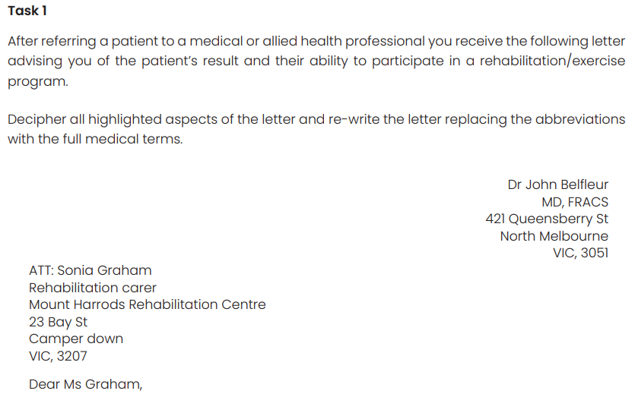
7. Written communications

Slide 47
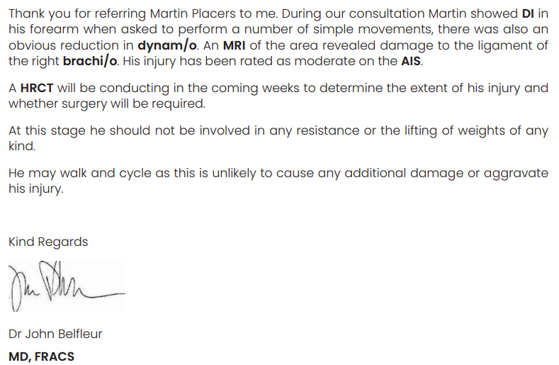
7. Written communications

Slide 48
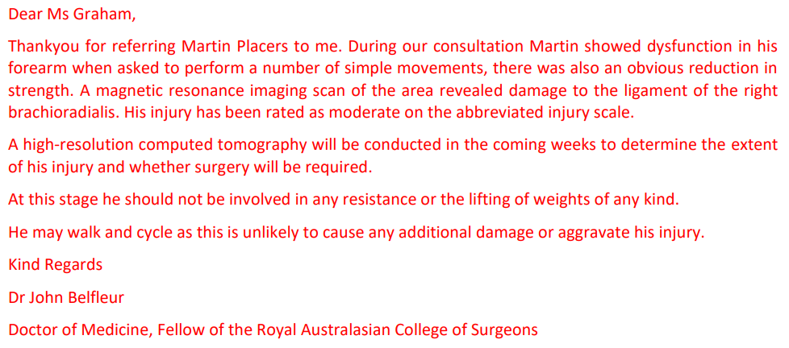

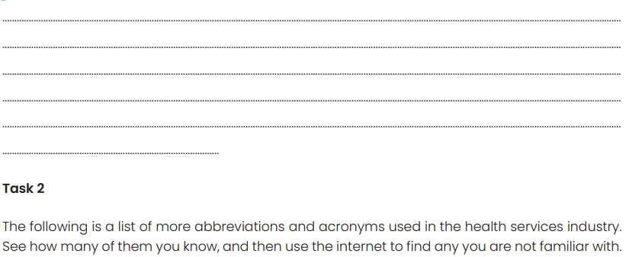
7. Written communications

Slide 49
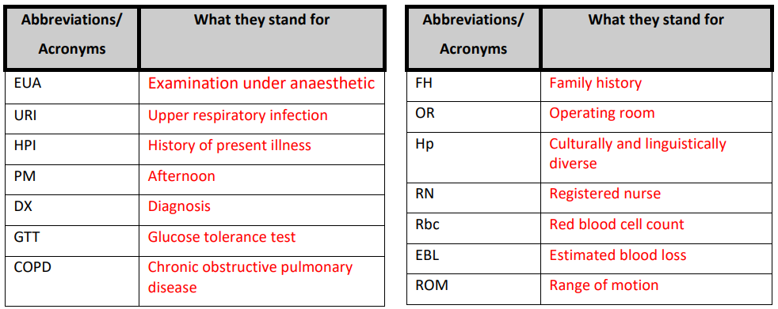
7. Written communications

Slide 50
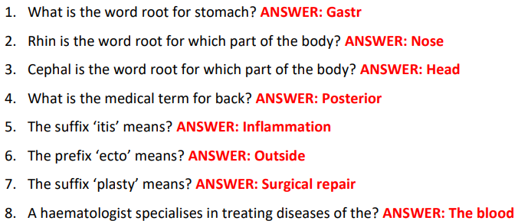
8. Do you know what I am saying?
Your task is to listen to the medical terminology read aloud by your teacher and correctly identify what they are saying. This activity is designed to test how well you can understand oral instructions using medical terminology.
Instructions:
1. Listen to the questions read aloud by your teacher.
2. Use the answer sheet below and write down the answer you think is correct.
3. Your teacher will then go through the answers and you can see how well you can receive, and interpret medical terminology.

Slide 51
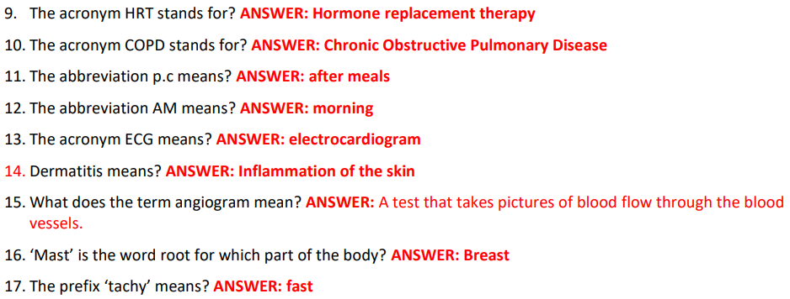
8. Do you know what I am saying?

Slide 52


Learning Checkpoint 1
1. Outline four benefits of knowing medical terminology.
Medical terminology, abbreviations and acronyms can be written down quickly and can save time. It also ensures all those involved in patient care are communicating using a common language. Knowing medical terminology allows you to be more efficient in your work role and make notes and records quickly and helps prevent errors that may occur when writing long sentences.
2. Medical terms are comprised of the following word elements. Explain each word element and provide an example for each.
• Word root:
A word root is the main part of the medical term and is specific to the body part to which the term refers. E.g. Mast – Breast
• Prefix:
Prefixes appear at the beginning of a word and tells you the how, why, where, when, how much, how many position, direction or number. E.g. Intercostal, Inter is the prefix.
• Suffix:
A suffix is found at the end of a word and indicates a procedure, condition or disease. E.g. Gastro-enter-ology, ology is the suffix
• Combining vowel:
The combining vowels (a, e, i, o and u) are used to join various elements of medical terms together. E.g. in gastroenteric the word root is ‘gastr’ and the o is the combining vowel that links ‘gastr’ and ‘enter’
• Combining form:
The combining form is a word root together with a combining vowel. For example, ‘gastr’ is the root for stomach but ‘gastro’ is the combining form of stomach. The combining form gastro is ready to join another root or a suffix.

Slide 53
Learning Checkpoint 1
3. Explain how medical terminology is used in the real world.
Medical terminology allows professionals to communicate the greatest quantity of information quick and easily with the least amount of confusion and with the most accuracy.
4. For the following word roots identify the body part in which it refers:
a) Acro - extremities
b) Abdomin - stomach
c) Gnath – jaw
d) Enter - intestine
e) Axil – armpit
f) Adip - fatty tissue
g) Odont - teeth
h) Gast - stomach
i) Brachi - arm
j) Angio – blood vessel
k) Pelv -pelvis
l) Haem - blood
m) Crani - skull
n) Bronchi -lungs
o) Rhin - nose
p) Hepat - liver
q) Derm - skin
r) Cost -rib
s) Pod - foot
t) Nephr - kidney
u) Osteo - bones
v) Gnath -jaw
w) Odont – teeth
x) My – muscle
y) Neuro – nerve
z) Oophoro – ovar

Slide 54
Learning Checkpoint 1
5. For the following prefixes identify their meaning and provide an example for each:
• Ab- away from normal e.g. abnormal
breathing
• Auto- self, e.g. autoimmune
• Endo- in e.g. endoscope
• Non- not e.g. non-infectious
• Ante- before e.g. antenatal
• Contra- against e.g. contraception
• Ex- outside e.g. excrete
• Poly- many e.g. polyuria
• De- down e.g. dehydrated
• Epi- on, above e.g. epidermis
• Hyper- excessive e.g. hypertension
• Tachy- fast e.g. tachycardia
• Ecto- outside e.g. ectopic
• Ad- toward e.g. adduct
• Hypo- beneath e.g. hypodermic
• Trans- through e.g. transfusion
• Inter- between e.g. intercostal
• Intra- inside e.g. intravenous
• Peri- around e.g pericardium
• Hydro- water e.g. hydroadipsia
• Post- after e.g. post-op
• Pre- before e.g. prenatal
• Un- not e.g. unconscious
• Dia- though e.g. diagnosis
6. For the following suffixes identify their meaning and provide an example for each:
• itis = inflammation e.g. tendonitis
• Ectomy = outside e.g. ectopic
• Pathy = disease e.g. cardiopathy
• Osis = condition e.g. dermatosis
• Scopy = visual examination e.g.
endoscopy
• Aemia= condition of the blood e.g.
Leukaemia
• Plasty = surgical repair e.g. rhinoplasty
• Gram = record e.g. angiogram
• Ist = brand of medicine e.g. dentist
• Phobia = fear e.g. arachnophobia
• Sclerosis = abnormal e.g.
arterioscelorsis
• Ism = state of e.g. hyperthyroidism
• Centesis = surgical puncture e.g.
thoracentesis
• Lepsy = seizure e.g. epilepsy
• Ar = pertaining to e.g. muscular
• Uria = Urinary condition e.g. polyuria
• Scope = instrument e.g. pelvicscope
• Ac = pertaining to e.g. cardiac

Slide 55
Learning Checkpoint 1
7. Explain the function of the combining vowel in a medical term.
The combining vowels (a, e, i, o and u) are used to join various elements of medical terms together.
8. Explain the main function of the combining form.
The combining vowels make the word easier to analyse and to pronounce. A combining vowel acts like a plus sign in mathematics. It is usually seen when two word roots are joined together or when a suffix starting with a consonant is added to a word root.
9. Provide five examples of a medical term that contains a vowel.
Gastro, entero, cardio, rhino and dermato.
10. Provide five examples of a medical term in its combined form.
Gastrology, Abdominoplasty, cardiogram, Rhinoplasty and Gastroenteritis.
11. Explain an ‘acronym’ and an ‘abbreviation’. How are these used in medical terminology?
An acronym is a word that is formed by the first letters or syllables of other words. Most acronyms are expressed in uppercase letters. There are many acronyms in medical terminology and they are used to make a word or phrase shorter, quicker and easier to pronounce. It is important to know the context in which they are used, because many are identical or sound similar, but have quite different meanings. Abbreviations are commonly used in medical terminology to shorten words and phrases.

Slide 56
Learning Checkpoint 1
12. Identify the meaning for each of the abbreviations:
• HRT = hormone replacement therapy
• CC = chief complaint
• ECG = electrocardiograph
• Rx = treatment
• SC = subcutaneous
• BMI = body mass index
• c/o = complains of
• UA = urine analysis
• LOC = level of consciousness
• PE = physical exam
• AMA = Australian medical association
• CBC = complete blood count
• Noc = night
• VS = vital signs
• CCU = corornary care unit
• CAT = computerised axial tomography
• CXR = chest x ray
• RR = recovery room
• SOB = shortness of breath
• LAC = laceration
• MRI = medical resonance imaging
• DVT = deep veinthrombosis
• NBM = nil by mouth
• Prep = prepare for
• OD = overdose

Slide 57
Working with medical terminology
When working in a health services environment, you will receive both written and oral instructions that you will have to interpret and document. This may be in the form of:
Medication orders and prescriptions
Instructions for postoperative care
Home care instructions
Notices, for example a hazard alert
Occupational health and safety (OHS) signs and instructions
incident or accident reports
Patient medical charts and files
Referrals
Routine reports, for example visitor sign-in sheets
Telephone calls
Emails
Test results
Operating theatre lists
Verbal communications or discussions
Appointments
Notes:
ASK- When working in a health services environment, you will receive both written and oral instructions these can come in many forms, what can these include?

Slide 58

Working with medical terminology - Checklist
There are many different types and situations where checklists are used in the health service industry,
these include:
Pre-admission (into hospital or rehabilitation) and admission
Patient information
Allergy and medical history checklists
Medical equipment checklists
Procedural checklists
Intraoperative record form
Patient observation checklists e.g. checking and reviewing blood pressure, heart and temperature
Diagnostic checklists e.g. CT scans, MRIs and ECG tests
Infection and prevention and control procedures
Cleaning logs
Notes:
ASK- there will be many times a checklist will be used in the health services industry. Who can describe five times when a checklist might be used?
ASK- has anyone heard of an Intraoperative record form?

Slide 59
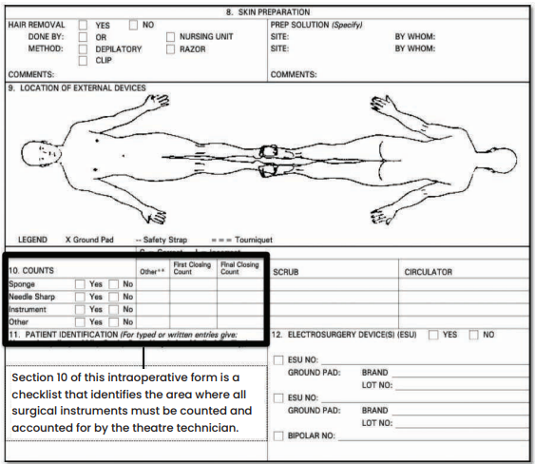
Working with medical terminology - Checklist

Slide 60
Interpreting and adhering to policies and procedures
All health services organisations will hold policies and procedures relating to:
Accessing and updating files
Infection prevention and control
Formal communications protocol
Emergency procedures
Following instructions
Organisation code of conduct (harassment, behaviour and discrimination)
Occupational health and safety (OHS)
Phone and email protocol
Recording information
Patient confidentiality and privacy procedures

Slide 61
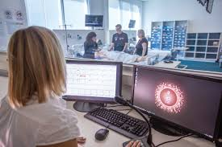
Interpreting and adhering to policies and procedures
Interpreting
workplace
policies and
procedures
Determining why it is important
Seeking clarification if you have not understood
Summarise the main points
Establish the main message or actions of the policy or procedure
Reading the policy or procedure carefully
Determining what the policy is about
Steps for interpreting and adhering to policies and procedures
Notes:
What is a policy ?
What is a procedure?
ASK- who can explain what a policy or procedure may relate to in a health service environment?
How to interpret workplace policies and procedures
ASK- there are six general steps to interpreting and adhering to polices and procedures, what are they?

Slide 62
9. Policies and procedures
The following are policies and procedures from the IVET Superclinic. Your task is to interpret each policy and procedure and answer the questions.
1: Alcohol and Drugs Policy
IVET Superclinic is concerned by factors affecting an employee’s ability to safely and effectively do their work to a satisfactory standard. The business recognises alcohol or other drug abuse can impair short-term or long-term work performance and is an occupational health and safety risk.
IVET Superclinic will do its utmost to create and maintain a safe, healthy and productive workplace for all employees. IVET Superclinic has a zero-tolerance policy in regards to the use of illicit drugs on their premises or the attending of other business-related premises (e.g. patients) while under the influence of illicit drugs. Contravening either of these points may lead to instant dismissal.
IVET Superclinic does not tolerate attending work under the influence of alcohol. This may result in performance improvement action or dismissal.
IVET Superclinic makes alcohol available to staff over the age of 18 during designated staff functions. Limiting the consumption of any alcohol made available is the responsibility of the employee. Driving over the legal limit or under the influence of illicit drugs is illegal.

Slide 63
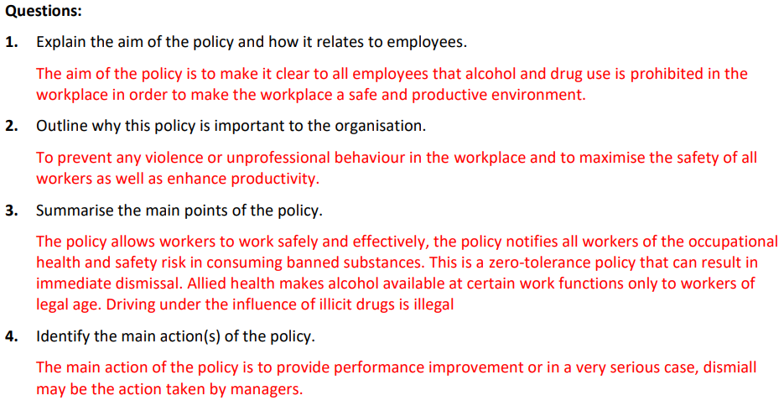
9. Policies and procedures
Questions:
Explain the aim of the policy and how it relates to employees.
2. Outline why this policy is important to the organisation.
3. Summarise the main points of the policy.
4. Identify the main action(s) of the policy.

Slide 64
9. Policies and procedures
Conflict of interest procedure
Conflict of interest arises whenever the personal, professional or business interests of an employee are potentially at odds with the best interests of the IVET Superclinic. As individuals, employees may have private interests that from time to time conflict, or appear to conflict, with their employment with IVET Superclinic. Employees should aim to avoid being put in a situation where there may be a conflict between the interests of IVET Superclinic and their own personal or professional interests, or those of relatives or friends. Where such a conflict occurs (or is perceived to occur), the interests of IVET Superclinic will be balanced against the interests of the staff member and, unless exceptional circumstances exist, resolved in favour of IVET Superclinic. It is impossible to define all potential areas of conflict of interest. If an employee is in doubt if a conflict exists, they should raise the matter with their manager or supervisor.
Procedure
Employees must:
declare any potential, actual or perceived conflicts of interest that exist on becoming employed by IVET Superclinic to management

Slide 65
9. Policies and procedures
declare any potential, actual or perceived conflicts of interest that arise or are likely to arise during employment by IVET Superclinic to management
avoid being placed in a situation where there is potential, actual or perceived conflict of interest if at all possible. If an employee declares such an interest, IVET Superclinic will review the potential areas of conflict with the employee and mutually agree on practical arrangements to resolve the situation.
Employees must disclose any other employment that might cause a conflict of interest with IVET Superclinic to their manager. Where there are external involvements that do not represent a conflict of interest, these must not affect performance or attendance whilst working at IVET Superclinic. If such involvement does affect performance or attendance, it will be considered a conflict of interest.
Employees must not set up or engage in private business or undertake other employment in direct or indirect competition with IVET Superclinic using knowledge and/or materials gained during the course of employment with IVET Superclinic. Engaging in other business interests during work hours will result in strong performance improvement action. Failure to declare a potential, actual or perceived conflict of interest or to take remedial action agreed with, in a timely manner, may result in performance improvement proceedings including dismissal.

Slide 66
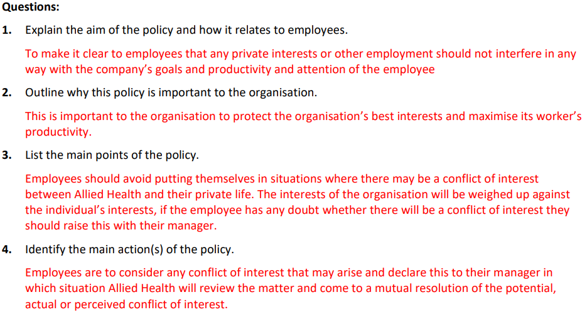
9. Policies and procedures
Questions:
1. Explain the aim of the policy and how it relates to employees.
2. Outline why this policy is important to the organisation.
3. List the main points of the policy.
4. Identify the main action(s) of the policy.

Slide 67
Learning Checkpoint 2
1. List five forms of written instructions that you may have to interpret and document when working in the health services industry.
OHS signs and instructions, referrals, emails, patient medical charts and files, routine reports.
2. List five forms of oral instructions that you may have to interpret and document when working in the health services industry.
Appointments, telephone calls, verbal communications or discussions, homecare instructions, medication orders.
3. Explain why checklists are widely used in the health service industry.
Checklists help to categorise items, simplifying the processes within them so that they are easier to remember.
4. Describe the benefits of using checklists.
Checklists used in the health services industry can promote process improvement and increase patient safety. Using checklists reduces errors caused by lack of information and inconsistent procedures. Checklists have improved processes for hospital discharges and patient transfers as well as for patient care in intensive care and trauma units.
5. For the following health services environments, identify where you may need to use a checklist to complete a routine task:
Hospital: patient observation checklist
Rehabilitation facility: pre-admission checklist
GP Clinic: First time patient checklist
Dentist surgery: medical equipment checklist
Psychologist office: patient information
Physiotherapy practice: previous injury checklist

Slide 68
Learning Checkpoint 2
6. Describe the difference between a policy and procedure.
A policy is made up of clear, simple statements of how an organisation intends to carry out its services, actions or business. A procedure describes how each policy will be put into action in an organisation. The procedures should outline who will do what, the steps they will need to take and what documentation or forms to use.
7. In a health service industry list five occasions where a policy and procedure would need to be in place.
Accessing and updating files, infection prevention and control, formal communication protocol, emergency procedures, organisation code of conduct.
8. When seeking out a workplace’s policies and procedures, outline strategies that can assist you to successfully interpret the information.
Seeking clarification if you have not understood, summarising the main points of the policy or procedure, determining what the policy is and how it relates to you.
9. Explain why it is important for health services workers to understand their workplace’s policies and procedures.
In order to avoid any legal issues, to make sure patient and staff safety is always prioritised and to allow for the smooth and productive running of the facility.
10. Briefly describe the importance of seeking clarification.
This is especially important in the health services industry, as a failure to clarify or understand information could potentially compromise the health of a patient. It could also result in miscommunication and mistakes between other health professionals.

Slide 69
Learning Checkpoint 2
11. List four sources you can use to seek clarification
Medication and prescription information databases, supervisor, experienced staff members, medical dictionary and policies and procedures handbook.
12. Outline a situation where it may not be appropriate to seek clarification from a supervisor or experienced staff member.
In front of a patient who needs to have full confidence in the health professionals taking care of him or her.
13. Explain one way to seek clarification.
To clarify something you need to ask more questions to gain more information that will help you better understand the situation or what someone is asking you to do.
14. List three possible situations where you would need to seek clarification.
a) Whenever you hear a medical term you don’t understand.
b) When receiving instructions.
c) Whenever you have asked something several times the same supervisor you could clarify using a medical dictionary or another experienced staff member, or simply if your supervisor is busy you need to find another method of clarification.

Slide 70
Carry out routine tasks
Routine tasks Include:
Answering patient enquiries
Contributing to meetings and discussions
Dealing with patient complaints
Entering patient details into computer system
Filing patient notes
Maintaining information to assist patients
Maintaining patient information
Maintaining reception areas, waiting rooms, consultation rooms and treatment room
y Ordering supplies (e.g. Stationery, medical supplies)
Preparing medical equipment
Preparing reports
Producing a range of medical documents (e.g. Patient history, referral letters)
Providing information to patients and families
Receiving and making telephone calls
Recording information and data
Storing and maintaining security of medications
Cleaning
Notes:
ASK- what might be routine tasks that you would perform on a daily basis?

Slide 71

Carry out routine tasks
Consequences of using incorrect medical terminology may Include:
Ordering the incorrect supplies may lead to lack of vital equipment.
Labelling medications and other equipment incorrectly could cause patients to receive the wrong medication or treatment. This could lead to further complications and health problems and in some cases death.
Medical staff could receive the wrong information about patients, which could cause delay in diagnosis and the wrong treatment.
Writing the wrong terminology down in notes and records could lead to the wrong treatment being given by health professionals

Slide 72
Seeking assistance
Apart from your supervisors and experienced staff members there are others within the workplace that you can seek assistance when required. They include:
Co-workers
The police and security staff
Work (Occupational) Health and Safety
Ambulance or other medical staff on hand
Experts or specialists in the management of particular
Counsellors

Slide 73

Seeking assistance
When to seek assistance
When starting a new job or role for the first time there will be many occasions where you will need to seek
assistance.
Don’t delay
Be strong and confident
Be specific about what you need help with and for how long
Asking for help is a sign of strength not weakness
Be prepared
How to seek assistance
In person (face to face)
Electronic communication
Notes:
ASK- apart from your supervisors and experienced staff who else might you seek assistance from in a health care setting? Provide an example of when you would seek this assistance.

Slide 74

Seeking assistance
Seeking clarification
Clarification may be sought from sources of information such as:
Medication and prescription information databases
Supervisor
Experienced staff members
Medical dictionary (hard copy or online)
Policies and procedures handbook
How to seek clarification
Clarifying meaning is the act of clearing up any existing confusion or making something easy to understand.
Clarification is important to ensure that you understand what has been spoken about and what you need to do from this point.
Notes:
ASK- where might you seek further clarification on sourced information?

Slide 75
Learning Checkpoint 3
1. List 5 routine tasks in the health services industry where you may use medical terminology.
• Answering patient enquiries
• Contributing to meetings and discussions
• Dealing with patient complaints
• Entering patient details into computer systems
• Filing patient notes
2. Explain the consequences of using medical terminology correctly.
• Ordering the incorrect supplies may lead to lack of vital equipment.
• Labelling medications and other equipment incorrectly could cause patients to receive the wrong medication or treatment. This could lead to further complications and health problems.
• Medical staff could receive the wrong information about patients, which could cause delay in diagnosis and the wrong treatment.
3. Explain why it is important to seek assistance from a supervisor or experienced staff member.
Seeking the assistance where required can provide support and advice to help you work through a situation in the most appropriate way. Supervisors and experienced staff can provide guidance and assist you to carry out your role more effectively. They can also provide you with feedback and potentially suggest alternative strategies that could be more appropriate or that may be worth trying when your own approach has failed or is not working as effectively as you had hoped.
You should only seek advice and assistance from legitimate sources as and when appropriate. A legitimate source is one that is recognised as an expert in the field and someone in a position of authority who can provide you with further guidance.

Slide 76
Learning Checkpoint 3
4. Briefly explain the role of a supervisor or experienced staff member.
The role of a supervisor is to oversee, support and assist employees with any difficulties. A supervisor is generally someone who is quite experienced in their industry and has the leadership skills to motivate employees, support them and resolve conflict.
5. Apart from supervisors and experienced staff members identify five other sources where you could seek assistance.
• Co-workers
• The police and security staff
• Work (Occupational) Health and Safety officers and representatives
• Ambulance or other medical staff on hand
• Experts or specialists in the management of particular areas
6. Describe why it is important to seek assistance in a timely manner.
It is important to seek assistance in a timely manner to avoid the risk of information being confused or misunderstood, which could potentially compromise the health of the patient. It could also cause other health service professionals to communicate incorrect information, which may cause errors.
7. Explain how being strong and confident can help you seek assistance.
By being confident and strong you demonstrate you are willing to learn and are not afraid to ask for help.
8. Briefly explain why it is important to be specific when asking for assistance.
Being specific when asking for assistance will help you save time and will make it easier for a supervisor or experienced staff member to provide you with an answer.

Slide 77
Learning Checkpoint 3
9. Explain how you would seek assistance ‘in person’ with a supervisor or experienced staff member.
This may include having a meeting, conversation or discussion with a supervisor or experienced staff member.
10. Explain how you could seek assistance through the use of electronic communication.
You could send an email to your supervisor or experienced staff member if you are unable to ask for assistance in person. You could also have a video conference with them or a telephone call.
11. Describe the advantages of seeking assistance ‘in person’.
When seeking assistance in person there is less chance for miscommunication or misunderstanding the information.
12. Explain why it is important to have good communication skills when working in the health services industry.
Effective communication is crucial for any workplace to function productively to achieve the desired outcomes. This is especially important in the health services industry, as the outcomes involve improving the health and wellbeing of patients. When interacting with patients and colleagues it is important to know what type of communication is appropriate for the task you are completing.
13. When communicating explain why it is important to be a good listener.
Good listening requires your full attention. When communicating with others it is important to show that you are listening by being an active listener and by responding appropriately. Being an effective communicator is a highly desirable skill when working in the health services industry. As well as being able to identify how to be a good listener you also need to be aware of things that make you a poor listener. Being aware of these factors can assist you to develop better skills, eliminate your listening barriers and overall become a better communicator.

Slide 78
Learning Checkpoint 3
14. When communicating verbally with a patient, colleague or supervisor explain why the following points should be considered:
• Being concise
  Being concise saves time and prevents miscommunication.
• Being direct
  Even if the conversation is difficult it is important to be direct, for example, if you have to ask for clarification because you haven’t understood an instruction. A message can be lost or misinterpreted if you fail to be direct.
• Avoiding information overload
  This will ensure that information is not miscommunicated or misinterpreted.
• Being positive
  When working with patients in the health services industry it is your job to be positive and optimistic. Your mood and demeanour can impact those of your patient’s and colleagues.
• The speed of your speech
  Pausing when speaking can be very powerful as it allows your listener to have 2 – 3 seconds to think about what you have said and process the information. Making sure you allow time for people to absorb and think about the information they are receiving helps prevent confusion and miscommunication
• Being polite and professional
  When communicating with patients, colleagues or supervisors you should always be courteous, friendly, open and honest. You should consider your tone and the words you use to avoid seeming passive-aggressive or sarcastic. It is also important to be genuine and empathetic. This is especially important when working with patients and families who are coping with illness, injury and disease. It is important to always be caring and empathetic while still maintaining your professionalism.

Slide 79
Use appropriate medical terminology in written and oral communication
Communication
Oral communication
Teamwork
Initiative
Written communication
Accuracy and checking information and terminology

Slide 80

Use appropriate medical terminology in written and oral communication
Communication
Effective communication is crucial for any workplace to function productively to achieve the desired outcomes.
Listening and responding
Good listening requires your full attention.
Listening barriers include:
being preoccupied, you have other things on your mind and are too busy
a lack of interest in what is being communicated
too busy thinking about what you are going to say next
you are distracted by another conversation nearby or noise
you don’t like what is being said, so you mentally detach yourself from the conversation
the person speaking is a poor communicator; they speak in monotone and give too much information
you already know what the person is going to say so you stop listening.
Notes:
ASK- who can explain what might be a barrier to listening?

Slide 81

Use appropriate medical terminology in written and oral communication
Be concise.
Be direct.
Avoid information overload.
Always be polite and professional.
Be positive.
Consider the speed of your speech and whether or not you paused between sentences.
Oral communication may include:
Answering routine telephone enquiries
Communicating with a range of health service professionals on patient related matters
Confirming appointments
Dealing with difficult patients or clients
Paging staff
Reporting to supervisors or other health service professionals at meetings
Transferring calls
Verbal instructions
Oral communication

Slide 82

Use appropriate medical terminology in written and oral communication
Teamwork
Undertaking work in the health services industry often involves working as part of a team and alongside people with different expertise and within different departments.
Initiative
To develop your ability to take initiative you should:
Always reach out and help co-workers who look like they need assistance.
Be decisive when making decisions and take action quickly.
Make suggestions to improve the workplace, for example simplifying work processes, increasing patient engagement and connectedness to the community, opportunities to reduce costs and increase productivity.
Volunteer to take on additional roles and responsibilities.
Be prepared for staff and/or patient meetings by completing any pre-reading and rehearsing for questions that you may be asked.

Slide 83
10. Oral communication
In this task there are four practical scenarios. You are required to work in pairs and role play these scenarios.
1. Each person will select a practical scenario from the list below.
2. One person in your pair will act as the assistant and the other will act as the supervisor or experienced staff member.
3. Each person will be required to write a script that they will use to act out their chosen scenario. You will need to write a script using the space provided for a conversation you will be having with the assistant (your partner). The conversation and script must include medical terminology relevant to the scenario you select.
4. Each conversation should last between 30 seconds to 1 minute.
5. You will need to give your completed script to your trainer before you commence your role play to verify you have used the correct medical terminology.
6. Once your teacher has reviewed your script you will perform it for the class.
Choose one of the following scenarios:
Scenario 1: You are a supervising physiotherapist at a private clinic and you are having a conversation with a physiotherapy student who is completing their work placement about the condition of patients in your care. You need to talk about a patient’s history, the reason they are in your care and what is being done to treat them.

Slide 84
10. Oral communication
Scenario 2: You work as a registered nurse in the emergency department of your local hospital. You are in charge of three nurse’s assistants that help you complete many routine tasks. A patient is brought into the emergency room after feeling unwell at home. While assessing the patient you have to communicate to the nurse’s assistants the patient’s symptoms, possible diagnosis and treatment.
Scenario 3: You are working as ward supervisor at a cosmetic surgery clinic. You have a number of patients returning to the recovery room and you need to communicate to the ward assistant on the type of surgery the patient is recovering from and an overall summary of the patient’s health after the operation.
Scenario 4: You are an experienced medical receptionist at GP clinic and you need to make a phone call to another clinic to organise some scans for a patient who is suffering from a chronic lung condition and a history of heart problems. You will also have to communicate to the patient about what procedures you will be arranging for them.
Scenario 5: You are a surgeon working in an operating theatre and are dictating to your theatre technician about the injuries sustained to a patient’s body after a car accident.
Chosen scenario: ___________________

Slide 85


Use appropriate medical terminology in written and oral communication
Written communication
Appointment diaries, cards and patient care plans
Medical notes
Communications to a range of health service professionals on patient related matters
Medical equipment ordering forms
Referral letters
Memos
Meeting minutes
Patient history documents
Patient records
Telephone messages
Emails
Notes:
ASK- what does written communication include?
ASK- what does it mean when we talk of designated persons? Who might be a designated person in a health care setting?

Slide 86

Use appropriate medical terminology in written and oral communication
Accuracy and checking information and terminology
General tips and ideas to help you when using medical terminology in written communications:
Read through carefully and check all information is correct
Ask supervisor or experienced staff member when unsure
In your own time practice common medical terms abbreviations so that you can interpret documentation efficiently and easily
Take your time and think about what you need to say. If you rush you might miss something that could have negative consequences.
Verification of written communication
If you are unsure, or simply want to double check terminology you have used in a written communication you will need to check with a designated person.
Designated persons may include:
Supervisor (e.g. doctor, nurse, physiotherapist)
Experienced staff member
Practice manager

Slide 87

11. Written communication
Your task is to read the following written communications you would find when working in the health services industry and correctly identify and decipher the medical terms within each communication. You may need to conduct some research to help you with this task.
a) Medical prescription: You will need to identify and decipher a minimum of four terms and/or abbreviations.

Slide 88


11. Written communication

Slide 89

11. Written communication
b) Patient evaluation sheet: You will need to identify and decipher a minimum of ten terms
and/or abbreviations.

Slide 90


11. Written communication

Slide 91

11. Written communication
c) Referral letter: You will need to identify and decipher a minimum of six terms and/or abbreviations.

Slide 92


11. Written communication

Slide 93

11. Written communication

Slide 94
Spelling and pronunciation
American versus English spelling
Dropping a vowel when joining word parts
Plurals
Exceptions to these principles
Reading backwards
Pronouncing medical words and phonetic spelling

Slide 95



Spelling and pronunciation
For example:
Inter muscular means between the muscles.
Intra muscular means into the muscle.
American versus English spelling

Slide 96


Spelling and pronunciation
Dropping a vowel when joining word parts

Slide 97

Spelling and pronunciation
Plurals
one gastroscope becomes two gastroscopes
one hysterectomy becomes two hysterectomies

Slide 98

Spelling and pronunciation
Exceptions to these principles
Unfortunately, you will also find words that do not. Some examples of these are set out below:
Reading backwards
This principle usually works, but it can be difficult when a prefix changes the meaning of the combining
form. For example:
gastralgia = gastr + -algia = pain in the stomach
(stomach) (pain)1111111
However, if you add the prefix epi (meaning upon or above) the word changes:
epigastralgia = epi + gastr + -algia = pain in the stomach above

Slide 99

Spelling and pronunciation
Pronouncing medical words and phonetic spelling
When a word is spelt phonetically there are some key elements to remember:
Words of two or more syllables are broken up with a hyphen (-).
The syllable that is stressed is shown in capital letters.
A vowel (a, e, i, o, u) gets a short pronunciation.
A short line over a vowel gives it a long pronunciation.
For example:
Cardiac is pronounced: KAR-di-ak
Cardiologist is pronounced: KAR-dee-OL-oh-jist
Gastroenteritis is pronounced: gas-troh-enter-I-tis
Gastropathy is pronounced: gass-TROP-uh-thee
Gastrostomy is pronounced: gass-TROST-omi
Thoracic is pronounced: thō-RAS-ik
Notes:
ASK- When a word is spelt phonetically what are some elements to remember?

Slide 100

Spelling and pronunciation
Pronouncing medical words and phonetic spelling
Many words are pronounced as they are spelt, but there are exceptions.

Slide 101

12. Medical terminology
Spelling certain medical terms can sometimes be difficult, however it will become easier when you practice. You will need to listen to the medical terms read aloud by your teacher. You will then have to correctly spell the word in the table provided below. At the end of the spelling bee your teacher will share the correct answers with you. If you have spelt the word correctly place a tick in the column that says ‘correct spelling’. If you have spelt the word incorrectly write the correct spelling in the ‘correct spelling’ column.
Number | Word | Correct spelling
1
2
3
4
5
6
7
8
9
Notes:
• Pneumonia • Gastroenteritis • Oesophagus • Anaemia • Foetal • Laryngitis • Haematologist • Luecocyte • Immunology • Hyperthyroidism • Diuretic • Diaphragm • Physiology • Homeostasis • Necrotic • Acidosis • Systole • Subcutaneous • Arteriovenous • Arteriosclerosis

Slide 102
12. Medical terminology
Number | Word | Correct spelling
10
11
12
13
14
15
16
17
18
19
20
Notes:
• Pneumonia • Gastroenteritis • Oesophagus • Anaemia • Foetal • Laryngitis • Haematologist • Luecocyte • Immunology • Hyperthyroidism • Diuretic • Diaphragm • Physiology • Homeostasis • Necrotic • Acidosis • Systole • Subcutaneous • Arteriovenous • Arteriosclerosis

Slide 103


13. All in the pronunciation
Pronouncing certain medical terms can sometimes be difficult, however it will become easier when you practice. You will need to read aloud the following phonetic forms then write down the word that you are trying to pronounce with the correct spelling.

Slide 104


13. All in the pronunciation

Slide 105



13. All in the pronunciation

Slide 106
Learning Checkpoint 4
1. Identify five types of ‘oral’ communication that you may complete within your role in the health services industry.
• Answering routine telephone enquiries
• Communicating with a range of health service professionals on patient related matters
• Confirming appointments
• Dealing with difficult patients or clients
• Paging staff
• Reporting to supervisors or other health service professionals at meetings
• Transferring calls
2. When communicating orally with patients and colleagues explain why it is important to always use the correct medical terminology.
This is to ensure that you communicate the correct information to the patient so they can fully understand any treatment, diagnosis or any information relating to their health.
3. Describe why it is important to be able to work effectively as part of a team within a health service environment.
When working in the health service industry you will often be working alongside people with different expertise and within different departments. By working effectively with others you can achieve a common goal and benefit from all the advantages that a team environment has to offer.

Slide 107
Learning Checkpoint 4
5. Identify five types of ‘written’ communication that you may complete within your role in the health services industry.
• Appointment diaries, cards and patient care plans
• Medical notes
• Communications to a range of health service professionals on patient related matters
• Medical equipment ordering forms
• Referral letters
• Memos
6. Describe two ways you can check that the information and terminology you have used is accurate.
You can seek clarification from a supervisor or in your own time practice common medical terms and abbreviations.
7. When checking the accuracy of your written information identify three persons who would be able to verify what you have written.
• Supervisor
• Experienced staff member
• Practice manager

Slide 108
Learning Checkpoint 4
8. For the medical terms below that are spelt the American way, spell the same words the English way.
American Spelling | English spelling
Anemia | Anaemia
Diarrhea | Diarrhoea
Edema | Oedema
Hemaglobin | Haemoglobin

Slide 109

1. Written Questions
1. What is one policy or procedure you need to follow when using medical terminology?
• Accessing and updating files
• Infection prevention and control
• Formal communications protocol
• Emergency procedures
• Following instructions
• Organisation code of conduct (e.g. harassment, behaviour and discrimination)
• Occupational health and safety (OHS)/Work Health and Safety (WHS)
• Phone and email protocol
• Recording information
• Patient confidentiality and privacy procedures

Slide 110
1. Written Questions
2. Explain each of the three main elements of medical terminology listed below:
There are three elements word root, prefixes, and suffixes.
Word root: A word root is the subject of the medical term and is specific to the body part to which the term refers. It provides the greatest amount of meaning. A word root usually describes the location, system or the specific element that has been affected by the disease, disorder or condition. a word root is incomplete and cannot stand-alone. It requires a prefix or suffix to complete its meaning, as they are usually only half words.
Prefix: Prefixes appear at the beginning of a word and tell you the how, why, where, when, how much, how many, position, direction or number. As the name suggests, ‘pre’ means before and is used in common words like preview, preface and predict. In medical terms a prefix comes before the word root and modifies or changes its meaning.
Suffix: A suffix is found at the end of a word and indicates the procedure, condition or disease.
3. Name two (2) sources of information to check on medical terminology.
• Supervisor or manager
• Workplace documents
• Work colleague
• Internet

Slide 111
1. Written Questions
4. Will, a nurses' assistant starts his 10-hour shift at 4pm on a Thursday afternoon. He arrives at the hospital with a list of duties to carry out before the evening. While he is learning to complete many tasks, he is still getting used to his new role. Will works under the supervision of an experienced nurse, mainly when attending to patients. Will’s supervisor has informed him that there has been a spill in one of the rooms and he is required to clean up. Will goes to check the room and he has come across some sharps that have been left behind. He knows that he needs gloves and the sharps disposal container but he’s not sure where they are located.
Suggest the best way for Will to seek clarification.
Will should seek clarification from his supervisor.
5. Identify the root words in the following medical terminology and explain the meaning of the root word.
Terminology | Root word | Meaning of the root word
Polymyositis | Myo | Muscle
Gastrology | Gastr | Stomach
Haemopoietic | Haem | Blood
Phlebitis | Phleb | Vein
Septicaemia | Sept | Infection

Slide 112
1. Written Questions
6. Identify the prefix in the following medical terminology, and explain the meaning of the prefix.
7. Identify the suffix in the following medical terminology, and explain the meaning of the suffix.
Terminology | Prefix | Meaning of the prefix
Hypertension | Hyper | excessive or above
Intravenous | Intra | inside or within
Prenatal | Pre | Before
Antiseptic | Anti | Against
Contraindication | Contra | Against, opposite
Terminology | Suffix | Meaning of the suffix
Arthritis | itis | Inflammation
Appendectomy | ectomy | Surgical removal of
Hemiplegia | plegia | Paralysis
Myalgia | algia | Pain
Claustrophobia | phobia | Fear of

Slide 113
1. Written Questions
8. Break down the following medical terminology into their fundamental structures and then explain the meaning of each terminology.
Medical Terminology | Breakdown | Meaning of the terminology
Appendicitis | Word root: Appendic Suffix: itis | Inflammation of the appendix
Antenatal | Prefix: Ante Suffix: Natal | Before birth
Gastroenteritis | Word root-Gastr Combining vowel: o Word root: enter Suffix: itis | Inflammation of stomach and intestines
Rhinoplasty | Word root-Rhin Combining vowel: o Suffix: Plasty | surgical repair of the nose
Autoimmune | Prefix: Auto Suffix: immune | Relating to disease that attack the body by its own immune system

Slide 114
1. Written Questions
9. Explain the meaning of each of the abbreviations listed below.
Abbreviation | Meaning
CPR | Cardiopulmonary Resuscitation
DOB | Date of Birth
ENT | Ear, Nose and Throat
UTI | Urinary Tract Infection
TB | Tuberculosis

Slide 115
2. Project
Please download the following documents/templates:
BSBMED301_PATIENT NOTES
BSBMED301_CLINICAL ABBREVIATIONS LIST
You are to read the following patient case description and write a patient note using the appropriate and correct medical terminology and abbreviations. You will be required to write your notes on the BSBMED301_ PATIENT NOTES template.
It is important to consider the following factors when writing your patient note:
Correct spelling of medical terms
Correct use of acronyms and abbreviations
Correct identification of symptoms, processes, conditions and/or diseases
Upload the completed BSBMED301_ PATIENT NOTES in IVET

Slide 116
2. Project
Patient case
Shirley McKenzie is a relatively healthy 24-year-old woman who exercises at least 30 minutes a day, is a non-smoker, and a non-drinker and works in the corporate sector. Shirley presents to the emergency room with a major complaint of severe chest pain that has been worsening since the morning.
The patient also complains of the following symptoms:
Dizziness
Shortness of breath
Headache
Low blood sugar.
The patient has a past medical history of deep vein thrombosis, and she has a family history of heart attack. The patient has not been experiencing any nausea or vomiting, but after a physical exam she is experiencing pain in her lower left quadrant of her abdomen. Her vital signs are normal, and she has not passed urine in the last 14 hours. She also has a temperature of 39.5 degrees Celsius.
The patient has been sent for the following investigations and has been admitted to the coronary care unit:
Full blood count
Chest x-ray
Urine analysis
Electrocardiogram
The patient suffers from no known allergies.

Slide 117
3. Observation
https://www.youtube.com/watch?v=fIABkSYOiv4
https://www.youtube.com/watch?app=desktop&v=Rn6r_hFWP0Q
Download the following template/document from the IVET portal:
• BSBMED301_ CLIENT HANDOVER CHECKLIST
• BSBMED301_POLICY AND PROCEDURE MANUAL
This assessment requires you to partner with another student. You will both act as health professionals and your assessor with play the role of your supervisor.
You will be conducting a handover of a patient/resident with your partner. You must complete the
BSBMED301_CLIENT_HANDOVER_CHECKLIST.
You will swap roles so that each of you manages the hand over whilst your Supervisor observes you.
You will need to select from one of the following scenarios:
• Handing over from a shift at the hospital to the next shift staff
• Rehabilitation clinic and handing over to an allied health professional.
• Aged care facility and you’re discussing a resident with your manager.
You will need to make up the details of the patient you are handing over, these will include details such as the patient’s name, date of birth, any medical issues arising during the shift and any vital sign assessments you conducted.
https://www.youtube.com/watch?v=rgSfpC1zCgQ
https://www.youtube.com/watch?v=5jY94y_nyNA

Slide 118
3. Observation
You will need to ensure that you:
• Follow workplace policies and procedures by using a workplace handover checklist.
• Seek clarification when necessary.
• Use medical terminology correctly e.g., pronounce.
• Present written communication to a designated person.
At the completion of this assessment, Students must upload the following completed documents to the IVET Portal, unless prior permission has been attained from IVET to complete the task(s) in hard copy:
• BSBMED301_ CLIENT HANDOVER CHECKLIST

Slide 119
3. Observation: Aged care resident handover
Resident name: Katie Perry
Low Falls Risk Type Of Care: Permanent Care Occupied: Tower Ward / Room 022
ID: 12345 Date of Birth: 17/09/1928 Medical Practitioner: Dr. Orlando Bloom
Medicare No: 1234567890 Admission Type: Permanent Care
Admission Date: 11/04/2024 14:49 Ethnicity: Neither Aboriginal nor Torres Strait Islander origin
Principal diagnosis - Fall, Left ATFL #, PPM, HT, Bilateral total hip replacement, Bilateral cataracts, cholecysectomy, OA
Main Medical Diagnosis
Left ATFL Avulsion fracture Severe Community Acquired Malnurishment Cognitive decline HT, PPM, OA, Bilateral Total hip replacement, Cholecystectomy
*Daily forms:
Weekly weights, CSC Hourly, falls risk low low bed with crash mats
Strict behavior charting regarding her mood during the shift until 07/05/24 Continence chart
*Appointment: Pysio 2/5/24 Thursday 14:30 at 2/550 Smollett Street, Albury NSW
*Incidents: Nil
*Medical: ACD to be attended
*Other:
-On thin fluids and mince moist diet
-Uses 4WF+ x1 assist .Physio referral sent , not walking with 4ww.
-Double incontinent
Vital signs on admission: 11/04/2024 17:53
P86, BP111/69, T36.4, Resp18, O2 SAT 98%, Wt 41.68kg

