Slide 1
Combining linear and geometric growth or decay to model compound interest investments with additions to the principal
8A

Slide 2
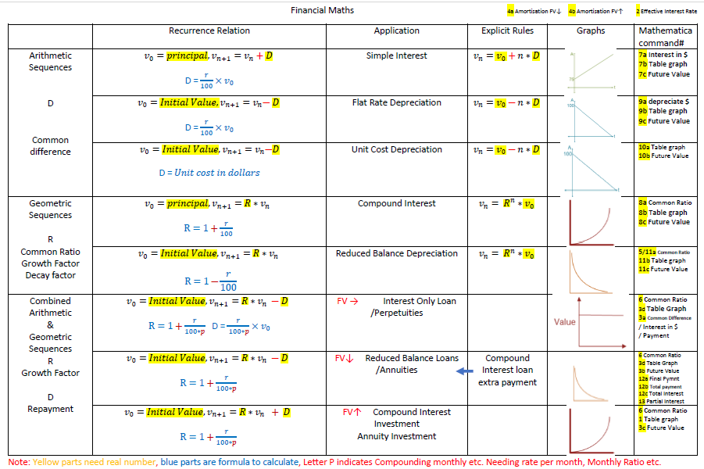

Slide 3
Combining geometric growth and decay
The principal of the loan is the amount that is borrowed. The amount owed, or the balance of the loan, will increase over time because interest is charged and added to the loan.
A recurrence relation of the form
$V_{0}$= starting value, $V_{n+1}$=𝑅× $V_{n}$±𝐷
can be used to model situations that involve both geometric and linear growth or decay.

Slide 4
Generating a sequence from a recurrence relation of the form $V_{n+1}$=R× $V_{n}$± D
Write down the sequence generated by the recurrence relation
$V_{0}$=3, $V_{n+1}$=4 $V_{n}$−1
$V_{0}$=3
$V_{1}$=4×3−1=11
$V_{2}$= 4×11−1=43
$V_{3}$= 4×43−1=171
$V_{4}$= 4×171−1=683
The sequence is 3,11,43,171,683,...

Slide 5
Modelling population change using a recurrence relation
The number of trout in a fish farm pond after 𝑛 months, $T_{n}$, can be modelled using the recurrence relation:
$T_{0}$=10000, $T_{n+1}$=1.1× $T_{n}$−3000
1. Use the recurrence relation to determine the number of trout in the pond after 2 months.
2. After how many months will there be no trout left in the pond?
1. $T_{0}$=10000 $T_{1}$=1.1×10000−3000=8000 $T_{2}$=1.1×8000−3000=5800
After 2 months there will be 5800 trout in the pond.
2. There will be no trout left in the pond after 5 months.

Slide 6
Compound interest investments with regular additions to the principal

Slide 7
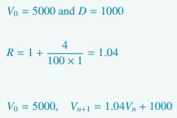
Modelling compound interest investments with additions to the principal

Slide 8
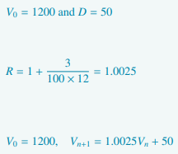
Modelling compound interest investments with additions to the principal

Slide 9
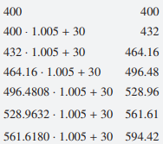
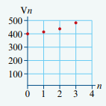
Using a recurrence relation to analyse compound interest investments with additions to the principal

Slide 10
Determining the annual interest rate from a recurrence relation

