Slide 1
Modelling and analysing reducing-balance loans and annuities
Chapter 8
Notes:
https://create.kahoot.it/details/5a41a964-bc95-4d53-a293-68ebcc45457f
https://create.kahoot.it/details/871230ce-9c62-45ee-a642-5bda2cab1aea

Slide 2
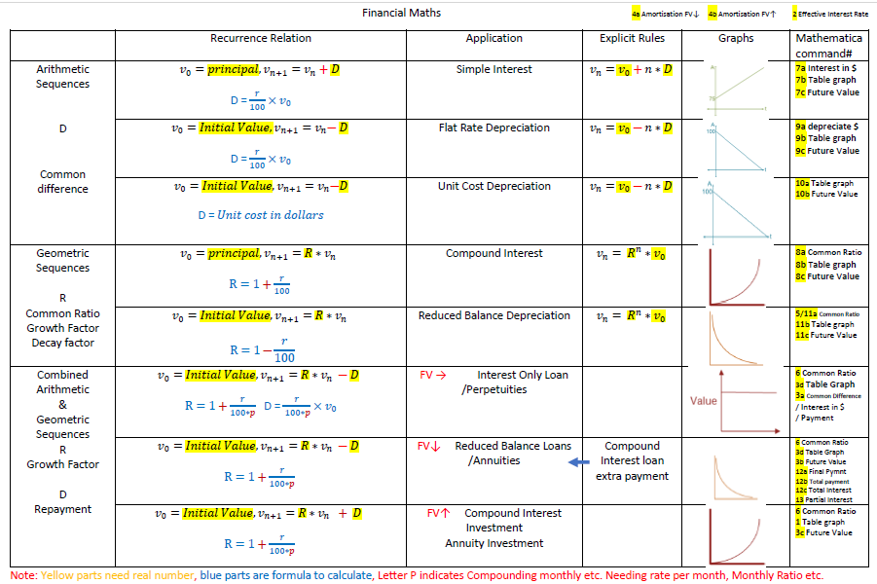

Slide 3
Amortisation table
Future value↓
Rate = r = $\frac{Interest}{Previous balance} ×$ 100
Regular Payment = Interest + Principal Reduction
Previous Balance – Principal Reduction = New Balance of Loan
Total Interest = Total Payment – Principal Reduction
Future value↑
Rate = r = $\frac{Interest}{Previous balance} ×$ 100
Regular Payment + Interest = Principal Increase
Previous Balance+ Principal Increase = New Balance
Total Interest = Final Balance – Principal – additional payment

Slide 4
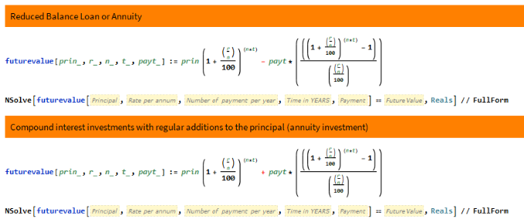
Financial solver
First, decide future value up or down by searching key words. mortgage loan annuity are down and investment or annuity investment are up. This is to decide which command to use.
Keywords of FINAL PAYMENT, PERPETUITY are using other commands.
Second, check to see you have different stages for rates change, condition changes.
Third, list key data for each stage to use Mathematica.
e.g. Stage 1 Future value↓, Principal=35000, rate=3.5, number of payment per year=12, time=3 years(has to be years), regular payment=?, FV=0 --> Payment=1025.57
Stage 2 Final payment Command, Principal=35000, rate=3.5, number of payment per year=12, time=35/12 years(has to be years), regular payment=1025.57, Final payment=? --> Final Payment=1025.68

Slide 5
Combining geometric growth and decay

Slide 6
Combining geometric growth and decay
The principal of the loan is the amount that is borrowed. The amount owed, or the balance of the loan, will increase over time because interest is charged and added to the loan.
A recurrence relation of the form
$V_{0}$= starting value, $V_{n+1}$=𝑅× $V_{n}$±𝐷
can be used to model situations that involve both geometric and linear growth or decay.

Slide 7
Generating a sequence from a recurrence relation of the form $V_{n+1}$=R× $V_{n}$± D
Write down the sequence generated by the recurrence relation
$V_{0}$=3, $V_{n+1}$=4 $V_{n}$−1
$V_{0}$=3
$V_{1}$=4×3−1=11
$V_{2}$= 4×11−1=43
$V_{3}$= 4×43−1=171
$V_{4}$= 4×171−1=683
The sequence is 3,11,43,171,683,...

Slide 8
Analysing reducing-balance loans with recurrence relations
9B

Slide 9
Reducing-balance loans
A reducing-balance loan is effectively a compound interest loan, with regular payments. Personal loans and mortgages (home loans) are examples of reducing-balance loans.
Modelling reducing balance loans
Let $V_{n}$ be the balance of the loan after 𝑛 payments have been made.
Let 𝑟 be the interest rate per compounding period.
Let 𝐷 be the payment made.
A recurrence relation rule that can be used to model a reducing balance loan is
$V_{0}$ = the principal, $V_{n+1}$ =𝑅 $V_{n}$ −𝐷
where 𝑅=1+$\frac{r}{100}$

Slide 10
Modelling a reducing-balance loan with a recurrence relation
Alyssa borrows $1000 at an interest rate of 15% per annum, compounding monthly.
She will repay the loan by making four monthly payments of $257.85.
Construct a recurrence relation to model this loan, in the form
$V_{0}$ = the principal, $V_{n+1}$ =𝑅 $V_{n}$ −𝐷 where 𝑅=1+$\frac{r}{100}$
$V_{0}$ =1000 𝑟= $\frac{15\%}{12}$=1.25%
𝑅= 1+$\frac{r}{100}$= 1+$\frac{1.25}{100}$=1.0125=1.0125
𝐷=257.85
$V_{0}$ =1000 $V_{n+1}$ =1.0125 $V_{n}$ −257.85

Slide 11
Amortisation tables
Interest paid = interest rate per payment period × unpaid balance
For example, when payment 1 is made, interest paid =1.25% of 1000=$12.50
1031.44
Principal reduction = payment made - interest paid
For example, when payment 1 is made, principal reduction =257.85−12.50=$245.35
Balance of loan = balance owing - reduction in balance
For example, when payment1 is made, reduction in balance =1000−245.35=$754.65

Slide 12
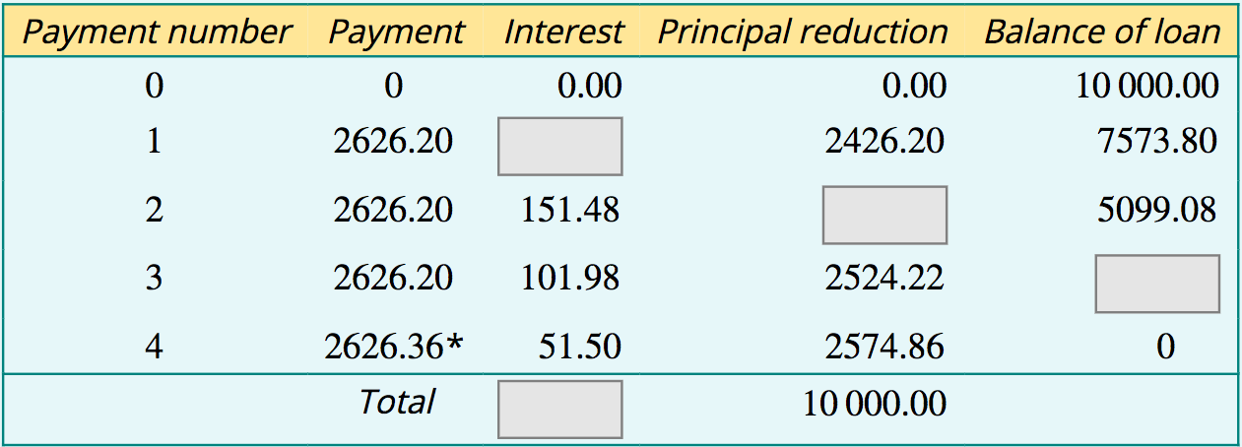
Reading and interpreting an amortisation table
A business borrows $10000 at a rate of 8% per annum. The loan is to be repaid by making four quarterly payments of $2626.20. The amortisation table for this loan is shown below.
*the final payment has been adjusted so that the final balance is zero.
a. Determine, to the nearest cent:
1. the quarterly interest rate
2. the interest paid when payment 1 is made using the quarterly interest rate
3. the principal repaid from payment 2
4. the balance of the loan after payment 3 has been made
5. the total cost of repaying the loan
b. verify that the total amount of interest paid = total cost of the loan - principal
Interest paid = 2% of $10000 = $200
Principal reduction = 2626.20−151.48 = $2474.72
Balance of the loan after 3 payments = 5099.08−2524.22 = $2574.86
Quarterly interest rate=8/4=2% or 0.02
Total cost = 3×2626.20+2626.36 = $10504.96
Total interest=$10504.96−10000=$504.96

Slide 13
Using a financial solver to analyse reducing-balance loans
9C

Slide 14
Mathematica
$−$ due to regular payment to make FV $↓$

Slide 15
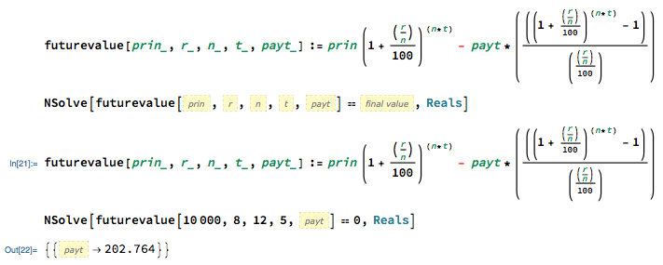
Determining the payment amount, total cost and total amount of interest paid
Sipho borrows $10000 to be repaid in equal payments over a period of 5 years. Interest is charged at the rate of 8% per annum, compounding monthly. Find:
1. the monthly payment amount, correct to the nearest cent
2. the total cost of repaying the loan to the nearest dollar
3. the total amount of interest paid to the nearest dollar.
1. Sipho repays $202.76 every month.
2. Total cost=number of payments × payment amount=60×202.7639…=12165.60
3. Interest paid=total cost−principal=12166−10000=$2166

Slide 16
Reducing-balance loans with changing conditions
An amount of $150000 is borrowed for 25 years at an interest rate of 6.8% per annum, compounding monthly.
1. What are the monthly payments for this loan?
2. How much is still owing at the end of 3 years?
After 3 years, the interest rate rises to 7.2% per annum.
3. What are the new monthly payments that will see the loan paid in 25 years.
4. How much extra does it now cost (to the nearest 10 dollars) to repay the loan in total?
1. The payments on this loan are $1041.11 each month.
2. After 3 years, there is $142391.84 still owing on the loan.
3. The new payments will be $1076.18 each month.
4. Extra paid each month:
extra=1076.18−1041.11=$35.07
Total extra paid:
total=264×35.07=$9258.48=$9260

Slide 17
Interest-only loans

Slide 18
Interest-only loan
Let $V_{0}$ be the principal.
Let 𝑟 be the interest rate per compounding period.
Let 𝐷 be the payment made.
For Interest-only loan:
payment made=interest earned only
so
𝐷=$\frac{r}{100}$× $V_{0}$

Slide 20
Repaying an interest-only loan
Jane borrows $50000 to buy some shares. Jane negotiates an interest-only loan for this amount, at an interest rate of 9% per annum, compounding monthly. What is the monthly amount Jane will be required to pay?
$V_{0}$=50000
𝑟= $\frac{9}{12}=$0.75%
D= $\frac{r}{100}$× $V_{0}=\frac{0.75}{100}\text{× }\text{50000 }$=375
Jane will need to repay $375 every month on this interest-only loan.

Slide 21
Annuities
9E
An annuity, also known as a lifetime or fixed-term pension, gives you a guaranteed income for a number of years. Or the rest of your life.
An annuity is a financial product that pays out a fixed stream of payments to an individual, and these financial products are primarily used as an income stream for retirees.

Slide 22
Modelling an annuity
Reducing Balance Depreciation
Loan
identical
Annuities
Financial Plan
Let 𝑟 be the interest 𝑟𝑎𝑡𝑒 per compounding period.
Let 𝐷 be the payment received.
A recurrence relation that can be used to model the value of an annuity after 𝑛 payments, $V_{n}$, is
$V_{0}$=principal, $V_{n+1}$=𝑅 $V_{n}$−𝐷 where 𝑅=1+ $\frac{r}{100}$

Slide 23
Modelling an annuity with a recurrence relation
Reza plans to travel overseas for 6 months. He invests $12000 in annuity that earns interest at the rate of 6% per annum, providing him with a monthly income of $2035 per month for 6 months.
Model this annuity using a recurrence relation of the form
$V_{0}$ = the principal, $V_{n+1}$=𝑅 $V_{n}$−𝐷 where 𝑅=1+ $\frac{r}{100}$
where $V_{n}$ is the value of the annuity after 𝑛 payments have been received.
$V_{0}$ =12000
𝑟= $\frac{6\%}{12}$=0.5% or 0.005 𝑅= 1+ $\frac{r}{100}$= 1+ $\frac{0.5}{100}$=1.005
𝐷=2035
$V_{0}$ =12000, $V_{n+1}$=1.005 $V_{n}$−2035

Slide 24
Mathematica
$−$ due to regular payment to make FV $↓$

Slide 25
Using a recurrence relation to analyse an annuity
Reza’s annuity can be modelled by the recurrence relation
$V_{0}$ =12000, $V_{n+1}$=1.005 $V_{n}$−2035
where $V_{n}$ is the value of the annuity after 𝑛 payments have been received.
1. Use your calculator to determine recursively the value of the annuity after Reza has received three payments from the annuity.
2. Is the annuity fully paid out after six monthly payments have been made? If not, how much will the last payment have to be to ensure that the annuity terminates after 6 months?
1. $6045.33 (to the nearest cent)
2. 𝐿𝑎𝑠𝑡 𝑝𝑎𝑦𝑚𝑒𝑛𝑡=2035+0.88=$2035.88

Slide 26
Perpetuities

Slide 27
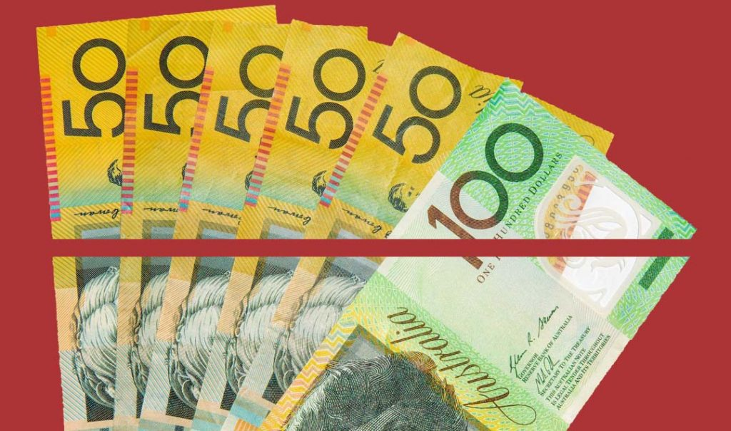
Perpetuities: Special annuity
Reducing Balance Depreciation
Loan
identical
Annuities
Financial plan
interest-only loan
Loan
identical
payment received=interest earned
Perpetuities
Financial plan
Notes:
https://www.youtube.com/watch?v=mUVwvw2toXM

Slide 28
Perpetuities
Let $V_{0}$ be the initial value of the annuity.
Let 𝑟 be the interest rate per compounding period.
Let 𝐷 be the regular payment received.
For perpetuities:
payment received=interest earned
so
𝐷=$\frac{r}{100}$× $V_{0}$

Slide 30
Calculating the withdrawal from a perpetuity
Elizabeth invests her superannuation payout of $500 000 into a perpetuity that will provide a monthly income without using any of the initial investment.
If the interest rate for the perpetuity is 6% per annum, what monthly payment will Elizabeth receive?
$V_{0}$=500000.
𝑟=$\frac{6}{12}$=0.5.
𝐷= $\frac{r}{100}$× $V_{0}$= $\frac{0.5}{100}$×500000=2500
Elizabeth will receive $2500 every month from her investment.

Slide 31
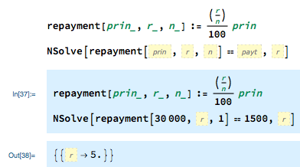
Calculating the interest rate of a perpetuity
A university mathematics faculty has $30000 to invest. It intends to award an annual mathematics prize of $1500 with the interest earned from investing this money in a perpetuity.
What is the minimum interest rate that will allow this prize to be awarded indefinitely?
Alternatively, Using a financial solver
The minimum annual interest rate to award this prize indefinitely is 5%.

Slide 32
Compound interest investments with regular additions to the principal (annuity investment)
9G

Slide 33
Modelling compound interest investments with regular additions to the principal
Let 𝑟 be the interest rate per compounding period.
Let 𝐷 be the payment made.
A recurrence relation that can be used to model the value of a compound interest investment, $V_{n}$, after 𝑛 additional payments have been made is
$V_{0}$ = the principal, $V_{n+1}$=𝑅 $V_{n}$+𝐷
where 𝑅=1+$\frac{r}{100}$.

Slide 34
Modelling compound interest investments with additions to the principal
Nor plans to travel overseas when she finishes her VCE. She has already saved $1200 and thinks that she can save an additional $50 each month that she plans to add to her savings account. The account pays interest at a rate of 3% per annum, compounding monthly.
Model this investment using a recurrence relation of the form
$V_{0}$ = the principal, $V_{n+1}$=𝑅 $V_{n}$+𝐷
where $V_{n}$ is the value of the investment after 𝑛 payments (additions to the principal) have been made.
$V_{0}$=1200
𝑟=$\frac{3\%}{12}$=0.25% or 0.0025
𝑅=1+ $\frac{r}{100}$ , so 𝑅=1+ $\frac{2.5}{100}$=1.0025.
𝐷=50
$V_{0}$=1200 , $V_{n+1}$=1.0025 $V_{n}$+50

Slide 35
Mathematica
+ instead of $−$ due to regular deposit, FV $↑$

Slide 36
Using a recurrence relation to analyse compound interest investments with additions to the principal
Nor’s investment can be modelled by the recurrence relation
$V_{0}$=1200 , $V_{n+1}$=1.0025 $V_{n}$+50
where $V_{n}$ is the value of the investment after 𝑛 payments have been received.
1. Use your calculator to determine recursively the value of the investment after Nor has made three additional payments to her investment.
2. What will be the value of her investment after 1 year?
1. After three additional payments, the value of Nor’s investment is $1359.40.
2. After 1 year , the value of Nor’s investment is $1844.82.

