Slide 1
Using matrices to model road and communication networks
4F

Slide 2
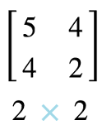
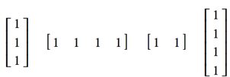
TYPES OF MATRICES
NAME | DESCRIPTION | EXAMPLE
Row matrix | A matrix with only 1 row
Column matrix | A matrix with only I column
Square matrix | the number of rows equals the number of columns
Zero (Null) matrix | A matrix with all zero entries
Summing matrix | A row or column matrix in which all the elements are 1. To sum the rows of an m × n matrix, post-multiply the matrix by an n × 1 column summing matrix. To sum the columns of an m × n matrix, pre-multiply the matrix by a 1 × m row summing matrix.

Slide 3
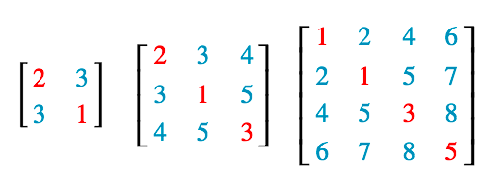
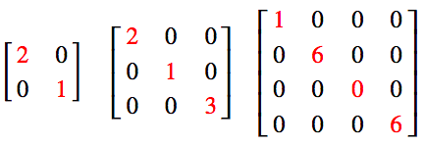
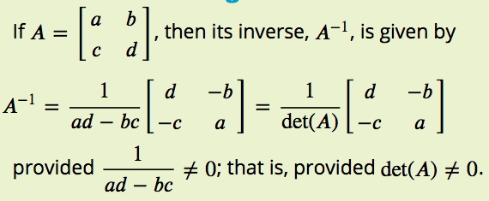
TYPES OF MATRICES
NAME | DESCRIPTION | EXAMPLE
Transpose of a matrix | a new matrix that is formed by interchanging the rows and columns.
Symmetric matrices | A matrix A is called symmetric if A^{T}= A
Diagonal matrices | if all of the elements off the leading diagonal are zero.
Identity matrices | This is denoted by the letter I and has zero entries except for 1’s on the diagonal.
Inverse matrices | A square matrix A has an inverse if there is a matrix $A^{−1}$ such that: A$A^{−1}$ = I

Slide 4
TYPES OF MATRICES
NAME | DESCRIPTION | EXAMPLE
Triangular matrices | 1. An upper triangular matrix: all elements below the leading diagonal are zeros. 2. A lower triangular matrix: all elements above the leading diagonal are zeros.
Binary matrices | A special kind of matrix that has only 1s and zeros as its elements.
Permutation matrices | A square binary matrix in which there is only one ‘1’ in each row and column.

Slide 5
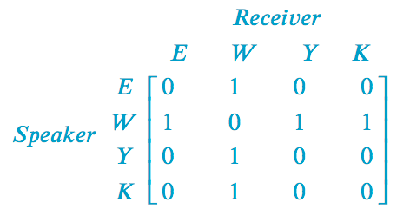
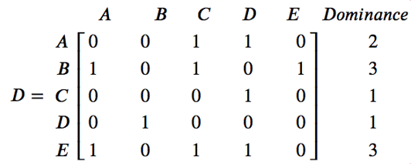
TYPES OF MATRICES
NAME | DESCRIPTION | EXAMPLE
Communication matrices | A square binary matrix in which the 1s represent the links in a communication system. All of the non-zero elements in the leading diagonal of a communication matrix, or its powers, represent redundant links in the matrix.
Dominance matrices | Is a square binary matrix in which 1s represent one-step dominance between members of a group.

Slide 6
Where to use Matrices?
To store numerical information in a data table.
To carry codes that encrypt credit-card numbers for internet transmission.
To carry all the information needed to solve sets of simultaneous equations.
To represent network diagrams.

Slide 7
Using a matrix to represent data tables
The numerical information in a data table is frequently presented in rows and columns. As such, it is relatively straight forward process to convert this information into matrix form.

Slide 8
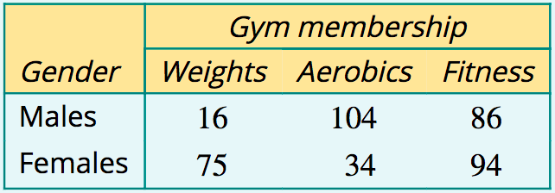
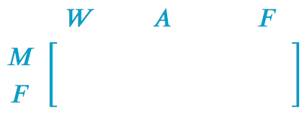
Representing information in a table by a matrix
The table below shows the three types of membership of a local gym and the number of males and females enrolled in each. Construct a matrix to display the numerical information in the table.

Slide 9
Entering a credit card number into a matrix
Convert the 16-digit credit card number: 4454817810293161 into a 2×8 matrix, listing the digits in pairs, one under the other. Ignore the spaces.

Slide 10
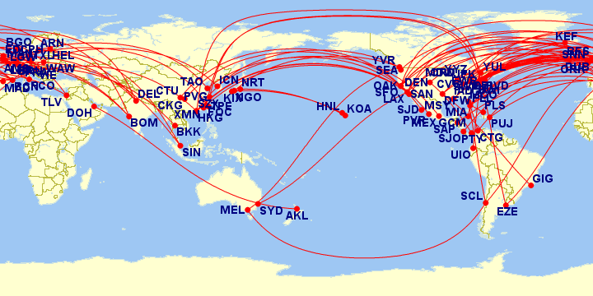
Using matrices to represent network diagrams
Network diagrams consist of a series of numbered or labelled points joined in various ways. They are a powerful way of representing and studying things as different as friendship networks, airline routes, electrical circuits and road links between towns.

Slide 11
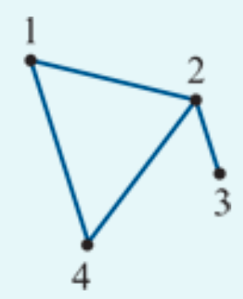
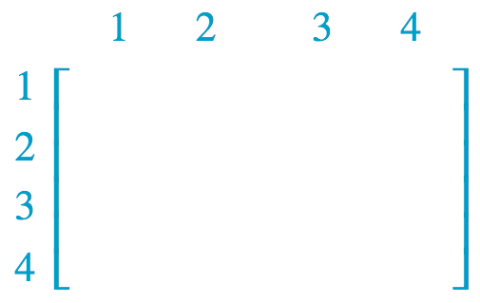
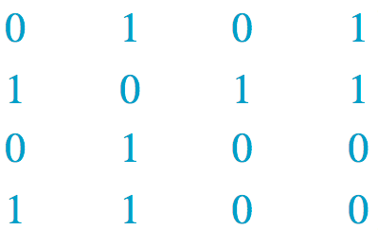
Representing a network diagram by a matrix
Represent the network diagram shown opposite as a 4×4 matrix 𝐴, where:
matrix element =1 if the two points are joined by a line
matrix element =0 if the two points are not connected.

Slide 12
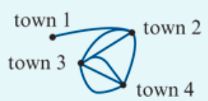
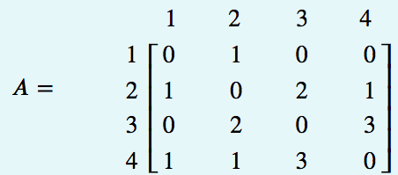
Interpreting a matrix representing a network diagram
The diagram opposite shows the roads connecting four towns: town 1, town 2, town 3, and town 4. This diagram has been represented by a 4×4 matrix, 𝐴. The elements show the number of roads between each pair of towns.
1. In the matrix A, $a_{24}$=1. What does this tell us?
2. In the matrix A, $a_{34}$=3. What does this tell us?
3. In the matrix A, $a_{41}$=0. What does this tell us?
4. What is the sum of the elements in row 3 of matrix A and what does this tell us?
5. What is the sum of all the elements of matrix A and what does this tell us?
1. 1 road between town 2 & 4;
2. 3 road between town 3 & 4;
3. 0 road between town 4 & 1;
4. total 5 roads between town 3 & others;
5. total 14 roads you can travel between towns.

Slide 13
Communication matrices
A communication matrix is a square binary matrix in which the 1s represent the links in a communication system.

Slide 14
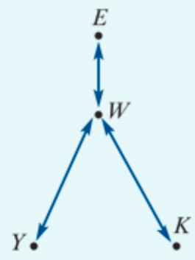
Constructing a communication matrix
Eva, Wong, Yumi and Kim are students who are staying in a backpacker’s hostel. Because they speak different languages, they can have problems communicating. The situation they must deal with is that:
Eva speaks English only
Yumi speaks Japanese only
Kim speaks Korean only
Wong speaks English, Japanese and Korean.
Conveniently, this information can be summarised in a network diagram, as shown above. In this diagram, the arrow linking Eva and Wong indicates that they can communicate directly because they both speak English.
The task is to construct a communication matrix.
Notes:
Designate each element as a ‘1’ or ‘0’ according to the following rules:the element =1 if two people can communicate directly because they speak the same language
the element =0 if two people cannot communicate directly because they do not have a common language.

Slide 15
one-step & two-step communication link
For example, we can see from the network diagram that Eva, who speaks only English, cannot communicate directly with Yumi, who speaks only Japanese. We call this a one-step communication link.
However, Eva can communicate with Yumi by sending a message via Wong, who speaks both English and Japanese. In the language of communication systems we call this a two-step communication link.

Slide 16
one-step & two-step communication link
A one-step communication link is when communication can occur directly between two people in the network.
We can see that W has a one-step communication link with each of the other 3 members of the network, and each of the other three have only a single one-step communication link (with W).
However, Y,K and E can still communicate with each other, by using W as an intermediary. For example:
K can communicate with Y using the links: 𝐾 → 𝑊 → 𝑌. This is called a two-step communication link, because there are two steps (and one intermediary).
Question:
Determine all the two-step communication links in this network?

Slide 17
The power of the matrix → 2-step communication link
The power of the matrix representation is that squaring the communication matrix generates a matrix that identifies all possible two-step communication links in a communication network. For example, if we call the communication matrix 𝐶, we have:

