Slide 1
WORK WITH DIVERSE PEOPLE
For this unit, you will be assessed on the following:
Assessment 1 Knowledge Questions
Assessment 2 Project
Assessment 3 Interview & Observations

Slide 2
Activity 5
Activity 6
Activity 7
Activity 8
Activity 9
Checkpoint 1
Checkpoint 2
Checkpoint 3
Checkpoint 4
Activity 1
Activity 2
Activity 3
Activity 4

Slide 3
1. Brainstorm - what does the term diversity mean to you?
As a class, discuss what the term ‘diversity’ means to you and your peers.
What sorts of things do you think the term diversity covers?
Diverse means variety and difference. It is a word that can describe how people differ from one to another, whether culturally or linguistically, or through their values and beliefs.
What are some of the things that make you diverse as a person?
Diversity can reflect but not be limited to:
Ability
Age
Economic status
Gender
Political persuasion
Race
Religion
Sexual preference
Do you think diversity is a good or bad thing?
Valuing diversity can strengthen positive relationships within the local community, nurture new perspectives, and encourage people from different backgrounds to access and use services.

Slide 4
What Is Diversity?
When working within the health and community services industries, you will find yourself
interacting with diverse people. They may be peers, clients, or a range of other people, so you need to ensure that you consider their
needs and respect their values and interests.
Diverse means variety and difference. It is a word that can describe how people differ from one to another, whether culturally or
linguistically, or through their values and beliefs.

Slide 5
WHAT DOES DIVERSITY MEAN TO YOU?

Slide 6
Diversity
Key areas of diversity and their characteristics may include:
Ability Age
Economic status Gender
Political persuasion Race
Religion
Sexual preference

Slide 7
Concepts And Definitions Of Diversity
The concept of diversity centres around the acceptance and respect for all human characteristics within a society. It makes an effort to recognise everyone as an
individual, each with their own perspective and life experiences. Understanding and applying diversity within the workplace requires a pro-active mindset in interactions with co-workers, colleagues and clients.

Slide 8
Key Areas Of Diversity
Culture Race
Ethnicity Disability
Physical Mental
Religious or spiritual beliefs Gender
Age
Generational
Sexual orientation

Slide 9
Features Of Diversity In Australia
Laws have been passed to prevent discrimination. In 1975, this saw the introduction of the Racial Discrimination Act. This was Australia’s first
federal anti-discrimination law and was expanded in 1995 to make public acts of racial hatred illegal.
Despite these laws, there are still people within Australia who continue to experience unfair treatment or prejudice because of who they are.
These can be in a variety of settings, including: Political
Social
Economic Cultural

Slide 10
Legal And Ethical Considerations
The government aims to ensure that everyone in Australia can live and work safely in a socially diverse environment, free from discrimination. This includes everyone,
regardless of background, is given the same opportunities and advantages. You need to be aware of and comply with your legislative obligations when working with clients and colleagues.

Slide 11
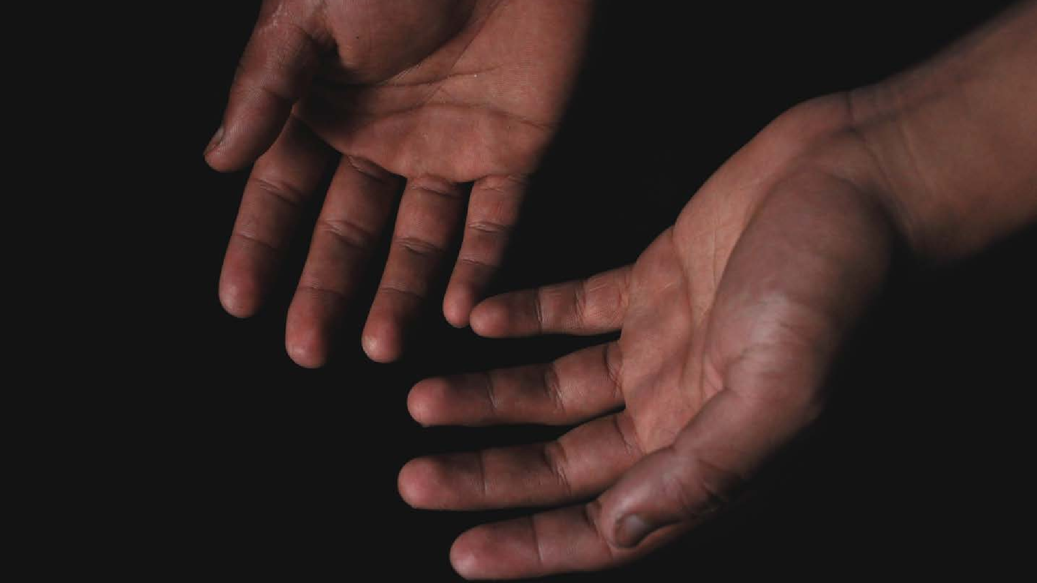
Human Rights
Human rights are rights that we have simply because we exist as human
beings. These are universal rights
that are inherent to us all. They were formally defined in 1948 as the
Universal Declaration of Human Rights.

Slide 12
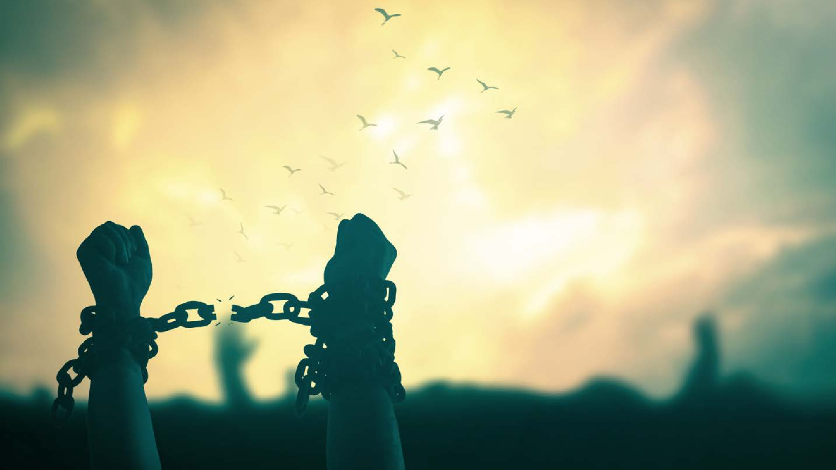
The Universal Declaration Of Human Rights
The Universal Declaration of Human Rights articulates fundamental rights and
freedoms for everybody. The General Assembly of the United Nations adopted the Declaration on 10 December 1948. The document recognises that "the inherent
dignity of all members of the human family is the foundation of freedom, justice and peace in the world" and declares that human rights are universal and to be enjoyed by everybody, no matter who they are or where they live. The Universal Declaration
includes civil and political rights, like the right to life, liberty, free speech and privacy. It also includes economic, social and cultural rights, like the right to social security,
health and education.

Slide 13
Needs and Rights
People are often confused as to the difference between someone's need for something and their rights. The
easiest way to understand the difference is that human needs are tangible and intangible possessions that
humans cannot survive without. These include things such as food, water, and shelter. Therefore, human
rights become the tangible and intangible possessions that humans are entitled to by virtue of being human,
such as the freedom to choose your religion or have an opinion on something like freedom of speech.

Slide 14
Frameworks,
Approaches and Instruments
Many frameworks within contemporary society influence how people 'place'
themselves within that society, ie. How individuals frame their identity.
Some of these primary frameworks and influences include:
Globalisation Culture
Institutions Families
Power
Gender roles

Slide 15
Rights And
Responsibilities
You have rights and responsibilities to yourself, your co-workers and your
clients if legal or organisational rights are breached or infringed upon. Your
organisation will have internal policies and procedures in place, which will
describe the processes you can
undertake. If the infringement is larger, you may need to report it to an external party.

Slide 16
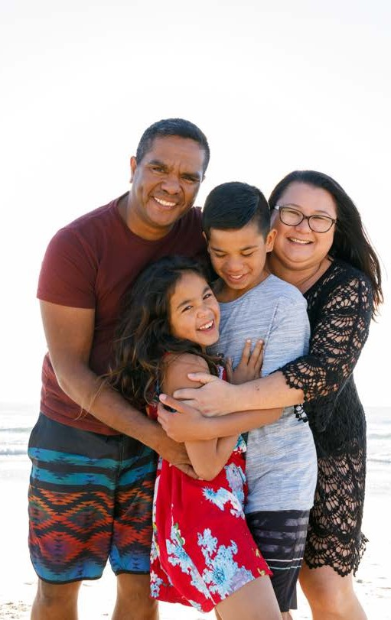
Aboriginal and/or Torres Strait Islander Peoples
Aboriginal and/or Torres Strait Islander people are
recognised as the first peoples of Australia. They hold a unique place within Australian history and continue to
make an essential contribution to our nation's ongoing development and identity. Aboriginal people make up
2.5% of the Australian resident population, Torres Strait
Islanders make up 0.1% of the total Australian population.

Slide 17
Aboriginal and/or Torres Strait Islander Peoples (cont.)
They are not a homogenous group – instead, they are a diverse group of hundreds of nations (known as cultural groups with clans within those nations. It has been
estimated that there were approximately 250 languages and some 600 dialects spoken before the arrival of the colonials.

Slide 18
Aboriginal and/or Torres Strait Islander flags
The Aboriginal Flag
The Aboriginal Flag was designed in the 1970s with its colours representing different aspects of Aboriginal life. The black symbolises Aboriginal people, the yellow represents the sun, and the
red represents the earth and the relationship between people and the land.

Slide 19
Aboriginal and/or Torres
Strait Islander flags (cont.)
This Photo by Unknown Author is licensed under CC BY
The Torres Strait Islander Flag was
designed in the 1990s and comprises of a white dharri or deri (a type of
headdress) with a five-pointed star representing the different island
groups. The white represents peace, the green represents land, the black represents the people, and the blue represents the sea.

Slide 20
Aboriginal and/or Torres
Strait Islander disadvantage
Despite their rich history, Aboriginal and Torres Strait Islanders still face multiple
challenges today. They continue to experience widespread inequality, discrimination, and cultural disconnection. This is due to Australia's complex policies and systems that have limited their voices in decision-making processes that impact their lives.
There is currently a gap between Indigenous Australians and non-Indigenous Australians in achieving key development indicators, such as child mortality, early years education,
children's literacy and numeracy, school attendance and completion, employment and life expectancy.

Slide 21
Reflect on Own Perspectives
It is essential to recognise that everyone in Australia has their own social identity and cultural background. This is often shaped by the groups and subcultures individuals
belong to and the contributing factors that make up their personal life experiences. Being aware of your own culture is the first step to becoming a culturally competent health or
community services employee.

Slide 22
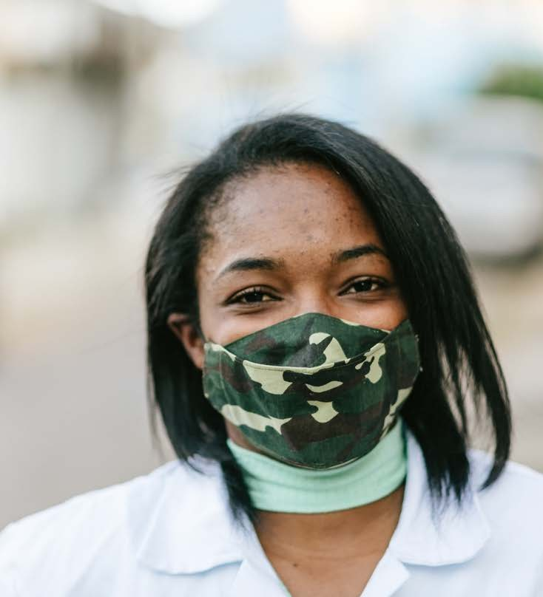
Identify and
Reflect on Own
Social and Cultural Perspectives and Biases
Your perspective is your point of view and attitude towards certain aspects of our society. Your perspectives form a
part of who you are, your opinions, ideas, and how you approach life and work and communicate and interact with others. It
is crucial to take the time to reflect on one's perspectives and how this could potentially affect their work.

Slide 23
Social
Perspective
One of the most common and influential social perspectives is socio-economic
status. A person's socio-economic status is based on their:
education occupation income

Slide 24
Cultural
Perspective
A person's cultural perspective can influence their:
Attitudes to work
Religious and other beliefs Language
Food
Attitudes to the family Communication style
Opinions about the roles of people in society
Holidays and celebrations

Slide 25
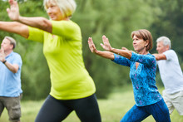
Cultural
Awareness
Cultural awareness is a sensitivity to the
differences and similarities between different cultures and how to use this awareness in
effective communication with an individual from another cultural group. Cultural
awareness requires a developed
understanding of how a person's culture
might inform values, beliefs, behaviours, and basic assumptions. Cultural awareness
recognises that an individual is shaped by their cultural background, which influences how they interpret their surrounding world, perceive themselves and relate to other
people.

Slide 26
Cultural Identity
Cultural identity refers to associating with and feeling like part of a group based on culture. It is part of a person's self-
concept and self-perception. It is related to nationality, ethnicity, religion, social
class, generation, locality or any social group with its own distinct culture.

Slide 27
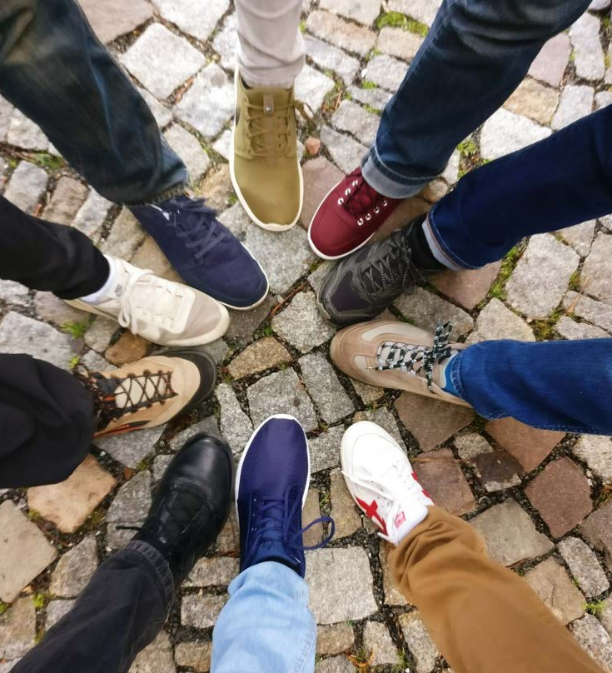
Cultural Safety
Cultural safety involves actions that recognise, respect, and nurture an
individual's unique cultural identity and
safely fulfilling their needs, expectations, and rights. It means operating from the cultural
perspective of the other person, not just from your perspective.

Slide 28
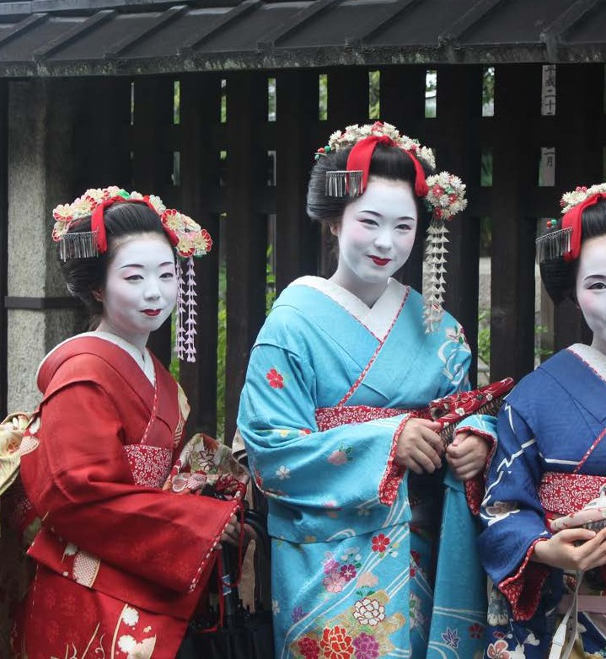
Cultural Respect
Cultural respect can be defined as
recognising, protecting, and continuing the advancement of that particular
culture's inherent rights, cultures, and traditions.

Slide 29
Cultural
Competence
Cultural competence means becoming aware of the cultural differences, appreciating and understanding those differences and
accepting them. It also means being
prepared to recognise that your behaviours, beliefs and actions may not be the norm.
The three elements of cultural competence are:
Attitudes Skills
Knowledge.

Slide 30
Bias
Acting with a bias means that you can feel or act with prejudice for or against a person or group of people that can be unfair. Bias can often be internalised, and a person may not know that they are biased until it is pointed out to them.

Slide 31
Work With Awareness of Own Limitations
Cultural competence is about thinking and acting in ways that build understanding between people. It can be used to be open and respectful to different cultural
perspectives, strengthen cultural security, and collaborate towards equality in various opportunities. Building relationships is fundamental to cultural competences.

Slide 32
Social Awareness
Social awareness is an important aspect of working with diverse people in the health and community services industry. Social awareness is about identifying and meeting the
needs of others. It is about considering what others want and finding a way to get it for them. A socially aware person shows empathy for others, values human rights, and
prioritises operating within a friendly, respectful, and well-balanced environment.

Slide 33
2. Watch - social awareness
As a class, watch the video at the YouTube link below.
https://www.youtube.com/watch?v=YUdOoTLv3kA
Discuss as a class:
Why the man did the things, he did.
Empathy, compassion and a genuine desire to make a positive difference.
What was the reaction of those observing him, and how did it make the recipients feel?
Confused (unnecessary), feel inspired or touched by his kindness.
What were some of the outcomes of his actions?
Alleviate their immediate hardships. Could inspire others to practice kindness and generosity.
How did it make you feel watching this?
A heartwarming reminder of the potential for goodness in the world.

Slide 34
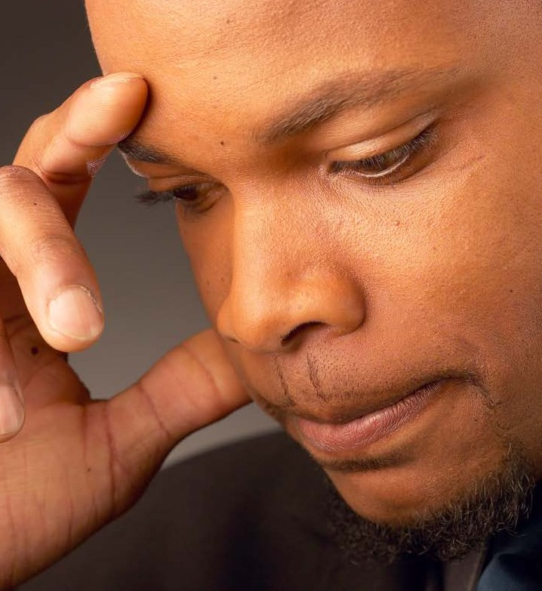
Identify and Act on Ways to Improve
Own Self and
Social Awareness
Develop awareness
Don't allow cultural differences
(preferences) to form the basis for judgements or criticisms.
Build friendships of mutual respect and a desire for understanding.
Be yourself and show that you care
Take time to listen.
Acquire knowledge about other cultures

Slide 35
Learning Checkpoint 1
1. Name three (3) things that can be influenced by a person's cultural perspective.
• Attitudes to work
• Religious and other beliefs
• Language
• Food
• Attitudes to the family
• Communication style
• Opinions about the roles of people in society
• Holidays and celebrations
2. Name two (2) traits that a socially aware individual would display.
• Empathy for others
• Values human rights
• Places a high priority on ensuring that they work in a friendly, respectful, and well-balanced environment.
3. What does it mean to act with bias?
It means that you can feel or act with prejudice for or against a person or group of people that can be unfair.
4. Name three (3) ways that you can improve your own social awareness.
• Watch the news
• Watch current affairs shows
• Read the newspaper
• Volunteer at a homeless shelter
• Visit an aged care facility
• Spend some time with the elderly
• Fundraise for an issue you feel strongly about
• Join social groups
• Volunteer your time within the local community

Slide 36
3. Partner discussion - what makes you diverse?
Working in pairs, ideally with someone you don’t know well, spend 10 minutes each talking about
your background and childhood.
Discuss things like:
Where were you born and raised? Were you born in Australia, or did you migrate here?
What was family life like as a child? Were you an only child, or did you have brothers and sisters?
What was school like?
What was home life like?
Do you have a culture or religion that you identified with? What are the common traits of that identity?
The other person should make notes and then have the opportunity to share answers to the
questions. Then, collectively, go through and find out the similarities and differences between
the two of you and present them back to the class.

Slide 37
Value and Respect Diversity
A culturally inclusive work environment requires: Clear communication
Critical self-reflection. Effective relationships
Explicit understandings about expectations Mutual respect

Slide 38
4. Watch - diversity in the workforce
Watch the video at the YouTube link below:
https://www.youtube.com/watch?v=8aLQytUM5dU
Break the class into approximately 4 groups.
Each group should brainstorm as many reasons as they can as to why they think having a
diverse workforce in a health and community services setting is important.
They should then rank their top five (5) answers.
The class should come together as a whole and compare answers. Did the groups have similar
lists, or did the diversity within each group lead to different answers?

Slide 39
Respecting Diversity
Respecting diversity requires more than tolerance which implies that something must be 'put up with', which is not ideal. When genuine acknowledgement,
appreciation, and interest in diversity is experienced, respectful relationships can develop. Engaging in respectful
relationships requires demonstrating a
positive appreciation of people and their cultural values, which is done by avoiding disrespectful behaviours.

Slide 40
Enhancing Cultural Inclusiveness
Inclusive practice is a dynamic process.
Cultural inclusiveness addresses the
requirements of people from diverse cultures valuing their contributions. It involves raising awareness with negotiations and compromise as necessary. Most of all, it is crucial to
regard cross-cultural interactions as an opportunity for all of us to learn.

Slide 41
Developing
Relationships
In Australia, it is illegal for any
establishment to discriminate against anyone based on sex, marital status, pregnancy, sexual preference, race or nationality, or physical or mental
impairment. Both state and federal levels have anti-discrimination legislation in
place. All establishments should make aware of this legislation and what it
means for day-to-day work practices.

Slide 42
Making Environments Safe for All
Be careful of stereotypes
Be aware of cultural norms and practices
Choose appropriate ways of making contact with certain cultural groups Identify any barriers to effective communication and think of possible
solutions
Respect people as individuals, regardless of culture Be sensitive to cultural needs and expectations
Ask questions if you are unsure
Reflect on your own socialisation and prejudices
Be aware of potential cultural conflicts to avoid offending others Recognise gender-specific roles amongst different cultures
Be aware of trauma and torture

Slide 43
5. Watch and reflect - building connections
Watch the video at the YouTube link below:
How Would You React After Looking In The Eyes Of A War Refugee?
https://www.youtube.com/watch?v=By_BHbskg_E
Then answer the questions below:
What were your feelings before and after watching the video?
Before: sympathy, curiosity. After: feel a heightened sense of empathy, a desire to take action or contribute.
2. Why are empathy and connection important in health and community services settings?
Effective communication, fostering a supportive and caring environment, improve overall well-being and motivation to engage in the services offered.
3. How will you connect with your clients and patients from diverse backgrounds?
Practice active listening and demonstrate empathy and respect.
Create inclusive and welcoming environments.
Collaborate with interpreters or cultural mediators to ensure effective communication and understanding.

Slide 44
Learning Checkpoint 2
1. When a professional relationship exists in a health or community services setting, clients and patients receive better care. Why is this the case?
Because when co-workers can use teamwork to look after their clients, they can share their ideas to achieve the best outcomes for their client's health physically, mentally, and socially.
2. How can you build rapport with the diverse range of patients and clients you meet in the health and community services sector?
You can build rapport by learning more about their beliefs, culture and where they came from.
3. What are three (3) things that you need to abide by if you're aiming to work in a culturally sensitive way?
• Be careful of stereotypes
• Be aware of cultural norms and practices
• Choose appropriate ways of contacting certain cultural groups
• Identify any barriers to effective communication and think of possible solutions
• Respect people as individuals, regardless of culture
• Be sensitive to cultural needs and expectations
• Ask questions if you are unsure
• Reflect on your own socialisation and prejudices
• Be aware of potential cultural conflicts to avoid offending others
• Recognise gender-specific roles amongst different cultures
• Be aware of trauma and torture
4. What is the name of the law that is in place to identify and eliminate any discriminatory barriers in the workplace?
Equal employment opportunity (EEO)

Slide 45
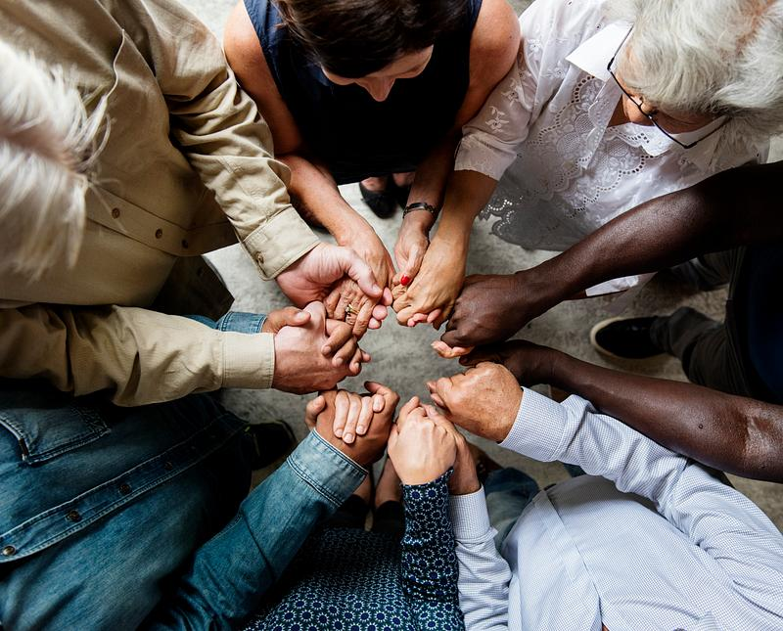
Show Respect for Diversity in Communication
The first step to establishing any relationship is to convey an attitude of
respect. When working with diverse people, respect must be demonstrated in all communications and interactions with clients, colleagues, and co-workers. This involves:
suspending our immediate judgments and being non-judgmental having a willingness to listen and learn
believing in the autonomy and self-determination of the individual, regardless of our personal beliefs and opinions.

Slide 46
Verbal Communication
Explaining your role to the other person. Being aware that people will express their emotions in different ways.
Remembering everyone will have a different proficiency in regards to language.
People may have a different understanding of words.
Not making assumptions about the level of understanding another person may have.
Respecting the beliefs and attitudes of others. Taking time to explore issues that may arise.
Speaking in a clear and concise manner.
Listening to others and observing their body language.

Slide 47
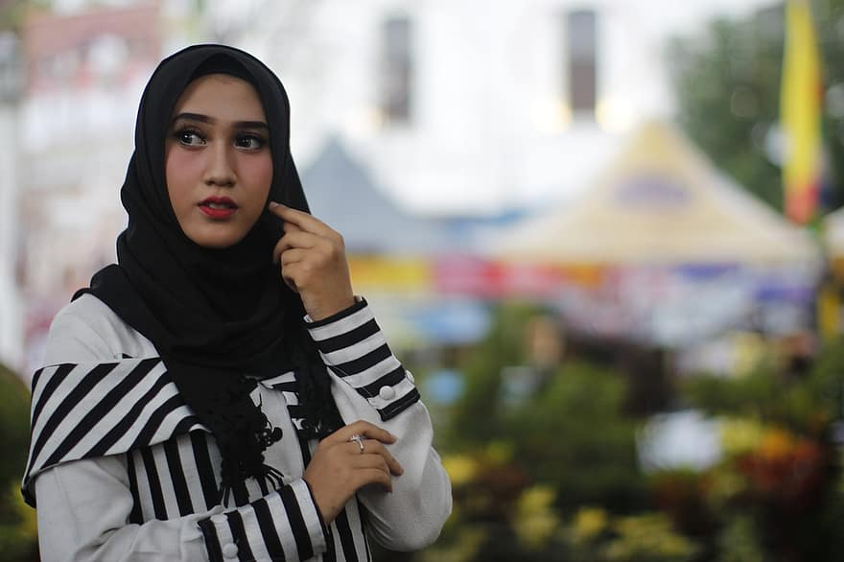
Non-Verbal Communication
Being able to decipher non-verbal communication is an invaluable skill.
The most common types of non-verbal communication are listed below: Eye contact
Body Language Tone of voice Gestures
Facial Expressions Touch

Slide 48
Use Effective Strategies to
Communicate if Language Barriers Exist
Cross-cultural communication can break down in many ways, including:
Words can have different meanings in different situations, which can cause miscommunication between individuals
In some cultures, silence can indicate a lack of communication, whilst in others, it is a key part of their communication strategy
What is acceptable verbal intensity can vary between cultures Who is given permission to speak based on their status
Understanding another person's language but not their culture, as there can be significant differences in what one stands for or believes

Slide 49
6. Watch - active listening
Watch the video link at the YouTube link below.
https://www.youtube.com/watch?v=z_-rNd7h6z8&t=101s
Once you have done this as a class, split into pairs.
Each person will take turns discussing something they find easy to talk about. It might be their
family, a sport they love, a topic they’re passionate about.
The first person will start with “I’m going to tell you about ………………………” and then the second person will respond with “That would be great,” and the conversation will begin.
The listener should practice being an active listener and taking in the information. Use the tips
on the video clip we have just watched. The listener may ask the occasional question; however,
the bulk of the conversation should come from the person discussing their topic of interest.
After 3-4 minutes, swap positions.
Once each person has had a turn, gather as a class again and discuss the task.
Did the person talking feel that the other person was listening actively? What made them think
this was the case?
Did the person listening find any challenges with being an active listener? If so, how could they
overcome this next time?

Slide 50
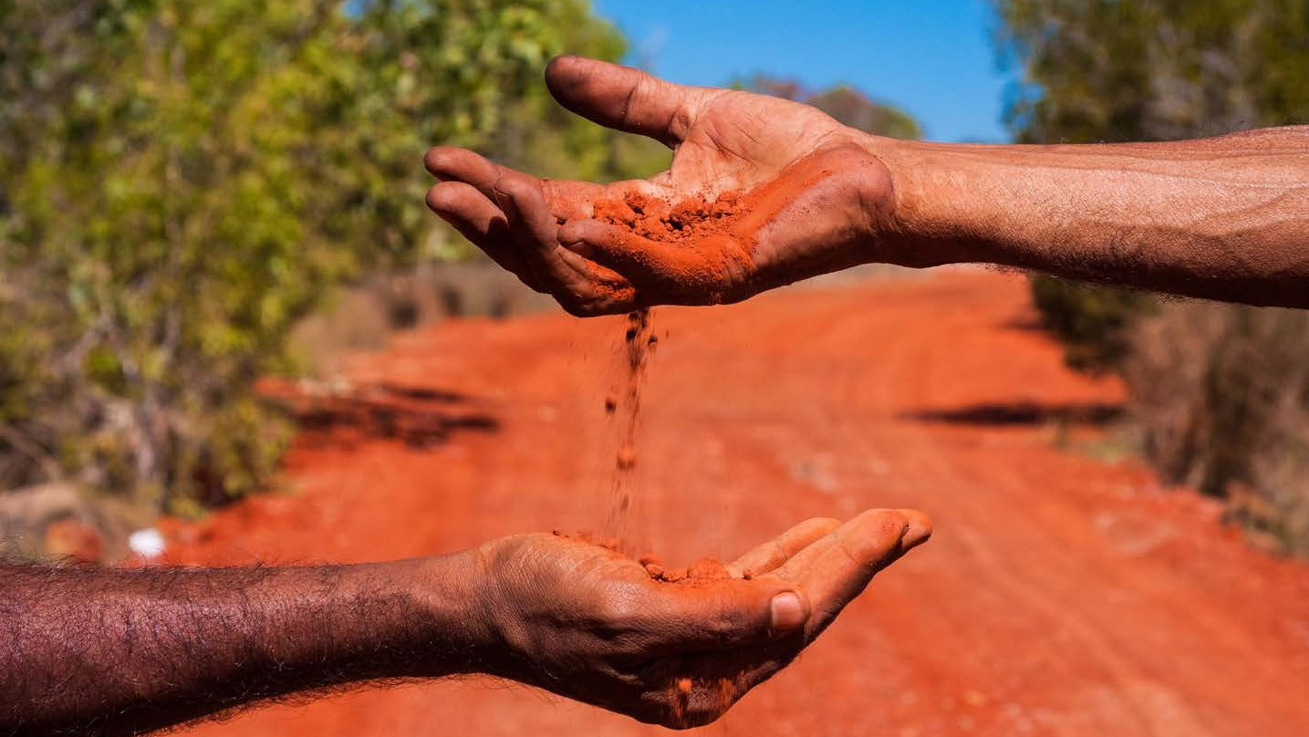
Seek Assistance From Interpreters Or Other Persons
Cross-cultural communication requires us to identify communication issues and address these so that we can develop and maintain effective relationships. There could be times
when a person requires assistance with communication; it may be sought from the following: Interpreters
Translators
Multilingual colleagues
A language aide/assistant Imagery

Slide 51
Basic Strategies to Overcome Language Barriers
There are some basic strategies you can engage to help you overcome language barriers in a
health and community services setting. They include:
Taking care to speak slowly and clearly Avoid the use of slang, sayings or
abbreviations
Ask questions to clarify understanding

Slide 52
7. Watch - clarifying understanding
Watch the video at the YouTube link below:
https://www.youtube.com/watch?v=dBT6u0FyKnc&t=296s
In this clip, the men both speak the same language, yet they are still having issues understanding
each other.
As a class, discuss what strategies could be put in place to alleviate these issues.

Slide 53
Learning Checkpoint 3
1. What are two (2) ways you can show respect when communicating in a cross-cultural situation?
• Suspending our immediate judgments and being non-judgmental
• Having a willingness to listen and learn
• Believing in the autonomy and self-determination of the individual, regardless of our personal beliefs and opinions
2. What are three (3) factors that may assist when communicating verbally with someone from a diverse background?
• Explaining your role to the other person.
• Being aware that people will express their emotions in different ways.
• Remembering everyone will have a different proficiency regarding language.
• People may have a different understanding of words.
• Not making assumptions about the level of understanding another person may have.
• Respecting the beliefs and attitudes of others.
• Taking time to explore issues that may arise.
• Speaking in a clear and concise manner.
• Listening to others and observing their body language.

Slide 54
Learning Checkpoint 3
3. What are two (2) things that can cause cross-cultural communication breakdowns?
• Words can have different meanings in different situations, which can cause miscommunication between individuals
• In some cultures, silence can indicate a lack of communication, whilst in others, it is a key part of their communication strategy
• What is an acceptable verbal intensity that can vary between cultures?
• Who is given permission to speak based on their status?
• Understanding another person's language but not their culture, as there can be significant differences in what one stands for or believes
4. Interpreters and translators can both assist with communication issues. What is the main difference between these roles?
An interpreter is a person who translates speech orally or into sign language. A translator primarily works from a recorded language, which may be printed text or video or audio recordings, converting these from one language into another while preserving the original's meaning.

Slide 55
Identify Issues
Things that may cause misunderstandings include:
Lack of time
Not paying attention
Jumping to conclusions A range of emotions
Being inconsistent Physical barriers
A difference in status Individual differences Lack of feedback

Slide 56
8. Self reflection - misunderstandings
Look back on the content we just covered. There are nine things highlighted that may lead to
communication misunderstandings.
Reflect on your own life; it could be at home, at school, in a sporting scenario or in your part-time
workplace. Choose three (3) topics that may cause misunderstandings
Topic | Example of misunderstanding
Being inconsistent | In my part-time job, I have different shift managers based on the day and time that I work. Often, I am given different instructions by each one about how tasks should be done. This is confusing, and I am always worried I will do something the wrong way as it's hard to remember who likes things done each way. This inconsistency causes me to be stressed and anxious.

Slide 57
Difficulties and
Misunderstandings
Issues that may cause misunderstandings or difficulties in communicating include:
Language
Poor Communication Stereotypes
Fear
Frustration
Different background Literacy
Stress
Understanding systems Cultural differences

Slide 58
9. Watch - cultural misunderstandings
Watch the YouTube video at the link below:
https://www.youtube.com/watch?v=GOHvMz7dl2A&t=6s
Whether you have ever suffered a misunderstanding because of cultural differences?
Perhaps some of you are from different cultures and can share beliefs or traditions that may
cause confusion to someone outside of your culture.

Slide 59
Learning Checkpoint 4
1. Name three (3) issues that may cause misunderstandings related to communication when working within health and community services, for example, a lack of feedback.
• Lack of time
• Not paying attention
• Jumping to conclusions
• A range of emotions
• Being inconsistent
• Physical barriers
• A difference in status
• Individual differences
• Lack of feedback
2. Name three (3) issues that may cause misunderstandings or difficulties in communicating when working in a health and community services environment.
• Language
• Poor communication
• Stereotypes
• Fear
• Frustration
• Different linguistic, social, and educational backgrounds
• Literacy
• Stress
• Understanding systems
• Cultural differences

Slide 60
Learning Checkpoint 4
3. How can active listening be beneficial when making an effort to sensitively resolve differences caused by social or cultural diversity?
You can use active listening to ascertain if a misunderstanding has occurred. Repeating what you thought you heard allows you to confirm that you have understood the communication correctly. It can still be an issue, however, if words are used differently between languages or cultural groups. Then, even active listening can fail to pick up misunderstandings.
4. Provide an example of a difficulty you may encounter when working within health and community services and who you could seek assistance from if this occurred.
Language barriers are common in health and community services. You could call on a colleague with these language skills or use an interpreter if you required help.

Slide 61
Make an Effort to Sensitively
Resolve
Differences
Knowledge is key when it comes to effective cross-cultural communication.
It is essential that people understand
potential problems associated with cross- cultural communication and then make a
conscious effort to overcome them. It is also important that you understand your efforts
won't always be successful and, as such,
that you may need to adjust your behaviour appropriately.

Slide 62
WHAT ARE SOME WAY WE
CAN RESOLVE DIFFERENCES?

Slide 63
Address Any Difficulties
To avoid conflict and misunderstandings, it helps to understand both etiquette and social rules used by other cultures use
when communicating and interacting. If you are unable to resolve situations then you should follow policies and
procedures to consult with either a co- worker or manager. Always try and be pro-active about resolving difficulties.

Slide 64
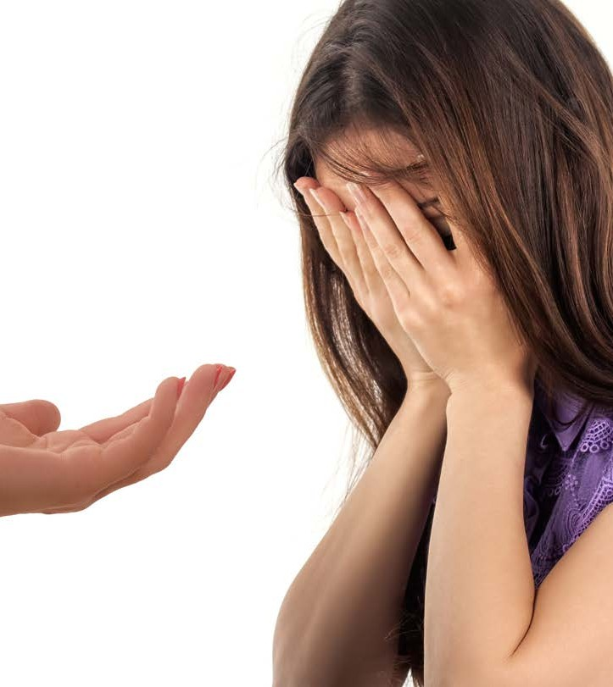
What to Do When You Recognise
Difficulties or
Misunderstandings
Some ways you can resolve differences sensitively include:
Not judging people Not issuing blame Offering support
Showing empathy

Slide 65
Support for Co- workers
Types of support which can be offered to co-workers may include:
Explaining/clarifying any issues or concerns they have
Helping co-workers
Providing encouragement Providing support
Providing feedback to a co-worker
Undertaking extra tasks if necessary

Slide 66
Support to Clients
To establish a positive and engaging rapport with clients that will enable all issues to be
dealt with, a worker will need to:
Have effective communication skills Be able to maintain appropriate
boundaries within their established rapport.
Assist clients in developing their own goals
Share relevant information with clients Work with clients to identify and plan for
potential consequences of their decisions. Implement procedures

Slide 67
Seek Assistance
When you encounter any difficulties in the health and community services
industry, you should address these
difficulties with the appropriate people and seek assistance when required.
These people may include:
Carers
Unpaid workers and respite carers Ancillary staff
Resource workers Administrators
Counsellors

Slide 68
1. Knowledge Questions
1. Describe what diversity means in relation to the workplace.
Workplace diversity means having an inclusive environment that accepts every individual and their differences, and embraces their strengths, providing an opportunity for all staff to achieve their full potential.
2. What are two (2) things you could do to improve your social and cultural awareness?
• Spend time learning about other cultures.
• Bridging the culture gap with strong communication skills; learning phrases and words in another language.
• Learning and respecting differences in culture such as holidays and customs.
• Take the time to interact with people with disabilities so that you can develop an understanding of the difficulties they might face.
3. In your learning environment, what are two (2) things you could do to support and promote relationships based on the appreciation of diversity and inclusiveness?
• You could have a themed day each month for a different culture so that everyone can learn about each other’s beliefs and customs.
• You could undertake research and find out what foods certain cultures eat or don’t eat so that you can cater for them.
• Spend time learning Auslan or another sign language.
• Visit an aboriginal art gallery or the immigration museum to support learnings.
• Host an event during Mardi Gras.

Slide 69
1. Knowledge Questions
4. Name two (2) things you can do personally to improve diversity in your learning environment or workplace?
• To be more inclusive of others that I don’t normally interact with.
• Take time to talk to new staff or students and get to know them better.
• Recognise my bias’ and work towards changing them.
5. If you worked in a business where several staff didn’t speak English as a first language, what could you do to help communicate health and safety to make sure that everyone is able to work in a safe environment?
• Make sure induction, and all signs and communications are available in multiple languages.
• Have an interpreter available to make sure that everyone understands.
• Make sure signs also have pictorial references.
6. What are some of the features of diversity in Australia? Give an example of each of the following: political, social, economic, and cultural.
• Politically by allowing people to speak freely.
• Socially by enjoying food and festivals of different cultures.
• Economically in that different businesses can exist.
• Culturally in that people have freedom to choose their own religion and practice their faith.

Slide 70
1. Knowledge Questions
7. For each of the examples complete the table to:
Discuss what the worker involved is being discriminated against, what rights are in place to protect them, and how the workplace should hold people accountable. Include examples of both legal and ethical considerations related to discrimination and human rights.
Discrimination | Type of discrimination & related rights and protections
Billy is in his late 50’s. He has made a career change late in life and has just started as a junior worker in the office. He really enjoys his job, but the other workers refer to him as ‘Grandpa’ and make fun of him asking if he remembered to bring his teeth. | Age. He is protected by the universal declaration of human rights, he has a right to work, and has a right for the harassment to stop.
Martha uses a mobility scooter for work as she had a bad accident several years ago. She has been told that she can’t use her scooter indoors as it will wreck the office carpet. | Disability. She has the right to use the mobility scooter – the office must make sure there are ramps and laneways available. She is protected by the anti-discrimination laws
Miki is Japanese and has just arrived in Australia. She learned English at high school in Osaka but is very timid and shy. She has just started a new job and is trying to join in team activities but is having trouble making friends. | Racial or cultural. Team members could invite her or make a conscious effort to socialise with her, learn about her interests and her culture.
Kyle works as a mechanic. He has just come out as being gay. His boss says that he has to find a new job as he thinks that having a gay mechanic will be bad for business. | Sex. This is against the law and the boss could face fines and legal charges.

Slide 71
1. Knowledge Questions
b. Identify the likely consequences for the businesses involved in these breaches?
Consequences could include legal challenges and fines, Workcover claims, or they may also lose top employees. Each of the people who has been discriminated against can raise a concern with the Equal Opportunity body in their own state or territory and be represented in a claim of discrimination.
c. Discuss the likely impact of discrimination, trauma, exclusion, and negative attitudes on each of the people/groups. Give at least one (1) example of an impact for each of the case study areas:
Impacts could include any of the following or any of the students own answers that represent a relevant impact to a person affected by discrimination:
• physical, mental, and emotional health affects
• economic effects like leaving the job or leaving the workplace
• political effects like mistrust in certain types of businesses or in certain government services
• social effects like withdrawal from health workplace relationships, withdrawal from relationships in the persons broader life, resistance to support or help, poor self-esteem or confidence

Slide 72
1. Knowledge Questions
d. Identify the potential needs of the marginalised person and their collective groups as a result of discrimination, trauma, exclusion or negative attitudes and strategies for responding to these in a workplace. Include at least two examples of both protective factors and physical, mental and emotional health issues and care needs, and their related workplace frameworks, approaches or instruments.
• protective factors such as promotion of a positive workplace, additional training and professional development in the area of diversity, development of confidence through regular work-based feedback, reduction of risk, involvement of police or authorities or other conflict management, development of appropriate workplace social connections, better workplace supervision and lines of reporting
• physical, mental and emotional health issues and care needs such as availability of counselling or employee assistance programs, active promotion of the Workcover process, promotion or active monitoring of breaks, implementation of lines of reporting and/or mentoring/buddying/coaching programs, training for supervisors to identify signs of stress and fatigue with strong policies, procedures and methods for promoting rest, breaks, holidays or mental health days that are paid, other similar strategies for acknowledging needs and promoting wellness.
e. Thinking about the needs you identified, how do they link to human rights. Give examples of two (2) of the needs you identified and their directly related human rights (including their article number).
Answers must link the need to the human rights. For example, in regards to protective factors the student might identify article 1, 2, 5, 7, 9 (in relation to a remedy), 18, 23, 27 and other similar examples. In regards to physical, mental and emotional issues and care needs, the student might link examples from the UDHR to the needs using articles 22, 23, 24 or other similar examples with some justification.

Slide 73
1. Knowledge Questions
7e Reference
Human Rights 1 2 5 7 9
Article 1
All human beings are born free and equal in dignity and rights. They are endowed with reason and conscience and should act towards one another in a spirit of brotherhood.
Article 2
Everyone is entitled to all the rights and freedoms set forth in this Declaration, without distinction of any kind, such as race, colour, sex, language, religion, political or other opinion, national or social origin, property, birth or other status. Furthermore, no distinction shall be made on the basis of the political, jurisdictional or international status of the country or territory to which a person belongs, whether it be independent, trust, non-self-governing or under any other limitation of sovereignty.
Article 5
No one shall be subjected to torture or to cruel, inhuman or degrading treatment or punishment.
Article 7
All are equal before the law and are entitled without any discrimination to equal protection of the law. All are entitled to equal protection against any discrimination in violation of this Declaration and against any incitement to such discrimination.
Article 9
No one shall be subjected to arbitrary arrest, detention or exile.

Slide 74
1. Knowledge Questions
7e Reference
Human Rights 18 23 27
Article 18
Everyone has the right to freedom of thought, conscience and religion; this right includes freedom to change his religion or belief, and freedom, either alone or in community with others and in public or private, to manifest his religion or belief in teaching, practice, worship and observance.
Article 23
Everyone has the right to work, to free choice of employment, to just and favourable conditions of work and to protection against unemployment.
Everyone, without any discrimination, has the right to equal pay for equal work.
Everyone who works has the right to just and favourable remuneration ensuring for himself and his family an existence worthy of human dignity, and supplemented, if necessary, by other means of social protection.
Everyone has the right to form and to join trade unions for the protection of his interests.
Article 27
Everyone has the right freely to participate in the cultural life of the community, to enjoy the arts and to share in scientific advancement and its benefits.
Everyone has the right to the protection of the moral and material interests resulting from any scientific, literary or artistic production of which he is the author.

Slide 75
1. Knowledge Questions
7e Reference
Human Rights 22 23 24
Article 22
Everyone, as a member of society, has the right to social security and is entitled to realization, through national effort and international co-operation and in accordance with the organization and resources of each State, of the economic, social and cultural rights indispensable for his dignity and the free development of his personality.
Article 23
Everyone has the right to work, to free choice of employment, to just and favourable conditions of work and to protection against unemployment.
Everyone, without any discrimination, has the right to equal pay for equal work.
Everyone who works has the right to just and favourable remuneration ensuring for himself and his family an existence worthy of human dignity, and supplemented, if necessary, by other means of social protection.
Everyone has the right to form and to join trade unions for the protection of his interests.
Article 24
Everyone has the right to rest and leisure, including reasonable limitation of working hours and periodic holidays with pay.

Slide 76
1. Knowledge Questions
8. What are some of the contributing factors of concern for those of Aboriginal and/or Torres Strait Islander culture in Australia? Write three hundred (300) words discussing the
• social,
• political and
• economic issues they face, and
• how culture, identity and the colonisation of Australia (including western systems and structures) have affected their engagement with services.
• What can be done to resolve this?
• Impacts of colonisation include: they have been decimated, felt oppression, and been stripped of their identity.
• Impacts of western systems include: they have suffered poor health, illness and addiction; many are low socio-economic and unemployed because of a lack of opportunities given to them.
• Engagement with services includes limited access and engagement because there is a lack of support to access the service and flexibility within the service to account for cultural norms and spirituality.
• Social, political and economic issues include poor access to health and education, poor representation in government, high levels of unemployment, drug and alcohol usage and family violence.
• Strategies for resolving this include engaging Aboriginal and Torres Strait Islanders in the design of new products and services, accounting for cultural aspects of engagement, providing funding for and support for education and health, representing the Aboriginal and Torres Strait Islander people in all levels of business and government.
9. If you were wanting to make contact with someone from another culture who didn’t speak English, what could you do?
Make contact with an interpreter to assist with translation or seek someone out who you know speaks the language.

Slide 77
1. Knowledge Questions
10. How could you show respect for diversity in communicating with others?
By taking the time to learn greetings or sayings to make them feel relaxed and included. Taking the time to clarify what is being said and avoiding miscommunication.
11. Why is understanding body language (either intentional or non-intentional) important when communicating with people from other cultures?
It is important as you can understand how they might be feeling; for example, crossed arms might say they are resisting something or feeling closed about an idea. Also, in some culture’s gestures mean different things and you could be insulting them without even knowing it.
12. If you are having trouble communicating with someone because they speak a different language, what are two (2) different ways you could resolve this?
• Use a translator, either through a formal service or another member of the community
• Write down your message and see if they can read English
• Type your message into online translator application if you know what language they speak

Slide 78
1. Knowledge Questions
13. There are issues that may occur that cause communication misunderstandings or other difficulties; these can have a considerable impact on social or cultural diversity. Discuss a time that you have been involved in a misunderstanding of this nature, outlining:
• What the issue was
• Who was involved in the issue?
• How you resolved the issue sensitively
• Did you need to involve anyone else to do this?
Sometimes age creates misunderstandings as young children do not always have the capacity to understand something fully.
When I was in primary school, there was a Muslim boy who didn’t eat any products from a pig. We used to tease him about it and say that it was because he loved pigs and therefore didn’t want to eat them. He said that no, this wasn’t the case and just said his Mum and Dad didn’t let him. So then we teased him that his whole family liked pigs.
One day, our teacher heard this and rather than yell at us, she gave the class a lesson on a wide range of different religious groups and things that were not allowed as part of following these. Muslims eating pork products was one of these, and we soon understood that his parents forbid it because of the religious implications and beliefs, not because they all loved cute pink cuddly animals.
As part of this the teacher suggested that part of being a good person was admitting when we had made a mistake and apologising without being asked to. After that lesson I went and apologised to Asim, and said I was sorry that I didn’t understand. I asked him if there was anything else that he couldn’t eat or do and it was a good way to learn more about religion in an interesting way, rather than reading a book.

Slide 79
1. Knowledge Questions
14. In relation to the seven (7) key areas of diversity:
a. Complete the following table of the key areas of diversity by writing a brief description of the characteristics of each.
Key Area of Diversity | Characteristics
Culture | Culture which is an umbrella term encompassing the social behaviour and norms found in human societies, as well as the knowledge, beliefs, arts, laws, customs, capabilities, and habits of the individuals in these groups.
Race | Race which is the physical differences and traits that exist from one person to another.
Ethnicity | Ethnicity, which is a person's nationality, i.e. where they formerly come from. In Australia, unless a person is of Indigenous descent, they have some element of ethnicity, including such things as Greek, Italian, French and African.
Disability | Disability which is a mental or physical condition. It can be caused by genetics, disease, trauma or an accident. Physical conditions can affect a person's mobility, such as their ability to function and/or their ability to see or hear. A mental disability can affect their thinking and ability to learn.

Slide 80
1. Knowledge Questions
14. In relation to the seven (7) key areas of diversity:
a. Complete the following table of the key areas of diversity by writing a brief description of the characteristics of each.
Key Area of Diversity | Characteristics
Religious or Spiritual Beliefs | Religious or spiritual which are the beliefs and cultural systems that a person dedicates their life to, such as Christianity, Catholicism, Buddhism and Islam.
Gender including transgender and intersex | Gender which refers to the roles, behaviours, activities, attributes and opportunities that any society considers appropriate for girls and boys, and women and men and catering for new and emerging gender identifies like transgender, non-binary, intersex and similar. Gender interacts with, but is different from, the binary categories of biological sex.
Age | Age which is how old a person is in years. Age diversity is important as younger people can learn a lot from people with experience. The same can also be said for older people who can learn a lot about new technologies and social trends from younger people.

Slide 81
1. Knowledge Questions
14. In relation to the seven (7) key areas of diversity:
a. Complete the following table of the key areas of diversity by writing a brief description of the characteristics of each.
Key Area of Diversity | Characteristics
Generational | Generational refers to people born in a range of generations. A generation refers to a time period, such as the Baby Boomers (those born from the end of World War II and the early 1960s), Gen X (born between the early 1960s and early 1980s), Generation Y (also known as the Millennials, born between 1980 and 2000), Generation Z (born between 2000 and 2009) and lastly Generation Alpha which is our current generation. Each generation may have varying attitudes, knowledge and skills that have been influenced by the focus of their time and technology available.
Sexual Orientation or Sexual Identity | Sexual orientation which is an enduring pattern of romantic or sexual attraction to persons of the opposite sex or gender, the same sex or gender, or to both sexes or more than one gender.

Slide 82
1. Knowledge Questions
b. Choose one (1) key area of diversity that is relevant to your own life.
• Discuss your own culture and the community language (language, terminology, other language concepts), policies and structures of that culture.
(For this task, culture will mean the social behaviours and norms found in a group of people who identify with an area of diversity)
• Have these impacted your personal behaviours or relationships with other individuals and groups?
o If yes, how? And
o if not, why do you think this is the case?
The student must identify one area of diversity relevant to them and include information about that diversity including at a minimum:
• Diversity- for example, Indian-Australian or Jewish or Australian or teenager or LGBTIQA+ or Disability any other diversity the student identifies with.
• Community language- Language specific to that diverse group, for example, Hindi, English or using correct pronouns if the student has chosen from the LGBTIQA+ community. This section could also include specific language requirements when communicating such as addressing elders as ‘Uncle’ or ‘Aunty’.
• Policies and Structures- Different cultures have different rules and guidelines called policies. These policies can focus on different things. For example, some cultures may think it's important to keep traditional values and customs alive, while others think it's important to include and accept different types of people. In some faiths, inter-faith marriages may not be acceptable however they might allow conversion for the union to go ahead whereas in some other faiths, this may not be the case. Another example is inheritance and whether females are allowed equal access to family inheritance in some cultures or not regardless of the laws of the land. If talking about disability or LGBTIQA+ some cultural policies and structures may not promote community or family support structures for people with disability or if they identify as a member of the LGBTIQA+ groups as they may be seen as issues or problems. These policies and strutures can affect how different people and groups are treated when it comes to getting things like opportunities, resources, and a fair chance to be heard and seen in society or live a life free of worry.
Impact on personal behaviours or relationships
Answers will vary but could include things like:
• No, they haven’t impacted me because I choose to surround myself with people who support my choice to be a lesbian and am comfortable enough to defend my decision to anyone who teases me about it.
• Yes, because I am Jewish and cannot always participate in all the weekend activities that my friends do, I feel it holds me back from having the same level of closeness other girls find as a group.

Slide 83
1. Knowledge Questions
15. Can you think of a recent example of an influence or changing practice in Australia that impacted a diverse community?
The legalisation of gay marriage was a huge step forward for the LGBTQIA community.
16. How can verbal communication help to build trust and confidence?
Verbal communication allows you to show your warmth, empathy, respect understanding and a range of other qualities that build trust and confidence.
17. Refugees are often marginalised groups within our society. What are some of the elements that might affect their
• They might be traumatised from escaping war-torn countries where they may have witnessed violence or persecution.
• They may have language barriers and not be comfortable culturally with English speaking people.
• They may have anger issues about the sacrifices they have had to make, or religious beliefs that are in conflict with those of a new country.
We can protect them by providing support, resources, and education.

Slide 84
2. Project Samples
1. Your social and cultural upbringing, and how this has influenced your perspective and biases include:
• A description of your culture including the community attitudes, language, policies and structures of that culture
• One (1) example of something in your identity that creates a perspective or bias
• Discussion on how your culture and your identified perspective or bias impacts on different people and groups
• One (1) example of something you have assumed or believed to be true about your own culture or the culture of someone connected to you that has now been corrected.
Example:
• Description of culture including community attitudes, language, policies and structures: My parents are 5th generation Australians from Italy. Italians always speak Italian, have strong ties to their culture and the community and look after each other – both within the family and in social connections. Everyone worked so that everyone could provide for others and be comfortable themselves. My family now considers themselves Australian because they work hard for other Australians and to run Australian businesses.
• Identification of something in the identity that creates bias: However, that makes them critical of other or new immigrants. Dad used to always say that it’s no wonder so many Australians are unemployed when ‘they’ (the immigrants) come here and steal our jobs. As such, I have always had a resentment for people of non-Australian backgrounds that I have met, and my parents have encouraged me not to pursue friendships outside of those with my Italian or Anglo-Saxon background.
• Discussion of the impact of culture/bias on other people: This has meant at times I’ve cut off or excluded people from my inner circle of friends and I possibly haven’t been as proactive about building workplace relationships.
• Assumptions or beliefs: I’ve assumed because people are not working then they must be getting government handouts or not contributing actively to the community.

Slide 85
2. Project Samples
2. Recognise a limitation that this creates in yourself and your social awareness.
• Discuss why you think this way, and then whether you feel it is right or it is wrong, and what could you do/have done to potentially change it.
• Discuss how your prior diversity practices and experiences have impacted your own personal behaviour, interpersonal relationships, and social expectations of others
• culture or the culture of someone connected to you that has now been corrected.
Firstly, the older I get, the more I realise that this is not right and that my parents, especially my Dad, have very racist views.
This has influenced my interactions at school, especially secondary school where there is a wider selection of nationalities in the student group. Initially I was hesitant to mix with those outside my Italian and Anglo Saxon groups but as girls started joining our wider group, I realised I had 2 choices; lose my own friends because they had no biases, or join in and maybe even learn a thing or 2 about other groups.
3. How have you/can you improve your own self and social awareness to improve your understanding of others and create a more inclusive work approach?
I have allowed myself to get to know people outside of those that I normally would have. In doing so, I have learned about why their families have immigrated here, and the places they have come from. Mainly it has been to find a better life, sometimes escaping war, or political agendas. Other times it is to follow other family members as family is very important in many cultures. What I have also realised is that it’s wrong that my parents are happy to accept me having friends who might have moved from the UK, NZ or the USA – how are they any different?

Slide 86
2. Project Samples 2
Social and Cultural Upbringing:
Description of Culture: Irish culture values community solidarity, storytelling, and a strong work ethic. Traditionally, Irish communities are tight-knit, with a fondness for gatherings and celebrations. The Irish language, though not widely spoken in Australia, holds significance in cultural events and familial connections.
Identification of Bias: Growing up, I absorbed my family's scepticism towards immigrants, particularly those perceived as competitors for jobs or resources. Hearing remarks about "outsiders" taking opportunities from Australians, I developed a bias against individuals of non-Irish or Anglo-Saxon backgrounds.
Impact on Others: This bias has influenced my social interactions, leading me to gravitate towards individuals with similar cultural backgrounds while subconsciously excluding others. In social settings, I may have unwittingly distanced myself from those perceived as "outsiders," hindering potential friendships and professional relationships.
Assumptions/Beliefs: Like many influenced by such biases, I once assumed that individuals not actively working were solely reliant on government support or were somehow not contributing to society. This assumption overlooked the diverse circumstances and challenges faced by individuals, regardless of their cultural background.
Recognising Limitations: Reflecting on my upbringing, I acknowledge the limitations in my social awareness, particularly regarding inclusivity and empathy towards those from diverse backgrounds. These biases stem from a combination of familial influence and societal narratives that I've internalised over the years.
While I understand the origins of these biases, I recognise that they are not inherently right or fair. Challenging these preconceptions requires active self-reflection and a willingness to engage with perspectives different from my own.
To address these limitations, I strive to broaden my social circles and actively seek out opportunities to learn from individuals with diverse backgrounds. By challenging my own assumptions and biases, I aim to foster a more inclusive and understanding approach to social interactions.

Slide 87
2. Project Samples 2
Improving Self and Social Awareness:
Over time, I've made a conscious effort to expand my social network and engage with individuals from various cultural backgrounds. These experiences have been eye-opening, allowing me to recognize the richness and diversity within our community.
By actively listening to others' stories and perspectives, I've gained a deeper understanding of the challenges faced by immigrants and marginalized communities. This increased awareness has prompted me to reassess my own biases and strive for greater empathy and inclusivity in my interactions.
Moving forward, I am committed to challenging stereotypes and promoting inclusivity both in my personal relationships and within broader social contexts. By recognizing the value of diversity and actively working to dismantle biases, I aim to contribute to a more cohesive and welcoming society for all.

Slide 88
3. Interview & Observations
1. You will need to interview three (3) people of diverse social or cultural backgrounds who work in or with alignment to your field and are part of your local community. At least one (1) of the people needs to be an interpreter OR another person who assists others with communication. This could include people from within your class group, from your social network or within a community group or service.
A person who assists others with communication could include but is not limited to:
o A person who assists an elderly person or a person with a disability with day-to-day communication
o A person who assists someone from Culturally and Linguistically diverse community
o An AUSLAN interpreter
o A disability support worker, an Allied Health worker or any person who assists a person with a disability who uses assistive devices for communication.
• Take notes during the interview. You will need to note the questions you asked, the answers you received and the techniques used to communicate with each person and in each interview situation.
• You should also record any quotes or answers that you think may be interesting to the group. Record can mean to write it down as a direct quote or to use your Smart Phone or another device, with the persons permission, to video or audio record their response (OPTIONAL).

Slide 89
3. Interview & Observations
2. You are going to prepare to make a short (3 minutes) contribution to a class discussion in the form of a presentation to your class. The group discussion will contribute to the development of workplace and professional relationships that are based on ‘the appreciation of diversity and inclusiveness.’
• After the interviews, take the time to record your responses in as much detail as possible to the questions in AT3: Planning for discussion document. This will form the basis of your contribution to the discussion.
• This will be a verbal presentation using written supporting information such as a PowerPoint presentation or a handout. You will have 10 minutes to setup and complete your presentation - you can use all or some of your allocated time as long as you address the key points.
• You will be assessed against the criteria in the Observation Demonstration Checklist provided – you should review this checklist prior to commencing this project.
• In addition to sharing the answers to the questions from AT3: Planning for discussion document, you should prepare to pass on the skills or knowledge you learned about diversity. You could choose to do this by showing a video or playing some audio, demonstrating a skill or the knowledge in a creative way or simply explaining the information to others.
• You will need to upload AT3: Planning for discussion document to the portal.
• You do not need to upload the PowerPoint, handout or any videos used for your verbal presentation.

