Slide 1
Using a finance solver to find the balance and final payment
8E

Slide 2
Using a finance solver to solve financial problems
Repayment monthly or fortnightly
Learning intentions
To be able to use the finance solver to find the value of a compounding interest investment with additional payments.
To be able to use the finance solver to find the balance and final payment of a reducing balance loan.
To be able to use the finance solver to find the balance of an annuity.

Slide 3
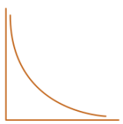
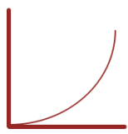
Reduced Balance Loan/ Mortgage
$7000/Month for 30 years term
FV↓
1 Million
$$v_{0}=Initial Value,v_{n+1}={R∗v}_{n} ― D$$
Annuity
$$R=1+\frac{r}{100∗p}$$
1 Million
$7000/Month for 30 years term
Annuity/Compound Investment
FV↑
Nil or Principal
$7000/Month for the whole term
$$v_{0}=Initial Value,v_{n+1}={R∗v}_{n} + D$$
$$R=1+\frac{r}{100∗p}$$

Slide 4
Using Finance solver for a compound interest investment with regular additions to the principal
Lars invests $500 000 at 5.5% per annum, compounding monthly. He makes a regular deposit of $500 per month into the account. What is the value of his investment after 5 years? Round your answer to the nearest cent.
Plus sign for FV ↑
prin=500 000
r= 5.5
n= 12
t= 5
payt=500
FV=?
After 5 years, Lars’ investment
will be worth $692 292.

Slide 5
Determining the balance and final payment of a reducing balance loan after a given number of payments
Andrew borrows $20 000 at an interest rate of 7.25% per annum, compounding monthly. This loan will be repaid over 4 years with regular payments of $481.25 each month for 47 months followed by a final payment to fully repay the loan.
a. How much does Andrew owe after 3 years? Round your answer to the nearest cent.
b. What is the final payment amount that Andrew must make to fully repay the loan within 4 years (48 months)? Round your answer to the nearest cent.
prin=20 000
r= 7.25
n= 12
t= 3
payt=481.25
FV=?
Minus sign for FV ↓
prin=20 000
r= 7.25
n= 12
t= 47/12
payt=481.25
FV=?
Andrew owes $5554.36.
$r_{a}=$ 7.25, $r_{m}$= $\frac{7.25}{12}$=0.6041667
478.253 + 478.253*$\frac{0.6041667}{100}=481.14$

Slide 6
Determining the balance of an annuity using a finance solver
Charlie invests $300 000 into an annuity, paying 5% interest per annum, compounding monthly. Over the next ten years, Charlie receives a payment of $3182 per month from the annuity for each month except the final month.
a. Find the value of the annuity after five years. Round your answer to the nearest cent.
b. Find the final payment from the annuity. Round your answer to the nearest cent.
Minus sign for FV ↓
prin=300 000
r= 5
n= 12
t= 5
payt=3182
FV=?
prin=300 000
r= 5
n= 12
t= 9+11/12
payt=3182
FV=?
The balance of the annuity is $168 612.
$r_{a}=$ 5, $r_{m}$= $\frac{5}{12}$=0.41667
3163.46 + 3163.46*$\frac{0.41667}{100}=3176.64$

Slide 7
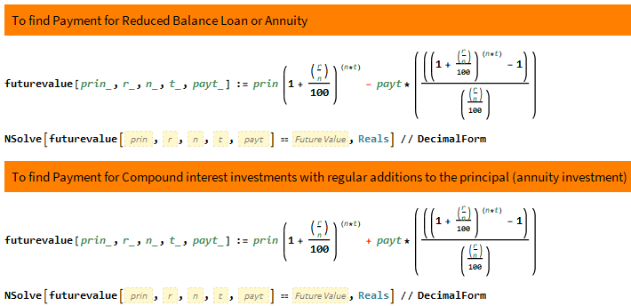
Mathematica
Minus sign for FV ↓
Plus sign for FV ↑

Slide 8
The final payment command

