Slide 1
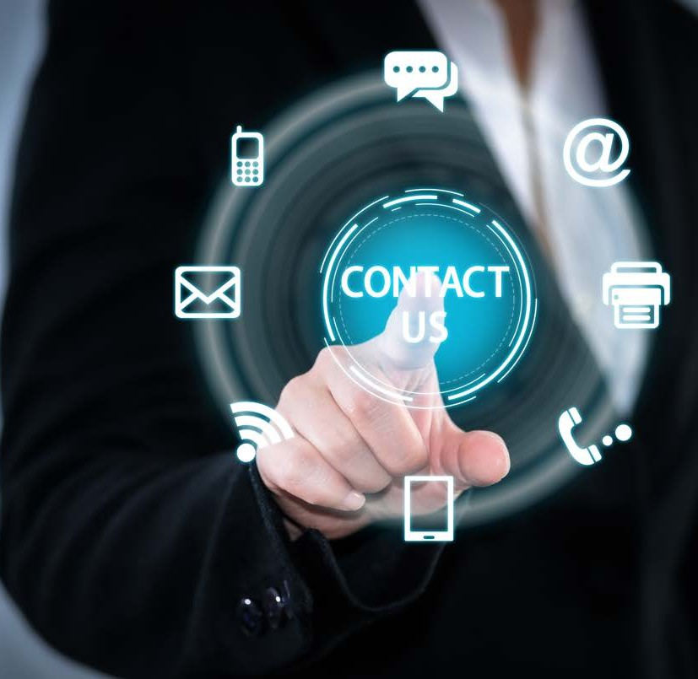
BSBTEC202 USE DIGITAL
TECHNOLOGIES
TO
COMMUNICATE IN A WORK
ENVIRONMENT
PRESENTED BY

Slide 2
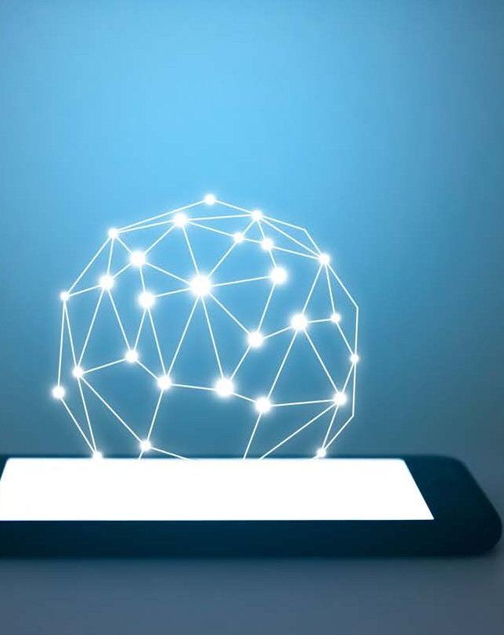
ASSESSMENTS
For this unit you will be assessed on the following:
Assessment Task 1- Multiple Choice Questions.
Assessment Task 2- Written Questions. Assessment Assessment Task 3- Demonstration/ observation.
Checkpoint 1
Checkpoint 2
Checkpoint 3
Checkpoint 4
Activity 1
Activity 2
Activity 3
Activity 4
Activity 5

Slide 3
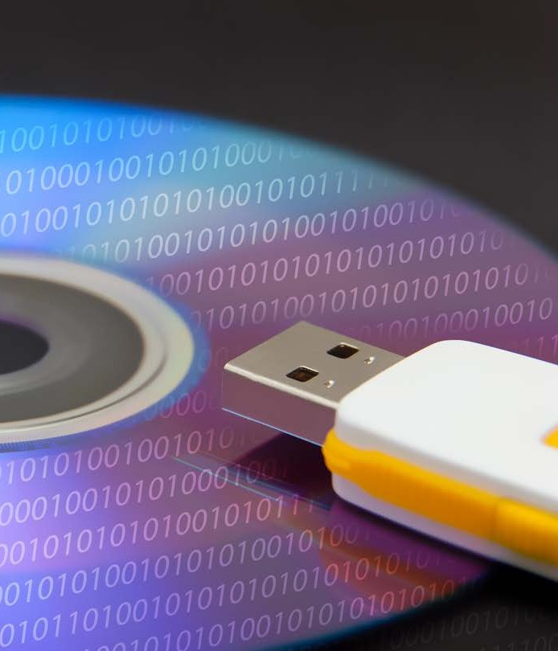
In this unit you are going to explore the many facets of digital communication, including:
The purpose and methods of digital communication.
The importance of sending and receiving digital information.
Managing digital information.

Slide 4
In your workplace digital communication allows staff and colleagues to communicate, collaborate and connect with each other across an office, a
department, a city, and even across the world.

Slide 5
What is Digital Communication?

Slide 6
PURPOSE AND METHODS OF DIGITAL COMMUNICATION
In today’s digital environment you can basically communicate with anyone from anywhere if you have reliable contact details and access to a digital device.

Slide 7
Do you know anyone that works remotely?
What methods of digital communication do they use to stay connected to others?

Slide 8
What is the Purpose of Digital Communication?

Slide 9
Why is Digital Communication Essential?
It provides a seamless customer, employee, and
stakeholder communication experience and often more than not, leads to effective real time communications.

Slide 10
Benefits of Digital Communication
Increased employee productivity.
New and better ways of working.
An increased tech savvy
workplace.

Slide 11
Digital Communication Allows You To ...
write a proposal document and attach it to an email and send it around the world instantly.

Slide 12
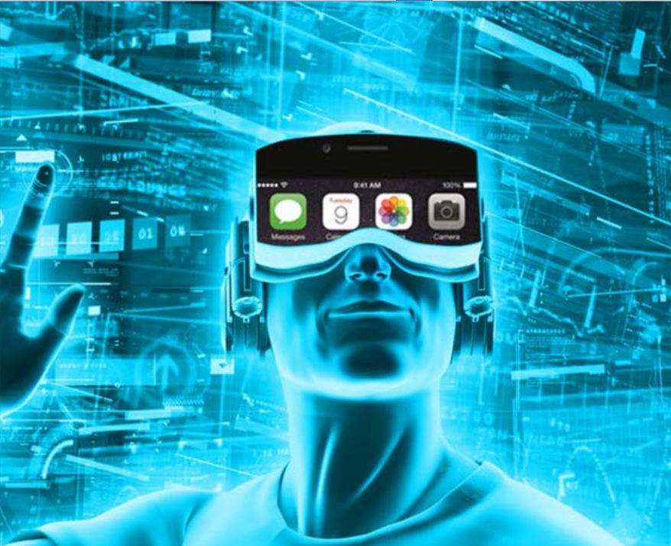
Digital Communication Applications
Is TikTok a digital application?
What other digital applications do your use at work or at home?
Where do communication applications come from?

Slide 13
Common Digital Communication
Television- high-definition digital resolution.
Websites and Apps- communicate art, entertainment, and promotional content.
Social media platforms- allows any user to publish and push out content to the world and selected social groups.
Email- still a dominant digital method of communicating. Messaging- is a message apps on iPhone, laptops, and other digital devices.
iPhone- and home lines use digital technology called voice-over-Ip reducing costs and increasing usage.

Slide 14
What is the Best Way to Communicate a Workplace Message?

Slide 15
Use Digital Communication That Represents Your Organisation
When in your uniform either in work or after school, you are responsible for
portraying a certain standard that reflects school or organisational standards.
When using digital communications, you are still representing your organisation by handling corporate social media accounts or speaking on your employer’s behalf.

Slide 16
Learning Checkpoint 1
1. What is the purpose of digital communication?
• Provides an opportunity for instantaneous sharing of information and ideas
• Creates an agile way of bringing teams and people together
• Provides a transparent and open communication platform
• Allows teams and individuals to embrace collaboration
• Ensure consistency across information shared
• Allows for immediate constructive feedback
• Keeps employees and stakeholders in the loop
2. What are five reason that make digital communication essential?
It provides a seamless customer, employee, and stakeholder communication experience and more often than not leads to a real time communication effectively.
It builds better customer, employee and stakeholder engagement. Digital communication builds better employee engagement. It encourages and transforms people into storytellers for the organisations brand.
Digital communications can also be customised content which can be repurposed into different formats such as infographics, animations, and online blogs
Digital communication amplifies your content and enables it to reach huge numbers of people across the world and can be shared instantly on social media
Digital communication provides measurable results. Algorithms calculate page views, website visits, the even the number of views a video has received. It can also tell an organisation how many times a document or reports has been viewed or downloaded.

Slide 17
Learning Checkpoint 1
3. There are factors that can influence digital communications, to help you understand these better what could be four questions that you could ask yourself?
• Is it for internal use or external (co-workers, or customers)
• Is it for a single specific person, a larger group, or the public?
• What is the best way to communicate the message – text, images, audio, video?
• Who is authorising this communication – i.e., is a branded message, or you communicating individually?
• What is the message?
• Is there any chance the message could be misinterpreted?
• Is there an alternative medium that might be more appropriate?
4. List the three greatest benefits of digital communication in the workplace.
• Increased employee productive
• Discovering new and better ways of working
• A more tech-savvy workforce
5. Digital communication allows you to …
• Write a proposal document and attach it to an email and send it around the world instantly
• Shoot a photograph of your new product and upload it to social media for your clients to see
• Share your thoughts on a subject matter via a post on Facebook or Twitter
• Record a video or audio and post it to social media for feedback from your peers
• Talk to somebody via video chat or conference.

Slide 18
Digital communication applications
As a class, discuss what digital communication applications you know of that can be used on your phone or your computer. Talk about how you use them in your personal life, and then discuss how you think they could be
beneficial tools for use in a workplace environment.

Slide 19
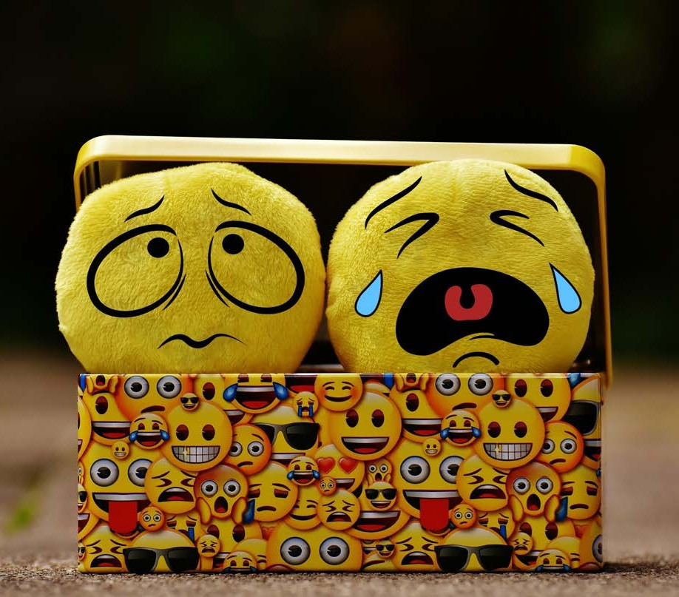
What is an Appropriate Communication Application?

Slide 20
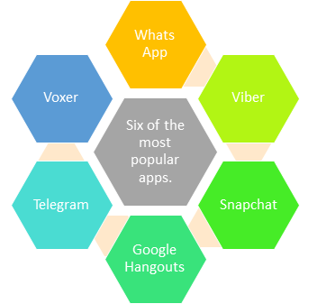
Social Media Apps
What social media apps do you use and why?
What is the general purpose for the communication?

Slide 21
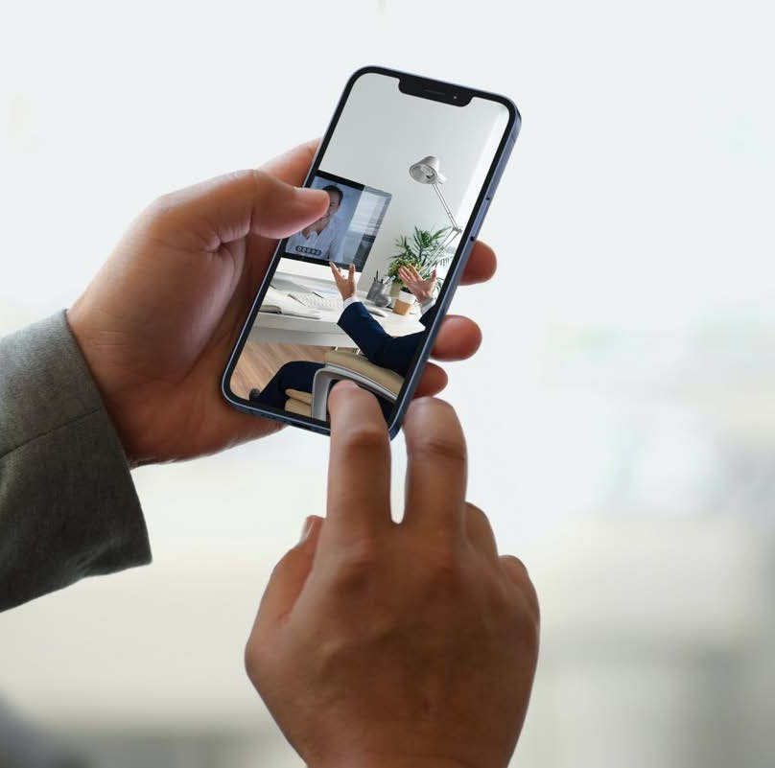
SEND AND RECIEVE DIGITAL COMMUNICATION
Before you even consider sending or receiving digital communication, you need to understand the importance of professionally presenting yourself and your workplace, just as you would professionally present your sporting team or school.

Slide 22
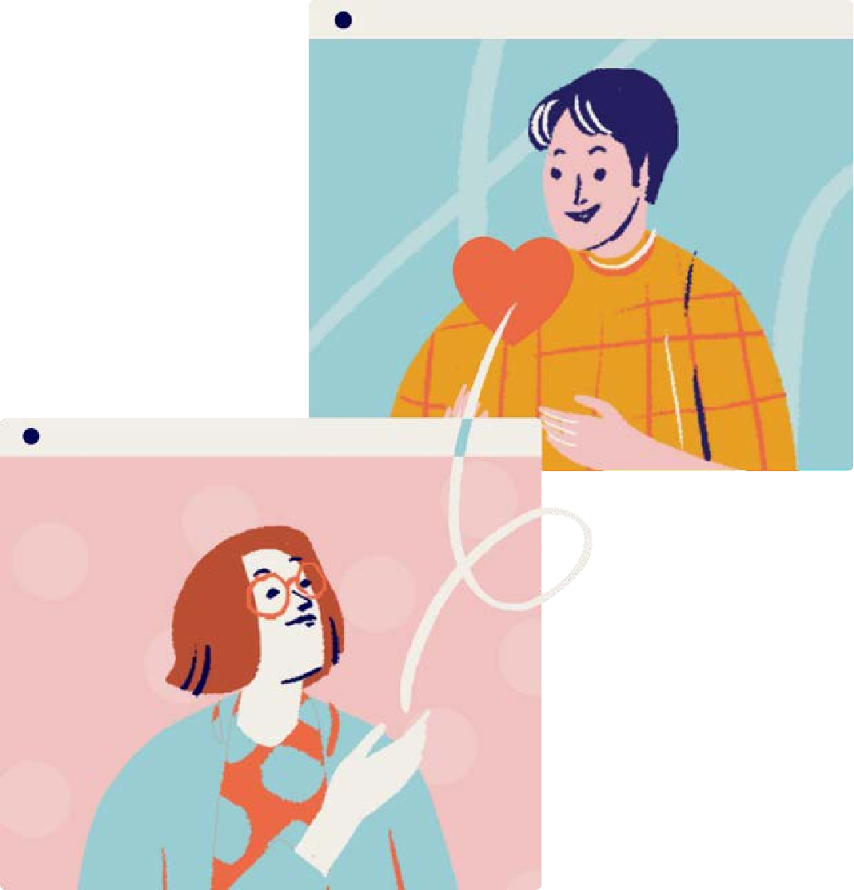
SEND AND RECIEVE DIGITAL COMMUNICATION
In this section of learning you are going to explore what it means to send and receive digital communication.
Creating digital communication. Identify digital communication content and respond.

Slide 23
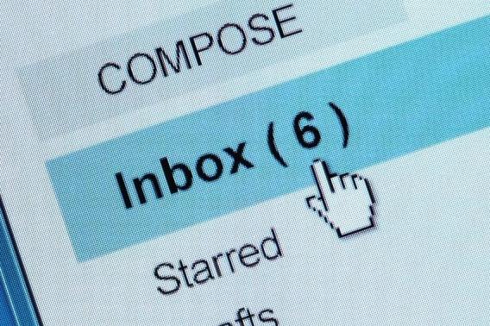
When you create an email, it is known as composing. There are several pieces of information you will require when composing an email.

Slide 24
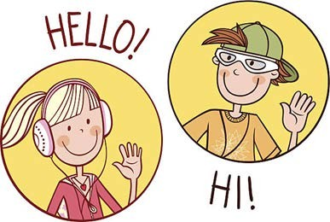
When would you use formal and relaxed communication tones?
Why?

Slide 25
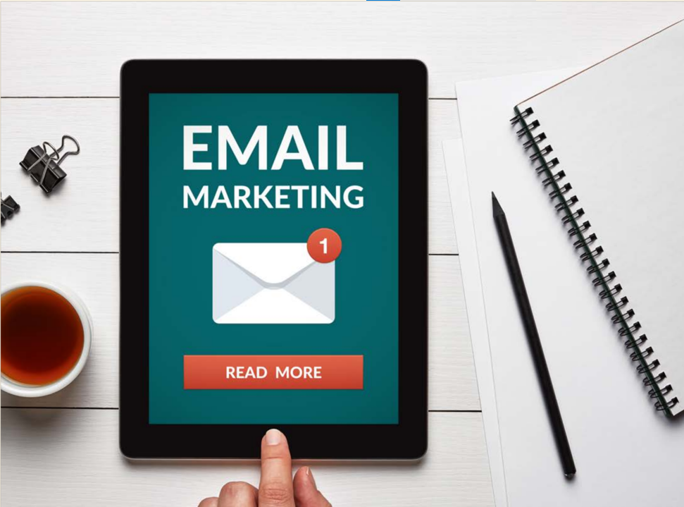
General Things That You Need to Know About Emails
Think about whether an email is the best form of contact.

Slide 26
Research Common Attachment File Types
In this activity you are required to work in teams of three/ four and conduct some research to familiarise yourself with a range of common attachment file types. Indicate in the space provided what the file type stands for, its purpose and whether it is safe or not. The file type has been completed as a guide.
File Type | Stands For | Description / Purpose | Safe / Unsafe?
BAT | Batch | Run commands automatically | No
BMP | Bitmap | Uncompressed image file | Yes
DOCX | Word document | Text based document | Yes
EXE | Executable | An application | No
GIF | Graphic Interchange format | Image format, for logos | Yes
JPG | Joint Photo Group | Compressed image file | Yes
PDF | Portable Document Format | Sending text-based documents | Yes
PNG | Portable Network Graphics | Compressed image file | Yes
PPTX | PowerPoint file | Slideshow presentation | Yes
XLSX | Excel File | Spreadsheet file | Yes
ZIP | Compressed Zip file | Container to compress other files | Yes/No

Slide 27
Learning Checkpoint 2
1. List three digital communication applications used in a professional environment
• Connecteam
• Slack
• Microsoft Teams
• Troop Messenger
• Chanty
• Rocket.Chat
• Hangouts
• Facebook Workplace
• Flowdock
• Flock
• ProofHub
• Convo
2. If were wanted to show a relaxed tone in an email, what could you do?
● use greetings such as ‘Hi.’
● address people by their first names
● use positive expressions such as ‘Hope you are well’ or ‘Have a great day.’
● employ more familiar signoffs such as ‘Thanks’ or ‘Cheers’.

Slide 28
Learning Checkpoint 2
3. What are three pieces of information that you need before even considering sending an email?
• You need to have an email address to send from. You may be provided your own unique email address when you start working for an organisation or you may be put in charge of managing one. For example, your role may include the monitoring of the 'sales' or 'info' email addresses.
• You will need an email client. This is the application that allows you to control and manage your email. Email goes into 'boxes' or 'folders'.
• New email that comes in goes into your 'inbox'.
• A copy of the email you send goes int your 'sent' box.
• An email you draft but haven't sent yet goes into your 'drafts' box

Slide 29
Creating, Checking and Prioritising Your Emails
What do you need to consider when creating an email?
What is your process for checking your digital communications like emails?

Slide 30
Emails that contain confidential information should be encrypted. This can be done, for example with Gmail, by sending the email as confidential. With confidential mode you can set an expiration date for the email or revoke access.

Slide 31
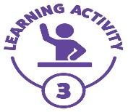
Composing and Sending an Email
Using a web-based email system such as Gmail, you should practice sending emails to each other and replying, using some of the functionality and flags such as CC, BCC, URENT etc.
If you do not already have an email account, you should set one up on one of the free platforms. Ask your trainer to assist you in doing this.

Slide 32
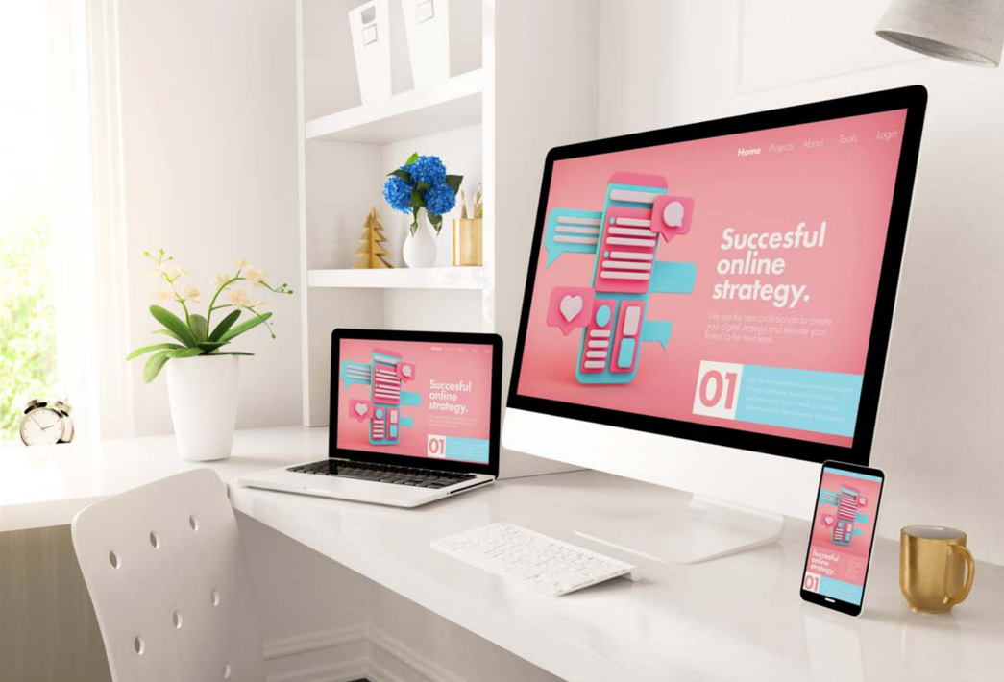
Identify Communication Content and Respond
How do you identify if digital communication needs to be responded to?

Slide 33
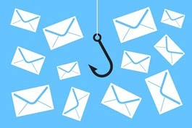
Spam and Dangerous Emails
What is spam email?
Have you ever received spam email, what was it?
What did you do with it?

Slide 34
What To Look For
Hidden links in emails.
Any email that contains unknown requests.
Emails that have attachments from unknown sources.

Slide 35
Dangers of Digital Communication
Digital communication can be easily misinterpreted.
Digital communication can sometimes raise the temperature.
Digital communication can go anywhere and is never really deleted.
Digital communication can create distance.

Slide 36
Communicate Electronically With Target Groups
What is a target group?
What types of digital communication would you send to a target group?
Have you ever been associated with a target group for the purposes of sharing digital communication?

Slide 37
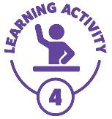
Selecting Appropriate Application For Digital Communication
Selecting the most appropriate application for communication is important. The purpose, audience, and content of the communication influences which application is most appropriate. Below is a list of communication situations. Indicate which communication application is the most appropriate (email, microblog, instant message, video/image sharing, forums.)
Situation | Communication application selected
A worker wishes to notify a co-worker that they have a meeting at 11am tomorrow. | Email
A famous person wants to keep their fans informed about their daily life. | Microblog
A traveler wishes to show pictures of their trip. | Image sharing
A user needs to ask a question about a product used by lots of people. | Forum
A bank needs to contact all its members about a possible data breach. | Email
A person wants to ask their friend a question. | Instant message
A skateboarder wants to distribute a montage video of their best tricks. | Video sharing
An internet company wants to keep users informed about possible short-term outages. | Microblog
A user wants to start a discussion with multiple users about the newest iPhone. | Forum
A user wants to send one photo to a friend. | Instant message

Slide 38
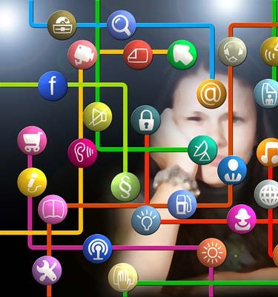
MANAGING DIGITAL COMMUNICATON
In this section of learning you are going to uncover the importance of managing digital communication.
Follow established security policies and procedures.
Plan, monitor and maintain digital communication.

Slide 39
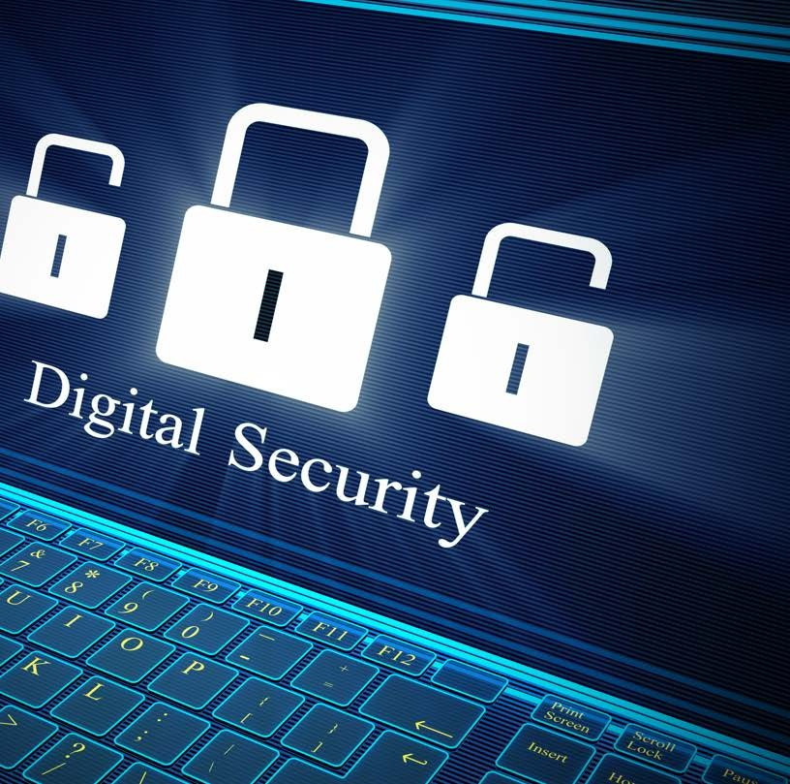
Follow Established Security Policies and Procedures
In this section of learning you are
going to uncover the importance of managing digital communication.
Follow established security policies and procedures.
Plan, monitor and maintain digital communication.
To protect the integrity of this information, your workplace or the one you aspire, to will have clear guidelines and security policies and procedures for managing all digital communication.

Slide 40
Follow Established Security Policies and Procedures
Never click on zip files or links from unknown contacts.
Refer any concerns about email content or authenticity to your line manager or supervisor or IT department.
Never alter the security settings established by the IT department.

Slide 41
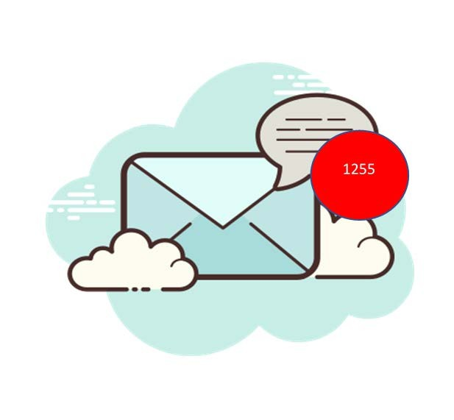
Plan, Monitor and Maintain Digital Communications
In a busy working environment not only will you have practical tasks to complete, but you could also have tasks that relate to
digital communications.

Slide 42
Learning Checkpoint 3
1. When monitoring spam and dangerous emails what are three things that you should always be on the look out for?
• Links in emails
• Emails that contain unknown requests
• Emails that have attachments from unknown sources
2. Digital communication is beneficial, but it can create distance. What can you do to prevent distance in the workplace?
• Try to move away from your digital devices and \communicate face to face. Good working relationships rely on regular in- person interactions.
• Never try to deal with an uncomfortable conversation or situations electronically.
3. What is phishing and provide an example?
A phishing email is an email that uses digital communication to either bait you or hook you into a situation. An example could be an email informing you that you have an outstanding bill, if you don't pay within 24-hours we will take you to court.
4. Whenever you open a work-related digital communication you should never….
• click on zip files or links from unknown contacts
• alter the security settings established by the I.T department
5. What is a targeted group?
A targeted group is a group of individuals, co-workers, or stakeholders that you plan on sending specific digital communications to. These individuals could be working with you on a special project, or they could be people that work within your team.

Slide 43
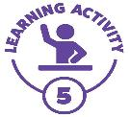
Digital Communication Policies and Procedures
In this activity you can either research your current workplace, or one you aspire to work, and access any Digital Communication Policies or Procedures and share with the group one of the aspects of the policy or procedure that you were most concerned about.
If you don’t have a workplace, you can access the Digital Communications Policies and Procedures Manual in the student portal and in small groups discuss the contents

Slide 44
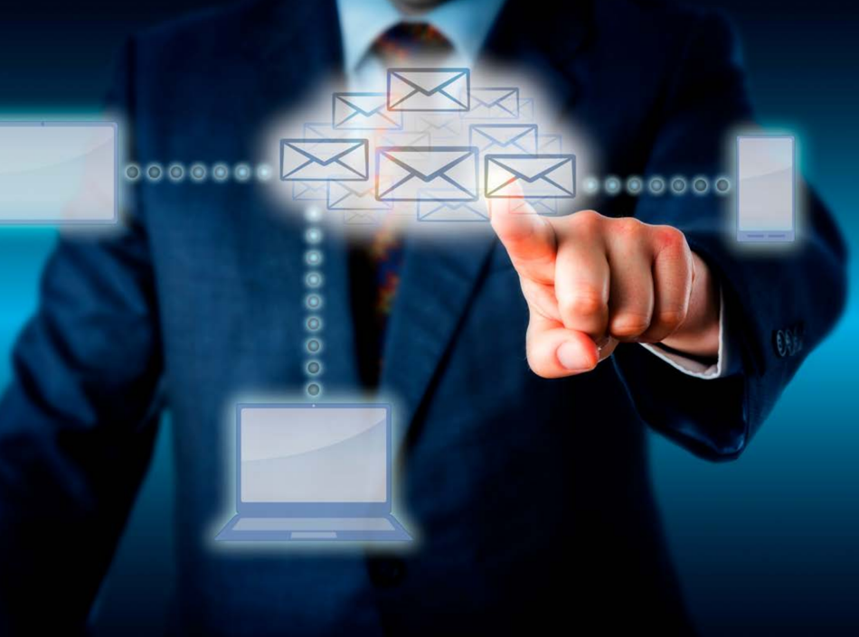
Managing Digital Communication Effectively
What
mana effecti
What is your understanding of
managing digital communications
effectively?

Slide 45
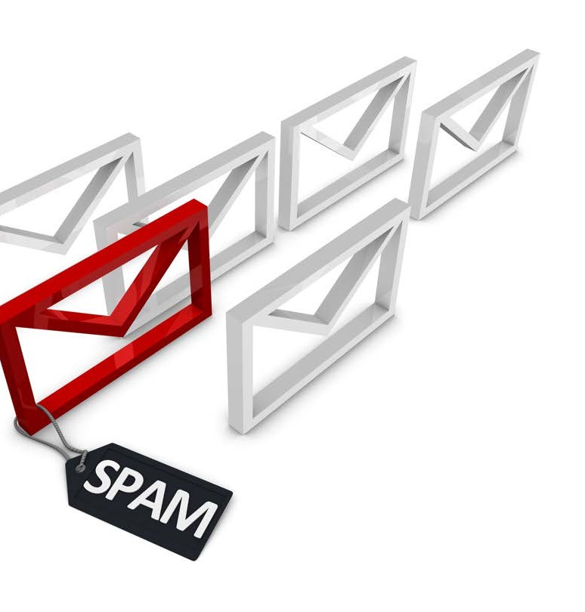
Creating Rules and Filters
Who can explain what an email rule or filter is?
What does it do?
When would you use it?

Slide 46
Saving, Deleting and Searching for Emails
You should always follow
your organisation's policies and procedures on where to save email attachments.
If you are finding your
email inbox overcrowded with email subscriptions to newsletters or other non- essential emails, you can either move them to
another folder or delete them.

Slide 47
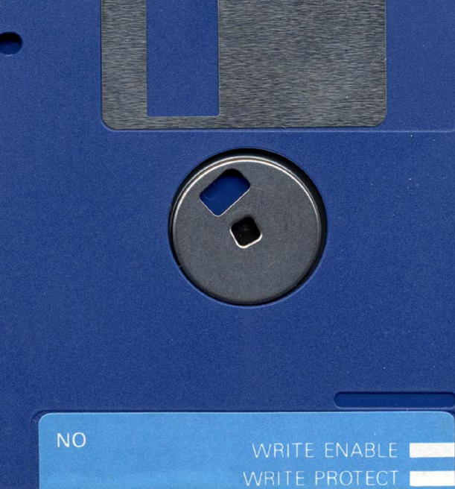
Storing Digital Communications
Can anyone tell me what these are?
Files and associated folders that house sensitive digital communications need to be named using the organisations specific naming conventions. This ensures that there are not numerous folders or files containing variants of the same content.

Slide 48
Archive Digital Communications
Did you know that the internet even has an archive?

Slide 49
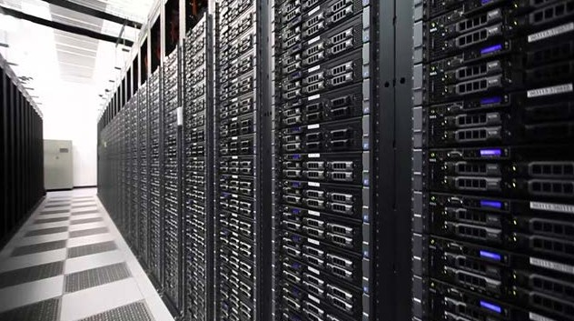
The archive.org is a free non- for-profit digital library that offers universal access to over 580 billion archived webpages

Slide 50
Digital Communication Skills and Career Pathways
Have you thought of a career in digital communication?

Slide 51
Learning Checkpoint 4
1. Brand loyalty is built …
With digital communication tools, which is why more and more companies are needing to explore these and be pro-active in how they utilise tools in their day-to-day environments.
2. What are the six steps you need to take when creating an email, a filter in Gmail?
1. Open Gmail.
2. In the search box at the top, click the ‘down arrow’.
3. Enter your search criteria. If you want to check that your search worked correctly, see what emails show up by clicking search.
4. At the bottom of the search window, click ‘create filter’.
5. Choose what you would like the filter to do.
6. Click ‘create filter’.
3. If you were thinking of a career in digital communications, what would be the four soft skills you would need to be successful?
• A commitment to lifelong learning
• A passion for story telling
• Empathy and curiosity
4. Your workplace will have policies and procedures that inform you of where to save email attachments. Before you save them there are two things that you should do. What are they?
• Check that you recognise the source
• Run the file through a virus checker scan before opening.
5. What would you do to delete an email in Gmail?
Simply click the check box to the left of the email you want to delete. Then click on the trash can icon and Gmail will inform you that it has moved the conversation to the bin.

Slide 52
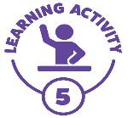
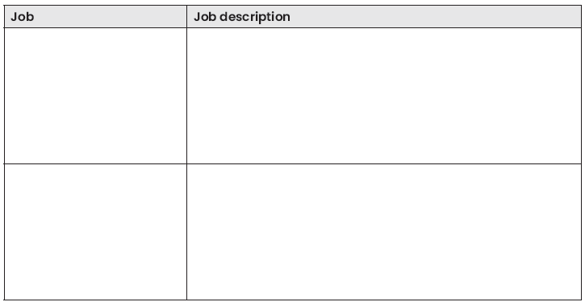
Research a digital communication career pathway
You have already explored some of the digital communication career pathways in your learning journey. Some of them may have inspired you to pursue a career in digital communication.
In this activity you are required to research further and come up with two other career pathway options. In the table provided describe the job title and a brief description.
If time permits, you can share your digital career aspirations with your class and provide a sentence or two on what you think you need to get you into the chosen career pathway. You could even discuss why you chose the digital career pathway you chose.

Slide 53
Assessment 1 Knowledge Questions
1. Which of the following are digital communication applications? (Select three)
a) social media platforms
b) streaming media
c) Immersive experience
d) social medium applications
2. What is the purpose for the digital communication? (Select three)
a) Creates an agile way of bringing teams and people together
b) Provides an opportunity for instantaneous sharing of information and ideas
c) To allow employees to share work information with other companies
d) Provides a transparent and open communication platform
3. Which of the following would be the most appropriate method of communication in an office environment? (Select two)
a) Facetime your work colleague to arrange a lunch date
b) Sent a meeting request via Microsoft Teams
c) Verbally disclose the personal details of the new staff member in front of the whole office
d) Email with information regarding a system upgrade or process change.
4. Which statement best describes the most inappropriate application for receiving and sending workplace communications? (Select two)
a) Sending a LinkedIn network request to your manager
b) Sending images or other not work-related files to a colleague’s personal phone
c) Attaching appropriate work-related documents to internal email trail
d) Attaching unsolicited materials to a group email chat.

Slide 54
Assessment 1 Knowledge Questions
5. When creating outgoing digital communications, what should you check for? (Select three)
a) Ensure you are sending to the right email recipient
b) Check attachments as required
c) To find out how you can access the internal power source
d) Check for information for accuracy
6. Why is it important to correctly store digital communications? (Select two)
a) So that all employees can access the information and share it with other work colleagues
b) Correctly storing digital communications helps to create extra space for other information.
c) It is important to correctly store all digital communications to ensure security and privacy of sensitive organisational information.
d) it is important to correctly store digital communications so that they are in one centralised location.
7. Which of the following is a medium that can be used to digitally communicate with a target audience? (Select two)
a) Digital advertising
b) Search engine optimisation
c) Data driven marketing
d) Social media

Slide 55
Assessment 2 Written questions
1.You have received the following emails in your inbox, as outlined in the table. Complete the table below, advising how you would mark each one, using the headings urgent, confidential, personal, and suspicious. You may refer to the ‘Electronic Communications and Social Media Policies document’ for clarification.
2. What is the importance of understanding your organisation’s policies and procedures when conducting digital communications?
With digital communications you are representing the business and need to maintain the integrity of the organisation as outlined by them.
3. What are the three main reasons why businesses need to safely store sensitive information?
1. To keep files and folders consistent and not store many versions
2. It is very important that all digital communications are stored correctly for security and privacy reasons
3. To ensure all data and information is stored in the one location
4. Give three (3) examples of digital communication etiquette in a workplace setting.
Response time to emails, checking grammar and spelling, no caps lock when sending emails.
Email | Mark as | Action to perform
From your manager: Urgent work needs to be completed | Urgent | Act and respond ASAP
From a friend: Asking what you’re doing on the weekend | Personal | Move to personal folder, address outside work hours.
From an unknown source: Your wire transfer for $1,244,434 has been sent | Suspicious | Delete and report
From your co-worker: Latest sales figures | Confidential | Not discuss with anyone outside team.

Slide 56
Assessment 2 Written questions
5. List two (2) existing or emerging digital communication technologies that might be used in the workplace and list their strengths and limitations.
Email: strengths are it’s trusted and universally used, weaknesses are it requires a reply to know it’s been received, and it’s not instantaneous
Instant messenger: strengths are it’s like a live chat, and it can be short bite sized communications, it happens instantly, weaknesses are needs to be online at the same time.
6. Your organisation states in its policies and procedures that you should minimise subscriptions to mailing lists unless they are work-related, and that they should be kept separate from all other mail. What are two (2) things you could you do to manage and maintain this requirement?
By creating a filter which moves all mailing list emails into a folder away from general business or other areas. You could also ensure personal mailing lists go to a personal account not your business one.
7. You have been put in charge of managing a support email address, as well as online platforms such as Facebook, Twitter and Instagram which included posting content as well as monitoring and replying to comments and threads. Your policy and procedures document requires a proactive that a proactive approach needs to be taken to this, and that all efforts should be made to respond to comments or reviews on digital platforms within one business day; negative reviews however should be acted upon ASAP with a view to resolve them. Write up a brief overview of how often you would action each of the tasks to monitor and manage them.
Answers will vary but you could set up alerts to let you know when people have posted or commented and aim to respond to them within half a day.
It might pay to read the comments straight away and then construct a response to urgent issues. Always follow up and if a mistake has occurred, acknowledge, and apologise.

Slide 57
Assessment 3 Performance Demonstration (Observation by the Assessor)
Send digital communications on four occasions
Student is required to send the following four digital communications.
Students that do not have an existing email address are to use an appropriate application and set up an email address for the purpose of this assessment. The student may delete set up email once assessment tasks have been completed satisfactorily. You trainer will observe you undertaking this demonstration.
Student’s need to ensure that all digital communication across all four occasions addresses the following:
• The purpose of the digital communication
• The relevant sources of information (attachments)
• Check for accuracy and that required attachments have been included
• See response and feedback from digital communication recipient
1. Send three emails and save Digital Communications Policies and Procedures Manual
Download the Digital Communications Policies and Procedures Manual from the student portal. Save it to your device. Choose three email contacts. Select an appropriate application for communication, this could be an email to a friend, family member, manager or significant other (intended audience).
In the digital communication inform them that you are completing an assessment task and that you have been asked to email and attach the Digital Communications Policies and Procedures Manual as part of your assessment.
In your email ask the three email contacts what part of the Digital Communication Policy did they find most interesting and why?

Slide 58
Assessment 3 Performance Demonstration (Observation by the Assessor)
Send digital communications on four occasions
Student is required to send the following four digital communications.
Students that do not have an existing email address are to use an appropriate application and set up an email address for the purpose of this assessment. The student may delete set up email once assessment tasks have been completed satisfactorily. You trainer will observe you undertaking this demonstration.
Student’s need to ensure that all digital communication across all four occasions addresses the following:
• The purpose of the digital communication
• The relevant sources of information (attachments)
• Check for accuracy and that required attachments have been included
• See response and feedback from digital communication recipient
2. Facebook PM article on global warming
Using messenger on Facebook you are to download the Digital Communication Policies and Procedures from the student portal. Save it to your device. Choose three Facebook contacts Select an appropriate application for communication, this could be a message via Facebook messenger a friend, family member, manage or significant other (intended audience).
In the digital communication inform them that you are completing an assessment task and that you have been asked to message them and attach an article about ‘Global Warming’ as part of your assessment.
In your Facebook message to selected contacts ask them what part of the global warming activity motivated them the most and why?

Slide 59
Assessment 3 Performance Demonstration (Observation by the Assessor)
Send digital communications on four occasions
Student is required to send the following four digital communications.
Students that do not have an existing email address are to use an appropriate application and set up an email address for the purpose of this assessment. The student may delete set up email once assessment tasks have been completed satisfactorily. You trainer will observe you undertaking this demonstration.
Student’s need to ensure that all digital communication across all four occasions addresses the following:
• The purpose of the digital communication
• The relevant sources of information (attachments)
• Check for accuracy and that required attachments have been included
• See response and feedback from digital communication recipient
3. Create an email group and receive bus or train timetable
Using contact names in your email address book, you will now be required to create a group email. Selecting three email contacts. Create a group name. Ask your contacts to attach a copy of a bus or train timetable. In the digital communication inform your contacts that you are completing an assessment task and that you have been asked to email them as part of your assessment.
Save the train or bus timetable in a folder titles, ‘Public Transport’

Slide 60
Assessment 3 Performance Demonstration (Observation by the Assessor)
Send digital communications on four occasions
Student is required to send the following four digital communications.
Students that do not have an existing email address are to use an appropriate application and set up an email address for the purpose of this assessment. The student may delete set up email once assessment tasks have been completed satisfactorily. You trainer will observe you undertaking this demonstration.
Student’s need to ensure that all digital communication across all four occasions addresses the following:
• The purpose of the digital communication
• The relevant sources of information (attachments)
• Check for accuracy and that required attachments have been included
• See response and feedback from digital communication recipient
4. Locate an image and send via text message
Using your Smart device (e.g., iPhone, android etc) or that of a friend, you are required to source an image of the Amazon rain forest. Cut and paste the image into a text message and send it to three of your contacts.
In your text message to selected contacts ask them what they feel when they see the image of the Amazon rain forest and one thing, they might do to save it.
In the digital communication inform your contact that you are completing an assessment task and that you have been asked to email and attach the image of the Amazon rain forest as part of your assessment.

