Slide 1
Preparation for the VCE VET HEALTH exam

Slide 2
An overview
Internal SAC scores contribute 66% towards your study score
End of year external exam contributes 34% towards your study score
Exam questions are from only two units of competency:
BSBMED301- Interpret and apply medical terminology appropriately
HLTAAP001- Recognise healthy body systems
The exam totals 100 marks and is broken down into:
Section A: Multiple-choice (20 marks)
Section B: Short answer (50 marks)
Section C: Case study (30 marks)
It lasts for 90min (1.5 hours) and has an additional 15min of reading time prior to commencing writing
Notes:
In terms of the order of answering, best to start with your longer sections worth more marks that also take more time, so generally speaking you would start with Section B then move onto Section C, then finish with multi-choice Section A, or start at Section C and work backwards, finishing again at Section A. The reason for this is that with the multi-choice, you have a 1 in 4 shot of getting the question right, and the questions are just worth one mark each, so best to spend the majority of your time where the questions do take longer in Sections B & C.
Rule of thumb in any test or exam is the ‘minute per mark’ principle. So definitely make sure that you are keeping an eye on the clock in the examination area to ensure that you leave yourself a solid 20min at the end. 15min at most to spend on the multi-choice section and 5min (or more depending on how quick you get through the multi-choice and make up an extra few minutes) to read over some of your longer answers, check for spelling errors etc.
So if you think about what I said above, it means that once you’ve left yourself 20min right at the end, you’re left with 70min (1 hour and 10 min). Now I’m no Maths teacher, but that leaves you in a bit of a conundrum if you haven’t already conned on right – 70 minutes to complete 80 marks – not quite a minute a mark, but unfortunately that’s the game. It just means that you need to go in prepared!
Remember that spelling is key here. Yes, it isn’t an English exam, but unfortunately medical terminology must be spelled correctly to get the marks!
Importance of Reading Time! (Skimming, refining the requirements of each question, formulate a plan i.e what will I tackle 1st/2nd etc.)

Slide 3
Section B & C - question breakdown
Questions are designed around terms such as list, identify, state, define, outline, describe, provide, compare and explain
List/Identify/State/Define/Outline questions are generally worth 1 mark per point made (total marks can vary between 2-6 marks)
Describe questions are generally worth 3-6 marks. These types of questions require the student to draw on the units specific terminology in its application to the scenario provided. You may need to provide more info on the body structures (anatomy), or the physiological functions of a system etc.
Provide questions are generally worth 2-4 marks. This type of question requires the student to quickly fill in the missing table sections, usually having to correctly spell a misspelt word, write in a singular or plural version of a med term, decipher an abbreviation or acronym etc.
Compare questions are generally worth 2-3 marks. This type of question requires the student to usually highlight the differences between something, such as the difference between male and female secondary sexual characteristics or the difference between a sprain and a strain etc. Be factual here when answering your question.
Explain questions are generally worth 2-4 marks. These types of questions require the student to draw on the units specific terminology in its application to the second keyword in the question itself i.e. is the question asking you to explain the relationship, explain the meaning of, explain the effect of, explain the function of etc. Those secondary keywords will guide the ‘how to’ part for your answer.
Section C contains 2 separate case studies. Each case study has a variety of different questions ranging from provide, list, explain, identify, outline and describe under it. Each case study contains 4-6 of the above different types of questions and are worth 2-6 marks per question. Each case study starts with a case. Each of the 4-6 questions follow on from that particular case, so always refer back to it. You never know what answers you may find.
Notes:
Label questions are probably the only exception here – they relate to your knowledge of both body systems and use of (spelling etc) correct medical name/term, but they tend to be worth half a mark.
Describe questions are generally seen in relation to the Body Systems unit.
Provide questions are generally related to the unit on Medical Terminology.
Compare questions are generally related to the unit on Body Systems.
Explain questions are generally related to the unit on Body Systems.
Questions in the Case Study section typically assess you in your combined knowledge of both examinable units intertwined – so you need to know your stuff on Body Systems and Medical Terms here.

Slide 4
Studying for BSBMED301 - Interpret and apply medical terminology appropriately
https://training.gov.au/Training/Details/BSBMED301
Areas to focus on:
Identifying and interpreting (deciphering) medical terms from medical documents, case studies/tables etc
Prefix, root word, suffix, combining vowel, abbreviation, acronym, time, plurals etc.
Correctly spelling medical terminology
Correctly breaking apart full medical terms into word parts or using word parts to correctly identify the full medical term’s meaning
Knowing your policies and procedures i.e. WHS, Infection Control, Privacy & Confidentiality etc.
Being able to list sources of info available to check medical terms i.e. Medical Dictionary, experienced HCWs, Supervisor etc.
How to best study:
Rote (parrot) learning, flip cards, word wall, matching games, downloadable Apps, Kahoots, Quizlets, practice exam questions, system maps, having someone quiz you (pop quiz) and you teaching someone else.
Notes:
The Training.gov website outlines the Australian-wide performance evidence, knowledge evidence and assessment conditions for this UOC. In terms of preparing you for an exam, it is best to focus on the ‘knowledge evidence’ i.e. how you can demonstrate your knowledge of this UOC in the exam.
Spelling is key. While you practice learning your medical terminology, you need to focus on the correct written spelling of the medical terms. One mistake, and you lose a whole mark. Why is the spelling important? Well medical literacy is very important. Studying medical terminology is like studying a language, so treat it as such. While you learn your ‘language’, pronounce the terms out loud to further solidify them into your memory banks by utilising another sense – audio. The best way to practice spelling of course, is to write it down. It is important that we get the language right, as one spelling or pronunciation error can mean a whole different diagnosis, prescription etc for the patient.
Studying medical terminology can be dry. So it is important to use all kinds of little tricks to jazz up your learning here, as a variety of methods can work best, rather than just one. You can learn medical terminology by rote learning (memorising technique based on repetition), system maps are where you draw simple maps of each system and label body part terms – you can even use your body system map to identify diseases affecting each and use the same concept to identify locations of specific procedures etc. Maybe you remember your primary school days where you used a whole bunch of songs and acronyms etc to remember your times tables etc. Apply the same here. Make a list of word parts, list words by similar sound, map words, memorise by body system, sing songs, recall devices like drawing a picture to represent the medical term, so when you see the picture you can remember the word etc. How do you all study best? Share tips amongst group! In the end of the day, do what is most comfortable and useful to you when it comes to studying medical terminology – you are the Captain of your own boat!
Medical documents can include reports, patient notes, instructions for post operative care, test results, referrals, drug orders etc.

Slide 5
Med Terms – recapping the basics
Prefixes: Appear at the beginning of a word and tells the how, why, where, when, how much, how many, position, direction, time or status.
Root words: Specifies the body part to which the term refers.
Suffixes: Appears at the end of a word and indicates a procedure, condition or disease.
Acronyms: Formed by the first letters or syllables of other words.
Abbreviations: Shortened version of a word. It is important to know the context to avoid misinterpretation.
Combining vowels: a, e, i, o and u. Used to join various elements of medical terms together. o and i are the most common.
Notes:
Acronyms/abbreviations context = ✓ MRI: Magnetic resonance imaging ✓ MRI: Medical Research Institute ✓ MRI: Medical records information = used to make a word or phrase shorter, quicker and easier to pronounce.
Abbreviations = Again used to shorten words or phrases. Important to note that acronyms and abbreviations are often referred to ass the same thing as they are both shortened versions of the original word, meaning or phrase.

Slide 6
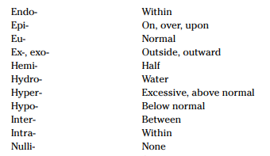
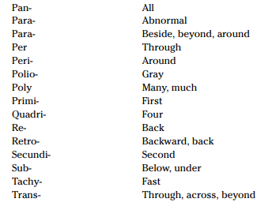
Common Prefixes:
Notes:
Obviously this is just a guide. Your teacher would have given you a list of ones by now, but as you have already figured out, the list is not exhaustive – like a language.
It is all about making connections – who has done a First Aid cert before for hypo/hyper connection? (thermia) Something like ‘sub’ might make you think of a submarine – under water.

Slide 7
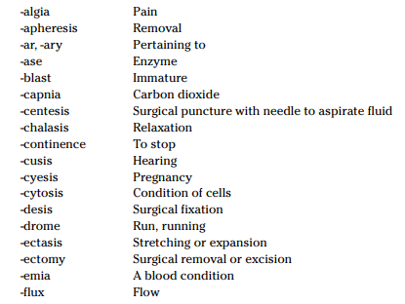
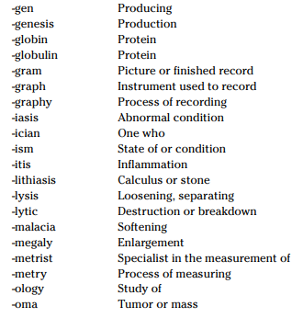
Common Suffixes:
Notes:
What connections can you make?

Slide 8
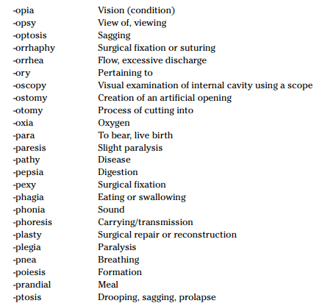
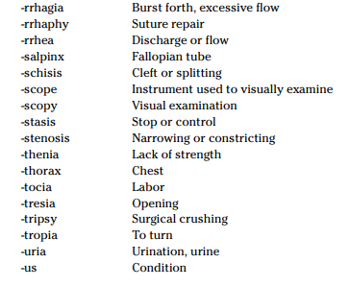
Common Suffixes:
Notes:
What connections can you make?

Slide 9
Plurals:
Rule 1: Change the a ending to ae
scapula → scapulae
By adding the e to the plural, the “aah” sound ending pronunciation becomes “eh.”
Rule 2: Change the um ending to a
bacterium → bacteria
The a at the end is pronounced “aah.”
Rule 3: Change the us ending to i
meniscus → menisci
The i at the end is pronounced “eye.”
Rule 4: Change the is ending to es
diagnosis → diagnoses
The es is pronounced “eez.”
Rule 5: When a term ends in yx, ax, or ix, change the x to c and add es
appendix → appendices
Rule 6: When a term ends in nx, change the x to g and add es
phalanx → phalanges
Rule 7: Change the ma or oma ending to mata
fibroma → fibromata
Notes:
By no means is the an exhaustive list, there are exceptions to some of these rules, but as a rule of thumb, this is a good starting point when thinking of plural forms of your medical terms.

Slide 10
Common Times:
Time | Abbreviation
ac | before meals/food
pc | after meal/food
mane | in the morning
midi | midday
nocte | at night
bd | twice a day
tds | three times a day
qid | four times a day
stat | Immediately
prn | as required
4/24 | four hours
5/7 | five days
6/52 | six weeks
1/12 | one month

Slide 11
Common Routes:
Method of drug administration | Abbreviation
oral | PO
subcutaneous | subcut
intramuscular | IM
intravenous | IV
per rectum | PR
inhalation | INH
per vagina | PV
topical | TOP
stat | Immediately

Slide 12
Med Terms - sample question 1
Using the case study below, correctly decipher the abbreviations/acronyms/times into the table following:
Edith McIntosh is an obese, 74 yo female who has been a smoker since the age of 21. She has a medical Hx of T2DM and OP.
She recently had a fall and Fx of her R) neck of femur. She underwent surgery and had a R) THR.
On 1/7, the PT visited Edith and began an active and passive rehabilitation program. She experienced some POP.
Notes:
HINT: Break down the abbreviations by looking at the case study. Which ones can you figure out and which ones require more attention.

Slide 13
Abbreviation/Acronym/Time | Definition
yo
Hx
T2DM
OP
Fx
THR
1/7
PT
POP
Notes:
HINT: Break down the abbreviations by looking at the case study. Which ones can you figure out and which ones require more attention.

Slide 14
Abbreviation/Acronym/Time | Definition
yo | year old
Hx | history
T2DM | Type 2 Diabetes Mellitus
OP | Osteoporosis
Fx | fracture
THR | Total Hip Replacement
1/7 | 1 day
PT | Physiotherapist
POP | pain on palpation
Notes:
Again, remember to refer to the case study for the context in which the abbreviation/acronym etc is stated. A tip is to read the case study and replace those abbreviations/acronyms with the full meaning to see if it makes sense in the context. For example PT: It would make sense looking at the context of a PT visiting Edith and starting exercises to assume it is referring to a Physiotherapist, rather than the other medical definition for PT being ‘prothrombin time’ (a blood test that measures how long it takes blood to clot).
For the times, make sure that you are precise and accurate. If for something like a PT reviewing a pts exercise program in 6/52 you state ‘6th week of 52’, it is incorrect and you won’t receive a mark. The correct answer is simply ‘6 weeks’. So you will review the exercise program in 6 weeks.

Slide 15
Med Terms - sample question 2
You are a RN and as part of your role, you have to provide pt handovers to the next shift when yours ends.
Rewrite the following case study, deciphering what is needed:
“Pt is a 49 yo female who reports to ED, with a h/o HTN, non-diabetic with a post-aortic valve replacement. FHx of CVD and pneumonia. Previous Hx of bilateral ankle odema, nocturnal cough, dyspnea on ordinary exertion, tachycardia, fever and CC being chest pains. Pt ordered an ECG. Pt’s current Dx is CHF. Pt referred by GP for EP 1/52.”

Slide 16
Patient is a 49 year old female who reports to Emergency Department, with a history of hypertension, non-diabetic with a post-aortic valve replacement. Family history of cardiovascular disease and pneumonia. Previous history of bilateral ankle odema, nocturnal cough, dyspnea on ordinary exertion, tachycardia, fever and chief complaint being chest pains. Patient ordered an Electrocardiogram (can also accept electrocardiograph). Patient’s current diagnosis is Congestive Heart Failure. Patient referred by General Practitioner for Exercise Physiology one week ago.”

Slide 17
Med Terms - sample question 3
Complete the table below by identifying the word parts and then providing the definition of each medical term listed.
 | Word parts
Medical term | Prefix | Root word | Combining vowel | Suffix | Definition of medical term
hypoglycaemia
polyneuropathy
nephritis
craniotomy

Slide 18
 | Word parts
Medical term | Prefix | Root word | Combining vowel | Suffix | Definition of medical term
hypoglycaemia | hypo | glyc |  | aemia | low blood sugar or condition of low glucose in the blood
polyneuropathy | poly | neur | o | pathy | disease of many nerves/neurons
nephritis |  | nephr |  | itis | inflammation of the kidney
craniotomy |  | crani | o | tomy | incision into the skull or cranium
Notes:
You don’t need to write anything in the shaded boxes. They have been left out for a reason, as they are not needed.
You are awarded a full mark for getting the whole line correct. If you do not correctly breakdown the medical term into its component parts and accurately provide the meaning of the medical term, you do not get awarded the mark. So if either or both sections are incorrect, no mark is awarded.

Slide 19
Med Terms - sample question 4
Kylie cannot understand the medical terms and abbreviations written in her patient’s medical record.
Provide two ways in which Kylie can find out what they mean.
Notes:
In the 2019 examiners report, only 50% of students got full marks for this question.

Slide 20
Possible correct responses could include:
Medical terminology dictionary
Medical terminology text book
Supervisor or Manager
Colleague
Organisation-approved medical abbreviation document/glossary
Answers not acceptable:
Google it
Look it up
Research it
Ask a friend
Search the internet

Slide 21
Med Terms - sample question 5
Complete the table by filling in the blank word parts or functions:
Abbreviation | Full name | Explain its function
 | Blood pressure
BPM |  | The unit of measure for the frequency of heart contractions each minute.
BSL |  | Blood sugar or blood glucose that present in the blood of human.
BMI | Body Mass Index
 | Cardio-pulmonary resuscitation | The manual application of chest compressions and ventilations to people in cardiac arrest.
HR | Heart rate

Slide 22
Abbreviation | Full name | Explain its function
BP | Blood pressure | The pressure of the circulating blood against the walls of the blood vessels - measured for a quick evaluation of a person's health.
BPM | Beats per minute | The unit of measure for the frequency of heart contractions each minute.
BSL | Blood sugar level | Blood sugar or blood glucose that present in the blood of human.
BMI | Body Mass Index | A statistical measure of the weight of a person scaled according to height, used to estimate if a person is underweight or overweight.
CPR | Cardio-pulmonary resuscitation | The manual application of chest compressions and ventilations to people in cardiac arrest.
HR | Heart rate | The rate at which the heart beats; usually measured to obtain a quick evaluation of a person's health.

Slide 23
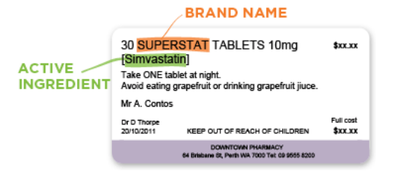
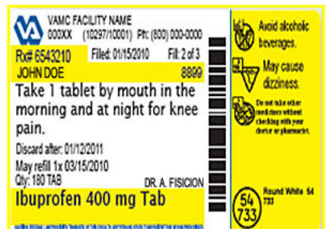
Med Terms - sample question 6
Read the below medication labels and complete the missing table items:
Definition | Medical abbreviation/time
One tablet at night
1 tablet by mouth in the morning and at night

Slide 24
Med Terms - sample question 6
Read the below medication labels and complete the missing table items:
Definition | Medical abbreviation/time
One tablet at night | 1 tab qpm or 1 tab nocte
1 tablet by mouth in the morning and at night | 1 tab po qam & qpm
Notes:
one tablet every evening or one tablet at night
one tablet by mouth every morning and every evening

Slide 25
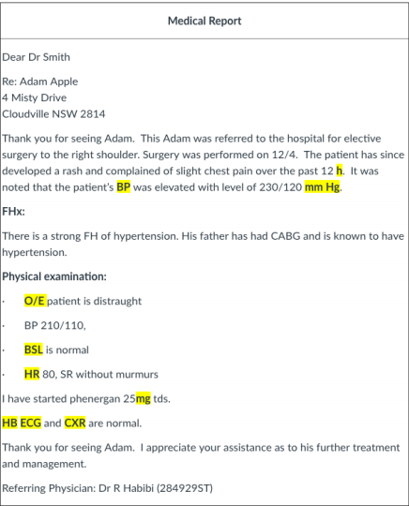
Med Terms - sample question 7
Read the medical report and record the highlighted abbreviations in the following table (are there any extra ones not highlighted that you can spot?):
Notes:
Sinus rhythm refers to the pace of your heart beat that's set by the sinus node, your body's natural pacemaker. A normal sinus rhythm means your heart rate is within a normal range. Murmur = A heart murmur is an abnormal sound of blood flowing between heartbeats. It usually sounds like a whooshing, swishing, or extra thumping.

Slide 26
Med Terms - sample question 6
Abbreviation | Full name
h | hour
BP | Blood pressure
mmHG | Millilitres of mercury
O/E | On examination
BSL | Blood sugar level
HR | Heart rate
mg | Milligram
HB | Heart block
ECG | Electrocardiograph
CXR | Chest X-ray
FHx or FH | Family history
CABG | Coronary artery bypass grafting
SR | When referring to Heart Rate SR can mean SR Sinus Rhythm. When referring to Medication it can be Slow Release
tds | Three times a day
Read the below medication labels and complete the missing table items:
Notes:
Meds = slow release = A slow-release drug is released into the body slowly over an extended period of time, meaning that the patient doesn’t need to medicate as frequently.

Slide 27
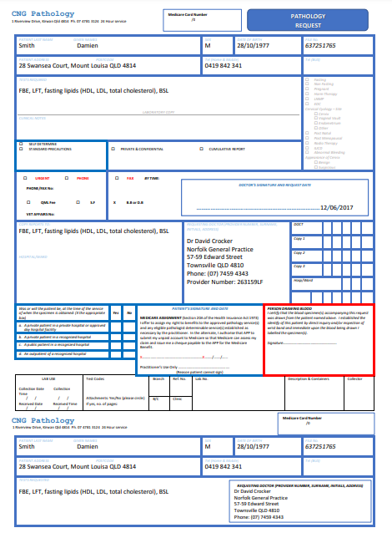
Med Terms - sample question 8
Damien Smith is a pt at Norfolk General Practice. He has been requested by Dr Crocker to have his 12 month bloods taken. Dr Crocker has given Damien a Pathology form to take to his local Pathology clinic to have his bloods taken. Read the Pathology form provided and decipher the tests required:

Slide 28
What do the following definitions test for:
FBE = Full blood examination
LFTs = Liver function test
BSL = Blood sugar levels
HDL = High density lipoprotein
LDL = Low density lipoprotein
What does fasting mean? Nothing to eat or drink except water. This is usually 8 hours prior to the test.
Notes:
FBE is a blood test used to evaluate your overall health and detect a wide range of disorders, including anemia, infection and leukemia. A complete blood count test measures several components and features of your blood, including red blood cells, white blood cells, platelets etc.
LFT = test that is performed to detect, evaluate, and monitor liver disease or damage.
BSL = diabetics to monitor their levels - Normal blood glucose levels are between 4.0–7.8
HDL = good cholesterol
LDL = bad cholesterol
Cholesterol is a waxy substance found in your blood. Your body needs cholesterol to build healthy cells, but high levels of cholesterol can increase your risk of heart disease.

Slide 29
Med Terms - sample question 9
Provide the singular or plural form of each medical term listed in the table below:
Medical term | Singular form | Plural form
bursae
emboli
thoraces
labia
testis
larynx
carcinoma
Notes:
Bursa
Labium
Embolus
Testes
Thorax
Larynges
Carcinomata

Slide 30
Medical term | Singular form | Plural form
bursae | bursa
emboli | embolus
thoraces | thorax
labia |  | labium
testis |  | testes
larynx |  | larynges
carcinoma |  | carcinomata

